Slide 1
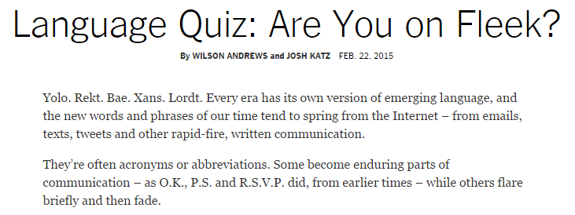
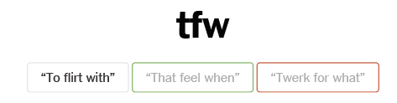
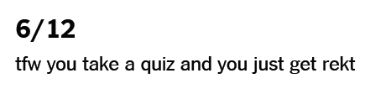
Speaking of language!?

Slide 2
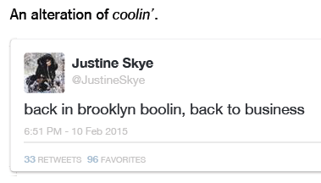
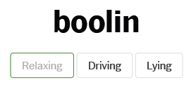

Slide 3
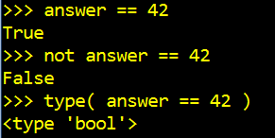
back to Python, boolin…

Slide 4
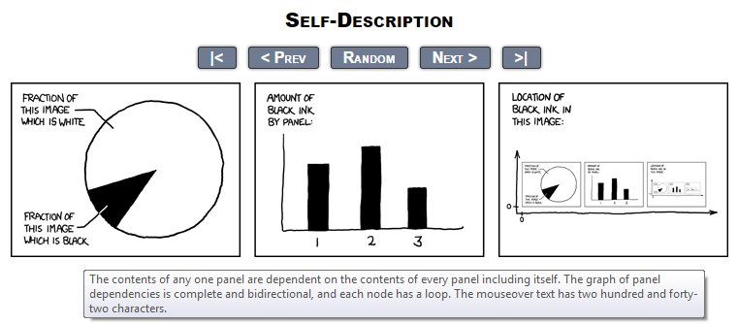
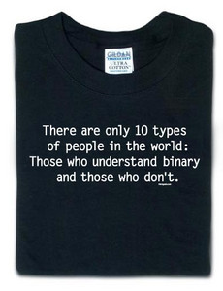
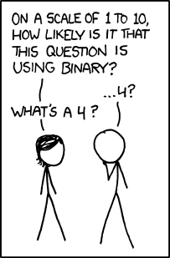
CS 101 Today
Jotto Corner
Mo B.
Kepa
AM guess
my guess
PM guess
my guess
alien: 2
????: ?
diner: 1
savvy: ?
alien: 2
?????: ?
diner: 0
savvy: ?
My top-10 list of binary jokes...
Looking Back Looking Forward
Computing as composition
Computing as representation
clay == functions
clay == data & bits

Slide 5
Some legs to stand on… ?
decipher
max
encipher
sScore
letScore
rot(c,n)
program organization
creating more and more capable compositions
ord
chr

Slide 6
Some legs to stand on!
It looks like I'm a head here…
decipher
max
encipher
sScore
letScore
rot(c,n)
program organization
creating more and more capable compositions
ord
chr
bits!
circuits
computer organization
how are even these fundamentals physically realized ?!

Slide 7
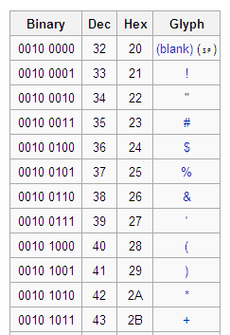
Binary Storage & Representation
8 bits = 1 byte = 1 box
value:
value:
'*'
42
00101010
00101010
type: str
bits
bits
type: int
name:
name:
But why these bits?
The same bits are in each container.
The SAME bits can represent different pieces of data, depending on type

Slide 8
42
What is 42 ?

Slide 9
Base 10
ONEs column
TENs column
42
What is 42 ?
4 tens + 2 ones
HUNDREDs column
TENs column
ONEs column
123
1 hundred + 2 tens + 3 ones

Slide 10
Base 2
Base 10
each column represents the base's next power
ONEs column
TENs column
THIRTYTWOs col.
EIGHTs column
SIXTEENs col.
FOURs column
TWOs column
ONEs column
42
101010
4 tens + 2 ones
123
128's column
HUNDREDs column
SIXTYFOURs col
THIRTYTWOs col.
EIGHTs column
SIXTEENs col.
FOURs column
TWOs column
ONEs column
TENs column
ONEs column
123
--------
1 hundred + 2 tens + 3 ones
Write 123 in binary…

Slide 11
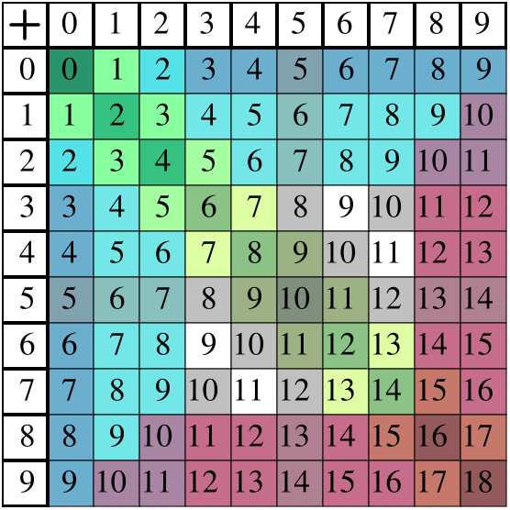
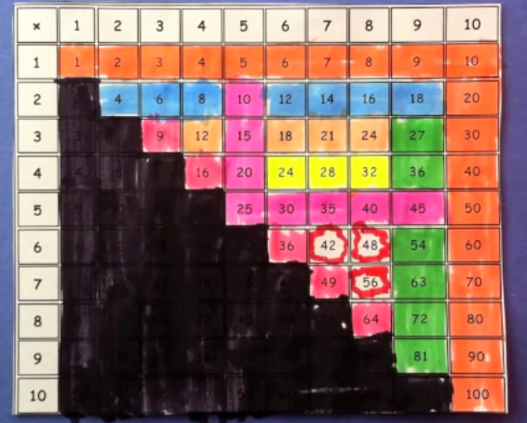
Binary math
Decimal math
tables of basic facts
+
Addition
*
Multiplication
www.youtube.com/watch?v=Nh7xapVB-Wk

Slide 12
Binary math
Decimal math
tables of basic facts
+
Addition
*
Multiplication
www.youtube.com/watch?v=Nh7xapVB-Wk

Slide 13
Name(s): ______________________________
Quiz
In binary, I'm an 11-eyed alien!
32
16
8
4
2
1
110011
10001000
Convert these two binary numbers to decimal:
32
16
8
4
2
1
Convert these two decimal numbers to binary:
28
101
10
10
Add these two binary numbers:
WITHOUT converting to decimal !
Multiply these binary numbers:
101101
101101
+
1110
*
1110
1
1
+
529
Hint: Remember these algorithms? They're the same in binary!
529
+
742
*
2
1271
1058
Extra! Can you figure out the last binary digit (bit) of 53 without determining any other bits? The last two? three?

Slide 14
Convert these two binary numbers to decimal:
32
16
8
4
2
1
128
64
32
16
8
4
2
1
110011
10001000
Convert these two decimal numbers to binary:
28
101
32
16
8
4
2
1
128
64
32
16
8
4
2
1
Extra! Can you figure out the last binary digit (bit) of 53 without determining any other bits? The last two? three?
We'll return to this in a bit…

Slide 15
Add these two binary numbers WITHOUT converting to decimal !
1
Hint:
529
+
742
Do you remember this algorithm? It's the same!
32
16
8
4
2
1
1271
101101
45
+
1110
14

Slide 16
Multiply these two binary numbers WITHOUT converting to decimal !
529
Hint:
*
42
Do you remember this algorithm? It's the same!
32
16
8
4
2
1
1058
101101
45
2116
+
*
1110
22218
14
A machine could - and probably should - be doing this !

Slide 17
Multiply these two binary numbers WITHOUT converting to decimal !
529
Hint:
*
42
Do you remember this algorithm? It's the same!
32
16
8
4
2
1
1058
101101
45
2116
+
*
1110
22218
14
000000
1011010
10110100
101101000
A machine could - and probably should - be doing this !
+
1001110110
630
512
256
128
64
32
16
8
4
2
1

Slide 18
Beyond Binary
base 1
digits: 1
111111111111111111111111111111111111111111
32
16
8
4
2
1
101010
base 2
digits: 0, 1
27
9
3
1
base 3
digits: 0, 1, 2
42 ?
There are 10 kinds of "people" in the universe: those who know ternary, those who don't, and those who think this is a binary joke!

Slide 19
Beyond Binary
base 1
digits: 1
111111111111111111111111111111111111111111
32
16
8
4
2
1
101010
base 2
digits: 0, 1
27
9
3
1
1120
base 3
digits: 0, 1, 2
16
4
1
base 4
base 5
Which of these isn't 42...?
base 6
222
60
54
46
39
base 7
base 8
and what are the bases of the rest?
base 9
base 10
42
digits: 0, 1, 2, 3, 4, 5, 6, 7, 8, 9
base 11
base 12
. . .
base 16

Slide 20
base 1
digits: 1
All 42s!
111111111111111111111111111111111111111111
128
64
32
16
8
4
2
1
101010
base 2
digits: 0, 1
81
27
9
3
1
1120
base 3
digits: 0, 1, 2
64
16
4
1
base 4
digits: 0, 1, 2, 3
222
125
25
5
1
base 5
digits: 0, 1, 2, 3, 4
132
216
36
6
1
base 6
digits: 0, 1, 2, 3, 4, 5
110
49
7
1
base 7
digits: 0, 1, 2, 3, 4, 5, 6
60
64
8
1
base 8
52
digits: 0, 1, 2, 3, 4, 5, 6, 7
81
9
1
base 9
46
digits: 0, 1, 2, 3, 4, 5, 6, 7, 8
100
10
1
base 10
42
digits: 0, 1, 2, 3, 4, 5, 6, 7, 8, 9
121
11
1
base 11
39
digits: 0, 1, 2, 3, 4, 5, 6, 7, 8, 9, A
Hexadecimal
256
16
1
base 16
2A
digits: 0, 1, 2, 3, 4, 5, 6, 7, 8, 9, A, B, C, D, E, F

Slide 21
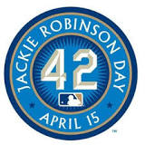
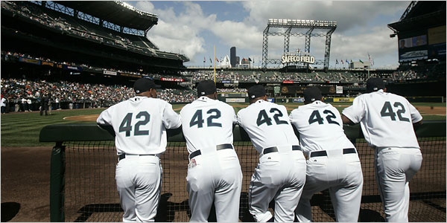
base 1
digits: 1
All 42s!
111111111111111111111111111111111111111111
128
64
32
16
8
4
2
1
101010
base 2
digits: 0, 1
81
27
9
3
1
1120
base 3
digits: 0, 1, 2
64
16
4
1
base 4
digits: 0, 1, 2, 3
222
125
25
5
1
base 5
digits: 0, 1, 2, 3, 4
132
216
36
6
1
base 6
digits: 0, 1, 2, 3, 4, 5
110
49
7
1
base 7
digits: 0, 1, 2, 3, 4, 5, 6
60
64
8
1
base 8
52
digits: 0, 1, 2, 3, 4, 5, 6, 7
81
9
1
base 9
46
digits: 0, 1, 2, 3, 4, 5, 6, 7, 8
100
10
1
base 10
42
digits: 0, 1, 2, 3, 4, 5, 6, 7, 8, 9
121
11
1
base 11
39
digits: 0, 1, 2, 3, 4, 5, 6, 7, 8, 9, A
Hexadecimal
256
16
1
base 16
2A
digits: 0, 1, 2, 3, 4, 5, 6, 7, 8, 9, A, B, C, D, E, F

Slide 22
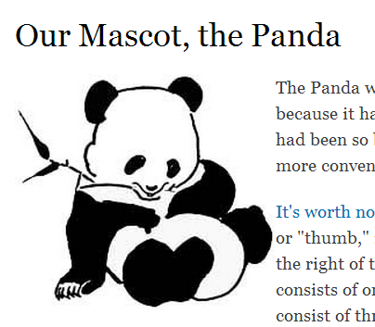
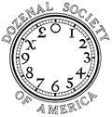


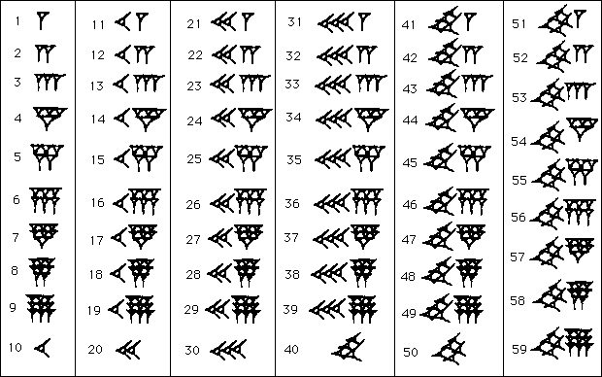
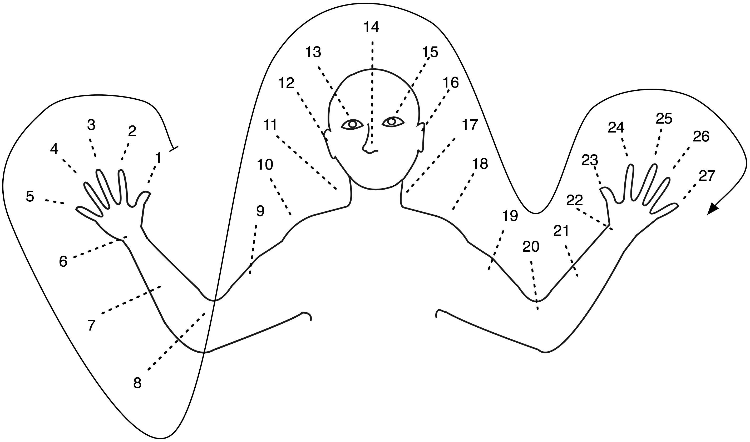
Off base?
Base 12 –
"Duodecimal Society" "Dozenal Society"
Base 20: Americas
Base 60 – Ancient Sumeria
6
16
Base 27: New Guinea
Olmec base-20 numbers
E. Mexico, ~ 300 AD
Some of these bases are still echoing around…
Notes:
Echoes:
dozen, gross -- show donzenal society pages:
http://www.dozenal.org/index.php?u=31
http://www.polar.sunynassau.edu/~dozenal/
British units: 12 inches, 12 ounces (Latin: uncia)
time: 12 hours
60: seconds, minutes, circular arcs -- from a 360 day calendar of the ancient sumerians and babylonians (circle of the sun going around the earth)
base 20 -- even though there is no evidence in Europe…
fingers + toes
"four score and seven years ago"
languages exhibit it:
French
Twenty (vingt) is used as a base number in the French language names of numbers from 60 to 99. So for example, quatre-vingts, the French word for 80 literally means "four twenties", and soixante quinze, the word for 75 is literally "sixty-fifteen.").

Slide 23
But why binary?

Slide 24
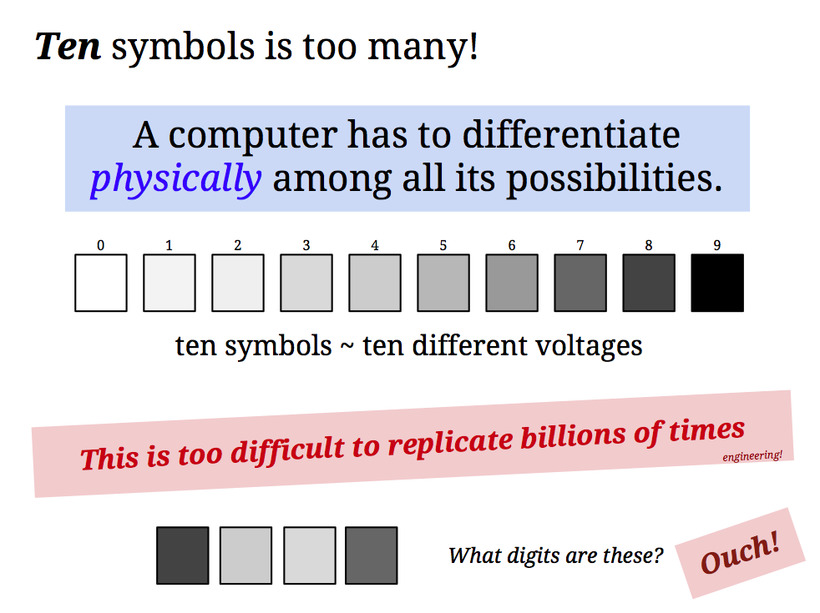


Slide 25
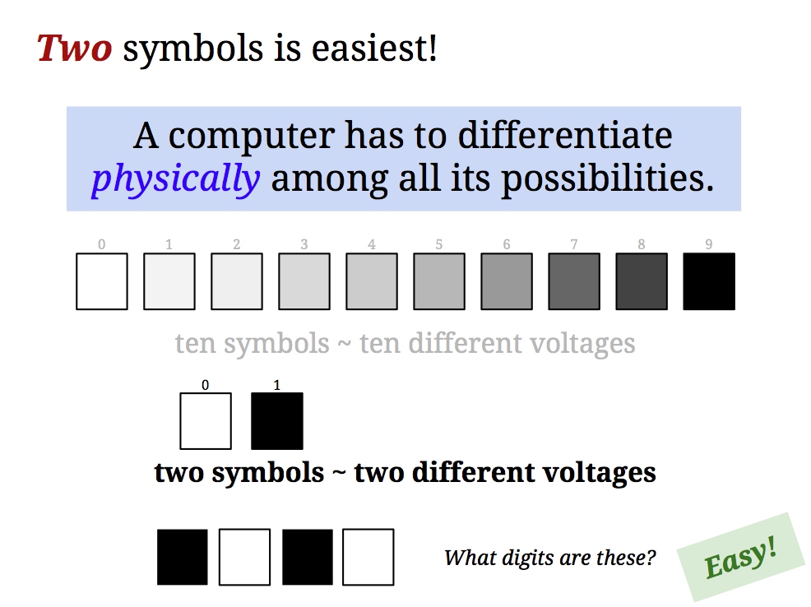
But why binary ?

Slide 26
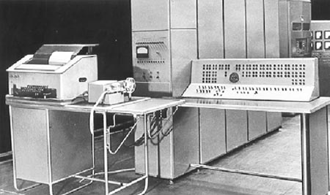

Ternary computers?
Everything should be base-3!
50 of these Setun ternary machines were made at Moscow U. ~ 1958
This project was discontinued in 1970… though not because of the ternary design!

Slide 27
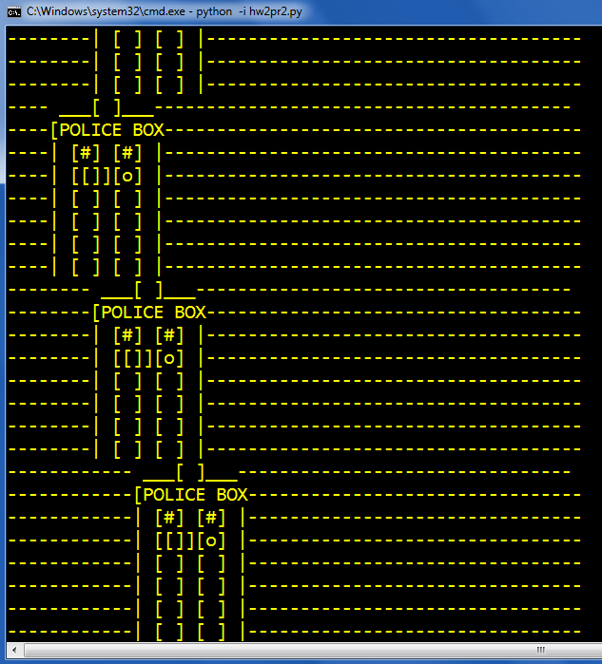
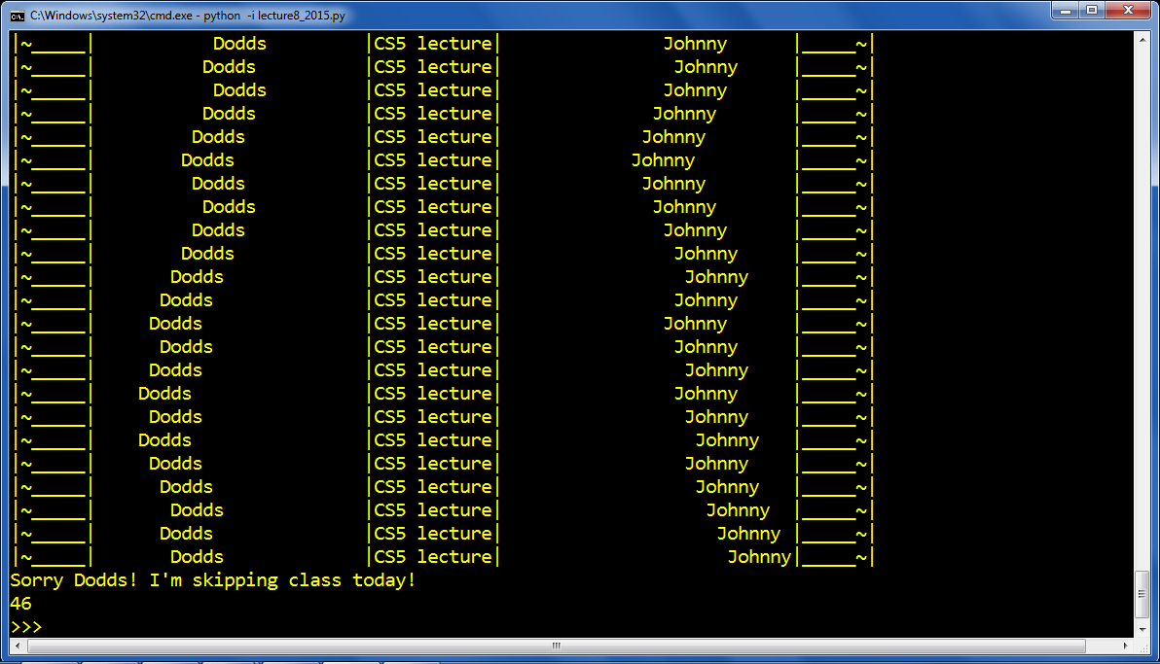
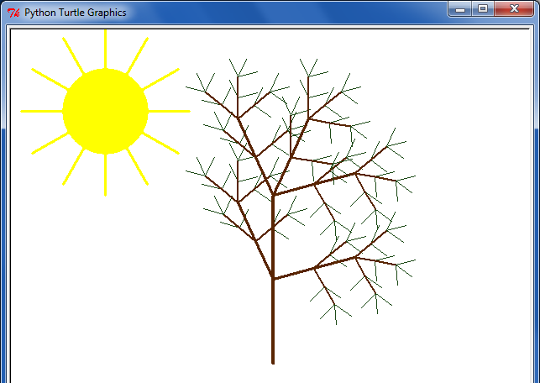
Eye-catching submissions...
and turtle art
ASCII wanderings...

Slide 28
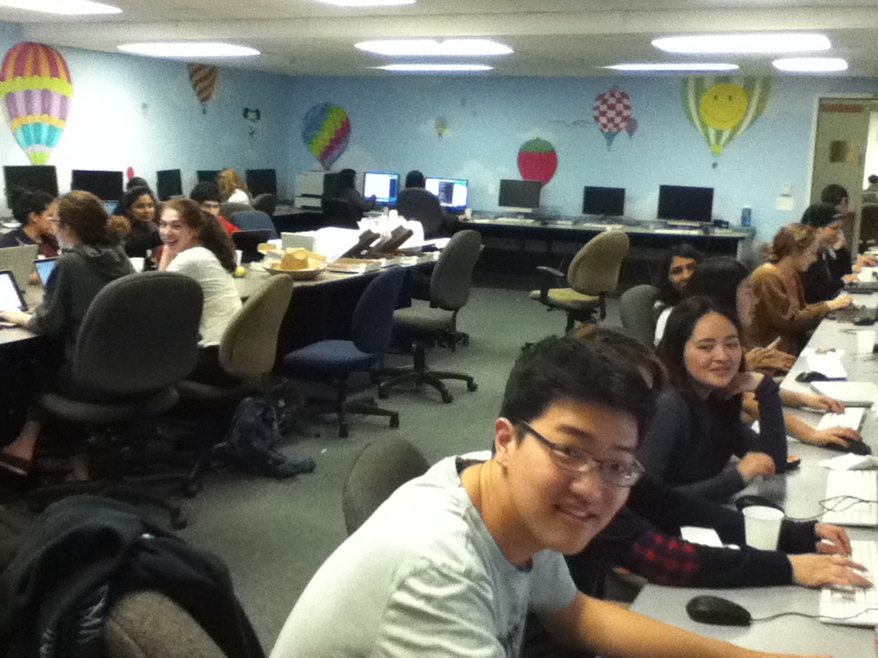
Ear-catching submissions, too...
Grutoring…
Th. @ 10pm…
Matt Bae

Slide 29
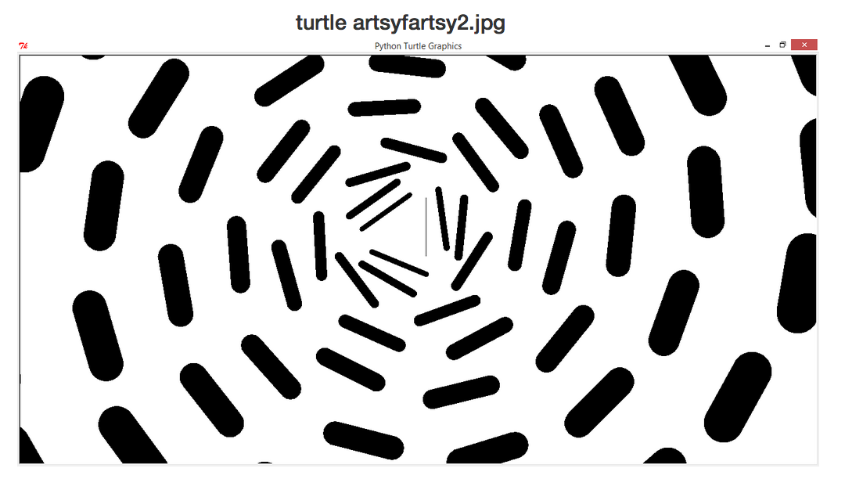
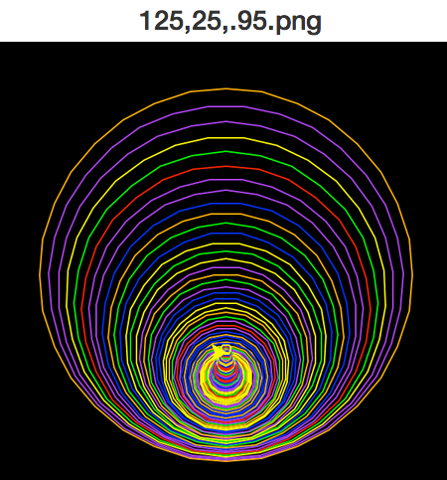
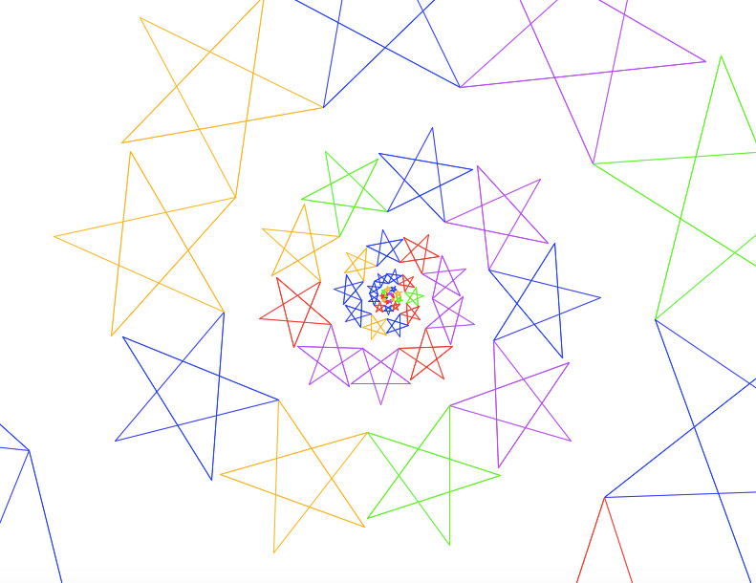
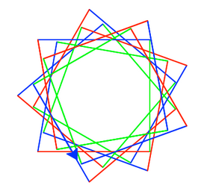
Abby Schantz
Anna Marburger
Kyle T
Chia Foo
Spirals...

Slide 30
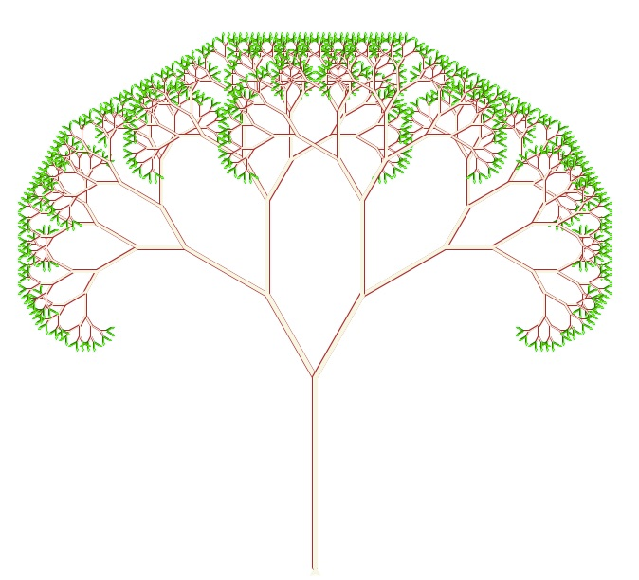
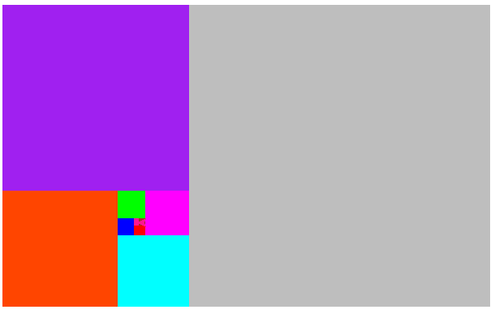
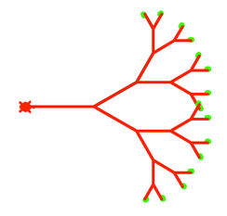
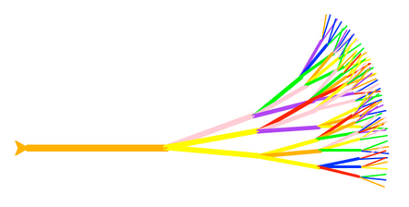
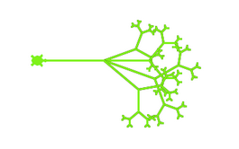
Trees!
Rachel O.
Eli Etzioni
Maite C. G.
Maya T.
Khadija H.

Slide 31
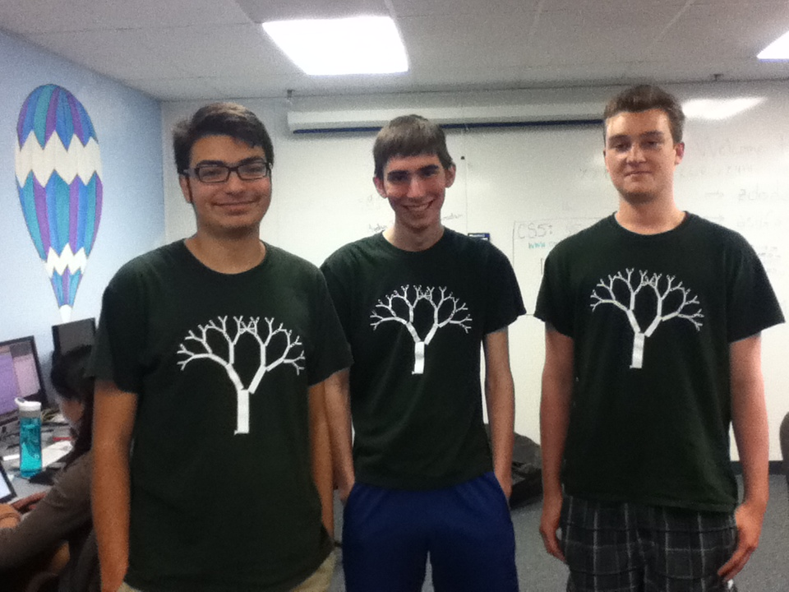
Trees!

Slide 32
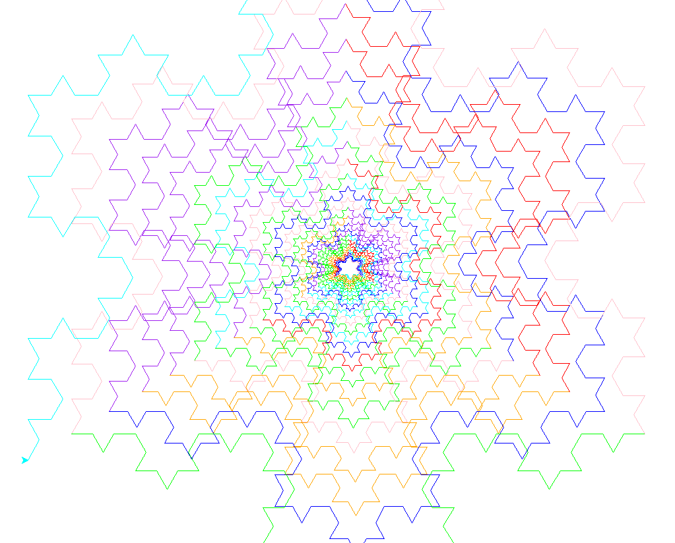
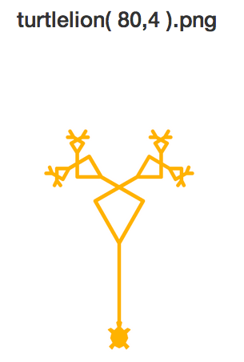
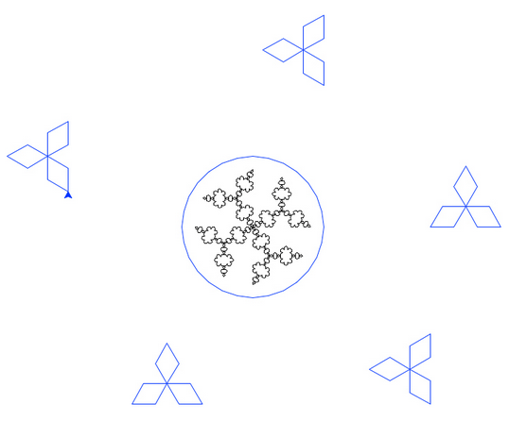
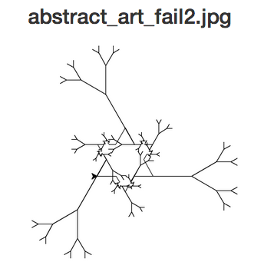
Both!?
Ryan D.
Sarah B.
Yuni K.

Slide 33
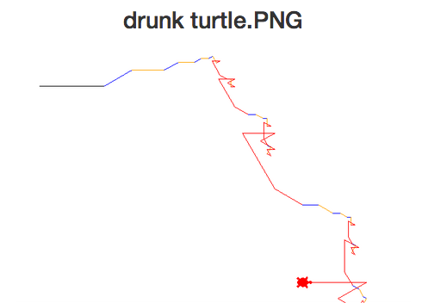
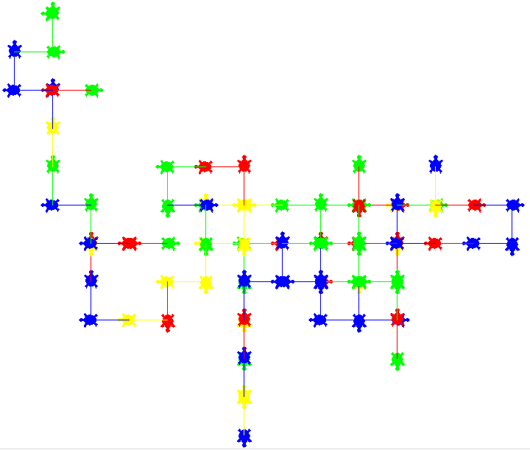

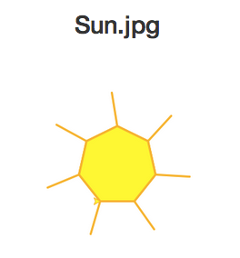

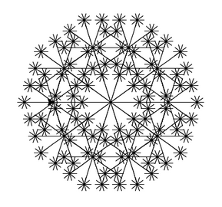
Sarah Hiller
Well-named images!
Jerry Jiang
Meteor Li
Sarah Baker
Cosette Dwyer

Slide 34
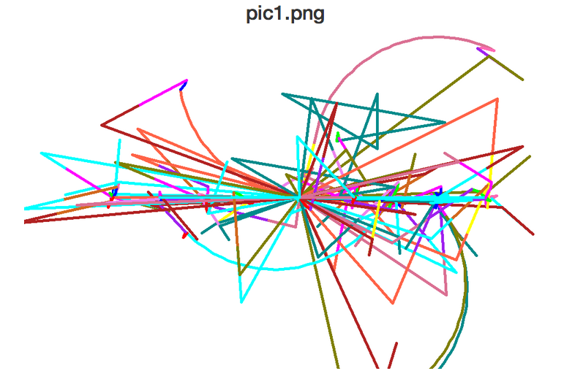
Sarah Hiller
Well-named images!
Jerry Jiang
Meteor Li
Sarah Baker
Cosette Dwyer

Slide 35
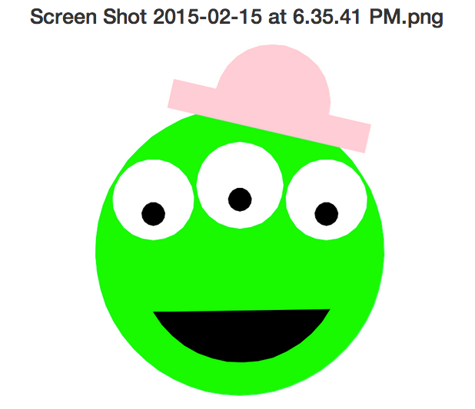
Jerry Jiang
Sarah Hiller
sometimes no name is needed!
Paige O.
Meteor Li
Sarah Baker
Cosette Dwyer

Slide 36
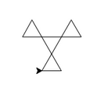
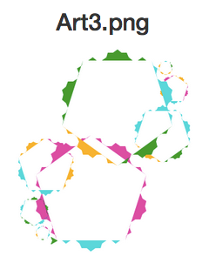
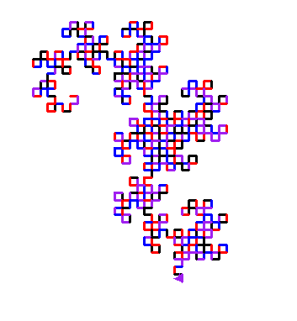
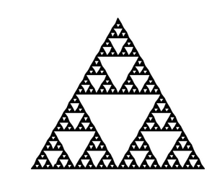
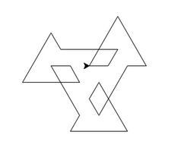




Daniel Lee ~ Dragon!
Suvena Y. ~ Sierpinski!
Shalina O.
geoshape1.png
geoshape2.png
Mara W.
geoshape3.png
geoshape5.png
geoshape4.png
geoshape6.png

Slide 37


Snowflake?
svtree?
It all depends on how you define success ...

Slide 38


treefail3.png
Snowflake?
svtree?
It all depends on how you define success ...

Slide 39

treefail3.png
Snowflake?
svtree?
It all depends on how you define success ...
SNOWFLAKE?!

Slide 40

Whoa!
'12
a turtle-drawn portrait from turtle graphics …

Slide 41

Whoa!
'15
A first in 2015!
A Turtle Movie…
Bo Jones

Slide 42
Back to binary…

Slide 43
Lab 4: Computing in binary
base 2
base 10
…
4
2
1
100
10
1
=
141
This first step of left-to-right conversion into binary is tricky to program... Why?
You mean aside from having to think in binary?

Slide 44
Lab 4: Computing in binary
base 2
base 10
128
64
32
16
8
4
2
1
100
10
1
=
141
This first step of left-to-right conversion into binary is tricky to program... Why?
It's tricky to find the largest power needed…

Slide 45

Extra! Can you figure out the last binary digit (bit) of 53 without determining any other bits? The last two? three?
All?
b.d. ~ binary digit ~ bit
"bit" first appeared in print in 1948 (Claude Shannon)
early document allocating different bits to control or data portions of a processor's work

Slide 46
Extra! Can you figure out the last binary digit (bit) of 53 without determining any other bits? The last two? three?
All?
…
8s
4s
2s
1s
in the end, we need "53"-worth of value
53

Slide 47
Extra! Can you figure out the last binary digit (bit) of 53 without determining any other bits? The last two? three?
All?
…
8s
4s
2s
1s
in the end, we need "53"-worth of value
53

Slide 48
Lab 4: Converting to binary…
base 10
base 2
100
10
1
128
64
32
16
8
4
2
1
141
=
What does the fact that 141 is ODD tell us?!
Try right-to-left!
141
=
10001101
answer
128
64
32
16
8
4
2
1

Slide 49
Lab 4: Converting to binary…
base 10
base 2
100
10
1
128
64
32
16
8
4
2
1
141
=
What does the fact that 141 is ODD tell us?!
Try right-to-left!
141
=
10001101
answer
128
64
32
16
8
4
2
1

Slide 50
Lab 4: Computing in binary
base 10
base 2
100
10
1
128
64
32
16
8
4
2
1
141
=
'10001101'
Right-to-left works!
numToBinary( N )
binaryToNum( S )
You'll write these right! (-to-left)
we'll represent binary numbers with strings
n2b(141)
b2n('10001101')

Slide 51
Lab 4: Computing in binary
base 10
base 2
100
10
1
128
64
32
16
8
4
2
1
141
=
'10001101'
def numToBinary( N ):
if N == 0:
return ''
elif N%2 == 0:
return numToBinary( ) +
else:
return numToBinary( ) +
empty string means 0
If N is even, what is the final bit?
?
If N is odd, what is the final bit?
How much VALUE is left to convert!?

Slide 52
Lab 4: Fleek binary conversion
def numToBinary( N ):
if N == 0: return ''
else: return numToBinary( N/2 ) +
def numToBinary( N ):
if N == 0:
return ''
elif N%2 == 0:
return numToBinary( N/2 ) + '0'
else:
return numToBinary( N/2 ) + '1'
empty string means 0
If N is even, what is the final bit?
If N is odd, what is the final bit?
How much VALUE is left to convert!?

Slide 53
Reasoning, bit by bit
<<
>>
&
|
left-shift
right-shift
and
or
left-shift by 1
11
3 << 1
110
6
and
(both)
&
|
or
(either)
left-shift by 2
bitwise and
3 << 2
5: 101
5 & 6
11
1100
6: 110
12
4
& 100
right-shift by 2
bitwise or
42 >> 2
5: 101
5 | 6
101010
1010
6: 110
10
7
| 111

Slide 54
Reasoning, bit by bit
<<
>>
Python did always look a little shifty to me…
left-shift
right-shift
left-shift by 1
11
3 << 1
110
6
What does left-shifting do to the value of a #?
left-shift by 2
11
3 << 2
1100
12
What does right-shifting do to the value of a #?
right-shift by 2
101010
42 >> 2
1010
10

Slide 55
Being bit-wise
Try these for a bit…
You don't need to convert to binary for these three…
14: 1110
9: 1001
You do need to use binary for these two!
7 << 1
left-shift
14 | 9
5 << 4
or
14 & 9
170 >> 2
right-shift
and
In processors shifts, ands, ors, adds, and subtractions are very fast, whereas multiplying, dividing, and mod, which are relatively slow.
N/4
Given this, what is a way to compute these expressions using only fast operations, maybe in combination?
N*7
N*17
N%16
extra fleek!

Slide 56
Being bit-wise
Try these for a bit…
You don't need to convert to binary for these three…
14: 1110
9: 1001
You do need to use binary for these two!
7 << 1
left-shift
14 | 9
5 << 4
or
14 & 9
170 >> 2
right-shift
and
In processors shifts, ands, ors, adds, and subtractions are very fast, whereas multiplying, dividing, and mod, which are relatively slow.
N/4
Given this, what is a way to compute these expressions using only fast operations, maybe in combination?
N*7
Let's first look at why you'd bother … !?
N*17
N%16
extra fleek!

Slide 57


Intel x86 processor instructions and their speeds (2014)
In processors shift, and, or, add, and subtract are much faster than multiply, divide, and mod, which are relatively slow.
MOD is the same
Old Microsoft systems-interview question:

Slide 58
Intel x86 processor instructions and their speeds (2014)
In processors shift, and, or, add, and subtract are much faster than multiply, divide, and mod, which are relatively slow.
MOD is the same
N/4
Given this, what is a way to compute these statements using combinations from only the fast operations above?
N*7
N*17
N%16

Slide 59

Insight: Ancient Egyptian Multiplication
or Russian Peasants' Multiplication
Notes:
This algorithm for multiplying two numbers was evidently widely used by peasants in Russia into the 19th century and is evidently still used in some parts of Russia!
The algorithm goes like this: Write down the two numbers side-by-side. In this case, 21 and 6. Then divide 21 by 2 (rounding down) and multiply 6 by 2. Repeat this process until the number in the left column becomes 1. Then, highlight those rows in which the first number is odd. In those rows, collect all the number in the second column and add them up. That’s the desired product!

Slide 60

Insight: Ancient Egyptian Multiplication
AEM/RPM algorithm
21 × 6 == 126
Write the factors in two columns.
Repeatedly halve the LEFT and double the RIGHT. (toss remainders…)
Pull out the RIGHT values where the LEFT values are odd.
Sum those values for the answer!
21 6
Why does this work?
11 × 15 == 165
Try it here
11 15
Buddy, can you spare an eye?
or Russian Peasants' Multiplication
Notes:
This algorithm for multiplying two numbers was evidently widely used by peasants in Russia into the 19th century and is evidently still used in some parts of Russia!
The algorithm goes like this: Write down the two numbers side-by-side. In this case, 21 and 6. Then divide 21 by 2 (rounding down) and multiply 6 by 2. Repeat this process until the number in the left column becomes 1. Then, highlight those rows in which the first number is odd. In those rows, collect all the number in the second column and add them up. That’s the desired product!

Slide 61
Insight: Egyptian + Russian Multiplication
110
10101
6
x
21
21 6
10 12
5 24
2 48
1 96
110
0000
11000
000000
1100000
6
24
96
6
12
24
48
+
96
+
1111110
126
126
Decimal
Binary
Notes:
To see why it works, let’s convert the numbers in both columns to binary.

Slide 62
Insight: Egyptian + Russian Multiplication
1111
1011
15
x
11
11 15
5 30
2 60
1 120
1111
11110
000000
1111000
15
30
120
15
30
60
+
120
+
10100101
165
165
Decimal
Binary
Notes:
To see why it works, let’s convert the numbers in both columns to binary.

Slide 63

Insight: Egyptian + Russian Multiplication
1111
1011
15
x
11
11 15
5 30
2 60
1 120
1111
11110
000000
1111000
15
30
120
15
30
60
+
120
+
10100101
165
165
Decimal
Binary
Notes:
To see why it works, let’s convert the numbers in both columns to binary.

Slide 64

When traveling, always insist on binary accommodations … !
This room is a 10!
See you at lab – in a bit!

Slide 66
Base 2
Base 10
each column represents the base's next power
ONEs column
TENs column
THIRTYTWOs col.
EIGHTs column
SIXTEENs col.
FOURs column
TWOs column
ONEs column
42
101010
4 tens + 2 ones
128's column
HUNDREDs column
SIXTYFOURs col
THIRTYTWOs col.
EIGHTs column
SIXTEENs col.
FOURs column
TWOs column
ONEs column
TENs column
ONEs column
123
--------
1 hundred + 2 tens + 3 ones
Write 123 in binary…

Slide 67
Extra! Can you figure out the last binary digit (bit) of 53 without determining any other bits? The last two? three?
All?
…
8s
4s
2s
1s
53

Slide 68
Binary math
Decimal math
tables of basic facts
+
Addition
*
Multiplication
www.youtube.com/watch?v=Nh7xapVB-Wk

Slide 69
Reasoning, bit by bit
<<
>>
Python did always look a little shifty to me…
left-shift
right-shift
left-shift by 1
11
3 << 1
6
What does left-shifting do to the value of a #?
left-shift by 2
11
3 << 2
What does right-shifting do to the value of a #?
right-shift by 2
101010
42 >> 2
5 & 6
5 | 6

Slide 70
Insight: Ancient Egyptian Multiplication
AEM/RPM algorithm
21 × 6 == 126
Write the factors in two columns.
Repeatedly halve the LEFT and double the RIGHT. (toss remainders…)
Pull out the RIGHT values where the LEFT values are odd.
Sum those values for the answer!
21 6
Why does this work?
11 × 15 == 165
Try it here
11 15
Buddy, can you spare an eye?
or Russian Peasants' Multiplication
Notes:
This algorithm for multiplying two numbers was evidently widely used by peasants in Russia into the 19th century and is evidently still used in some parts of Russia!
The algorithm goes like this: Write down the two numbers side-by-side. In this case, 21 and 6. Then divide 21 by 2 (rounding down) and multiply 6 by 2. Repeat this process until the number in the left column becomes 1. Then, highlight those rows in which the first number is odd. In those rows, collect all the number in the second column and add them up. That’s the desired product!

Slide 71
Being bit-wise
Try these on the back page first…
You don't need to convert to binary for these three…
14: 1110
9: 1001
You do need to use binary for these two!
7 << 1
left-shift
14 | 9
5 << 4
or
14 & 9
170 >> 2
right-shift
and
In processors shifts, ands, ors, adds, and subtractions are much faster than multiplying, dividing, and mod, which are relatively slow.
N/4
Given this, what is a way to compute these expressions using only combinations of the fast operations above?
N*7
N*17
N%16
extra fleek!

Slide 72
Being bit-wise
Try these on the back page first…
You don't need to convert to binary for these three…
14: 1110
13: 1011
You will need to use binary here!
7 << 1
5 << 4
14 & 13
14 | 13
170 >> 2
In processors shifts, ands, ors, adds, and subtractions are much faster than multiplying, dividing, and mod, which are relatively slow.
N/4
Given this, what is a way to compute these statements using combinations from only the fast operations above?
N*7
Let's first look at why you'd bother … !?
N*17
N%16

Slide 73
Being bit-wise
Try these on the back page first…
You don't need to convert to binary for these three…
14: 1110
13: 1011
You will need to use binary here!
7 << 1
5 << 4
14 & 13
14 | 13
170 >> 2
In processors shifts, ands, ors, adds, and subtractions are much faster than multiplying, dividing, and mod, which are relatively slow.
N/4
Given this, what is a way to compute these statements using combinations from only the fast operations above?
N*7
N*17
N%16

Slide 74




Thomas Fowler's Ternary Computer
finally some sanity in human computing!
balanced ternary calculations from Fowler's papers
the carry mechanism
the reconstruction
the computational components
T. Fowler 1777-1843, Treasurer of the Poor Law Union
Notes:
http://www.mortati.com/glusker/fowler/fowlerbio.htm
"In the 1830’s, Fowler was Treasurer of the Poor Law Union. This job required a considerable number of repetitive monetary calculations, made more complex by the pre-decimal British currency."

Slide 75

The machine was rebuilt from two sources:
a two-page description (with no images) by mathematician A. DeMorgan
http://www.mortati.com/glusker/fowler/index.htm

Slide 76

The machine was rebuilt from two sources:
a two-page description (with no images) by mathematician A. DeMorgan
a picture of it as a stained-glass window in Fowler's church: St. Michael's of Great Torrington, North Devon, U.K.!
http://www.mortati.com/glusker/fowler/index.htm

Slide 77
This week's homework may be submitted in two formats: electronically or in stained glass.
See you in Lab!

Slide 79
Insight: Multiplication with Russian Peasants
21 × 6 == 126
Write the factors in two columns.
Repeatedly halve the LEFT and double the RIGHT.
Pull out the RIGHT values where the LEFT values are odd.
Sum those values for the answer.
21 6
Try it. Why does it work?
11 × 15 == 165
11 15
Hey, buddy, can you spare an eye?
(Translation: “Hello, American Students!” I've been told there's a typo here, too!)
Notes:
This algorithm for multiplying two numbers was evidently widely used by peasants in Russia into the 19th century and is evidently still used in some parts of Russia!
The algorithm goes like this: Write down the two numbers side-by-side. In this case, 21 and 6. Then divide 21 by 2 (rounding down) and multiply 6 by 2. Repeat this process until the number in the left column becomes 1. Then, highlight those rows in which the first number is odd. In those rows, collect all the number in the second column and add them up. That’s the desired product!

Slide 80
Base 2
Base 10
each column represents the base's next power
ONEs column
TENs column
THIRTYTWOs col.
EIGHTs column
SIXTEENs col.
FOURs column
TWOs column
ONEs column
42
101010
4 tens + 2 ones
128's column
HUNDREDs column
SIXTYFOURs col
THIRTYTWOs col.
EIGHTs column
SIXTEENs col.
FOURs column
TWOs column
ONEs column
TENs column
ONEs column
123
--------
1 hundred + 2 tens + 3 ones
Write 123 in binary…

Slide 81
Binary math
Decimal math
tables of basic facts
+
Addition
*
Multiplication
www.youtube.com/watch?v=Nh7xapVB-Wk

Slide 82
Convert these two binary numbers to decimal:
32
16
8
4
2
1
128
64
32
16
8
4
2
1
110011
10001000
Convert these two decimal numbers to binary:
28
101
32
16
8
4
2
1
128
64
32
16
8
4
2
1
Extra! Can you figure out the last two binary digits of 78,922,353 without determining any other bits?
We'll return to this in a bit…

Slide 83
Add these two binary numbers WITHOUT converting to decimal !
1
Hint:
529
+
742
Do you remember this algorithm? It's the same!
101101
1271
+
1110
45
14

Slide 84
Multiply these two binary numbers WITHOUT converting to decimal !
529
Hint:
*
42
Do you remember this algorithm? It's the same!
101101
1058
2116
*
1110
22218
A machine could - and probably should - be doing this !
45
14

Slide 85
Beyond Binary
base 1
digits: 1
111111111111111111111111111111111111111111
32
16
8
4
2
1
101010
base 2
digits: 0, 1
27
9
3
1
base 3
digits: 0, 1, 2
42 ?
There are 10 kinds of "people" in the universe: those who know ternary, those who don't, and those who think this is a binary joke!

Slide 86
Beyond Binary
base 1
digits: 1
111111111111111111111111111111111111111111
32
16
8
4
2
1
101010
base 2
digits: 0, 1
27
9
3
1
1120
base 3
digits: 0, 1, 2
base 4
base 5
Which of these isn't 42...?
base 6
222
60
54
46
39
base 7
base 8
and what are the bases of the rest?
base 9
base 10
42
digits: 0, 1, 2, 3, 4, 5, 6, 7, 8, 9
base 11
base 12

Slide 87
Extra! Can you figure out the last binary digit (bit) of 7,053 without determining any other bits? The last two? three?
…
8s
4s
2s
1s
53

Slide 88
Lab 4: Computing in binary
base 2
base 10
128
64
32
16
8
4
2
1
100
10
1
=
139
Try right-to-left!
What does the fact that 139 is ODD tell us?!

Slide 89
Being bit-wise
Evaluate these bitwise operations
You don't need to convert to binary for these three…!
14: 1110
13: 1011
7 << 1
You'll need to use binary here.
14 & 13
5 << 4
14 | 13
170 >> 2
In processors shifts, ands, ors, adds, and subtractions are much faster than multiplying, dividing, and mod, which are relatively slow.
N/4
Given this, what is a way to compute these statements using combinations from only the fast operations above?
N*7
N*17
N%16

Slide 90

Intel x86 processor instructions and their speeds (2011)
In processors shift, and, or, add, and subtract are much faster than multiply, divide, and mod, which are relatively slow.
+ MOD
N/4
Given this, what is a way to compute these statements using combinations from only the fast operations above?
N*7
N*17
N%16

Slide 91
Insight: Russian Peasants' Multiplication
The RPM algorithm
21 × 6 == 126
Write the factors in two columns.
Repeatedly halve the LEFT and double the RIGHT.
Pull out the RIGHT values where the LEFT values are odd.
Sum those values for the answer!
21 6
Why does this work?
11 × 15 == 165
11 15
Hey, buddy, can you spare an eye?
(Translation: “Hello, American Students!” I've been told there's a typo here, too!)
Notes:
This algorithm for multiplying two numbers was evidently widely used by peasants in Russia into the 19th century and is evidently still used in some parts of Russia!
The algorithm goes like this: Write down the two numbers side-by-side. In this case, 21 and 6. Then divide 21 by 2 (rounding down) and multiply 6 by 2. Repeat this process until the number in the left column becomes 1. Then, highlight those rows in which the first number is odd. In those rows, collect all the number in the second column and add them up. That’s the desired product!

Slide 92

Binary math
Decimal math
tables of basic facts
Addition
+
Multiplication
*

Slide 93

Shift happens...
100
10
1
42
def leftshift( s ):
""" left-shift by one bit """
return s + '0'
420
What does left-shifting do to the value of a decimal number?
4
2
1
11
110
What does it do to the value of a binary number?

Slide 94
Shift happens...
100
10
1
420
def rightshift( s ):
""" right-shift by one bit """
return
42
What does right-shifting do to the value of a decimal number?
4
2
1
110
11
What does it do to the value of a binary number?

Slide 95
A bit of intuition…
Sometimes the bits are almost visible:
21 << 1
5 & 6
5 | 6
?
?
?
21 >> 1
5 ^ 6
?
?
What will these output values be?

Slide 96
Insight: Multiplication with Russian Peasants
110
10101
6
x
21
21 6
10 12
5 24
2 48
1 96
110
0000
11000
000000
1100000
6
24
96
6
12
24
48
+
96
+
1111110
126
126
Decimal
Binary
Notes:
To see why it works, let’s convert the numbers in both columns to binary.

Slide 97
Thomas Fowler's Ternary Computer
finally some sanity in human computing!
balanced ternary calculations from Fowler's papers
the carry mechanism
the reconstruction
the computational components
T. Fowler 1777-1843, Treasurer of the Poor Law Union
Notes:
http://www.mortati.com/glusker/fowler/fowlerbio.htm
"In the 1830’s, Fowler was Treasurer of the Poor Law Union. This job required a considerable number of repetitive monetary calculations, made more complex by the pre-decimal British currency."

Slide 98
The machine was rebuilt from two sources:
a two-page description (with no images) by mathematician A. DeMorgan
http://www.mortati.com/glusker/fowler/index.htm

Slide 99
The machine was rebuilt from two sources:
a two-page description (with no images) by mathematician A. DeMorgan
a picture of it as a stained-glass window in Fowler's church: St. Michael's of Great Torrington, North Devon, U.K.!
http://www.mortati.com/glusker/fowler/index.htm

Slide 100
This week's homework may be submitted in two formats: electronically or in stained glass.
See you in Lab!

Slide 101
Base 2
Base 10
each column represents another power of the base
TWOS
THOUSANDTHS
HUNDRETHS
DECIMAL point
ONES
QUARTERS
TENTHS
ONES
EIGHTHS
BINARY point
HALVES
10.011
2.375
0.0001100110011001100110011...
0.1
Now I see the "point" of binary!

Slide 102

Floats? Let's look at math.pi...
>>> import math
>>> math.pi
3.141592653589793
Seems ok...
How to get the least significant figures?

Slide 103


?!?!

Slide 104


Eye-catching submissions...

Slide 105


Eye-catching submissions...

Slide 106


Turtle Art…

Slide 107


Bits everywhere!
LA County Fair
most binary dessert!

Slide 108
Imagine if we had only 4 bits …
.0625
.125
We could only represent these values!
.25
.5
0.0000
0.0000
How would the machine represent 8/10 ?
0.0001
0.0625
0.0010
0.1250
We might type the decimal value 0.8
The computer represents it as the closest available float:
This float's decimal value is 0.8125
So, it acts like you typed 0.8125 !
Including when the value gets printed
0.0011
0.1875
0.0100
0.2500
0.0101
0.3125
…
…
0.1100
0.7500
0.1101
0.8125
0.1110
0.8750
0.1111
0.9375
4 bits

Slide 109


IEEE* floats
*Institute of Electrical and Electronics Engineers
Python uses double precision floats
64 bits == 8 bytes each

Slide 110
Base 2
Base 10
each column represents another power of the base
TENs column
ONEs column
THIRTYTWOs col.
EIGHTs column
SIXTEENs col.
FOURs column
TWOs column
ONEs column
42
101010
4 tens + 2 ones
128s column
SIXTYFOURs col
THIRTYTWOs col.
HUNDREDs column
EIGHTs column
SIXTEENs col.
FOURs column
TWOs column
ONEs column
TENs column
ONEs column
123
--------
1 hundred + 2 tens + 3 ones
Write 123 in binary…

Slide 111
Binary math
Decimal math
tables of basic facts
Addition
+
Multiplication
*

Slide 112
MULTIPLY these two binary numbers WITHOUT converting to decimal !
529
*
42
Hint:
101101
Do you remember this algorithm? It's the same!
1058
*
1110
2116
22218

Slide 113
Lab 4
base 2
base 10
RIGHT-to-LEFT conversion !
128
64
32
16
8
4
2
1
100
10
1
10001000
=
136
def numToBinary( N ):
if N == 0:
return ''
elif N%2==0:
return
Which other operators will you need in this recursive case of numToBinary?

Slide 114
Base 2
Base 10
each column represents another power of the base
TENs column
ONEs column
THIRTYTWOs col.
EIGHTs column
SIXTEENs col.
FOURs column
TWOs column
ONEs column
42
101010
4 tens + 2 ones
128s column
SIXTYFOURs col
THIRTYTWOs col.
HUNDREDs column
EIGHTs column
SIXTEENs col.
FOURs column
TWOs column
ONEs column
TENs column
ONEs column
123
--------
1 hundred + 2 tens + 3 ones
Write 123 in binary…

Slide 115
Binary math
Decimal math
tables of basic facts
Addition
+
Multiplication
*

Slide 116
"Quiz"
There are 10 kinds of "people" in the universe: those who use binary, and those who do not!
Name(s):
32
16
8
4
2
1
Convert these two binary numbers to decimal:
110011
10001000
Convert these two decimal numbers to binary:
28
101
WITHOUT converting to decimal !
Add these two binary numbers:
Multiply these binary numbers:
101101
101101
+
1110
*
1110
1
529
+
Hint: Remember this algorithm? It's the same…
742
1271

Slide 117

Off base?
All this focus on 10 seems so alien!
Base 60 – Ancient Sumeria
Base 12 – "Duodecimal Society" "Dozenal Society"
Olmec base-20 number representation (East Mexico, 1200 BC-600 AD)
Base 20 – America, precolombus
Echoes of these bases are still bouncing around…
Notes:
Echoes:
dozen, gross -- show donzenal society pages:
http://www.dozenal.org/index.php?u=31
http://www.polar.sunynassau.edu/~dozenal/
British units: 12 inches, 12 ounces (Latin: uncia)
time: 12 hours
60: seconds, minutes, circular arcs -- from a 360 day calendar of the ancient sumerians and babylonians (circle of the sun going around the earth)
base 20 -- even though there is no evidence in Europe…
fingers + toes
"four score and seven years ago"
languages exhibit it:
French
Twenty (vingt) is used as a base number in the French language names of numbers from 60 to 99. So for example, quatre-vingts, the French word for 80 literally means "four twenties", and soixante quinze, the word for 75 is literally "sixty-fifteen.").

Slide 118
Lab 4
base 2
base 10
RIGHT-to-LEFT conversion !
128
64
32
16
8
4
2
1
100
10
1
10001000
=
136
def numToBinary( N ):
if N == 0:
return ''
elif N%2==0:
return
Which other operators will you need in this recursive case of numToBinary?

Slide 119
Beyond Binary
base 1
digits: 1
111111111111111111111111111111111111111111
128
64
32
16
8
4
2
1
101010
base 2
digits: 0, 1
base 10
42
digits: 0, 1, 2, 3, 4, 5, 6, 7, 8, 9

Slide 120
Beyond Binary
base 1
digits: 1
111111111111111111111111111111111111111111
128
64
32
16
8
4
2
1
101010
base 2
digits: 0, 1
81
27
9
3
1
base 3
digits: 0, 1, 2
base 10
42
digits: 0, 1, 2, 3, 4, 5, 6, 7, 8, 9

Slide 121

What isn't 42?
(A)
222
Wake Forest U.
(D)
46
(B)
60
(E)
39
(C)
54
Only one of these is not 42, regardless of the base of the numbering system... Which?
Notes:
Jeopardy music?
Backwards?

Slide 122

The power of shifting…
100
10
1
420
def rightshift( s ):
""" right-shift by 1 """
return
42
What does right-shifting do to the value of a decimal number?
4
2
1
110
11
What does it do to the value of a binary number?

Slide 123

Speed…
What would be a fast way to determine these values… ?
other than typing them into Python ?!?
5 << 4
100 >> 3
In many processors shifting, adding, and subtracting are faster than multiplying and dividing.
What is a "fast" way to multiply N*7 or N*17 ?
On an Intel Pentium, an integer multiply takes 10 clock ticks (cycles).
The same chip can do 2 additions in one clock tick (cycle).
http://www.xmission.com/pub/lists/fractint/archive/v01.n028

Slide 124
Lab 4
base 2
base 10
RIGHT-to-LEFT conversion !
128
64
32
16
8
4
2
1
100
10
1
10001000
=
136
def numToBinary( N ):
if N == 0:
return ''
elif N%2==0:
return
(A)
(B)
(C)
(D)
(E)
%
/
%,/
+,%
+,/
Which other operators will you need in this recursive case of numToBinary?

Slide 125
Aside: Multiplication with Russian Peasants
Compute 21 × 6:
21 6
10 12
5 24
2 48
1 96
Write the factors in two columns. Repeatedly halve and double, respectively.
Add the right-hand values in rows where the left-hand side is ODD…
Odd is an understatement here!
(Translation: “Hello, American Students!”)
Notes:
This algorithm for multiplying two numbers was evidently widely used by peasants in Russia into the 19th century and is evidently still used in some parts of Russia!
The algorithm goes like this: Write down the two numbers side-by-side. In this case, 21 and 6. Then divide 21 by 2 (rounding down) and multiply 6 by 2. Repeat this process until the number in the left column becomes 1. Then, highlight those rows in which the first number is odd. In those rows, collect all the number in the second column and add them up. That’s the desired product!

Slide 126
Aside: Multiplication with Russian Peasants
110
10101
110
000
11000
000
1100000
The values in binary…
110
1010 1100
101 11000
10 110000
1 1100000
1111110
1111110
This is just the grade-school algorithm for multiplication!
Why the doubling? Why the halving?

Slide 127
sinking with floats
.0625
Imagine we had only 4 bits …
.125
.25
.5
0.0000
0.0000
0.0001
0.0625
0.0010
0.1250
0.0011
0.1875
0.0100
0.2500
lots of gaps in here…
0.0101
0.3125
…
…
0.1100
0.7500
0.1101
0.8125
0.1110
0.8750
0.1111
0.9375
In reality, 23 bits or 52 bits will be used to represent the fractional part of a floating-point number
4 bits

Slide 128



Spirals et al.
Jacob R.
Austin C.

Slide 129



Trees
Errick Jackson
Katelyn B.

Slide 130


Trees
Marissa L.
and snowflakes…

Slide 131


Kevin B.

Slide 132


Treeflakes?

Slide 133


Others… !
C. Hoyt
Annie Ludlow

