Slide 1


The CS5 Times
Eager Penguins Invade Computer Lab
Claremont (AP): The first-day offering of Harvey Mudd’s popular CS5 laboratory was disrupted when a large flock of penguins took every seat in the room. “They’re cute,” complained a distraught student, “but they smell like fish and there’s no room for us.”
Professors attempted to drive the penguins away by repeatedly shouting “Shark!”, but the penguins were unmoved.
Handouts (read them all!):
  Today’s lecture notes
  A preprinted blank "worksheet”
Light reading? ;^)
(Official course alien)
Prof. Geoff Kuenning, Olin 1255
http://www.cs.hmc.edu/~geoff/geoff-schedule.html
Notes:
Before lecture begins, have a browser window with Picobot, and have the maze solution ready to paste in so you can demo solving the maze.

Slide 2
Overview
Weeks 1-3: Thinking functionally
Weeks 4-6: Computer organization
Weeks 7-10: Oops! (Object oriented programs)
Weeks 11-14: Theoretical foundations
Capstone Project!
14 weeks of action-packed excitement!

Slide 3
Programming Languages…
* A+
* A++
* A#
* A-0 programming language
* ABAP
* ABC
* ABC ALGOL
* ABLE
* ABSET
* ABSYS
* ACC
* Accent
* ACT-III
* ATOLL - Acceptance, Test Or Launch Language
* Action!
* ACS
* ActionScript
* Actor
* Ada
2000± languages omitted
* YAFL
* Yellow - Rejected prototype for Ada
* Yorick
* Y Language
* Z notation - A program specification language, like UML
* ZOPL.
* ZPL
* ZUG
* ZZT-oop

Slide 4
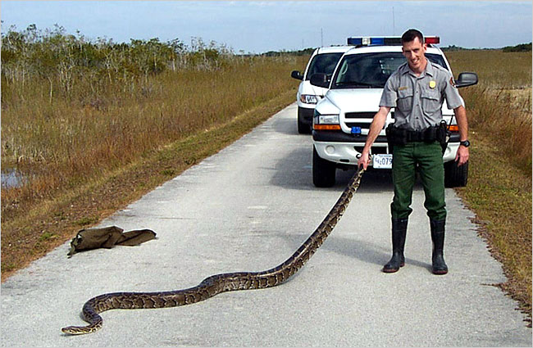

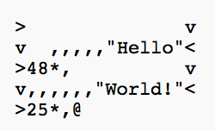

Python
Relatively “nice” syntax
Emerging as language of choice in many fields
Packages for graphics, audio, scientific computing, …
print("Hello World")
Python
Prof. Geoff takes on Python…
class HelloWorld {
static public void main(String args[]) {
System.out.println("Hello World!");
}
}
Java
Befunge

Slide 5
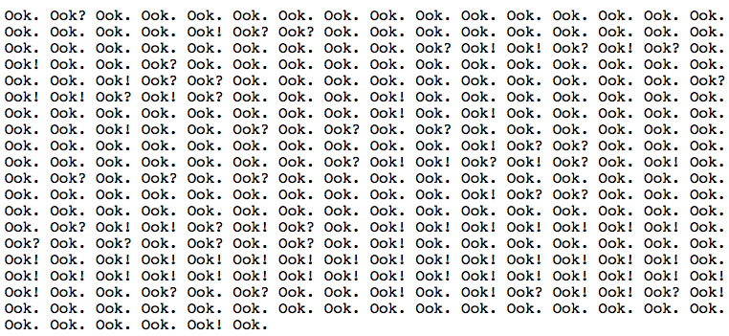
Hello World…
#include <iostream.h>
main()
{
cout << "Hello World!" << endl;
return 0;
}
C++
Ook

Slide 6
Some Things You’ll Do This Semester…
Sequence alignment
ATTATCG
ACATTC
ATTATCG ->
A TATCG ->
A CAT_CG ->
A CATTCG ->
A CATTC
Delete T
Change T to C
Insert T here
Delete G
Distance is 4
ATTAT-CG
A-CATTC-

Slide 7
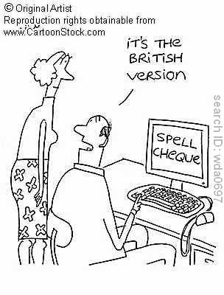
Spel Cheking…

Slide 8
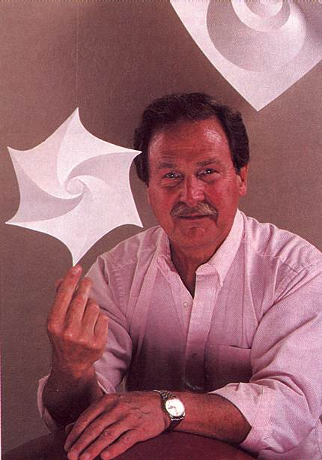
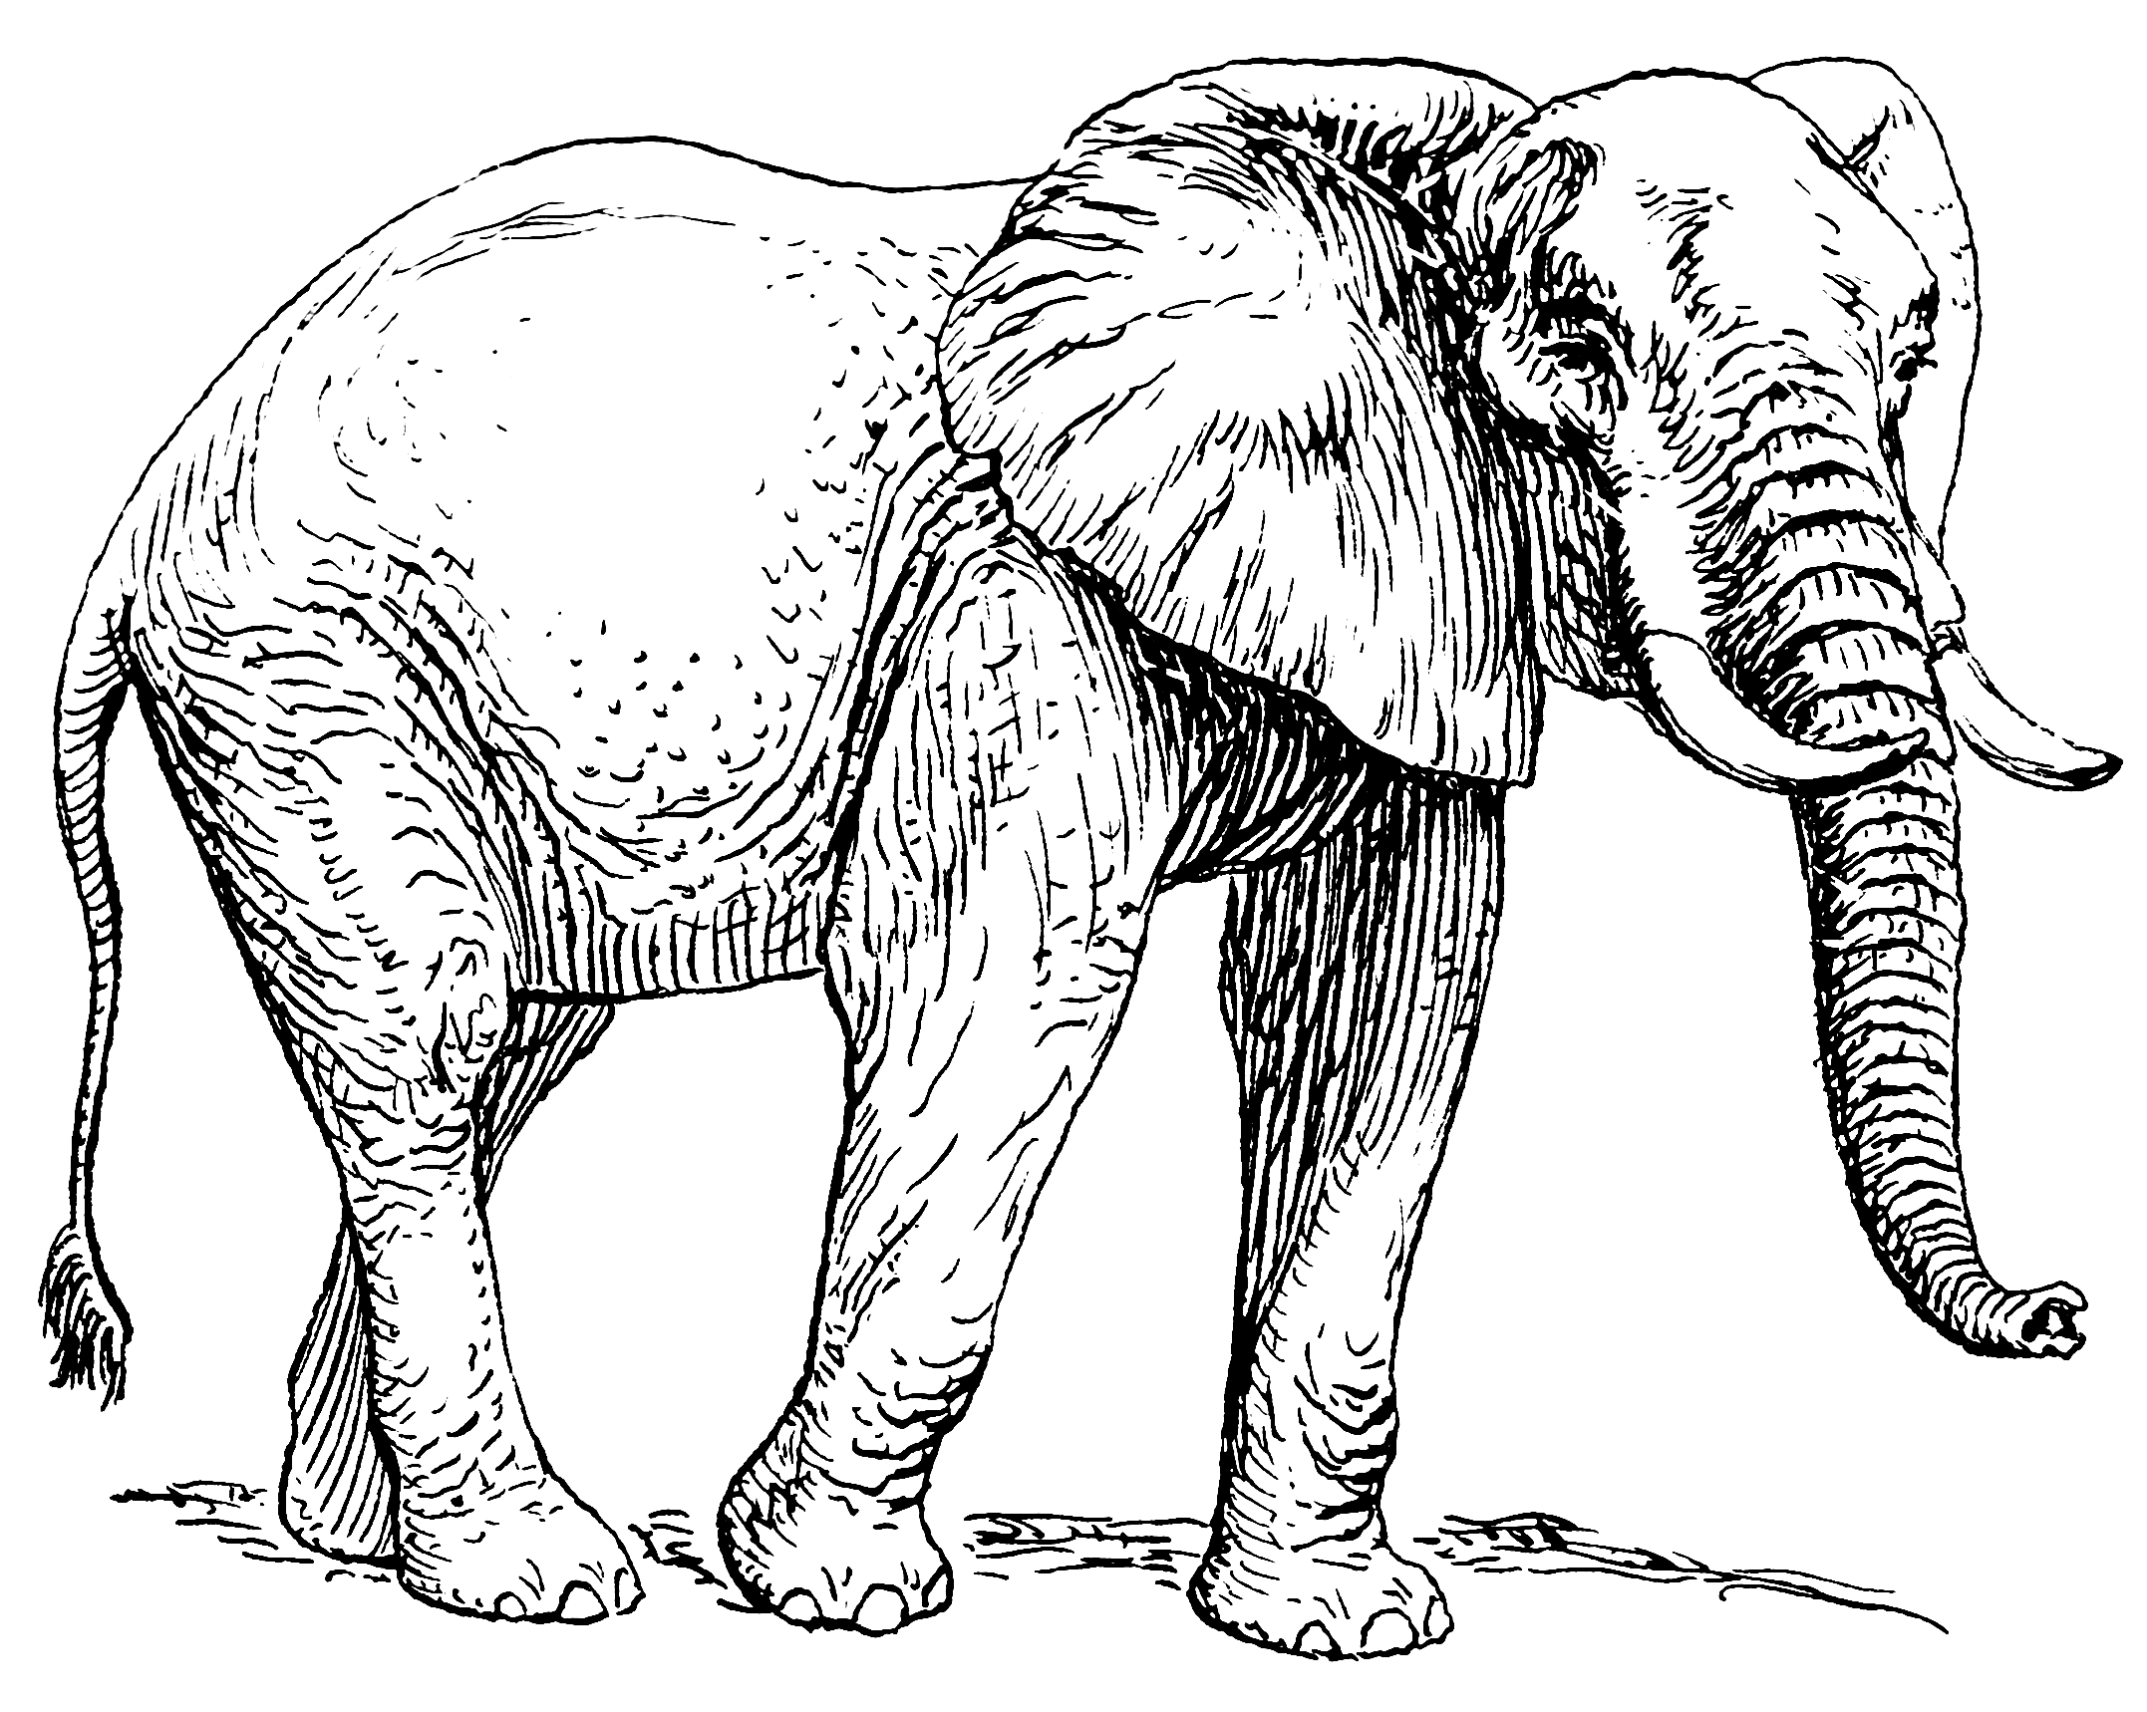

Huffman Data Compression

Slide 9
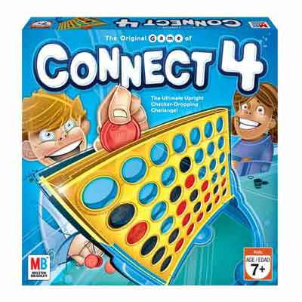
Connect 4 AI

Slide 10
The Alien's Life Advice
SMILE!
It makes people think you’re fun to be with.

Slide 11
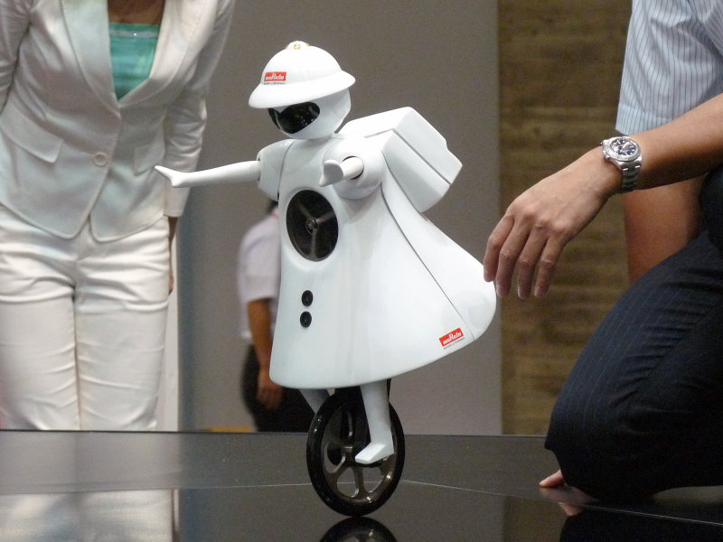
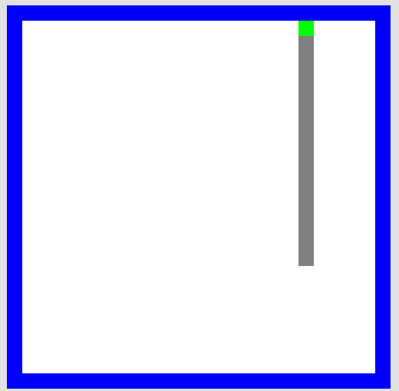
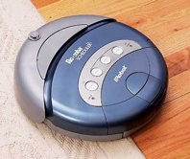
Picobot!
This language is not Turing-Complete. I guess that makes it “unreasonable”!
Reading: Chapter 1 in the book
(http://www.cs.hmc.edu/csforall/)
walls
Picobot
area not covered (yet!)
Murata Girl
area already covered
Goal: whole-environment coverage with only local sensing…
Roomba
DEMO!
Notes:
Demo can be found at http://www.cs.hmc.edu/picobot
Book is at http://www.cs.hmc.edu/csforall/

Slide 12
Environment in the NEWS!
N
Picobot can only sense things directly to the N, E, W, and S
W
E
S
For example, here its surroundings are
NxWx
Surroundings are always in NEWS order.
N E W S

Slide 13
Surroundings
N
How many distinct surroundings are there?
W
E
S
2⁴
== 16 possible…
xxxx
Nxxx
xExx
xxWx
xxxS
NExx
NxWx
NxxS
xEWx
xExS
xxWS
NEWx
NExS
NxWS
xEWS
NEWS
(won’t happen)

Slide 14
State
I am in state 0.
My surroundings
are xxWS.
Picobot's memory is a single number, called its state.
State is the internal context of computation.
Picobot always starts in state 0.
State and surroundings represent everything the robot knows about the world

Slide 15
Rules
Aha!
I should move N.
I should enter state 0.
I am in state 0.
My surroundings
are xxWS.
Picobot moves according to a set of rules:
A capital “X” here means “Don’t Move”
state
surroundings
direction
new state
0
xxWS
N
0
If I'm in state 0 seeing xxWS,
Then I move North, and change to state 0.

Slide 16
Wildcards
I am in state 0.
My surroundings
are xxWS.
Aha! This matches x***
Asterisks * are wild cards. They match walls or empty space:
state
surroundings
direction
new state
0
x***
N
0
and EWS may be wall or empty space
N must be empty

Slide 17
What Will This Set of Rules Do to Picobot?
A capital “X” here means “Don’t Move”
state
surroundings
direction
new state
0
x***
->
N
0
0
N***
->
X
0
Add some code here to make Picobot go up and down in the same column forever!
Picobot checks its rules from the top each time.
When it finds a matching rule, that rule runs.
Only one rule is allowed per state and surroundings.

Slide 18
What Will This Set of Rules Do to Picobot?
state
surroundings
direction
new state
0
x***
->
N
0
0
N***
->
X
1
1
***x
->
S
1
1
***S
->
X
0
Picobot checks its rules to find one that applies
When it finds a matching rule, that rule runs.
Only one rule is allowed per state and surroundings.

Slide 19

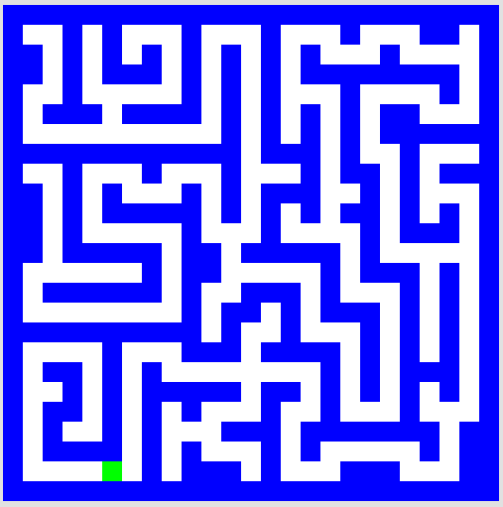
This Week!
Write rules that will always cover these two rooms.
(separate sets of rules are encouraged…)
Lab Problem
Problem 2
Your “program” can be slow but it should work for any starting location and for any wall-connected maze!
DEMO!
our best: 3 states, 7 rules (but Cam Zhou had 6)
our best: 4 states, 8 rules

Slide 20
What’s the Point?
Simple syntax can support “powerful” computation: The picobot language syntax is very simple, yet it can control a robot in a complex environment.
Computer scientists examine limitations of languages:
  Are there environments that the picobot language cannot navigate?
  If so, what features could be added to give the language more “power”?

Slide 21
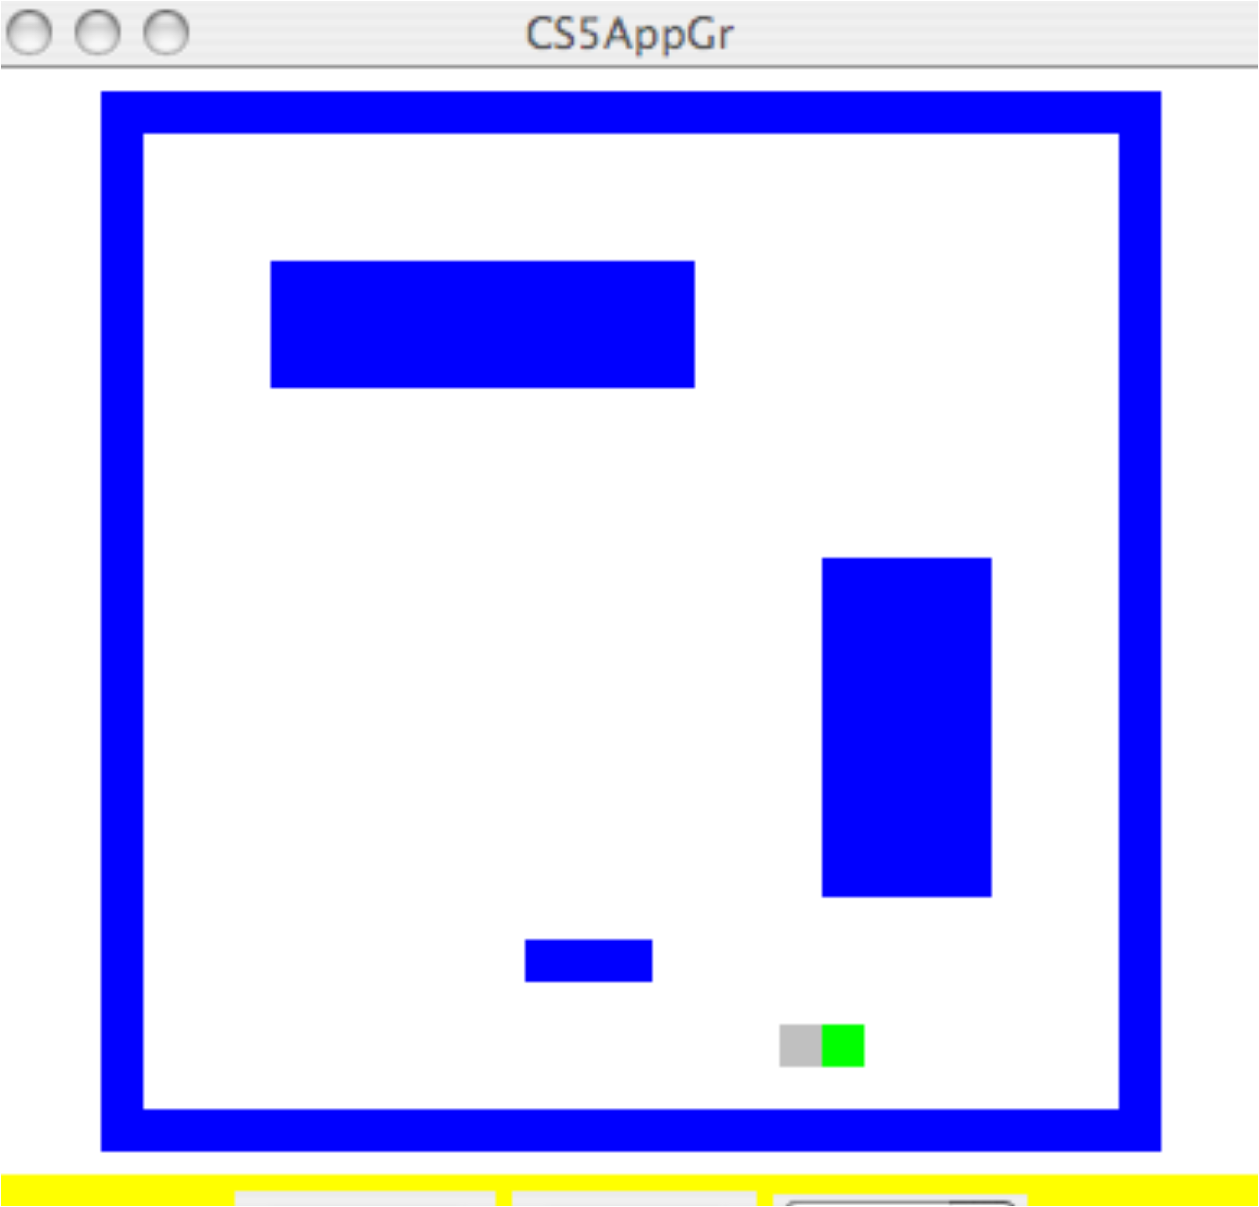
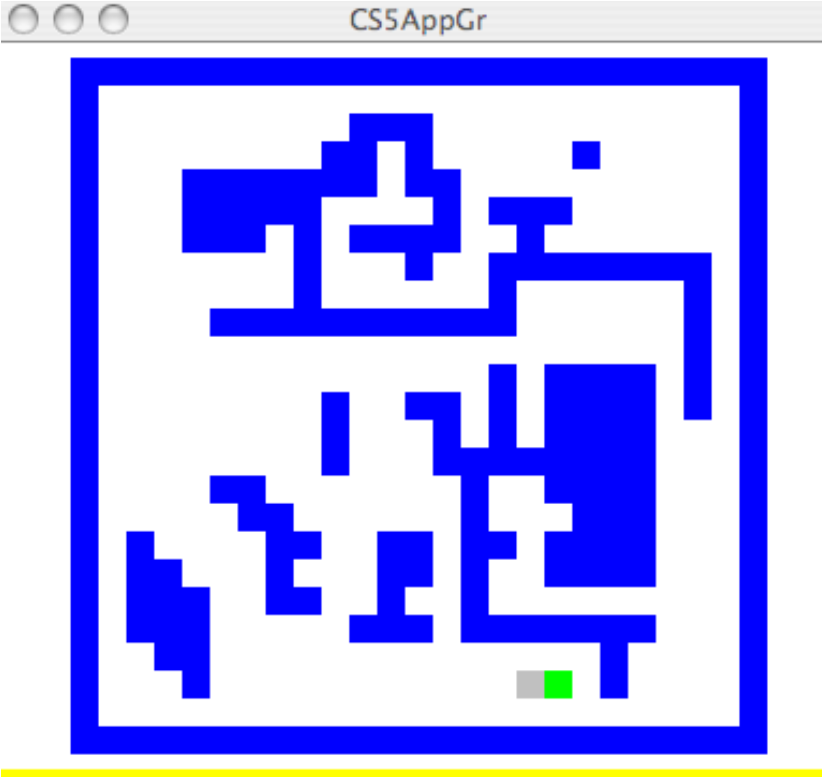
How About “General” Rooms?
Picobot has 100 states, but the “room” could be arbitrarily big and weird!
Notes:
It turns out that Picobot can’t solve a general maze. However, if you add the ability to drop, detect, and pick up markers, and provide only three (?) markers, a general maze can be solved.

Slide 22
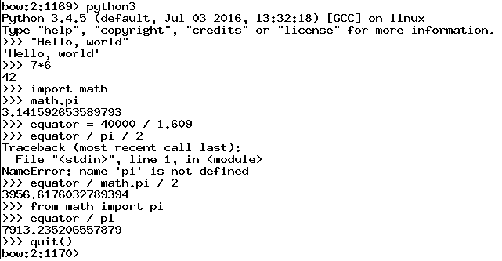
Python and the Command Line
I goofed here
No worries, just try again
This way I don’t have to say math.pi
Python makes it easy to experiment!
Notes:
Addition, multiplication, division 1//3 vs 1/3
Naming values
Import math
Math functions
Lists and range
List functions (e.g. sum, max)

Slide 23
Python and the Command Line
Python makes it easy to experiment!
Notes:
Addition, multiplication, division 1//3 vs 1/3
Naming values
Import math
Math functions
Lists and range
List functions (e.g. sum, max)

Slide 24
Defining Your Own Functions!
def dbl(x):
return 2 * x
x
dbl
2 * x
Notice the indentation. This is done using “tab” and it’s absolutely necessary!
def dbl(myArgument):
myResult = 2 * myArgument
return myResult
VScode often indents for you!
“Outdent” with shift-tab!
Notes:
Two functions here (second animated) are equivalent. You can choose variable names, and you can assign the result or just return it.

Slide 25
Docstrings!
def dbl(x):
"""This function takes a number x
and returns 2 * x"""
return 2 * x
This is sort of like teaching your programs to talk to you!

Slide 26
Docstrings…and Comments
# Doubling program
# Author: Ran Libeskind-Hadas
# Date: August 27, 2011
# Time Spent: 14 hours
def dbl(x):
"""This function takes a number x
and returns 2 * x"""
return 2 * x

Slide 27
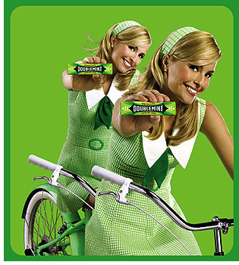
Composition of Functions
def quad(x):
return 4 * x
x
quad
4 * x
def quad(x):
return dbl(dbl(x))
Doubly cool!

Slide 28
Multiple Arguments...
x, y
myFunc
x + 42 * y
That’s a kind of a funky function!
# myFunc
# Author: Ran Libeskind-Hadas
# Date: August 27, 2011
def myFunc(x, y):
"""returns x + 42 * y"""
return x + 42 * y

Slide 29
Mapping with Python...
def dbl(x):
"""returns 2 * x"""
return 2 * x
>>> list(map(dbl, [0, 1, 2, 3, 4]))
[0, 2, 4, 6, 8]
def evens(n):
myList = range(n)
doubled = list(map(dbl, myList))
return doubled
Alternatively….
def evens(n):
return list(map(dbl, range(n)))

Slide 30
reduce-ing with Python...
from functools import reduce
def add(x, y):
"""returns x + y"""
return x + y
>>> reduce(add, [1, 2, 3, 4])
10
add
add
add

Slide 31
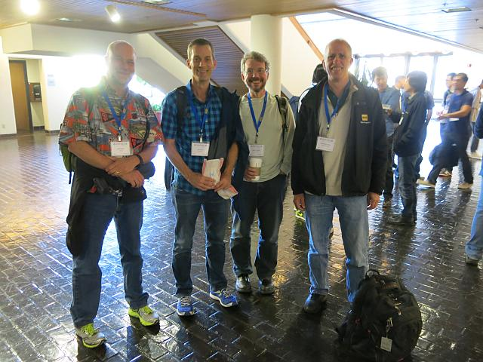
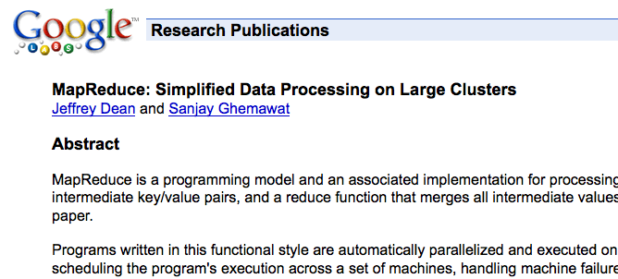
Google’s “Secret”
This is what put Google on the map!

Slide 32
Try This…
Write a function called span that returns the difference
between the maximum and minimum numbers in a list…
>>> span([3, 1, 42, 7])
41
>>> span([42, 42, 42, 42])
0
min(x, y)
max(x, y)
These are built in to Python!

Slide 33
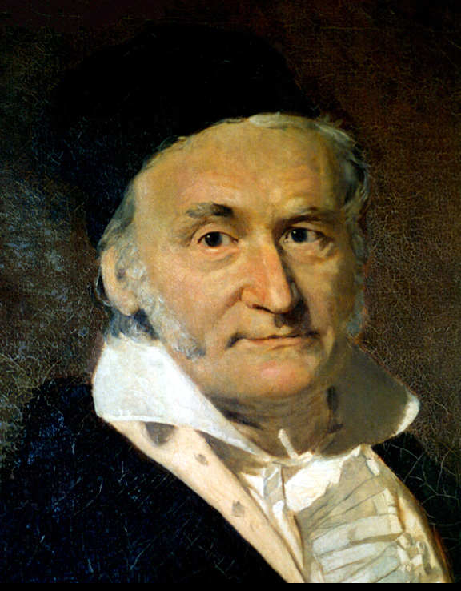
Try This...
Write a python function called gauss that accepts a positive integer N and returns the sum
1 + 2 + … + N
2. Write a python function called sumOfSquares that accepts a positive integer N and returns the sum
1² + 2² + 3² + … + N²
You can write extra “helper” functions too!

