Slide 1
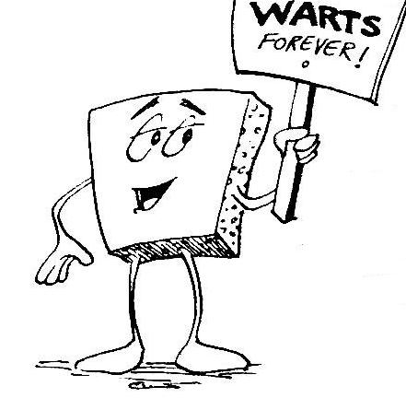
Welcome to CS 5 !
Grab these lecture notes…
Introduction to CS
Wally Wart, a protrusive advocate of concrete computing
We don't have words strong enough to describe this class.
- US News and Course Report
Everyone will get out of this course – a lot!
- NYTimes Review of Courses
1 handout…
We give this course two thumbs…
slides & syllabus
- Metametacritic
Notes:
INHANDOUT
Prep: have Visual Studio Code (“code”) ready to run on a python program.
Have a browser window ready to show “andromeda milky way collision” from YouTube; have sound turned down. Also have tab ready to show make3d flythrough.

Slide 2
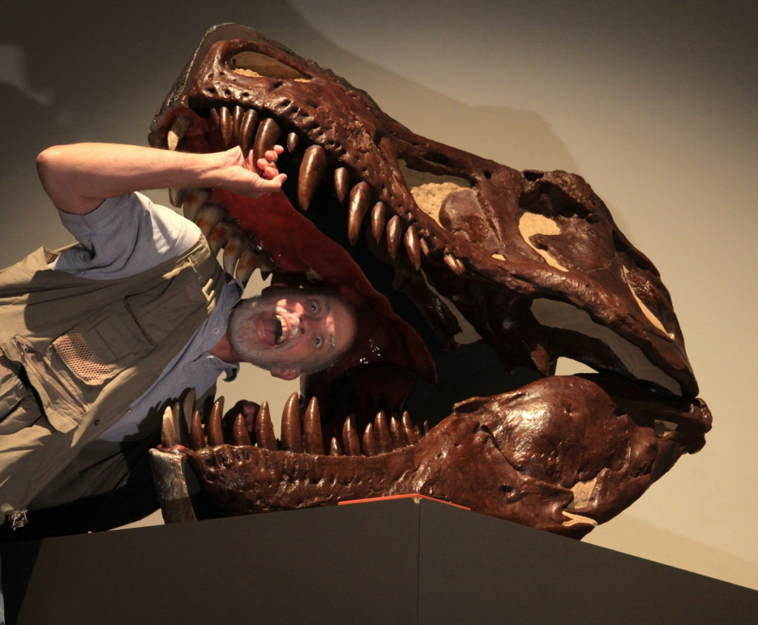
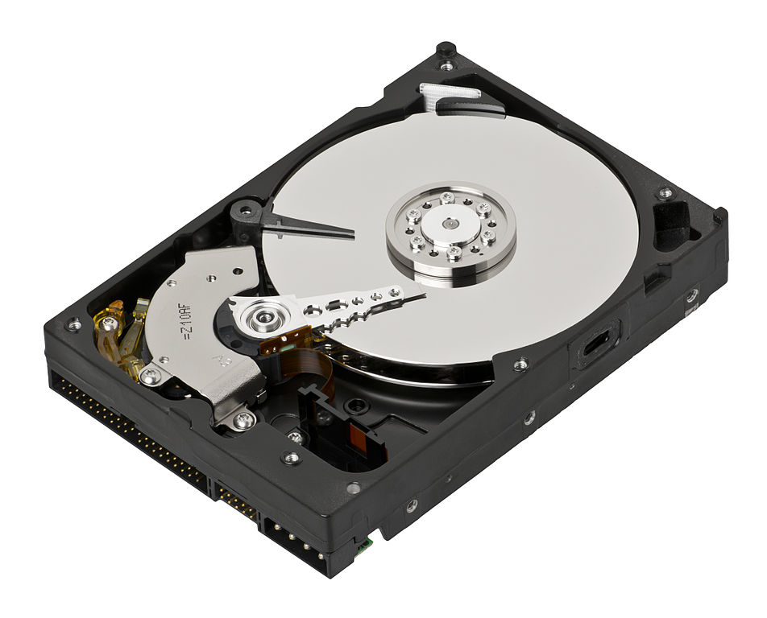
Introductions...
Geoff Kuenning
Olin 1255 (HMC)
geoff@cs.hmc.edu
Put “CS 5” in your subject line!
I think hard drives are cool…
Not entirely sensible!
Speaking of introductions
Notes:
INHANDOUT
Take 15 seconds to introduce yourself to a neighbor and say one word regarding what you did over break.
Introduce the alien.

Slide 3
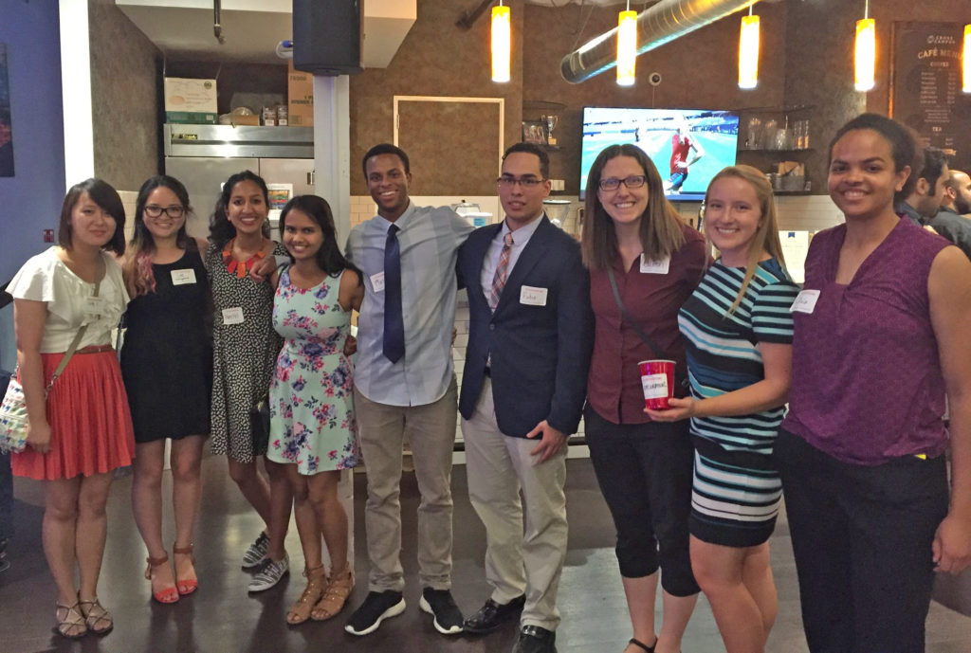
Summer research
Lots of opportunities surrounding computing... (at the 5Cs and beyond)

Slide 4

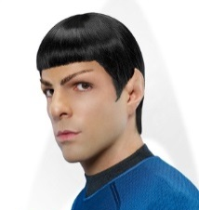
Today in CS5…
2) How CS 5 runs…
3) Python?!
Shouldn’t there be an alien in this game?
CS is just programming, right?
1) What is CS?
I'm not so sure…
Whatever it is, it's definitely alien!
Notes:
INHANDOUT

Slide 5
CS vs. programming ?
Notes:
Introduce that they’re different. People think CS == programming but that’s not the case.

Slide 6
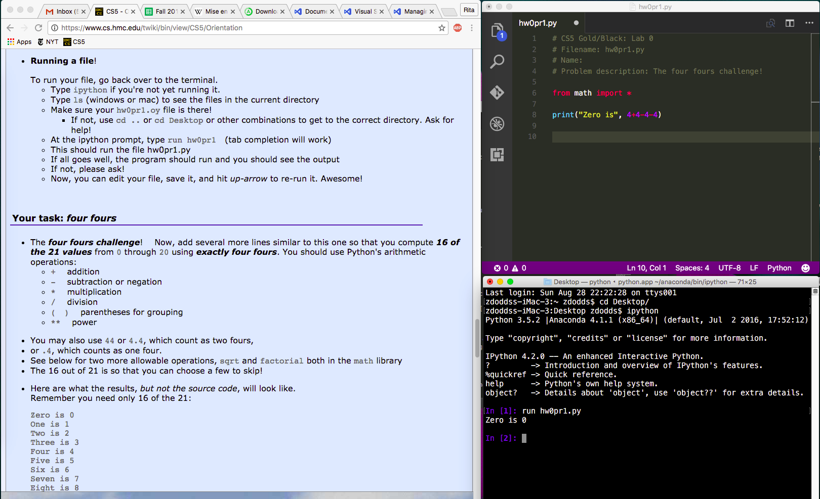
A minute of cs5 programming…
Python source code, a plain-text file
(here, edited by the VS Code text editor)
Demo
lab and hw instructions
shell or command-line or terminal
(the execution environment)
get everything running on your own machine
Notes:
Start by running demo in editor, show hello world (welcome to CS 5). Run it in ipython. Change the message, save, run again, show that it changes.
Tell them to come to lab and we’ll help install.

Slide 7
Spot the differences here?
print('hi')
print 'hi'
I still get it wrong
Notes:
Syntax is important. It’s one of the things that makes programming painful at first.

Slide 8
Spot the differences here?
print('hi')
print 'hi'
Syntax!
python 3
python 2
We will be using python 3 this term...

Slide 9
CS != programming
"not equal to"

Slide 10
CS != programming
So, what is CS?
Punctuation matters!
So what? is CS

Slide 11
CS != programming
programming : CS ::
longboards : HMC maybe 5Cs?
capital : business venture
equations : mathematics
CS
language : ideas
Programming
web search : knowledge
Tesla : Google
programs are a vehicle, not the destination
Notes:
Google has a special parking area for charging Teslas.

Slide 12
What is CS a science of ?
the study of complexity:
How can it be done?
it ~ information
How well can it be done?
Can it be done at all?
or, more precisely, a process transforming
information from one form to another
We'll look at 3 examples – each of which you'll construct in CS 5 …at least to some extent!
3 examples? That's it for me!
Notes:
creative side ~ dreamworks, game companies, google, microsoft, soc. networking <-- the design and creation of original algorithms and software
and a commodity side ~ application use, configuration, customization, certification, your favorite acronym here…
our department pays only about 5-10% of its attention to the commodity side
it pays 90-95% of its attention to the creative side… Why?
robotics? taught yourself to build or create something… game levels, etc.?

Slide 13
'HUMAN'
What is CS?
'CHIMPANZEE'
How can it be done?
What is the Longest Common Subsequence between 2 strings?
How well can it be done?
biology's string-matching problem, "LCS"
Can it be done at all?
'CGCTGAGCTAGGCC...'
Can you solve the problem?
'ATCCTAGGTAACTG...'
Can you create a process to solve such problems?
+10⁹more
Eye oneder if this haz othur aplications?
Notes:
define string: sequence of characters surrounded by quotes.
Distinguish subsequence from substring.
Highlight that either A or C might be the first letter of the best first match. The complexity is challenging!

Slide 14
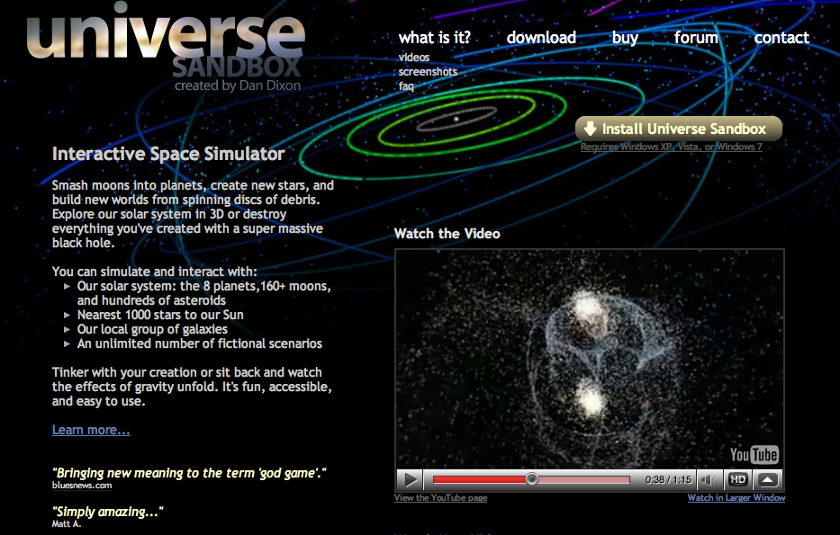
Feels like home!
What is CS?
How can it be done?
How well can it be done?
Can it be done at all?
How quickly can you find a solution?
How much work is needed to simulate N stars?
Is your solution the "best" possible?
chemistry's + physics's "N-body" problem
what if N is a million-and-one…?
Notes:
Demo: andromeda milky way collision (youtube). This will happen in about 4 billion years.
Suppose there are a million & 1 stars in the two galaxies. How many interactions are modeled?
Universe Sandbox is downloadable but only runs in Windows. (But is much more cool 3D than the video.)

Slide 15
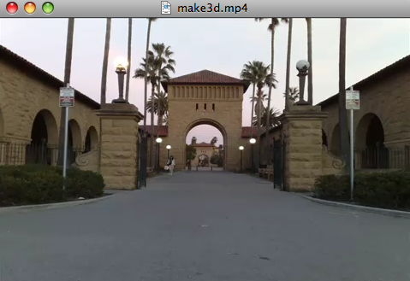
What is CS?
How can it be done?
How well can it be done?
Can it be done at all?
Can we build a 3d model from one 2d image?
Is your problem solvable?
Andrew Ng's "Make3d"
How can you tell !?
many problems are uncomputable… … and you'll prove this!
All three eyes tell me that Make3d has just failed ~ epically!
Notes:
This is Stanford’s front gate.
You can think of a 3D model as a first-person game.
Show make3d flythrough. What errors are there in the 3d model?
The model thinks the sky is a wall with the palm trees painted on it.

Slide 16
What is CS?
Can you solve this problem?
CS is the study of complexity
Can you create a process to solve such problems?
How can it be done?
How well can it be done?
How quickly can you find solutions?
Can it be done at all?
Do you have the “best” solution?
CS's six big questions are here.
Is every problem solvable?
But only one is
programming.
Do you see which?
Is there a way to tell?
There isn’t always!
Notes:
INHANDOUT
POPUP COMING with answer to question.

Slide 17
What is CS?
CS
Can you solve this problem?
CS is the study of complexity
Can you create a process to solve such problems?
programming
+ CS
How can it be done?
How well can it be done?
How quickly can you find solutions?
CS
Can it be done at all?
Do you have the “best” solution?
CS
CS's six big questions are here.
CS
Is every problem solvable?
But only one is
programming.
Do you see which?
Is there a way to tell?
CS
There isn’t always!
Notes:
programming is only about 1/6th of computer science as a science – it is perhaps more of the commodity side of the field – but that’s a good thing!

Slide 18
CS’s—and CS5's— philosophy:
Whatever you are, be a good one.
- Abraham Lincoln
More and more, CS can help!
Notes:
CS is a great resource for amplifying whatever you do.

Slide 19
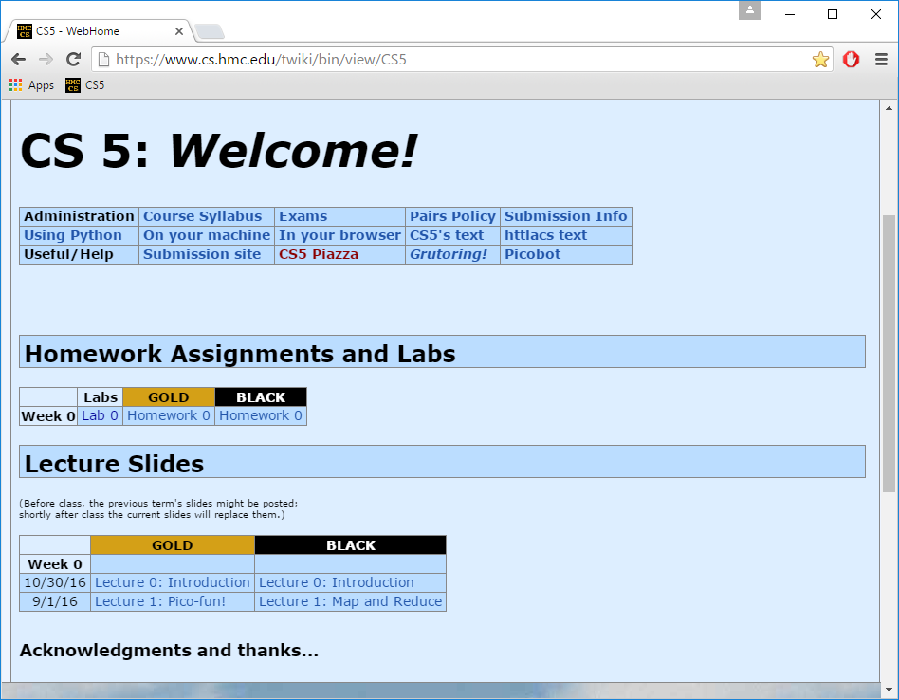
Take-home message…
depending on where "home" is, perhaps…
Now in 2018!
Just Google for
hmc cs5
www.cs.hmc.edu/cs5
Notes:
INHANDOUT
Show that you can Google for the site. Then demo it. Show that the assignments and lectures are there; show the very useful links at the top.

Slide 20
You're here ~ what's next?
2) How CS 5 runs…
3) Python?!
Shouldn’t there be an alien in this game?
the first Python HW is choice!
CS is just programming, right?
1) What is CS?
I'm not so sure…
Whatever it is, it's definitely alien!

Slide 21
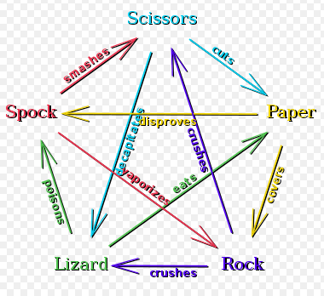
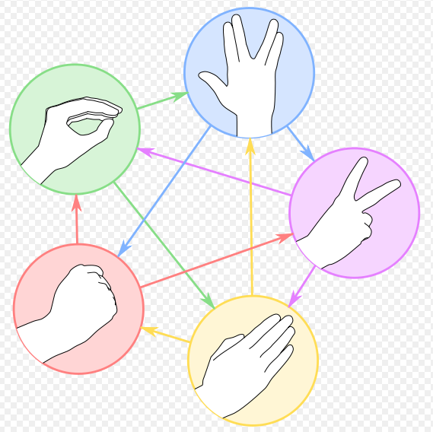
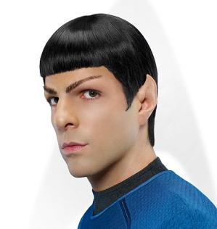
rock – paper – scissors – lizard – Spock!
Logically, I've got game!
http://www.youtube.com/watch?v=fqlDc2VICZ0 start at about :22
Notes:
INHANDOUT
The lower-right corner has a link to a Big Bang theory excerpt that’s a bit funny (and nerdy). Probably not worth showing.

Slide 22
Syllabus, briefly
Tu and Th: 1:15-2:30pm
Lectures
Key skills, topics, and their motivation
Come to Lectures!
Insight into the HW problems (what, why, how)
We’d like to see you! Let us know if you’ll be sick…
Lab
Tu: 2:45-4:45pm and 6:00-8:00pm
recommended by 4 out of 5 CS5 alums!
Guided progress on the week's hw
Come to Labs!
Not required, but encouraged: full credit for lab
Will SAVE you time and effort in CS 5
Office hrs
Lots of help is available!
See https://www.cs.hmc.edu/~geoff/geoff-schedule.html
or, come to any of the many tutoring hrs!
HW
Hw is due on Monday nights...
Monday nights: due by 11:59 pm
Notes:
Lectures motivate why.
Bring laptops to labs!

Slide 23
Syllabus, briefly
Tu and Th: 1:15-2:30pm
Lectures
Key skills, topics, and their motivation
Insight into the HW problems (what, why, how)
We’d like to see you! Let us know if you’ll be sick…
Lab
Tu: 2:45-4:45pm and 6:00-8:00pm
recommended by 4 out of 5 CS5 alums!
Guided progress on the week's homework
Not required, but encouraged: full credit for lab
Will SAVE you time and effort in CS 5
Office hrs
See https://www.cs.hmc.edu/~geoff/geoff-schedule.html
or, come to any of the many tutoring hrs!
HW
Monday nights: due by 11:59 pm
Notes:
INHANDOUT
Lectures motivate why.
Bring laptops to labs!

Slide 24
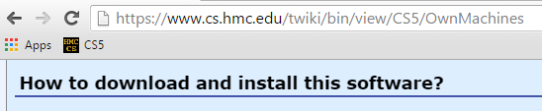
Each week's lab…
0) Find the lab! Sign in…
Labs are optional, but incentivized.
If you come to lab, give a good-faith effort, and please sign in, you'll receive all of the credit for the lab problems even if you don't finish
(you don't need to finish)
1) Get Python running…
download things now, perhaps!
2) Edit, run, + submit a file…
demo
Encouraged: bring your laptop
Notes:
INHANDOUT

Slide 25
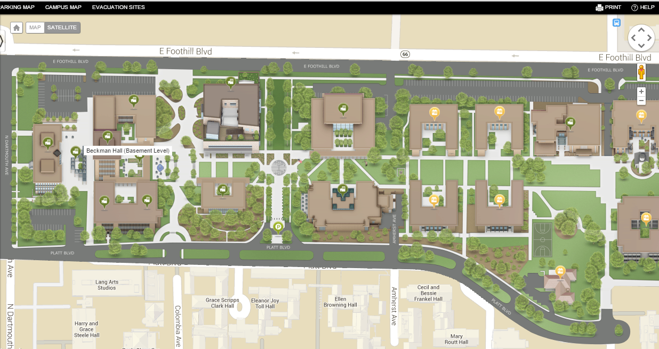
Evening lab?
Facilities and Maintenance
You can get your keycard activated @ F&M in Platt
you do need to show you're in cs5!
Enter through Olin building
We’re here!
the south door is open late!
Platt building. F&M is in the basement.
Beckman B102, B105, B126
Notes:
INHANDOUT

Slide 26
Map to CS Lab
Shan
coffee
Koi
Edwards
Macalister
Pryne
Physicists, chemists & other parenthesis-needing individuals,
cool machines - drills, lathes, etc.
Your account for CS
submissions?
Laptop? Bring it!
Galileo
other keyboard-free machines
login:
B102
B100
Beckman
passwd:
CS Hallway and Labs
Big Beckman (B126)
B105
Biologists, bees, spiders and other arachnophiles
from Olin (Bio+CS)
South Olin Door
Notes:
INHANDOUT
Your login is your email address. We’ll have a printed page of the emails we used to build the site. Password is asdf (reset it!)

Slide 27
This week: Lab 0
Python source code, a plain-text file
(here, edited by the VS Code text editor)
lab and hw instructions
shell or command-line or terminal
(the execution environment)
get everything running on your own machine
Notes:
Bring up the hello world program again. Change it to “print(‘zero is 0’)”. Then edit it to print 4+4-4-4.

Slide 28
Homework
Assignments
~ 5 problems/week
Due Monday evenings by 11:59 pm.
Eur-ollowed to use one Euro for up to three hwks.
No need to let us know, even.
Extra credit is usually available…
You have 3 CS 5 Euros to use…
"Late Days"
Some problems are specified “individual-only.”
Others offer the option of working as pairs/partners:
Collaborate!
You don’t have to work in pairs/partners (that said, it's fun!)
If you do, you must share the work equally—typing and coaching
Be sure to indicate who your partner was at the submission site!
Put your name(s) in the code, as well!
Notes:
INHANDOUT

Slide 29

Pairs
Partners
one computer
two computers
tradeoff typing/debugging ~ about every 20 minutes
both partners type/debug ~ provide help as needed
Standard is the same either way:
After finishing the homework, (a) each person has contributed equally and (b) both could complete the problems on their own
Submit with a partner as full co-owners of the work.
Notes:
INHANDOUT

Slide 30
Honor Code
You're encouraged to discuss problems with other students—or tutors—or any instructors.
You may not share written, electronic or verbal solutions with other students, past, present or future:
Even with three eyes, I need to borrow others' to find the syntax errors here!
Please do use the Internet for Python language references.
Pleas do use other's eyes for finding syntax erorrs.
Do not use the Internet (or intranet) to (try to) find solutions…
If you work as a pair/partners, the rules apply for the duo.
Sign & submit CS's honesty policy online in this week's lab.
Notes:
INHANDOUT
OTHER PEOPLE ARE CRITICAL FOR SYNTAX. Even a 3-eyed alien won’t spot the errors in that green line (there are three).

Slide 31
Grading
if pct > .95:
print('A')
elif pct > .90:
print('A-')
elif pct > .70:
print('Pass')
~ 65% Assignments
~ 30% Exams
many take cs5 P/NC
~ 5% Participation/“quizzes”
see online syllabus for the full grade list...
Midterm? This feels more like a 3/4-term!
Exams
Midterm
Th, Mar. 29, in-class
Final
Tue, May 8 (2pm)
using a page of notes is OK on exams
the exams are written, not coded
the problems are modeled on the in-class "quizzes"
Notes:
INHANDOUT
Homework really comprises the key skills I hope that everyone takes away from this class…
weighted accordingly!
if you never submit anything before 11:59pm on Wednesday – I have complete sympathy!

Slide 32
Choices, choices!
Let's set the value of pct to 0.91...
pct = 0.91
if pct > 0.95:
print 'A'
elif pct > 0.90:
print 'A-'
elif pct > 0.70:
print 'Pass'
else:
print 'Aargh!'
What will this program print, if pct is 0.91?
What's here?
First – who sees the syntax errors here !?
# of BLOCKS here:
# of TESTS here:
CONTROL STRUCTURES
# of here:

Slide 33
Choices, choices!
Let's set the value of pct to 0.91...
pct = 0.91
if pct > 0.95:
print('A')
elif pct > 0.90:
print('A-')
elif pct > 0.70:
print('Pass')
else:
print('Aargh!')
What will this program print, if pct is 0.91?
Lots of Illuminating Solid Parentheses!
What's here?
# of BLOCKS here:
Aargh! ;-)
# of TESTS here:
CONTROL STRUCTURES
# of here:

Slide 34
Choices, choices!
Let's set the value of pct to 0.91...
pct = 0.91
if pct > 0.95:
print('A')
elif pct > 0.90:
print('A-')
elif pct > 0.70:
print('Pass')
else:
print('Aargh!')
What will this program print, if pct is 0.91?
What's here?
# of BLOCKS here:
# of TESTS here:
CONTROL STRUCTURES
# of here:

Slide 35
Choices, choices!
pct = 0.80
if pct > 0.95:
print('A')
elif pct > 0.90:
print('A-')
elif pct > 0.70:
print('Pass')
else:
print('Aargh!')
pct = 0.80
if pct > 0.00:
print('Aargh!')
elif pct > 0.70:
print('Pass')
elif pct > 0.90:
print('A-')
else:
print('A')
What does each of these programs print out, if pct is 0.80?
What value of pct gives an 'A-' on the right?
How can you get a better grade on the right than the left?

Slide 36
Exclusive Choices
if ... elif ... else
pct = 0
if pct > 0.95:
print('A')
elif pct > 0.90:
print('A-')
elif pct > 0.70:
print('Pass')
else:
print('Aargh!')
4 mutually exclusive blocks
in a single control structure
When using
if . elif … . else
at most one block will run: the first whose test is True. If all fail, the else will run
elif and else are optional
Notes:
INHANDOUT

Slide 37
Exclusive Choices
if ... elif ... else
Every if starts a new control structure.
pct = 0
if pct > 0.95:
print('A')
elif pct > 0.90:
print('A-')
elif pct > 0.70:
print('Pass')
else:
print('Aargh!')
4 mutually exclusive blocks
Every elif and else continues an existing control structure.
in a single control structure
When using
if . elif … . else
at most one block will run: the first whose test is True. If all fail, the else will run
elif and else are optional

Slide 38
What's the difference?
mutually exclusive blocks
nonexclusive blocks
pct
pct
if pct > .95:
print('A')
elif pct > .90:
print('A-')
elif pct > .70:
print('Pass')
if pct > .95:
print('A')
if pct > .90:
print('A-')
if pct > .70:
print('Pass')
What if pct == .99 ? (How would we set it?)
How many separate control structures does each side have?
Notes:
Call attention to = vs. ==

Slide 39
What's the difference?
mutually exclusive blocks
nonexclusive blocks
pct
pct
if pct > .95:
print('A')
elif pct > .90:
print('A-')
elif pct > .70:
print('Pass')
if pct > .95:
print('A')
if pct > .90:
print('A-')
if pct > .70:
print('Pass')
1
3
thing
things
What if pct == .99 ? (How would we set it?)
How many separate control structures does each side have?

Slide 40
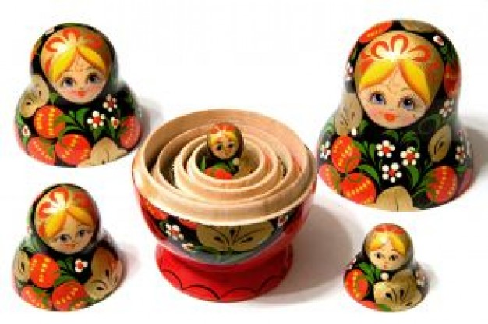
Nesting
for decision-making, we now have it all…
Notes:
We have now completely covered conditionals…at least, if you add nesting.

Slide 41
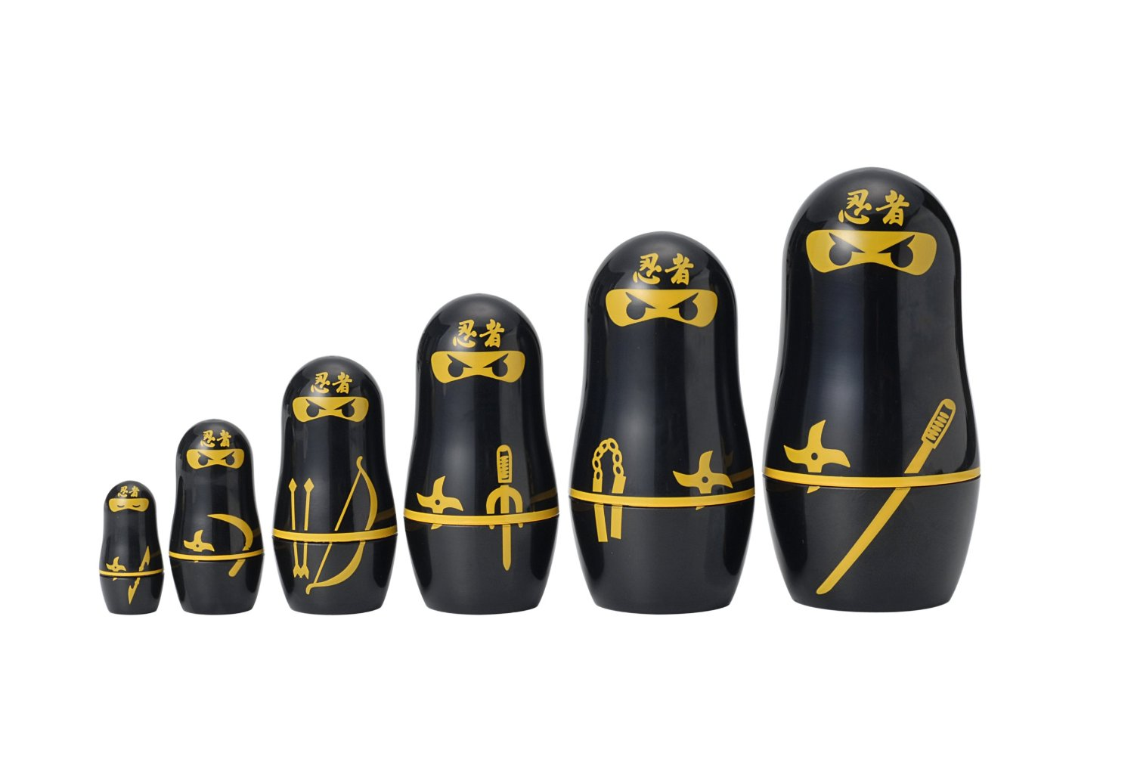
Nesting
for decision-making, we now have it all…

Slide 42
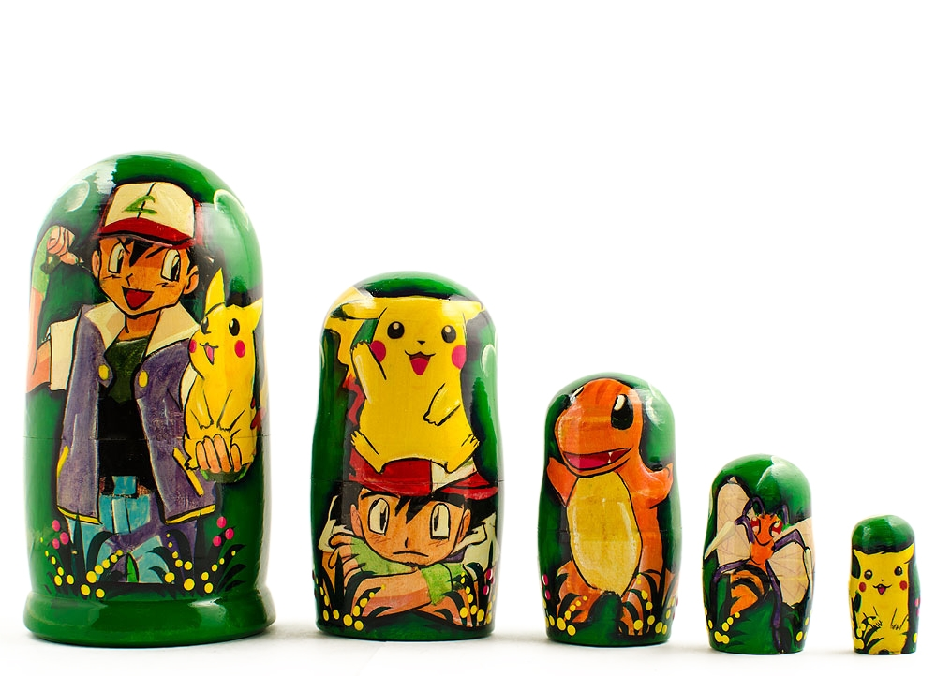
Nesting
for decision-making, we now have it all…

Slide 43
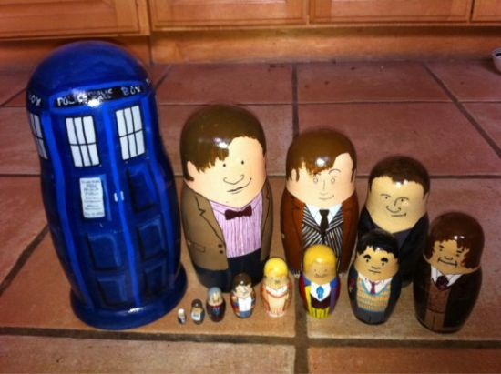
Nesting
for decision-making, we now have it all…

Slide 44
Nesting
Does this program print the correct RPS result this time? Does it always?
comp = 'rock'
user = 'paper'
if comp == 'paper' and user == 'paper':
print('We tie. Try again?')
elif comp == 'rock':
if user == 'scissors':
print('I win! *_*')
else:
print('You win. Aargh!')
BLOCKS ?
TESTS ?
Control Structures ?
Notes:
INHANDOUT
The real power of if statements comes when the conditionals nest.

Slide 45
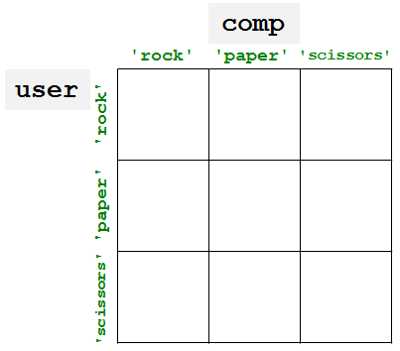
"Quiz"
Pair up with someone nearby – answer these questions together…
Name ______________________
Your favorite __________ is ____________.
Your least favorite ____________ is ____________.
Name ______________________
Your favorite __________ is ____________.
Your least favorite ____________ is ____________.
What is something non-Claremont-collegey you have in common?
Then, try these Python q's:
(2) As written, what output does this print?
(3) Change these inputs to produce a completely correct RPS output here.
(0) Find the 3 tests and 4 blocks here.
comp = 'rock'
user = 'rock'
if comp == 'rock':
print('I win *_*!')
if user == 'paper':
print('You win.')
else:
print('Tie.')
(1) What does this code print?
(4) How many of the 9 RPS input cases are fully correctly handled here?
comp = 'rock'
user = 'rock'
if comp == 'rock':
if user == 'paper':
print('I win *_*!')
elif user == 'scissors':
print('You win.')
else:
print('Tie.')
(5) What is the smallest number of blocks and tests you'd need for a full game of RPS?
(Extra) What if it were RPS-5, which includes Lizard and Spock? How about RPS-101?
Notes:
QUIZSLIDE
This is the quiz, then there’s an overview slide and then the quiz again.

Slide 46
"Quiz"
Pair up with someone nearby – answer these questions together…
Name ______________________
Your favorite __________ is ____________.
Your least favorite ____________ is ____________.
Name ______________________
Your favorite __________ is ____________.
Your least favorite ____________ is ____________.
People
Paper
What is something non-Claremont-collegey you have in common?
Then, try these Python q's:
(2) As written, what output does this print?
(3) Change these inputs to produce a completely correct RPS output here.
(0) Find the 3 tests and 4 blocks here.
comp = 'rock'
user = 'rock'
if comp == 'rock':
print('I win *_*!')
if user == 'paper':
print('You win.')
else:
print('Tie.')
(1) What does this code print?
(4) How many of the 9 RPS input cases are fully correctly handled here?
comp = 'rock'
user = 'rock'
if comp == 'rock':
if user == 'paper':
print('I win *_*!')
elif user == 'scissors':
print('You win.')
else:
print('Tie.')
Python
(5) What is the smallest number of blocks and tests you'd need for a full game of RPS?
(Extra) What if it were RPS-5, which includes Lizard and Spock? How about RPS-101?

Slide 47
"Quiz"
Pair up with someone nearby – answer these questions together…
Name ______________________
Your favorite __________ is ____________.
Your least favorite ____________ is ____________.
Name ______________________
Your favorite __________ is ____________.
Your least favorite ____________ is ____________.
What is something non-Claremont-collegey you have in common?
Then, try these Python q's:
(2) As written, what output does this print?
(3) Change these inputs to produce a completely correct RPS output here.
(0) Find the 3 tests and 4 blocks here.
comp = 'rock'
user = 'rock'
if comp == 'rock':
print('I win *_*!')
if user == 'paper':
print('You win.')
else:
print('Tie.')
(1) What does this code print?
(4) How many of the 9 RPS input cases are fully correctly handled here?
comp = 'rock'
user = 'rock'
if comp == 'rock':
if user == 'paper':
print('I win *_*!')
elif user == 'scissors':
print('You win.')
else:
print('Tie.')
(5) What is the smallest number of blocks and tests you'd need for a full game of RPS?
(Extra) What if it were RPS-5, which includes Lizard and Spock? How about RPS-101?
Notes:
Note that it’s only correct for scissors/scissors.

Slide 48
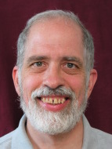
"Quiz"
Name
Your favorite _____ is ________________.
Your least favorite _______ is ______________.
Geoff Kuenning
movie
Princess Bride
vegetable
cucumbers
Name
Your favorite _________ is _______.
Your least favorite _______ is ________.
T. E. Alien
canned-meat food product
spam
#
41.999
so close!
Something in common?
Goofy grins!

Slide 49
"Quiz"
Pair up with someone nearby – answer these questions together…
Name ______________________
Your favorite __________ is ____________.
Your least favorite ____________ is ____________.
Name ______________________
Your favorite __________ is ____________.
Your least favorite ____________ is ____________.
Please pass these up the aisles…
(take a picture, if you'd like)
… then, turn back to the notes
What is something non-Claremont-collegey you have in common?
Then, try these Python q's:
(2) As written, what output does this print?
(3) Change these inputs to produce a completely correct RPS output here.
(0) Find the 3 tests and 4 blocks here.
comp = 'rock'
user = 'rock'
if comp == 'rock':
print('I win *_*!')
if user == 'paper':
print('You win.')
else:
print('Tie.')
(1) What does this code print?
(4) How many of the 9 RPS input cases are fully correctly handled here?
comp = 'rock'
user = 'rock'
if comp == 'rock':
if user == 'paper':
print('I win *_*!')
elif user == 'scissors':
print('You win.')
else:
print('Tie.')
(5) What is the smallest number of blocks and tests you'd need for a full game of RPS?
(Extra) What if it were RPS-5, which includes Lizard and Spock? How about RPS-101?

Slide 50
"Quiz" ~ problems 1+2
comp = 'rock'
user = 'rock'
if comp == 'rock':
if user == 'paper':
print('I win *_*!')
elif user == 'scissors':
print('You win.')
else:
print('Tie.')
print('Ties go to the runner.')
print(' - and I am running!')
... what if this else block were indented?

Slide 51
"Quiz" ~ problems 3-5
comp = 'rock'
user = 'rock'
if comp == 'rock':
print('I win *_*!')
if user == 'paper':
print('You win.')
else:
print('An awful tie')
What does this program print?

Slide 52
"Quiz" ~ problems 3-5
comp = 'rock'
user = 'rock'
if comp == 'rock':
print('I win *_*!')
if user == 'paper':
print('You win.')
else:
print('An awful tie')
comp
'rock'
'paper'
'scissors'
user
'rock'
'paper'
'scissors'
How many possible “input cases” are there?
How efficient can we be?
For RPS-3? RPS-5? RPS-101?
For how many is this program correct?

Slide 53
"Quiz" ~ problems 3-5
comp = 'rock'
user = 'rock'
if comp == 'rock':
print 'I win *_*!'
if user == 'paper':
print 'You win.'
else:
print 'An awful tie'
comp
'rock'
'paper'
'scissors'
user
'rock'
A correct RPS is possible with only if … elif … else !
'paper'
'scissors'
How many possible “input cases” are there?
How efficient can we be?
For RPS-3? RPS-5? RPS-101?
For how many is this program correct?

Slide 54
Remember ~ Lab this week
Tuesday afternoon or evening
Bring your laptop to Beckman B126
- or use one of the CS machines in B105
Get started with Python/text editor/cmdline…
See you in lab! (perhaps at 2:44:44 today…?)
though it's a few bits early!
Alien defeats everything – even Alien
How about a sneak peek at this week's HW… ?
… you must mean sneak Pic !

