Slide 1
Welcome Back to CS 5 Black!
PENGUIN GETS $1B IN FUNDING
San Jose (AFP): A penguin who was chased out of a Harvey Mudd College computer science lab by an angry mob has turned the experience into a startup with a billion dollars in venture funding. The new company will market an app that helps penguins track and dodge predators. “The market is huge,” said one investor. “Antarctica is full of penguins and they don’t have any way to know where the sharks are. We expect massive returns.”
The founding penguin will celebrate in a local sushi restaurant.
Please pick up these
lecture notes & a blank
“worksheet”!

Slide 2
Defining Your Own Functions!
def dbl(x):
return 2 * x
x
dbl
2 * x
Notice the indentation. This is done using “tab” and it’s absolutely necessary!
def dbl(myArgument):
myResult = 2 * myArgument
return myResult
Be sure to set your editor to indent using spaces!

Slide 3
Docstrings!
def dbl(x):
"""This function takes a number x
and returns 2 * x"""
return 2 * x
This is sort of like teaching your programs to talk to you!

Slide 4
Docstrings…and Comments
# Doubling program
# Author: Ran Libeskind-Hadas
# Date: August 27, 2011
def dbl(x):
"""This function takes a number x
and returns 2 * x"""
return 2 * x

Slide 5
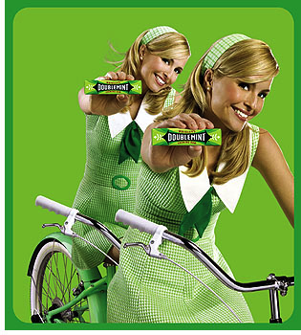
Composition of Functions
def quad(x):
return 4 * x
x
quad
4 * x
def quad(x):
return dbl(dbl(x))
Doubly cool!
Notes:
In math, you can compose functions: f(g(x)). You can do the same in Python.

Slide 6
Multiple Arguments...
x, y
myFunc
x + 42 * y
That’s a kind of a funky function!
# myFunc
# Author: Ran Libeskind-Hadas
# Date: August 27, 2011
def myFunc(x, y):
"""returns x + 42 * y"""
return x + 42 * y

Slide 7
Mapping with Python...
def dbl(x):
"""returns 2 * x"""
return 2 * x
>>> list(map(dbl, [0, 1, 2, 3, 4]))
[0, 2, 4, 6, 8]
def evens(n):
myList = range(n)
doubled = list(map(dbl, myList))
return doubled
Alternatively….
def evens(n):
return list(map(dbl, range(n)))

Slide 8
reduce-ing with Python...
from functools import reduce
def add(x, y):
"""returns x + y"""
return x + y
>>> reduce(add, [1, 2, 3, 4])
10
add
add
add

Slide 9
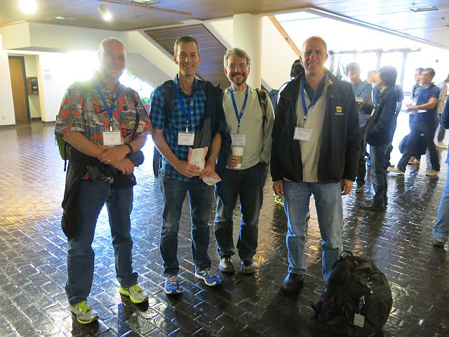
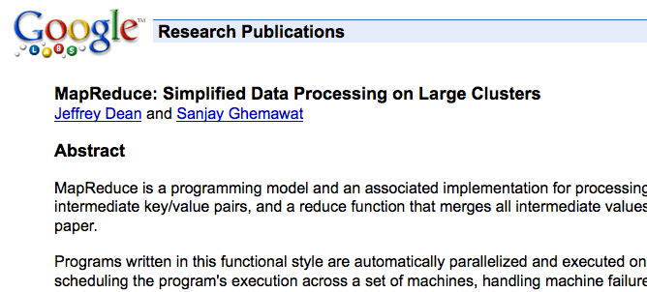
Google’s “Secret”
This is what put Google on the map!
Notes:
Note that Google didn’t invent MapReduce. But what Dean and Ghemawat did was to show how you could efficiently apply this powerful concept to huge datasets using large clusters of computers.

Slide 10
Try This…
Write a function called span that returns the difference
between the maximum and minimum numbers in a list…
>>> span([3, 1, 42, 7])
41
>>> span([42, 42, 42, 42])
0
min(x, y)
max(x, y)
These are built into Python!

Slide 11
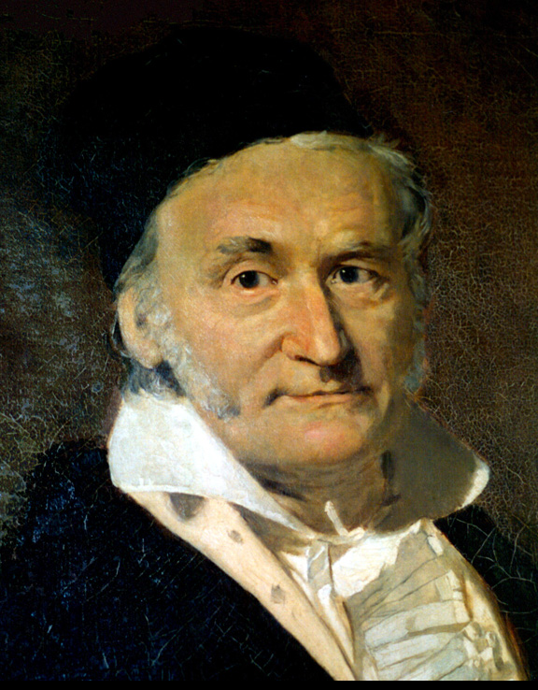
Try This...
Write a python function called gauss that accepts a positive integer argument N and returns the sum
1 + 2 + … + N
2. Write a python function called sumOfSquares that accepts a positive integer N and returns the sum
1² + 2² + 3² + … + N²
You can write extra “helper” functions too!
Notes:
When Carl Friedrich Gauss was in primary school, his teacher assigned the class to the problem of adding up the numbers 1 to 100. Gauss figured out the shortcut formula n(n+1)/2 and finished the task in a short time. The teacher punished him for “misbehavior”!

Slide 12
return vs print...
def dbl(x):
return 2 * x
def trbl(x):
print 2 * x
def happy(input):
y = dbl(input)
return y + 42
def sad(input):
y = trbl(input)
return y + 42
def friendly(input):
y = dbl(input)
print(y, "is very nice!")
return y + 42
Strings are in single
or double quotes

Slide 13
The Alien's Life Advice
Sit with a stranger at lunch
…but don't steal food off their plate!

