Slide 1
Welcome Back to CS 5 Black!
PENGUIN GETS $1B IN FUNDING
San Jose (AFP): A penguin who was chased out of a Harvey Mudd College computer science lab by an angry mob has turned the experience into a startup with a billion dollars in venture funding. The new company will market an app that helps penguins track and dodge predators. “The market is huge,” said one investor. “Antarctica is full of penguins and they don’t have any way to know where the sharks are. We expect massive returns.”
The founding penguin will celebrate in a local sushi restaurant.
Please pick up these
lecture notes & a blank
“worksheet”!
Notes:
Be ready to demo writing functions in ipython.

Slide 2
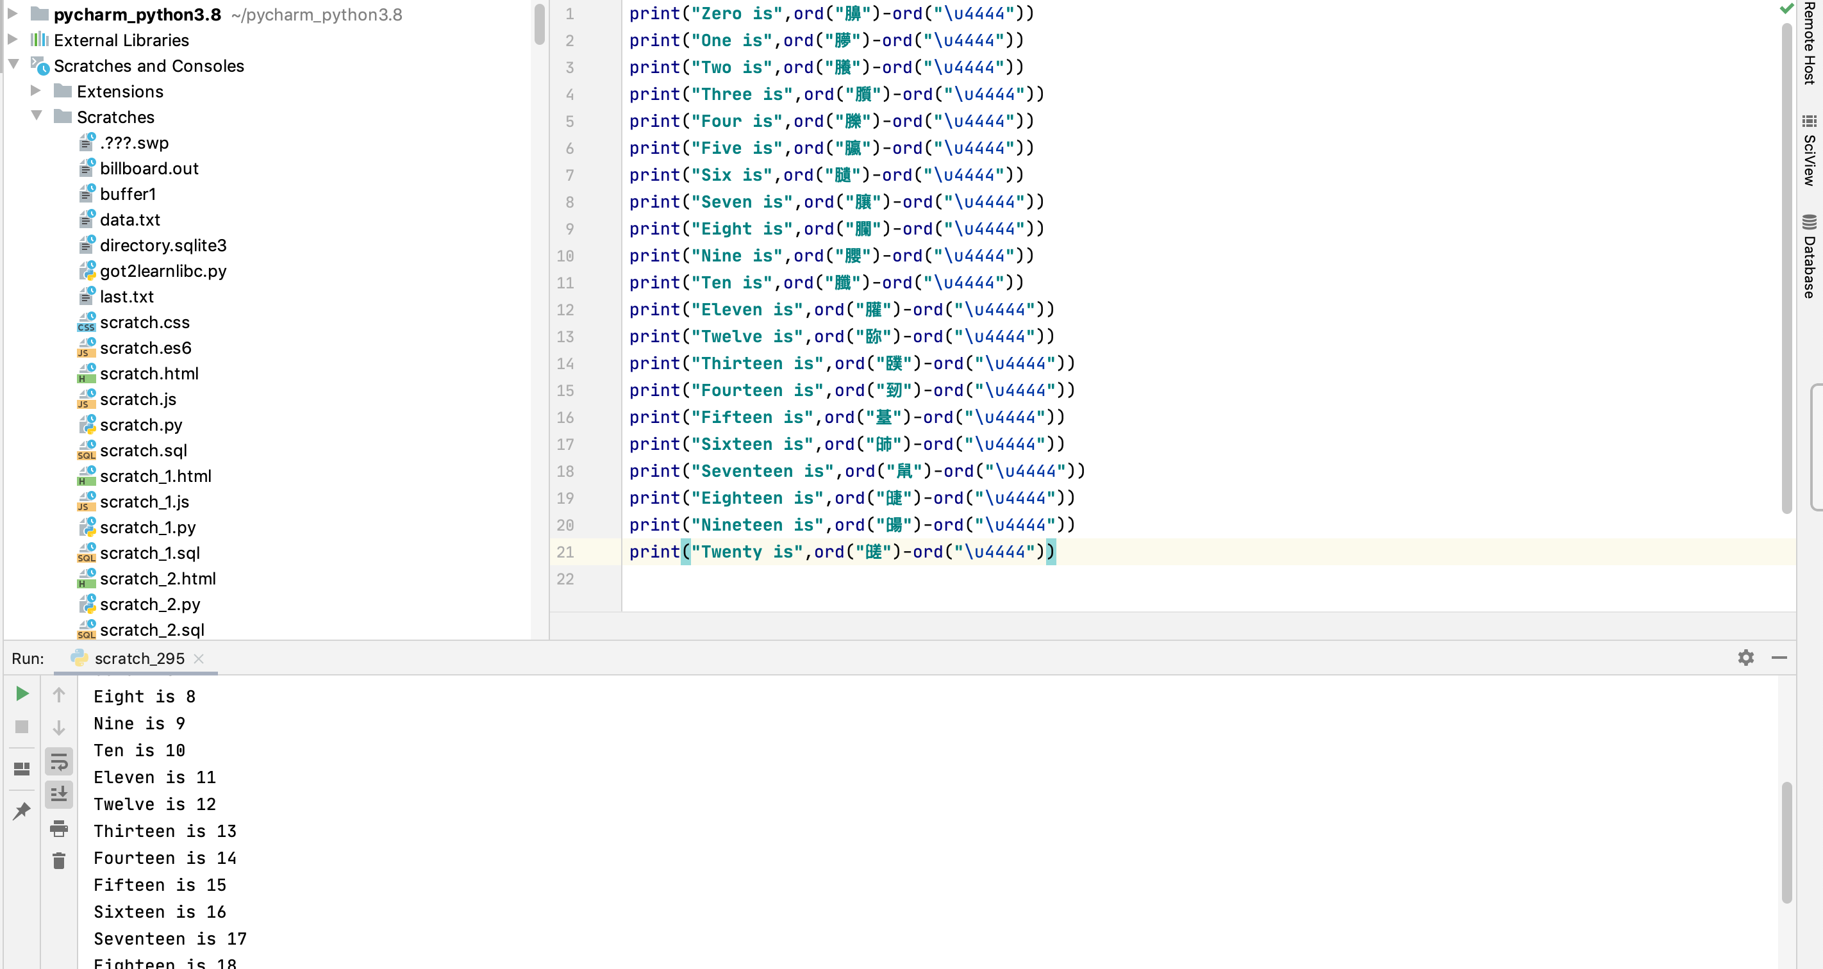
Four Fours…the Weird Way
Notes:
From Mia Wang, Fall 2020

Slide 3
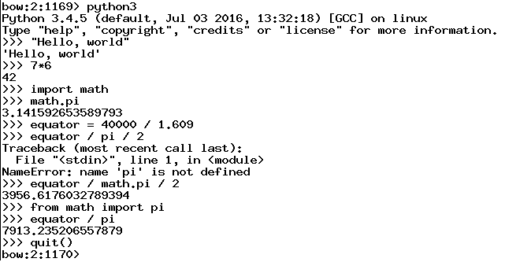
Python and the Command Line
I goofed here
No worries, just try again
This way I don’t have to say math.pi
Python makes it easy to experiment!
Notes:
Addition, multiplication, division 1//3 vs 1/3
Naming values
Import math
Math functions
Lists and range
List functions (e.g. sum, max)
List indexing from zero, list slicing of [1:] but no other slicing for now (no time for that)

Slide 4
Python and the Command Line
Python makes it easy to experiment!
Notes:
Addition, multiplication, division 1//3 vs 1/3
Naming values
Import math
Math functions
Lists and range
List functions (e.g. sum, max)

Slide 5
Defining Your Own Functions!
def dbl(x):
return 2 * x
x
dbl
2 * x
Notice the indentation. This is done using “tab” and it’s absolutely necessary!
def dbl(myArgument):
myResult = 2 * myArgument
return myResult
Be sure to set your editor to indent using spaces!

Slide 6
Docstrings!
def dbl(x):
"""This function takes a number x
and returns 2 * x"""
return 2 * x
This is sort of like teaching your programs to talk to you!

Slide 7
Docstrings…and Comments
# Doubling program
# Author: Ran Libeskind-Hadas
# Date: August 27, 2011
def dbl(x):
"""This function takes a number x
and returns 2 * x"""
return 2 * x

Slide 8
Composition of Functions
def quad(x):
return 4 * x
x
quad
4 * x
def quad(x):
return dbl(dbl(x))
Doubly cool!
Notes:
In math, you can compose functions: f(g(x)). You can do the same in Python.

Slide 9
Multiple Arguments...
x, y
myFunc
x + 42 * y
That’s a kind of a funky function!
# myFunc
# Author: Ran Libeskind-Hadas
# Date: August 27, 2011
def myFunc(x, y):
"""Returns x + 42 * y"""
return x + 42 * y

Slide 10
The Alien's Life Advice
Sit with a stranger at lunch
…but don't steal food off their plate!

Slide 11
Mapping with Python...
def dbl(x):
"""Returns 2 * x"""
return 2 * x
>>> list(map(dbl, [0, 1, 2, 3, 4]))
[0, 2, 4, 6, 8]
def evens(n):
myList = range(n)
doubled = list(map(dbl, myList))
return doubled
Alternatively….
def evens(n):
return list(map(dbl, range(n)))

Slide 12
reduce-ing with Python...
from functools import reduce
def add(x, y):
"""Returns x + y"""
return x + y
>>> reduce(add, [1, 2, 3, 4])
10
add
add
add

Slide 13
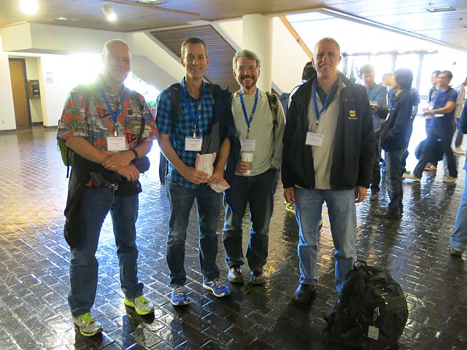
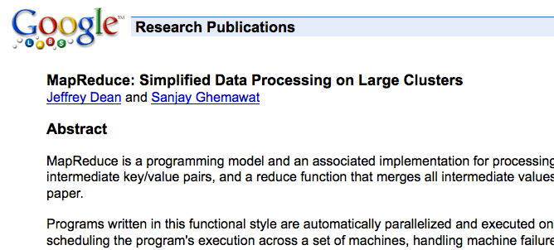
Google’s “Secret”
This is what put Google on the map!
Notes:
Note that Google didn’t invent MapReduce. But what Dean and Ghemawat did was to show how you could efficiently apply this powerful concept to huge datasets using large clusters of computers.

Slide 14
Try This…
Write a function called span that returns the difference
between the maximum and minimum numbers in a list…
>>> span([3, 1, 42, 7])
41
>>> span([42, 42, 42, 42, 42])
0
min(x, y)
max(x, y)
These are built into Python!
Notes:
Don’t use min(L) even if you know about it.

Slide 15
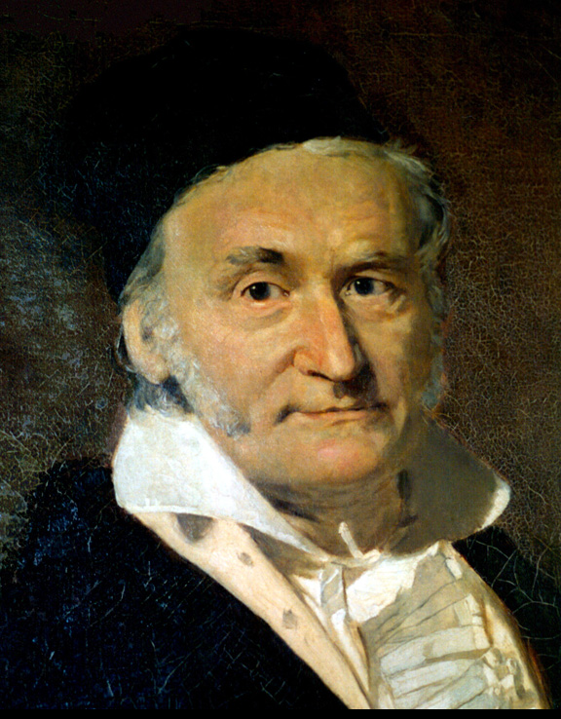
Try This...
Write a python function called gauss that accepts a positive integer argument N and returns the sum
1 + 2 + … + N
2. Write a python function called sumOfSquares that accepts a positive integer N and returns the sum
1² + 2² + 3² + … + N²
You can write extra “helper” functions too!
Worksheet
Notes:
When Carl Friedrich Gauss was in primary school, his teacher assigned the class to the problem of adding up the numbers 1 to 100. Gauss figured out the shortcut formula n(n+1)/2 and finished the task in a short time. The teacher punished him for “misbehavior”!

Slide 16
return vs print...
def dbl(x):
return 2 * x
def trbl(x):
print(2 * x)
def happy(yay):
y = dbl(yay)
return y + 42
def sad(boo):
y = trbl(boo)
return y + 42
def friendly(pal):
y = dbl(pal)
print(y, "is very nice!")
return y + 42
Strings are in single
or double quotes

Slide 17
What Happens Inside a Function?
6
def f(x):
x = x-1
return g(x)+1
def g(x):
return x*2
def h(x):
if x%2 == 1: # x odd
return f(x) + x//2
else: # x even
return f(f(x))
h(3):
return f(3) + 3//2
5
f(3):
return g(2) + 1
4
g(2):
return 4
Two key points…
Functions return to where they were called from
Each function keeps its own values of its variables
Notes:
5 clicks of animation on this slide.
Highlight the integer division, and demo the difference between / and // in the terminal.

Slide 18
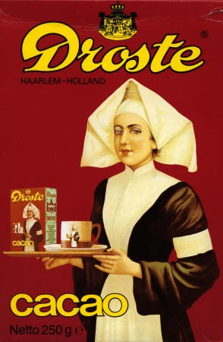
Recursion…
n! = n×(n-1)×(n-2)×…×1
n! = n×[(n-1)!] “inductive definition”
0! = 1 “base case”
Why is 0! = 1?
Notes:
0! Is 1 because we get to pick and it makes certain other math (e.g., combinatorics) convenient.

Slide 19
Math Induction = CS Recursion
Math
inductive definition
Python (Functional)
recursive function
0! = 1
n! = n×[(n-1)!]
# recursive factorial
def factorial(n):
Notes:
Students do factorial in notes. Then, click to show solution. If you have time, write factorial in python and run it.

Slide 20
Math Induction = CS Recursion
Math
inductive definition
Python (Functional)
recursive function
0! = 1
n! = n×[(n-1)!]
# recursive factorial
def factorial(n):
if n == 0:
return 1
else:
return n*factorial(n - 1)
Notes:
Fall ‘20 ended here (and had to skip some stuff)

Slide 21
Is Recursion Magic?
factorial(3):
6
“To understand recursion, you must first understand recursion”—anonymous Mudd alum
return 3 * factorial(2)
2
return 2 * factorial(1)
1
return 1 * factorial(0)
# recursive factorial
def factorial(n):
'''This computes n!'''
if n == 0:
return 1
else:
return n*factorial(n-1)
Notes:
5 clicks of animation on this slide.

Slide 22
Is Recursion Magic?
factorial(3):
6
“To understand recursion, you must first understand recursion”—anonymous Mudd alum
return 3 * factorial(2)
2
return 2 * factorial(1)
1
return 1 * factorial(0)
Notes:
5 clicks of animation on this slide.

Slide 23
Computing the Length of a List
>>> len([1, 42, “spam”])
3
>>> len([1, [2, [3, 4]]])
def len(List):
'''Returns the length of List'''
Python has this built in!
Notes:
Have them figure out the length of the second list. Then have them write len together with you, starting with the base case.

Slide 24
A Tower of Fun!
Math
Python (Functional)
recursive function
2
2
tower(3) =
2
2
# recursive tower
def tower(n):
2
2
tower(4) =
2
tower(5) =
The tower function is taking recursion to new heights!
Notes:
2 clicks of animation on this slide.

Slide 25
A Tower of Fun!
Math
Python (Functional)
recursive function
2
2
tower(3) =
2
2
# recursive tower
def tower(n):
2
2
tower(4) =
2
2
2
2
2
tower(5) =
2
inductive definition:
Try this on your worksheet! (Recall that x^{y} is computed using x**y)
Notes:
Ask them to develop the math (inductive) definition of tower. Remind them to remember the base case. Next slide has the inductive definition that leads to the solution.

Slide 26
A Tower of Fun!
Math
Python (Functional)
recursive function
2
2
tower(3) =
2
2
# recursive tower
def tower(n):
2
2
tower(4) =
2
2
2
2
2
tower(5) =
2
inductive definition:
inductive case:
tower(n) = 2^{tower(n-1)}
base case:
tower(0) = ?
Notes:
Now let them develop tower(n) from the inductive definition. Solution is on the next slide.

Slide 27
A Tower of Fun!
Math
Python (Functional)
recursive function
2
2
tower(3) =
2
2
# recursive tower
def tower(n):
'''Tower of n'''
if n == 0:
return 1
else:
return 2**tower(n - 1)
2
2
tower(4) =
2
2
2
2
2
tower(5) =
2
inductive definition:
inductive case:
tower(n) = 2^{tower(n-1)}
base case:
tower(0) = 1
demo!
Notes:
First animation is the base case; click to show full solution. If you have time, demo tower(1)-tower(5). Tower(4) is just 65536, but tower(5) has 19,729 digits! (Yet Python calculates it quickly. The same isn’t true for tower(6)…)

Slide 28
Reversing a List
>>> reverse([1, 2, 3, 4])
[4, 3, 2, 1]
def reverse(L):
'''Returns a new list that is the
reverse of the input list'''
Notes:
If you have time, make it a worksheet problem; otherwise develop it together.

Slide 29
Reversing a List
>>> reverse([1, [2, [4, 5], 6], 7])
Notes:
What’s the reverse of this list? With simple reverse, it’s [7, [2, [4, 5], 6], 1].

Slide 30
Deep-Reversing a List
>>> reverse([1, [2, [4, 5], 6], 7])
[7, [2, [4, 5], 6], 1]
>>> deepReverse([1, [2, [4, 5], 6], 7])
[7, [6, [5, 4], 2], 1])
This definitely requires recursion!
Fun problem on this week’s HW!
Notes:
One click needed to show the deep reversal.

Slide 31
Recursion = :^)
Recursion, conditional statements, and lists suffice to give
us a Turing-complete programming language!
Variables, assignment (=), if, while, etc.
are all unnecessary!

