Slide 1
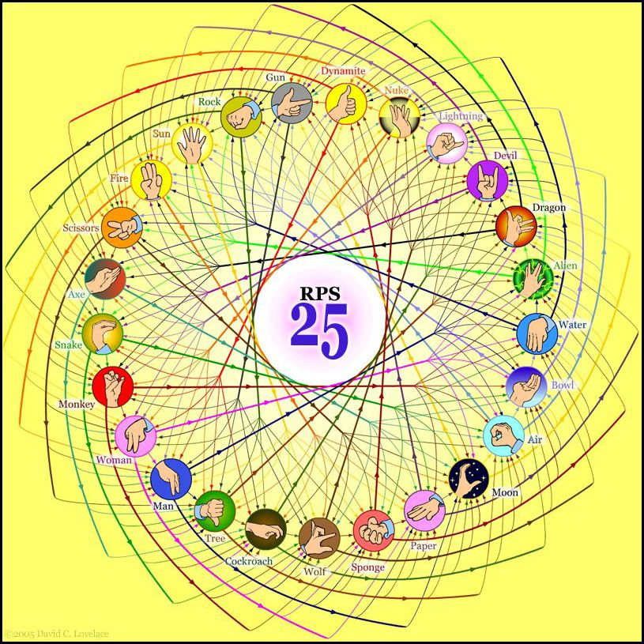
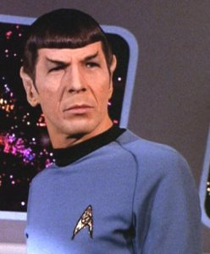
http://www.youtube.com/watch?v=iapcKVn7DdY
http://www.youtube.com/watch?v=yuEZEyDdmvQ
RPS-25 ?!
They call that an alien?
Spock mind-melds three-eyed aliens!
Provably.
Notes:
Setup: have two browser tabs open to the Picobot site. One should have the broken space-filling program that’s the site default; the other should have a correct maze solution, pasted from lec02prog03.txt, and should be on map 1.
Network access needed.
Online version of RPS-25 has clickable Javascript? I couldn’t get it to work.

Slide 2
Lab lookback…
Get things working
Lab's goal:
Complete 25-50% of the hw
Nick's rule…
Finished with lab? OK! No need to stay longer
print "Five is", (4**4)/44
Wow!?
Four fours is ~
sometimes too many…
other times too few…
and never enough! -- Prof. Su
Notes:
33 is from a proud student from last year.
Every math prof knows and fell in love with 4 4’s. Francis did it in middle school and still has his answers—up to 100!

Slide 3
Notes:
Every math prof knows and fell in love with 4 4’s. Francis did it in middle school and still has his answers.

Slide 5
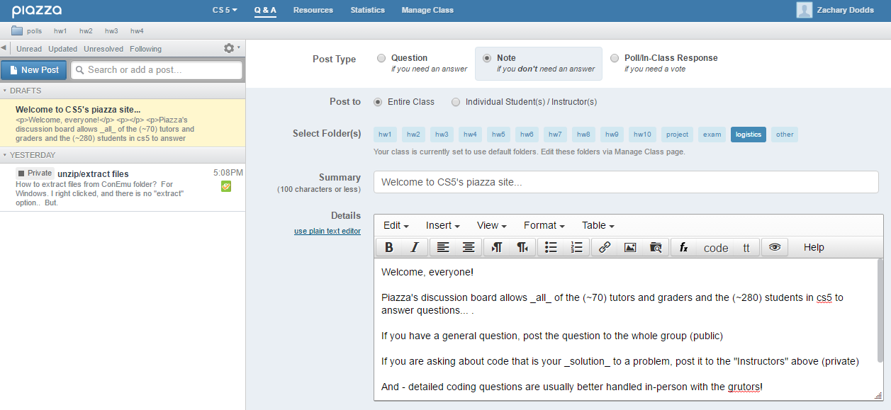
Help via email/Piazza...
for some questions, Piazza is a great resource:
this link:
this Q&Apage
Notes:
They will get email from Piazza. When posting questions that include source code, make it private to instructors. Grutors and profs read the messages.

Slide 6
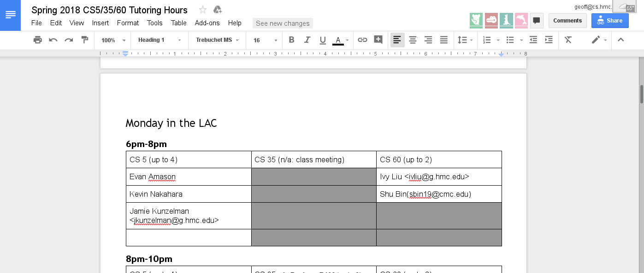
In-person help: "grutoring"
Linde Activities Center
every day there are tutoring hours in the LAC lab
many days there are tutoring hours at other campuses
this link:
this Google doc
Notes:
CS 5 home page has piazza link, also link to grutoring spreadsheet.

Slide 7
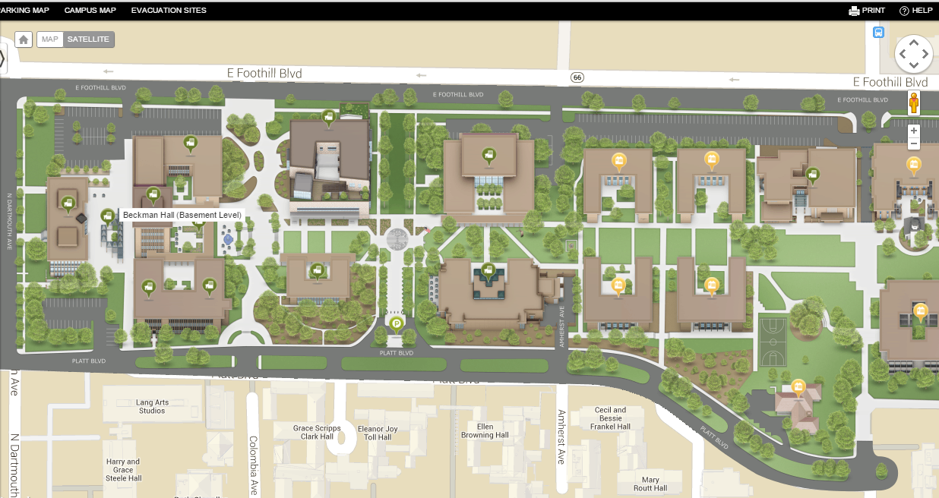
CS5 tutoring location: LAC
Tutoring hours are in the Linde Activities Center computer lab (LAC lab)
west-side entrance
Come by!
coffee
I have office hours Monday 6:00-8:00!
LOTS of tutoring hours, as well…

Slide 8
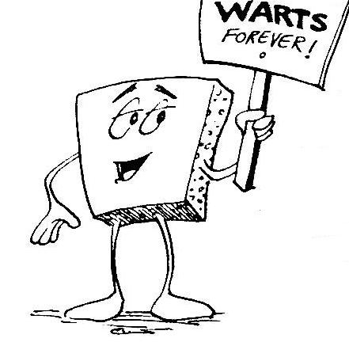
Welcome back to CS 5 !
Average of these two?
Alien
Wally
Problem 0: Reading + response…
Homework 1
Problem 1: Four-fours program: Can be done for lab...
due Mon. night (11:59pm)
Problem 2: Rock-paper-scissors program (Maybe done already!)
Problems 3-4: Picobot! empty room (3) maze (4)
Notes:
INHANDOUT
The average will be the green square

Slide 9
Welcome back to CS 5 !
Yes! I see the resemblance
Picobot!
Alien
Wally
Problem 0: Reading + response…
Homework 1
Problem 1: Four-fours program: Can be done for lab...
due Mon. night (11:59pm)
Problem 2: Rock-paper-scissors program (Maybe done already!)
Problems 3-4: Picobot! empty room (3) maze (4)

Slide 10
Problem 0?
Typically an article on CS or an application...
A few sentences that raise or address questions, using the article as a guide.
Submit a one-paragraph response
5 – insightful, careful
4 – thoughtful
3 – complete, on topic
0-2 – less than complete
Small part (5 pts)
This week's article might not seem like CS at first…
Notes:
Grading is done on Thursday nights.

Slide 11
and I thought my language was alien!
Seventy years ago, in 1940, a popular science magazine published a short article that set in motion one of the trendiest intellectual fads of the 20th century. At first glance, there seemed little about the article to augur its subsequent celebrity. Neither the title, “Science and Linguistics,” nor the magazine, M.I.T.’s Technology Review, was most people’s idea of glamour. And the author, a chemical engineer who worked for an insurance company and moonlighted as an anthropology lecturer at Yale University, was an unlikely candidate for international superstardom. And yet Benjamin Lee Whorf let loose an alluring idea about language’s power over the mind, and his stirring prose seduced a whole generation into believing that our mother tongue restricts what we are able to think.

Slide 12
and I thought my language was alien!
Seventy years ago, in 1940, a popular science magazine published a short article that set in motion one of the trendiest intellectual fads of the 20th century. At first glance, there seemed little about the article to augur its subsequent celebrity. Neither the title, “Science and Linguistics,” nor the magazine, M.I.T.’s Technology Review, was most people’s idea of glamour. And the author, a chemical engineer who worked for an insurance company and moonlighted as an anthropology lecturer at Yale University, was an unlikely candidate for international superstardom. And yet Benjamin Lee Whorf let loose an alluring idea about language’s power over the mind, and his stirring prose seduced a whole generation into believing that our mother tongue restricts what we are able to think.

Slide 13
Last time…
CS != Programming
Notes:
Lab goal was to get the fundamental programming experience: edit, run & test, loop.

Slide 14
What is programming ?
Programming as recipe-writing
vs.
Programming as learning a foreign language
Baggage!
1) Expect it to be different!
2) Don't try to memorize things!
3) Immerse == Experiment!
ser/estar
go/went
Notes:
#2 is different from foreign languages, where you have to work to develop vocabulary.

Slide 15
What about the Python programming language ?

Slide 16
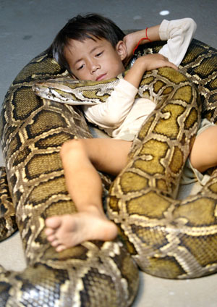
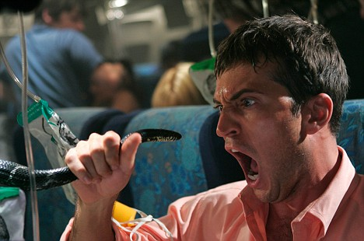
Python!
One possible relationship...
Happy co-existence… It can even be comfy!
Notes:
Slide has animations.

Slide 17
The foreign language of Python…
syntax
semantics
intent
How it looks
What it does
What it should do

Slide 18
The foreign language of Python…
syntax
semantics
intent
How it looks
What it does
What it should do
name = input('Hi... what is your name? ')
print() # prints a blank line
if name == 'Eliot' or name == 'Ran':
print('I\'m "offline." Try later.')
elif name == ‘Geoff': # is it Geoff?
print('Do you mean Jeff?', 'No?', 'Oh.')
else: # in all other cases...
print('Welcome', name, '!')
my_choice = random.choice( [ 'R','P','S' ] )
print('My favorite object is', my_choice, "!")
This program should greet its user appropriately.
human-desired output
Notes:
Slide has animations.

Slide 19
The foreign language of Python…
syntax
semantics
intent
How it looks
What it does
What it should do
name = input('Hi... what is your name? ')
print() # prints a blank line
if name == 'Eliot' or name == 'Ran':
print('I\'m "offline." Try later.')
elif name == ‘Geoff': # is it Geoff?
print('Do you mean Jeff?', 'No?', 'Oh.')
else: # in all other cases...
print('Welcome', name, '!')
my_choice = random.choice( [ 'R','P','S' ] )
print('My favorite object is', my_choice, "!")
Notes:
INHANDOUT
Popup coming

Slide 20
The foreign language of Python…
syntax
semantics
intent
How it looks
What it does
What it should do
machine-producedoutput
name = input('Hi... what is your name? ')
print() # prints a blank line
if name == 'Eliot' or name == 'Ran':
print('I\'m "offline." Try later.')
elif name == ‘Geoff': # is it Geoff?
print('Do you mean Jeff?', 'No?', 'Oh.')
else: # in all other cases...
print('Welcome', name, '!')
my_choice = random.choice( [ 'R','P','S' ] )
print('My favorite object is', my_choice, "!")

Slide 21
prompt and
get user input
Flowchart
a graphical view of a program's semantics
name
decision
Is name equal to ‘Eliot’ or ‘Ran’
YES
NO
machine-producedoutput
print
message for
Eliot or Ran
decision
Is name equal to ‘Geoff’
YES
NO
print
message for
Geoff
print
message for
everyone else
What about me?

Slide 22
The foreign language of Python…
syntax
semantics
intent
How it looks
What it does
What it should do
human-typed input
www.theonion.com
How Python looks!
how punctuation is used
the language keywords used
use of whitespace
peculiarities of formatting
how behavior is affected …
Notes:
Slide has animations (popup of “human-typed input).
Onion article summarizes what syntax is: surface structure

Slide 23
The challenge of programming…
syntax
semantics
intent
How it looks
What it does
What it should do
human-typed input
machine-producedoutput
human-desired output
?
Notes:
The question mark is “is this what I wanted?”

Slide 24
Name(s):
(1) Find and correct as many errors as you can in this code:
Syntax challenge!
import random
(2) This one line does three things… what are they?
user = input("Choose your weapon! ")
comp = random.choice(['rock','paper','scissors")]
print('user (you) chose:', 'user')
print('comp (me!) chose:' comp)
if user == rock and comp = 'paper'
print('The result is, YOU LOSE.'
print('unless you're a CS 5 grader, then YOU WIN!')
(3) Extra! Can you find 7 punctuation marks used in more than one way here?
Notes:
QUIZSLIDE
Answers are on next slide.
Have rps_starter.py (lec02prog01.py) and run it.

Slide 25
Syntax challenge!
(1) Find and correct as many errors as you can here…
(2) This line is doing three things… what are they?
import random
(1) prints the "weapon" prompt
(2) gets user's input from the kbd
(3) assigns that input to the variable user
set-equals always uses ONE equals sign
user = input("Choose your weapon! ")
comp = random.choice(['rock','paper','scissors'])
print('user (you) chose:', user)
print('comp (me!) chose:', comp)
every block of code must line up!
match brackets and quotes !
test-equals uses TWO equals signs
The comma prints a space and does NOT go to the next line.
if user == rock and comp == 'paper':
print('The result is, YOU LOSE.')
print('unless you\'re a CS 5 grader, then YOU WIN!')
a colon starts a new block
every block of code must line up!
flattering - or flouting - graders is encouraged!
a backslash handles special characters
(3) Punctuation used in more than one way: ().'=,:

Slide 26
Include your full name
Tear off that page
Pass those to the aisles & Westward…
take a picture if you'd like to keep it
… then turn back into the packet

Slide 27
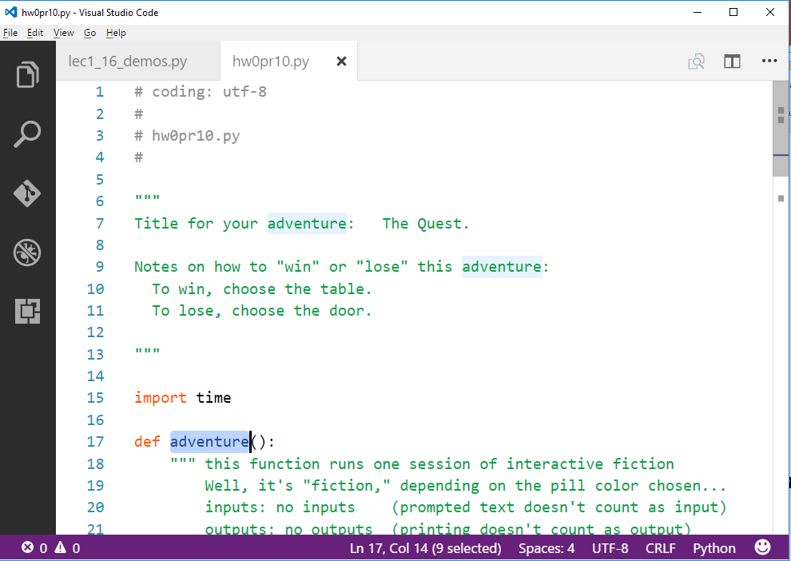
Your Quest!?
Create a short text-adventure in Python...
Use at least five control structures with decisions:
(if/elif/else)
We look forward to adventuring!
Notes:
Highlight the triple quotes?
At this point run a simple sample adventure program (lec02prog02.py)

Slide 28
Another language!
Let's not only add another language…
… but also make it half the hw!
Even with three eyes, I must be misreading this!

Slide 29
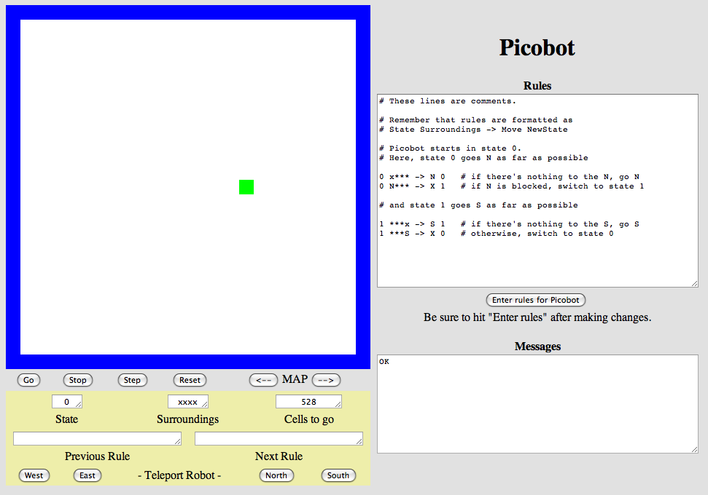
Another language already?
Picobot!
Python
General-purpose language
you might see 50% by the end of the term
even then, <1% of its libraries!
Picobot
Special-purpose language
you'll see 100% in the next 10 minutes
The Picobot simulator
www.cs.hmc.edu/picobot
Notes:
INHANDOUT
Don’t demo here; demo after next slide.

Slide 30
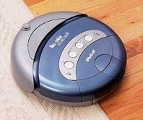
HW problems 3 and 4: Picobot!
Goal: full-room coverage with only local sensing…
walls
Picobot
area not covered (yet!)
area already covered
Picobot can't tell…
Inspiration?
The Roomba!
can't tell "vacuumed" from "unvacuumed" area
Let's see it!
Notes:
Has popups. Demo empty room here.

Slide 31
Surroundings
N
Picobot can only sense things directly to the N, E, W, and S
W
E
S
For example, here its surroundings are
NxWx
N E W S
Surroundings are always in NEWS order.
Notes:
INHANDOUT

Slide 32
What are these surroundings?
Surroundings are always in NEWS order.
N E W S
NxWx
Wow - this one is disgusting!

Slide 33
Surroundings
N
How many distinct surroundings are there?
W
E
2⁴
== 16 possible
S
xxxx
Nxxx
xExx
xxWx
xxxS
NExx
NxWx
NxxS
Aargh!
xEWx
xExS
xxWS
NEWx
NExS
NxWS
xEWS
NEWS
(won’t happen)

Slide 34
State
I am in state 0.
My surroundings
are xxWS.
Picobot's memory is a single number, called its state.
State is the internal context of a computation, i.e., its subtask.
0
Picobot always starts in state 0.
State and surroundings represent everything Picobot knows about the world
self-contained
but not simplistic
Notes:
INHANDOUT

Slide 35
Rules
I am in state 0.
My surroundings
are xxWS.
Picobot acts through a set of rules
0
Each rule expresses your intent for Picobot!
current state
surroundings
direction
new state
0
xxWS
N
0
syntax
If Picobot's in state 0 seeing xxWS,
Then move North, and "change" to state 0.
semantics

Slide 36
Picobot programming ~ rules
current state
surroundings
direction
new state
rule (A)
0
Nxxx
S
0
0
xxxx
N
0
rule (B)
these two rules are a complete Picobot program
Picobot checks its rules from the top each time.
Notes
When it finds a matching rule, that rule runs.
Start
Step 1
Step 2
Step 3
Step 4
…
?
Notes:
Rather than doing these slides, use physical demo with Picobot on a whiteboard: green square held by magnets, Post-Its for state, 16-cell empty room.
After the demo, type the same two rules into the simulator. Develop code to go up/down infinitely. Then have it move west at south boundary. Finally show problem at corner and introduce *.

Slide 37
Picobot programming ~ rules
current state
surroundings
direction
new state
rule (A)
0
Nxxx
S
0
0
xxxx
N
0
rule (B)
these two rules are a complete Picobot program
Picobot checks its rules from the top each time.
Notes
When it finds a matching rule, that rule runs.
Start
Step 1
Step 2
Step 3
Step 4
…
?

Slide 38
Picobot programming ~ rules
current state
surroundings
direction
new state
rule (A)
0
Nxxx
S
0
0
xxxx
N
0
rule (B)
these two rules are a complete Picobot program
Picobot checks its rules from the top each time.
Notes
When it finds a matching rule, that rule runs.
Start
Step 1
Step 2
Step 3
Step 4
…
?

Slide 39
Picobot programming ~ rules
current state
surroundings
direction
new state
rule (A)
0
Nxxx
S
0
0
xxxx
N
0
rule (B)
these two rules are a complete Picobot program
Picobot checks its rules from the top each time.
Notes
When it finds a matching rule, that rule runs.
Start
Step 1
Step 2
Step 3
Step 4
?

Slide 40
Picobot programming ~ rules
current state
surroundings
direction
new state
rule (A)
0
Nxxx
S
0
0
xxxx
N
0
rule (B)
these two rules are a complete Picobot program
Picobot checks its rules from the top each time.
Notes
When it finds a matching rule, that rule runs.
Start
Step 1
Step 2
Step 3
Step 4
…
?

Slide 41
Picobot programming ~ rules
current state
surroundings
direction
new state
rule (A)
0
Nxxx
S
0
0
xxxx
N
0
rule (B)
these two rules are a complete Picobot program
Picobot checks its rules from the top each time.
Notes
When it finds a matching rule, that rule runs.
Start
Step 1
Step 2
Step 3
Step 4
these cycle back and forth…

Slide 42
Wildcards
I only care about NORTH being EMPTY
Asterisks * are wild cards. They match walls or empty space:
current state
surroundings
direction
new state
0
x***
N
0
EWS may be wall or empty space
N must be empty
8 surroundings in one rule
that's it!
Notes:
INHANDOUT

Slide 43
The Rule is
One step per rule
One rule to rule them all?
That's precious!
state
surr.
move
new state
0 N*** -> W 1
0 x*** -> N 0
1 ***x -> S 1
rule (A)
rule (B)
P
rule (C)
more rules
Picobot's world
1. Run Picobot! Which rule A, B, or C runs first? ________
1a. How many times does rule (A) run? __________
1b. How many times does rule (B) run? __________
1c. How many times does rule (C) run? __________
Extra #1 Rule A has a bug! What is it?
Extra #2 Add rules to finish exploring the empty room from any starting point…
Extra #3 How to do this in only 6 rules total?!
2. Picobot stops when no rule matches. Where does it stop?
3. Add a rule so that Picobot continues back upward!
Notes:
INHANDOUTFULL
This should be printed in the notes as a full page, not a reduced one. Fill in the squares with P₀, P₁, etc.
Part of the point here is to take people in the direction of solving the homework.
Highlight that rule A crashes in the upper-left corner.

Slide 44
Warning! What's wrong here?
state
surroundings
direction
new state
0
x***
S
0
0
***x
N
0
these two rules are a broken Picobot program!
Picobot checks its rules from the top each time.
Notes
When it finds a matching rule, that rule runs.
Notes:
INHANDOUT

Slide 45
Warning! What's wrong here?
state
surroundings
direction
new state
0
x***
S
0
These two situations COULD BE the same!
0
***x
N
0
these two rules are a broken Picobot program!
Picobot checks its rules from the top each time.
Notes
When it finds a matching rule, that rule runs.
There can only be ONE rule per situation!
and a "situation" is state and surroundings

Slide 46
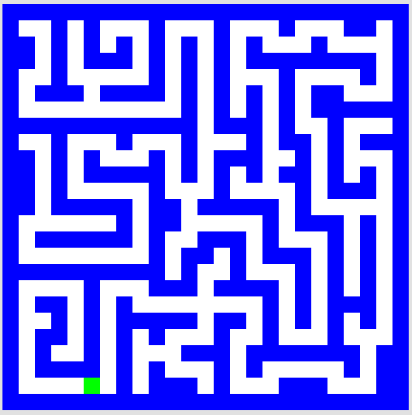
CS ~ Complexity Science
pr. 5 (extra!)
problem 3
problem 4
Shortest Picobot program:
6 rules
Shortest Picobot program:
8 rules
pr. 6 (extra!)
Notes:
INHANDOUT

Slide 47
Maze strategies?

Slide 48
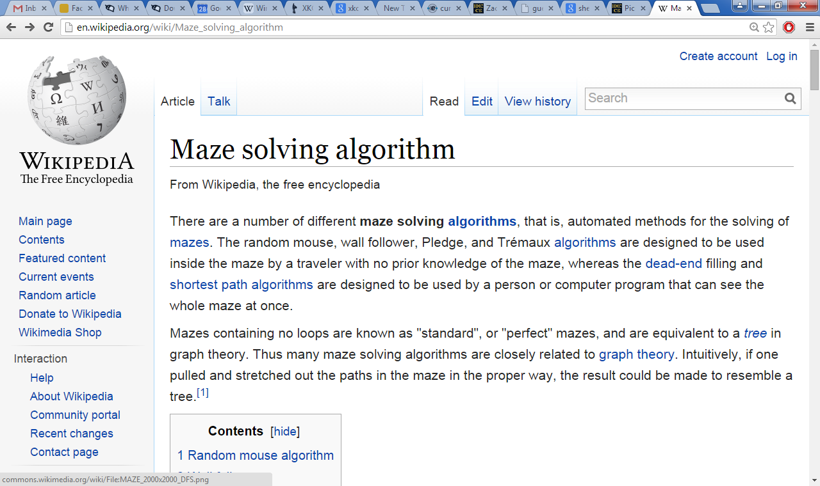
Right Hand Rule

Slide 49
Maze strategies?
Right Hand Rule
Keep your "right hand" on the wall, Picobot!
Why might this be difficult for Picobot?
Notes:
INHANDOUT

Slide 50
Maze strategies?
Right Hand Rule
facing
on the right
Keep your "right hand" on the wall, Picobot!
State 0
State 1
State 2
State 3
We'll need to use state to represent the direction Picobot is facing.
Notes:
To be consistent across the class, have states 0-3 represent NEWS respectively.

Slide 51
Suppose Picobot wants to traverse a maze with its right hand always on the wall...
(A) CORRIDOR rule
If you're facing N with a wall at right and space ahead then go forward”
0
xE**
->
N
0
state 0 means "still facing north"
0
(A)
(B) INTERSECTION rule
“If you're facing North and lose the wall, then get over to the wall now!”
0
0
.
->
E
1
(B)
(C) DEAD END rule
Write 1 or 2 rules to tell Picobot to do the right thing if it hits a dead end.
0
(C)
Repeat this IDEA for all four states, representing all four facing directions.
Notes:
INHANDOUT
B: 0 *x** -> E 1
C: 0 NE** -> X 2
This is 3/12 of the problem (North is completely solved).

Slide 52
Suppose Picobot wants to traverse a maze with its right hand always on the wall...
(A) CORRIDOR rule
If you're facing N with a wall at right and space ahead then go forward”
0
xE**
->
N
0
state 0 means "still facing north"
0
(A)
(B) INTERSECTION rule
“If you're facing North and lose the wall, then get over to the wall now!”
0
0
*x**
->
E
1
state 1 means "now facing east"
(B)
(C) DEAD END rule
Write 1 or 2 rules to tell Picobot to do the right thing if it hits a dead end.
0
NE**
->
X
2
state 2 means "now facing west"
0
(C)
Repeat this IDEA for all four states, representing all four facing directions.

Slide 53
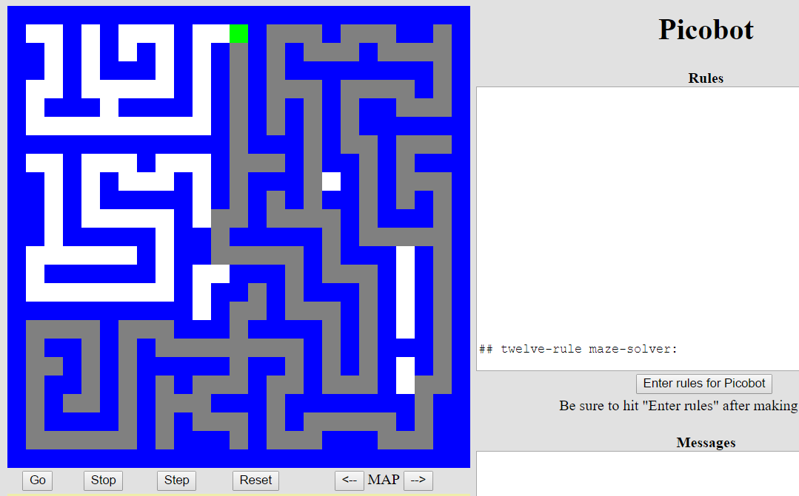
Hooray!?!
Is it working?

Slide 54
— Westward, Ho! —
Lab/hw
You are not alone!
Come to tutoring hours!
I can attest to that!
Post questions to Piazza...
Lead on! I will follow.
Happy Picobotting!
And, good luck with the adventure of Python!

