Slide 1
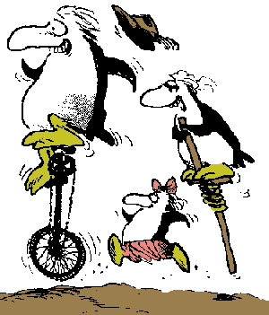
The CS 5 Black Post
Penguins Invade Dormitory
Claremont (AP)—A wild group of unicycling, pogo-sticking, freelining penguins raced through HMC’s South Dorm yesterday, upsetting students who were diligently attempting to complete their CS 5 homework. “I had just gotten my program to work,” sobbed one student, “when the pogo stick landed directly on my ‘delete’ key and wiped it all out! Now I have to start all over. It took my hours to get my program to say ‘Hello, world’ and now I’ll never have time to finish it.” College officials were
Notes:
Class 03 functional1
Have lec03prog01-print.py ready to go.

Slide 2

return vs print...
def dbl(x):
return 2 * x
def trbl(x):
print(2 * x)
def happy(yay):
y = dbl(yay)
return y + 42
def sad(boo):
y = trbl(boo)
return y + 42
def friendly(pal):
y = dbl(pal)
print(y, "is very nice!")
return y + 42
Strings are in single
or double quotes
Notes:
Demo these from lec03prog01-print.py

Slide 3
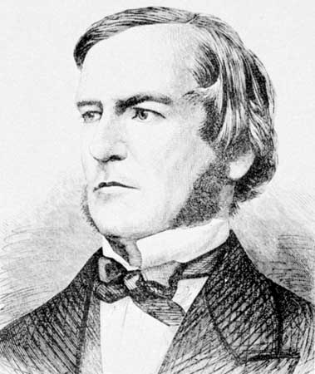
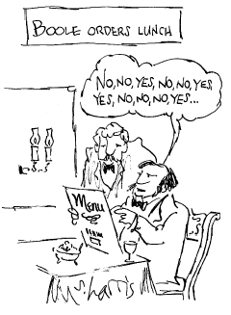
Booleans
>>> 3 == 1+2
True
>>> 42 == "ham"
False
>>> "spam" > "ham"
True
>>> 42 > "spam"
Barf!
Strings!
George Boole
1815-1864

Slide 4


The “Truth” about Python’s Booleans
>>> True + 41
42
>>> 2**False == True
True
Demonstrating the True “power” of Falsity!

Slide 5
Lists!
>>> L = [1, 42, 3, 4]
>>> L
[1, 42, 3, 4]
>>> L + 10
Traceback (most recent call last):
File "<stdin>", line 1, in ?
TypeError: can only concatenate list (not "int") to list
>>> L + [50]
[1, 42, 3, 4, 50]
>>> L
[1, 42, 3, 4]
>>> L*2
[1, 42, 3, 4, 1, 42, 3, 4]
>>> M = [42, "hello", 3+2j, 3.141, [1, 2, 3, 4, 5, 6]]
L doesn’t change!
Lists are “polymorphic”
Notes:
Three animations on this slide. Things that we show:
1. Lists aren’t regular objects
2. You can append to a list if you get the syntax right.
3. Appending creates a new list; the original is unchanged. (Later, we’ll learn how to change lists.)
4. Multiplication duplicates things; this is especially useful for creating a long list with all the same value.
5. Lists are polymorphic, including being able to have other lists as members.
6. Python supports complex numbers (but “i” is “j” because Guido has an engineering background.)

Slide 6

List Indexing and Slicing!
Python slices just like slapchop!
0
1
2
3
>>> M = [42, 3, 98, 37]
>>> M[0]
>>> M[2]
>>> M[0:2]
>>> M[0:3:2]
>>> M[1:]
>>> M[:-1]
>>> M[1:-2]
>>>
“What kind of thing does this return?
Try to reverse the list!
Notes:
If you have time, let the class figure these out. If you have less time, demo them or just give answers.

Slide 7

Strings Revisited
0
1
2
3
4
5
6
7
8
9
10
11
>>> S = "I love Spam!"
>>> S[0]
>>> S[11]
>>> S[2:6]
>>> S[11:6:-1]
>>> S*2
Hey penguins, get off my slides!
Notes:
If you have time, let the class figure these out. If you have less time, demo them or just give answers.

Slide 8
if, elif, else…
def special(x):
"""This function demonstrates the use
of if and else"""
if x == 42:
return "Very special number!"
else:
return "Stupid, boring number."
def special(x):
if x == 42:
return "Very special number!"
return "Stupid, boring number."
Alternatively??
Notice how lines with the same level of indentation are in the same code block!

Slide 9
if, elif, else…
def superSpecial(x):
"""This function demonstrates the use
of if, elif, and else"""
if x < 41:
ans = "Small number"
elif x == 42 or x % 42 == 0:
ans = "Nice!"
elif 41 <= x <= 43:
ans = "So close!"
else:
# We might do more stuff here...
ans = "Yuck!"
return ans
Would swapping
the order of these
elif’s give the
same behavior?
Notice how lines with the same level of indentation are in the same code block!
Notes:
Emphasize that whenever you have mutually exclusive conditions, you should take advantage of elif. Don’t try to write the mutual exclusion yourself; you’ll screw it up! See next slide and demo unwise (lec03prog02-elif.py).

Slide 10
Avoiding elif
def unwise(x):
"""This function avoids using elif"""
if x == 42 or x % 42 == 0:
ans = "Nice!"
if 41 <= x <= 43 or x != 42:
ans = "So close!"
if x != 42 or x % 42 != 0:
ans = "Yuck!"
return ans
I’m getting quite confused here…
Notes:
Emphasize that whenever you have mutually exclusive conditions, you should take advantage of elif. Don’t try to write the mutual exclusion yourself; you’ll screw it up! Demo is in lec03prog02-elif.py; show superSpecial(42) and unwise(42).

Slide 11
The Alien's Life Advice
Give people hugs
You’ll find out where their wallet is!

Slide 12
What Happens Inside a Function?
6
def f(x):
x = x-1
return g(x)+1
def g(x):
return x*2
def h(x):
if x%2 == 1: # x odd
return f(x) + x//2
else: # x even
return f(f(x))
h(3):
return f(3) + 3//2
5
f(3):
return g(2) + 1
4
g(2):
return 4
Two key points…
  Functions return to where they were called from
  Each function keeps its own values of its variables
Notes:
5 clicks of animation on this slide.
Highlight the integer division, and demo the difference between / and // in the terminal.

Slide 13
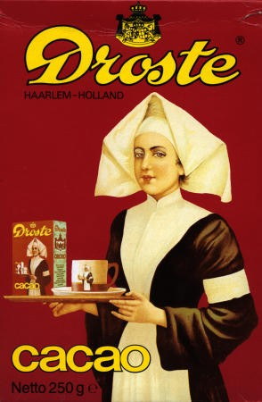
Recursion…
n! = n×(n-1)×(n-2)×…×1
n! = n×[(n-1)!] “inductive definition”
0! = 1 “base case”
Why is 0! = 1?
Notes:
0! Is 1 because we get to pick and it makes certain other math (e.g., combinatorics) convenient.

Slide 14
Math Induction = CS Recursion
Math
inductive definition
Python (Functional)
recursive function
0! = 1
n! = n×[(n-1)!]
# recursive factorial
def factorial(n):
Notes:
Students do factorial in notes. Then, click to show solution. If you have time, write factorial in python and run it.

Slide 15
Math Induction = CS Recursion
Math
inductive definition
Python (Functional)
recursive function
0! = 1
n! = n×[(n-1)!]
# recursive factorial
def factorial(n):
if n == 0:
return 1
else:
return n*factorial(n - 1)
Notes:
Students do factorial in notes. Then, click to show solution. If you have time, write factorial in python and run it.

Slide 16
Is Recursion Magic?
factorial(3):
6
“To understand recursion, you must first understand recursion”—anonymous Mudd alum
return 3 * factorial(2)
2
return 2 * factorial(1)
1
return 1 * factorial(0)
# recursive factorial
def factorial(n):
'''This computes n!'''
if n == 0:
return 1
else:
return n*factorial(n-1)
Notes:
5 clicks of animation on this slide.

Slide 17
Is Recursion Magic?
factorial(3):
6
“To understand recursion, you must first understand recursion”—anonymous Mudd alum
return 3 * factorial(2)
2
return 2 * factorial(1)
1
return 1 * factorial(0)
Notes:
5 clicks of animation on this slide.

Slide 18
A Tower of Fun!
Math
Python (Functional)
recursive function
2
2
tower(3) =
2
2
# recursive tower
def tower(n):
2
2
tower(4) =
2
tower(5) =
The tower function is taking recursion to new heights!
Notes:
2 clicks of animation on this slide.

Slide 19
A Tower of Fun!
Math
Python (Functional)
recursive function
2
2
tower(3) =
2
2
# recursive tower
def tower(n):
2
2
tower(4) =
2
2
2
2
2
tower(5) =
2
inductive definition:
Try this on your worksheet! (Recall that x^{y} is computed using x**y)
Notes:
Ask them to develop the math (inductive) definition of tower. Remind them to remember the base case. Next slide has the inductive definition that leads to the solution.

Slide 20
A Tower of Fun!
Math
Python (Functional)
recursive function
2
2
tower(3) =
2
2
# recursive tower
def tower(n):
2
2
tower(4) =
2
2
2
2
2
tower(5) =
2
inductive definition:
inductive case:
tower(n) = 2^{tower(n-1)}
base case:
tower(0) = ?
Notes:
Now let them develop tower(n) from the inductive definition. Solution is on the next slide.

Slide 21
A Tower of Fun!
Math
Python (Functional)
recursive function
2
2
tower(3) =
2
2
# recursive tower
def tower(n):
'''Tower of n'''
if n == 0:
return 1
else:
return 2**tower(n - 1)
2
2
tower(4) =
2
2
2
2
2
tower(5) =
2
inductive definition:
inductive case:
tower(n) = 2^{tower(n-1)}
base case:
tower(0) = 1
demo!
Notes:
First animation is the base case; click to show full solution. If you have time, demo tower(1)-tower(5). Tower(4) is just 65536, but tower(5) has 19,729 digits! (Yet Python calculates it quickly. The same isn’t true for tower(6)…)

Slide 22
Computing the Length of a List
>>> len([1, 42, “spam”])
3
>>> len([1, [2, [3, 4]]])
def len(List):
'''Returns the length of List'''
Python has this built in!
Notes:
Have them figure out the length of the second list. Then have them write len together with you, starting with the base case.

Slide 23
Reversing a List
>>> reverse([1, 2, 3, 4])
[4, 3, 2, 1]
def reverse(L):
'''Returns a new list that is the
reverse of the input list'''
Notes:
If you have time, make it a worksheet problem; otherwise develop it together.

Slide 24
Reversing a List
>>> reverse([1, [2, [4, 5], 6], 7])
Notes:
What’s the reverse of this list? With simple reverse, it’s [7, [2, [4, 5], 6], 1].

Slide 25

Deep-Reversing a List
>>> reverse([1, [2, [4, 5], 6], 7])
[7, [2, [4, 5], 6], 1]
>>> deepReverse([1, [2, [4, 5], 6], 7])
[7, [6, [5, 4], 2], 1])
This definitely requires recursion!
Fun problem on this week’s HW!
Notes:
One click needed to show the deep reversal.

Slide 26
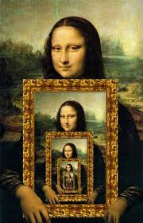



Recursion = :^)
Recursion, conditional statements, and lists suffice to give
us a Turing-complete programming language!
Variables, assignment (=), if, while, etc.
are all unnecessary!

