Slide 1
Today’s whether: if, elif, or else!
Monday, January 23, 2017
Three-eyed aliens causing most computer troubles...
Homework #2 Due Mon., 1/29
0) Reading + response
Alien Attack?! Picobot programmer G. Kuen-ning was subjected to a bizarre encounter with three-eyed aliens yesterday. The tri-nocular tourists, it seems, were conducting experiments that would help them under-stand “how humans think.”
The aliens apparently used a shrinking ray that let them enter the programmer’s head to see what was happening. A witness reports deeply disappointed voices emanating from within.
To escape the attack, Kuenning had to turn the ray on himself. As he shrank, the aliens quickly flew off, departing so fast that he was unable to use the reverse ray before they left. “I don’t mind,” Kuenning mused. In fact, this might help me hide from students tomorrow. ”
1) Lab: data
2) Lab: functions
Composite sketch of one of the attackers, drawn from three-eyewitness accounts
3) The fun in functions!
(ExCr) HTMLanguage
Automatic translation: does it really work?
see three-eyed alien attack, p. 42
Notes:
INHANDOUT
Announcements:
This class is for people with no experience! Don’t be intimidated by the ten people who have some.
Office hours will be irregular for the next few weeks, and in particular no Mon 4-5 and 6-8 office hours until Feb. 19
Identify unregistered people; get pictures of newcomers
Tell hydraulic ram story
Setup: in ipython (or in VSCode split screen), set M = [4, 7, 100, 42, 5, 47]
L = [3.14, [2, 40], 'third', 42]
s = 'harvey mudd college'
clear screen with ^L
Make demo xterm ½-height [why?—fill in]
Props: desktop computer to disassemble
Boxes to represent variables, with velcro values.

Slide 2
The challenge of programming…
syntax
semantics
intent
How it looks
What it does
What it should do
human-typed input
machine-producedoutput
www.theonion.com
human-desired output
?

Slide 3
learning a language ~ syntax
unavoidable, but not the point
… but learning CS ~ semantics
learning how machines think!
Notes:
INHANDOUT

Slide 4
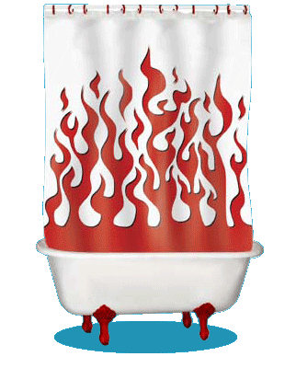
Inside the machine…
What's behind the scenes (processing + memory):
Computation
Data Storage
41
42
name: x
type: int
LOC: 312
name: y
type: int
LOC: 324
memory location 312
memory location 324
variables ~ boxes
id, del
Notes:
Next time we’ll do the computation side. This one is data.
In ipython, demonstrate:
x = 41
x + 1
id(x)
del x
x <= undefined. Define/describe NameError

Slide 5
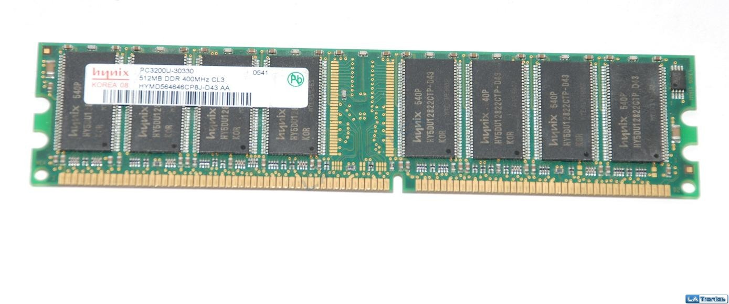
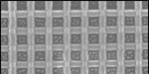
Memory!
Random Access Memory
41
42
83
83
name: x
type: int
LOC: 312
name: y
type: int
LOC: 324
name: z
type: int
LOC: 336
name:
type: int
LOC: 348
a big list of boxes, each with a name, type, location, and value
512 MB of memory
on or off
bit = smallest amt. of info.: 0 or 1
False
True
byte = 8 bits
word = 64 bits
Notes:
INHANDOUT
We will look at this in more detail later in the course.
Take a desktop apart. Show hard drive, RAM, heat sink, CPU

Slide 6
All languages use data types
Type
Example
What is it?
numeric values with a fractional part, even if the fractional part is .0
float
3.14
or
3.0
int
42
10**100
integers – Python has infinite-precision ints!
or
the T/F results from a test or comparison:
bool
True
or
False
==, !=, <, >, <=, >=
Hey! Someone can't spelle !
"Boolean values"
"Boolean operators"
George Boole
type( x )
Notes:
INHANDOUT
The three numeric types are on this slide.
Demonstrate using type(x) to ask for types.

Slide 7
Operate!
higher precedence
( )
**
-
* / % //
+ -
> == <
=
Notes:
Kind of looks like a Dalik.

Slide 8
O-per-ate!
higher precedence
( )
**
-
* / % //
+ -
> == <
=

Slide 9
Python operators
higher precedence
( )
parens
**
power
-
negate
* / % //
times, mod, divide
add, subtract
+ -
> == <
compare
=
assign
It's hard to remember all these %+/* things! At first, prefer parentheses over precedence.
Notes:
INHANDOUT
Beginners use lots of parentheses; experts tend to avoid their clutter.
For power, note different notation (not ^). Next slide will be % & //; we’ll also review == vs. =.

Slide 10
% the mod operator
7 % 3
9 % 3
8 % 3
30 % 7
x % y is the remainder when x is divided by y
x % 2 == 0
x % 2 == 1
For what values of x are these True?
x % 4 == 0
If x is a year, what happens on these years!?
x % 4 == 3
What happens on these years, football-wise!?
Notes:
INHANDOUT
%4 == 3 is Women’s World Cup (soccer)

Slide 11
// integer division
7 // 3
x//y is x/y, rounded down to an integer
8 // 3
9 // 3
30 // 7
Decomposition of 31 into 7’s:
31 == (4) * 7 + (3)
But why?
Decomposition of x into y’s:
x == (x // y) * y + (x % y)
# of full y's in x
remainder after "taking" all of the full y's in x
Notes:
INHANDOUT
Demo mod & div: 30 % 7; 30 // 7
The decomposition is always true. Experiment on your own: does decomposition work with negative numbers? What are the pieces?

Slide 12
the "equals" operators
= != ==
This is true – but what is it saying!?
Notes:
INHANDOUT

Slide 13
the "equals" operators
= != ==
SET equals
isn't equal to
TEST equals
I want === !
Notes:
JavaScript has ===

Slide 14
how = works
"Quiz"
name(s)
x = 41
y = x + 1
z = x + y
Run
these lines
x
y
z
What are x, y, and z at this time?
Then run this line
x = x + y
x
y
z
What are x, y, and z at this time?
Extra!
a = 11 // 2
b = a % 3
c = b** a+b *a
What are the values of a, b, and c after the 3 lines, at left, run?
a
b
c
Notes:
QUIZSLIDE
The x = x + y line bothers some people.
After quiz, act it out with props (pre-prepared boxes for variables). Then demo in Python, show how x gets a new ID. The name moves to the data.
Spacing is deliberately off.

Slide 15
Inside the machine…
x = 41
y = x + 1
z = x + y
x = x + y
What's happening in python:
What's happening behind the scenes (in memory):
Computation
Memory (Data Storage)
41
42
name: x
type: int
LOC: 312
name: y
type: int
LOC: 324
83
83
name: z
type: int
LOC: 316
name: x
type: int
LOC: 328
id, del
Notes:
INHANDOUT

Slide 16
Are numbers enough for everything?
Yes and no…
You need lists of numbers, as well!
and strings—lists of characters—too.
Both of these are Python sequences…
Notes:
…and more, covered later in the course

Slide 17
strings: textual data
s = 'scripps'
strings
c = 'college'
type...
type(s)
len
len(s)
add!
s + c
multiply!!
2*s + 3*c
What did you say!?!
Notes:
INHANDOUT

Slide 18
strings: textual data
s1 = 'ha'
Given
s2 = 't'
What are
s1 + s2
2*s1 + s2 + 2*(s1 + s2)
What did you say!?!
Notes:
hahathathat

Slide 19
Data, data everywhere…
Data

Slide 20
Data, data everywhere…
2015
2020
2011
1 Zettabyte
2009
44 ZB
1.8 ZB
8.0 ZB
800 EB
2002
Data produced each year
161 EB
2006
logarithmic scale
1 Exabyte
5 EB
100 years of HD video + audio
1 Petabyte
Human brain's capacity
60 PB
14 PB
1 Petabyte, PB == 1000 Terabytes, TB
1 Terabyte, TB == 1000 Gigabytes, GB
References
(2020) 44ZB: http://www.emc.com/leadership/digital-universe/2014iview/executive-summary.htm
(2015) 8 ZB: http://www.emc.com/collateral/analyst-reports/idc-extracting-value-from-chaos-ar.pdf
(2011) 1.8 ZB: http://www.emc.com/leadership/programs/digital-universe.htm
(2009) 800 EB: http://www.emc.com/collateral/analyst-reports/idc-digital-universe-are-you-ready.pdf
(2006) 161 EB: http://www.emc.com/collateral/analyst-reports/expanding-digital-idc-white-paper.pdf
(2002) 5 EB: http://www2.sims.berkeley.edu/research/projects/how-much-info-2003/execsum.htm
(life in video) 60 PB: in 4320p resolution, extrapolated from 16MB for 1:21 of 640x480 video (w/sound) – almost certainly a gross overestimate, as sleep can be compressed significantly!
(brain) 14 PB: http://www.quora.com/Neuroscience-1/How-much-data-can-the-human-brain-store
Notes:
It took about 15 years to go from 1 exabyte to 1 zettabyte. After zetta comes yotta, and after that we don’t have a word. So at this rate, by 2060 we’ll have more data than we know how to describe!

Slide 21
Big Data?

Slide 22
'debt'
more-than-average searches for debt: sell
around-average searches for debt: hold
fewer-than-average searches for debt: buy
strategy:
Notes:
Right now, Google Trends says debt is average but on the uptick.

Slide 23
'fun'
If you torture the data enough, it will confess.
- R. Coates, statistician
'water'
Notes:
This slide has a popup.

Slide 24
wisdom
G.G.M, et al.
knowledge
G. Garcia Marquez
Google's users
Data's elevation?
information
Google
data
Notes:
CS focuses on turning data into information.

Slide 25
Lists ~ ordered collections
of any data
M = [4, 7, 100, 42, 5, 47]
Notes:
M, L, and S can be set by running lec03prog01-setvars.py.

Slide 26
Lists ~ ordered collections
of any data
Square brackets tell python you want a list.
Commas separate elements.
M = [4, 7, 100, 42, 5, 47]
len(M)
M[0]
M[0:3]
top-level length
indexing
slicing
Notes:
Have M ready in ipython

Slide 27
Lists ~ ordered collections
of any data
string
L = [3.14, [2, 40], 'third', 42]
len(L)
L[0]
L[0:1]
top-level length
indexing
slicing
only counts top-level elements
could return a different type
always returns the same type, and always returns a substructure!
Notes:
INHANDOUT
Also show L[2][1:3]
Note that the one-element slice (L[0:1]) is confusing vis-à-vis L[0]; discuss

Slide 28
Indexing uses [ ]
s = 'harvey mudd college'
0
1
2
3
4
5
6
7
8
9
10
11
12
13
14
15
16
17
18
index
Read as
"s-of-zero“
or "s-zero“
or “s-sub-zero”
s[0]
'h'
is
s[17]
is
s[6]
is
s[ ]
'e'
is
Notes:
INHANDOUT
Emphasize that s[6] is blank; demo that len is 1 but len('') is zero.

Slide 29
Negative indices…
In a negative mood ? Python's there for you !
0
1
2
3
4
5
6
7
8
9
10
11
12
13
14
15
16
17
18
s = 'harvey mudd college'
-19
-17
-15
-13
-11
-9
-7
-5
-3
-1
-18
-16
-14
-12
-10
-8
-6
-4
-2
Negative indices count backwards from the end!
s[-1]
'e'
is
s[-18]
is
s[-7]
is
s[-0]
is
Notes:
INHANDOUT

Slide 30
Slicing
s = 'harvey mudd college'
0
1
2
3
4
5
6
7
8
9
10
11
12
13
14
15
16
17
18
s[ : ]
slices the string, returning a substring
What's going on here?
s[0:6]
is
'harvey'
s[12:18]
is
'colleg'
s[17:]
is
'ge'
s[:]
is
'harvey mudd college'
Notes:
Explanations are on following slide

Slide 31
Slicing
s = 'harvey mudd college'
0
1
2
3
4
5
6
7
8
9
10
11
12
13
14
15
16
17
18
start
end+1
s[ : ]
slices the string, returning a substring
first index is the first character
second index is ONE AFTER the last character
a missing index means that end of the string
s[0:6]
is
'harvey'
s[12:18]
is
'colleg'
s[17:]
is
'ge'
s[:]
is
'harvey mudd college'
Notes:
INHANDOUT

Slide 32
Slicing
0
1
2
3
4
5
6
7
8
9
10
11
12
13
14
15
16
17
18
s = 'harvey mudd college'
-19
-18
-17
-16
-15
-14
-13
-12
-11
-10
-9
-8
-7
-6
-5
-4
-3
-2
-1
start
end+1
s[15:-1]
is
What are these slices?
s[:2]
is
is
'mud'
and these?
is
'e'
Don't wor'e'-
Be hap'e' !
Notes:
INHANDOUT

Slide 33
Skip Slicing
s[ : : ]
the third index is the stride length
default is +1
start
end+1
s = 'harvey mudd college'
0
1
2
3
4
5
6
7
8
9
10
11
12
13
14
15
16
17
18
s[0:8:2]
'hre '
is
s[17:12:-1]
is
s[::-1]
is
G. Garcia Marquez
is
'doe'
s[1::6]
is
I love this one.
Notes:
INHANDOUT
Stride is like hopping: hop 2, not skip 2.

Slide 34
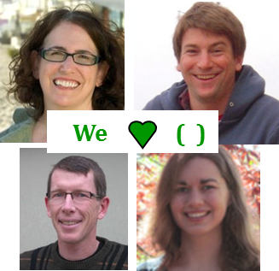
pi = [3,1,4,1,5,9]
Try it!
L = ['pi', "isn't", [4,2]]
M = 'You need parentheses for chemistry !'
0
4
8
12
16
20
24
28
32
Part 1
Part 2
6
'pi'
What is len(pi)
What is L[0]
These three are all different
What is len(L)
What is L[0][1]
What is len(L[1])
What is L[0:1]
What slice of M is 'try'?
What is pi[2:4]
What slice of M is 'shoe'?
What slice of pi is [3,1,4]
pi[0:3]
What is M[9:15]
What slice of pi is [3,4,5]
What is M[::5]
Extra! Mind Muddler
What are pi[0]*(pi[1]+pi[2]) and pi[0]*(pi[1:2]+pi[2:3]) ?
These two are different!
Notes:
INHANDOUTFULL
Prof. Aaron Laconte, Claremont HS; Prof. Katie Purvis-Roberts, Keck science

Slide 35
pi = [3,1,4,1,5,9]
Try it!
L = ['pi', "isn't", [4,2]]
We ( )
M = 'You need parentheses for chemistry !'
0
4
8
12
16
20
24
28
32
Part 1
Part 2
6
'pi'
What is len(pi)
What is L[0]
These three are all different
3
'i'
What is len(L)
What is L[0][1]
['pi']
What is len(L[1])
What is L[0:1]
[4,1]
What slice of M is 'try'?
M[31:34]
or
M[-5:-2]
What is pi[2:4]
pi[:3]
What slice of M is 'shoe'?
What slice of pi is [3,1,4]
'parent'
What is M[9:15]
pi[::2]
What slice of pi is [3,4,5]
What is M[::5]
Extra! Mind Muddlers
What are pi[0]*(pi[1]+pi[2]) and pi[0]*(pi[1:2]+pi[2:3]) ?
These two are different!
15
[1,4,1,4,1,4]
Notes:
len(L[1]) = 5
show is M[30:17:-4]
M[::5] = ‘yeah cs!’
Note that L[0:1] is a list!
Humans don’t need the structure but Python does.
L[0][1] is 'i' – which one? (pi)

Slide 36
Python slices - it dices...
( data, at least )
… but wait, there's more!
Notes:
Teaser for next time

Slide 37
Python slices - it dices...
( data, at least )
Python functions
… but wait, there's more!

Slide 38
Functioning in Python
# my own function!
def dbl(x):
"""Returns double its argument, x"""
return 2x
This doesn't look quite right…

Slide 39
Functioning in Python
Still broken… !
Notes:
VSCode tries to help.

Slide 40
Functioning in Python
comment for other coders
# my own function!
def dbl( x ):
"""Returns double its argument, x"""
return 2*x
documentation string for all users
Python's keywords
Some of Python's baggage…
Notes:
INHANDOUT

Slide 41
Function Fun !
def undo(s):
"""This "undoes" its argument, s"""
return 'de' + s
>>> undo('caf')
'decaf'
>>> undo(undo('caf'))
strings, lists, numbers … all data are fair game
Notes:
INHANDOUT

Slide 42
Have a dedecaf-ternoon!
morning + evening, too
This week's lab ~ first two hw problems

