Slide 1
The CS 5 Black Times
Penguin Leads Surfing Trip
Oceanside (UPI)—In an attempt to make up for the damage caused to a Harvey Mudd College dormitory by her ill-behaved colleagues, a well-tanned penguin took a group of first-year students on a beach outing in which they learned to surf. “It was awesome,” gushed one surfer. I stood up the very first time and I would have made it all the way in except that I slipped on some fish oil.”
Another beginner lauded the experience even though he returned with gashes on his chin. “I got to see the ocean from underneath!” he exclaimed. “I had no idea there were fish under there!”
Notes:
Class 04 functional2
This class needs to cover use-it-or-lose-it
Setup: be ready to run Python on lec04prog*.py (primes, powerset, knapsack)
Have CS 5 page up so you can show grutoring info

Slide 2
Getting Help and Office Hours
Come to office hours or set up times to come talk to Geoff, Xanda, and Zach! Also, grutoring hours are great!
Be sure to put "CS5" in your e-mail subject lines!
Oh, and there’s candy!
Notes:
The CS 5 grutoring page has links to office hours (dynamic).
Show example or screenshots of the grutoring page.
Note that email to evilgeoff@cs.hmc.edu will get a snippy answer.

Slide 3
Join
HMC chapter of
Company-sponsored tech talks and events
Resume Workshops / Interview Prep
Dinners with cool profs (like the one standing in front of you!)
Meet other students in CS!
Students of all gender identities are welcome!
Join by filling out a quick form at tinyurl.com/wacm-5c

Slide 4
Member
>>> member(42, [1, 3, 5, 42, 7])
True
>>> member(42, ["spam", "is", "yummy"])
False
def member(x, L):
Worksheet please!
Notes:
This has already been done in lab.

Slide 5
Writing Map and Reduce
>>> list(map(dbl, [0, 1, 2, 3]))
[0, 2, 4, 6]
from functools import reduce
>>> reduce(add, [1, 2, 3])
6
The shortest possible list has length 0
def map(f, L):
The shortest possible list has length 1
def reduce(g, L):
In your notes
Worksheet please!

Slide 6
Filter
Java doesn’t have a filter!
def even(x):
'''Returns True iff x is even'''
return x % 2 == 0
>>> list(filter(even, range(100)))
[0, 2, 4, 6, …, 98]
A function that returns
either True or False
Is called a predicate

Slide 7
Filter
def short(List):
'''Returns True iff List has len <= 2'''
return len(List) <= 2
>>> list(filter(short, [["spam", "yum"], [42], [1, 2, 3]]))
filter can be written from scratch using recursion.

Slide 8
Functions are Data
def divides(n):
def div(k):
return n % k == 0
return div
>>> div10 = divides(10)
>>> div10
<function divides.<locals>.div at 0x14a15eb28b70>
>>> div10(2)
>>> listOfFunctions = [divides(10), divides(20)]
>>> listOfFunctions[0](2)

Slide 9
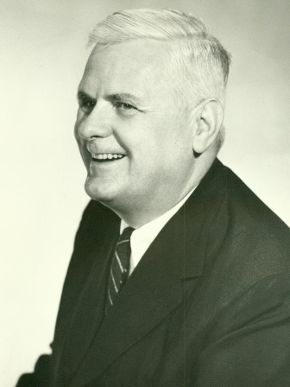
Anonymous Functions
filter(def even(x): return x%2 == 0,
range(100))
filter(def (x): return x%2 == 0,
range(100))
filter(lambda x: x%2 == 0, range(100))
>>> lambda_dbl = lambda x: 2 * x
>>> lambda_dbl(21)
42
Alonzo Church
1903-1955
One line
no parentheses on the argument
return is implicit
Can filter filter out the bugs from my code?
Notes:
This slide has 5 clicks of animation: 1: cancel first idea; 2: second idea; 3: cancel that; 4: lambda; 5: defining a function with lambda.
American mathematician, invented the lambda calculus and the Church-Turing thesis (basically, says that a human can calculate on pencil and paper if and only if a Turing machine can do it).

Slide 10
Lambda
AKA “anonymous functions”
>>> list(filter(lambda x: x%2 == 0,
range(100)))
>>> list(filter(lambda List: len(List) <= 2,
[["spam", "yum"], [42], [1, 2, 3]]))

Slide 11
Lambda
even = lambda x: x%2 == 0
def even(x):
'''Returns True iff x is even'''
return x % 2 == 0
short = lambda List: len(List) <= 2
def short(List):
'''Returns True iff List has len <= 2'''
return len(List) <= 2
Notes:
Note that help on a lambda function is unhelpful, but help on def’d functions is at least somewhat helpful.

Slide 12
Lambda Evil
def ugly(item, L):
newL = list(map(lambda x: x == item, L))
return sum(newL) > 0
This is exploiting the fact that True == 1 and False == 0.
Notes:
This is bad style. You can do it, but the next slide is better. BTW, “list” isn’t necessary here. But what does this function do? Think, pair, share.

Slide 13
Lambda
from functools import reduce
def mystery(item, L):
newL = list(map(lambda x: x == item, L))
return reduce(lambda x, y: x or y, newL)
MUCH better!
Notes:
Is this the same? TPS.

Slide 14
A Prime Example
Write a function called prime(n) that returns True if n is
prime and False otherwise by testing all possible divisors
from 2 to n-1 (or sqrt of n)
def isPrime(n):
possibleDivisors = range(2, n)
divisors = filter(lambda X: n % X == 0, possibleDivisors)
return ???
A version of this was an extra-credit problem in Homework 0!
Notes:
Worksheet problem.

Slide 15
A Prime Example
Write a function called prime(n) that returns True if n is
prime and False otherwise by testing all possible divisors
from 2 to n-1 (or sqrt of n)
def isPrime(n):
possibleDivisors = range(2, n)
divisors = list(filter(lambda x: n % x == 0, possibleDivisors))
return len(divisors) == 0
Alternatively, which of these works?…
def divides(x):
return n % x == 0
def isPrime(n):
possibleDivisors = range(2, n)
divisors = list(filter(divides,
possibleDivisors))
return len(divisors) == 0
def isPrime(n):
def divides(X):
return n % X == 0
possibleDivisors = range(2, n)
divisors = list(filter(divides,
possibleDivisors))
return len(divisors) == 0
Notes:
Here, the list typecast is necessary. TPS on the bottom two. Answer: on the left, n is unbound. The one on the right works; it’s the same as the lambda version.

Slide 16
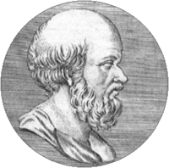
Listing Primes…
Eratosthenes
200 BCE
Objective: Find all primes less than or equal to some given n.
Approach 1: Test 2, 3, …, n for primality
Approach 2: The Sieve of Eratosthenes…
2, 3, 4, 5, 6, 7, 8, 9, 10, 11, 12, 13, 14, 15,…
2, 3, 4, 5, 6, 7, 8, 9, 10, 11, 12, 13, 14, 15,…
2, 3, 4, 5, 6, 7, 8, 9, 10, 11, 12, 13, 14, 15,…

Slide 17
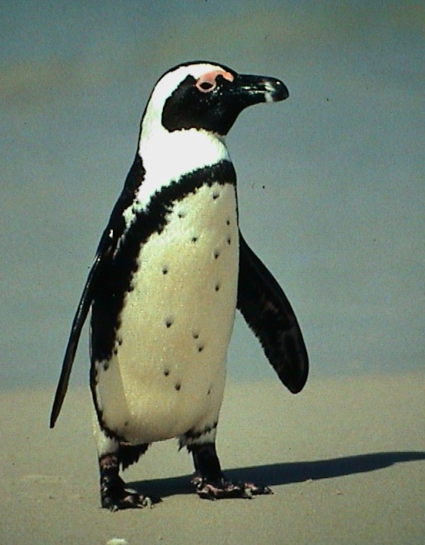
Nifty Sifty…
>>> sieve([2, 3, 4, 5, 6, 7, 8, 9])
[2, 3, 5, 7]
def primes(n):
'''Returns the list of primes <= n'''
return sieve(range(2, n+1))
def sieve(L):
if L == []: return []
else: return ???
This is a fun challenge. Try it in your notes!
Notes:
Do this in notes, not on worksheet.

Slide 18
Nifty Sifty…
>>> sieve([2, 3, 4, 5, 6, 8, 9])
[2, 3, 5, 7]
def primes(n):
'''Returns the list of primes <= n'''
return sieve(range(2, n+1))
def sieve(L):
if L == []: return []
else: return [L[0]] + ???

Slide 19
Filter it, Baby!
>>> sieve([2, 3, 4, 5, 6, 7, 8, 9])
[2, 3, 5, 7]
def sieve(L):
if L == []: return []
else: return [L[0]] + primes
filter(lambda x: x % L[0] != 0, L[1:])
This is a good start, but we’re not quite done!
Notes:
Note that this really isn’t the sieve; see Prof. O’Neill’s paper on the subject (using the Haskell language). Google “O’Neill sieve” to find it. Her approach is faster but also a few lines longer.

Slide 20
Is This Sweet or What!?
>>> sieve([2, 3, 4, 5, 6])
[2, 3, 5]
def sieve(L):
if L == []: return []
else: return [L[0]] + sieve(
list(filter(lambda x: x % L[0] != 0,
L[1:])))
def primes(n):
return sieve(range(2, n+1))
Demo!
Notes:
First demo primes(n). Then run noisy_primes(30) to show how it works.

Slide 21
The Alien's Life Advice
Ask lots of questions!
That’s how Hermione learned so much!

Slide 22
The Alien's Life Advice
Don't be Hermione Granger
Let somebody else answer for a change

Slide 23
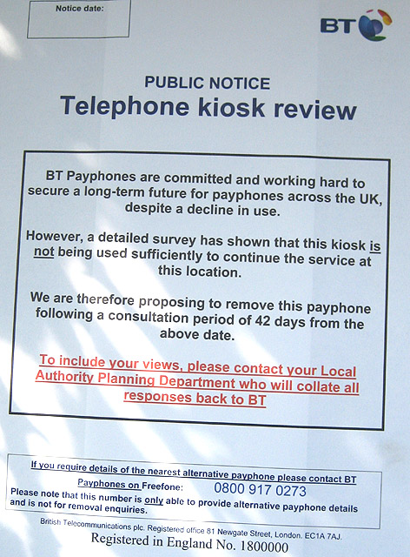
Use-It-Or-Lose-It
Photo by Pauline Eccles via Wikimedia Commons, CC-Attribution ShareAlike 2.0
Notes:
Highlight the 42 days.

Slide 24
The Packing Problem
>> subset(12, [2, 3, 4, 7, 10, 42])
True
>>> subset(8, [2, 3, 4, 7, 10, 42])
False
def subset(target, L):
Two inputs means two base cases!
Notes:
Subset(x, L): can we make exactly x by adding up elements of L?

Slide 25
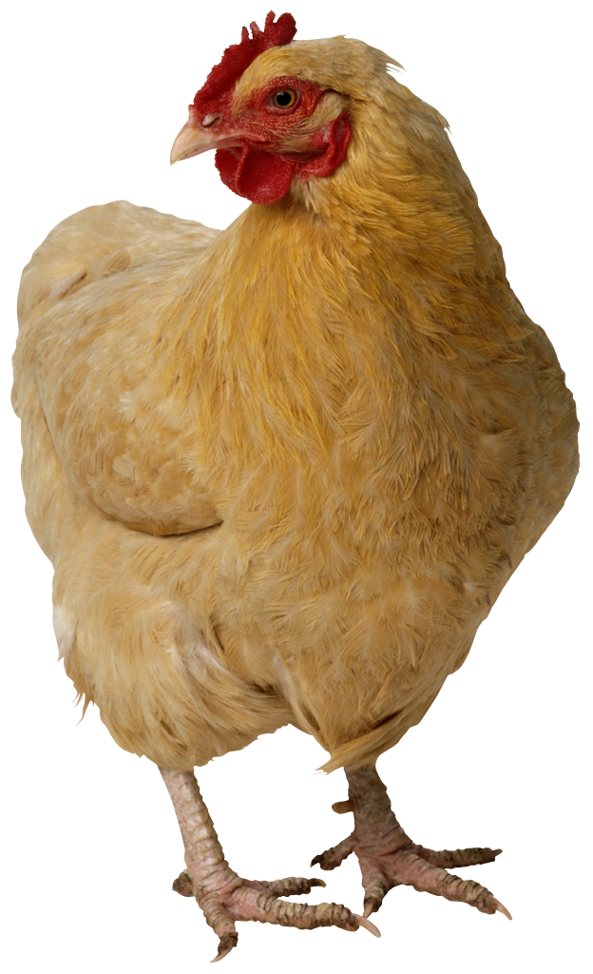
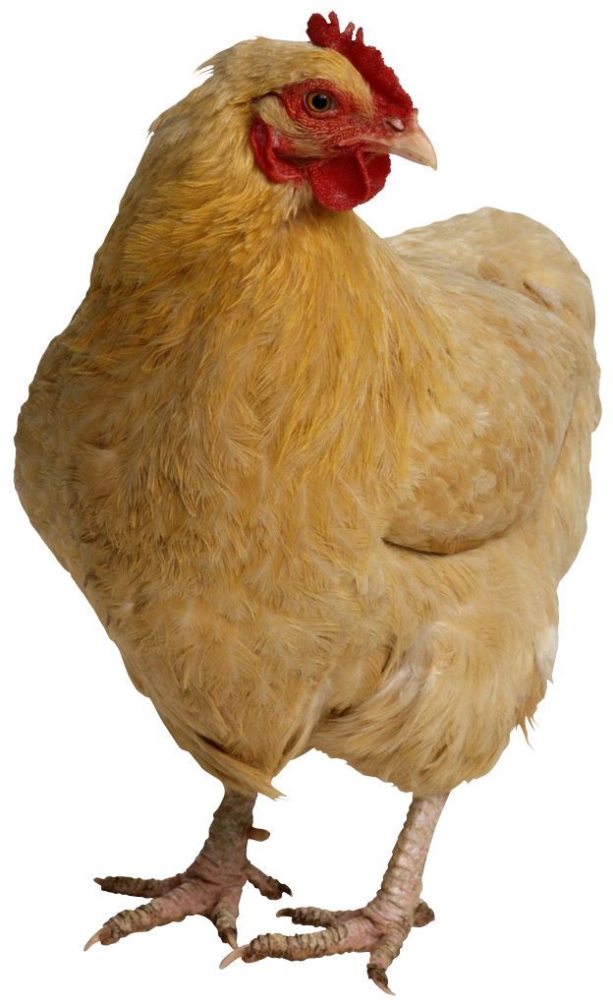
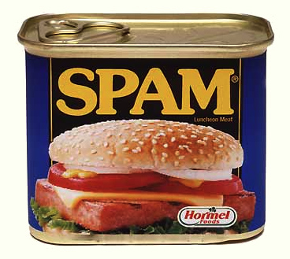
The Knapsack Problem…
Item Weight Value
Spam 2 100
Tofu 3 112
Chocolate 4 125
Knapsack Capacity: 5? 6? 7?
Kingdom of Shmorbodia
>>> knapsack(7, [[2, 100], [3, 112], [4, 125]])
237
Prof. I. Lai thinks that a “greedy solution” is the way to go!
Worksheet and Demo
Notes:
This is knapsack1 in lec04prog03-knapsack.py

Slide 26
The Knapsack Problem…
Item Weight Value
Spam 2 100
Tofu 3 112
Chocolate 4 125
Knapsack Capacity: 5? 6? 7?
Kingdom of Shmorbodia
def knapsack(limit, items):
if limit == 0 or items == []:
return 0
elif items[0][0] > limit:
return knapsack(limit, items[1:])
else:
useIt = knapsack(limit - items[0][0], items[1:]) \
+ items[0][1]
loseIt = knapsack(limit, items[1:])
return max(useIt, loseIt)
Notes:
This is knapsack1 in lec04prog03-knapsack.py. The slide has three animations: base 1, base 2, and use-it-or-lose-it.

Slide 27
The Knapsack Revisited…
Item Weight Value
Spam 2 100
Tofu 3 112
Chocolate 4 125
Knapsack Capacity: 5? 6? 7?
Kingdom of Shmorbodia
>>> knapsack(7, [[2, 100], [3, 112], [4, 125]])
[237, [[3, 112], [4, 125]]]
Notes:
This is knapsack2 in lec04prog03-knapsack.py. The return value is a “care package” that tells exactly how to get the weight of 7.

Slide 28
Power Set!
This really demonstrates the power of functional programming!
>>> powerset([1, 2])
[[], [2], [1], [1, 2]]
>>> powerset([1, 2, 3])
[[], [3], [2], [2, 3], [1], [1, 3], [1, 2], [1, 2, 3]]
>>> powerset([1])
>>> powerset([])
The order in which the subsets
are presented is unimportant
but within each subset, the
order should be consistent
with the input set.
Notes:
Demo is in lec04prog02-powerset.py

Slide 29
Power Set!
def powerset(L):
In your notes…
Notes:
Let them work on it first, then develop answer:
def powerset(L):
if L == []: return [[]]
else:
loseIt = powerset(L[1:])
useIt = list(map(lambda x: [L[0]] + x, loseIt))
return loseIt + useIt

Slide 30
Power Set!
def powerset(L):
'''powerset accepts a list and returns the LIST
of all sublists (subsets) of L.'''
if L == []:
return [[]]
loseIt = powerset(L[1:])
useIt = list(map(lambda x: [L[0]] + x, loseIt))
return loseIt + useIt
Notes:
This slide has four animations that develop the base case, the loseIt, the useIt, and the return.

Slide 31
Comparing DNA via Longest Common Subsequence (LCS)
AGGACAT
ATTACGAT
>>> LCS("AGGACAT", "ATTACGAT")
5
>>> LCS("spam", "sam!")
3
>>> LCS("spam", "xsam")
3
I prefer spam to an xsam!
Notes:
This is in lecture 5; no need to cover it today.

Slide 32
Recursive Approach…
def LCS(S1, S2):
if BASE CASE
else:
LCS("spam", "sam!")
Try this in your notes!
Solution follows

Slide 33
Recursive Approach…
def LCS(S1, S2):
if S1 == "" or S2 == "": return 0
else:
LCS("spam", "sam!")

Slide 34
Recursive Approach…
def LCS(S1, S2):
if S1 == "" or S2 == "": return 0
else:
if S1[0] == S2[0]: # DO THE FIRST SYMBOLS MATCH?
return 1 + ???
else:
LCS("spam", "sam!")

Slide 35
Recursive Approach…
def LCS(S1, S2):
if S1 == "" or S2 == "": return 0
else:
if S1[0] == S2[0]: # DO THE FIRST SYMBOLS MATCH?
return 1 + LCS(S1[1:], S2[1:])
else:
LCS("spam", "sam!")

Slide 36
Recursive Approach…
def LCS(S1, S2):
if S1 == "" or S2 == "": return 0
else:
if S1[0] == S2[0]: # DO THE FIRST SYMBOLS MATCH?
return 1 + LCS(S1[1:], S2[1:])
else:
return max(LCS(S1, S2[1:]), LCS(S1[1:], S2))
LCS("spam", "sam!")

