Slide 1
MAGIC!?
As close as CS gets to magic
a.k.a., CS's version of mathematical induction
Tutoring hours: LOTS!
Hw #2 due this Monday, 1/29, at 11:59 pm
This is the last CS 5 lecture you’ll ever "need"!*
HMC's legal counsel requires us to include these footnotes…
On Warner Brothers' insistence, we affirm that this 'C' does not stand for 'Chamber' and 'S' does not stand for 'Secrets.'
*
Caution: do not take this statement too literally or you might find yourself in twice as many CS 5 lectures as you need!
Notes:
INHANDOUT
If’s and recursion suffice to solve all problems (i.e., Turing-complete).
Have lec04prog01-funcs.py ready live in an ipython window and also in Code.

Slide 2
Python is… in
MAGIC!
>>> 'i' in 'team'
False
>>> 'cs' in 'physics'
True
I guess Python's the in thing
>>> 'i' in 'alien'
True
>>> 3*'i' in 'alien'
False
>>> 42 in [41,42,43]
True
>>> 42 in [[42], '42']
False

Slide 3
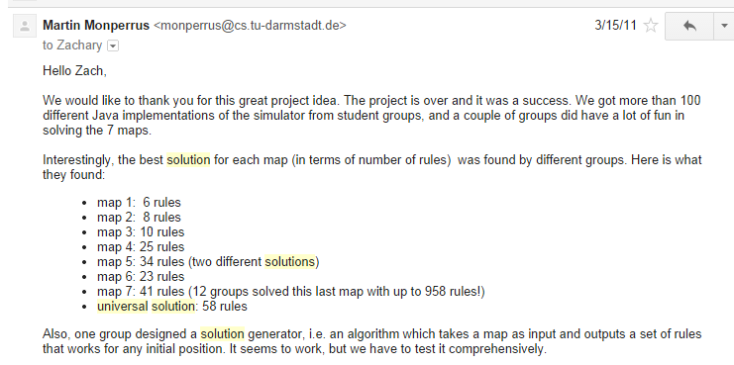
Picobot, Aargh!
+ "universal" solution…

Slide 4
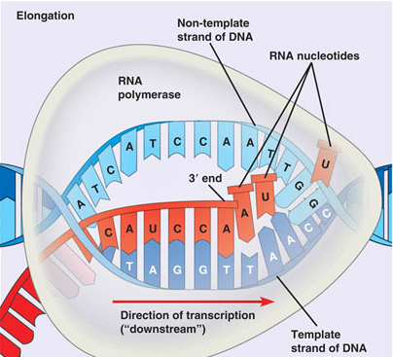
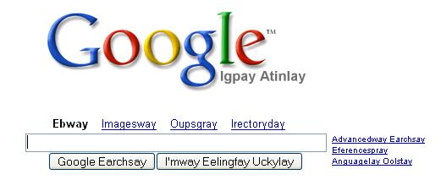
hw2
:
if you attended lab and submit pr1+pr2
you get full credit for hw2pr1 and hw2pr2
else
:
you should complete the two lab problems, pr1 + pr2
Is this Python??
either way: submit pr1 + pr2
complete and submit hw2pr3
Extra Credit: Pig Latin / CodingBat
DNA transcription
Notes:
DNA transcription is in problem 3 on HW

Slide 5
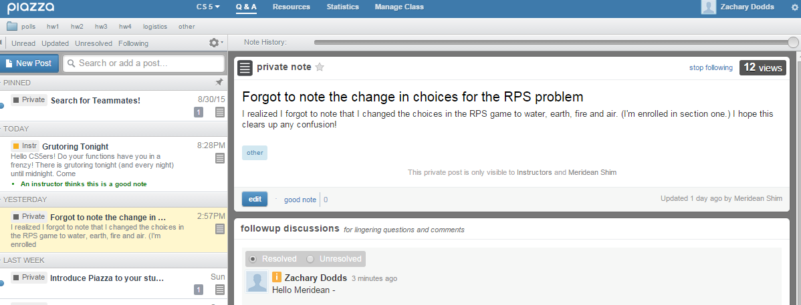
Piazza!
Questions?
+ add'l 4C grading
see online hours!

Slide 6
This week's reading on data…
Petabytes? This article is old-school!
Notes:
The article questions whether we need to build models or can we just use big data.

Slide 7
Python is… in
I guess Python's the in thing
>>> 'i' in 'team'
False
>>> 'cs' in 'physics'
True
>>> 'i' in 'alien'
True
>>> 3*'i' in 'alien'
False
>>> 42 in [41,42,43]
True
>>> 42 in [[42], '42']
False
Notes:
INHANDOUT

Slide 8
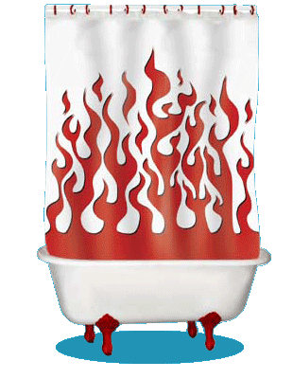
Computation's Dual Identity
Computation
Data Storage
41
42
name: x
type: int
LOC: 300
name: y
type: int
LOC: 304
memory location 300
memory location 304
variables ~ boxes
Last time
But what does the stuff on this side look like ?

Slide 9
Computation's Dual Identity
accessed through functions…
Computation
Data Storage
41
42
name: x
type: int
LOC: 300
name: y
type: int
LOC: 304
memory location 300
memory location 304
Functions!
variables ~ boxes
It's no coincidence this starts with fun!
Notes:
The picture is of Carly Rae Jepsen, who has a single named “Call Me Maybe”—cf. me_maybe as a demo function.
Demo functions. Start with me_maybe, show that it generates two outputs. Run x=42; me_maybe(x). This shows two ways information gets passed around (really 3: assignment, function call, print). Show that noargs doesn’t need an argument. Show that demo calls f, which ignores its argument.

Slide 10
Functioning across disciplines
procedure
structure
def g(x):
return x**100
g(x) = x¹⁰⁰
CS's googolizer
Math's googolizer
defined by what it does
defined by what it is
+ what follows behaviorally
+ what follows logically
Notes:
Math is about relationships; CS is procedural.

Slide 11
Giving names to data helps functions
def flipside(s):
"""flipside(s): swaps s's sides!
Argument s: a string
"""
x = len(s) // 2
return s[x:] + s[:x]
This idea is the key to your happiness!
Notes:
This was a lab problem. Here’s the answer.

Slide 12
Use variables!
I'm happy about this, too!
def flipside(s):
mid = len(s) // 2
return s[mid:] + s[:mid]
def flipside(s):
return s[len(s) // 2:] + s[:len(s) // 2]
Aargh!
Why would computers "prefer" the top version, too?
Notes:
INHANDOUT
The top version is clearer as well as being more efficient.
Show how to uncomment in Code with control-slash, then show how running lec3fun.py now runs print tests. The comment out again, break the code by chnaging // to -, and show how the assertions fail.

Slide 13
Test!
def flipside(s):
"""flipside(s): swaps s's sides!
input s: a string
"""
mid = len(s)/2
return s[mid:] + s[:mid]
#
# Tests!
#
assert flipside('homework') == "workhome"
assert flipside('carpets') == "petscar"
assert flipside('5!cs') == "cs5!"
(1) function definition
(2) function tests
We provide tests (for now…)

Slide 14
Using variables…
This program uses variables constantly!
def convertFromSeconds(s): # total seconds
"""convertFromSeconds(s): Converts an
integer # of seconds into a list of
[days, hours, minutes, seconds]
Argument s: an int
"""
days = s // (24*60*60) # total days
s = s % (24*60*60) # remainder s
hours = s // (60*60) # total hours
s = s % (60*60) # remainder s
minutes = s // 60 # total minutes
s = s % 60 # remainder s
return [days, hours, minutes, s]

Slide 15
Using variables…
This program uses variables constantly!
name
signature line
def convertFromSeconds(s): # total seconds
"""convertFromSeconds(s): Converts an
integer # of seconds into a list of
[days, hours, minutes, seconds]
input s: an int
"""
days = s // (24*60*60) # total days
s = s % (24*60*60) # remainder s
hours = s // (60*60) # total hours
s = s % (60*60) # remainder s
minutes = s // 60 # total minutes
s = s % 60 # remainder s
return [days, hours, minutes, s]
docstring
comments –these are mostly optional in CS 5
code block
return statement
Notes:
INHANDOUT
Show help(flipside) and help(demo).

Slide 16
return vs. print
def dbl(x):
"""dbls x?"""
return 2*x
def dblPR(x):
"""dbls x?"""
print(2*x)
In[1]: ans = dbl(20)
In[1]: ans = dblPR(20)
What's the difference ?!
Notes:
INHANDOUT
Show briefly, then to next slide.

Slide 17
return > print
def dbl(x):
"""dbls x?"""
return 2*x
def dblPR(x):
"""dbls x?"""
print(2*x)
In[1]: ans = dbl(20)+2
In[1]: ans = dblPR(20)+2
yes!
ouch!
print changes pixels on the screen...
… which the shell then prints!
return yields the function call's value …
Notes:
Show that ans is nothing at all (“ans” at Python prompt gives no result) and that ans + 2 breaks.

Slide 18
Name(s):
Quiz
15
How f‘uns work…
What is demo(15) here?
def demo(x):
y = x // 3
z = g(y)
return z + y + x
def g(x):
result = 4*x + 2
return result
I might have a guess at both of these…
What is f(2) here?
def f(x):
if x == 0:
return 12
else:
return f(x - 1) + 10 * x
Notes:
QUIZSLIDE

Slide 19
How functions work…
15
"the stack"
def demo(x):
y = x // 3
z = g(y)
return z + y + x
def g(x):
result = 4*x + 2
return result
they stack.

Slide 20
How functions work…
15
"the stack"
def demo(x):
y = x // 3
z = g(y)
return z + y + x
call: demo(15)
stack frame
local variables:
x = 15
y = 5
z = ?????
def g(x):
result = 4*x + 2
return result
they stack.

Slide 21
How functions work…
15
"the stack"
def demo(x):
y = x // 3
z = g(y)
return z + y + x
call: demo(15)
stack frame
local variables:
x = 15
y = 5
z = ?????
def g(x):
result = 4*x + 2
return result
call: g(5)
stack frame
local variables:
x = 5
result = 22
returns 22
they stack.
Notes:
INHANDOUT
Funcall g(x) “renames” y

Slide 22
How functions work…
15
"the stack"
def demo(x):
y = x // 3
z = g(y)
return z + y + x
call: demo(15)
stack frame
local variables:
x = 15
y = 5
z = ?????
def g(x):
result = 4*x + 2
return result
call: g(5)
stack frame
local variables:
x = 5
result = 22
returns 22
they stack.

Slide 23
How functions work…
15
"the stack"
def demo(x):
y = x // 3
z = g(y)
return z + y + x
call: demo(15)
stack frame
local variables:
x = 15
y = 5
z = 22
def g(x):
result = 4*x + 2
return result
they stack.

Slide 24
How functions work…
15
"the stack"
def demo(x):
y = x // 3
z = g(y)
return z + y + x
call: demo(15)
stack frame
local variables:
x = 15
y = 5
z = 22
return 42
def g(x):
result = 4*x + 2
return result
they stack.

Slide 25
How functions work…
15
"the stack"
42
def demo(x):
y = x // 3
z = g(y)
return z + y + x
afterwards, the stack is empty…, but ready if another function is called
output
def g(x):
result = 4*x + 2
return result
they stack.

Slide 26
How functions work…
2
what's f(2) ?
"the stack"
def f(x):
if x == 0:
return 12
else:
return f(x - 1) + 10*x

Slide 27
How functions work…
2
"the stack"
def f(x):
if x == 0:
return 12
else:
return f(x - 1) + 10*x
call: f(2)
stack frame
local variables:
x = 2
need f(1)

Slide 28
How functions work…
1
"the stack"
def f(x):
if x == 0:
return 12
else:
return f(x - 1) + 10*x
call: f(2)
stack frame
local variables:
x = 2
need f(1)
call: f(1)
stack frame
local variables:
x = 1
need f(0)

Slide 29
How functions work…
0
"the stack"
def f(x):
if x == 0:
return 12
else:
return f(x - 1) + 10*x
call: f(2)
stack frame
local variables:
x = 2
need f(1)
call: f(1)
stack frame
local variables:
x = 1
need f(0)
call: f(0)
stack frame
local variables:
x = 0
returns 12

Slide 30
How functions work…
0
"the stack"
def f(x):
if x == 0:
return 12
else:
return f(x - 1) + 10*x
call: f(2)
stack frame
local variables:
x = 2
need f(1)
call: f(1)
stack frame
local variables:
x = 1
need f(0)
call: f(0)
stack frame
local variables:
x = 0
returns 12
Notes:
INHANDOUT

Slide 31
How functions work…
1
"the stack"
def f(x):
if x == 0:
return 12
else:
return f(x - 1) + 10*x
call: f(2)
stack frame
local variables:
x = 2
need f(1)
call: f(1)
stack frame
local variables:
x = 1
f(0) = 12
result =
How do we compute the result?

Slide 32
How functions work…
1
"the stack"
def f(x):
if x == 0:
return 12
else:
return f(x - 1) + 10*x
call: f(2)
stack frame
local variables:
x = 2
need f(1)
call: f(1)
stack frame
local variables:
x = 1
f(0) = 12
result = 22
Where does that result go?

Slide 33
How functions work…
1
"the stack"
def f(x):
if x == 0:
return 12
else:
return f(x - 1) + 10*x
call: f(2)
stack frame
local variables:
x = 2
need f(1)
call: f(1)
stack frame
local variables:
x = 1
f(0) = 12
result = 22

Slide 34
How functions work…
2
"the stack"
def f(x):
if x == 0:
return 12
else:
return f(x - 1) + 10*x
call: f(2)
stack frame
local variables:
x = 2
f(1) = 22
result =
What's this return value?

Slide 35
How functions work…
2
"the stack"
def f(x):
if x == 0:
return 12
else:
return f(x - 1) + 10*x
call: f(2)
stack frame
local variables:
x = 2
f(1) = 22
result = 42
which then gets returned…

Slide 36
How functions work…
2
"the stack"
def f(x):
if x == 0:
return 12
else:
return f(x - 1) + 10*x
call: f(2)
stack frame
local variables:
x = 2
f(1) = 22
result = 42
the result then gets returned…

Slide 37
How functions work…
2
42
"the stack"
def f(x):
if x == 0:
return 12
else:
return f(x - 1) + 10*x
output
again, the stack is empty, but ready if another function is called…
Functions are like cells: software's building blocks…
… each one, a self-contained computational unit!
functions stack.
Notes:
This slide has a popup.

Slide 38
function design

Slide 39
Thinking sequentially
factorial
5 ! = 120
math
March & beyond…
fac(5) = 5 * 4 * 3 * 2 * 1
CS
fac(N) = N * (N-1) * … * 3 * 2 * 1
Notes:
This slide has a popup.

Slide 40
Thinking recursively
factorial
5 ! = 120
fac(5) = 5 * 4 * 3 * 2 * 1
fac(5) =
can we express fac w/ a smaller version of itself?
fac(N) = N * (N-1) * … * 3 * 2 * 1
fac(N) =
Notes:
INHANDOUT
Note that 4*3*2*1 is 4!

Slide 41
Thinking recursively
Recursion ~ self-similarity
factorial
5 ! = 120
fac(5) = 5 * 4 * 3 * 2 * 1
fac(5) = 5 * fac(4)
can we express fac w/ a smaller version of itself?
fac(N) = N * (N-1)* … * 3 * 2 * 1
fac(N) = N * fac(N-1)

Slide 42
overall goal
fac(5)
output value of 5*4*3*2*1
Recursion, the process
fac(5)
starting from 5, decreasing to 1
5 * 4 * 3 * 2 * 1
integers from 5 down to 1, multiplied together
fac(5)
Notes:
recursion—seems like magic
Gilderoy Lockhart [why?]

Slide 43
overall goal
fac(5)
output value of 5*4*3*2*1
is
fac(5)
overall goal
value of 5
output value of 4*3*2*1
*
combined with
fac(4)
one, small piece
self-similar "rest"
Recursion, the process
Notes:
The key conceptual leap: the small green box is the same as the large one—but seeing the levels can be tricky.

Slide 44
overall goal
fac(N)
output value of N*(N-1)*...*2*1
is
fac(N)
overall goal
value of N
output value of (N-1)*...*2*1
*
combined with
fac(N-1)
one, small piece
self-similar "rest"
Recursion, the process

Slide 45
Recursion's conceptual challenge?
You need to see BOTH the self-similar pieces AND the whole thing simultaneously!
Nature loves recursion!

Slide 46
overall goal
fac(N)
output value of N*(N-1)*...*2*1
is
fac(N)
overall goal
value of N
output value of (N-1)*...*2*1
*
combined with
fac(N-1)
one, small piece
self-similar "rest"
fac(N)
Recursion, the code!

Slide 47
Warning: this is legal!
def facBad(N):
return N * facBad(N - 1)
I wonder how this code will STACK up!?
Notes:
Was that Gandalf or Dumbledore that "fell forever" ?
Run facBad (note that it has print and sleep) and show infinite recursion

Slide 48
legal != recommended
def facBad(N):
return N * facBad(N - 1)
calls to facBad will never stop: there's no BASE CASE
Make sure you have a base case
a.k.a. "escape hatch"
How about an escape from recursion itself!?!
Notes:
For fun, Google “recursion” and then click on “did you mean recurision”.

Slide 49
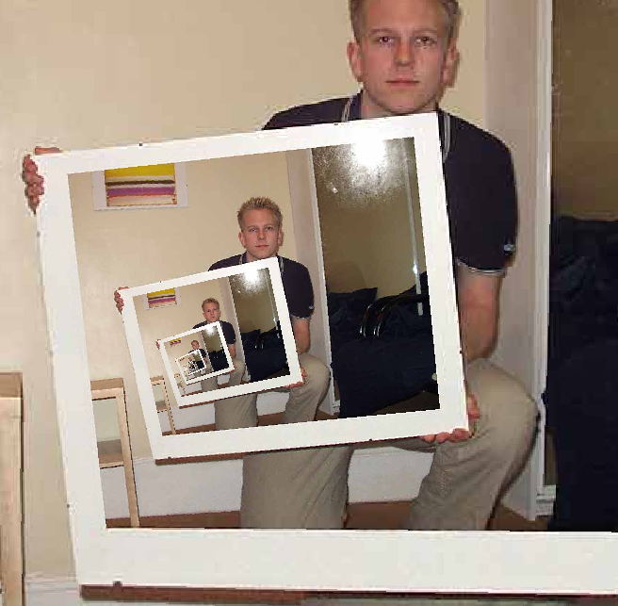
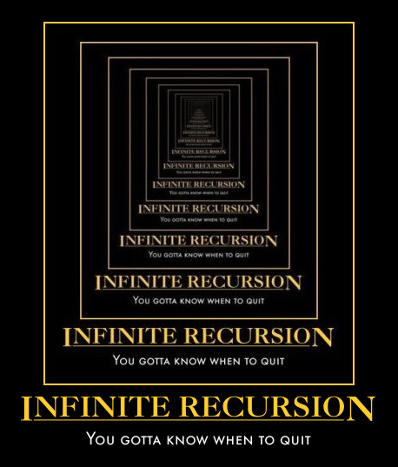
This "works" ~ but doesn't work!
def fac(N):
return fac(N)
Recursion
the dizzying dangers of having no base case!
Notes:
On the left is an animated SWF of infinite recursion. However, it doesn’t open as of 1/2018.

Slide 50
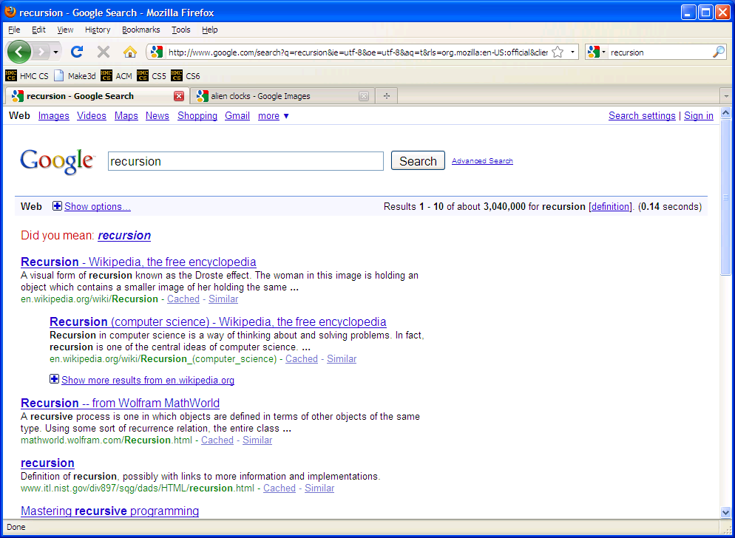
Notes:
Demo that clicking “recursion” takes you to the same page.

Slide 51
overall goal
fac(N)
Result of
N*(N-1)*...*2*1
is
fac(N)
overall goal
value of N
Result of
(N-1)*...*2*1
*
combined with
fac(N-1)
one, small piece
self-similar "rest"
fac(N)
base case:
output for fac(0) is 1
smallest possible argument
its result
Notes:
INHANDOUT

Slide 52
Thinking recursively...
def fac(N):
if N == 0:
return 1
else:
return N * fac(N-1)
Base case
Recursive case
(too short?)
Notes:
INHANDOUT
The base case is an “escape hatch.” Always put the base case first.

Slide 53
Acting recursively
def fac(N):
if N <= 1:
return 1
else:
return N*fac(N-1)
def fac(N):
if N <= 1:
return 1
else:
rest = fac(N-1)
return N*rest
this recursion happens first!
hooray for variables!
Conceptual
Actual
Notes:
The right side is a better explanation of what happens.

Slide 54
Behind the curtain:
how recursion works...
def fac(N):
if N <= 1:
return 1.0
else:
return N * fac(N-1)
fac(5)
5 * fac(4)
4 * fac(3)
3 * fac(2)
2 * fac(1)
1.0

Slide 55
Behind the curtain:
how recursion works...
def fac(N):
if N <= 1:
return 1.0
else:
return N * fac(N-1)
fac(5)
5 * fac(4)
stack frame with N = 5
4 * fac(3)
stack frame with N = 4
3 * fac(2)
stack frame with N = 3
2 * fac(1)
stack frame with N = 2
1.0
stack frame with N = 1

Slide 56
Behind the curtain:
how recursion works...
def fac(N):
if N <= 1:
return 1.0
else:
return N * fac(N-1)
fac(5)
5 * fac(4)
stack frame with N = 5
4 * fac(3)
stack frame with N = 4
3 * fac(2)
stack frame with N = 3
2 * 1.0
stack frame with N = 2

Slide 57
Behind the curtain:
how recursion works...
def fac(N):
if N <= 1:
return 1.0
else:
return N * fac(N-1)
fac(5)
5 * fac(4)
stack frame with N = 5
4 * fac(3)
stack frame with N = 4
3 * 2.0
stack frame with N = 3

Slide 58
Behind the curtain:
how recursion works...
def fac(N):
if N <= 1:
return 1.0
else:
return N * fac(N-1)
fac(5)
5 * fac(4)
stack frame with N = 5
4 * 6.0
stack frame with N = 4

Slide 59
Behind the curtain:
how recursion works...
def fac(N):
if N <= 1:
return 1.0
else:
return N * fac(N-1)
fac(5)
5 * 24.0
stack frame with N = 5

Slide 60
Behind the curtain:
how recursion works...
def fac(N):
if N <= 1:
return 1.0
else:
return N * fac(N-1)
fac(5)
complete!
120.0

Slide 61
Behind the curtain:
how recursion works...
def fac(N):
if N <= 1:
return 1.0
else:
return N * fac(N-1)
fac(5)
complete!
120.0
Recursion, the design process

Slide 62
Recursive Design: the 3 i's
Eye approve!
identify
self-similarities & base cases
intuition
implement

Slide 63
Recursive Design: the 3 i's
Eye approve!
What's the self-similarity?
Examples!
identify
self-similarities & base cases
Python...
intuition
implement
Notes:
INHANDOUT

Slide 64
overall goal
fac(5)
output value of 5*4*3*2*1
fac(5)
starting from 5, decreasing to 1
Examples!
5*4*3*2*1
integers from 5 down to 1, multiplied together
fac(5)
Notes:
When generating examples, try concrete data.

Slide 65
overall goal
fac(5)
output value of 5*4*3*2*1
is
fac(5)
overall goal
value of 5
output value of 4*3*2*1
*
combined with
fac(4)
one, small piece
self-similar "rest"
Examples!
What's the self-similarity?
Notes:
INHANDOUT

Slide 66
overall goal
fac(N)
output value of N*(N-1)*...*2*1
is
fac(N)
What's the self-similarity?
overall goal
value of N
output value of (N-1)*...*2*1
*
combined with
fac(N-1)
one, small piece
self-similar "rest"
What's the base case?
base case:
output for fac(0) is 1
smallest possible argument
its result
Notes:
INHANDOUT

Slide 67
Python...
def fac(N):
if N <= 1:
return 1
else:
return N * fac(N-1)
Base case
Recursive case
(too short?)

Slide 68
Recursive Design: the 3 i's
Aye, aye, eye!
rec.
fac(5) is 5*4*3*2*1
fac(N) is N*fac(N-1)
rec.
self-similarities
fac(4) is 4*3*2*1
fac(3) is 3*2*1
identify
base cases
base cases
self-similarities & base cases
fac(2) is 2*1
fac(1) is 1
base case
def fac(N):
if N <= 1:
return 1.0
else:
return N * fac(N-1)
fac(0) is 1
rec.
base case(s)
intuit
implement
Notes:
INHANDOUT
Note: It’s best to put the base case first.

Slide 69
Recursive Design: the 3 i's
rec.
fac(5) is 5*4*3*2*1
fac(N) is N*fac(N-1)
rec.
self-similarities
fac(4) is 4*3*2*1
It’s best to put the base case first
fac(3) = 3*2*1
identify
base cases
base cases
self-similarities & base cases
fac(2) = 2*1
fac(1) = 1
rec.
def fac(N):
if N > 0:
return N * fac(N-1)
else:
return 1.0
fac(0) is 1
base case(s)
base case
intuit
implement

Slide 70
Recursive Design: the 3 i's
rec.
fac(5) is 5*4*3*2*1
fac(N) is N*fac(N-1)
rec.
self-similarities
Let's try two more examples together – and then try 2-3 on your own...
fac(4) is 4*3*2*1
fac(3) = 3*2*1
identify
base cases
base cases
self-similarities & base cases
fac(2) = 2*1
fac(1) = 1
rec.
def fac(N):
if N > 0:
return N * fac(N-1)
else:
return 1.0
fac(0) is 1
base case(s)
base case
intuit
implement

Slide 71
Recursive Design: the 3 i's
rec.
plusone(4) is 1+1+1+1
plusone(N)
recursion?
self-similarities
plusone(3) is 1+1+1
plusone(2) is 1+1
identify
base cases
base cases
self-similarities & base cases
plusone(1) is 1
plusone(0) is 0
base case
def plusone(N):
if _______:
return ___
else:
return ______________
rec.
base case(s)
intuit
implement
Notes:
INHANDOUT

Slide 72
overall goal
plusone(4)
output value of 1+1+1+1
plusone(4)
4 times
1+1+1+1
+1 added together, 4 times
plusone(4)

Slide 73
overall goal
plusone(4)
output value of 1+1+1+1
is
plusone(4)
overall goal
value of 1
output value of 1+1+1
+
combined with
plusone(3)
one, small piece
self-similar "rest"
example with concrete values

Slide 74
overall goal
plusone(N)
output value of 1+1+...+1
is
plusone(N)
overall goal
value of 1
output value of 1+...+1
+
combined with
plusone(N-1)
one, small piece
self-similar "rest"
base case:
output of plusone(0) is 0
smallest possible argument
its result

Slide 75
Recursive Design: the 3 i's
rec.
plusone(4) is 1+1+1+1
plusone(N)
recursion?
self-similarities
plusone(3) is 1+1+1
plusone(2) is 1+1
identify
base cases
base cases
self-similarities & base cases
plusone(1) is 1
plusone(0) is 0
base case
def plusone(N):
if _______:
return ___
else:
return ______________
rec.
base case(s)
intuit
implement
Notes:
INHANDOUT

Slide 76
Recursive Design: the 3 i's
rec.
plusone(4) is 1+1+1+1
plusone(N) is 1 + plusone(N-1)
recursion?
self-similarities
plusone(3) is 1+1+1
plusone(0) is 0
plusone(2) is 1+1
identify
base cases
base cases
self-similarities & base cases
plusone(1) is 1
plusone(0) is 0
base case
def plusone(N):
if N == 0:
return 0
else:
return 1 + plusone(N-1)
rec.
base case(s)
intuit
implement

Slide 77
Recursive Design: leng(L)
rec.
leng([5, 42, 7]) is 3
leng(L)
recursion?
self-similarities
leng([42, 7]) is 2
leng([7]) is 1
identify
base cases
base cases
self-similarities & base cases
leng([ ]) is 0
base case
def leng(L):
if ______________:
return ___
else:
return ______________
base case(s)
rec.
leng( 'and me?' )
intuit
implement
Notes:
INHANDOUT
Have them ID the relationships between lists. Then introduce faith.

Slide 78
Recursive Design: leng(L)
rec.
leng([5, 42, 7]) is 3
leng(L) is 1 + leng(L[1:])
recursion?
self-similarities
leng([42, 7]) is 2
leng([ ]) is 0
leng('') is 0
leng([7]) is 1
identify
base cases
base cases
self-similarities & base cases
leng([ ]) is 0
base case
def leng(L):
if L == [] or L == '':
return 0
else:
return 1 + leng(L[1:])
base case(s)
rec.
leng( 'and me?' )
intuit
implement

Slide 79
Design patterns…
Recursion's a design—not a formula, BUT, these pieces are common:
Handle base cases, with if …
Do one piece of work: L[0] or s[0]
Recur with the rest: L[1:] or s[1:]
Combine & make sure the types match!
Notes:
INHANDOUT
Faith-based programming!

Slide 80
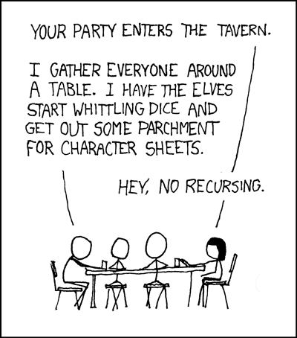
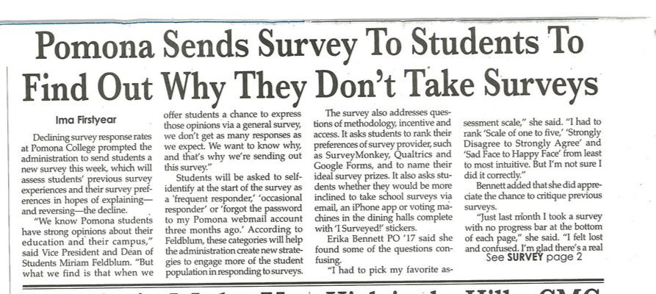
Recursion's advantage:
It handles arbitrary structural depth—all at once & on its own!
As a hat, I'm recursive, too!
Notes:
The Dr. Strange movie had recursion. Also “Inception”—dreams can have dreams; top-right image is youtube “hallway fight”. Also a link giving how the fight scenes were filmed. Class loves it.

Slide 81
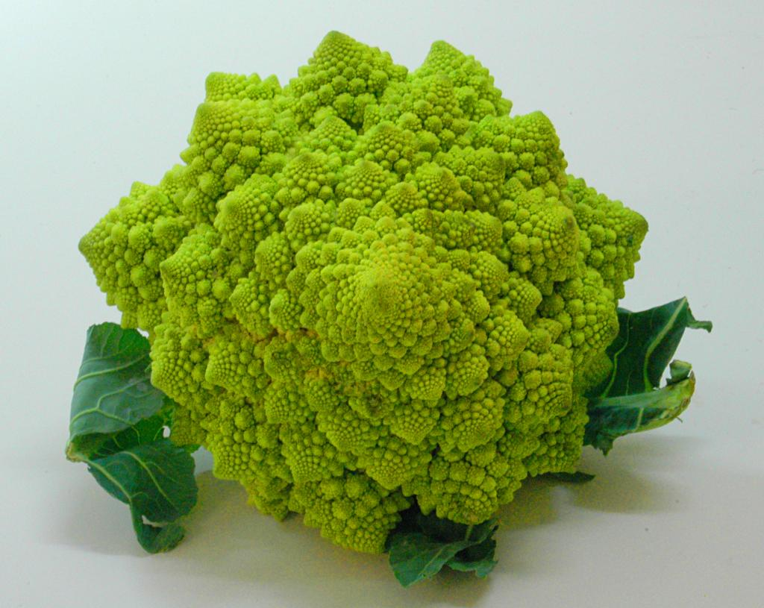
romanesco broccoli

Slide 82
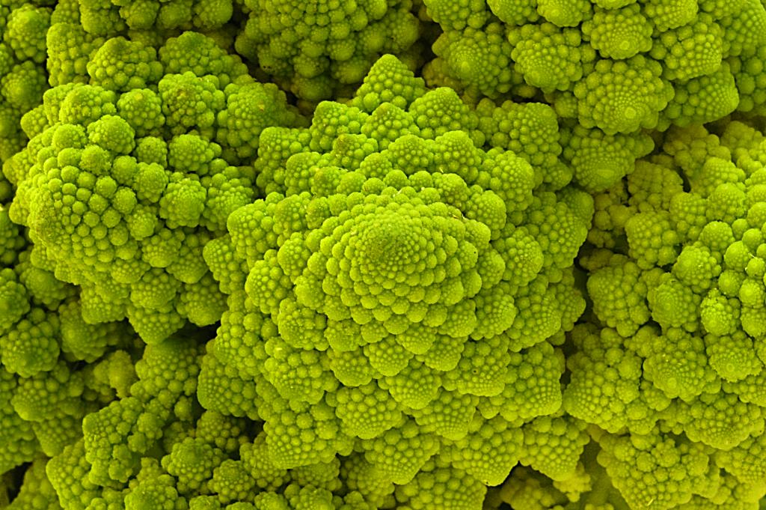
Are these rules for real?
Yes... and no.

Slide 83
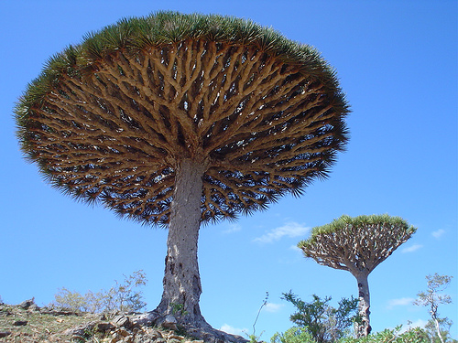
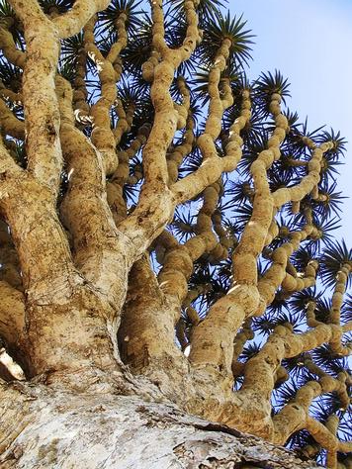
Dragon's-blood Tree

Slide 84
There still has to be a base case…

Slide 85
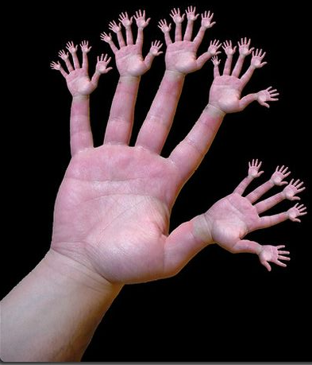
or else!

Slide 86
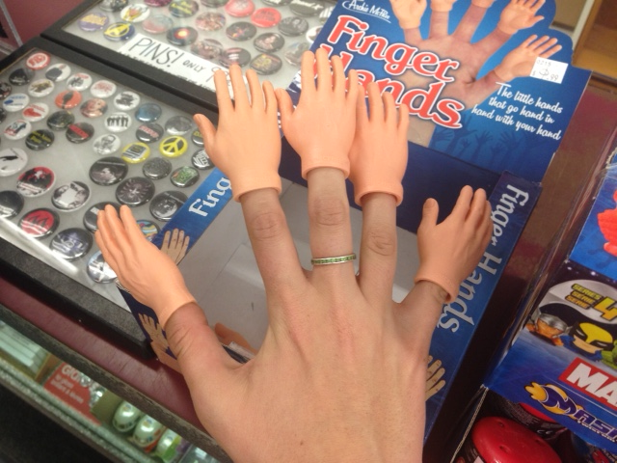
or one layer up!?
Notes:
A student found these finger tips. There’s some evidence that the same evolutionary/biological process that produces five fingers produces the five “fingers” of arms, legs, and head.

Slide 87
pow(b, p)
pow(b, p)
returns b**p, but using only multiplication times b
pow(2, 4) ~ 2*2*2*2
pow(b, p)
= 16
self-similarities
pow(2, 3) ~ 2*2*2
= 8
identify
base cases
self-similarities & base cases
pow(2, 2) ~ 2*2
def pow(b, p):
if ________:
return ____
else:
return _____________
pow(2 ,1) ~ 2
pow(2, 0) ~ 1
anything to the zero power is 1.0
intuit
Extra! See if you can also handle negative powers...
implement
Notes:
INHANDOUT
Show pow; vwl('computerscience'); mymax; zeroest([4, -3, 42])

Slide 88
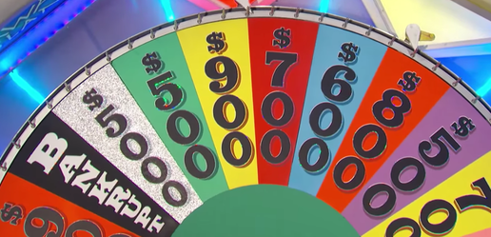
vwl(s)
vwl(s)
returns the number of vowels in the string s, s may or may not be empty.
let's count y!
vwl('crazy') ~ 2
IF
vwl(s)
vwl('razy') ~ 2
IF
self-similarities
vwl('azy') ~ 2
multiple possibilities!
identify
vwl('zy') ~ 1
base cases
self-similarities & base cases
vwl('y') ~ 1
def vwl(s):
if
elif
else:
vwl('') ~ 0
What is the really simplest base case!?
intuit
Extra! What 7-letter English word maximizes vwl(s) ?
implement
Notes:
INHANDOUT
Answer to extra: there are a lot: aeolian alienee amoebae aquaria aqueous aureate aureola aureole aurorae Boeotia dequeue enqueue Eugenia Eurasia evacuee nouveau Oceania ouabain queue's rouleau sequoia uraemia. If you include the obscure words from english.3, there are 40.

Slide 89
Answer: pow
pow(b,p)
return b**p, but using only multiplication times b
pow(2, 4) ~ 2*2*2*2
pow(b, p) = pow(b, p-1) * b
= 16
self-similarities
pow(2, 3) ~ 2*2*2
= 8
pow(b, 0) = 1.0
identify
base cases
self-similarities & base cases
pow(2, 2) ~ 2*2
def pow(b, p):
if p == 0:
return 1.0
else:
return pow(b ,p-1) * b
pow(2, 1) ~ 2
pow(2, 0) ~ 1
anything to the zero power is 1.0
intuit
Extra! See if you can also handle negative powers...
implement

Slide 90
Answer: vwl
vwl(s)
return the number of vowels in the string s, s may or may not be empty.
let's count y!
vwl('crazy') ~ 2
vwl(s[1:]), if s[0] is not a vowel
1 + vwl(s[1:]), if s[0] is a vowel
vwl(s) =
vwl('razy') ~ 2
self-similarities
vwl('azy') ~ 2
vwl( '' ) = 0
identify
vwl('zy') ~ 1
base cases
self-similarities & base cases
vwl('y') ~ 1
def vwl(s):
if s == '':
return 0
elif s[0] in 'aeiouy':
return 1 + vwl(s[1:])
else:
return 0 + vwl(s[1:])
vwl('') ~ 0
What is the really simplest base case!?
intuit
Extra! What 7-letter English word maximizes vwl(s) ?
implement

Slide 91
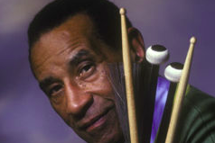
max(L)
max(L)
return the biggest element in L, given that L has at least one element!
max([9, 8 ,5]) ~ 9
max(L)
max([8, 5]) ~ 8
self-similarities
identify
base cases
self-similarities & base cases
max([2 ,8, 5]) ~ 8
def max(L):
max([8, 5]) ~ 8
max([5]) ~ 5
intuit
implement
Notes:
INHANDOUT

Slide 92
zeroest(L)
zeroest(L)
return the element of L closest to 0; L will have at least one element
Consider these examples:
zeroest(L)
zeroest([4, -3, 42]) ~ -3
self-similarities
zeroest([1, -3, 42]) ~ 1
identify
base cases
self-similarities & base cases
def zeroest(L):
zeroest([-3, 42]) ~ -3
zeroest([42]) ~ 42
don't forget the base case!
intuit
Note: The function abs is built into Python….
implement
Notes:
INHANDOUT

Slide 93
The key to understanding recursion is, first, to understand recursion.
- former CS 5 student
It's the eeriest!
Good luck with Homework #1
tutors @ LAC + 4C's Th/F/Sa/Su/M/Tu/We

Slide 94
Answer: max
max(L)
return the biggest element in L, given that L has at least one element!
max([9, 8, 5]) ~ 9
L[0], if L[0] > max(L[1:])
max(L[1:]), otherwise
max(L) is
max([8, 5]) ~ 8
self-similarities
max(L) is L[0]
identify
base cases
if len(L) == 1
self-similarities & base cases
max([2, 8, 5]) ~ 8
def max(L):
if len(L) == 1:
return L[0]
elif L[0] > max(L[1:])
return L[0]
else:
return max(L[1:])
max([8, 5]) ~ 8
max([5]) ~ 5
intuit
implement

Slide 95
zeroest(L)
zeroest(L)
return the element of L closest to 0; L will have at least one element
Consider these examples:
L[0], if abs(L[0]) < abs(zeroest(L[1:]))
zeroest(L[1:]), otherwise
zeroest([4,-3,42]) ~ -3
zeroest(L)
self-similarities
self-similarities
zeroest(L) is L[0]
zeroest([1,-3,42]) ~ 1
identify
base cases
if len(L) == 1
self-similarities & base cases
def zeroest(L):
if len(L) == 1:
return L[0]
rest = zeroest(L[1:])
if abs(L[0]) < abs(rest):
return L[0]
else:
return rest
zeroest([-3,42]) ~ -3
zeroest([42]) ~ 42
don't forget the base case!
intuit
Note: The function abs is built-in to Python….
implement

