Slide 1
The CS 5 Times
Arts: New band “The Recursions” performs songs from
first album on first album.
Sports: HMC Web surfing team advances to Nationals
“Zach and Geoff
to be Replaced by
Two Penguins,” says HMC Dean
Claremont(AP): Beginning next week, CS 5 will be taught by a pair of penguins, announced an HMC dean. “Penguins are very smart,” said the dean, “and they are also quite adorable, which is more than we can say about the CS 5 faculty. Plus, we won’t need to heat their offices in the winter.”
Photos of the two new
CS 5 penguin professors
Notes:
Setup: pull lec05prog01-turtle.py into Python in the console window, type clear() to activate the drawing window, and position the drawing window so it will show.

Slide 2
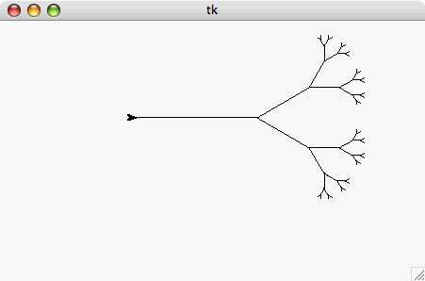
This Week
Homework 2:
Reading on AI and Jeopardy
Lab: Fractal art
Problem 2: Groodies
Problem 3: Sorting
Problem 4: Giigle Maps
You’re ready
for this today!
You’re ready
for this today!
Thursday!
Optional BONUS problem

Slide 3
Speaking of Illness…
Please e-mail the prof as soon as you feel bad!

Slide 4
Comparing DNA via Longest Common Subsequence (LCS)
AGGACAT
ATTACGAT
>>> LCS(“AGGACAT”, “ATTACGAT”)
5
>>> LCS(“can”, “man!”)
2

Slide 5
Recursive Approach…
def LCS(s1, s2):
if BASE CASE:
???
else:
LCS(“spam”, “sam!”)

Slide 6
Recursive Approach…
def LCS(s1, s2):
if s1 == "" or s2 == "":
return 0
else:
LCS(“spam”, “sam!”)
Notes:
We know that there’s at least a 1-length LCS here. It would be handy if there was a function that would tell us the LCS of the rest of the string, since then the LCS is 1 greater than that.

Slide 7
Recursive Approach…
def LCS(s1, s2):
if s1 == "" or s2 == "":
return 0
else:
if s1[0] == s2[0]: # DO THE FIRST SYMBOLS MATCH?
return 1 + ???
else:
LCS(“spam”, “sam!”)
Notes:
We know that there’s at least a 1-length LCS here. It would be handy if there was a function that would tell us the LCS of the rest of the string, since then the LCS is 1 greater than that.

Slide 8
Recursive Approach…
def LCS(s1, s2):
if s1 == "" or s2 == "":
return 0
else:
if s1[0] == s2[0]: # DO THE FIRST SYMBOLS MATCH?
return 1 + LCS(s1[1:], s2[1:])
else:
LCS(“spam”, “sam!”)
Finish this on your worksheet!
Solution follows

Slide 9
Recursive Approach…
def LCS(s1, s2):
if s1 == "" or s2 == "":
return 0
else:
if s1[0] == s2[0]: # DO THE FIRST SYMBOLS MATCH?
return 1 + LCS(s1[1:], s2[1:])
else:
return max(LCS(s1, s2[1:]), LCS(s1[1:], s2))
LCS(“spam”, “sam!”)
What does it actually do when it runs?
Notes:
Note that this is actually use-it-or-lose-it, just on one line.

Slide 10
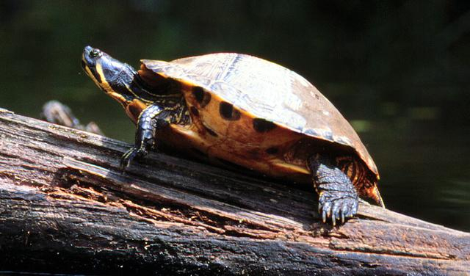
Turtle Graphics
forward(100)
right(90)

Slide 11
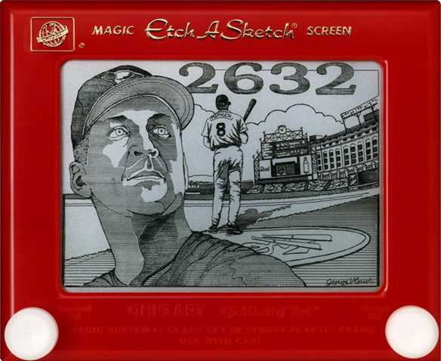
Etch-a-Sketch craziness…
No way this is real…
except that it is !
Notes:
This is Cal Ripken, Jr., who played in 2,632 consecutive major-league games to break Lou Gehrig's previous "Iron Man" record of 2,130. He voluntarily ended the streak after reaching 2,632. The drawing is by George Vlosich, "The world's greatest Etch-a-Sketch artist," who takes 70-80 hours to complete a work.

Slide 12
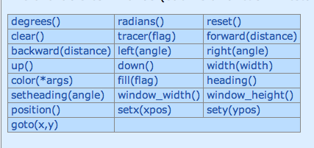
Turtle Graphics
Turtle graphics are built into Python!
>>> import turtle
>>> turtle.forward(50)
>>> turtle.right(90)
>>> turte.backward(50)
Problem 2 has a link to the turtle documentation

Slide 13
Fractals
Notes:
On the left, each part of the fern is in fact a duplicate of the larger fern. Likewise for the tree on the right!

Slide 14
“I Wonder About Trees” – Robert Frost
“We wonder about Robert Frost” - Trees
>>> svTree(128, 6)
Notes:
svTree stands for "side view of tree"

Slide 15
trunk length
recursion level
>>> svTree(100, 3)

Slide 16
trunk length
recursion level
>>> svTree(100, 3)
100 long!

Slide 17
trunk length
recursion level
>>> svTree(100, 3)
svTree(50, 2)
100 long!

Slide 18
trunk length
recursion level
>>> svTree(100, 3)
svTree(50, 2)
100 long!

Slide 19
trunk length
recursion level
>>> svTree(100, 3)
svTree(25, 1)
svTree(50, 2)
100 long!

Slide 20
trunk length
recursion level
>>> svTree(100, 3)
svTree(25, 1)
svTree(50, 2)
100 long!

Slide 21
trunk length
recursion level
>>> svTree(100, 3)
svTree(25, 1)
svTree(50, 2)
100 long!

Slide 22
trunk length
recursion level
>>> svTree(100, 3)
svTree(25, 1)
svTree(50, 2)
100 long!

Slide 23
trunk length
recursion level
>>> svTree(100, 3)
svTree(25, 1)
svTree(50, 2)
100 long!

Slide 24
trunk length
recursion level
>>> svTree(100, 3)
svTree(25, 1)
svTree(50, 2)
100 long!

Slide 25
trunk length
recursion level
>>> svTree(100, 3)
svTree(25, 1)
svTree(50, 2)
100 long!

Slide 26
trunk length
recursion level
>>> svTree(100, 3)
svTree(25, 1)
svTree(50, 2)
100 long!

Slide 27
trunk length
recursion level
>>> svTree(100, 3)
svTree(25, 1)
svTree(50, 2)
100 long!

Slide 28
trunk length
recursion level
>>> svTree(100, 3)
svTree(25, 1)
svTree(50, 2)
100 long!

Slide 29
trunk length
recursion level
>>> svTree(100, 3)
svTree(25, 1)
svTree(50, 2)
100 long!

Slide 30
The Alien's Life Advice
Help the person sitting next to you
…or let them help you!

Slide 31
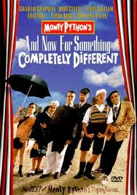
And now for something completely different…
(…or at least it will seem different until we see that it’s not!)

Slide 32
Tuples (“Immutable Lists”)
>>> foo = (42, 'hello', (5, 'spam'), 'penguin')
>>> foo
(42, 'hello', (5, 'spam'), 'penguin')
>>> foo[0]
42
>>> foo[-1]
'penguin'
>>> foo[0:2]
(42, 'hello')
>>> foo[0:1]
(42,)

Slide 33
Tuples (“Immutable Lists”)
>>> foo = (42, 'hello', (5, 'spam'), 'penguin')
>>> foo
(42, 'hello', (5, 'spam'), 'penguin')
>>> foo[0]
42
>>> foo[-1]
'penguin'
>>> foo[0:2]
(42, 'hello')
>>> foo[0:1]
(42,)
>>> foo[0] = 100
BARF!!!

Slide 34
Dictionaries
>>> D = {}
>>> D["Geoff"]= "spam"
>>> D["Zach"]= "donuts"
>>> D["Alien"]= 42
>>> D["Geoff"]
'spam'
>>> D["Alien"]
42
>>> D["Suicide Squad"]
BARF!
“Geoff”, “Zach”, and “Alien” are called the
“keys” in the dictionary. Any immutable
object can be a key.
Notes:
Immutable includes strings, integers, floats, and tuples but NOT lists – even if they're nested inside tuples, they're illegal.

Slide 35
Dictionaries
>>> D = {}
>>> D["Geoff"]= "spam"
>>> D["Zach"]= "donuts"
>>> D["Alien"]= 42
>>> D["Geoff"]
'spam'
>>> D["Alien"]
42
>>> D["Suicide Squad"]
BARF!
>>> D
{ 'Geoff': 'spam', 'Zach': 'donuts', 'Alien' : 42 }

Slide 36
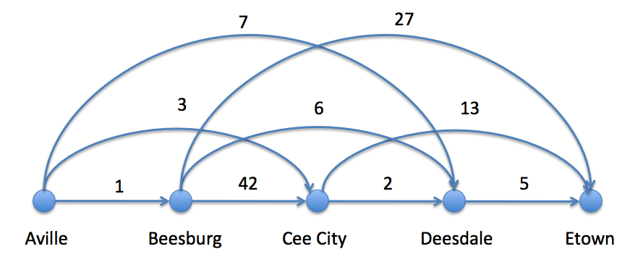
Giigle maps
>>> FiveDists[ ("B", "C") ]
42

Slide 37
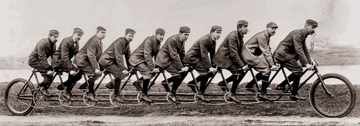
Sometimes We Need to Make More Than 2 Recursive Calls!
Notes:
…and we’ll cover that in this week’s homework.

Slide 38
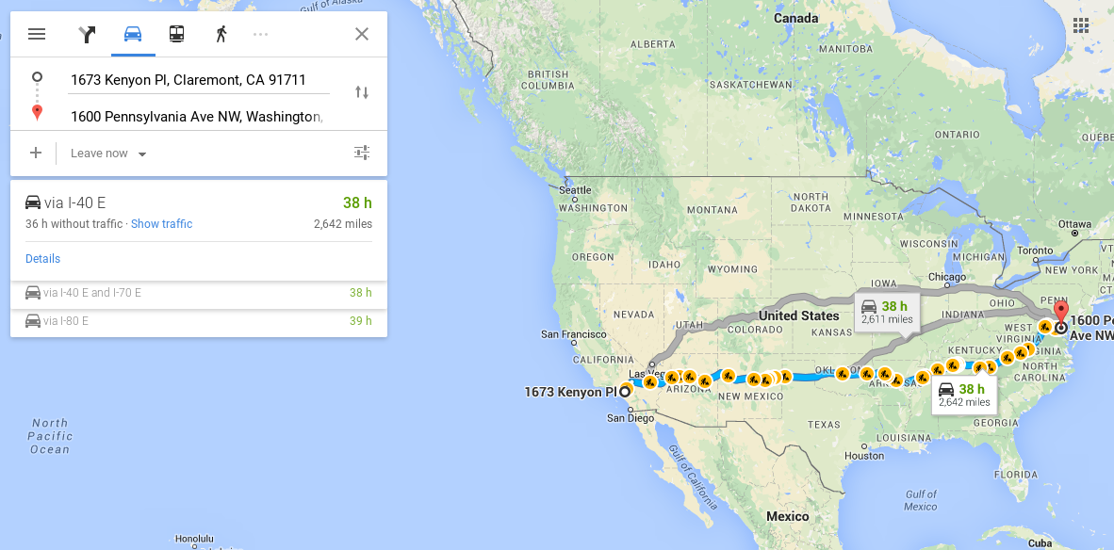
Finding Shortest Paths

Slide 39
Giigle maps
7
27
3
6
13
1
42
2
5
Aville
Beesburg
Cee City
Deesdale
Etown
All roads point east!
Shortest path?
Is greed good?
How does the use-it-or-lose-it idea get used here?

Slide 40
>>> shortestPath (FiveCities, FiveDists)
10
>>> shortestPath (["C", "D", "E"], FiveDists)
7
>>> shortestPath (["E"], FiveDists)
0
Notes:
The shortest path is A->C->D->E.

Slide 41
def shortestPath (cities, dists):
'''Returns the length of the shortest path
from the leftmost to the rightmost city in
in the cities list.'''
if BLAH:
return BLAH BLAH
else:
return BLAH BLAH BLAH
Just four lines of code!!!
It’s fitting that
map gets used
here!

Slide 42
def shortestPath (cities, dists):
'''Returns the length of the shortest path
from the leftmost to the rightmost city in
in the cities list.'''
if len(cities) <= 1:
return 0
else:
return BLAH BLAH BLAH

Slide 43
We Admit It’s Tricky
def shortestPath (cities, dists):
'''Returns the length of the shortest path
from the leftmost to the rightmost city in
in the cities list.'‘’
if len(Cities) <= 1:
return 0
else:
return min(map(
lambda hop: dists[(cities[0], cities[hop])] + shortestPath(cities[hop:], dists), range(1, len(cities))))
Notes:
Note that hop (the value being mapped over) is an index into cities. Draw on slide to show how it goes together.

Slide 44
SnowFlake Fractals
The Koch Snowflake Fractal:
level 0
level 1
level 2
level 3
level 4
level 5

Slide 45
Snowflake Fractals
The Koch Snowflake Fractal:
level 0
level 1
level 2
level 3
level 4
level 5
level 0
1/3
1/3
level 1
1/3
1/3
1/3

