Slide 1
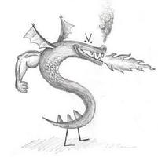
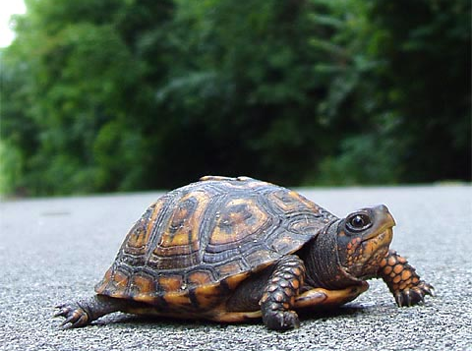
CS 5 Today
CS 5 alien on strike!
Fractals and Turtles
More Eyes!
Photograph of CS 5 co-worker accused of burnination.
CS 5's three-eyed spokesalien has walked off the job, according to an AFL-CIO (Alien Federation of Labor and Congress of Interplanetary Organizations) life-form. "I can't work under these conditions—when I arrived this morning, I was immediately—and indecorously—burninated by a new co-worker," sources reported hearing as the trinocular terrestrial stormed off. No word yet on who this reputed co-worker might be, though…
How random!
Hw3 due Monday…
Lots of tutoring…
picket lines consumed by flames, p. 42
https://www.youtube.com/watch?v=TfrAf1a9Qhs 1:00-1:30
Notes:
INHANDOUT
Setup: ipython with lec05prog01-random.py and code editor window with same.
Make a simple turtle window : reset() and resize it to be the top half of the screen?
Specific functions that will be demonstrated: guess, guess_orig, countDoubles, MCMH MCMHnp, rwpos, rwSteps, tri, rwalk, svtree, sf/sfnt
Note that the first recursion homework is always challenging, so don’t despair if it gave you trouble.

Slide 2
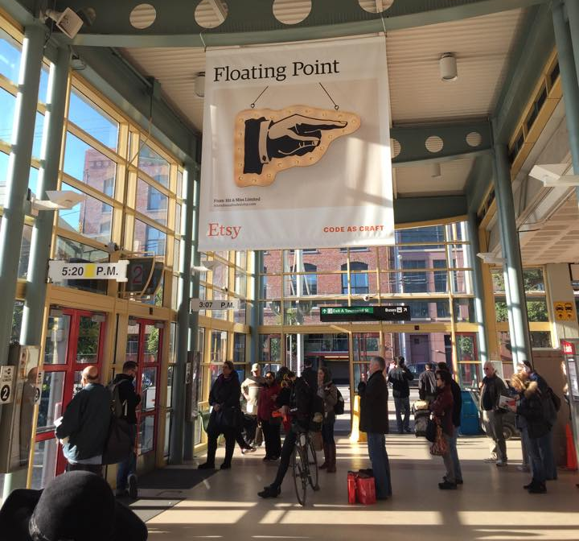
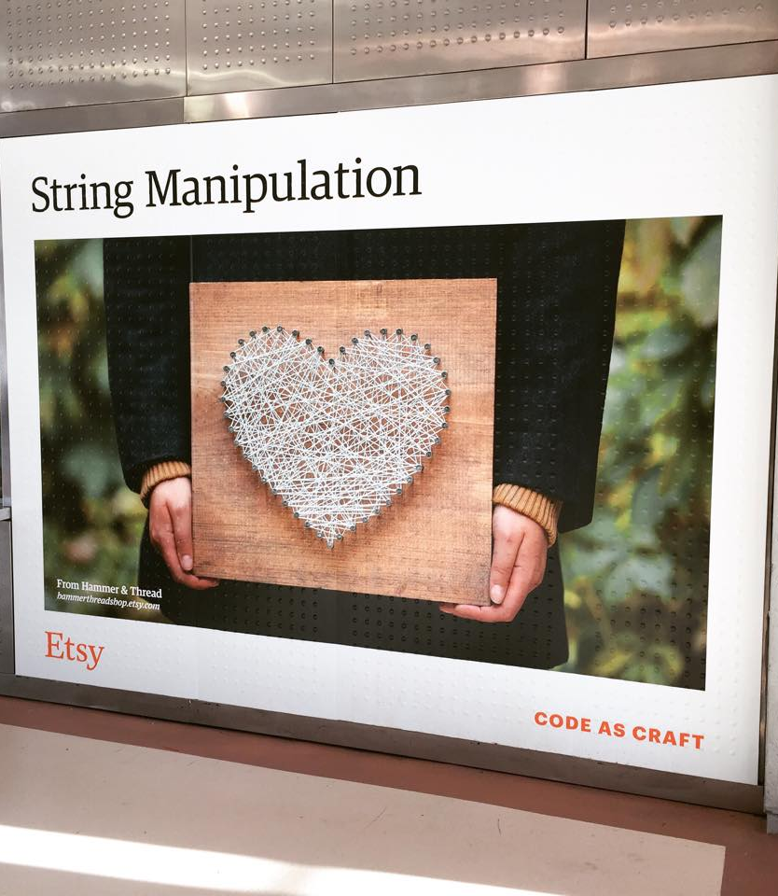
Career Fair!
Come by the Career Fair!
Thursday, Feb. 1 at HMC's LAC, 11-2

Slide 3
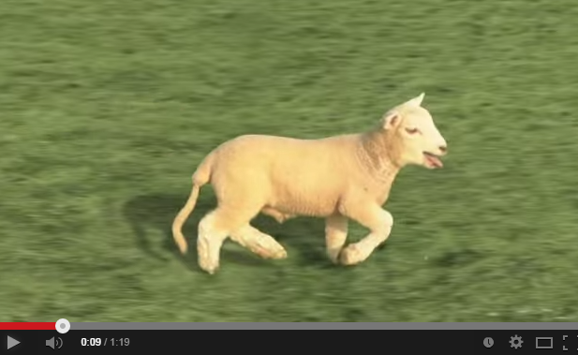
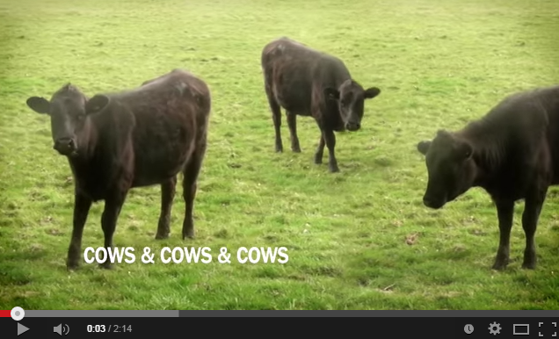
Cyriak: conceptually disruptive recursion…
Baaa
Notes:
Baaa: https://www.youtube.com/watch?v=WQO-aOdJLiw
Cows: https://www.youtube.com/watch?v=FavUpD_IjVY

Slide 4
Recursion's 80/20:
def dot(L, K):
if len(L) == 0 or len(K) == 0:
return 0.0
elif len(L) != len(K):
return 0.0
else:
return L[0]*K[0] + dot(L[1:], K[1:])
Basic?
combine
handle the FIRST of L
handle the FIRST of K
handle the REST of L
handle the REST of K
firsts, as appropriate
recursion w/the rest
first
rest
Notes:
80% of the work is done by 20% of the code.
The programmer does the first step, the rest is delegated to the machine (or the recursion, or the faith…)

Slide 5
def dot(L, K):
if len(L) == 0 or len(K) == 0:
return 0.0
elif len(L) != len(K):
return 0.0
else:
return L[0]*K[0] + dot(L[1:], K[1:])
dot …
dot([3, 2, 4], [4, 7, 4])
L = [3, 2, 4] and K = [4, 7, 4]
3*4 + dot([2, 4], [7, 4])
L = [2, 4] and K = [7, 4]
2*7 + dot([4], [4])
L = [4] and K = [4]
4*4 + dot([], [])
L = [ ] and K = [ ]
0.0
16.0
30.0
42.0

Slide 6
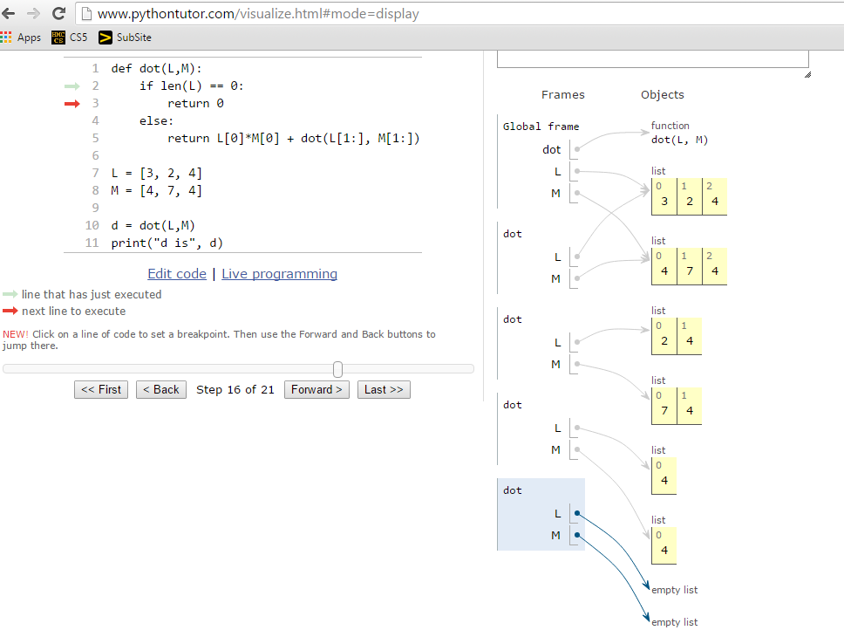
pythontutor.com
There are four different values of L and four different values of M—all alive, simultaneously, in the stack
Seeing the "stack" ...
Notes:
We could animate this but we won’t because of the time it takes. The computer is better at bookkeeping than we are!

Slide 7
Some random asides…
import random
# allows use of dir(random) and help(random)
from random import *
# all random functions are now available!
choice(L)
# chooses 1 element from the sequence L
choice('mudd')
# ...or 1 character from a string
choice(['cmc','scripps','pitzer','pomona'])
list(range(1, 5))
[1, 2, 3, 4]
How would you get a random integer from 0 to 99 inclusive?
uniform(low,hi)
chooses a random float from low to hi
floats have 16 places of precision
Aargh—so close!
Notes:
INHANDOUT
Show both import random and random.choice, then from random import * and choice.
The file has cc = Claremont Colleges so we can do choice(cc)
choice('mudd') – what might come out, what’s most likely, what’s the probability?
The show choice(list(range(1,101).
Uniform is for floating point; note that probability of 42 is effectively 0!

Slide 8
A random function…
from random import *
def guess(hidden):
"""Tries to guess our "hidden" number
"""
compguess = choice(list(range(100)))
if compguess == hidden: # at last!
print('I got it!')
else:
guess(hidden)
Remember, this is [0,1,…,99]
Suspicious? I am!
print the guesses ?
slow down…
return the number of guesses ?
investigate expected # of guesses?!??
Notes:
INHANDOUT
Show guess. Edit to add print of intermediates. Then edit again to do count. Show counting version several times.

Slide 9
Recursive guess-counting
from random import *
import time
def countGuess(hidden):
"""Guessing game"""
compguess = choice(list(range(100)))
# print('I choose', compguess)
# time.sleep(0.05)
if compguess == hidden: # at last!
# print('I got it!')
return 1
else:
return 1 + countGuess(hidden)
code available in hw3pr2
Notes:
Show counting version several times.

Slide 10
Quiz
A few random thoughts…
Name(s):
from random import *
choice([1, 2, 3, 2])
What are the chances this returns a 2 ?
choice(list(range(1, 5)) + [4, 2, 4, 2])
What are the chances of this returning a 4 ?
[1, 2, 3, 4]
choice('1,2,3,4')
Careful!
What's the most likely return value here?
choice(['1, 2, 3, 4'])
What's the most likely return value here?
choice('[1,2,3,4]')
What's the most likely return value here?
choice(list(range(5)))
Is this more likely to be even or odd (or same)?
[0, 1, 2, 3, 4]
uniform(-20.5, 0.5)
What're the chances of this being >= 0?
and how likely is each of these?
Extra!
choice(0, 1, 2, 3, 4)
Which two of these 3 are syntax errors?
Also, what does the third one—the one syntactically correct—actually do?
Syntax corner…
choice([list(range(5))])
choice[list(range(5))]
Notes:
QUIZSLIDE
The questions intentionally contain syntactic variations; the idea is to get people to understand the differences.
Technically choice(0, 1, 2, 3, 4) isn’t a syntax error, it’s a semantic error.

Slide 11
Data is in black. Probabilities are in blue.
from random import *
choice([1, 2, 3, 2])
What are the chances this returns a 2 ?
2/4 or 50%
choice(list(range(1, 5)) + [4, 2, 4, 2] )
What are the chances of this returning a 4 ?
[1, 2, 3, 4]
[1, 2, 3, 4, 4 ,2 ,4, 2]
3/8
choice('1,2,3,4')
',' 3/7
What's the most likely return value here?
choice(['1, 2, 3, 4'])
What's the most likely return value here?
'1, 2, 3, 4' 1/1
choice('[1,2,3,4]')
',' 3/9
What's the most likely return value here?
choice(list(range(5)))
Is this more likely to be even or odd (or same)?
even 3/5
[0, 1, 2, 3, 4]
uniform(-20.5, 0.5)
What're the chances of this being >= 0?
1/42
and how likely are all these?
choice(0, 1, 2, 3, 4)
syntax error: needs [...] or '...'
choice([list(range(5))])
correct: always returns [0, 1, 2, 3, 4]
choice[list(range(5))]
1/1 chance
syntax error: needs choice( ... )

Slide 12
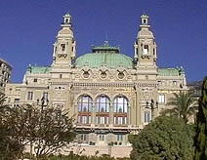
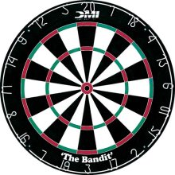
The two Monte Carlos
and their denizens…
Insights via random trials
Monte Carlo methods, Math/CS
Monte Carlo casino, Monaco

Slide 13
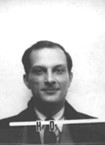
The two Monte Carlos
and their denizens…
Ulam, Stan Ulam
Stanislaw Ulam (Los Alamos badge)
Insights via random trials
Bond, James Bond
Monte Carlo methods, Math/CS
Monte Carlo casino, Monaco
Notes:
Stanislaw Ulam invented the Monte Carlo method. He also worked on the Manhattan Project and suggested nuclear pulse propulsion (a really bad idea!).

Slide 14
Monte Carlo in action
How many doubles will you get in N rolls of 2 dice?
N is the total number of rolls
def countDoubles(N):
""“Argument: the number of dice rolls to make
Result: the number of doubles seen"""
if N == 0:
return 0 # zero rolls, zero doubles...
else:
d1 = choice([1, 2, 3, 4, 5, 6])
d2 = choice(list(range(1, 7)))
if d1 != d2:
return 0 + countDoubles(N - 1) # don't count it
else:
return 1 + countDoubles(N - 1) # COUNT IT!
two dice from 1-6 inclusive
where and how is the check for doubles?
Notes:
INHANDOUT
Note the difference between the two notations for lists 1-6.
Q: does the if statement check for doubles or non-doubles?
Run countDoubles(600) – the analytical becomes the empirical

Slide 15
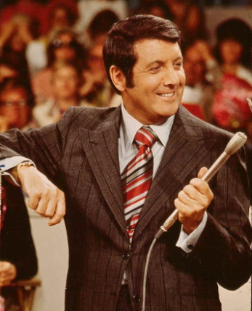
Another Monty… ?
inspiring the “Monty Hall paradox”
Notes:
Monty Hall, Canadian

Slide 16
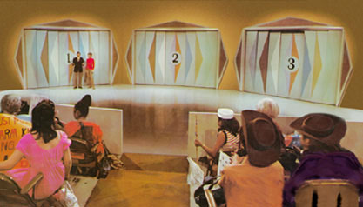
Let's make a deal…
Monty
'63-'86
inspiring the Monty Hall paradox
Notes:
Later hosted by Drew Carey

Slide 17
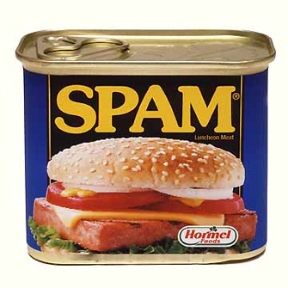
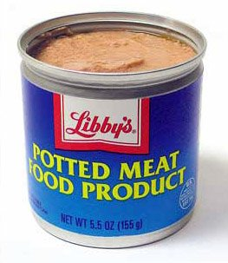
Monte Carlo Monty Hall
Suppose you always switch to the other door...
What are the chances that you will win the prize ?
Let's play (randomly) 300 times and see!
Notes:
Run MCMH(1, 'stay', 300), then with 'switch'. Repeat with MCMHnp and bigger counts.

Slide 18
Monte Carlo Monty Hall
'switch' or 'stay'
Your initial choice!
number of times to play
def MCMH(init, sors, N):
"""Plays the "Let's make a deal" game N times
Returns the number of times you win the *Spam!*
"""
if N == 0: return 0 # don't play, can't win
przDoor = choice([1, 2, 3]) # where the spam (prize) is…
if init == przDoor and sors == 'stay': result = 'Spam!'
elif init == przDoor and sors == 'switch': result = 'pmfp.'
elif init != przDoor and sors == 'switch': result = 'Spam!'
else: result = 'pmfp.'
print 'You get the', result
if result == 'Spam!': return 1 + MCMH(init, sors, N - 1)
else: return 0 + MCMH(init, sors, N - 1)
Notes:
INHANDOUT
Highlight bad style of one-line ifs.
Note that the second elif is a win regardless of which losing door was originally chosen. (And that’s why switching is wise!)

Slide 19
0
1
2
3
4
5
6
7
8
9
A
B
C
D
E
F
G
H

Slide 20
0
1
2
3
4
5
6
7
8
9
A
B
C
D
E
F
G
H

Slide 21
Let's make a deal: XKCD's take…
Monty
inspiring the Monty Hall paradox
… but what if you considered the goat the grand prize!?

Slide 22
An example closer to home
hw2pr2
start
Class
...
S
...
Dorm
(W)
(E)
0
22
23
24
25
26
27
28
50
An overworked 5C student (S) leaves H/S after their “late-night” breakfast—or lunch. Each moment, they randomly stumble toward class (W) or the dorm (E)
Once the student arrives at the dorm or classroom, the trip is complete.
The program should then print the total number of steps taken.
Write a program to model and analyze! this scenario...
rwpos(s, nsteps)
rwsteps(s, low, hi)
take nsteps random steps starting at s
take random steps starting at s until you reach either low or hi
Notes:
INHANDOUT
Show rwpos(25, 500) several times. It just prints the number of steps needed.
Don’t show rwsteps here.

Slide 23
An example closer to home
hw2pr2
start
Class
...
S
...
Dorm
(W)
(E)
0
22
23
24
25
26
27
28
50
An overworked 5C student (S) leaves H/S after their “late-night” breakfast – or lunch. Each moment, they randomly stumble toward class (N) or the Dorm (S)
How could we create this as an ASCII “animation”?
Once the student arrives at the dorm or classroom, the trip is complete.
The program should then print the total number of steps taken.
Write a program to model and analyze! this scenario...
rwpos(s, nsteps)
rwsteps(s, low, hi)
take nsteps random steps starting at s
take random steps starting at s until you reach either low or hi
Notes:
Now run rwsteps(25, 0, 50)
Note that rwSteps takes a third argument, the delay (defaults to 0.05 which is good).

Slide 24
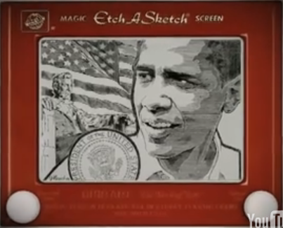
Etch-a-Sketch ?
No way this is real… but it is !
www.gvetchedintime.com
Notes:
The drawing is by George Vlosich, "The world's greatest Etch-a-Sketch artist," who takes 70-80 hours to complete a work.

Slide 25
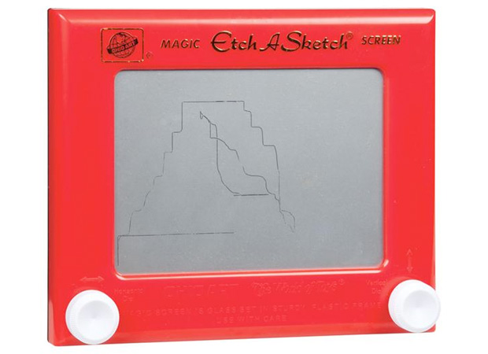
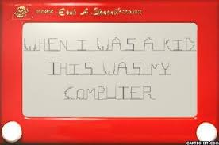
more usual etch-a-sketch work...
No way this is real… but it is !

Slide 26
Python's Etch-a-Sketch
import time
from turtle import *
def draw(): # define it!
shape('turtle')
# pause
time.sleep(2)
# drawing...
width(5)
left(90)
forward(50)
right(90)
backward(50)
down() or up()
color('darkgreen')
tracer(1) or tracer(0)
# run it and done!
draw()
done()
the turtle's canvas
(42,42)
pixels!
window_height()
(0,0)
degrees!
is the pen on the "paper"?
sets if the pen animates or not
window_width()
http://docs.python.org/library/turtle.html
Notes:
INHANDOUT
Demo turtle here—draw “hi”:
left(90); forward(100); forward(-50); right(90); forward(50); right(90); forward(50)
left(90); up(); forward(50); down(); left(90); forward(50); up(); forward(50)

Slide 27
Turtle happiness?
you can always run
done()
after turtle drawing
This releases control of the turtle window to the computer (the operating system).
don't use it in your functions, however
To be honest, it seems that not every machine needs this…

Slide 28
Single-path recursion
(1)
Let's tri this with recursion:
def tri(): # define it!
"""A triangle!
"""
forward(100)
left(120)
forward(100)
left(120)
forward(100)
left(120)
# run now
tri()
def tri(n):
"""Draws a triangle"""
if n == 0: return
else:
forward(100) # one side
left(120) # turn 360/3
tri(n-1) # draw rest
(2)
How about any regular N-gon?
def poly(n, N):
"""Draws a polygon"""
if n == 0: return
else:
forward(100) # one side
left(360 / N) # turn 360/N
poly(n-1, N) # draw rest
I don't know about tri, but there sure is NO return … !
Notes:
INHANDOUT
Run tri(3). Then run tri(9) (without reseting)
Then run tri(9) with the “new” tri.
Show poly(9, 9). Note that Hoch-Shanahan cups are nonagons!

Slide 29
Be the turtle !
Have rwalk draw a "stock-market" path:
N steps of 10 pixels each. Use recursion.
(2)
(1)
What would chai(100) draw?
one possible result of rwalk(20)
from random import *
def rwalk(N):
"""Make N 10-pixel steps, NE or SE"""
if N == 0: return
elif choice(['left', 'right']) == 'left':
else: # this handles 'right'
def chai(dist):
"""Mystery func!"""
if dist < 5: return
forward(dist)
left(90)
forward(dist / 2)
right(90)
right(90)
forward(dist)
left(90)
left(90)
forward(dist / 2)
right(90)
backward(dist)
left(45)
forward(10)
?
?
Extra! How could you make this a bull (or a bear) market?
Extra #2! What if the line chai(dist/2) were placed between the two right(90) lines? And between the two left(90) lines?
Notes:
INHANDOUTFULL
This is chai_orig
rw_setup prepares for random walk. Show rwalk(30) a couple of times.
Chai == “T” (groan)

Slide 30
from random import *
def rwalk(N):
"""Make N 10-px steps, NE or SE"""
if N == 0: return
elif choice(['left', 'right']) == 'left':
left(45)
forward(10)
right(45)
rwalk(N - 1)
else: # 'right'
right(45)
forward(10)
left(45)
rwalk(N - 1)
rwalk(N) is a random "stock market" walk...
What if we didn't turn back to face east each time?
Single-path (or counting) recursion
Notes:
rwalk(20)
rw_not is without the angle corrections.

Slide 31
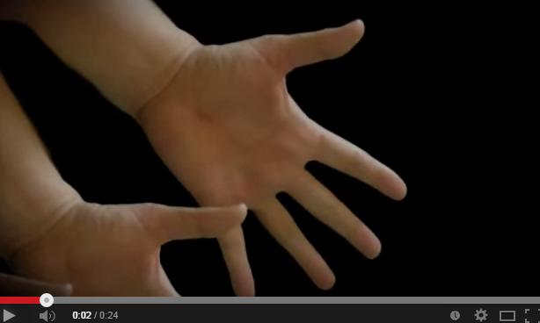
Cyriak: conceptually disruptive recursion…
handfingers
is the branching, not the single-path variety.

Slide 32
Single-path recursion
def chai(dist):
"""Mystery!"""
if dist < 5:
return
forward(dist)
left(90)
forward(dist / 2)
right(90)
right(90)
forward(dist)
left(90)
left(90)
forward(dist / 2)
right(90)
backward(dist)
What does chai(50) do here?
How could you add more to each T's tips?
Why are there two identical commands in a row ~ twice!?
Notes:
INHANDOUT
This is chai_orig. Don’t demo it.

Slide 33
Branching recursion
def chai(dist):
"""Mystery!"""
if dist < 5:
return
forward(dist)
left(90)
forward(dist / 2)
right(90)
chai(dist / 2)
right(90)
forward(dist)
left(90)
chai(dist / 2)
left(90)
forward(dist / 2)
right(90)
backward(dist)
Now, what does chai(50) do?
Notes:
This is chai
It looks like a sports bracket.
If you comment out the lower recursion, you get the top seed’s games.

Slide 34
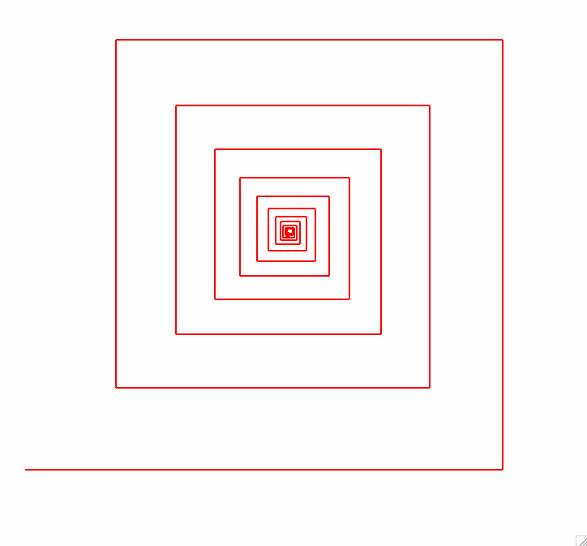
lab ~ hw2pr1
64
fractal art
80
spiral(100, 90, 0.8)
100
spiral(initLength, angle, multiplier)
Notes:
Don’t demo spiral

Slide 35
lab ~ hw2pr1
spiral(80, 90, 0.8)
64
fractal art
80
spiral(100, 90, 0.8)
100
spiral(initLength, angle, multiplier)
Notes:
INHANDOUT
Lower line is initial piece, box is another spiral.

Slide 36
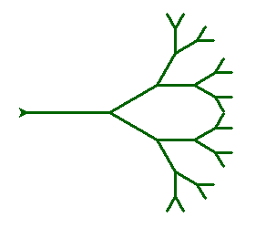
svtree(trunkLength, levels)
svtree(100, 5)
levels == 5
levels == 4
levels == 3
levels == 2
levels == 0
(no drawing)
levels == 1
Notes:
Demo svtree

Slide 37
svtree( trunkLength, levels )
svtree(100, 5)
svtree(75, 4)
levels == 5
levels == 4
levels == 3
What steps does the turtle need to take before recurring?
levels == 2
levels == 0
(no drawing)
levels == 1
Notes:
Have the students find the self-similarity.

Slide 38
svtree(trunkLength, levels)
step #3: draw a smaller svtree!
svtree(100, 5)
step #2: turn a bit…
step #1: go forward…
levels == 5
step #6: get back to the start by turning and moving!
levels == 4
step #4: turn to another heading
levels == 3
Be sure the turtle always returns to its starting position!
levels == 2
levels == 0
(no drawing)
levels == 1
step #5: draw another smaller svtree!
Notes:
INHANDOUT
If you don’t return to the starting position it’ll get lost.

Slide 39
svtree(trunkLength, levels)
svtree(100, 5)
svtree(75, 4)
Be sure the turtle always returns to its starting position!
levels == 5
levels == 4
that means it will finish the recursive call right here!
levels == 3
levels == 2
so that it can change heading and draw another one…
levels == 0
(no drawing)
levels == 1

Slide 40
The Koch curve
snowflake(100, 0)
snowflake(100, 1)
snowflake(100, 2)
snowflake(100, 3)
snowflake(100, 4)
snowflake(100, 5)
Notes:
INHANDOUT
Demo sf(300, 4), then sfnt(300, 5)

Slide 41
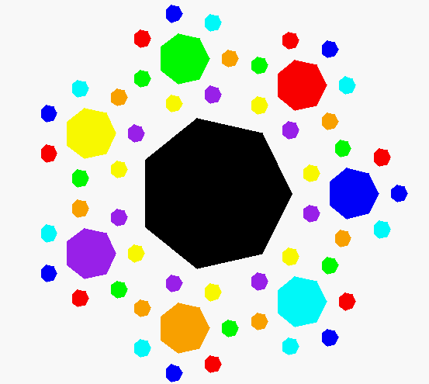
Recursive art? Create your own…
Happy turtling in lab!
seven-cornered confetti
What? Way too happy to be art…
My recursive compositions burninate even Cyriak's brain!

