Slide 1
The CS 5 Times
CS 5 Penguin Knocked Into Icy Waters
Claremont (AP): “Our friendly CS 5 penguin was knocked into icy waters by an evil rival,” claimed a distraught HMC CS professor. Geoff and Zach are investigating the incident, which was caught on security cameras. Geoff will fly first-class to Antarctica to collect further evidence.

Slide 2
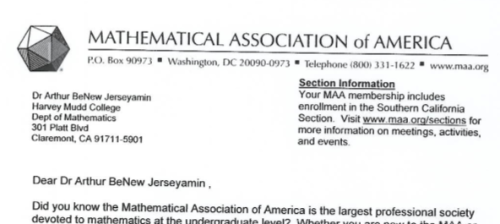
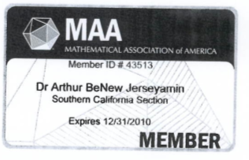
True Story…
That’s crArizonay!

Slide 3
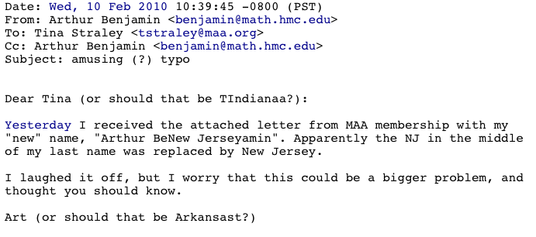

Slide 4
Sorting Algorithms!
This is my sort of algorithm!
Insertion Sort:
isort([42, 10, 1, 6, 5])
Through the wonders of recursion!
[1, 5, 6, 10]
insert(42, [1, 5, 6, 10])
[1, 5, 6, 10, 42] A new sorted list!
Write the program (both functions) on your worksheet!
Solution follows…
Notes:
To generate the insert line, wouldn’t it be wonderful if we had a function that could return the tail of the list in sorted form?

Slide 5
Insertion Sort
def isort(L):
if L == []:
return []
else:
return insert(L[0], isort(L[1:]))
def insert(x, L):
if L == []:
return ???

Slide 6
Insertion Sort
def isort(L):
if L == []:
return []
else:
return insert(L[0], isort(L[1:]))
def insert(x, L):
if L == []:
return [x]
elif x <= L[0]:
return ???

Slide 7
Insertion Sort
def isort(L):
if L == []:
return []
else:
return insert(L[0], isort(L[1:]))
def insert(x, L):
if L == []:
return [x]
elif x <= L[0]:
return [x] + L
else:
return ???

Slide 8
Insertion Sort
def isort(L):
if L == []:
return []
else:
return insert(L[0], isort(L[1:]))
def insert(x, L):
if L == []:
return [x]
elif x <= L[0]:
return [x] + L
else:
return [L[0]] + insert(x, L[1:])

Slide 9
Analyzing Algorithms!
def member(item, List):
if List == []:
return False
elif List[0] == item:
return True
else:
return member(item, List[1:])
What is the worst-case running time as a function of the length of the input (denoted “n”)?
It’s approximately…
Notes:
If List is empty, clearly it takes two steps (if and return). If item is the first thing in the list, it takes three steps (if, elif, and return). Otherwise, it takes 4 (if/elif/else/return) plus T(member(N-1)).
So T(N) = 4 + T(N-1) = 4 + 4 + T(N-2) = 4*(# mismatches) + 3. The worst case is if the item isn’t found; then it’s 4*len(List) + 2.
This is a recurrence relation: T(N) = f(T(N-1)). Finding running times often requires solving recurrence relations. Recurrence relations are closely related to recursion (note the root word: recur). In both situations, you need a base case!

Slide 10
Asymptotic Analysis
“Asymptotic” is a fancy word!
3n + 42
“asymptotically
linear”
42n+4242
100 n
(0.1)n² + n + 1
“asymptotically quadratic”
100 n²
n³ - 100n² + 2n + 42
2n³ + 10
1/5 n³
“asymptotically cubic”
Notes:
There’s good math behind this, covered in CS 70 and CS 140.
Why does this work? See next slide.

Slide 11
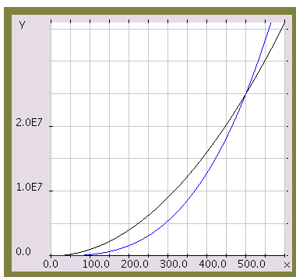
Asymptotic Analysis
100 n²
Those look like two awesome water-slides!
1/5 n³
n

Slide 12
Asymptotic Analysis
Simple (and not-quite-correct) rules:
Replace all additive and multiplicative constants by 1
Replace constant bases of exponents/logs by 2
Discard all but the highest power
2^{n} beats n^{k} for any constant k
n^{k} beats n^{j} for k > j
n¹ beats log n

Slide 13
Analyzing Algorithms!
We’re looking for the worst-case analysis!
Insertion Sort:
isort([42, 10, 1, 65, 5])
“the magic of recursion!”
[1, 5, 10, 65]

Slide 14
Analyzing Algorithms!
This is amazingly cool stuff!
Insertion Sort:
isort([42, 10, 1, 6, 5])
insert(42, [1, 5, 10, 65])
[1, 5, 10, 42, 65] A new list!
Let’s solve this on the board!
Notes:
Because of the rules above, the base case is assumed to take 1 step. Show how for insert, T(N) = 1+T(N-1). Then show that in the worst case, T(insert) = N. Finally, show that the worst case for isort is T(insert(1)) + T(insert(2)) + … = 1 + 2 + … + N

Slide 15
This Space Property of CS 5 Black
1 + 2 + 3 + 4 + … + (n-1) + n = ?
1
2
3
4
n
n
Notes:
There are tons of ways to solve this summation. This one is visually cute: you have exactly half of n^2 colored, plus half of the n squares on the diagonal. So ½ of n^2 + n = ½ of n(n+1) = n(n+1)/2. But writing it as 0.5 n^2 + 0.5n and then applying our asymptotic rules, we get O(isort) = 1n^2 + 1 = n^2.

Slide 16
The Alien's Life Advice
Knowing an obscure fact isn’t proof of intelligence
…or even wisdom!

Slide 17
Mergesort
msort([42, 3, 1, 5, 27, 8, 2, 7])
Assume—just for a moment—that the length, n, is a power of 2.

Slide 18
Mergesort
msort([42, 3, 1, 5, 27, 8, 2, 7])
msort([42, 3, 1, 5])
msort([27, 8, 2, 7])
“the magic of recursion!”
[1, 3, 5, 42]
[2, 7, 8, 27]

Slide 19
Mergesort
msort([42, 3, 1, 5, 27, 8, 2, 7])
msort([42, 3, 1, 5])
msort([27, 8, 2, 7])
merge([1, 3, 5, 42], [2, 7, 8, 27])
[

Slide 20
Mergesort
msort([42, 3, 1, 5, 27, 8, 2, 7])
msort([42, 3, 1, 5])
msort([27, 8, 2, 7])
merge([1, 3, 5, 42], [2, 7, 8, 27])
✓
[1,

Slide 21
Mergesort
msort([42, 3, 1, 5, 27, 8, 2, 7])
msort([42, 3, 1, 5])
msort([27, 8, 2, 7])
merge([1, 3, 5, 42], [2, 7, 8, 27])
✓
✓
[1,2

Slide 22
Mergesort
msort([42, 3, 1, 5, 27, 8, 2, 7])
msort([42, 3, 1, 5])
msort([27, 8, 2, 7])
merge([1, 3, 5, 42], [2, 7, 8, 27])
✓
✓
✓
[1,2,3

Slide 23
Mergesort
msort([42, 3, 1, 5, 27, 8, 2, 7])
msort([42, 3, 1, 5])
msort([27, 8, 2, 7])
merge([1, 3, 5, 42], [2, 7, 8, 27])
✓
✓
✓
✓
[1,2,3,5

Slide 24
Mergesort
msort([42, 3, 1, 5, 27, 8, 2, 7])
msort([42, 3, 1, 5])
msort([27, 8, 2, 7])
merge([1, 3, 5, 42], [2, 7, 8, 27])
✓
✓
✓
✓
✓
[1,2,3,5,7

Slide 25
Mergesort
msort([42, 3, 1, 5, 27, 8, 2, 7])
msort([42, 3, 1, 5])
msort([27, 8, 2, 7])
merge([1, 3, 5, 42], [2, 7, 8, 27])
✓
✓
✓
✓
✓
✓
[1,2,3,5,7,8

Slide 26
Mergesort
msort([42, 3, 1, 5, 27, 8, 2, 7])
msort([42, 3, 1, 5])
msort([27, 8, 2, 7])
merge([1, 3, 5, 42], [2, 7, 8, 27])
✓
✓
✓
✓
✓
✓
✓
[1,2,3,5,7,8,27

Slide 27
Mergesort
msort([42, 3, 1, 5, 27, 8, 2, 7])
msort([42, 3, 1, 5])
msort([27, 8, 2, 7])
merge([1, 3, 5, 42], [2, 7, 8, 27])
✓
✓
✓
✓
✓
✓
✓
✓
[1,2,3,5,7,8,27,42]
Done!

Slide 28
Let’s try it out - and let’s not even make n a power of 2!
msort([42, 3, 1, 6, 5, 2, 7])
msort([42, 3, 1])
msort([6, 5, 2, 7])

Slide 29
msort([42, 3, 1, 6, 5, 2, 7])
msort([42, 3, 1])
msort([6, 5, 2, 7])
msort([42])
msort([3, 1])
msort([6, 5])
msort([2, 7])

Slide 30
msort([42, 3, 1, 6, 5, 2, 7])
msort([42, 3, 1])
msort([6, 5, 2, 7])
[42]
msort([42])
msort([3, 1])
msort([6, 5])
msort([2, 7])
msort([3])
msort([1])

Slide 31
msort([42, 3, 1, 6, 5, 2, 7])
msort([42, 3, 1])
msort([6, 5, 2, 7])
[42]
msort([42])
msort([3, 1])
msort([6, 5])
msort([2, 7])
[3]
[1]
msort([3])
msort([1])

Slide 32
msort([42, 3, 1, 6, 5, 2, 7])
msort([42, 3, 1])
msort([6, 5, 2, 7])
[42]
[1,3]
msort([42])
msort([3, 1])
msort([6, 5])
msort([2, 7])
[3]
[1]
msort([3])
msort([1])

Slide 33
msort([42, 3, 1, 6, 5, 2, 7])
[1,3,42]
msort([42, 3, 1])
msort([6, 5, 2, 7])
[42]
[1,3]
msort([42])
msort([3, 1])
msort([6, 5])
msort([2, 7])
[3]
[1]
msort([3])
msort([1])

Slide 34
msort([42, 3, 1, 6, 5, 2, 7])
[1,3,42]
[2, 5, 6, 7]
msort([42, 3, 1])
msort([6, 5, 2, 7])
[42]
[1,3]
msort([42])
msort([3, 1])
msort([6, 5])
msort([2, 7])
[3]
[1]
msort([3])
msort([1])

Slide 35
[1, 2, 3, 5, 6, 7, 42]
msort([42, 3, 1, 6, 5, 2, 7])
[1,3,42]
[2, 5, 6, 7]
msort([42, 3, 1])
msort([6, 5, 2, 7])
[42]
[1,3]
msort([42])
msort([3, 1])
msort([6, 5])
msort([2, 7])
[3]
[1]
msort([3])
msort([1])

Slide 36
How “Efficient” Is Mergesort?
Notes:
First figure out T(merge). Clearly, T(merge) for two lists of length N = roughly 2N. How many merges do we have to do? It’s 1 for N/2, 1 for N/4, …, 1. That means there are log N merges. Each merge takes 2N steps, so the total is 2N log N steps = O(N log N).
Draw right side in tree form, showing how each N/k list comes from two N/2k lists
T_merge(half lists) = 2(N/2) + 2(N/2) = 2N
T_merge(quarter lists) = 2(N/4) + 2(N/4) + 2(N/4) + 2(N/4) = 2N
T_merge(eighth lists) = 2(N/8) + … = 2N
…
T_merge(lists of size 1) = 2N
So the total time is #rows * 2N. How many rows? Starting from the bottom, we have to double log2(N) times to get N. So there are log2(N) rows and the total time is 2N log2 N = O(N log N).

Slide 37
How big a deal is this?
Geoff’s Super-O-Matic Supercomputer:
100 billion steps/second
n² algorithm n log₂ n algorithm
n = 10⁸ 11.5+ days

Slide 38
How big a deal is this?
Geoff’s Super-O-Matic Supercomputer:
100 billion steps/second
n² algorithm n log₂ n algorithm
n = 10⁸ 11.5+ days 0.27 seconds

