Slide 1
The CS 5 Herald
CS 5 and Physics
Penguins Stranded
in Spaceship Crash
Wellington (AP): Two HMC penguins
were missing after their spaceship lost
power and crashed into the southern ocean. “The CS
penguin had kindly offered a ride to her friend,” blubbered a distraught professor, “and apparently he was fiddling with the flight computer just before takeoff. I don’t know what I’ll do for classroom examples now.”
With weather worsening, there is little hope for rescue. A memorial service will be held Sunday in the Hoch-Shanahan freezer.
Read Sections 3.6‒3.7
Notes:
class06-black-functional4
Review mergesort complexity derivation in full immediately before class; re-review at break.

Slide 2
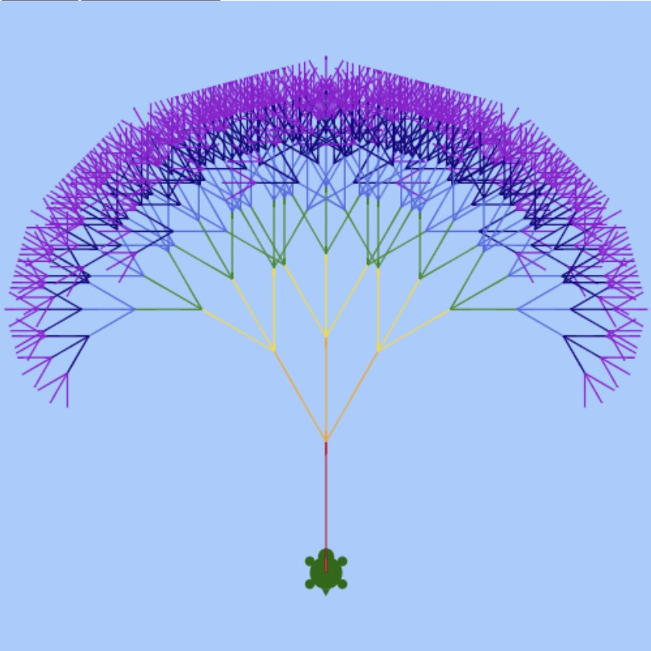
Simi’s Tree
Notes:
Simi Vora ‘25, CS 5 Black Fall ‘21

Slide 3
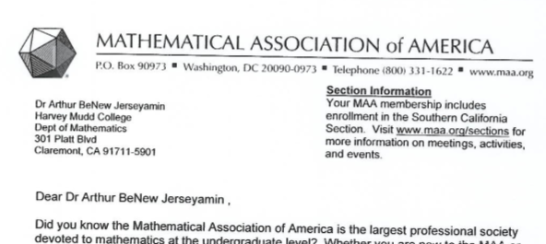
True Story…
That’s crArizonay!

Slide 4
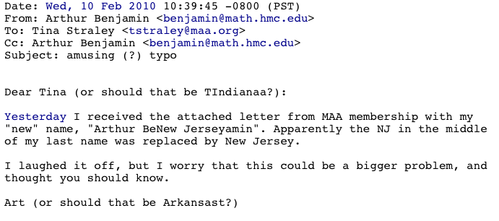

Slide 5
Sorting Algorithms!
This is my sort of algorithm!
Insertion Sort:
isort([42, 10, 1, 6, 5])
Through the wonders of recursion!
[1, 5, 6, 10]
insert(42, [1, 5, 6, 10])
[1, 5, 6, 10, 42] A new sorted list!
Write the program (both functions) on your worksheet! (insert assumes that L is sorted.)
Solution follows…
Notes:
To generate the insert line, wouldn’t it be wonderful if we had a function that could return the tail of the list in sorted form?
While they’re attacking the worksheet, show the next slide to help them structure their code. Then come back to this slide.

Slide 6
Insertion Sort 1
def isort(L):
if L == []:
return ???
else:
???
def insert(x, L):
"Inserts x into sorted list L"
if L == []:
return ???

Slide 7
Insertion Sort 2
def isort(L):
if L == []:
return []
else:
return insert(L[0], isort(L[1:]))
def insert(x, L):
"Inserts x into sorted list L"
if L == []:
return ???

Slide 8
Insertion Sort 3
def isort(L):
if L == []:
return []
else:
return insert(L[0], isort(L[1:]))
def insert(x, L):
"Inserts x into sorted list L"
if L == []:
return [x]
elif x <= L[0]:
return ???

Slide 9
Insertion Sort 4
def isort(L):
if L == []:
return []
else:
return insert(L[0], isort(L[1:]))
def insert(x, L):
"Inserts x into sorted list L"
if L == []:
return [x]
elif x <= L[0]:
return [x] + L
else:
return ???

Slide 10
Insertion Sort 5
def isort(L):
if L == []:
return []
else:
return insert(L[0], isort(L[1:]))
def insert(x, L):
"Inserts x into sorted list L"
if L == []:
return [x]
elif x <= L[0]:
return [x] + L
else:
return [L[0]] + insert(x, L[1:])

Slide 11
Analyzing Algorithms!
def member(item, List):
if List == []:
return False
elif List[0] == item:
return True
else:
return member(item, List[1:])
What is the worst-case running time as a function of the length of the input (denoted “n”)?
It’s approximately…
Notes:
If List is empty, clearly it takes two steps (if and return). If item is the first thing in the list, it takes three steps (if, elif, and return). Otherwise, it takes 4 (if/elif/else/return) plus T(member(N-1)).
So T(N) = 4 + T(N-1) = 4 + 4 + T(N-2) = 4*(# mismatches) + 3. The worst case is if the item isn’t found; then it’s 4*len(List) + 2.
This is a recurrence relation: T(N) = f(T(N-1)). Finding running times often requires solving recurrence relations. Recurrence relations are closely related to recursion (note the root word: recur). In both situations, you need a base case!

Slide 12
Asymptotic Analysis
“Asymptotic” is a fancy word!
3n + 42
“asymptotically
linear”
42n+4242
100 n
(0.1)n² + n + 1
“asymptotically quadratic”
100 n²
n³ - 100n² + 2n + 42
2n³ + 10
1/5 n³
“asymptotically cubic”
Notes:
There’s good math behind this, covered in CS 70 and CS 140.
Why does this work? See next slide.

Slide 13
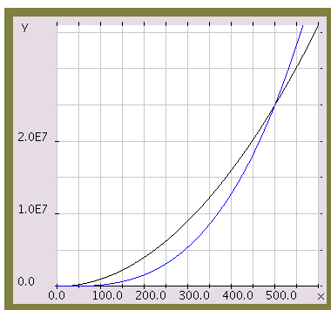
Asymptotic Analysis
100 n²
Those look like two awesome water-slides!
1/5 n³
n

Slide 14
Asymptotic Analysis
Simple (and not-quite-correct) rules:
Replace all additive and multiplicative constants by 1
Replace constant bases of exponents/logs by 2
Discard all but the highest power
2^{n} beats n^{k} for any constant k
n^{k} beats n^{j} for k > j
n log n beats n¹
n¹ beats log n
log n beats 1

Slide 15
Analyzing Algorithms!
We’re looking for the worst-case analysis!
Insertion Sort:
isort([42, 10, 1, 65, 5])
“the magic of recursion!”
[1, 5, 10, 65]
Notes:
The circle, the magic of recursion, and the sorted list are a popup.

Slide 16
Analyzing Algorithms!
This is amazingly cool stuff!
Insertion Sort:
isort([42, 10, 1, 6, 5])
insert(42, [1, 5, 10, 65])
[1, 5, 10, 42, 65] A new list!
Let’s solve this on the board!
Notes:
Because of the rules above, the base case is assumed to take 1 step. Show how for insert, T(N) = 1+T(N-1). Then show that in the worst case, T(insert) = N. Finally, show that the worst case for isort is T(insert(1)) + T(insert(2)) + … = 1 + 2 + … + N

Slide 17
This Space Property of CS 5 Black
1 + 2 + 3 + 4 + … + (n-1) + n = ?
1
2
3
4
n
n
Notes:
There are tons of ways to solve this summation. This one is visually cute: you have exactly half of n^2 colored, plus half of the n squares on the diagonal. So ½ of n^2 + n = ½ of n(n+1) = n(n+1)/2. But writing it as 0.5 n^2 + 0.5n and then applying our asymptotic rules, we get O(isort) = 1n^2 + 1 = n^2.

Slide 18
The Alien's Life Advice
Knowing an obscure fact isn’t proof of intelligence
…or even wisdom!

Slide 19
Mergesort
msort([42, 3, 1, 5, 27, 8, 2, 7])
Assume—just for a moment—that the length, n, is a power of 2.

Slide 20
Mergesort
msort([42, 3, 1, 5, 27, 8, 2, 7])
msort([42, 3, 1, 5])
msort([27, 8, 2, 7])
“the magic of recursion!”
[1, 3, 5, 42]
[2, 7, 8, 27]
Notes:
There are three animations on this slide.

Slide 21
Mergesort
msort([42, 3, 1, 5, 27, 8, 2, 7])
msort([42, 3, 1, 5])
msort([27, 8, 2, 7])
merge([1, 3, 5, 42], [2, 7, 8, 27])
[

Slide 22
Mergesort
msort([42, 3, 1, 5, 27, 8, 2, 7])
msort([42, 3, 1, 5])
msort([27, 8, 2, 7])
merge([1, 3, 5, 42], [2, 7, 8, 27])
✓
[1,

Slide 23
Mergesort
msort([42, 3, 1, 5, 27, 8, 2, 7])
msort([42, 3, 1, 5])
msort([27, 8, 2, 7])
merge([1, 3, 5, 42], [2, 7, 8, 27])
✓
✓
[1,2

Slide 24
Mergesort
msort([42, 3, 1, 5, 27, 8, 2, 7])
msort([42, 3, 1, 5])
msort([27, 8, 2, 7])
merge([1, 3, 5, 42], [2, 7, 8, 27])
✓
✓
✓
[1,2,3

Slide 25
Mergesort
msort([42, 3, 1, 5, 27, 8, 2, 7])
msort([42, 3, 1, 5])
msort([27, 8, 2, 7])
merge([1, 3, 5, 42], [2, 7, 8, 27])
✓
✓
✓
✓
[1,2,3,5

Slide 26
Mergesort
msort([42, 3, 1, 5, 27, 8, 2, 7])
msort([42, 3, 1, 5])
msort([27, 8, 2, 7])
merge([1, 3, 5, 42], [2, 7, 8, 27])
✓
✓
✓
✓
✓
[1,2,3,5,7

Slide 27
Mergesort
msort([42, 3, 1, 5, 27, 8, 2, 7])
msort([42, 3, 1, 5])
msort([27, 8, 2, 7])
merge([1, 3, 5, 42], [2, 7, 8, 27])
✓
✓
✓
✓
✓
✓
[1,2,3,5,7,8

Slide 28
Mergesort
msort([42, 3, 1, 5, 27, 8, 2, 7])
msort([42, 3, 1, 5])
msort([27, 8, 2, 7])
merge([1, 3, 5, 42], [2, 7, 8, 27])
✓
✓
✓
✓
✓
✓
✓
[1,2,3,5,7,8,27

Slide 29
Mergesort
msort([42, 3, 1, 5, 27, 8, 2, 7])
msort([42, 3, 1, 5])
msort([27, 8, 2, 7])
merge([1, 3, 5, 42], [2, 7, 8, 27])
✓
✓
✓
✓
✓
✓
✓
✓
[1,2,3,5,7,8,27,42]
Done!

Slide 30
Let’s try it out - and let’s not even make n a power of 2!
msort([42, 3, 1, 6, 5, 2, 7])
msort([42, 3, 1])
msort([6, 5, 2, 7])

Slide 31
msort([42, 3, 1, 6, 5, 2, 7])
msort([42, 3, 1])
msort([6, 5, 2, 7])
msort([42])
msort([3, 1])
msort([6, 5])
msort([2, 7])

Slide 32
msort([42, 3, 1, 6, 5, 2, 7])
msort([42, 3, 1])
msort([6, 5, 2, 7])
[42]
msort([42])
msort([3, 1])
msort([6, 5])
msort([2, 7])
msort([3])
msort([1])

Slide 33
msort([42, 3, 1, 6, 5, 2, 7])
msort([42, 3, 1])
msort([6, 5, 2, 7])
[42]
msort([42])
msort([3, 1])
msort([6, 5])
msort([2, 7])
[3]
[1]
msort([3])
msort([1])

Slide 34
msort([42, 3, 1, 6, 5, 2, 7])
msort([42, 3, 1])
msort([6, 5, 2, 7])
[42]
[1,3]
msort([42])
msort([3, 1])
msort([6, 5])
msort([2, 7])
[3]
[1]
msort([3])
msort([1])

Slide 35
msort([42, 3, 1, 6, 5, 2, 7])
[1,3,42]
msort([42, 3, 1])
msort([6, 5, 2, 7])
[42]
[1,3]
msort([42])
msort([3, 1])
msort([6, 5])
msort([2, 7])
[3]
[1]
msort([3])
msort([1])

Slide 36
msort([42, 3, 1, 6, 5, 2, 7])
[1,3,42]
[2, 5, 6, 7]
msort([42, 3, 1])
msort([6, 5, 2, 7])
[42]
[1,3]
msort([42])
msort([3, 1])
msort([6, 5])
msort([2, 7])
[3]
[1]
msort([3])
msort([1])

Slide 37
[1, 2, 3, 5, 6, 7, 42]
msort([42, 3, 1, 6, 5, 2, 7])
[1,3,42]
[2, 5, 6, 7]
msort([42, 3, 1])
msort([6, 5, 2, 7])
[42]
[1,3]
msort([42])
msort([3, 1])
msort([6, 5])
msort([2, 7])
[3]
[1]
msort([3])
msort([1])

Slide 38
How “Efficient” Is Mergesort?
Notes:
First figure out T(merge). Clearly, T(merge) for two lists of length N = roughly 2N. Don’t even try to do the recurrence relation for T(sort); just ask how many merge levels we have to do. It’s 1 for N/2, 1 (with 2 merges) for N/4, 1 (with 4 merges) for N/8, …, 1 (with N merges) for N/N = 1. That means there are log N merge levels. Each level takes a total of 2N steps, so the total is 2N log N steps = O(N log N).
Draw right side in tree form, showing how each N/k list comes from two N/2k lists
T_merge(half lists) = 2(N/2) + 2(N/2) = 2N
T_merge(quarter lists) = 2(N/4) + 2(N/4) + 2(N/4) + 2(N/4) = 2N
T_merge(eighth lists) = 2(N/8) + … = 2N
…
T_merge(lists of size 1) = 2N
So the total time is #rows * 2N. How many rows? Starting from the bottom, we have to double log2(N) times to get N. So there are log2(N) rows and the total time is 2N log2 N = O(N log N).

Slide 39
How big a deal is this?
Geoff’s Super-O-Matic Supercomputer:
100 billion steps/second
n² algorithm n log₂ n algorithm
n = 10⁸ 11.5+ days

Slide 40
How big a deal is this?
Geoff’s Super-O-Matic Supercomputer:
100 billion steps/second
n² algorithm n log₂ n algorithm
n = 10⁸ 11.5+ days 0.27 seconds

