Slide 1
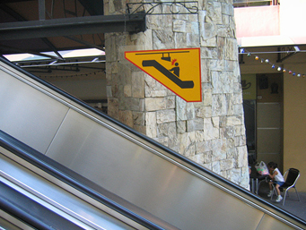
Welcome back! Be sure to watch your head…
Notes:
Setup: ipython and code with lec06prog01-listcomp.py.
The labs were intricate so it’s OK if you had troubles. But if you created accidental or intentional turtle art, screenshot it and submit it so we can enjoy it!
The sign is recursive (see next slide).

Slide 2
Notes:
Photoshopped by a student.

Slide 3
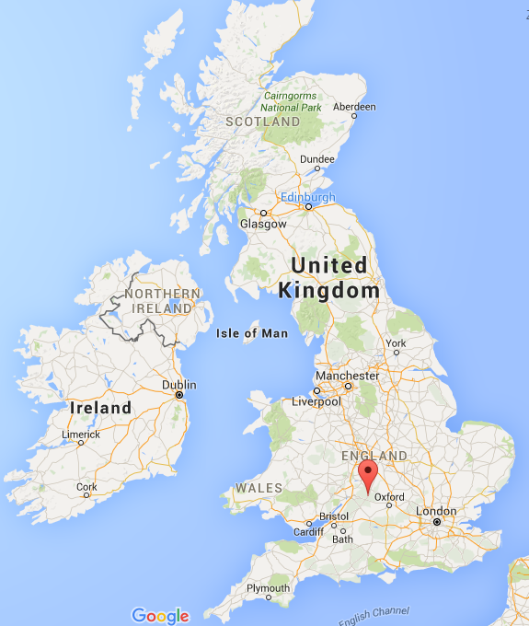
Bourton-on-the-water

Slide 4
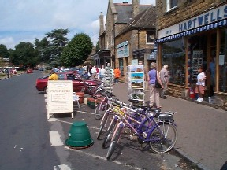
Bourton-on-the-water
town of 2000 people

Slide 5
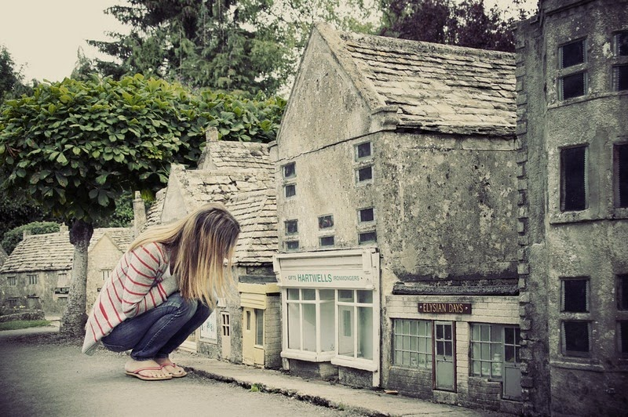
Bourton-on-the-water's 1/9 model

Slide 6
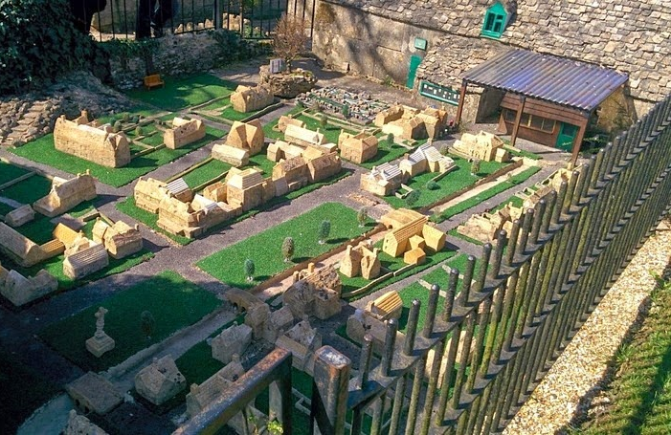
has a level-2 model…

Slide 7
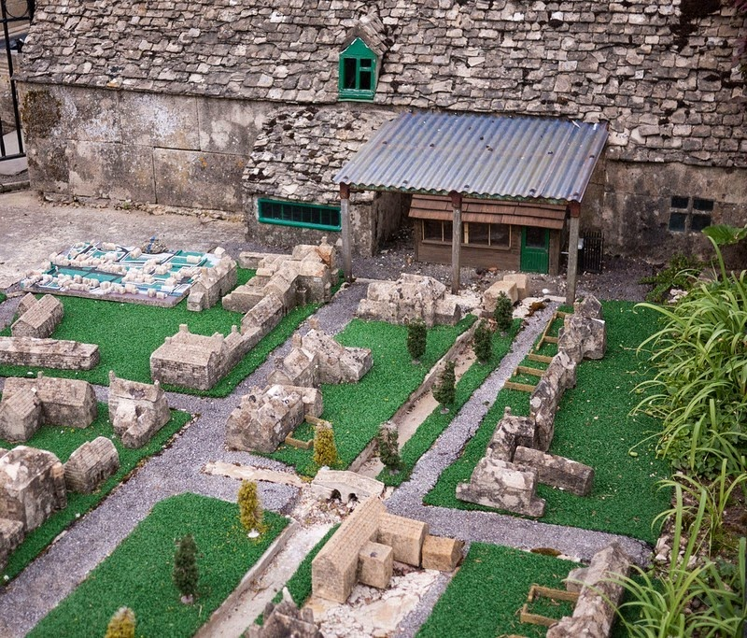
has a level-2 model…

Slide 8
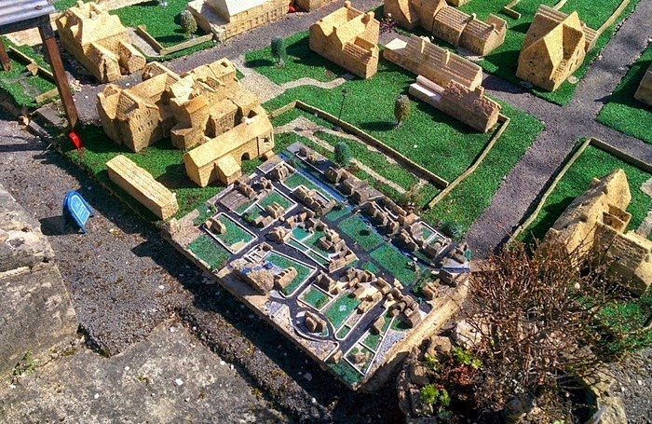
and a level-3 model…

Slide 9
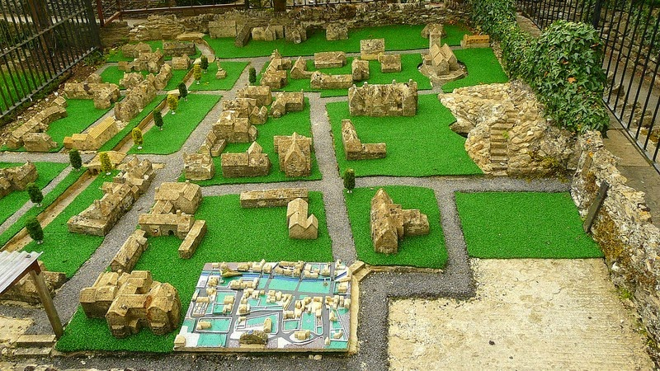
and a level-3 model…

Slide 10
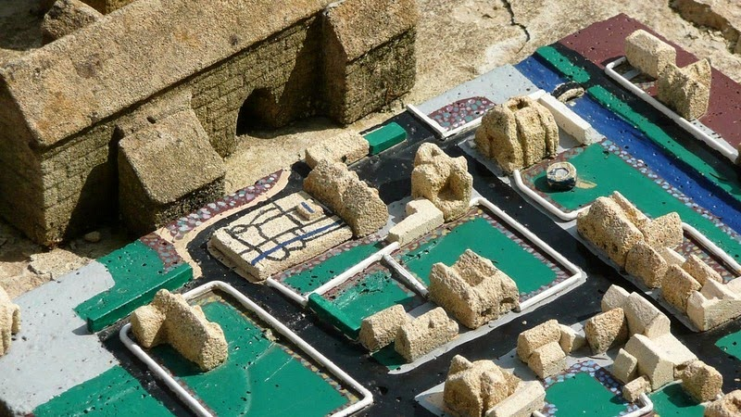
and even a (very small!) level-4 model

Slide 11
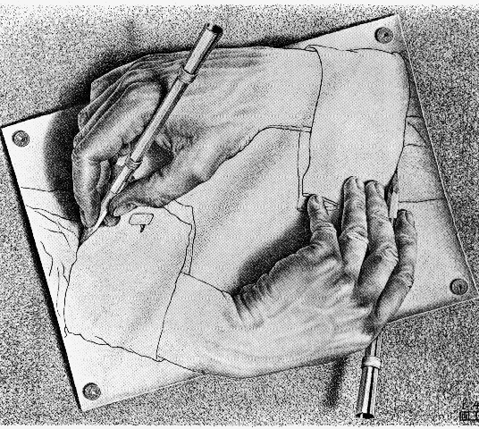
CS 5: now recurring…
Hw3—due Monday evening—usual time
Or re-cursing, depending on your feelings about recursion!
pr0 reading—Watson!
pr1 lab—Turtle!
pr2, pr3—Python probs…
pr4—extra-credit turtle… !
We're computationally complete!
What's next?
putting Python to work!
& adding building blocks
Notes:
INHANDOUT

Slide 12
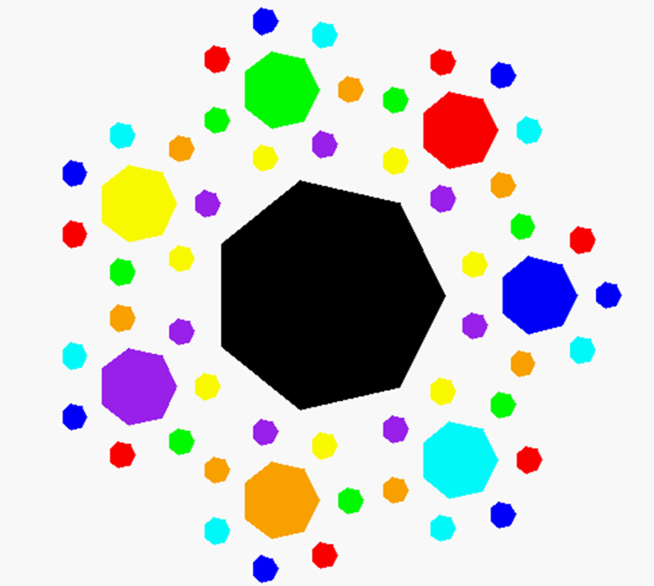
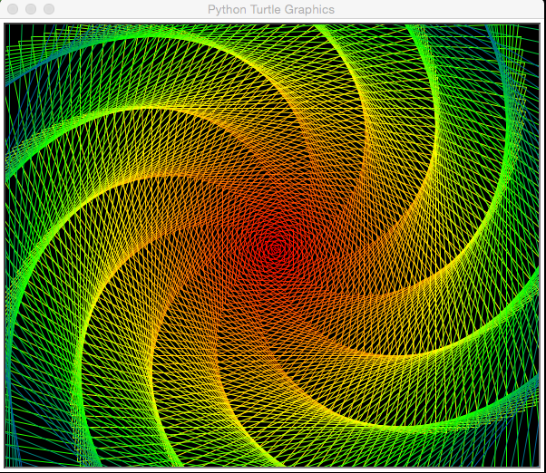
Recursive Art ~ hw3pr4
Submit things that work …
septagonal confetti
dramatic spiral!
patrick kidwell

Slide 13
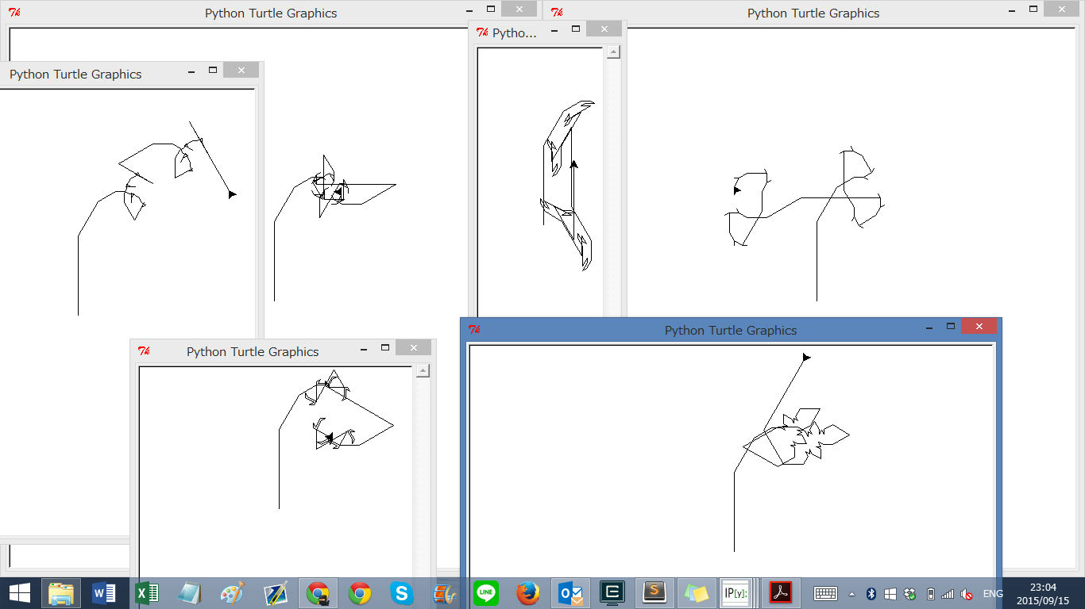
Recursive Art ~ hw3pr4
Submit things that work …
… and even things that don't!
"Cyriak's pet snake…"

Slide 14
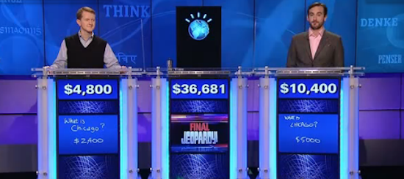
this week's hw2pr0
https://www.youtube.com/watch?v=lI-M7O_bRNg 3:00-3:42
Category: U.S. Cities. Clue: Its largest airport is named for a World War II hero, its second largest for a World War II battle.
Watson
Burninated by syntax!

Slide 15
Functional Programming
>>> 'fun' in 'functional'
True
Representation via list structures (data)
Leverage self-similarity (recursion)
Create small building blocks (functions)
Composed together —to solve/investigate problems
Functional programming
conceptually concise
vs.
easiest for the computer…
functional
procedural or sequential
Notes:
INHANDOUT

Slide 16
Data
[13, 14, 15]
[3, 4, 5, 6, 7, 8, 9]
Functions
sum(…)
… and their compositions
Notes:
Show sum(range(3, 11)) then correct to range(3,10)

Slide 17
sum range
def sum(L):
"""Argument: L, a list of #s
Result: L's sum
"""
if len(L) == 0:
return 0
else:
return L[0] + sum(L[1:])
Base Case
Recursive Case
Notes:
INHANDOUT
L[0] is “first”, recursion is “rest”. Many recursive solutions operate on a first part and delegate the rest to the machine (i.e., to self, to faith).

Slide 18
sum range
list
list(range(low,hi))
step?
what's cookin' here?
def range(low, hi):
"""Arguments: ints low and hi
Result: int list from low to hi
"""
if low >= hi:
return []
else:
return
excluding hi
Notes:
INHANDOUT

Slide 19
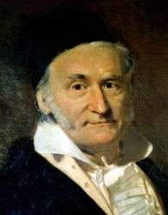
sum and range
1784
list
>>> sum(list(range(1, 101)))
?
I'd bet you have a 50/50 chance on this one…
- Ben. L '14
Notes:
Carl Friedrich Gauss was seven when his teacher assigned a make-work task of adding up 1 to 100. Gauss solved it in moments—and got in trouble for doing so! (But see next slide…)

Slide 20
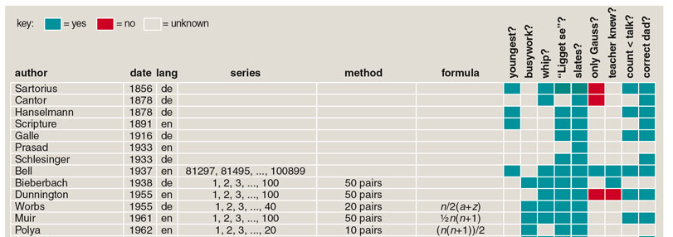
sum and range
1784
list
>>> sum(list(range(1, 101)))
?
I'd bet you have a 50/50 chance on this one…
- Ben. L '14
Gauss's storied story…
and 100 more…
http://www.americanscientist.org/template/AssetDetail/assetid/50686
Notes:
This is from an article in American Scientist about the many variations of the story.

Slide 21
sum and range
1784
list
>>> sum(list(range(1, 101)))
5050
Looks sort of scruffy for a 7-year old… !
1 + 2 + 3 + ... + 98 + 99 + 100
50+51
101
101
101
50 101's == 5050

Slide 22
Data
[8, 9, 10]
Functions
sq()
[64, 81, 100]
[sq(x) for x in [8, 9, 10]]
…together
Notes:
We want to apply a function to data.

Slide 23
List Comprehensions
[2*x for x in [0, 1, 2, 3, 4, 5]]
List Comprehenion
[0, 2, 4, 6, 8, 10]
result
What's the syntax saying here?
Notes:
Next slide discusses the syntax.

Slide 24
List Comprehensions
Expression to evaluate for each list element
Name for each list element
The list - or string to run
[2*x for x in [0, 1, 2, 3, 4, 5]]
List Comprehenion
[0, 2, 4, 6, 8, 10]
result
What's the syntax saying here?
Notes:
INHANDOUT
Draw arrows from x to 0, then to result 0. Next slide has full set of arrows.
Zach calls x a “runner” variable.

Slide 25
List Comprehensions
this "runner" variable can have any name...
x takes on each value
What to do
[2*x for x in [0, 1, 2, 3, 4, 5]]
[0, 2, 4, 6, 8, 10]
and 2*x is result for each one
output
Notes:
INHANDOUT

Slide 26
List Comprehensions
[10*x for x in [0, 1, 2, 3, 4, 5] if x%2 == 0]
result
[y*21 for y in list(range(0, 3))]
result
[s[1] for s in ["hi", "5Cs!"]]
result
Notes:
INHANDOUT
Work out with students.

Slide 27
Quiz!
A range of list comprehensions...
Write Python's result for each L.C.:
Name(s): ___________________________
[n**2 for n in range(0, 5)]
list
[42 for z in [0, 1, 2]]
[z for z in [0, 1, 2]]
[s[1::2] for s in ['aces', '451!']]
[-7*b for b in range(-6, 6) if abs(b) > 4]
list
[a*(a-1) for a in range(8) if a % 2 == 1]
list
Got it. But what about that name?
Notes:
QUIZSLIDE
Warn students: output of every l.c. is a list.
They may need to evaluate what the input is.
The 2nd pair is hard because it seems unnatural…but if you just apply the rule, you’ll get the right result!
Do the first two and the last together; the next slide has solutions.

Slide 28
Quiz!
A range of list comprehensions...
Write Python's result for each L.C.:
Join with a neighbor and try this on the back page first
[n**2 for n in range(0, 5)]
list
[0, 1, 4, 9, 16]
[42 for z in [0, 1, 2]]
[z for z in [0, 1, 2]]
[42, 42, 42]
[0, 1, 2]
[s[1::2] for s in ['aces', '451!']]
[ -6, -5, -4, -3, -2, -1, 0, 1, 2, 3, 4, 5 ]
[-7*b for b in range(-6, 6) if abs(b) > 4]
list
[ -6, -5, 5 ]
[ 0, 1, 2, 3, 4, 5, 6, 7 ]
[a*(a-1) for a in range(8) if a % 2 == 1]
list
[ 1, 3, 5, 7 ]
[ 0, 6, 20, 42 ]
Got it. But what about that name?
Notes:
Note: in ipython, “%pprint” toggles pretty printing and shows lists compactly.

Slide 29
Quiz!
A range of list comprehensions...
Write Python's result for each L.C.:
Join with a neighbor and try this on the back page first
[ n**2 for n in range(0,5) ]
list
[0,1,4,9,16]
Pass those up...
[ 42 for z in [0,1,2] ]
[ z for z in [0,1,2] ]
[42,42,42]
[0,1,2]
[ s[1::2] for s in ['aces','451!'] ]
[ 'cs', '5!' ]
[ -6, -5, -4, -3, -2, -1, 0, 1, 2, 3, 4, 5 ]
[ -7*b for b in range(-6,6) if abs(b)>4 ]
list
[ 42, 35, -35 ]
[ -6, -5, 5 ]
[ 0, 1, 2, 3, 4, 5, 6, 7 ]
[ a*(a-1) for a in range(8) if a%2==1 ]
list
[ 1, 3, 5, 7 ]
[ 0, 6, 20, 42 ]
Got it. But what about that name?

Slide 30
[2*x for x in [0, 1, 2, 3, 4, 5]]
[0, 2, 4, 6, 8, 10]
List Comprehensions?
Is this really the best name Guido Van Rossum could think of?

Slide 31
[2*x for x in [0, 1, 2, 3, 4, 5]]
[0, 2, 4, 6, 8, 10]
A list comprehension by any other name would be even sweeter…
List Comprehensions?
Google maps?
Datafuncs?
FunLists!

Slide 32
Syntax ?!
[2*x for x in [0, 1, 2, 3, 4, 5]]
[0, 2, 4, 6, 8, 10]
at first…
a jumble of characters and random other stuff
Notes:
Everybody has a language they’re unfamiliar with that just looks like a jumble. Greek, Ruby, …

Slide 33
Syntax ?!
[2*x for x in [0, 1, 2, 3, 4, 5]]
[0, 2, 4, 6, 8, 10]
at first…
a jumble of characters and random other stuff
a (frustrated!) rendering of an unfamiliar math problem

Slide 34
Syntax ~ is CS's key resource!
Where'd the change happen?
a (frustrated!) rendering of an unfamiliar math problem
which was likely similar to these…
Notes:
change ~ internally to us
We see things not as they are but as we are…

Slide 35
Syntax !?!
... unforgivingly literal ...
Notes:
Things gradually come into focus…

Slide 36
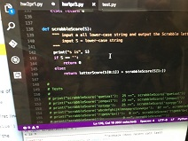
Syntax !?!
... unforgivingly literal ...

Slide 37
Syntax !?!
... unforgivingly literal ...

Slide 38
Syntax !?!
... unforgivingly literal ...
Notes:
Syntax error: the S is a 5!

Slide 39
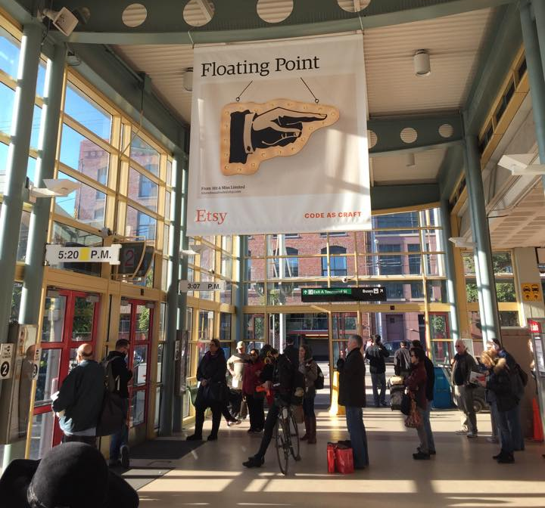
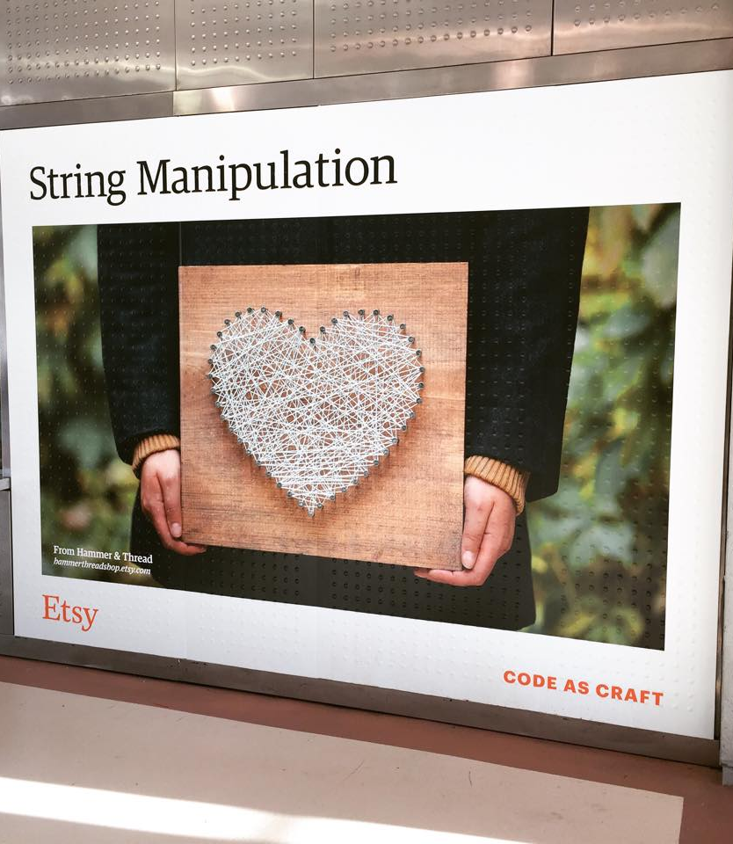
Syntax vs. Semantics
Come by the 5C Career Fair!
Th./F., Oct. 6-7 at HMC's LAC…

Slide 40
LCs for Monte Carlo Analysis…
# this line runs guess(42) 1000 times
LC = [guess(42) for x in range(1000)]
# Let's look at the first ten of them:
print(LC[0:10])
# Let's find the average:
print("av.#guesses:", sum(LC) / len(LC))
list
Hah! Now I see why they told me I'd be making a zillion euros as spokesalien for this class!
a.k.a.
Run it a "zillion" times!
Notes:
INHANDOUT
This is countGuess from last time. Spend time demonstrating. Show min and max of LC.

Slide 41
Zillion-times testing!
doubles-counting
# this runs the doubles-counter 600 times…
cd_np(600) # np: no printing
# Run _that_ 1000 times (600,000 rolls total!)
LC = [cd_np(600) for x in range(1000)]
# Look at the first 10 of these
print(LC[0:10])
# Then, find the average:
print("av.dbls (/600):", sum(LC) / len(LC))
list
the average #doubles per 600 rolls
Notes:
INHANDOUT
How would we change this to print a correct fraction?

Slide 42
Zillion-times testing!
Monte Carlo Monty Hall
# this runs the MCMH-counter 300 times…
MCMHnp(1, 'switch', 300) # np: no printing
# Run _that_ 1000 times (300,000 games total!)
LC = [MCMHnp(300) for x in range(1000)]
# Look at the first 10 of these
print(LC[0:10])
# Let's find the average:
print("av. spams (/300):", sum(LC) / len(LC))
list
the average #wins per 300 games
Monagasques might use foie gras instead…
Notes:
In the homework we’ll do the average for a random walk.

Slide 43
On balance?
or maybe lighter is better?

Slide 44
Designing with LCs
write
[_______ for x in range(4)]
[0, 14, 28, 42]
list
[0, 1, 2, 3]
result
write
[_____________ for c in 'igetthis']
[True, False, False, False, False, False, True, False]
[ 1, 0, 0, 0, 0, 0, 1, 0 ]
result
And if we wanted the ints (in red)…?
Notes:
INHANDOUT
You can get the ints by casting the comparison to int. Show doing this, and then that sum(LC) gives the number of i’s.

Slide 45
Using LCs
Short and sweet!
[7, 8, 9]
def
fun1(L):
LC = [1 for x in L]
return sum(LC)
def
letScore(c):
'twelve'
lots of ifs…
return score
def
fun2(S):
LC = [letScore(c) for c in S]
return sum(LC)
Notes:
INHANDOUT
What does fun1 do?
They wrote fun2 last week (scrabbleScore)

Slide 46
Using LCs
[7, 8, 9]
But one-liners are my specialty…
def
len(L):
LC = [1 for x in L]
return sum(LC)
def
letScore(c):
'twelve'
lots of ifs…
return score
def
scrabbleScore(S):
LC = [letScore(c) for c in S]
return sum(LC)
Notes:
Twelve is the only number whose name is its score.

Slide 47
"One-line" LCs
'cs5'
def
len(L):
LC = [1 for x in L]
return sum(LC)
I only ever get one line— who are the writers around here?
possible, but not recommendable!
def
len(L):
return sum([1 for x in L])
Maybe too terse!

Slide 48
'sequoia'
if
# of vowels
def
vwl(s):
LC = [ for c in s ]
return sum(LC)
42
[3, 42, 5, 7, 42]
# of times e is in L
def
count(e, L):
LC = [ for x in L ]
return sum(LC)
the too-terse approaches to these...
LC = [ for c in s ]
top
remember True == 1 and False == 0
LC = [ for x in L ]
bottom
Notes:
INHANDOUT
Show count(42, [3, 42, 5, 7, 42])

Slide 49
Write each of these functions using list comprehensions…
Go!
Argument: L, any list of numbers
Result: the count of odd numbers in L
First, demos()
def nodds(L):
Example: nodds([3, 4, 5, 7, 42] ) == 3
LC = [ for x in L ]
return sum(LC)
Y are your #s
W are the winning #s
Arguments: Y and W, two lists of "lottery" numbers (ints)
Result: the number of matches between Y & W
def lotto(Y, W):
Example: lotto([5, 7, 42, 47], [3, 5, 7, 44, 47] ) == 3
LC = [
return sum(LC)
Argument: N, an int >= 2
Result: the number of positive divisors of N
def ndivs(N):
Example: numdivs(12) == 6 (1, 2, 3, 4, 6, 12)
LC = [
return sum(LC)
Argument: P, an int >= 2
Result: alist of prime numbers up to & incl. P
def primesUpTo(P):
Example: primesUpTo(12) == [2, 3, 5, 7, 11]
Extra!
return LC
Notes:
demos() will run all four. Next slide is blank; then solutions come one by one.

Slide 50
Write each of these functions using list comprehensions…
Go!
Argument: L, any list of numbers
Result: the count of odd numbers in L
def nodds(L):
Example: nodds([3, 4, 5, 7, 42] ) == 3
LC = [ for x in L ]
return sum(LC)
Y are your #s
W are the winning #s
Arguments: Y and W, two lists of "lottery" numbers (ints)
Result: the number of matches between Y & W
def lotto(Y, W):
Example: lotto([5, 7, 42, 47], [3, 5, 7, 44, 47] ) == 3
LC = [
return sum(LC)
Argument: N, an int >= 2
Result: the number of positive divisors of N
def ndivs(N):
Example: numdivs(12) == 6 (1, 2, 3, 4, 6, 12)
LC = [
return sum(LC)
Argument: P, an int >= 2
Result: alist of prime numbers up to & incl. P
def primesUpTo(P):
Example: primesUpTo(12) == [2, 3, 5, 7, 11]
Extra!
return LC
Notes:
INHANDOUTFULL

Slide 51
Write each of these functions using list comprehensions…
Go!
def nodds(L):
LC = [1 for x in L if x%2 == 1]
return sum(LC)
too terse?
[ x % 2 for x in L ]
def lotto(Y, W):
LC = [ ]
too terse?
return sum(LC)
[ ]
def ndivs(N):
LC = [1 for x in range(1, N + 1) if N % x == 0]
list
too terse?
return sum(LC)
[ N % x == 0 for x in range(1, N + 1) ]
def primesUpTo(P):
Extra!
LC = [x for x in range(2, P+1) if ndivs(x) == 2]
list
return LC
Notes:
Demo primesUpTo(1000)
Demo lotto (actually lotto_sol). Y and W are already in lec6fun. Correct answer is 3.

Slide 52
Write each of these functions using list comprehensions…
Go!
def nodds(L):
LC = [1 for x in L if x%2 == 1]
return sum(LC)
too terse?
[ x % 2 for x in L ]
def lotto(Y,W):
LC = [1 for y in Y if y in W]
too terse?
return sum(LC)
[ y in W for y in Y ]
def ndivs(N):
LC = [1 for x in range(1, N + 1) if N % x == 0]
list
too terse?
return sum(LC)
[ N % x == 0 for x in range(1, N + 1) ]
def primesUpTo(P):
Extra!
LC = [x for x in range(2, P+1) if ndivs(x) == 2]
list
return LC
Notes:
Demo primesUpTo(1000)
Demo lotto (actually lotto_sol). Y and W are already in lec6fun. Correct answer is 3.

Slide 53
hw3pr3: areas from rectangles
y = 2x
y = 2x
(7.5,15)
(7.5,15)
(5,10)
(5,10)
(2.5,5)
(2.5,5)
(0,0)
(0,0)
Areas of 4 rectangles
Areas of 8 rectangles

Slide 54
hw2pr3: areas from rectangles
y = 2x
(10,20)
y = 2x
y = 2x
(7.5,15)
(7.5,15)
(7.5,15)
(5,10)
(5,10)
(5,10)
(2.5,5)
(2.5,5)
(2.5,5)
(2.5,5)
(0,0)
(0,0)
(0,0)
(0,0)
Area of N rectangles in the limit

Slide 55
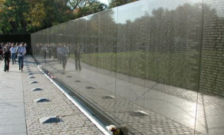
hw2pr3: Maya Lin, Architect…

Slide 56
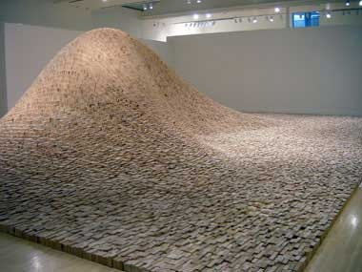
Maya Lin, Artist and Computer Scientist…
"two-by-four landscape"

Slide 57
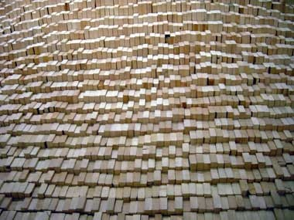
Maya Lin, Artist and Computer Scientist…
One building block, deliberately applied, over 50,000 times…

Slide 58
Building blocks == CS!
y = 2x
scaledfracs(low, hi, N)
(7.5,15)
f_of_fracs(f, low, hi, N)
(5,10)
integrate(f, low, hi, N)
(2.5,5)
only a few lines...
(0,0)
Where are the LCs?
Areas of 8 rectangles

Slide 59
Building blocks == CS!
y = 2x
Good luck with hw#3…
scaledfracs(low,hi,N)
(7.5,15)
f_of_fracs(f,low,hi,N)
(5,10)
integrate(f,low,hi,N)
... and may your weekend be syntactically smooth!
(2.5,5)
only a few lines...
(0,0)
Where are the LCs?
Areas of 8 rectangles

