Slide 1

The CS 5 Times
CS 5 and Physics
Penguins Stranded
in Spaceship Crash
Wellington (AP): Two HMC penguins
were missing after their spaceship lost
power and crashed into the southern ocean. “The CS
penguin had kindly offered a ride to her friend,” blubbered a distraught professor, “and apparently he was fiddling with the flight computer just before takeoff. I don’t know what I’ll do for classroom examples now.”
With weather worsening, there is little hope for rescue. A memorial service will be held Sunday in the Hoch-Shanahan freezer.

Slide 2
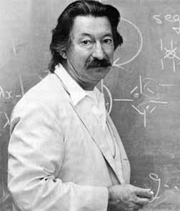

True Story
Joseph Weizenbaum
1923-2008
Eliza, the Rogerian therapist

Slide 3


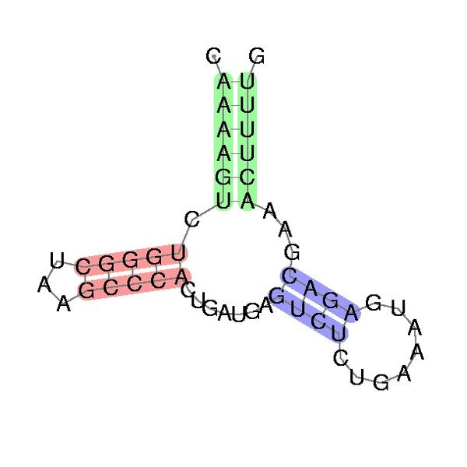
This Week
Homework 3:
  Reading
  Black lab (Problem 1) is same as Gold this week
  Problem 2: Spel Chekking
  Problem 3: RNA folding
You’re ready
for this today!
You’re ready
for this today!
Thursday!

Slide 4
Aside: Another Way to map
def doubleList1(L):
return list(map(lambda x: 2*x, L))
def doubleList2(L):
return [2*x for x in L]
def doubleListFiltered1(L):
return list(map(lambda x: 2*x, filter(lambda x: x != 42, L)))
def doubleListFiltered2(L):
return [2*x for x in L if x != 42]
Notes:
These are called "list comprehensions". There are two animations here, one to make each comprehension appear.

Slide 5
Conditionalizing lambda
>>> list(map(lambda x: "nice" if x == 42 else “blech!”,
[42, 7, 6, 42, 3]))
[“nice”, “blech!”, “blech!”, “nice”, “blech!”]
>>> list(map(lambda x: "HM" if x == 42
else "PO" if x == 47
else x,
[42, 7, 6, 47, 3]))
['HM', 7, 6, 'PO', 3]

Slide 6
“Easy” Problems
Sorting a list of n numbers: [42, 3, 17, 26, … , 100]
n log₂ n
Multiplying two n x n matrices:
(
)
(
)
(
)
3 5 2 7
1 6 8 9
2 4 6 10
9 3 2 12
1 5 5 4
5 12 8 6
7 6 1 5
9 23 5 8
n
=
n
n
n
n
Notes:
Naïve matrix multiplication is O(n**3), but best-known algorithm is n**2.373 (only works for square matrices).

Slide 7
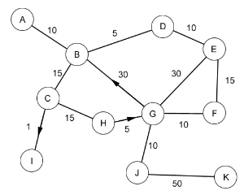

“Easy” Problems
The Shortest Path Problem (i.e. “Google Maps”
Edsgar Dijkstra

Slide 8

“Easy” Problems
“Polynomial Time” = “Efficient”
n, n², n³, n⁴, n⁵,…
sorting
How about something like n log₂ n ?
matrix multiplication
shortest paths
The “class” P

Slide 9

“Hard” Problems
Snowplows of Northern Minnesota
Burrsburg
Tundratown
Frostbite City
Shiversville
Freezeapolis
Brute-force? Greed?
Notes:
This is an expression of the Vertex Cover problem: choose a set of vertices such that every edge has at least one endpoint in the vertex set. In this case, the problem is to place the minimum number of snowplows such that any snowy road can be plowed without first crossing a clear road.

Slide 10

“Hard” Problems
The Travelling Salesperson Problem
New York
2566
4664
San Francisco
Moscow
5868
5563
2417
3627
366
1545
6060
Paris
Claremont
5625
Brute Force? Greed?

Slide 11
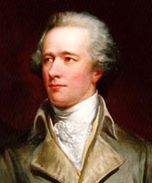
The Hamiltonian Path Problem
Athens, GA
William Rowan
Hamilton
Homer, GA
Rome, GA
Damascus, GA
Bethlehem, GA
Those are some peachy names!
Notes:
A Hamiltonian path is a path that visits each vertex exactly once.
Sir William Rowan Hamilton, 1805-1865: Hamiltonian path problem

Slide 12


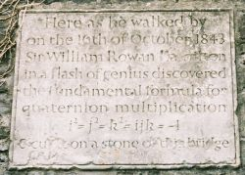
William Rowan Hamilton
William Rowan
Hamilton
1806-1865
Dunsink Observatory
Broom Bridge, Dublin Ireland

Slide 13

n² Versus 2^{n}
Geoff-O-Matic
The Geoff-O-Matic performs 10⁹ operations/sec
n = 10 n = 30 n = 50 n = 70
n²
2^{n}
n!
100
< 1 sec
900
< 1 sec
2500
< 1 sec
4900
< 1 sec
1024
< 1 sec
10⁹
1 sec
10¹⁵
11.6 days
10²¹
31,688 years
< 1 sec
10¹⁶ years
10⁵⁷ years
10⁹³ years
Notes:
10! = 3628800. The other factorials are just silly.
The animations pop up the various answers one at a time.

Slide 14
Here’s an Idea!
Let’s just buy a computer that’s twice as fast!
Size of largest problem
solvable with “old”
computer in one hour = S
n n² n³ n⁵ 2^{n} n!
Size of largest problem
solvable with “new”
twice-as-fast computer in one hour
2S
1.41S
1.26S
1.15S
S+1
S

Slide 15
Snowplows and Travelling Salesperson Revisited!
So are there polynomial time algorithms for the Snowplow and Travelling Salesperson, and Hamiltonian Path Problems?!
Tens of thousands of other known problems go in this cloud!!
Snowplow Problem
Travelling Salesperson Problem
Hamiltonian Path Problem
…
NP-complete problems
Notes:
The alien on this slide appears first; the animation shows the NP-complete problems.

Slide 16
Snowplows and Travelling Salesperson Revisited!
If a problem is NP-complete, it doesn’t necessarily
mean that it can’t be solved in polynomial time. It
does mean…
Tens of thousands of other known problems go in this cloud!!
Travelling Salesperson Problem
Snowplow Problem
Hamiltonian Path Problem
…
NP-complete problems

Slide 17

“I can’t find an efficient algorithm. I guess I’m too dumb.”
Cartoon courtesy of “Computers and Intractability: A Guide to the Theory of NP-Completeness” by M. Garey and D. Johnson

Slide 18

“I can’t find an efficient algorithm because no such
algorithm is possible!”
Cartoon courtesy of “Computers and Intractability: A Guide to the Theory of NP-Completeness” by M. Garey and D. Johnson

Slide 19
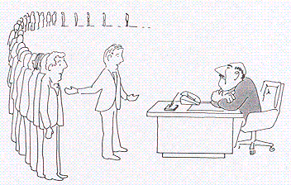
“I can’t find an efficient algorithm, but neither
can all these famous people.”
Cartoon courtesy of “Computers and Intractability: A Guide to the Theory of NP-Completeness” by M. Garey and D. Johnson

Slide 20
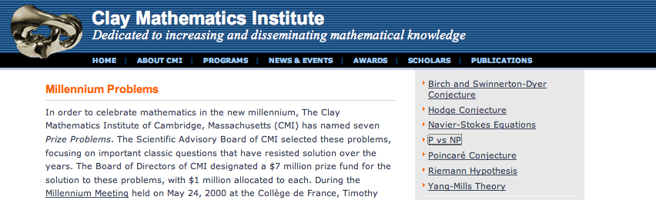


$1 million
Vinay Deolalikar
Notes:
Deolalikar published an alleged proof in 2010. But it has flaws, and he has gone back to the drawing board.

Slide 21

What Is This?!
Notes:
This seen is from “Futurama”.

Slide 22
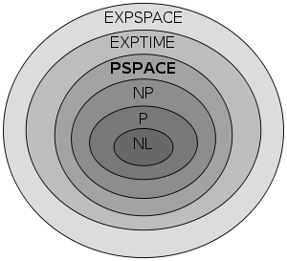
Are There Problems That Are Even Harder Than NP-Complete?
Kryptonite problems?

Slide 23
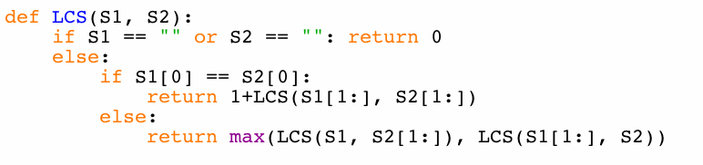
Is LCS NP-Complete?
Demo LCS, fastLCS
Two strings of length 100 nucleotides each…
>>> steps = 2**100
>>> speed = 3 * 10**9
>>> seconds = steps / speed
>>> years = seconds / (60*60*24*365.25)
>>> years
13389807845846.213
>>>
60 seconds per minute
60 minutes per hour
24 hours per day
365.25 days per year
13 trillion years!
Notes:
Set abet= the alphabet, then abet2=abet[:14]. Have the students time LCS(abet2,abet2[::-1]). Then increase abet2 to 15 and then 16, timing it each time. On my laptop I got about 1:15 for 16. Then run fastLCS first on abet2, then on abet.

Slide 24

LCS(“spam”, “pims”)
LCS(“spam”, “ims”)
LCS(“pam”, “pims”)
1+
LCS(“spam”, “ms”)
LCS(“pam”, “ims”)
LCS(“am”, “ims”)
LCS(“pam”, “ms”)
LCS(“am”, “ims”)
I love “am and ims”!
Notes:
Highlight that “am” and “ims” are used in the rightmost branch of the left subtree, and in the right subtree.

Slide 25
Dictionaries Revisited
>>> D = {“spam” : “yummy!”, (42, 42): “an important point”}
>>> D[“spam”]
“yummy!”
>>> D[(42, 42)]
“an important point”
>>> D[ [“zaster!”, “putrid”, “smoke!”] ]
BARF!

Slide 26
Dictionaries Revisited
>>> D = {“spam” : “yummy!”, (42, 42): “an important point”}
>>> D = {}
>>> D[ “spam” ] = “yummy!”
>>> D[ (42, 42) ] = “an important point”
>>> D[ [1, 2] ] = “but this is bad”
BARF!
>>> “spam” in D
True
>>> 42 in D
False
>>> (42, 42) in D
True
>>> D[(42, 42)]
“an important point”

Slide 27
How Dictionaries Work: Hashing
>>> D
{“Ran”: “spam”, … }
>>> x = (1, 2)
>>> D[x] = “my tuple”
>>> D
{“Ran: “spam”, (1, 2): “my tuple”}
Memory
locations
D[“Ran”]
D[x] =
D[(1, 2)]
5999
1
2
3
“my tuple”
3
5999
“spam”
Imagine that we now changed x[0]=42
6000

Slide 28
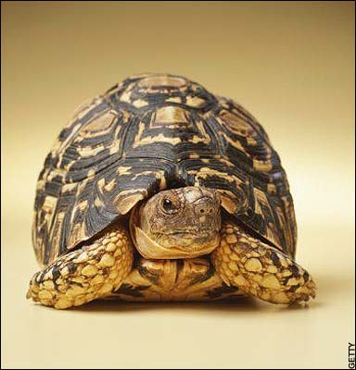
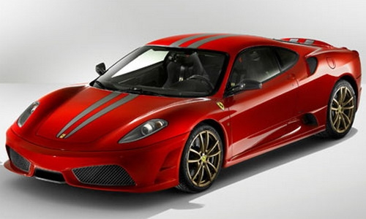
def LCS(S1, S2):
if S1 == "" or S2 == "": return 0
elif S1[0] == S2[0]:
return 1+LCS(S1[1:], S2[1:])
else:
return max(LCS(S1, S2[1:]), LCS(S1[1:], S2))
Old slow version
memo = {} # global empty dictionary
def fastLCS(S1, S2):
if (S1, S2) in memo: return memo[(S1, S2)]
elif S1 == "" or S2 == "":
answer = 0
elif S1[0] == S2[0]:
answer = 1+LCS(S1[1:], S2[1:])
else:
answer = max(LCS(S1, S2[1:]), LCS(S1[1:], S2))
memo[(S1, S2)] = answer
return answer
New fast
“memoized”
version

Slide 29
The Aliens’ Life Advice
Don’t always win, even if you can.
Nobody likes losing all the time.

Slide 30
Changing change
def change(value, coins):
if value <= 0:
return 0
elif coins == []:
return float("inf")
loseIt = change(value, coins[1:])
if value < coins[0]:
return loseIt
else:
useIt = 1 + change(value - coins[0], coins)
return min(useIt, loseIt)

Slide 31
Changing change
memo = {} # Empty dictionary
def fastChange(value, coins):
if (value, coins) in memo:
return memo[(value, coins)]
elif value <= 0:
return 0
elif coins == []:
return float("inf")
# Finish writing this!
coins must be a tuple rather
than a list!
Geoff’s solution coming up…

Slide 32
Changing change
memo = {} # Empty dictionary
def fastChange(value, coins):
if (value, coins) in memo:
return memo[(value, coins)]
elif value <= 0:
return 0
elif coins == []:
return float("inf")
loseIt = fastChange(value, coins[1:])
if value < coins[0]:
memo[(value, coins)] = loseIt
return loseIt
else:
useIt = 1 + fastChange(value - coins[0], coins)
best = min(useIt, loseIt)
memo[(value, coins)] = best
return best
coins must be a tuple rather
than a list!

Slide 33
Beyond LCS: Edit Distance
>>> ED("ATTATCG", "ACATTC")
4
ATTAT-CG
A-CATTC-
The lower the edit distance the better!

Slide 34
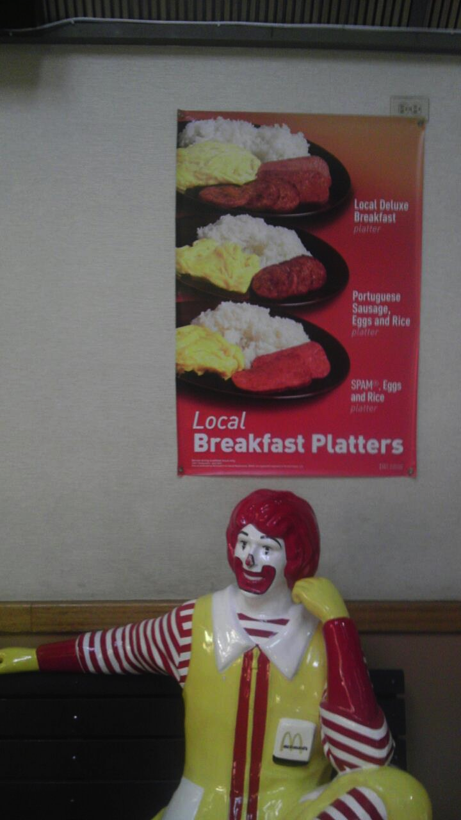
Beyond LCS: Edit Distance
>>> ED("ATTATCG", "ACATTC")
4
ATTAT-CG
A-CATTC-
>>> ED("spam", "scramble")
5
sp_am___
scramble
spam ->
scam ->
scram ->
scramb -> scrambl -> scramble
Notes:
The animation shows the answer (5) and how it is achieved.

Slide 35
Beyond LCS: Edit Distance
>>> ED("spam", "scramble")
5
spam ->
scam ->
scram ->
scramb -> scrambl -> scramble
def ED(S1, S2):
if S1 == '': return ???
elif S2 == '': return ???
elif S1[0] == S2[0]: return ???
else: # substitute, insert, or delete!

Slide 36
Beyond LCS: Edit Distance
>>> ED("spam", "scramble")
5
spam ->
scam ->
scram ->
scramb -> scrambl -> scramble
def ED(S1, S2):
if S1 == '': return len(S2)
elif S2 == '': return len(S1)
elif S1[0] == S2[0]: return ???
else: # substitute, insert, or delete!

Slide 37
Beyond LCS: Edit Distance
>>> ED("spam", "scramble")
5
spam ->
scam ->
scram ->
scramb -> scrambl -> scramble
def ED(S1, S2):
if S1 == '': return len(S2)
elif S2 == '': return len(S1)
elif S1[0] == S2[0]: return ED(S1[1:], S2[1:])
else: # substitute, insert, or delete!
substitute =
insert =
delete =
return min(substitute, insert, delete)

Slide 38
Beyond LCS: Edit Distance
>>> ED("spam", "scramble")
5
spam ->
scam ->
scram ->
scramb -> scrambl -> scramble
def ED(S1, S2):
if S1 == '': return len(S2)
elif S2 == '': return len(S1)
elif S1[0] == S2[0]: return ED(S1[1:], S2[1:])
else: # substitute, insert, or delete!
substitute = 1 + ED(S1[1:], S2[1:])
insert =
delete =
return min(substitute, insert, delete)

Slide 39
Beyond LCS: Edit Distance
>>> ED("spam", "scramble")
5
spam ->
scam ->
scram ->
scramb -> scrambl -> scramble
def ED(S1, S2):
if S1 == '': return len(S2)
elif S2 == '': return len(S1)
elif S1[0] == S2[0]: return ED(S1[1:], S2[1:])
else: # substitute, insert, or delete!
substitute = 1 + ED(S1[1:], S2[1:])
insert = 1 + ED(S1, S2[1:])
delete =
return min(substitute, insert, delete)

Slide 40
Beyond LCS: Edit Distance
>>> ED("spam", "scramble")
5
spam ->
scam ->
scram ->
scramb -> scrambl -> scramble
def ED(S1, S2):
if S1 == '': return len(S2)
elif S2 == ‘'': return len(S1)
elif S1[0] == S2[0]: return ED(S1[1:], S2[1:])
else: # substitute, insert, or delete!
substitute = 1 + ED(S1[1:], S2[1:])
insert = 1 + ED(S1, S2[1:])
delete = 1 + ED(S1[1:], S2)
return min(substitute, insert, delete)

Slide 41


Problem 2 This Week…
New! Millisoft Office, featuring
Millisoft Sentence (word processor)
Energy Dot (presentation software)
Succeed (spreadsheet software)
Gill Bates
Spelling A La Millisoft (SPAM)
DEMO!

