Slide 1
The CS 5 Examiner
Penguin Rescue!
Dunedin, New Zealand (Penguin Press):
A daring mission has been
mounted to rescue two adorable penguins
who had been given up as lost after a
spaceship crash. Risking her life with an
untested experimental jet pack, a brave Chemistry penguin mixed a witches’ brew of propellant, fueled the pack, and set off across the sky in search of her missing colleagues, who were running out of fish when last heard from.
“We are, like, so grateful for this, like, attempt, and, like, we, like, hope for her, like, success,” stated a jittery CS 5 student. “We like, love our, like, penguins and are, like, so helpless with our, like, homework assignments without, like, their, like, help.”
Further quotes were unavailable due to an unexpected attack from a WRIT 1 instructor.
No reading today!
Notes:
Functional5
Setup: lec07prog01lcs.py
Worksheet: edit distance and changing “change” (change is too late; so use edit distance instead)

Slide 2
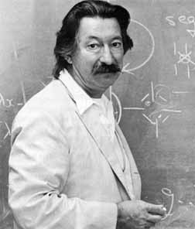
True Story
Joseph Weizenbaum
1923-2008
Eliza, the Rogerian therapist

Slide 3
This Week
Homework 3:
Reading
Black lab (Problem 1) is same as Gold this week
Problem 2: Spel Chekking
Problem 3: Word Break
You’re ready
for this today!
You’re ready
for this today!
Thursday!
Notes:
Lab is “sounds good”.

Slide 4
Beyond LCS: Edit Distance
>>> ED("ATTATCG", "ACATTC")
4
ATTAT-CG
A-CATTC-
The lower the edit distance the better!

Slide 5
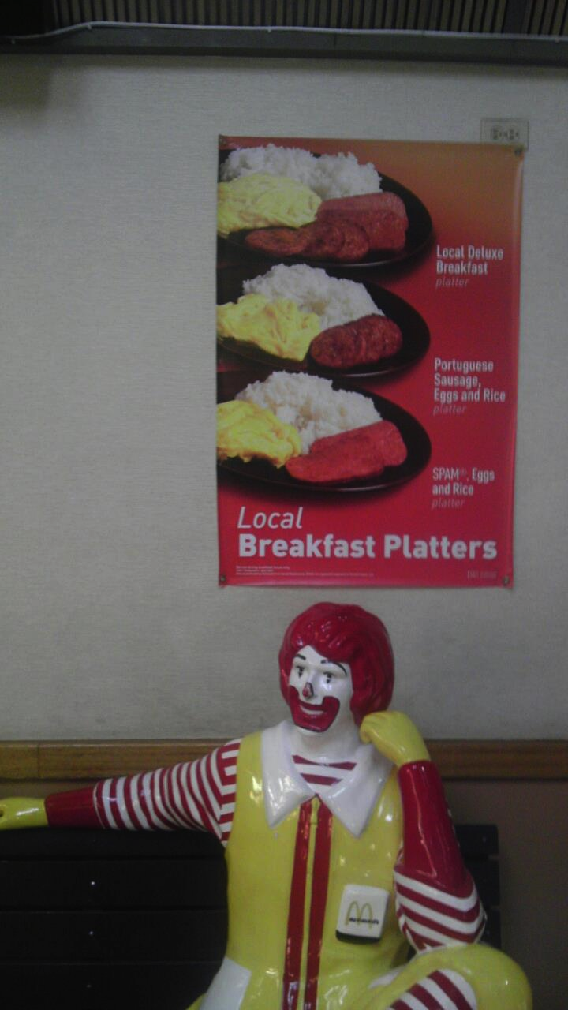
Beyond LCS: Edit Distance
>>> ED("ATTATCG", "ACATTC")
4
ATTAT-CG
A-CATTC-
>>> ED("spam", "scramble")
5
sp_am___
scramble
spam ->
scam ->
scram ->
scramb -> scrambl -> scramble
Notes:
The animation shows the answer (5) and how it is achieved.

Slide 6
Beyond LCS: Edit Distance
>>> ED("spam", "scramble")
5
spam ->
scam ->
scram ->
scramb -> scrambl -> scramble
def ED(S1, S2):
if S1 == '':
return ???
elif S2 == '':
return ???
elif S1[0] == S2[0]:
return ???
else: # substitute, insert, or delete!
Worksheet!

Slide 7
Beyond LCS: Edit Distance
>>> ED("spam", "scramble")
5
spam ->
scam ->
scram ->
scramb -> scrambl -> scramble
def ED(S1, S2):
if S1 == '':
return len(S2)
elif S2 == '':
return len(S1)
elif S1[0] == S2[0]:
return ???
else: # substitute, insert, or delete!

Slide 8
Beyond LCS: Edit Distance
>>> ED("spam", "scramble")
5
spam ->
scam ->
scram ->
scramb -> scrambl -> scramble
def ED(S1, S2):
if S1 == '':
return len(S2)
elif S2 == '':
return len(S1)
elif S1[0] == S2[0]:
return ED(S1[1:], S2[1:])
else: # substitute, insert, or delete!
substitute =
insert =
delete =
return min(substitute, insert, delete)

Slide 9
Beyond LCS: Edit Distance
>>> ED("spam", "scramble")
5
spam ->
scam ->
scram ->
scramb -> scrambl -> scramble
def ED(S1, S2):
if S1 == '':
return len(S2)
elif S2 == '':
return len(S1)
elif S1[0] == S2[0]:
return ED(S1[1:], S2[1:])
else: # substitute, insert, or delete!
substitute = 1 + ED(S1[1:], S2[1:])
insert =
delete =
return min(substitute, insert, delete)

Slide 10
Beyond LCS: Edit Distance
>>> ED("spam", "scramble")
5
spam ->
scam ->
scram ->
scramb -> scrambl -> scramble
def ED(S1, S2):
if S1 == '':
return len(S2)
elif S2 == '':
return len(S1)
elif S1[0] == S2[0]:
return ED(S1[1:], S2[1:])
else: # substitute, insert, or delete!
substitute = 1 + ED(S1[1:], S2[1:])
insert = 1 + ED(S1, S2[1:])
delete =
return min(substitute, insert, delete)

Slide 11
Beyond LCS: Edit Distance
>>> ED("spam", "scramble")
5
spam ->
scam ->
scram ->
scramb -> scrambl -> scramble
def ED(S1, S2):
if S1 == '':
return len(S2)
elif S2 == '':
return len(S1)
elif S1[0] == S2[0]:
return ED(S1[1:], S2[1:])
else: # substitute, insert, or delete!
substitute = 1 + ED(S1[1:], S2[1:])
insert = 1 + ED(S1, S2[1:])
delete = 1 + ED(S1[1:], S2)
return min(substitute, insert, delete)

Slide 12
Problem 2 This Week…
New! Millisoft Office, featuring
Millisoft Sentence (word processor)
Energy Dot (presentation software)
Succeed (spreadsheet software)
Gill Bates
Spelling A La Millisoft (SPAM)

Slide 13
Aside: Another Way to map
def doubleList1(L):
return list(map(lambda x: 2*x, L))
def doubleList2(L):
return [2*x for x in L]
def doubleListFiltered1(L):
return list(map(lambda x: 2*x, filter(lambda x: x != 42, L)))
def doubleListFiltered2(L):
return [2*x for x in L if x != 42]
These are called list comprehensions!
Notes:
These are called "list comprehensions". List comprehensions are considered to be more “Pythonic”.
There are two animations here, one to make each comprehension appear.

Slide 14
Conditionalizing lambda
>>> list(map(lambda x: "nice" if x == 42 else “blech!”,
[42, 7, 6, 42, 3]))
[“nice”, “blech!”, “blech!”, “nice”, “blech!”]
>>> list(map(lambda x: "HM" if x == 42
else "PO" if x == 47
else x,
[42, 7, 6, 47, 3]))
['HM', 7, 6, 'PO', 3]
>>> ["HM" if x == 42 else "PO" if x == 47 else x
for x in [42, 7, 6, 47, 3]]
['HM', 7, 6, 'PO', 3]
Notes:
Note that this syntax is very confusing because the condition is in between the two values. Guido didn’t like ?: in C and this is the result.

Slide 15
The Aliens’ Life Advice
Don’t always win, even if you can.
Nobody likes losing all the time.

Slide 16
“Easy” Problems
Sorting a list of n numbers: [42, 3, 17, 26, … , 100]
n log₂ n
Multiplying two n x n matrices:
(
)
(
)
(
)
3 5 2 7
1 6 8 9
2 4 6 10
9 3 2 12
1 5 5 4
5 12 8 6
7 6 1 5
9 23 5 8
n
=
n
n
n
n
Notes:
Naïve matrix multiplication is O(n**3), but best-known algorithm is n**2.373 (only works for square matrices).

Slide 17
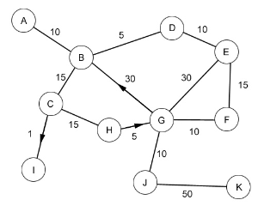
“Easy” Problems
The Shortest Path Problem (i.e. “Google Maps”
Edsgar Dijkstra

Slide 18
“Easy” Problems
“Polynomial Time” = “Efficient”
n, n², n³, n⁴, n⁵,…
sorting
How about something like n log₂ n ?
matrix multiplication
shortest paths
The “class” P

Slide 19
“Hard” Problems
Snowplows of Northern Minnesota
Burrsburg
Tundratown
Frostbite City
Shiversville
Freezeapolis
Brute-force? Greed?
Notes:
This is an expression of the Vertex Cover problem: choose a set of vertices such that every edge has at least one endpoint in the vertex set. In this case, the problem is to place the minimum number of snowplows such that any snowy road can be plowed without first crossing a clear road.

Slide 20
“Hard” Problems
The Traveling Salesperson Problem
New York
2566
4664
San Francisco
Moscow
5868
5563
2417
3627
366
1545
6060
Paris
Claremont
5625
Brute Force? Greed?

Slide 21
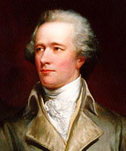
The Hamiltonian Path Problem
Athens, GA
William Rowan
Hamilton
Homer, GA
Rome, GA
Damascus, GA
Bethlehem, GA
Those are some peachy names!
Notes:
A Hamiltonian path is a path that visits each vertex exactly once.
Sir William Rowan Hamilton, 1805-1865: Hamiltonian path problem

Slide 22
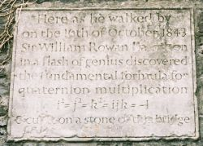
William Rowan Hamilton
William Rowan
Hamilton
1806-1865
Dunsink Observatory
Broom Bridge, Dublin Ireland

Slide 23
n² Versus 2^{n}
Geoff-O-Matic
The Geoff-O-Matic performs 10⁹ operations/sec
n = 10 n = 30 n = 50 n = 70
n²
2^{n}
n!
100
< 1 sec
900
< 1 sec
2500
< 1 sec
4900
< 1 sec
1024
< 1 sec
10⁹
1 sec
10¹⁵
11.6 days
10²¹
31,688 years
< 1 sec
10¹⁶ years
10⁵⁷ years
10⁹³ years
Notes:
10! = 3628800. The other factorials are just silly.
The animations pop up the various answers one at a time.

Slide 24
Here’s an Idea!
Let’s just buy a computer that’s twice as fast!
Size of largest problem
solvable with “old”
computer in one hour = S
n n² n³ n⁵ 2^{n} n!
Size of largest problem
solvable with “new”
twice-as-fast computer in one hour
2S
1.41S
1.26S
1.15S
S+1
S

Slide 25
Snowplows and Traveling Salesperson Revisited!
So are there polynomial time algorithms for the Snowplow and Travelling Salesperson, and Hamiltonian Path Problems?!
Tens of thousands of other known problems go in this cloud!!
Snowplow Problem
Travelling Salesperson Problem
Hamiltonian Path Problem
…
NP-complete problems
Notes:
The alien on this slide appears first; the animation shows the NP-complete problems.

Slide 26
Snowplows and Traveling Salesperson Revisited!
If a problem is NP-complete, it doesn’t necessarily
mean that it can’t be solved in polynomial time. It
does mean…
Tens of thousands of other known problems go in this cloud!!
Travelling Salesperson Problem
Snowplow Problem
Hamiltonian Path Problem
…
NP-complete problems

Slide 27
“I can’t find an efficient algorithm. I guess I’m too dumb.”
Cartoon courtesy of “Computers and Intractability: A Guide to the Theory of NP-Completeness” by M. Garey and D. Johnson

Slide 28
“I can’t find an efficient algorithm because no such
algorithm is possible!”
Cartoon courtesy of “Computers and Intractability: A Guide to the Theory of NP-Completeness” by M. Garey and D. Johnson

Slide 29
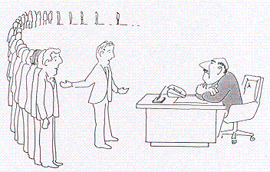
“I can’t find an efficient algorithm, but neither
can all these famous people.”
Cartoon courtesy of “Computers and Intractability: A Guide to the Theory of NP-Completeness” by M. Garey and D. Johnson

Slide 30
$1 million
Vinay Deolalikar
Notes:
Deolalikar published an alleged proof in 2010. But it has flaws, and he has gone back to the drawing board.

Slide 31
What Is This?!
Notes:
This seen is from “Futurama”.

Slide 32
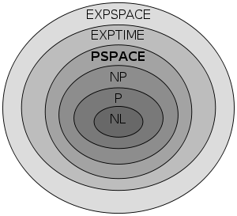
Are There Problems That Are Even Harder Than NP-Complete?
Kryptonite problems?
Notes:
Some of these are discussed in CS 140/Math 168, Algorithms. Others are grad-school topics.

Slide 33
Is LCS NP-Complete?
def LCS(S1, S2):
if S1 == "" or S2 == "":
return 0
elif S1[0] == S2[0]:
return 1 + LCS(S1[1:], S2[1:])
else:
return max(LCS(S1, S2[1:]), LCS(S1[1:], S2))
Demo LCS
Two strings of length 100 nucleotides each…
>>> steps = 2**100
>>> speed = 3 * 10**9
>>> seconds = steps / speed
>>> years = seconds / (60*60*24*365.25)
>>> years
13389807845846.213
>>>
60 seconds per minute
60 minutes per hour
24 hours per day
365.25 days per year
13 trillion years!
Notes:
Run lec07prog01-lcs.py.
Set abet= the alphabet, then abet2=abet[:14]. Have the students time LCS(abet2,abet2[::-1]), or run timer(LCS, abet2, abet2[::-1]). Then increase abet2 to 15 and then 16, timing it each time. On my laptop I got about 1:15 for 16. Don’t run fastLCS yet.

Slide 34
LCS(“spam”, “pims”)
LCS(“spam”, “ims”)
LCS(“pam”, “pims”)
1+
LCS(“spam”, “ms”)
LCS(“pam”, “ims”)
LCS(“am”, “ims”)
LCS(“pam”, “ms”)
LCS(“am”, “ims”)
I love “am and ims”!
Notes:
Animation highlights that “am” and “ims” are used in the rightmost branch of the left subtree, and in the right subtree.

Slide 35
Dictionaries Revisited
>>> D = {"spam" : "yummy!", (42, 42): "an important point"}
>>> D["spam"]
“yummy!”
>>> D[(42, 42)]
"an important point"
>>> D[["zaster!", "putrid", "smoke!"]]
BARF!

Slide 36
Dictionaries Revisited
>>> D = {“spam” : “yummy!”, (42, 42): “an important point”}
>>> D = {}
>>> D[“spam”] = “yummy!”
>>> D[(42, 42)] = “an important point”
>>> D[[1, 2]] = “but this is bad”
BARF!
>>> "spam" in D
True
>>> 42 in D
False
>>> (42, 42) in D
True
>>> D[(42, 42)]
“an important point”

Slide 37
How Dictionaries Work: Hashing
>>> D
{"Ran": "spam", …}
>>> x = (1, 2)
>>> D[x] = "my tuple"
>>> D
{"Ran": "spam", (1, 2): "my tuple"}
Memory
locations
D["Ran"]
D[x] =
D[(1, 2)]
5999
1
2
3
"my tuple"
3
5999
"spam"
Imagine that we now changed x[0]=42
6000

Slide 38
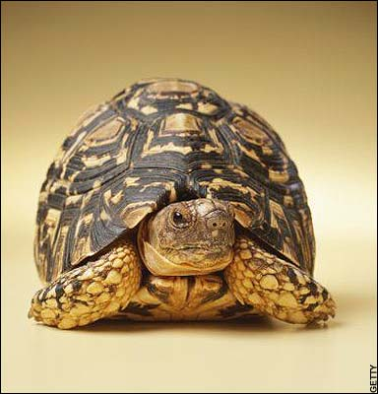
def LCS(S1, S2):
if S1 == "" or S2 == "":
return 0
elif S1[0] == S2[0]:
return 1 + LCS(S1[1:], S2[1:])
else:
return max(LCS(S1, S2[1:]), LCS(S1[1:], S2))
Old slow version
memo = {} # global empty dictionary
def fastLCS(S1, S2):
if (S1, S2) in memo:
return memo[(S1, S2)]
elif S1 == "" or S2 == "":
answer = 0
elif S1[0] == S2[0]:
answer = 1 + LCS(S1[1:], S2[1:])
else:
answer = max(LCS(S1, S2[1:]), LCS(S1[1:], S2))
memo[(S1, S2)] = answer
return answer
New fast
“memoized”
version
Notes:
Demo fastLCS here. Circle the recursive calls that are avoided by memorization.

Slide 39
Changing change
def change(value, coins):
if value <= 0:
return 0
elif coins == []:
return float("inf")
loseIt = change(value, coins[1:])
if value < coins[0]:
return loseIt
else:
useIt = 1 + change(value - coins[0], coins)
return min(useIt, loseIt)

Slide 40
Changing change
memo = {} # Empty dictionary
def fastChange(value, coins):
if (value, coins) in memo:
return memo[(value, coins)]
elif value <= 0:
return 0
elif coins == []:
return float("inf")
# Finish writing this!
coins must be a tuple rather
than a list!
Geoff’s solution coming up…
Worksheet!

Slide 41
Changing change
memo = {} # Empty dictionary
def fastChange(value, coins):
if (value, coins) in memo:
return memo[(value, coins)]
elif value <= 0:
return 0
elif coins == []:
return float("inf")
loseIt = fastChange(value, coins[1:])
if value < coins[0]:
memo[(value, coins)] = loseIt
return loseIt
else:
useIt = 1 + fastChange(value - coins[0], coins)
best = min(useIt, loseIt)
memo[(value, coins)] = best
return best
coins must be a tuple rather
than a list!
Notes:
There is an animation on this slide that brings up the else (use-it) case.

