Slide 1
This would make me hungry… but I ate breakfast this morning!
Computing to the max
The not-so-subtle art of singling out the best (and worst) of anything…
Last hw?
N-step sleepwalking?
Turtle graphics??
a comparison comparison
Artistic renderings!!!
'm+ms'
'coffee'
[0, 42]
[4, 2]
This week!
[0, 'm+ms']
[4, 'coffee']
Hw #4 due next Monday…
> or <
pr0: Are we The Matrix?
pr1: Lab…
Computing with language
pr2: Sorting + Caesar!
What's in an essay, anyway?
pr3: create a '90s webpage
Battle-tested ciphers & how to break them…
Notes:
class 7 lol
INHANDOUT
Have pysound_sols/hw4pr1_solutions.py ready in ipython as well as lec07funs.py
In HW we did integration.
Bring earbuds to lab!
For sleepwalking, average squared displacement is N so distance from start is sqrt(N).
HW problem 3 was list comprehensions; we’ll do more today.
Demo these comparisons and ask what’s happening. Note that 'cs' < 'clear' is false!
Then show max([0, 'm+ms'], [4, 'coffee'])

Slide 2
Write each of these functions using list comprehensions…
Last Time...
def nodds(L):
LC = [1 for x in L if x%2 == 1]
return sum(LC)
too terse?
[ x % 2 for x in L ]
def lotto(Y, W):
LC = [ ]
too terse?
return sum(LC)
[ ]
def ndivs(N):
LC = [1 for x in range(1, N + 1) if N % x == 0]
list
too terse?
return sum(LC)
[ N % x == 0 for x in range(1, N + 1) ]
def primesUpTo(P):
Extra!
LC = [x for x in range(2, P+1) if ndivs(x) == 2]
list
return LC

Slide 3
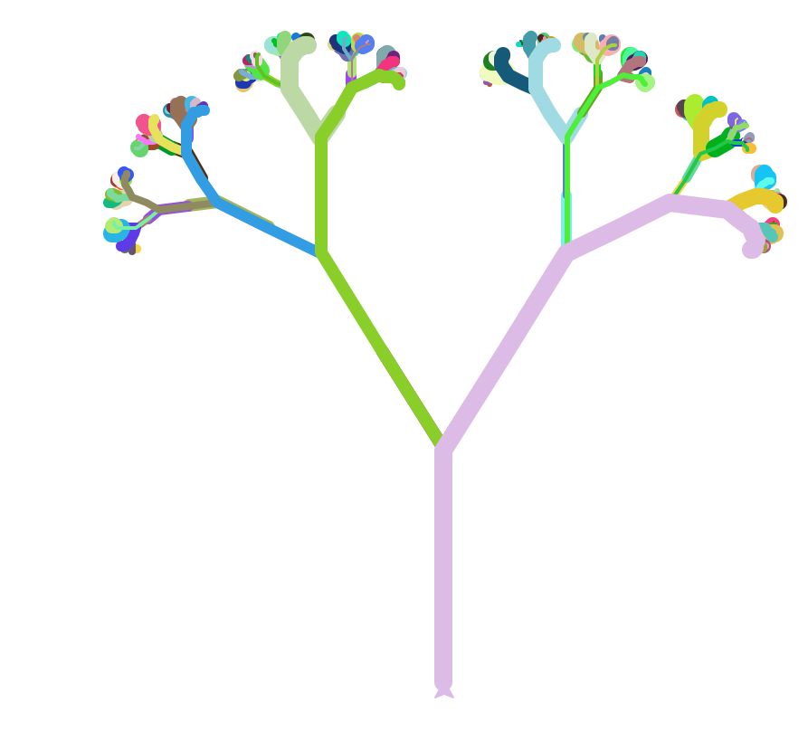
Turtle thoughts...
def flakeside(L,N):
if N==0: forward(L)
flakeside(L/3)
right(60)
flakeside(L/3)
left(120)
flakeside(L/3)
right(60)
flakeside(L/3)
and Flo Walsh!
Evy Larsen!
def svtree( L, N ):
if N==0: return
forward( L )
left(30)
svtree( L/2, N-1 )
right(60)
svtree( L/2, N-1 )
left(30)
backward( L )
1
1
2
1
4
3
2
1
3
2
1
The numbers show the value of N for each call ...
2
1
1
1
The colors show the entire stack of calls up to that branch!

Slide 4
max
A recipe for life ?
and python already has it for us…
The real problem is knowing what we want to maximize!
... or minimize, with min

Slide 5
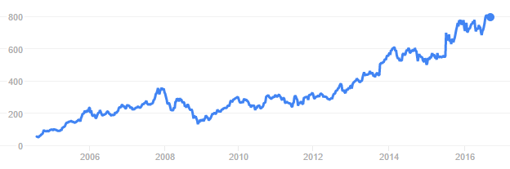
to the max
And I thought $100 was overpriced!
NASDAQ: GOOGL
Want the highest price?
max([475.5, 458.0, 441.3, 470.8, 532.8, 520.9])
ST
'nov'
'jan'
'mar'
'may'
'jul'
'sep'
What if the months are in there, as well?
max([[470.8,'may'], [532.8,'jul'], [520.9,'sep']])
STm
max([['may',470.8], ['jul',532.8], ['sep',520.9]])
mST
Notes:
In the demo file, ST is the stock prices. STm is with months. mST has the months first.

Slide 6
to the max
And I thought $100 was overpriced!
NASDAQ: GOOGL
Want the highest price?
max([475.5, 458.0, 441.3, 470.8, 532.8, 520.9])
ST
'nov'
'jan'
'mar'
'may'
'jul'
'sep'
What if the months are in there, as well?
max([[470.8,'may'],[532.8,'jul'], [520.9,'sep']])
STm
max([['may',470.8],['jul',532.8], ['sep',520.9]])
mST
Mudd's max?
MSt
MSt = ['Harvey', 'Mudd', 'College', 'seeks', 'to', 'educate', 'engineers,', 'scientists', 'and', 'mathematicians', 'well-versed', 'in', 'all', 'of', 'these', 'areas', 'and', 'in', 'the', 'humanities', 'and', 'the', 'social', 'sciences', 'so', 'that', 'they', 'may', 'assume', 'leadership', 'in', 'their', 'fields', 'with', 'a', 'clear', 'understanding', 'of', 'the', 'impact', 'of', 'their', 'work', 'on', 'society']
max(MSt)
Or Mudd's min?
min(MSt)
Notes:
INHANDOUT
ScrMSt, CMCMSt, PomMSt, PitMSt are all in the file. MSts has them all in a list of lists.

Slide 7
recursive max
L
[ 7, 10, -2, 42, 15 ]
L = [ 'aliens', 'zap', 'hazy', 'code' ]
L[1:]
def max(L):
"""Returns the max element from L
Argument: L, a nonempty list
"""
if len(L) < 2: return L[0] # only 1 elem.
maxOfRest = max(L[1:]) # max of the rest
if L[0] > maxOfRest:
return L[0] # either L[0]
else:
return maxOfRest # or maxOfRest!
I love max rest!
Notes:
INHANDOUT

Slide 8
max with scrabble-score
L = [ 'aliens', 'zap', 'hazy', 'code' ]
Which element has the highest scrabble score?
def maxSS(L):
"""Returns L's highest scrabble-scoring
element (Argument: L, a nonempty list)
"""
if len(L) < 2: return L[0] # only 1 elem.
maxOfRest = maxSS(L[1:]) # rest's max
if L[0] > maxOfRest :
return L[0] # either L[0]
else:
return maxOfRest # or maxOfRest!
Spacey! I like it!
Notes:
INHANDOUT
Show that we could specialize by asking for sscore in the comparison.

Slide 9
max with scrabble-score
L = [ 'aliens', 'zap', 'hazy', 'code' ]
Which element has the highest scrabble score?
def maxSS(L):
"""Returns L's highest scrabble-scoring
element (Argument: L, a nonempty list)
"""
if len(L) < 2: return L[0] # only 1 elem.
maxOfRest = maxSS(L[1:]) # rest's max
if sScore(L[0]) > sScore(maxOfRest):
return L[0] # either L[0]
else:
return maxOfRest # or maxOfRest!
Spacey! I like it!

Slide 10
max with scrabble-score
L = [ 'aliens', 'zap', 'hazy', 'code' ]
Which element has the highest scrabble score?
def maxSS(L):
"""Returns L's highest scrabble-scoring
element (Argument: L, a nonempty list)
"""
if len(L) < 2: return L[0] # only 1 elem.
maxOfRest = maxSS(L[1:]) # rest's max
if sScore(L[0]) > sScore(maxOfRest):
return L[0] # either L[0]
else:
return maxOfRest # or maxOfRest!
Let's see if we can simplify this process... just for LoLs!
Spacey! I like it!

Slide 11
A more comprehensive solution: LoL
L = [ 'aliens', 'zap', 'hazy', 'code' ]
def maxSS(L):
"""Returns L's max-scrabble-score word
"""
LoL = [[sScore(w), w] for w in L]
bestpair = max(LoL)
return bestpair[1]
This does look funny!
Notes:
INHANDOUT

Slide 12
A more comprehensive solution
L = [ 'aliens', 'zap', 'hazy', 'code' ]
I loathe hazy code!
def maxSS(L):
"""Returns L's max-scrabble-score word
"""
LoL = [[sScore(w), w] for w in L]
bestpair = max(LoL)
return bestpair[1]
LoL = [ [6, 'aliens'], [14, 'zap'], [19, 'hazy'], [7, 'code'] ]
bestpair = [19, 'hazy']
'hazy'
Notes:
Why is it called LoL?

Slide 13
Everything … is a max problem?
I know the best word here… but does Python?
L = [ 'aliens', 'zap', 'hazy', 'code' ]
def revviestword(L):
"""Another example –- what's returned?
"""
LoL = [[w[::-1], w] for w in L]
bestpair = max(LoL)
return bestpair[1]
LoL = [ [ 'sneila' ,'aliens'], [ 'paz' ,'zap'], [ 'yzah' ,'hazy'], [ 'edoc' ,'code'] ]
bestpair =
Notes:
Show that there are 4 sublists. Why are there 4?

Slide 14
Other examples…
What is bestnumb ?
What is mostnumb ?
>>> bestnumb([10, 20, 30, 40, 50, 60])
40
>>> bestnumb([100, 200, 300, 400])
100
>>> bestnumb([2, 3, 4, 5, 6, 7, 8, 7])
8
>>> mostnumb([2, 3, 4, 5, 6, 7, 8, 7])
7
These functions have made me number

Slide 15
L = [ 'aliens', 'zap', 'hazy', 'code' ]
Name(s)
Quiz
def maxlen(L):
LoL = [[len(s), s] for s in L]
bstpr = max(LoL)
return bstpr[1]
1. What is LoL?
here is a start: LoL is [ [6, 'aliens'], [3, 'zap'], ___________, __________ ]
2. What is bstpr?
Extra!
Change exactly three characters in this code so that 3 is returned.
3. What is returned?
L = [ 30, 40, 50 ]
Use the LoL method to write these two functions
def bestnumb(L):
"""returns the # in L closest to 42"""
LoL = [ ]
bstpr =
return bstpr[1]
Hint: Python has abs(x) built-in
L = [ 3, 4, 5, 7, 6, 7 ]
def mostnumb(L):
"""returns the item most often in L"""
LoL = [ ]
bstpr =
return bstpr[1]
Hint: Define a helper function!
def count(e, L):
"""return # of e's in L"""
Notes:
QUIZSLIDE
bstpr is a lousy variable name. What does it stand for? What’s a better choice?
maxlen is a warmup for the others.
Solutions are in the handout.

Slide 16
Quiz
L = [ 'aliens', 'zap', 'hazy', 'code' ]
Try this on the back page first!
def maxlen(L):
LoL = [[len(s), s] for s in L]
bstpr = max(LoL)
return bstpr[1]
1. What is LoL?
[ [6, 'aliens'], [3, 'zap'], [4, 'hazy'], [4, 'code'] ]
2. What is bstpr?
[6, 'aliens']
Extra!
Change exactly three characters in this code so that 3 is returned.
3. What is returned?
'aliens'
L = [ 30, 40, 50 ]
def bestnumb(L):
"""returns the # in L closest to 42"""
LoL = [[abs(x-42), x] for x in L]
bstpr = min(LoL)
return bstpr[1]
Hint: Python has abs(x) built-in
L = [ 3, 4, 5, 7, 6, 7 ]
def mostnumb(L):
"""returns the item most often in L"""
LoL = [[count(e, L), e] for e in L]
bstpr = max(LoL)
return bstpr[1]
Hint: Define a helper function!
def count(e, L):
LC = [1 for x in L \
if x == e]
return sum(LC)
Notes:
INHANDOUT

Slide 17
L = [ 'aliens', 'zap', 'hazy', 'code' ]
def maxlen(L):
LoL = [[len(s), s] for s in L]
bstpr = max(LoL)
return bstpr[1]
1. What is LoL?
[ [6, 'aliens'], [3, 'zap'], [4, 'hazy'], [4, 'code'] ]
2. What is bstpr?
[6, 'aliens']
'aliens'
3. What is returned?
Extra! Change exactly three characters in this code so that 3 is returned.

Slide 18
bestnumb
[30,40,50]
L
[[12, 30], [2, 40], [8, 50]]
LoL
[2, 40]
bstpr
[ 30, 40, 50 ]
40
bstpr[1]
def bestnumb(L):
"""Returns the # closest to 42 in L"""
LoL = [[abs(x-42), x] for x in L]
bstpr = min(LoL)
return bstpr[1]

Slide 19
Helper function: count(e, L)
mostnumb
def count(e, L):
"""Returns the # of e's in L"""
LC = [1 for x in L if x == e]
return sum( LC )
L
[6,7,7,8]
LoL
[ [1,6], [2,7], [2,7], [1,8] ]
bstpr
[2, 7]
[6, 7, 7, 8]
bstpr[1]
7
def mostnumb(L):
"""Returns the item most often in L"""
LoL = [[count(e, L), e] for e in L]
bstpr = max(LoL)
return bstpr[1]
Could you use x here instead of e?
Notes:
Note that max will tie-break duplicates.
We wrote count last time.
Note that variable names are independent (this answers the alien’s question).

Slide 20
Today's lab: big data?
Any guesses as to what kind of data this is?
I find your lack of faith in this data disturbing.

Slide 21
Today's lab: sound data!
what are the vertical and horizontal axes here?
Notes:
One could demo audacity here.

Slide 22
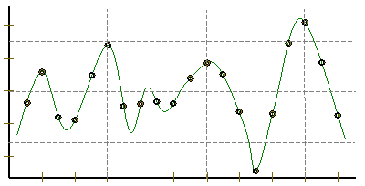
Lab3 ~ Sound
physics
continuous variation of air pressure vs. time
air pressure
sampling
samples taken every 1/22050th of a second (or some sampling rate)
time
quantization
Each sample is measured on a loudness scale from -32,768 to 32,767. (This fits into 2 bytes.)
storage
These two bytes are called a frame. Raw audio data - such as what is written to the surface of a CD - is simply a list of these frames.
pulse code modulation = PCM data
some examples...
Notes:
INHANDOUT
These functions and files are in pysound_sols, hw4pr1_solutions.py
play(SW): faith
play(DO): do or do not
play(SP): spam
changeSpeed(SW, 44100)
flipflop(DO)
reverse(DO)
reverse(SP)

Slide 23
Computing with language
ideas / meaning
language / words / phrases
Python strings are here.
strings
numbers / bits
Notes:
The rest of this week’s homework computes with language in various ways.

Slide 24
Computing with language
open questions in AI …
ideas / meaning
Eliza, Siri, Tay ... trouble?
language / words / phrases
This week…
processing language – how English-y is it?
strings
how strings are represented and stored
numbers / bits
Next week…

Slide 25
Caesar Cipher: encipher
What is it doing?
encipher(s, n)
encipher( 'I <3 Latin', 0 )
'I <3 Latin'
'J <3 Mbujo'
'K <3 Ncvkp'
'L <3 Odwlq'
'M <3 Pexmr'
'N <3 Qfyns'
returns
encipher( 'I <3 Latin', 1 )
returns
encipher( 'I <3 Latin', 2 )
returns
encipher( 'I <3 Latin', 3 )
returns
encipher( 'I <3 Latin', 4 )
returns
encipher( 'I <3 Latin', 5 )
returns
encipher( 'I <3 Latin', 25 )
'H <3 Kzshm'
returns
Notes:
INHANDOUT
enc('I <3 Latin', 1) – show
Ask enc('I <3 Zebras')
Then enc('J <3 Mbujo', 25)
Caesar himself always shifted by 4.

Slide 26
Caesar Cipher: encipher
should return the string s with each alphabetic character shifted/wrapped by n places in the alphabet
encipher(s, n)
encipher( 'I <3 Latin', 0 )
'I <3 Latin'
'J <3 Mbujo'
'K <3 Ncvkp'
'L <3 Odwlq'
'M <3 Pexmr'
'N <3 Qfyns'
returns
encipher( 'I <3 Latin', 1 )
returns
encipher( 'I <3 Latin', 2 )
returns
encipher( 'I <3 Latin', 3 )
returns
encipher( 'I <3 Latin', 4 )
returns
encipher( 'I <3 Latin', 5 )
returns
encipher( 'I <3 Latin', 25 )
'H <3 Kzshm'
returns

Slide 27
ASCII
American Standard Code for Information Interchange
convert # to char
chr
1 byte
ord
8 bits
convert char to #
The SAME bits represent an integer or a string, depending on type: int or str
Notes:
INHANDOUT

Slide 28
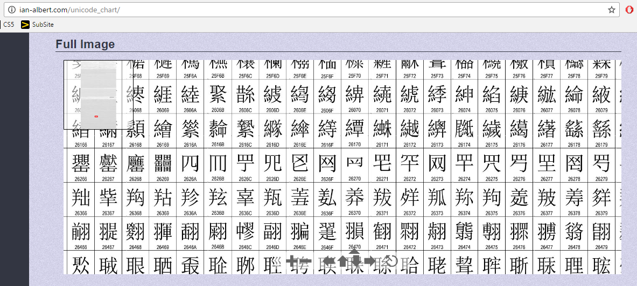
Unicode
Universal Character Encoding
!!!
http://ian-albert.com/unicode_chart/
Some fun characters...
chr(156265)
chr(9835)
chr(9731)
My favorite is chr(1661)
on Win10: chcp 65001
Notes:
Your laptop might print these. 156265 appears to be a browser test. 9835 is beamed 8th notes; 9731 is a snowman.
If these don’t work on your command line, try Googling “unicode 9731”.

Slide 29
ASCII or Unicode...
value:
'/'
00101111
type: str
bits
name:
Identical bits are stored in each variable!
The types determine how to interpret the bits; the names don't matter at all…
1 byte
value:
47
8 bits
00101111
type: int
bits
name:
The SAME bits represent an integer or a string, depending on type: int or str
over in memory…

Slide 30
ASCII and Unicode
convert # to char
chr
ord
convert char to #
This is why 'CS' < 'clear' !
Julius spr'15
Notes:
INHANDOUT
Show ord('c') and ord('C')
Note that letters are sequential.

Slide 31
ASCII and Unicode
Ex1
convert # to char
[[i, chr(i)] for i in range(128)]
chr
Ex2
ord
[ord(i) for i in '**** CS! ****']
convert char to #
This is why 'CS' < 'clear' !
Julius spr'15
Notes:
INHANDOUT
Slanted boxes are Ex1 and Ex2 in lec7fun.py.
Ask class what they’re saying (especially Ex2).

Slide 32
Rot13
a useful and illustrative starting point...
rot13('a') should output 'n'
adding 13
rot13('M') should output 'Z'
rot13('n') should output 'a'
wrapping
rot13('W') should output 'J'
rot13(' ') should output ' '
spaces + other characters
rot13('<') should output '<'

Slide 33
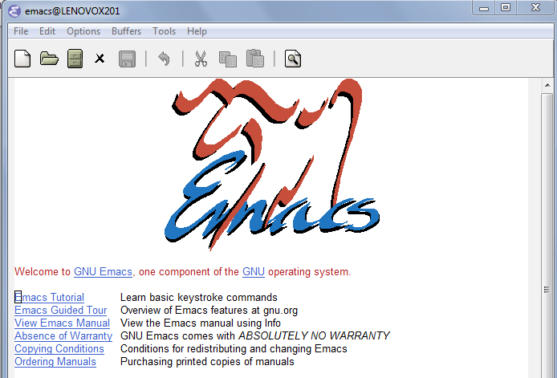
rot13's surprising history...
Notes:
Emacs supports M-x rot13-other-window
Also M-x tetris, M-x dunnet. In dunnet, try “eat shovel”.

Slide 34
ASCII and Unicode
chr value
abcdefghijklmnopqrstuvwxyz
97
ord value
99
101
103
105
107
109
111
113
115
117
119
122
chr value
ABCDEFGHIJKLMNOPQRSTUVWXYZ
65
ord value
67
69
71
73
75
77
79
81
83
85
87
90
convert # to char
chr
What is ord('U')//2?
What is chr(ord('i') + 13)?
ord
What is chr(ord('W') + 13 )?
convert char to #
how do we wrap?
Notes:
INHANDOUT
This is to familiarize them with chrs and ords.

Slide 35
any single character, c
Writing Rot13
def rot13(c):
"""Rotates c by 13 chars, "wrapping" as needed.
NON-LETTERS don't change!
"""
if 'a' <= c <= 'z':
if ord(c)+13 <= ord('z'):
return chr(ord(c)+13)
else:
return chr( )
elif 'A' <= c <= 'Z': # upper-case test!
else:
(0) What do these tests do?
(1) What code will "wrap" to the alphabet's other side?
(2) How will upper case change? Try noting only the code differences…
(3) What if c is not a letter at all?
Extra: How would you rotate n places, instead of 13?
Notes:
INHANDOUT

Slide 36
any single character, c
Writing Rot13
def rot13(c):
"""rotates c by 13 chars, "wrapping" as needed
NON-LETTERS don't change!
"""
if 'a' <= c <= 'z':
if ord(c)+13 <= ord('z'):
return chr(ord(c)+13)
else:
return chr(ord(c)+13-26)
elif 'A' <= c <= 'Z': # upper-case test!
else:
(0) What do these tests do?
(1) What code will "wrap" to the alphabet's other side?
same, but for 'Z'
(2) How will upper case change? Try noting only the code differences…
return c
(3) What if c is not a letter at all?
use n instead of 13
Extra: How would you rotate n places, instead of 13?
Notes:
Circle the “n” and then show adding it as an argument.

Slide 37
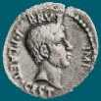
Caesar Cipher: encipher
Caesar
Brutus
>>> encipher('Bzdrzq bhogdq? H oqdedq Bzdrzq rzkzc.', 25)
'Aycqyp agnfcp? G npcdcp Aycqyp qyjyb.'
S1
>>> encipher('Bzdrzq bhogdq? H oqdedq Bzdrzq rzkzc.', 15)
'Qosgof qwdvsf? W dfstsf Qosgof gozor.'
>>> encipher('Bzdrzq bhogdq? H oqdedq Bzdrzq rzkzc.', 4)
'Fdhvdu flskhu? L suhihu Fdhvdu vdodg.'
>>> encipher('Bzdrzq bhogdq? H oqdedq Bzdrzq rzkzc.', 1)
'Caesar cipher? I prefer Caesar salad.'
>>> encipher('Hu lkbjhapvu pz doha ylthpuz hmaly dl mvynla '\
'lclyfaopun dl ohcl slhyulk.', 19)
'An education is what remains after we forget everything we have learned.'
S2
Notes:
INHANDOUT
enc(S1, 1)

Slide 38
Caesar Cipher: decipher
Caesar
Brutus
>>> decipher('Bzdrzq bhogdq? H oqdedq Bzdrzq rzkzc.')
'Caesar cipher? I prefer Caesar salad.'
S1
S2
>>> decipher('Hu lkbjhapvu pz doha ylthpuz hmaly dl mvynla '\
'lclyfaopun dl ohcl slhyulk.')
'An education is what remains after we forget everything we have learned.'
>>> decipher('Uifz xpsl ju pvu xjui b qfodjm!')
PL
LAT
>>> decipher('gv vw dtwvg')
How!?
Which is more difficult computationally?
Notes:
dec(S1)
S100 = enc(S1, 7)
dec(S100)
What’s the big-picture behavior?
dec(S2); dec(LAT)

Slide 39
Decipher?
Strategies?
Algorithms?

Slide 40
gv vw dtwvg
hw wx euxwh
ix xy fvyxi
jy yz gwzyj
kz za hxazk
la ab iybal
mb bc jzcbm
nc cd kadcn
od de lbedo
pe ef mcfep
qf fg ndgfq
rg gh oehgr
sh hi pfihs
ti ij qgjit
uj jk rhkju
vk kl silkv
wl lm tjmlw
xm mn uknmx
yn no vlony
zo op wmpoz
ap pq xnqpa
bq qr yorqb
cr rs zpsrc
ds st aqtsd
et tu brute
fu uv csvuf
Decipher?
All possible decipherings
Strategies?
Algorithms?

Slide 41
gv vw dtwvg
hw wx euxwh
ix xy fvyxi
jy yz gwzyj
kz za hxazk
la ab iybal
mb bc jzcbm
nc cd kadcn
od de lbedo
pe ef mcfep
qf fg ndgfq
rg gh oehgr
sh hi pfihs
ti ij qgjit
uj jk rhkju
vk kl silkv
wl lm tjmlw
xm mn uknmx
yn no vlony
zo op wmpoz
ap pq xnqpa
bq qr yorqb
cr rs zpsrc
ds st aqtsd
et tu brute
fu uv csvuf
[0, 'gv vw dtwvg'],
[2, 'hw wx euxwh'],
[2, 'ix xy fvyxi'],
[0, 'jy yz gwzyj'],
[2, 'kz za hxazk'],
[4, 'la ab iybal'],
[0, 'mb bc jzcbm'],
[1, 'nc cd kadcn'],
[4, 'od de lbedo'],
[3, 'pe ef mcfep'],
[0, 'qf fg ndgfq'],
[2, 'rg gh oehgr'],
[2, 'sh hi pfihs'],
[3, 'ti ij qgjit'],
[2, 'uj jk rhkju'],
[1, 'vk kl silkv'],
[0, 'wl lm tjmlw'],
[1, 'xm mn uknmx'],
[2, 'yn no vlony'],
[3, 'zo op wmpoz'],
[2, 'ap pq xnqpa'],
[1, 'bq qr yorqb'],
[0, 'cr rs zpsrc'],
[1, 'ds st aqtsd'],
[4, 'et tu brute'],
[3, 'fu uv csvuf']
Decipher?
All possible decipherings
Score them all
Strategies?
Algorithms?
quantifying Englishness?
Notes:
This is vowel count. Next slide shows max vowel count.

Slide 42
gv vw dtwvg
hw wx euxwh
ix xy fvyxi
jy yz gwzyj
kz za hxazk
la ab iybal
mb bc jzcbm
nc cd kadcn
od de lbedo
pe ef mcfep
qf fg ndgfq
rg gh oehgr
sh hi pfihs
ti ij qgjit
uj jk rhkju
vk kl silkv
wl lm tjmlw
xm mn uknmx
yn no vlony
zo op wmpoz
ap pq xnqpa
bq qr yorqb
cr rs zpsrc
ds st aqtsd
et tu brute
fu uv csvuf
[0, 'gv vw dtwvg'],
[2, 'hw wx euxwh'],
[2, 'ix xy fvyxi'],
[0, 'jy yz gwzyj'],
[2, 'kz za hxazk'],
[4, 'la ab iybal'],
[0, 'mb bc jzcbm'],
[1, 'nc cd kadcn'],
[4, 'od de lbedo'],
[3, 'pe ef mcfep'],
[0, 'qf fg ndgfq'],
[2, 'rg gh oehgr'],
[2, 'sh hi pfihs'],
[3, 'ti ij qgjit'],
[2, 'uj jk rhkju'],
[1, 'vk kl silkv'],
[0, 'wl lm tjmlw'],
[1, 'xm mn uknmx'],
[2, 'yn no vlony'],
[3, 'zo op wmpoz'],
[2, 'ap pq xnqpa'],
[1, 'bq qr yorqb'],
[0, 'cr rs zpsrc'],
[1, 'ds st aqtsd'],
[4, 'et tu brute'],
[3, 'fu uv csvuf']
Decipher?
All possible decipherings
max!
Score them all
Strategies?
Algorithms?
yields the "most English" phrase
Notes:
Max vowel count (comes later).

Slide 43
Measuring Englishness
Very English-y
"Call me Ishmael."
"Attack at dawn!"
"rainbow, table, candle"
higher scores
"Yow! Legally-imposed CULTURE-reduction is CABBAGE-BRAINED!"
"quadruplicity drinks procrastination"
"Hold the newsreader's nose squarely, waiter, or friendly milk will countermand my trousers."
quantifying Englishness?
"the gostak distims the doshes"
"hension, framble, bardle"
"jufict, stofwus, lictpub"
"itehbs, rsnevtr, khbsota"
lower scores
"epadxo, nojarpn, gdxokpw"
"h o q dedqBzdrzqrzkzc"
All of these sound good to me!
Not English-y

Slide 44
gv vw dtwvg
hw wx euxwh
ix xy fvyxi
jy yz gwzyj
kz za hxazk
la ab iybal
mb bc jzcbm
nc cd kadcn
od de lbedo
pe ef mcfep
qf fg ndgfq
rg gh oehgr
sh hi pfihs
ti ij qgjit
uj jk rhkju
vk kl silkv
wl lm tjmlw
xm mn uknmx
yn no vlony
zo op wmpoz
ap pq xnqpa
bq qr yorqb
cr rs zpsrc
ds st aqtsd
et tu brute
fu uv csvuf
[0, 'gv vw dtwvg'],
[2, 'hw wx euxwh'],
[2, 'ix xy fvyxi'],
[0, 'jy yz gwzyj'],
[2, 'kz za hxazk'],
[4, 'la ab iybal'],
[0, 'mb bc jzcbm'],
[1, 'nc cd kadcn'],
[4, 'od de lbedo'],
[3, 'pe ef mcfep'],
[0, 'qf fg ndgfq'],
[2, 'rg gh oehgr'],
[2, 'sh hi pfihs'],
[3, 'ti ij qgjit'],
[2, 'uj jk rhkju'],
[1, 'vk kl silkv'],
[0, 'wl lm tjmlw'],
[1, 'xm mn uknmx'],
[2, 'yn no vlony'],
[3, 'zo op wmpoz'],
[2, 'ap pq xnqpa'],
[1, 'bq qr yorqb'],
[0, 'cr rs zpsrc'],
[1, 'ds st aqtsd'],
[4, 'et tu brute'],
[3, 'fu uv csvuf']
Decipher?
All possible decipherings
max!
Score them all
Strategies?
Algorithms?
"Englishness" score based on # of vowels

Slide 45
gv vw dtwvg
hw wx euxwh
ix xy fvyxi
jy yz gwzyj
kz za hxazk
la ab iybal
mb bc jzcbm
nc cd kadcn
od de lbedo
pe ef mcfep
qf fg ndgfq
rg gh oehgr
sh hi pfihs
ti ij qgjit
uj jk rhkju
vk kl silkv
wl lm tjmlw
xm mn uknmx
yn no vlony
zo op wmpoz
ap pq xnqpa
bq qr yorqb
cr rs zpsrc
ds st aqtsd
et tu brute
fu uv csvuf
[6.9e-05, 'gv vw dtwvg'],
[3.6e-05, 'hw wx euxwh'],
[1.4e-07, 'ix xy fvyxi'],
[8.8e-11, 'jy yz gwzyj'],
[7.2e-10, 'kz za hxazk'],
[0.01503, 'la ab iybal'],
[3.7e-08, 'mb bc jzcbm'],
[0.00524, 'nc cd kadcn'],
[0.29041, 'od de lbedo'],
[0.00874, 'pe ef mcfep'],
[7.3e-07, 'qf fg ndgfq'],
[0.06410, 'rg gh oehgr'],
[0.11955, 'sh hi pfihs'],
[3.1e-06, 'ti ij qgjit'],
[1.1e-08, 'uj jk rhkju'],
[2.6e-05, 'vk kl silkv'],
[0.00012, 'wl lm tjmlw'],
[3.1e-06, 'xm mn uknmx'],
[0.02011, 'yn no vlony'],
[1.5e-06, 'zo op wmpoz'],
[1.9e-07, 'ap pq xnqpa'],
[5.7e-08, 'bq qr yorqb'],
[0.00024, 'cr rs zpsrc'],
[0.02060, 'ds st aqtsd'],
[0.45555, 'et tu brute'],
[0.00011, 'fu uv csvuf']
Decipher?
All possible decipherings
S
c
o
r
e
s
Strategies?
Algorithms?
"Englishness" based on letter probabilities
max!
Notes:
Scrabblescore quantifies Englishness…but you want the min, not the max.

Slide 46
We'll see you in Lab3 !
hear
Earbuds are helpful for lab—unless you really like Darth Vader!

