Slide 1
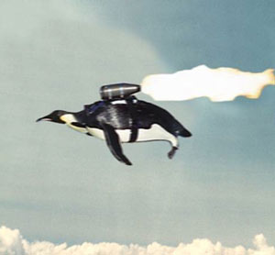
The CS 5 Times
Penguin Rescue!
Dunedin, New Zealand (Penguin Press):
A daring mission has been
mounted to rescue two adorable penguins
who had been given up as lost after a
spaceship crash. Risking her life with an
untested experimental jet pack, a brave Chemistry penguin mixed a witches’ brew of propellant, fueled the pack, and set off across the sky in search of her missing colleagues, who were running out of fish when last heard from.
“We are, like, so grateful for this, like, attempt, and, like, we, like, hope for her, like, success,” stated a jittery CS 5 student. “We like, love our, like, penguins and are, like, so helpless with our, like, homework assignments without, like, their, like, help.”
Further quotes were unavailable due to an unexpected attack from a WRIT 1 instructor.

Slide 2
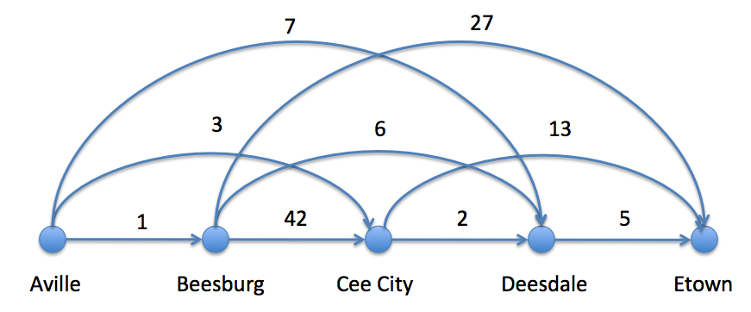

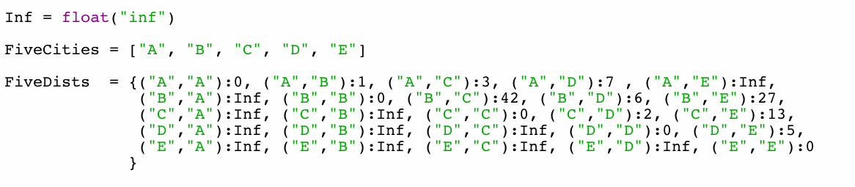
Giigle maps in four lines of code!
>>> shortestPath (FiveCities, FiveDists)
10
>>> shortestPath ([“C”, “D”, “E”], FiveDists)
7
>>> shortestPath ([“E”], FiveDists)
0

Slide 3
Bonus problem!
def shortestPath (cities, dists):
‘’’ returns the length of the shortest path
from the leftmost to the rightmost city in
in the cities list.’’’
if BLAH:
return BLAH BLAH
else:
return BLAH BLAH BLAH
It’s fitting that
map gets used
here!

Slide 4
Bonus problem!
def shortestPath (cities, dists):
‘’’ returns the length of the shortest path
from the leftmost to the rightmost city in
in the cities list.’’’
if len(cities) == 1:
return 0
else:
return BLAH BLAH BLAH

Slide 5
Bonus problem!
def shortestPath (cities, dists):
‘’’ returns the length of the shortest path
from the leftmost to the rightmost city in
in the Cities list.’’’
if len(Cities) == 1:
return 0
else:
return min(map(lambda x: dists[(cities[0], cities[x])] +
shortestPath(cities[x:], dists),
range(1, len(cities))))

Slide 6
A Mystery, Shrouded in an Enigma, and Veiled
in Obscurity!
def mystery(word):
if len(word) <= 1:
return len(word)
else:
myList = list(map(lambda x:
2 + mystery(word[1:x]) if word[0] == word[x]
else 0,
range(1, len(word))))
return max(myList)
01234
>>> mystery("radar")
5
>>> mystery("ahha! I like it!")
4
0123468911111111
01234567"

Slide 7
A Mystery, Shrouded in an Enigma, and Veiled
in Obscurity!
def mystery(word):
if len(word) <= 1:
return len(word)
else:
myList = list(map(lambda x:
2 + mystery(word[1:x]) if word[0] == word[x]
else 0,
range(1, len(word))))
return max(myList)
01234
It’s not quite as palindromic as these examples suggest!
>>> mystery("radar")
5
>>> mystery("ahha! I like it!")
4
0123468911111111
01234567
Notes:
Why isn't it palindromic? Because mystery("area") will return 2…

Slide 8
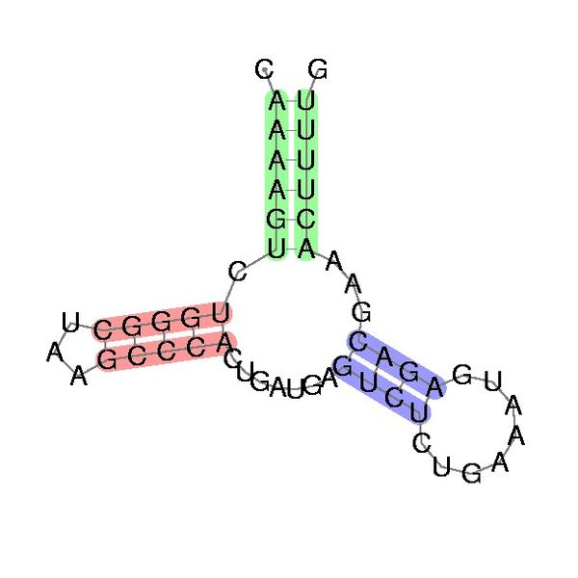
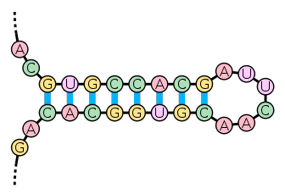
RNA Folding!
A and U
C and G
A C U G A G C C C U
A C U G A G C C C U
A C U G A G C C C U
Crossings
(“pseudo-knots”)
not permitted!

Slide 9
RNA Folding!
A and U
C and G
What’s the best score for this one?
C A G G C C U G U U A A C

Slide 10
RNA Folding!
A and U
C and G
C A G G C C U G U U A A C
Notes:
Give them time to copy this down!

Slide 11
RNA Use-It-Or-Lose-It
A and U
C and G
C A G G C C U G U U A A C
Notes:
This is tricky and a hard problem. The basic idea is that use-it is “S[0] can fold with something in S[1:], but which one?” Here, we need to return to the mystery function from before: map and if/else can find the matches and try recursive folding on the substrings from 1 to X-1 and X+1 to end, and filter can then get rid of the losers. Lose-it is easier: S[0] folds with nothing, so you just fold the rest of the chain. But lose-it will only happen with very short strings, right?

Slide 12
A Sneaky Trick
A and U
C and G
How do you figure out what matches what?
Ugly:
if S[0] == ‘A’:
if S[x] == ‘U’:
...
elif ...
...
elif ...
...

Slide 13
A Nicer Approach
A and U
C and G
How do you figure out what matches what?
matchingGenes = {'U': 'A', 'A': 'U',
'C': 'G', 'G': 'C'}
...
if S[0] == matchingGenes[S[x]]:
...

Slide 14
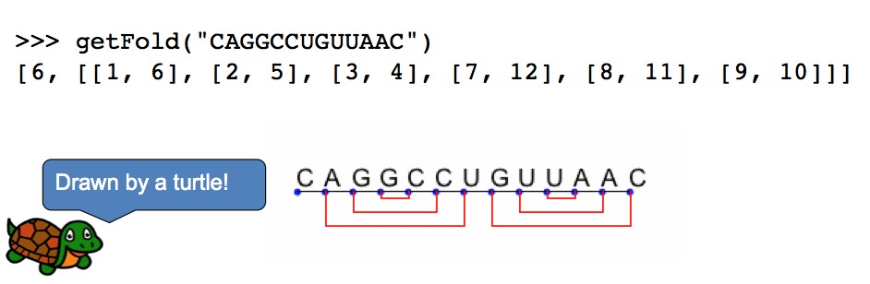
Bonus!
Notes:
Bonus 1 is to give the indices of the matches. Bonus 2 is to draw the matches. It helps to know that turtle.write can write a text string (see help), and (how convenient!) turtle.write doesn’t necessarily move the turtle. It may help to use a fixed-width font such as Courier.

Slide 15
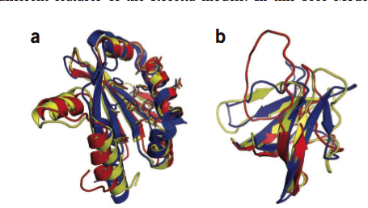
Protein Folding
From “Crystal structure of monomeric retroviral protease solved by protein folding game players”, Nature Structural and
Molecular Biology, September 18, 2011
Notes:
Proteins fold like RNA, but the chemistry is way more complicated.

Slide 16
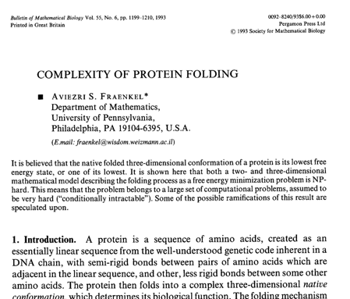
Protein folding is NP-complete!
Notes:
Well…this paper says NP-hard. That means that we know how to convert it into the Traveling Salesman Problem, but we don’t know how to convert Traveling Salesman into it. So if we solve TSP we’ve solved folding (and thousands of others), but if we solve folding we don’t have a solution for TSP.

Slide 17
The Alien's Life Advice
You don’t need to BE humble, just act that way!
No worries, people will still figure out how great you are!

Slide 18
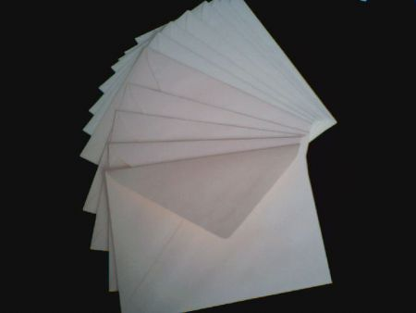
Upper Envelope
def f1(x):
return 5x + 1
def f2(x):
return x ** 2
>>> newf = upper(f1, f2)
>>> newf(1)
>>> newf(2)
>>> newf(10)
max(x,y) is built in!
Try this in your notes…
def upper(f1, f2):
return ???
Notes:
Upper creates a new function that, for any x, returns max(f1(x), f2(x)). How can we define it?
Remember that we did something similar a couple of weeks ago when we wrote divides(n), which returns a function that returns T/F depending on whether its argument divides n.

Slide 19
Upper Envelope
def f1(x):
return 5 * x + 1
def f2(x):
return x ** 2
>>> newf = upper(f1, f2)
>>> newf(1)
>>> newf(2)
>>> newf(10)
max(x,y) is built in!
Try this in your notes…
def upper(f1, f2):
return lambda x: max(f1(x), f2(x))
Notes:
This is called a “higher-order” function. We’ve seen higher-order functions briefly before (creating the div function when finding primes) but now we’re going to create much slicker ones. Note that we use a lambda here. We could also have defined a function inside the function, but this way is simpler.

Slide 20
Super Envelope!
def times10(x):
return 10 * x
def add42(x):
return x + 42
def ttt(x):
return 2 ** x
flist = [times10, add42, ttt]
>>> f = se(flist)
>>> f(1)
>>> f(2)
>>> f(5)
>>> f(10)
max(List) is built in!
Worksheet!
(One line of code)

Slide 21
def times10(x):
return 10 * x
def add42(x):
return x + 42
def ttt(x):
return 2 ** x
flist = [times10, add42, ttt]
>>> f = se(flist)
>>> f(1)
>>> f(2)
>>> f(5)
>>> f(10)
def se(L):
def super(x):
values = [f(x) for f in L]
return max(values)
return super
def seFunky(L):
return lambda x: max([f(x) for f in L])
Notes:
Why do we care? And why the funky version? Because this same idea can be used to calculate derivatives…

Slide 22
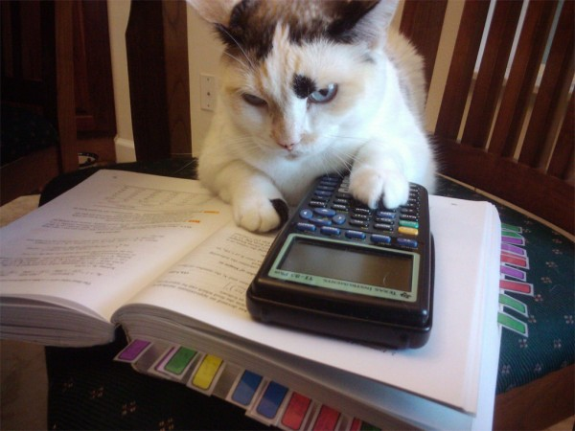
Derivatives
>>> def f(x):
return x ** 2
>>> f = lambda x: x ** 2
>>> fprime = deriv(f, 0.001)
>>> fprime(10)
20.0001
>>> import math
>>> h = deriv(math.cos, 0.001)
>>> h(math.pi)
0.0000…
def deriv(f, h):
return ???
Worksheet…
Notes:
return lambda x: (f(x+h)-f(x))/h

Slide 23
n^{th} Derivative
>>> def f(X):
return X ** 4
>>> g = nthDeriv(f, 2, 0.001)
>>> g(10)
def nthDeriv(f, n, h):
Worksheet…
Notes:
Hint: f’’(x) = f’(x). So if you can create a function that does f’(x) and then get its derivative, you’re nearly done…
What’s the base case?
Recursive case: return nthDeriv(deriv(f, h), n – 1, h)

Slide 24

Secret Sharing…
Original Image
“Magnified” Image
Heads?
Slide 1
Slide 2
Slide 1
Slide 2
Tails?
Notes:
Everything from here on out is just for fun, if we have time.
Use gimp on xandie-1bit_merged.xcf

Slide 25

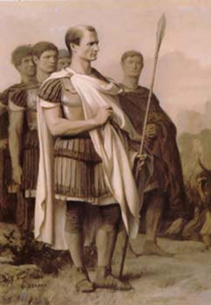
Cryptography!
Spartan scytale (500 BCE)
Caesar Cipher (100 BCE)
"senddonuts"
"vhqggrqtwv"

Slide 26
Symbols ⬅➔Numbers
Symbol Number
>>> ord('A')
65
>>> ord('!')
33
>>> chr(65)
'A'
>>> chr(33)
'!'
' ' 32
! 33
…
. 46
…
A 65
B 66 …
Z 90
a 97
b 98 …
z 122

Slide 27
Symbols ⬅➔Numbers⬅➔Binary Strings
Symbol Number Binary String
' ' 32
! 33
…
. 46
…
A 65
B 66 …
Z 90
a 97
b 98 …
z 122
'00100000'
'00100001'
'00101110'
'01000001'
'01000010'
'01011010'
'01100001'
'01100010'
'01111010'

Slide 28
XOR
A B A XOR B
0 0 0
0 1 1
1 0 1
1 1 0
0 XOR 0 = 0
0 XOR 1 = 1
1 XOR 0 = 1
1 XOR 1 = 0
Associative: (0 XOR 1) XOR 0 = 0 XOR (1 XOR 0)
Commutative: 0 XOR 1 = 1 XOR 0
What is 0 XOR 1 XOR 1 XOR 0 XOR 1?
Notes:
XOR forms an Abelian group, something studied in abstract algebra
But for cryptography, here’s the important point: 1 XOR 1 = 0, so by associativity and commutativity, ANY even number of ones gives a zero; likewise, any group of zeros gives a zero. And zero XOR x gives x.

Slide 29




XOR
A B A XOR B
0 0 0
0 1 1
1 0 1
1 1 0
0 XOR 0 = 0
0 XOR 1 = 1
1 XOR 0 = 1
1 XOR 1 = 0
One-time pad
00111101 01111010 00010011 …
One-time pad images from www.ranum.com and www.home.egge.net
Notes:
KGB one-time pads: One-time pad book and one-time pad hidden in a walnut shell

Slide 30
Encoding and Decoding
Original Message:
I space h …
Binary Version:
01001001 00100000 01101000
One-time pad:
00111101 01111010 00010011
XOR
Encrypted:
01110100 01011010 01111011
In text form: t Z {

Slide 31
Encoding and Decoding
Original Message:
I space h …
Binary Version:
01001001 00100000 01101000
One-time pad:
00111101 01111010 00010011
XOR
Encrypted:
01110100 01011010 01111011
One-time pad:
XOR
00111101 01111010 00010011
Original
Message!
01001001 00100000 01101000
I space h …
Notes:
Since the one-time pad appears twice, we can commute and associate to put it next to itself. Then it XORs to zero, so it has no effect on the original message!

Slide 32
What's the “One Time” Part?
Tuesday’s message:
ATTACK AT DAWN => HBWAKYBYAVLMQ4
Wednesday’s message:
RETREAT AT TEN => [SWRMS68T"(XC4
Tuesday XOR Wednesday:
Not printable, but the one-time pad drops out!
Notes:
Now we have ATTACK AT DAWN XOR RETREAT AT TEN. Where the letters match up, we ALWAYS get zero. The most common letters (in order) are ETAOINS. So when we get a zero, it’s likely to be one of those letters, not X or J or Z (there’s a reason those letters score high in Scrabble). That gives us a hint, and we can leverage that hint to decipher the message. In fact, this is easy for computers to do. (See this week’s Gold HW if you’re curious.)
True story: if x and y are the same, x XOR y = 0. If they are close, their XOR has relatively few “1” bits. If they’re very different, the XOR has a lot. So a count of the “1” bits is a measure of their difference. Many computers, especially powerful supercomputers, have special “count the number of 1’s” instructions that aren’t useful in “normal” programs. They exist because the NSA has a lot of money to pay manufacturers to build computers with those instructions!

