Slide 1
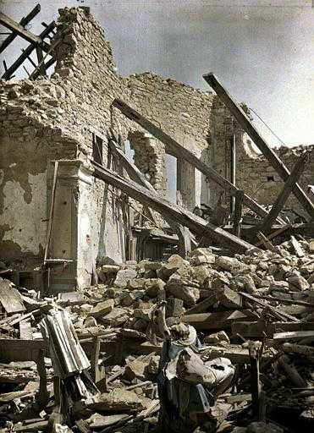
The CS 5 Times
Dormitory Destroyed
Claremont (PP): A Harvey Mudd College dormitory
was left in shambles Tuesday after an unexpected
low-frequency resonance caused it to self-destruct.
“I didn’t mean any harm,” reported a shaken
student. “I was doing my CS lab, and I thought it
would be cool to share my sounds with the other Westies, so I hooked my computer up to the dorm speakers. Who knew that 42 Hertz was a special frequency?”
Rescuers worked frantically to recover the student’s hard drive, which reportedly contained notes for an upcoming physics exam. At press time, the drive remained buried under tons of rubble, and hope for a positive outcome was fading. “I’d give anything for a copy of the Lorentz velocity transformation equations,” wailed the distraught student.
Upon hearing of this offer, North dorm residents reportedly got together and, after much difficulty, reconstructed the equation and offered it in return for West’s best speakers.
“West” dormitory after unfortunate incident.
No reading today!
Notes:
Functional6
Show how to find grutoring hours on Web site.
Setup: have xandie-1bit_merged.xcf file ready to go in The Gimp. Offset top layer by 2 in both X and Y. Move and resize window to fit into 1024x768 upper left corner (covering other dialogs). Note that ^L brings up the layers dialog.

Slide 2
A Mystery, Shrouded in an Enigma, and Veiled
in Obscurity!
def mystery(word):
if len(word) <= 1:
return len(word)
else:
myList = list(map(lambda x:
2 + mystery(word[1:x]) if word[0] == word[x]
else 0,
range(1, len(word))))
return max(myList)
01234
>>> mystery("radar")
5
>>> mystery("ahha! I like it!")
4
0123456789111111
012345

Slide 3
A Mystery, Shrouded in an Enigma, and Veiled
in Obscurity!
def mystery(word):
if len(word) <= 1:
return len(word)
else:
myList = list(map(lambda x:
2 + mystery(word[1:x]) if word[0] == word[x]
else 0,
range(1, len(word))))
return max(myList)
01234
It’s not quite as palindromic as these examples suggest!
>>> mystery("radar")
5
>>> mystery("ahha! I like it!")
4
0123468911111111
01234567
Notes:
Why isn't it palindromic? Because mystery("area") will return 2…

Slide 4
Is LCS NP-Complete?
def LCS(S1, S2):
if S1 == "" or S2 == "":
return 0
elif S1[0] == S2[0]:
return 1 + LCS(S1[1:], S2[1:])
else:
return max(LCS(S1, S2[1:]), LCS(S1[1:], S2))
Demo LCS
Two strings of length 100 nucleotides each…
>>> steps = 2**100
>>> speed = 3 * 10**9
>>> seconds = steps / speed
>>> years = seconds / (60*60*24*365.25)
>>> years
13389807845846.213
>>>
60 seconds per minute
60 minutes per hour
24 hours per day
365.25 days per year
13 trillion years!
Notes:
Run lec07prog01-lcs.py.
Set abet= the alphabet, then abet2=abet[:14]. Have the students time LCS(abet2,abet2[::-1]), or run timer(LCS, abet2, abet2[::-1]). Then increase abet2 to 15 and then 16, timing it each time. On my laptop I got about 1:15 for 16. Don’t run fastLCS yet.

Slide 5
LCS(“spam”, “pims”)
LCS(“spam”, “ims”)
LCS(“pam”, “pims”)
1+
LCS(“spam”, “ms”)
LCS(“pam”, “ims”)
LCS(“am”, “ims”)
LCS(“pam”, “ms”)
LCS(“am”, “ims”)
I love “am and ims”!
Notes:
Animation highlights that “am” and “ims” are used in the rightmost branch of the left subtree, and in the right subtree.

Slide 6
Dictionaries Revisited
>>> D = {"spam" : "yummy!", (42, 42): "an important point"}
>>> D["spam"]
“yummy!”
>>> D[(42, 42)]
"an important point"
>>> D[["zaster!", "putrid", "smoke!"]]
BARF!

Slide 7
Dictionaries Revisited
>>> D = {“spam” : “yummy!”, (42, 42): “an important point”}
>>> D = {}
>>> D[“spam”] = “yummy!”
>>> D[(42, 42)] = “an important point”
>>> D[[1, 2]] = “but this is bad”
BARF!
>>> "spam" in D
True
>>> 42 in D
False
>>> (42, 42) in D
True
>>> D[(42, 42)]
“an important point”

Slide 8
How Dictionaries Work: Hashing
>>> D
{"Ran": "spam", …}
>>> x = (1, 2)
>>> D[x] = "my tuple"
>>> D
{"Ran": "spam", (1, 2): "my tuple"}
Memory
locations
D["Ran"]
D[x] =
D[(1, 2)]
5999
1
2
3
"my tuple"
3
5999
"spam"
Imagine that we now changed x[0]=42
6000

Slide 9
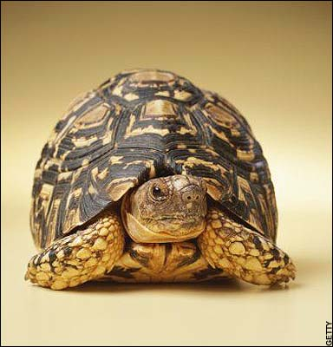
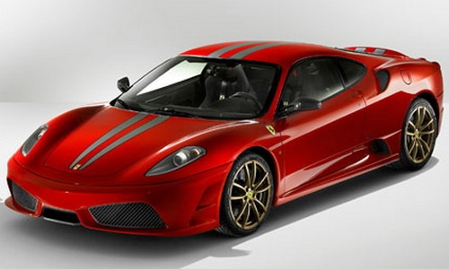
def LCS(S1, S2):
if S1 == "" or S2 == "":
return 0
elif S1[0] == S2[0]:
return 1 + LCS(S1[1:], S2[1:])
else:
return max(LCS(S1, S2[1:]), LCS(S1[1:], S2))
Old slow version
memo = {} # global empty dictionary
def fastLCS(S1, S2):
if (S1, S2) in memo:
return memo[(S1, S2)]
elif S1 == "" or S2 == "":
answer = 0
elif S1[0] == S2[0]:
answer = 1 + LCS(S1[1:], S2[1:])
else:
answer = max(LCS(S1, S2[1:]), LCS(S1[1:], S2))
memo[(S1, S2)] = answer
return answer
New fast
“memoized”
version
Notes:
Demo fastLCS here. Circle the recursive calls that are avoided by memorization.

Slide 10
Changing change
def change(value, coins):
if value <= 0:
return 0
elif coins == []:
return float("inf")
loseIt = change(value, coins[1:])
if value < coins[0]:
return loseIt
else:
useIt = 1 + change(value - coins[0], coins)
return min(useIt, loseIt)

Slide 11
Changing change
memo = {} # Empty dictionary
def fastChange(value, coins):
if (value, coins) in memo:
return memo[(value, coins)]
elif value <= 0:
return 0
elif coins == []:
return float("inf")
# Finish writing this!
coins must be a tuple rather
than a list!
Geoff’s solution coming up…
Worksheet!

Slide 12
Changing change
memo = {} # Empty dictionary
def fastChange(value, coins):
if (value, coins) in memo:
return memo[(value, coins)]
elif value <= 0:
return 0
elif coins == []:
return float("inf")
loseIt = fastChange(value, coins[1:])
if value < coins[0]:
memo[(value, coins)] = loseIt
return loseIt
else:
useIt = 1 + fastChange(value - coins[0], coins)
best = min(useIt, loseIt)
memo[(value, coins)] = best
return best
coins must be a tuple rather
than a list!
Notes:
There is an animation on this slide that brings up the else (use-it) case.

Slide 13
Secret Sharing…
Original Image
“Magnified” Image
Heads?
Slide 1
Slide 2
Slide 1
Slide 2
Tails?
Notes:
Everything from here on out is just for fun, if we have time.
Use gimp on xandie-1bit_merged.xcf. Use ^L to bring up the layers menu so you can show that each layer alone is just noise (roughly grayscale). Then enable both layers, right-click on layers title bar to hide them, and use arrow keys by 2 in each direction to reveal the picture.

Slide 14
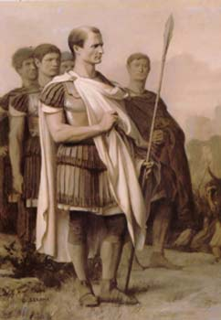
Cryptography!
Spartan scytale (500 BCE)
Caesar Cipher (100 BCE)
"senddonuts"
"vhqggrqtwv"

Slide 15
Symbols ⬅➔Numbers
Symbol Number
>>> ord('A')
65
>>> ord('!')
33
>>> chr(65)
'A'
>>> chr(33)
'!'
' ' 32
! 33
…
. 46
…
A 65
B 66 …
Z 90
a 97
b 98 …
z 122

Slide 16
Symbols ⬅➔Numbers⬅➔Binary Strings
Symbol Number Binary String
' ' 32
! 33
…
. 46
…
A 65
B 66 …
Z 90
a 97
b 98 …
z 122
'00100000'
'00100001'
'00101110'
'01000001'
'01000010'
'01011010'
'01100001'
'01100010'
'01111010'
Notes:
We’ll talk more about binary (and XOR) next week, so not to worry if it’s unfamiliar.

Slide 17
XOR
A B A XOR B
0 0 0
0 1 1
1 0 1
1 1 0
0 XOR 0 = 0
0 XOR 1 = 1
1 XOR 0 = 1
1 XOR 1 = 0
Associative: (0 XOR 1) XOR 0 = 0 XOR (1 XOR 0)
Commutative: 0 XOR 1 = 1 XOR 0
What is 0 XOR 1 XOR 1 XOR 0 XOR 1?
What is x XOR y XOR x?
Worksheet!
Notes:
XOR forms an Abelian group, something studied in abstract algebra
But for cryptography, here’s the important point: 1 XOR 1 = 0, so by associativity and commutativity, ANY even number of ones gives a zero; likewise, any group of zeros gives a zero. And zero XOR x gives x.
Also, for any x and y, x XOR y XOR x = y. Order doesn’t matter: if x appears twice in an xor sequence, it disappears.

Slide 18
XOR
A B A XOR B
0 0 0
0 1 1
1 0 1
1 1 0
0 XOR 0 = 0
0 XOR 1 = 1
1 XOR 0 = 1
1 XOR 1 = 0
One-time pad
00111101 01111010 00010011 …
One-time pad images from www.ranum.com and www.home.egge.net
Notes:
KGB one-time pads: One-time pad book and one-time pad hidden in a walnut shell

Slide 19
Encoding and Decoding
Original Message:
I space h …
Binary Version:
01001001 00100000 01101000
One-time pad:
00111101 01111010 00010011
XOR
Encrypted:
01110100 01011010 01111011
In text form: t Z {

Slide 20
Encoding and Decoding
Original Message:
I space h …
Binary Version:
01001001 00100000 01101000
One-time pad:
00111101 01111010 00010011
XOR
Encrypted:
01110100 01011010 01111011
One-time pad:
XOR
00111101 01111010 00010011
Original
Message!
01001001 00100000 01101000
I space h …
Notes:
Since the one-time pad appears twice, we can commute and associate to put it next to itself. Then it XORs to zero, so it has no effect on the original message!

Slide 21
Letter Frequencies
Histogram courtesy of http://www.simonsingh.net/The_Black_Chamber
Notes:
From the above web site: “Please note, these frequencies are averages, and E will not always constitute 12.7 % of all the letters in a text, and may not even be the most common letter. The longer the message, the more likely it is that will obey the average distribution shown above. However, there are exceptions to this rule. In 1969, the French author Georges Perec managed to write a 20-page book called 'La Disparition' without using any words containing the letter E. Amazingly, the book was later translated into English by Gilbert Adair, again avoiding the use of the letter E.”

Slide 22
What's the “One Time” Part?
Tuesday’s message:
ATTACK AT DAWN => HBWAKYBYAVLMQ4
Wednesday’s message:
RETREAT AT TEN => [SWRMS68T"(XC4
Tuesday XOR Wednesday:
Not printable, but the one-time pad drops out!
Notes:
Now we have ATTACK AT DAWN XOR RETREAT AT TEN. Where the letters match up, we ALWAYS get zero. The most common letters (in order) are ETAOINS. So when we get a zero, it’s likely to be one of those letters, not X or J or Z (there’s a reason those letters score high in Scrabble). That gives us a hint, and we can leverage that hint to decipher the message. In fact, this is easy for computers to do. (See this week’s Gold HW if you’re curious.)
True story: if x and y are the same, x XOR y = 0. If they are close, their XOR has relatively few “1” bits. If they’re very different, the XOR has a lot. So a count of the “1” bits is a measure of their difference. Many computers, especially powerful supercomputers, have special “count the number of 1’s” instructions that aren’t useful in “normal” programs. They exist because the NSA has a lot of money to pay manufacturers to build computers with those instructions!

Slide 23
The Alien's Life Advice
You don’t need to BE humble, just act that way!
No worries, people will still figure out how great you are!

Slide 24
Alice, Bob, and their Locks
Klepto Mail
Alice
Bob
Notes:
Alice wishes to send Bob a gift. However, the mail service, Klepto Mail, will steal the package unless it is sent in a locked box. Fortunately, Alice and Bob have lots of boxes and lots of key-locks. However, they only have keys to their OWN locks. How can Alice send Bob the present?

Slide 25
Alice, Bob, and their Locks
Alice
Bob
Notes:
Alice locks the gift in a box using one of her locks and sends the locked package to Bob.

Slide 26
Alice, Bob, and their Locks
Alice
Bob
Notes:
Bob attaches one of his locks to the package and sends it back to Alice.

Slide 27
Alice, Bob, and their Locks
Alice
Bob
Notes:
Alice removes her lock from the box and sends it back to Bob.

Slide 28
Alice, Bob, and Their Locks
Alice
Bob
Notes:
Bob receives the package and removes his lock!

Slide 29
How Does This Help Us?
Alice
Bob
Pad_{Alice}
Pad_{Bob}
Notes:
Our one-time pads are the locks!

Slide 30
How Does this Help Us?
Pad_{Alice} XOR Message
Alice
Bob
Pad_{Alice}
Pad_{Bob}

Slide 31
How Does this Help Us?
(Pad_{Alice} XOR Message)
XOR Pad_{Bob}
Alice
Bob
Pad_{Alice}
Pad_{Bob}

Slide 32
How Does this Help Us?
((Pad_{Alice} XOR Message)
XOR Pad_{Bob} ) XOR Pad_{Alice}
= ?
Alice
Bob
Pad_{Alice}
Pad_{Bob}

Slide 33
How Does this Help Us?
((Pad_{Alice} XOR Message)
XOR Pad_{Bob} ) XOR Pad_{Alice})
= Message XOR Pad_{Bob}
Alice
Bob
Pad_{Alice}
Pad_{Bob}

Slide 34
How Does this Help Us?
(Message XOR Pad_{Bob})
XOR Pad_{Bob} =?
Alice
Bob
Pad_{Alice}
Pad_{Bob}
This seems like a great trick but…
Worksheet!
Notes:
This is the basis of a cryptographic protocol called the Diffie-Hellman Algorithm. But the problem is this:
Alice sends A xor M
Bob sends (A xor M) xor B
Alice sends ((A xor M) xor B) xor A = M xor B
Problem: An eavesdropper can observe (A xor M) = y and (A xor M) xor B = y xor B. So by xor-ing y with y xor B, y drops out and you get Bob's one-time pad. Then the eavesdropper can decode the final message!

Slide 35
Public Key Cryptography!
Alice’s Public Key: 10100
Bob’s Public Key: 11100
Carol’s Public Key: 01010
Danny’s Public Key: 10111
Alice (Private Key: 010110)
Bob (Private
Key: 001010)

Slide 36
Public Key Cryptography!
Alice’s Public Key: 10100
Bob’s Public Key: 11100
Carol’s Public Key: 01010
Danny’s Public Key: 10111
f is public and used
by all parties!
"I like spam"
10110100010
f(1011010010, 11100)
Alice (Private Key: 010110)
Bob (Private
Key: 001010)
101010001010

Slide 37
Public Key Cryptography!
g is public and used
by all parties!
"I like spam"
Alice’s Public Key: 10100
Bob’s Public Key: 11100
Carol’s Public Key: 01010
Danny’s Public Key: 10111
10110100010
g(101010001010, 001010)
101010001010
"I like spam"
10110100010
f(1011010010, 11100)
Alice (Private Key: 010110)
Bob (Private
Key: 001010)
101010001010

Slide 38
Cryptographic Hashes
def badhash(s):
x = sum([ord(c) for c in s])
return x % 1009
>>> badhash("hello")
532
>>> badhash("hello there")
91
Notes:
The essence of a cryptographic hash is that it should be hard to find a string that hashes to a given value. Knowing that “hello there” hashes to 91, what other strings hash to the same value? We know there are only 1009 possibilities, so we can do an exhaustive search. For example:
for i in range(2000):
if badhash(i*’a’) == 91:
print(i)
Tells us that 313 and 1322 a’s are solutions. Note that 1322 % 1009 = 313. For b’s, 73 and 1082 solve it; again 1082 % 1009 = 73.

Slide 39
Cryptographic Hashes
def sha1(s):
x = # much magic
return x
>>> sha1("hello")
f572d396fae9206628714fb2ce00f72e94f2258f
>>> sha1("hello there")
55e82e1eb131597ce6ef77ff775b2c2e5f4d6b45
Notes:
Python has sha1 (and others) built into hashlib, although the interface is a bit strange.

Slide 40
Digital Signatures
message = "Pay $1M to SAT proctor"
hash = sha256(message)
proof = encrypt(hash, felicity_private_key)
secret = encrypt(message + proof,
bank_public_key)
send(secret)
Notes:
Now only the bank can decrypt the secret message.

Slide 41
Verifying Digital Signatures
plain = decrypt(secret, bank_private_key)
message = plain[:-prooflen]
hash = sha256(message)
proof = plain[-prooflen:]
proof = decrypt(proof, felicity_public_key)
if hash == proof:
execute(message)
Notes:
The decrypted message contains proof that could only have been generated by Felicity.

