Slide 1
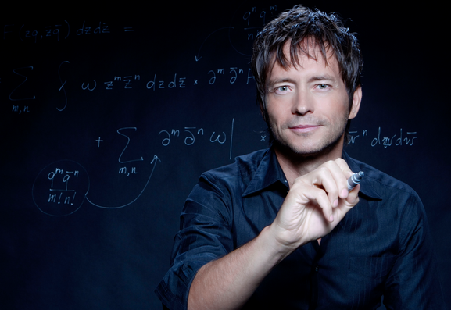
BR 5 Snczx
Gesundheit!
Algorithms
Edward Frenkel
Englishness...
Classifying life
Removing/Sorting
and Jotto!
HW 4
Hw #4 due Monday, 11:59
Sound Lab!
Several algorithms ...
Notes:
INHANDOUT

Slide 2
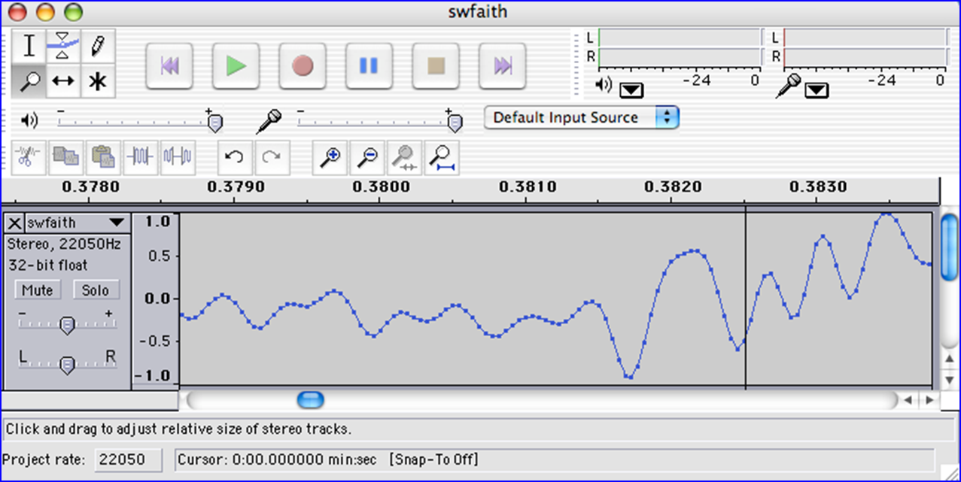
We saw you in Lab4…
heard

Slide 3
Warm-up + cool-down from lab...
[2*x for x in L]
L = [1, 11, 21]
N = len(L)
[2*L[i] for i in range(N)]
Notes:
INHANDOUT

Slide 4
But why use indices?!
[??? + x for x in L]
[ _________ for x in L]
Aargh!
L = [1, 11, 21]
N = len(L)
[L[i-1] + L[i] for i in range(N)]
Notes:
INHANDOUT
Use x or e for elements, I for indices.
Note that in this example you have to be able to use indices.

Slide 5
But why use indices?!
Today in CS5:
[??? + x for x in L]
chr(9829)
[ _________ for x in L]
Aargh!
The ♥ of CS (and CSers...)
L = [1, 11, 21]
N = len(L)
[L[i-1] + L[i] for i in range(N)]
Algorithms!
Notes:
Start here?

Slide 6
Caesar Cipher: encipher
should return the string s with each alphabetic character shifted/wrapped by n places in the alphabet
encipher(s, n)
encipher( 'I <3 Latin' , 0 )
'I <3 Latin'
'J <3 Mbujo'
'K <3 Ncvkp'
'L <3 Odwlq'
'M <3 Pexmr'
'N <3 Qfyns'
returns
encipher( 'I <3 Latin' , 1 )
returns
encipher( 'I <3 Latin' , 2 )
returns
encipher( 'I <3 Latin' , 3 )
returns
encipher( 'I <3 Latin' , 4 )
returns
encipher( 'I <3 Latin' , 5 )
returns
Now, where were we... ?
encipher( 'I <3 Latin' , 25 )
'H <3 Kzshm'
returns
Notes:
Review, show encipher

Slide 7
ASCII and Unicode
convert # to char
chr
ord
convert char to #
This is why 'CS' < 'clear' !
Julius spr'15

Slide 8
any single character, c
Writing Rot13
def rot13(c):
"""Rotates c by 13 chars, "wrapping" as needed
NON-LETTERS don't change!
"""
if 'a' <= c <= 'z':
if ord(c) + 13 <= ord('z'):
return chr(ord(c) + 13)
else:
return chr(ord(c) + 13 - 26)
elif 'A' <= c <= 'Z': # uppercase test!
else:
(0) What do these tests do?
(1) What code will "wrap" to the alphabet's other side?
same, but for 'Z'
(2) How will uppercase change? Try noting only the code differences…
return c
(3) What if c is not a letter at all?
use n instead of 13
Extra: How would you rotate n places, instead of 13?
Notes:
INHANDOUT

Slide 9
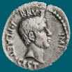
Caesar Cipher: encipher
Caesar
Brutus
>>> encipher('Bzdrzq bhogdq? H oqdedq Bzdrzq rzkzc.',25)
'Aycqyp agnfcp? G npcdcp Aycqyp qyjyb.'
S1
>>> encipher('Bzdrzq bhogdq? H oqdedq Bzdrzq rzkzc.',15)
'Qosgof qwdvsf? W dfstsf Qosgof gozor.'
>>> encipher('Bzdrzq bhogdq? H oqdedq Bzdrzq rzkzc.',4)
'Fdhvdu flskhu? L suhihu Fdhvdu vdodg.'
>>> encipher('Bzdrzq bhogdq? H oqdedq Bzdrzq rzkzc.',1)
'Caesar cipher? I prefer Caesar salad.'
>>> encipher('Hu lkbjhapvu pz doha ylthpuz hmaly dl mvynla '\
'lclyfaopun dl ohcl slhyulk.',19)
'An education is what remains after we forget everything we have learned.'
S2

Slide 10
Caesar Cipher: decipher
Caesar
Brutus
>>> decipher('Bzdrzq bhogdq? H oqdedq Bzdrzq rzkzc.')
'Caesar cipher? I prefer Caesar salad.'
S1
S2
>>> decipher('Hu lkbjhapvu pz doha ylthpuz hmaly dl mvynla '\
'lclyfaopun dl ohcl slhyulk.')
'An education is what remains after we forget everything we have learned.'
>>> decipher('Uifz xpsl ju pvu xjui b qfodjm!')
PL, PL2
>>> decipher('gv vw dtwvg')
LAT
But how ?
Notes:
Blue is English for green

Slide 11
Measuring Englishness
Very English-y
"Call me Ishmael."
"Attack at dawn!"
"rainbow, table, candle"
higher scores
"Yow! Legally-imposed CULTURE-reduction is CABBAGE-BRAINED!"
"quadruplicity drinks procrastination"
"Hold the newsreader's nose squarely, waiter, or friendly milk will countermand my trousers."
quantifying "Englishness"?
"the gostak distims the doshes"
"hension, framble, bardle"
"jufict, stofwus, lictpub"
"itehbs, rsnevtr, khbsota"
lower scores
"epadxo, nojarpn, gdxokpw"
"h o q dedqBzdrzqrzkzc"
All of these sound good to me!
Not English-y

Slide 12
gv vw dtwvg
hw wx euxwh
ix xy fvyxi
jy yz gwzyj
kz za hxazk
la ab iybal
mb bc jzcbm
nc cd kadcn
od de lbedo
pe ef mcfep
qf fg ndgfq
rg gh oehgr
sh hi pfihs
ti ij qgjit
uj jk rhkju
vk kl silkv
wl lm tjmlw
xm mn uknmx
yn no vlony
zo op wmpoz
ap pq xnqpa
bq qr yorqb
cr rs zpsrc
ds st aqtsd
et tu brute
fu uv csvuf
[6.9e-05, 'gv vw dtwvg'],
[3.6e-05, 'hw wx euxwh'],
[1.4e-07, 'ix xy fvyxi'],
[8.8e-11, 'jy yz gwzyj'],
[7.2e-10, 'kz za hxazk'],
[0.01503, 'la ab iybal'],
[3.7e-08, 'mb bc jzcbm'],
[0.00524, 'nc cd kadcn'],
[0.29041, 'od de lbedo'],
[0.00874, 'pe ef mcfep'],
[7.3e-07, 'qf fg ndgfq'],
[0.06410, 'rg gh oehgr'],
[0.11955, 'sh hi pfihs'],
[3.1e-06, 'ti ij qgjit'],
[1.1e-08, 'uj jk rhkju'],
[2.6e-05, 'vk kl silkv'],
[0.00012, 'wl lm tjmlw'],
[3.1e-06, 'xm mn uknmx'],
[0.02011, 'yn no vlony'],
[1.5e-06, 'zo op wmpoz'],
[1.9e-07, 'ap pq xnqpa'],
[5.7e-08, 'bq qr yorqb'],
[0.00024, 'cr rs zpsrc'],
[0.02060, 'ds st aqtsd'],
[0.45555, 'et tu brute'],
[0.00011, 'fu uv csvuf']
Decipher?
All possible decipherings
S
c
o
r
e
s
Strategies?
Algorithms?
"Englishness" based on letter-probabilities
max!
Notes:
Demo 3 ways of measuring Englishness
decPR has prints to show what’s going on
decPR1/2
For Scrabble score, lowest is best

Slide 13
DIY Design…
remAll(e, L)
remove all e's from L
The ♥ of CS (and CSers...)
Algorithms!

Slide 14
Design…
remAll(e, L)
remove all e's from L
Top-down design
remAll(42, [5, 7, 42, 8, 42])
Visualize
[5, 7, 8]
Split into parts
Build each part
Combine
remAll('q', 'qaqqlqqiqqiiqeqqnqs')
Test
'aliiiens'
Notes:
Syntax is a barrier to learning.
e (42) is first argument
L ([…]) is second
second example doesn’t remove ‘e’, it removes e the variable, i.e. ‘q’

Slide 15
Design…
remAll(e, L)
remove all e's from L
Top-down design
it
Use it!
'the rest'
remAll(42, [5, 7, 42, 8, 42])
Visualize
'it'
[5, 7, 8]
Split into parts
L[0] and L[1:]
'the rest'
Build each part
it
Combine
'the rest'
remAll('q', 'qaqqlqqiqqiiqeqqnqs')
Test
'aliiiens'
Lose it!
Notes:
Use it or lose it – some combination of working with and without an element
Each problem has its own relationships between use and lose

Slide 16
Design…
remAll(e, L)
remove all e's from L
Top-down design
it
Use it!
'the rest'
remAll(42, [5, 7, 42, 8, 42])
Visualize
keep L[0]
+ remove e from the rest
[5, 7, 8]
Split into parts
Build each part
it
Combine
'the rest'
remAll('q', 'qaqqlqqiqqiiqeqqnqs')
Test
drop L[0]
+ remove e from the rest
'aliiiens'
Lose it!
Notes:
INHANDOUT

Slide 17
Design…
remAll(e, L)
remove all e's from L
Top-down design
it
Use it!
remAll(42,[5,7,42,8,42])
Use it!
Visualize
keep L[0]
+ remove e from the rest
[5,7,8]
Split into parts
- or -
Build each part
it
Combine
remAll('q','qaqqlqqiqqiiqeqqnqs')
Lose it.
Test
drop L[0]
+ remove e from the rest
'aliiiens'
Lose it!

Slide 18
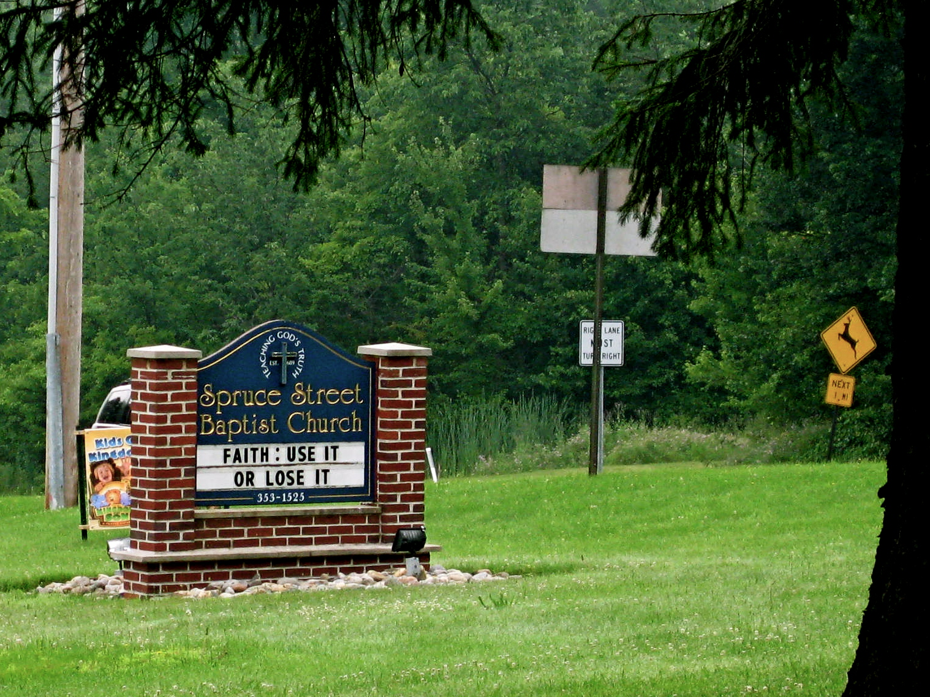
Allie Russell, '12
speaking of roadside church signs…

Slide 19
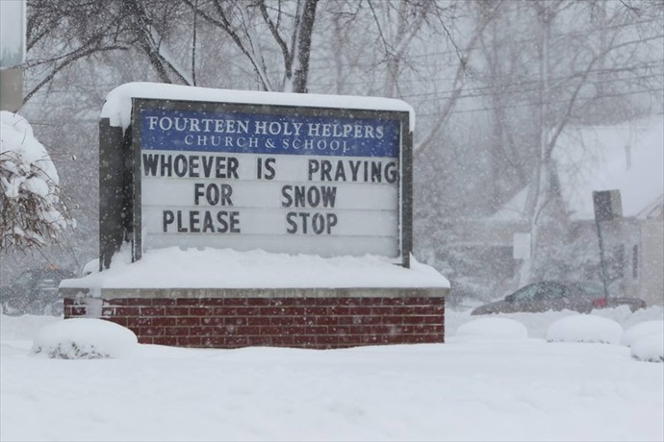
speaking of roadside church signs…

Slide 20
Design ~ code
remAll(e, L)
remove all e's from L
Top-down design
Visualize
def remAll(e, L):
if len(L) == 0:
elif L[0] != e:
else:
L empty
Split into parts
it
Build each part
it wasn't e
Combine
it was e
Test
Notes:
The test in the elif is inverted so that use-it is first.

Slide 21
Design ~ code
remAll(e, L)
remove all e's from L
Top-down design
Visualize
def remAll(e, L):
if len(L) == 0:
return L
elif L[0] != e:
return L[0:1] + remAll(e, L[1:])
else:
return remAll(e, L[1:])
Split into parts
Build each part
Use it!
Combine
Test
Lose it!
Notes:
INHANDOUT
Point out that the slice in the first return gives a list (and slicing is needed to be able to handle strings)

Slide 22
Teal… !
remAll(e, L)
remove all e's from L
Top-down design
Visualize
def remAll(e, L):
if len(L) == 0:
return L
elif L[0] != e:
return L[0:1] + remAll(e, L[1:])
else:
return remAll(e, L[1:])
Split into parts
Build each part
Use it!
Combine
Test
Lose it!
Notes:
remall is a common interview question
Teal nailed an interview at MS just after doing this in class and was told she was the first ever to solve it recursively.

Slide 23
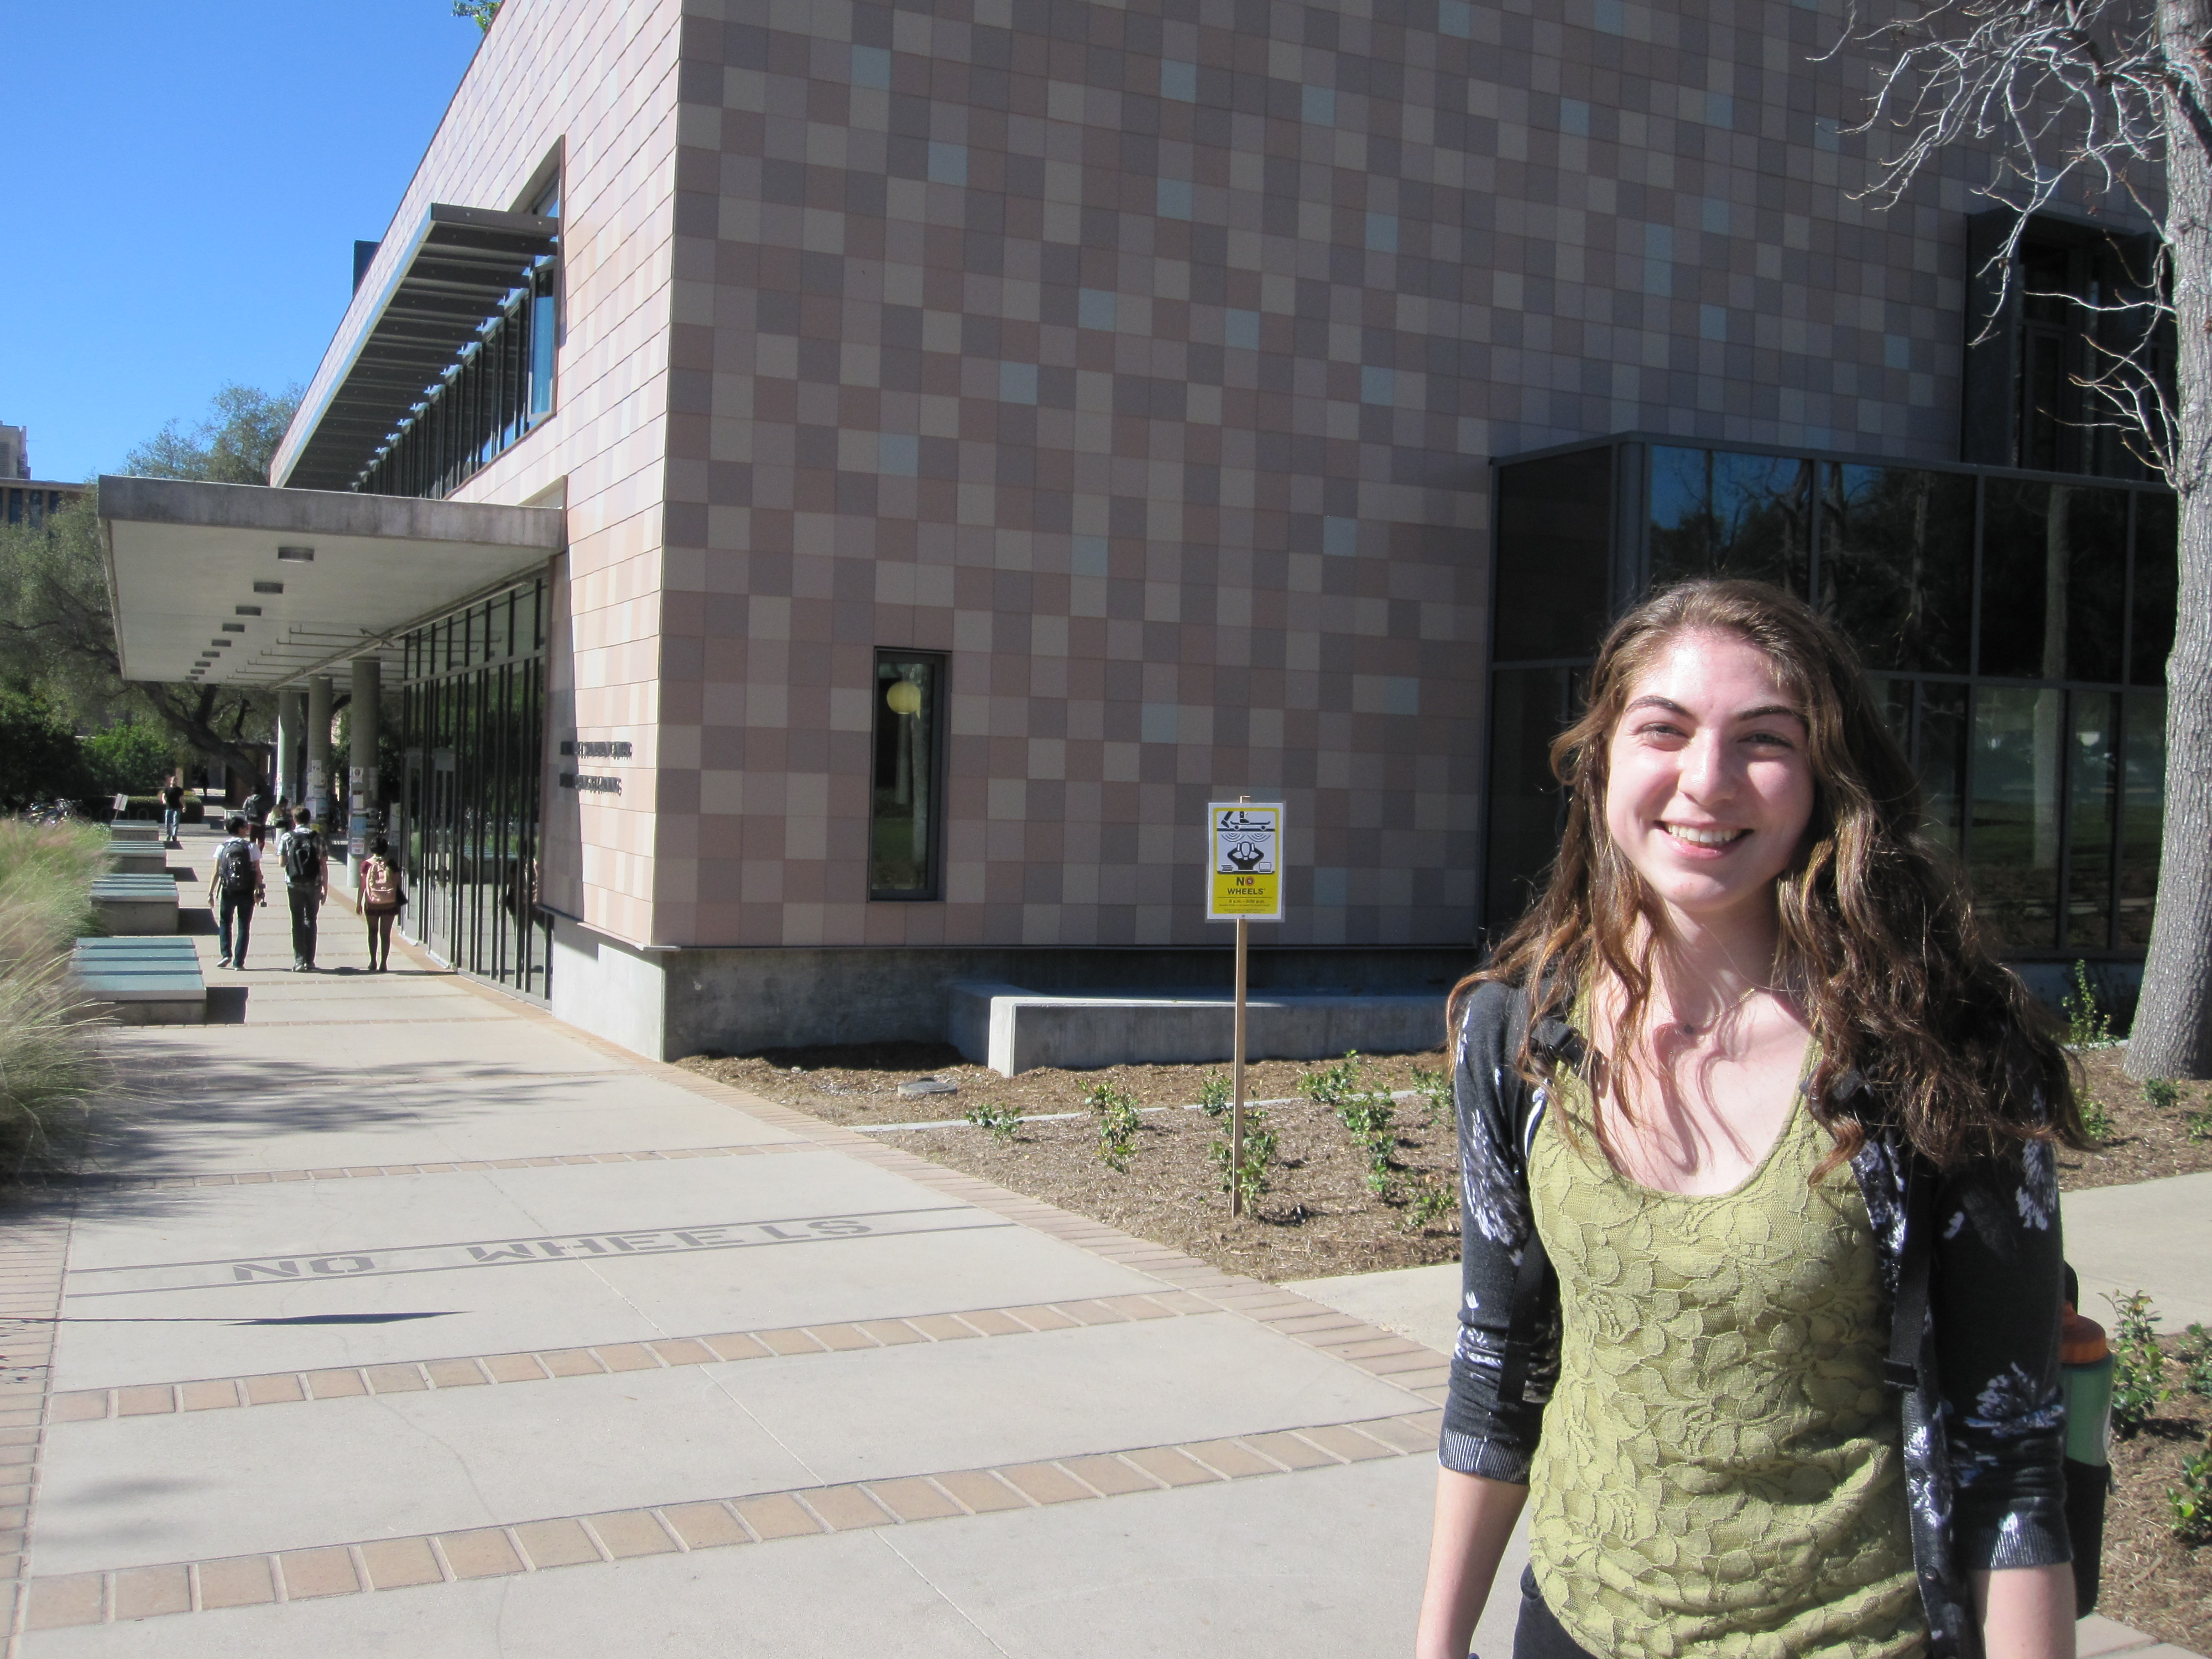
Teal… !
remAll(e,L)
remove all e's from L
Top-down design
Visualize
def remAll( e, L ):
if len(L) == 0:
return L
elif L[0] != e:
return L[0:1] + remAll(e,L[1:])
else:
return remAll(e,L[1:])
Split into parts
Build each part
Combine
Use it!
Test
Lose it!

Slide 24
Design…
design of what?
Code?
syntax

Slide 25
Design…
design of what?
Code?
syntax
Notes:
This is The Economist explaining what “code” is (using our editor and Python!)

Slide 26
Design…
design of what?
Code?
syntax
Algorithms!
ideas!
Notes:
INHANDOUT

Slide 27
What's the problem?!
Top-down design
Visualize
Split into parts
Which one of these steps is the most important?
Build each part
Combine
Test

Slide 28
What's the problem?!
Top-down design
Visualize
understanding what the problem demands!!
Split into parts
Build each part
Combine
Test
I want some examples!

Slide 29
other rem examples…
remAll(8, [7,8,9,8]) [7,9]
remAll
remOne(8, [7,8,9,8]) [7,9,8]
remOne
remUpto(8,[7,8,9,8]) [9,8]
remUpto
remAll('d', 'coded') 'coe'
remAll
remOne('d', 'coded') 'coed'
remOne
remUpto('d','coded') 'ed'
remUpto
Notes:
INHANDOUT

Slide 30
Subsequences
in order, but not necessarily adjacent…
def subseq(s, sbig)
True or False?
s is the subsequence to find (or not)
sbig is the bigger string in which we are looking for s
T or F?
True
subseq('', 'cataga')
subseq('ctg', 'cataga')
True
subseq('ctg', 'tacggta')
False
True
subseq('aliens', 'always frighten dragons')
subseq('trogdor', 'that dragon is gone for good')
False
Here there be NO dragons!
Why are these True? or False?
Notes:
INHANDOUT
Visualize subsequences (demo) before diving in.

Slide 31
Subsequences
in order, but not necessarily adjacent…
def subseq(s, sbig)
True or False?
s is the subsequence to find (or not)
sbig is the bigger string in which we are looking for s
T or F?
True
subseq('', 'cataga')
subseq('ctg', 'cataga')
True
False
subseq('ctg', 'tacggta')
False
True
True
subseq('aliens', 'always frighten dragons')
subseq('trogdor', 'that dragon is gone for good')
False
False
Here there be NO dragons!
Why are these True? or False?

Slide 32
Quiz
Algorithm design
Name(s):
1
Change remAll so that it removes only one e from L. (We could call it remOne.)
def remAll(e, L):
"""Removes all e's from L."""
if len(L) == 0:
return L
elif L[0] != e:
return L[0:1] + remAll(e,L[1:])
else:
return remAll(e,L[1:])
remOne(8, [7,8,9,8])
[7,9,8]
2
Make more changes to remAll so that it removes all of the elements up to and including the first e in L.
(We could call it remUpto.)
remUpto('d','coded') 'ed'
If e is not in L, remUpto should remove everything...
Hint: In both cases, all that's needed is crossing stuff out! What stuff?
def subseq(s, sbig):
"""Returns True if s is a subsequence of sbig,
False otherwise. Both are strings.
"""
if s == '':
return True
elif
3
Challenge…
Write the other cases needed for subseq…
subseq('alg', 'magical')
False
subseq('alg', 'twasbrillig')
True
Notes:
QUIZSLIDE

Slide 33
Quiz
Algorithm design
Name(s):
1
Change remAll so that it removes only one e from L. (We could call it remOne.)
def remAll(e, L):
"""Removes all e's from .L"""
if len(L) == 0:
return L
elif L[0] != e:
return L[0:1] + remAll(e,L[1:])
else:
return remAll(e,L[1:])
Hint: remove one thing for remOne!
remOne(8, [7,8,9,8])
[7,9,8]
2
Make more changes to remAll so that it removes all of the elements up to and including the first e in L.
(We could call it remUpto.)
remUpto('d','coded') 'ed'
If e is not in L, remUpto should remove everything...
Hint: In both cases, all that's needed is crossing stuff out! What stuff?
Hint: remove one more thing for remUpto!
def subseq(s, sbig):
"""Returns True if s is a subsequence of sbig,
False otherwise. Both are strings.
"""
if s == '':
return True
elif
3
Challenge…
Write the other cases needed for subseq…
Hint: you'll need 3-4 cases total for subseq.
subseq('alg', 'magical')
False
subseq('alg', 'twasbrillig')
True

Slide 34
from remAll to remOne
Hint: remove one thing for remOne!
def remAll(e, L):
"""Removes all e’s from L."""
if len(L) == 0:
return L
elif L[0] != e:
return L[0:1] + remAll(e, L[1:])
else:
return remAll(e, L[1:])
remOne(8, [7,8,9,8])
[7,9,8]
remOne('d', 'coded')
'coed'
Notes:
Mark changes on slide to convert remAll to remOne:
s/All/One/g
last return is return L[1:]
Note that L[0:1] in first return is “keeping it”

Slide 35
from remOne to remUpto
Hint: remove one more thing for remUpto!
def remOne(e, L):
"""Returns sequence L with one e removed.
"""
if len(L) == 0:
return L
elif L[0] != e:
return L[0:1] + remOne(e, L[1:])
else:
return L[1:]
remUpto(8, [7,8,9,8])
[9,8]
remUpto('d', 'coded')
'ed'
Notes:
INHANDOUT

Slide 36
Subseq ~ trying (coding) it out…
def subseq(s, sbig):
"""Returns True if s is a subsequence of sbig;
False otherwise. Both are strings.
"""
if s == '':
return True
Base case(s)
Recursive step(s)
subseq('alg', 'magical')
subseq('alg', 'twasbrillig')
Let's try it!
False
True
Notes:
INHANDOUT
Type code into editor and then run
lec8nfun.py includes demos
def subseq(s, sbig):
"""Returns True if s is a subsequence of
sbig; False otherwise. Both are strings.
"""
if len(s) == 0:
return True
elif s[0] not in sbig:
return False
else:
restofsbig = removeUpto(s[0], sbig)
return subseq(s[1:], restofsbig)

Slide 37
Subseq ~ trying (coding) it out…
Hint: you'll need 3-4 cases total for subseq.
def subseq(s, sbig):
"""Returns True if s is a subseq. of sbig;
False otherwise. Both are strings.
"""
if s == '':
return True
Base case(s)
Recursive step(s)
subseq('alg','magical')
subseq('alg','twasbrillig')
False
True
Notes:
def subseq(s, sbig):
"""Returns True if s is a subsequence of
sbig; False otherwise. Both are strings.
"""
if len(s) == 0:
return True
elif s[0] not in sbig:
return False
else:
restofsbig = removeUpto(s[0], sbig)
return subseq(s[1:], restofsbig)

Slide 38
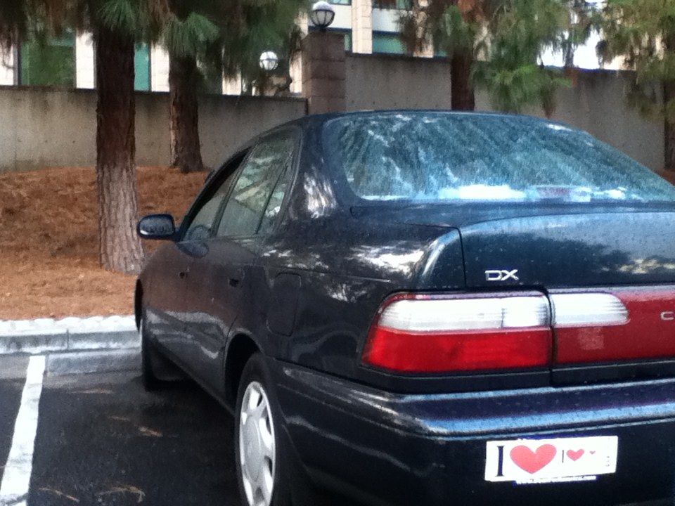

Slide 39
Subseq ~ thinking it out…
subseq(s, sbig)
subseq('ctg', 'tacggta')
What is a small (initial) piece of the problem?
Use it!
How would we describe it in terms of the inputs?
- or -
What is left after handling this piece?
Lose it!
Are there other functions we will need?
Notes:
INHANDOUT

Slide 40
hw4pr2: use it or lose it
Longest Common Subsequence
LCS( S, T )
Jotto Score counting
jscore( s1, s2 )
binary list and general list sorting
blsort( L ), gensort( L )
exact_change making
exact_change( t, L )
Notes:
Final problem this week. Five different things.

Slide 41
hw4pr2: use it or lose it
Longest Common Subsequence
LCS( S, T )
'HUMAN'
'CGCTGAGCTAGGCA...'
'CHIMPANZEE'
'ATCCTAGGTAACTG...'
+10⁹more
Eye oneder if this haz other aplications?
Notes:
INHANDOUT
This was a first-day example.
Demo LCS('human', 'chimpanzee')
LCS('human', 'computer')
LCS(2*'human', 2*'computer')

Slide 42
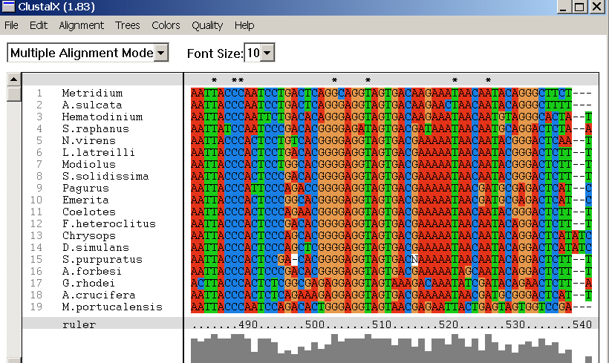
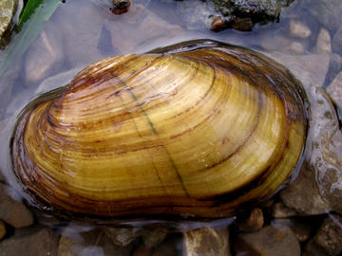
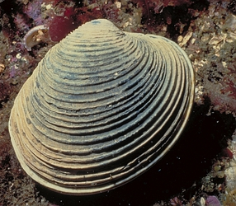
design of what? Code? Algorithms!
Why LCS?
Screenshot from the ClustalX multiple subsequence alignment tool...
Algorithmic challenge: How to find the best common subsequences among these very big genome strings ?!?
Notes:
This is why LCS is important.
These are mollusk genes.

Slide 43
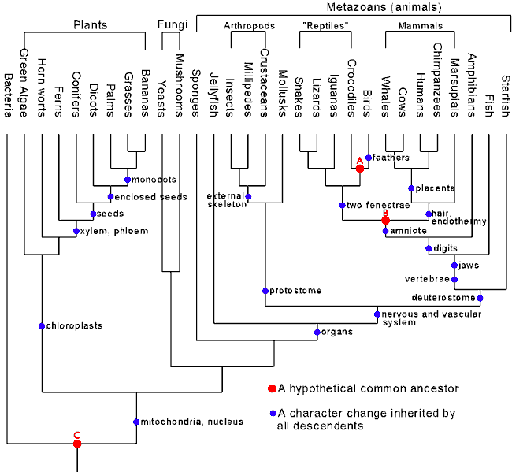
Hey!?
Trinocular aliens
?
Phylogeny
What was gained (or lost) here?
Notes:
INHANDOUT
The important split (in red) is plants vs. animals. What was gained was the ability to survive in the dark.

Slide 44
Hey!?
Trinocular aliens
?
The sundown side!
Phylogeny
What was gained (or lost) here?
caffeine
cinema
chocolate
(poptarts!)

Slide 45
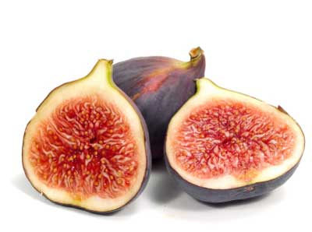
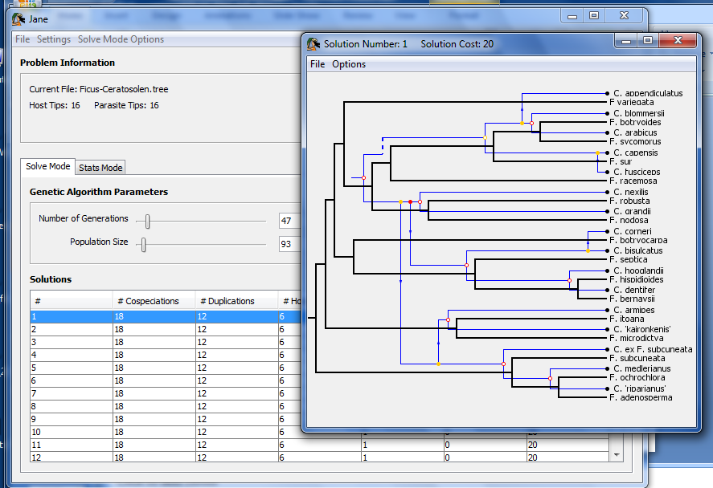
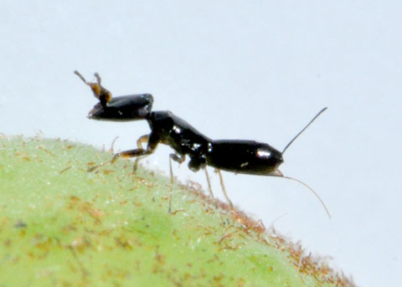
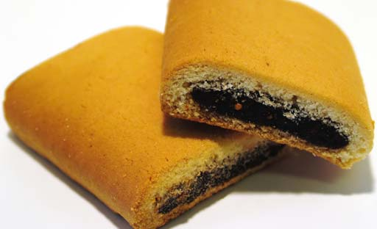
Subsequences @ 5Cs
Jane
host: figs
parasites: wasps
matching two phylogenies together
together!
Notes:
The biggest known matching was built in 2012 by Jane – Prof. Ran’s research

Slide 46
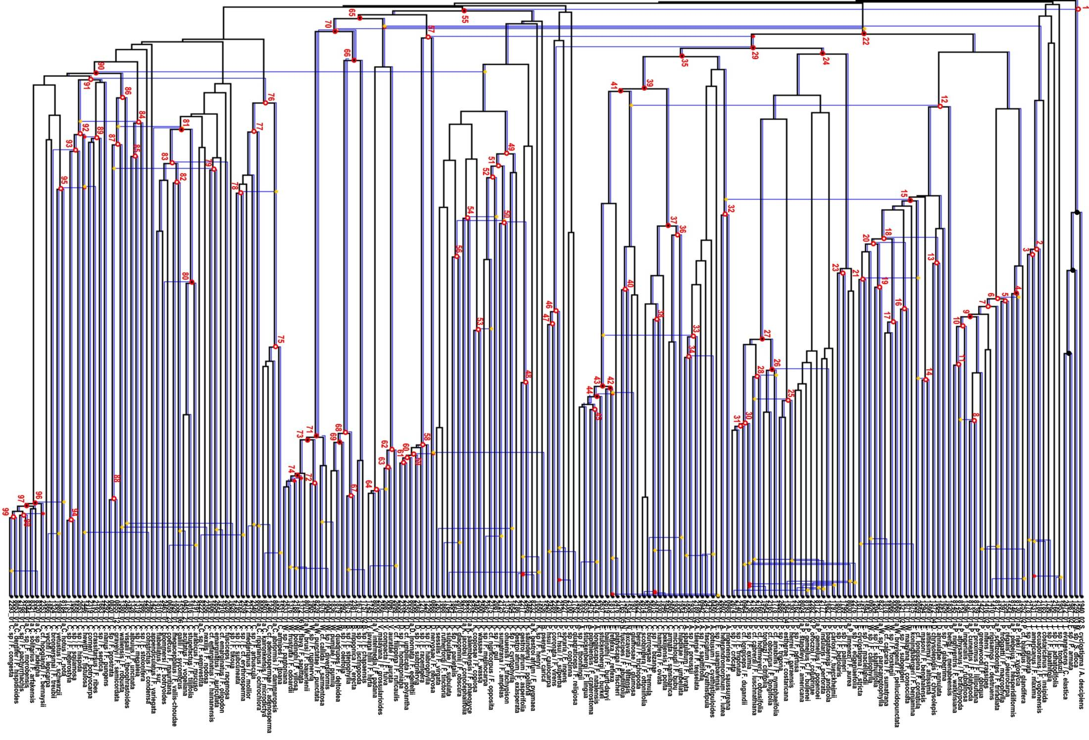
Complete!
Jane
Largest co-phylogeny ever computed (2012)

Slide 47
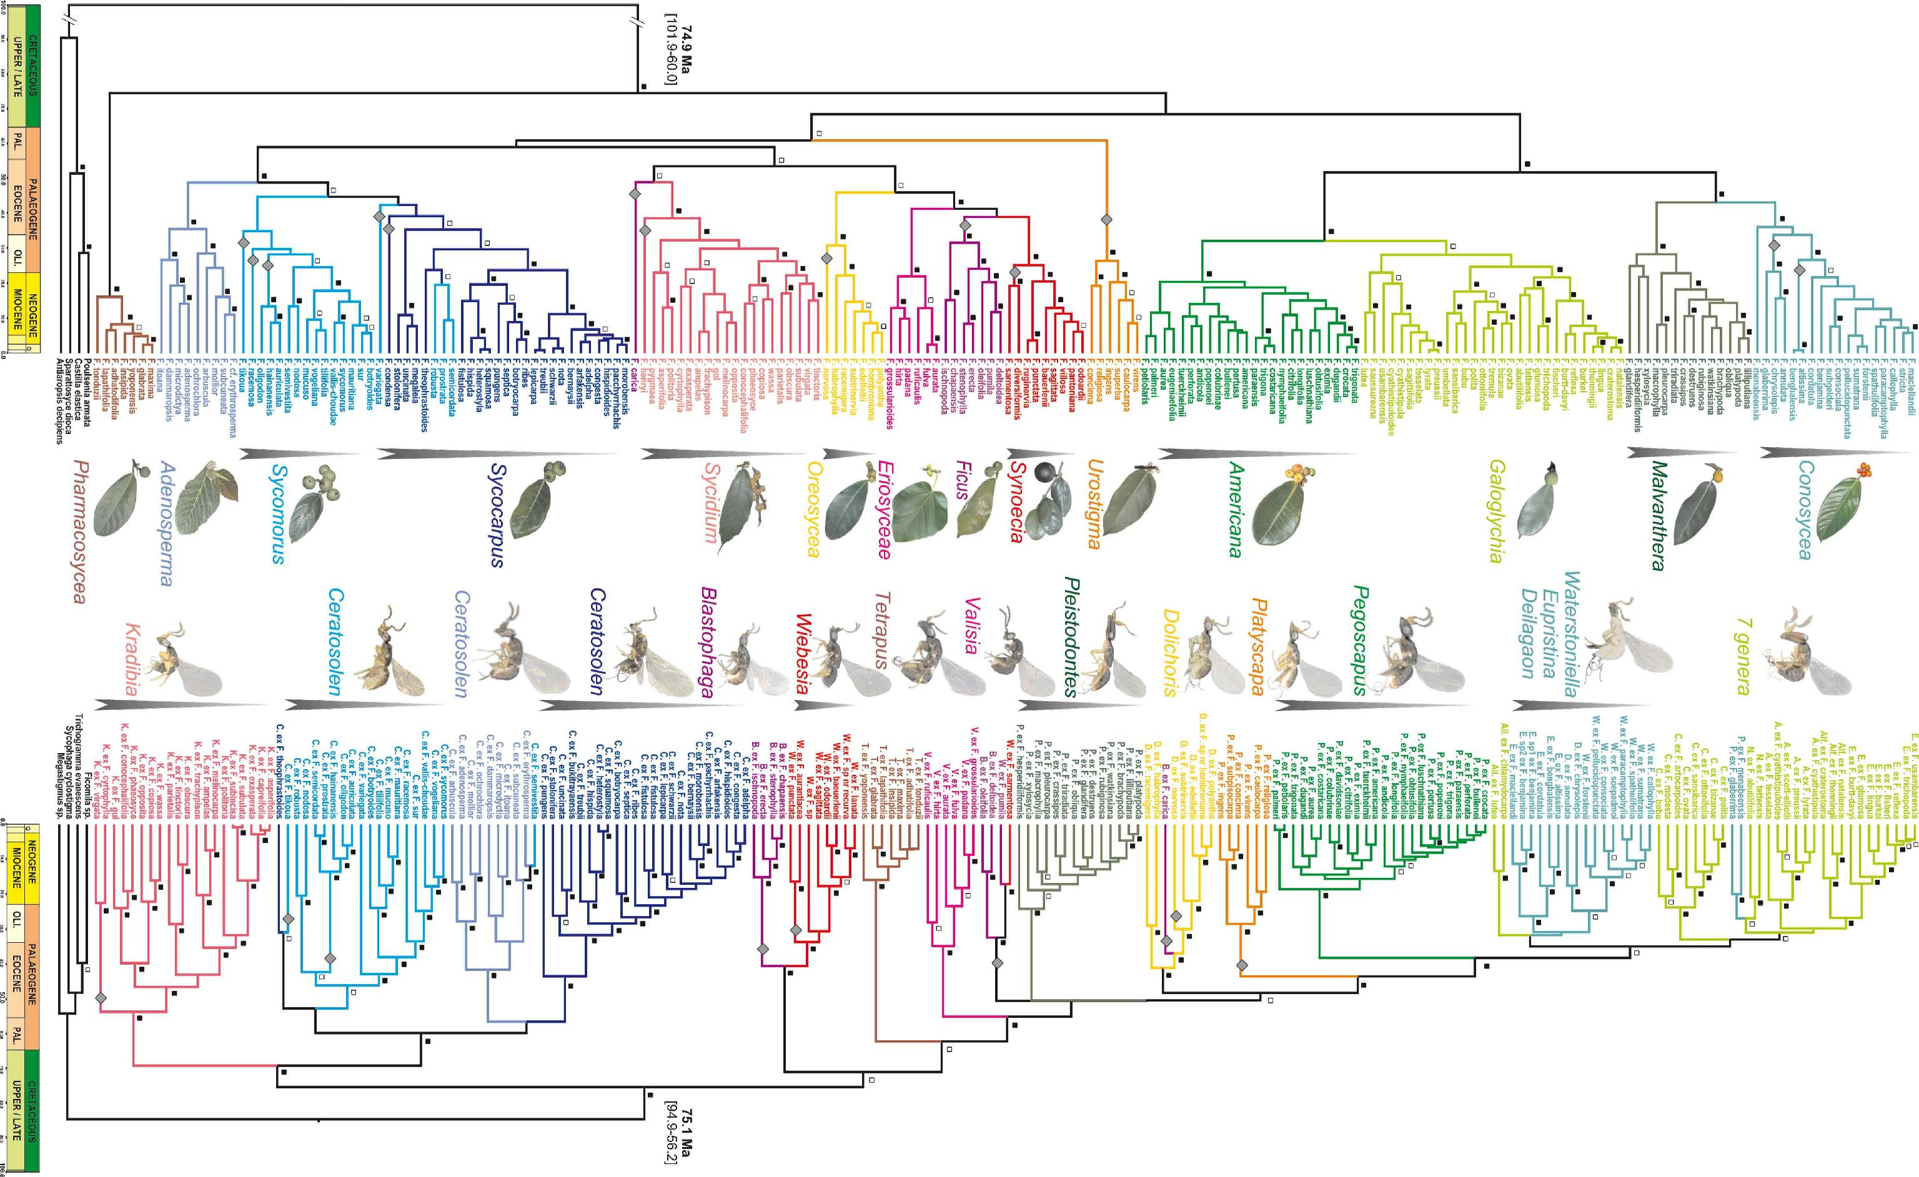
Jane's source data: 100s of species, 6 continents …

Slide 48
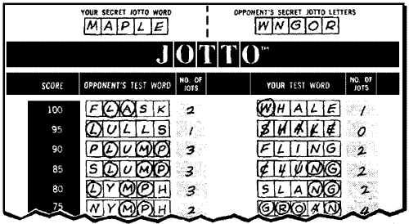
also in hw4pr2: Jotto !
a word-guessing game…
jscore( S, T )

Slide 49
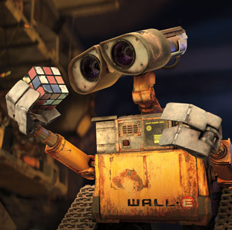
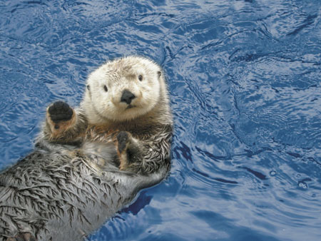
also in hw4pr2: Jotto !
jscore( S, T )
'robot'
'otter'
These are two cute
jscore( 'robot', 'otter' )
Let's try it!
Notes:
INHANDOUT
Robot is the hidden word, otter the guess.
How many letters cancel? 3

Slide 50
should return the jotto score for any strings s1 and s2
should return a new list that is the sorted version of the input L
should return the Longest Common Subsequence of strings S and T
jscore(s1,s2)
sort(L)
LCS(S,T)
jscore('robot', 'otter')
sort( [42,5,7] )
LCS( 'ctga', 'tagca' )
'tga'
3
[5,7,42]
sort( [42,7] )
LCS( 'tga', 'taacg' )
'ta' (or 'tg')
jscore('geese', 'seems')
3
[7,42]
sort( [42] )
LCS( 'tga', 'a' )
'a'
jscore('fluff', 'lulls')
2
[42]
jscore('pears', 'diner')
sort( [ ] )
LCS( 'gattaca', 'ctctgcgat')
jscore('xylyl', 'slyly')
blsort( [1,0,1] )
4 chars
Extra! Which of these 10 is the cruellest hidden jotto word?
binary-list sort: same as sort, but all of the #s are 0 or 1
Use it!
don't write any code for these…
do try the examples + brainstorm
remOne
Lose it!
Brainstorm algorithms for these problems -- what helper functions might help each one?
exact_change( 42, [25,30,2,5] )
False
returns True if any subset of elements in L add up to t; returns False otherwise
exact_change( 42, [40,17,1,7] )
False
exact_change( 42, [18,21,22] )
False
exact_change(t,L)
exact_change( 42, [22,16,3,2,17] )
True
exact_change( 20, [16,3,2,17] )
True
Notes:
Brainstorm with each other how to do these.
Demo jscore; LCS('tga', 'agt')
bisort can be more efficient than general sort.
exact_change(42, [25, 03, 2, 5]); then show it again with 10
The last exact_change is the crucial piece of the next-to-last.
Note that remone is needed for jscore.

Slide 51
should return the jotto score for any strings s1 and s2
should return a new list that is the sorted version of the input L
should return the Longest Common Subsequence of strings S and T
jscore(s1,s2)
sort( L )
LCS(S,T)
jscore('robot', 'otter')
sort( [42,5,7] )
LCS( 'ctga', 'tagca' )
'tga'
3
[5,7,42]
sort( [42,7] )
LCS( 'tga', 'taacg' )
'ta' (or 'tg')
jscore('geese', 'seems')
3
[7,42]
sort( [42] )
LCS( 'tga', 'a' )
'a'
jscore('fluff', 'lulls')
2
[42]
jscore('pears', 'diner')
[ ]
LCS( 'gattaca', 'ctctgcgat')
2
sort( [ ] )
jscore('xylyl', 'slyly')
blsort( [1,0,1] )
'ttca'
4
[0,1,1]
4 chars
Extra! Which of these 10 is the cruellest hidden jotto word?
binary-list sort: same as sort, but all of the #s are 0 or 1
Use it!
Lose it!
Lose it!
Use it!
don't write any code for these…
min
do try the examples + brainstorm
remOne
Use it!
only recursion here…
Lose it!
remOne
Brainstorm algorithms for these problems -- what helper functions might help each one?
exact_change( 42, [25,30,2,5] )
False
Use it!
returns True if any subset of elements in L add up to t; returns False otherwise
exact_change( 42, [40,17,1,7] )
False
Lose it!
exact_change( 42, [18,21,22] )
False
exact_change(t,L)
exact_change( 42, [22,16,3,2,17] )
True
… and here
exact_change( 20, [16,3,2,17] )
True
Notes:
“Pears” has the most anagrams of 5-letter English words.
Talk about selection and insertion sorts, demo with card deck?

Slide 52
decipher( 'Weet bksa ed xecumeha 4!' )
kxn rkfo k qbokd goouoxn ...
Notes:
INHANDOUT

Slide 53
decipher( 'Weet bksa ed xecumeha 4!' )
Good luck on homework 4!
kxn rkfo k qbokd goouoxn ...
and have a great weekend ...

