Slide 1

The CS 5 Times
Professor Loses Drinking
Contest in Local Bar
Pomona (Penguin Press): A little-known professor
from a local college was found under the table here
after coming in second in a game that required him
to consume twice as many mugs of liquid as his opponent.
“His mistake was to agree to compete on the basis of mug count,” explained the winner. “He left the choice of mugs up to me.”
In other news, a second professor’s dog was found soaking wet and yelping in a neighbor’s back yard. “The odor was overpowering,” said the neighbor. “We had to hose the animal down before we could approach it.” Police are investigating a rumor that the canine had been attacked by a tuxedo-wearing street gang.
Penguin celebrates win over professor.
Notes:
Setup: have a circuitverse tab on a blank sheet or the XOR circuit, and have logisim ready to go on logisim/lec11_demos.circ.
Worksheet options: the full adder, the first step of “Sending a message to Prof. Ben” (preferred), or analyzing a D latch.

Slide 2
More on Circuits!
Last time…
1. String representation
2. From Boolean functions to digital circuits
Today…
1. A circuit for adding
2. A circuit simulator
3. How logic gates really work
4. Universality of logic gates
5. Memory

Slide 3
Finding the Formula!
The Minterm Expansion Principle
Consider this function…
Words Truth Table Formula
x y x XOR y
0 0 0
0 1 1
1 0 1
1 1 0
A function of
TWO binary
inputs x,y
where the
output is 1 iff
x ≠ y
Notes:
This slide has six animations. The first four highlight the result-true lines and then the associated formulas. The fifth highlights all the result-false lines. The last highlights the resulting formula.
The principle is that each line in the truth table can be written as an AND of the inputs (and their inverses), such that this term (a "minterm") is one (true) only for that precise set of inputs. By selecting the inputs for which the function is true, and OR-ing them together, we can create an expression that exactly reproduces the truth table.
In this case, the first blue line in the truth table is selected when x = 0 and y = 1. We can write this as (x-bar)y. That’s true when x is 0 (since x-bar is then 1) and y is 1. Convince yourself that it’s true ONLY when x = 0 and y = 1. So that minterm implements just one line of the truth table. Likewise, x(y-bar) is true only for the second blue line. If we OR them together, we get a function that’s true only for the two blue lines. Convince yourself of that fact by plugging all four combinations of x and y into f(x,y) and showing that it produces 1 when x and y are different, and 0 when they are the same.
In general, the minterm expansion of a function is NOT optimal. For example, the expansion of f(x,y) = x is non-minimal because it considers the values of y when they could simply be ignored. There are "minimization techniques" that can help to find a more optimal representation.

Slide 4
You Try It!
The Minterm Expansion Principle
Consider this function…
Words Truth Table Formula
A function of
TWO binary
inputs x,y
where the
output is 1 iff
x ≥ y
Circuit
Notes:
This can be done on a worksheet or in notes, depending on the space they need.

Slide 5

Try This One…
Consider this function…
Words Truth Table Formula
A function of
THREE binary
inputs x,y,z
where the
output is 1 iff
the number of 1’s
is odd
Circuit
This is called an “odd parity” circuit
Notes:
WORKSHEET.
This is pretty much the same thing, only with three inputs. The truth table will have eight lines. A good way to enumerate the inputs is to think of them as a binary number. Start with 000 and then increment (count) until you have 111.
Your truth table should have exactly four lines where the output is 1. How many AND gates do you need? How many OR gates? (Hint: an OR gate can have more than two inputs; in that case its output is 1 if any input is a 1.)

Slide 6
A Circuit for Adding!
Base 2 Addition
0 1 0 1
1 0 0 1
+
0
FA
carry out
sum
Notes:
This slide has an animation that causes the FA to pop up.
FA = "Full Adder", so called because it is possible to build it from two identical "Half Adders". We won't do half adders; it's easier to create a full adder directly.
If you have a FA for one bit position, you can wire up a multi-bit adder…see the next slide.

Slide 7
A Circuit for Adding!
Base 2 Addition
0 1 0 1
1 0 0 1
+
0
FA
FA
FA
FA
Cool, but how do we build a FA?
Notes:
If you have a working full adder, you can treat it as a black box that takes three inputs and produces TWO outputs. Then wire a “carry” of zero to the right-most FA, and wire each other FA’s carry to the next higher one. What happens to the final carry?

Slide 8
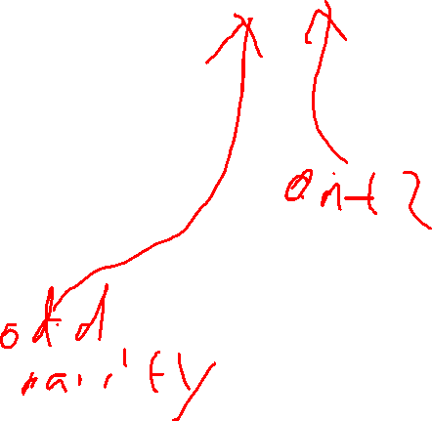
A Circuit for Adding!
Base 2 Addition
x y carry_{in} sum carry_{out}
0 0 0 0 0 0 0 1 1 0
0 1 0 1
1 0 0 1
+
0
FA
FA
FA
FA
x
y
carry_{in}
FA
carry_{out}
sum
Notes:
Note that a FA has three inputs and TWO outputs. The easy way to build it is to write a separate truth table for each output, and then build a circuit for each. Then just wire the “global” input x to the x input for each sub-circuit, and do the same for y and carry!
Notice that one of the columns in the truth table is the odd-parity circuit we built earlier. The other column we could build using the minterm expansion principle again.
This is a problem on this week’s homework/lab.

Slide 9
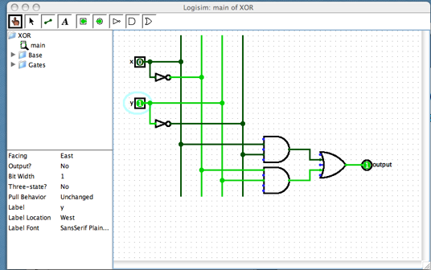
Logisim: A Digital Logic Simulator
Notes:
Demo Logisim. Explain drawing, deleting, labeling, projects, objects, reusing objects to build larger objects, and simulation. This will likely take 15 minutes.

Slide 10
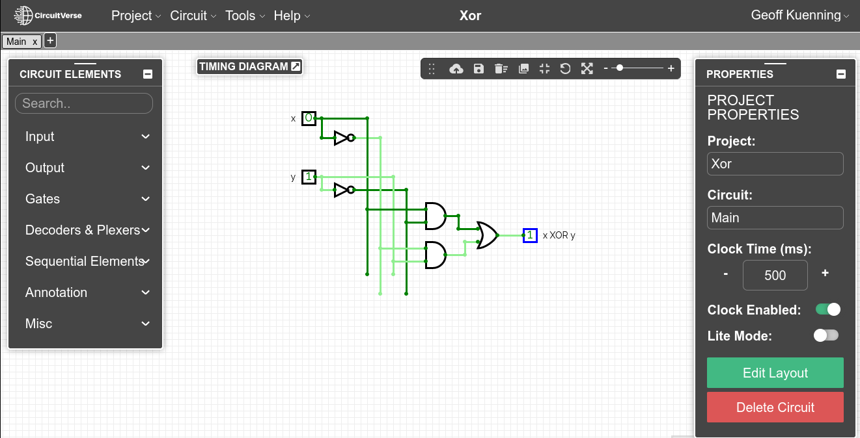
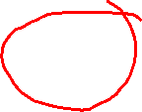
CircuitVerse:
A Digital Logic Simulator
Notes:
Demo CircuitVerse. Explain drawing, deleting, labeling, projects, objects, reusing objects to build larger objects, and simulation. This will likely take 15 minutes.

Slide 11
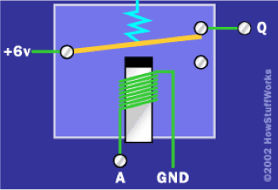
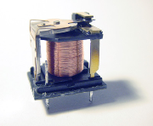

Implementing Gates with Relays
NOT Gate
A
Q = A
Figures courtesy of HowStuffWorks.com
6v power

Slide 12
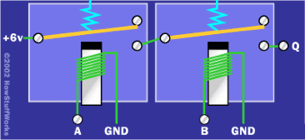

And AND…
A
AB
B
6v power
Figure courtesy of HowStuffWorks.com
Notes:
How about an OR gate?

Slide 13
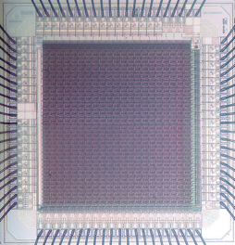
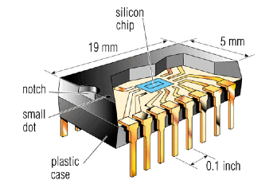
Integrated Circuits
3mm
http://personalpages.manchester.ac.uk/staff/p.dudek/projects/scamp
http://www.helicon.co.uk

Slide 14
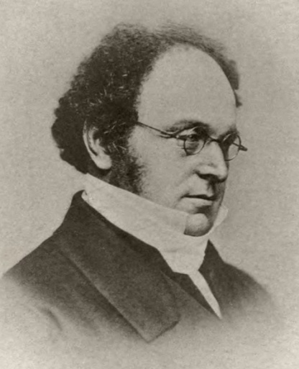
AND, OR, NOT Is a “Universal Set”
De Morgan’s Laws:
x y = x + y
x+y = x y
Augustus De Morgan
1806-1871
Are there other universal sets of gates?
By Sophia Elizabeth De Morgan - Memoir of Augustus De Morgan, Public Domain
https://commons.wikimedia.org/w/index.php?curid=4722207
Notes:
Augustus De Morgan: British mathematician, born in India, died in London.
Explain and justify universality.
How do you prove De Morgan’s Laws? Truth tables!
Now show that AND and NOT suffice. OR and NOT too. Define NAND and show that it’s universal.

Slide 15

The Alien’s Life Advice
Get your eyes off the ground (and your phone)!
Your poor sore nose will appreciate it...and so will the people you look at.

Slide 16
Sending a Message to Prof. Ben
Worksheet!
Notes:
This will probably take 15 minutes. Practice it before class, or have preset circuits in Logisim.
A Logisim alternative: logic.ly
Bring up a blank Logisim, explaining that you’d like to send Ben a message (1 or 0). This works, but you have to lean on the button. So how can we modify this circuit so that if I push the button, it remembers the 1 so I can let go and Ben will still see the 1? That’s the worksheet problem; they should come up with adding a feedback OR gate.
Having solved that problem by inserting an OR gate, now we can’t reset the message to 0 later. Lead them (not with worksheet) to inserting an AND gate (facing west) that can force the feedback loop back to 0. For now, the input to the AND is normally 1, and needs to be set to 0 if you want to reset the feedback loop. Show how when the AND input is 0, the output follows the button; when it’s 1 it’s “sticky”.
It’s unpleasant to require a constant 1 to let the OR gate be “normal”. Insert a NOT gate on the (input) reset line to cure that. For Logisim, first insert a physical NOT gate. Then remove it and show how Logisim can just put a NOT circle on one of the inputs. CircuitVerse can’t do that, so just put a NOT directly on the AND input.
Now comes a tricky part: it’s going to turn out to be ugly to have a NOT on only one of the AND gate’s inputs. So invert the other input, and change the OR gate to a NOR gate to compensate. Note that this makes the output inverted; we’ll fix that in a minute. Demonstrate the circuit.
The next step is DeMorgan’s laws: the AND with inverted inputs is also a NOR gate. Remove the AND, insert a NOR in its place, and demonstrate that the circuit works in the same way. Note that now we have two NOR gates.
Finally, neatness counts. Turn the reset NOR gate back to facing east, and cross-connect it. Label S, R, and ~Q. Then connect the output of the reset NOR to an output pin, label it Q, and show how it is in fact Q.
Given time, also talk about what happens when both S and R are 1.

Slide 17



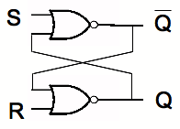
A 1-Bit Memory
This stuff is truly unforgettable!
OR + NOT = NOR
Notes:
Next slides have animations to explain how this works.

Slide 18
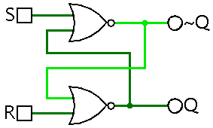
A 1-Bit Memory
Notes:
This circuit is the simplest type of "latch" or a "flip-flop". It is called an "S-R latch" or sometimes an "R-S" one.

Slide 19
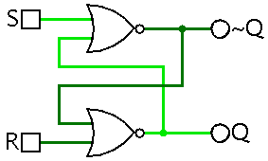
Setting a 1-Bit Memory
Notes:
This circuit is the simplest type of "latch" or a "flip-flop". It is called an "S-R latch" or sometimes an "R-S" one.

Slide 20
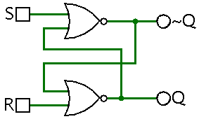
Initializing a 1-Bit Memory
Notes:
This circuit is the simplest type of "latch" or a "flip-flop". It is called an "S-R latch" or sometimes an "R-S" one.

Slide 21
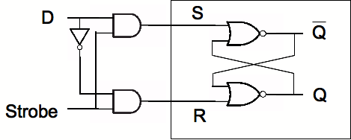

From S-R Latches to D-Latches
>
Notes:
WORKSHEET PROBLEM: What does this circuit do when "Strobe" is high? What about when it is low?
Strobes are often called clocks, and may be represented by greater-than signs or triangles. In Logisim, S-R flip-flops have clocks. Clocks can be active-low, active-high, or edge-triggered on either the rising or the falling edge. In Logisim, flip-flops clock on the rising edge.

Slide 22
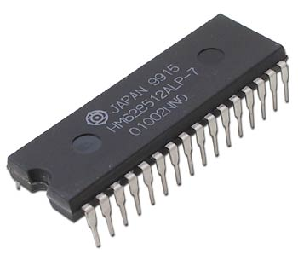

A Random-Access Memory (RAM)
A 512K x 8 RAM
(About 4.2 million bits)
Notes:
If you Google for HM628512 you can learn all about this chip. Some RAM is x1, some x4, and some x8. SIMMs and DIMMs aggregate RAM chips to make x32 and x64.

Slide 23
A Random-Access Memory (RAM)
small!
2 address
bits
0 1 0
3 data
bits (in)
1 1 1
3 data
bits (out)
0 0 0
Read
Write
0 0 1

Slide 24
A Random-Access Memory (RAM)
2 address
bits
D
D
D
D
Latch
Q
D
Latch
Q
D
Latch
Q
Strobe
Strobe
Strobe
D
D
D
D
Latch
Q
D
Latch
Q
D
Latch
Q
3 data
bits (in)
3 data
bits (out)
Strobe
Strobe
Strobe
D
D
D
D
Latch
Q
D
Latch
Q
D
Latch
Q
Read
Write
Strobe
Strobe
Strobe
D
D
D
D
Latch
Q
D
Latch
Q
D
Latch
Q
Strobe
Strobe
Strobe

Slide 25
A Random-Access Memory (RAM)
2 address
bits
D
D
D
D
Latch
Q
D
Latch
Q
D
Latch
Q
Decoder
Strobe
Strobe
Strobe
D
D
D
D
Latch
Q
D
Latch
Q
D
Latch
Q
3 data
bits (in)
3 data
bits (out)
Strobe
Strobe
Strobe
D
D
D
D
Latch
Q
D
Latch
Q
D
Latch
Q
Read
Write
Strobe
Strobe
Strobe
D
D
D
D
Latch
Q
D
Latch
Q
D
Latch
Q
Strobe
Strobe
Strobe
Notes:
Explain what a decoder does. Building one is a homework problem this week!

Slide 26

A Random-Access Memory (RAM)
2 address
bits
D
D
D
D
Latch
Q
D
Latch
Q
D
Latch
Q
Decoder
Strobe
Strobe
Strobe
D
D
D
D
Latch
Q
D
Latch
Q
D
Latch
Q
3 data
bits (in)
3 data
bits (out)
Strobe
Strobe
Strobe
D
D
D
D
Latch
Q
D
Latch
Q
D
Latch
Q
Read
Write
Strobe
Strobe
Strobe
D
D
D
D
Latch
Q
D
Latch
Q
D
Latch
Q
Strobe
Strobe
Strobe

Slide 27
A Random-Access Memory (RAM)
2 address
bits
D
D
D
D
Latch
Q
D
Latch
Q
D
Latch
Q
Decoder
Strobe
Strobe
Strobe
D
D
D
D
Latch
Q
D
Latch
Q
D
Latch
Q
3 data
bits (in)
3 data
bits (out)
Strobe
Strobe
Strobe
D
D
D
D
Latch
Q
D
Latch
Q
D
Latch
Q
Read
Write
Strobe
Strobe
Strobe
D
D
D
D
Latch
Q
D
Latch
Q
D
Latch
Q
Strobe
Strobe
Strobe

Slide 28
A Random-Access Memory (RAM)
2 address
bits
D
D
D
D
Latch
Q
D
Latch
Q
D
Latch
Q
Decoder
Strobe
Strobe
Strobe
D
D
D
D
Latch
Q
D
Latch
Q
D
Latch
Q
3 data
bits (in)
3 data
bits (out)
Strobe
Strobe
Strobe
D
D
D
D
Latch
Q
D
Latch
Q
D
Latch
Q
Read
Write
Strobe
Strobe
Strobe
D
D
D
D
Latch
Q
D
Latch
Q
D
Latch
Q
Strobe
Strobe
Strobe

Slide 29
A Random-Access Memory (RAM)
2 address
bits
D
D
D
D
Latch
Q
D
Latch
Q
D
Latch
Q
Decoder
Strobe
Strobe
Strobe
D
D
D
D
Latch
Q
D
Latch
Q
D
Latch
Q
3 data
bits (in)
3 data
bits (out)
Strobe
Strobe
Strobe
D
D
D
D
Latch
Q
D
Latch
Q
D
Latch
Q
Read
Write
Strobe
Strobe
Strobe
D
D
D
D
Latch
Q
D
Latch
Q
D
Latch
Q
Strobe
Strobe
Strobe

Slide 30
A Random-Access Memory (RAM)
2 address
bits
D
D
D
D
Latch
Q
D
Latch
Q
D
Latch
Q
Decoder
Strobe
Strobe
Strobe
D
D
D
D
Latch
Q
D
Latch
Q
D
Latch
Q
3 data
bits (in)
3 data
bits (out)
Strobe
Strobe
Strobe
D
D
D
D
Latch
Q
D
Latch
Q
D
Latch
Q
Read
Write
Strobe
Strobe
Strobe
D
D
D
D
Latch
Q
D
Latch
Q
D
Latch
Q
Strobe
Strobe
Strobe

Slide 31
A Random-Access Memory (RAM)
2 address
bits
D
D
D
D
Latch
Q
D
Latch
Q
D
Latch
Q
Decoder
Strobe
Strobe
Strobe
D
D
D
D
Latch
Q
D
Latch
Q
D
Latch
Q
3 data
bits (in)
3 data
bits (out)
Strobe
Strobe
Strobe
D
D
D
D
Latch
Q
D
Latch
Q
D
Latch
Q
Read
Write
Strobe
Strobe
Strobe
D
D
D
D
Latch
Q
D
Latch
Q
D
Latch
Q
Strobe
Strobe
Strobe
Notes:
Note that a real modern RAM would have literally hundreds of millions of “rows” of memory, each of which might be 8 bits (columns) wide or wider! Actually, since the chip surface is 2-dimensional, the bits are arranged in rows and columns, with a more complicated selection scheme.
Connecting the latches to the output is left as an exercise.

