Slide 1
OK Recurring?
OKer than before?
Hw#5: binary + Python
Professor Disappears!
Claremont (AP) —An obscure computer science professor failed to show up for classes last week. Some sources suggest that he was present but invisible, but others alleged that he had decamped to Oakland, California. Still others felt that it was unlikely that anybody would voluntarily visit Oakland, and were convinced that he had been abducted by three-eyed aliens who probed him (continued on p. 42)
Circuit design, part 1
This circuit was NOT, in fact, designed!
CS Today
A circuit for any function can be built from…
Minterm Expansion Principle
That's minterm, NOT midterm
…just these three logic gates!
Notes:
INHANDOUT
Class 11 logic
We’ll take a break from Python starting today, for a couple of weeks.
Setup: have Logisim running with lec11_demos.circ.

Slide 2
In a computer, each bit is represented as a voltage (1 is +3v and 0 is 0v)
The big picture...
Computation is simply the deliberate combination of those voltages!
101010
42
(2) perform computation
(1) set input voltages
ADDER circuit
51
110011
(3) read output voltages
9
001001
What's in that green box?
Richard Feynman: "Computation is just a physics experiment that always works!"
Notes:
INHANDOUT

Slide 3
Part 1: Represent your function as bits…
Any function can be represented using only bits…
IN
OUT
x
y
c
circuit output
0
0
0
0
0
0
1
1
0
1
0
1
This one is named the sum function
0
1
1
0
1
0
0
1
1
0
1
0
That's some function, all right!
1
1
0
0
1
1
1
1
three bits in...
...one bit out
Notes:
INHANDOUT
There are three steps. Here’s the big picture of them.
Draw decimal values of the inputs.

Slide 4
Part 1: Represent your function as bits…
Any function can be represented using only bits…
IN
OUT
x
y
c
circuit output
0
0
0
0
0
0
1
0
0
1
0
1
0
1
1
0
our function!
1
0
0
0
fun!
1
0
1
0
1
1
0
1
1
1
1
1
three bits in...
...one bit out
Notes:
Very short: just that this is another three-argument function.

Slide 5
All computations…
…are simply functions of bits
binary inputs A and B
output, A+B
A
B
add
You built this in Python last week as addB
00
00
000
You'll build this function in Logisim this week!
00
01
001
00
10
010
00
11
011
01
00
001
01
01
010
01
10
011
01
11
bitwise
addition function
100
10
00
010
10
01
011
10
10
100
10
11
101
11
00
011
11
01
100
four bits in...
...three bits out
11
10
101
11
11
110
Each of these columns uses the sum function!
Notes:
Highlight that the green rows represent the sums 1+1=2 and 2+3=5.

Slide 6
Part 2: Arrange logic gates to do the work…
input
output
input
output
x
y
AND(x,y)
x
y
OR(x,y)
input
output
x
NOT(x)
0
0
0
0
0
0
0
1
0
0
1
1
0
1
1
0
0
1
0
1
1
0
1
1
1
1
1
1
AND outputs 1 only if ALL inputs are 1
OR outputs 1 if ANY input is 1
NOT reverses its input
AND
OR
NOT
not just theoretical models!
Notes:
These are also Boolean functions in Python—same thing!

Slide 7
Our building blocks: logic gates
AND outputs 1 only if ALL inputs are 1
OR outputs 1 if ANY input is 1
NOT reverses its input
AND
OR
NOT
These circuits are physical functions of bits…
not just theoretical models
…and all mathematical functions can be built from them!

Slide 8
AND
drill sergeant metaphor?
Strict! Everything input must be True to output a True
inputs
AND
output
AND outputs 1 when ALL inputs are 1
otherwise it outputs 0
Notes:
Straight line: drill sergeants don’t bend.

Slide 9
AND
Strict! Everything input must be True to output a True
x
inputs
AND
output
y
output
input
output
x
y
AND(x,y)
AND's function:
0
0
0
0
1
0
"Truth table"
1
0
0
1
1
1

Slide 10
AND
Strict! Everything input must be True to output a True
inputs
AND
output
How many different input combinations yield an output of 0 here?
AND outputs 1 when ALL inputs are 1
otherwise it outputs 0

Slide 11
AND
Strict! Everything input must be True to output a True
x
y
inputs
z
AND
output
output
w
input
output
x
y
z
w
AND(xyzw)
AND's function:
0
0
0
0
0
0
0
0
1
0
fifteen 0s
…12 more rows not shown…
0
1
1
1
0
0
1
1
1
1
1
one 1

Slide 12
OR
camp counselor metaphor?
easy-going: if anything is OK, everything's OK
inputs
OR
output
OR outputs 1 when ANY input is 1
It outputs 0 only if all inputs are 0.
Notes:
Arms open: it embraces you.

Slide 13
OR
easy-going: if anything is True, the output is True
x
inputs
OR
output
y
output
input
output
x
y
OR(x,y)
OR's function:
0
0
0
0
1
1
1
0
1
1
1
1

Slide 14
OR
easy-going: if anything is OK, everything's OK
inputs
OR
output
How many different 4-input combinations yield an output of 1?
OR outputs 1 when ANY input is 1
It outputs 0 only if all inputs are 0.

Slide 15
OR
easy-going: if anything is OK, everything's OK
x
y
inputs
z
OR
output
output
w
input
output
x
y
z
w
OR(xyzw)
OR's function:
0
0
0
0
0
one 0
0
0
0
1
1
…12 more rows not shown…
1
1
1
1
0
1
fifteen 1s
1
1
1
1
1

Slide 16
NOT
"NOT bubble" (or the only thing needed!)
inputs
x
NOT
output
NOT's function:
input
output
x
NOT(x)
0
1
one 1
1
0
one 0

Slide 17
Our building blocks: logic gates
input
output
input
output
x
y
AND(x,y)
x
y
OR(x,y)
input
output
x
NOT(x)
0
0
0
0
0
0
0
1
0
0
1
1
0
1
1
0
0
1
0
1
1
0
1
1
1
1
1
1
AND outputs 1 only if ALL inputs are 1
OR outputs 1 if ANY input is 1
NOT reverses its input
AND
OR
NOT
Notes:
INHANDOUT
Orange is where the outputs are 1.

Slide 18
Claim!?
We need only these three building blocks to compute anything at all
I need proof!
AND
AND outputs 1 iff ALL its inputs are 1
OR
OR outputs 1 iff ANY input is 1
NOT
NOT reverses its input

Slide 19
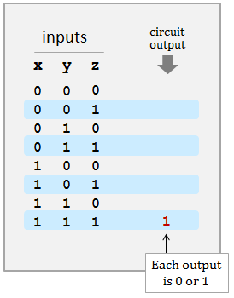
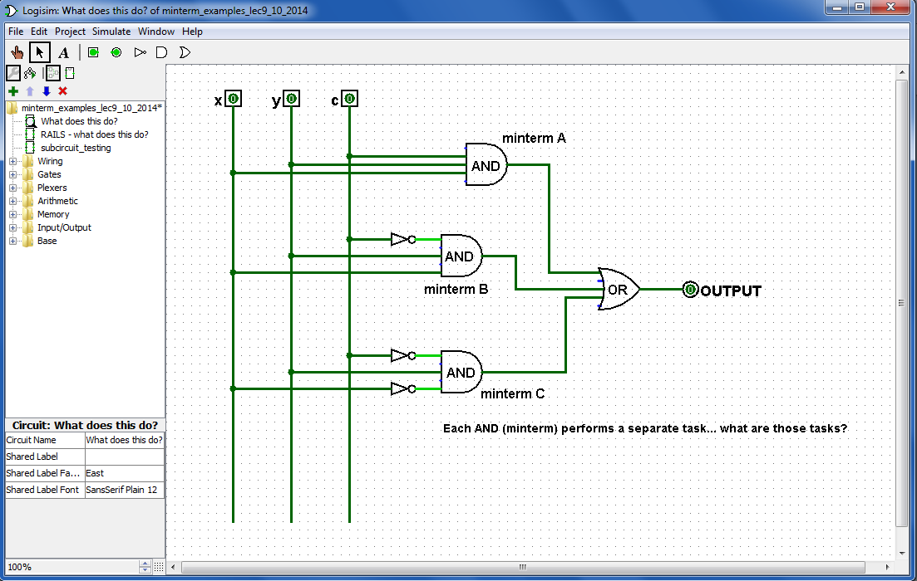
A circuit…
What are ALL its outputs?
c
What inputs make this circuit output 1?
Logisim
What inputs make this circuit output 0?
Notes:
INHANDOUT
Demo Logisim here
COME TO LAB to get help installing Logisim (it can be troublesome!)
To understand a circuit, “swim upstream”.
Demo all three combinations – this is the whole truth table.
Demo adding an AND gate to handle 011.

Slide 20
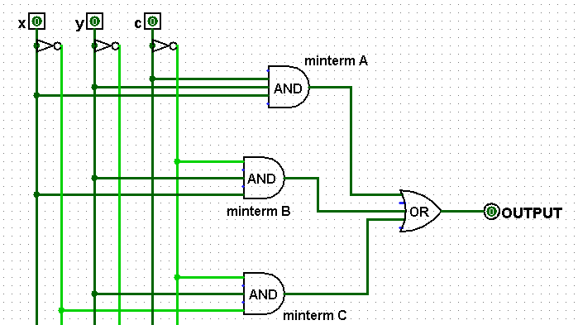
Rails
There is NO difference between these two circuits!
How?
using rails for not x, not y, not c
Any advantages of this "rails" approach?
Any disadvantages?
Notes:
INHANDOUT
Disadvantage: appearance is more complex. Advantages: minimum NOTs and easier wiring.

Slide 21
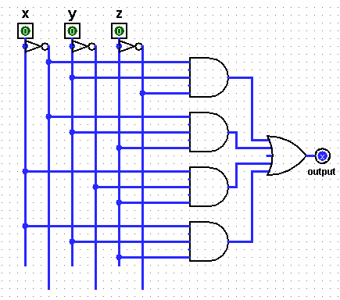
Quiz
Fill in the function values for this circuit (the truth table)
Name(s) ___________________________________
Each input x, y, and z can independently be 0 or 1, for eight total possible inputs:
inputs
circuit
output
x
y
z
A
0
0
0
0
0
1
0
1
0
B
0
1
1
1
0
0
C
1
0
1
1
1
0
1
1
1
1
D
Each output is 0 or 1
(1) This circuit uses 8 logic gates – how many of each? AND ___ OR ___ NOT ___
(2) Follow the inputs of x=1, y=1, z=1 and see why the overall output is 1 ... (already labeled)
(3) For each possible input, write the circuit output in the truth table above.
This circuit is prime!
(4) Could this circuit use fewer logic gates? If so, how?! If not, how do you know?!
Notes:
QUIZSLIDE
This is 2+3+5+7, or ~xy~z + ~xyz + x~yz + xyz = ~xy + xz, i.e. prime numbers.

Slide 22
Quiz
Fill in the function values for this circuit (the truth table)
Try this on the back page first…
Each input x, y, and z can independently be 0 or 1, for eight total possible inputs:
inputs
circuit
output
x
y
z
A
0
0
0
0
0
0
1
0
0
1
0
A
1
B
0
1
1
B
1
1
0
0
0
C
1
0
1
C
1
1
1
0
0
D
1
1
1
1
1
D
Each output is 0 or 1
4
1
3
(1) This circuit uses 8 logic gates – how many of each? AND ___ OR ___ NOT ___
(2) Follow the inputs of x=1, y=1, z=1 and see why the overall output is 1 ... (already labeled)
(3) For each possible input, write the circuit output in the truth table above.
This circuit is prime!
(4) Could this circuit use fewer logic gates? If so, how?! If not, how do you know?!
YES!

Slide 23
Real! logic gates...
Hex NOT gate
Notes:
These are Schottky inverters, which are faster and lower-power but more expensive than non-Shottky. You can get them for about a dime (or free from the Engineering stockroom).
If you put 0 on I₀, where does the 5V for O₀ come from?

Slide 24
Real? logic gates
"It's not real unless it can be done in Minecraft."
1:11
https://www.youtube.com/watch?v=P7E4K5D834g "Minecraft Logi Gates"
https://www.youtube.com/watch?v=r7N3K8ulEEM "Minecraft Logic Gates Water"
:41

Slide 25
The claim…
AND outputs 1 only if ALL its inputs are 1
AND
OR outputs 1 if ANY input is 1
OR
NOT
NOT reverses its input
We need only these three building blocks to compute anything at all
I need proof!

Slide 26
The proof… !
AND outputs 1 only if ALL its inputs are 1
AND
We prove this constructively using the minterm expansion principle.
OR outputs 1 if ANY input is 1
OR
NOT
NOT reverses its input
We need only these three building blocks to compute anything at all
I need proof!

Slide 27
A constructive proof… !
i
Specify a truth table defining any function you want
For each input row whose output needs to be 1, build an AND circuit that outputs 1 only for that specific input!
ii
input
output
x
y
f(x,y)
0
0
0
Hey! This is a 3-i'ed proof!
0
1
1
iii
OR them all together
1
0
1
1
1
0

Slide 28
A constructive proof…
i
Specify a truth table defining any function you want
For each input row whose output needs to be 1, build an AND circuit that outputs 1 only for that specific input!
ii
input
output
x
y
f(x,y)
0
0
0
0
1
1
iii
OR them all together
1
0
1
1
1
0
We ensure this OR outputs zero by default.
x
y
The ZERO rows ALREADY work – with no connections at all !
0
OR
x
y

Slide 29
A constructive proof…
i
Specify a truth table defining any function you want
For each input row whose output needs to be 1, build an AND circuit that outputs 1 only for that specific input!
ii
input
output
x
y
f(x,y)
0
0
0
0
1
1
iii
OR them all together
1
0
1
1
1
0
x
y
NOT
AND
OR
Does this wire turn on for the red input row?
x
y
Does this wire turn on for any other input rows?

Slide 30
A constructive proof…
i
Specify a truth table defining any function you want
For each input row whose output needs to be 1, build an AND circuit that outputs 1 only for that specific input!
ii
input
output
x
y
f(x,y)
0
0
0
0
1
1
iii
OR them all together
1
0
1
1
1
0
x
y
NOT
AND
OR
AND
NOT
blue row?
other rows?
x
y
Notes:
INHANDOUT

Slide 31
A constructive proof…
but ALL functions are just functions of bits !
i
Specify a truth table defining any function you want
For each input row whose output needs to be 1, build an AND circuit that outputs 1 only for that specific input!
ii
input
output
x
y
This is a constructive proof that AND, OR, NOT suffice to build any function of bits!
f(x,y)
0
0
0
0
1
1
iii
OR them all together
1
0
1
1
1
0
x
y
NOT
AND
OR
AND
NOT
blue row?
other rows?
x
y

Slide 32
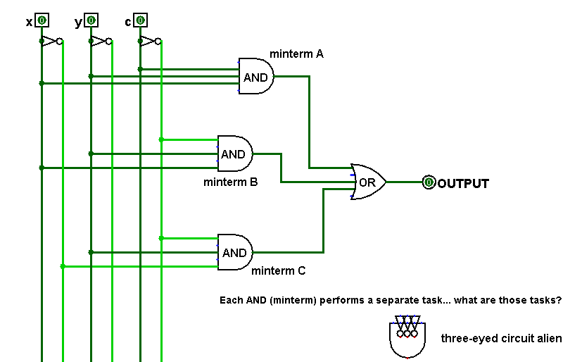
Minterm?
A minterm is an AND gate connected to all input bits - either directly or inverted
What input "activates" each of these minterms?
we did this before!
Minterm Expansion Principle
Notes:
Minterm == Minimum term, i.e. something that matches a minimum set of inputs: exactly 1.
Expansion because we use the OR gate to expand a bunch of minterms into a function.

Slide 33
Each minterm selects one input:
a minterm is an AND gate that "selects" a single input row
x y c
111
the ONLY input to make this minterm output 1
x y c
110
the ONLY input to make this minterm output 1
x y c
010
the ONLY input to make this minterm output 1
Looks a little wiry to me!
Minterm Expansion Principle
Notes:
INHANDOUT

Slide 34
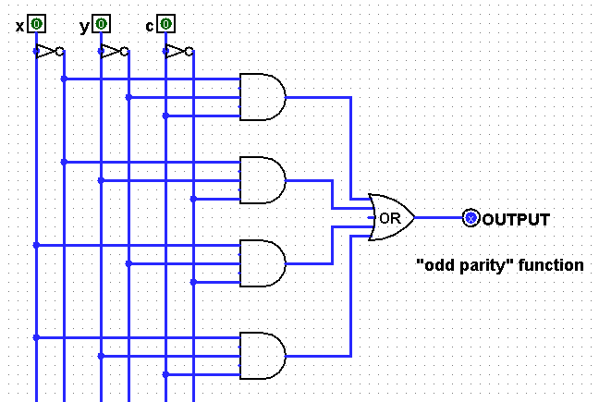
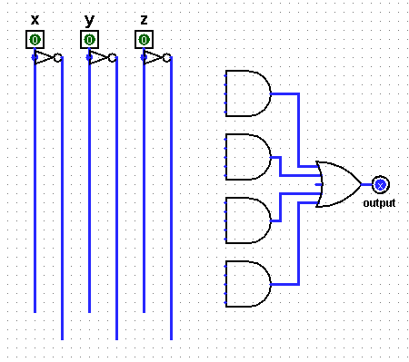
Take 2…
input
output
A
x
y
c
0
0
0
(1) Fill in the function values (the truth table) for this circuit…
0
0
1
B
0
1
0
0
1
1
1
0
0
Hint: Determine the input that turns each AND gate—each minterm—to True
C
SUM
1
0
1
1
1
0
D
1
1
1
(2) Draw the upstream wires that will implement this function as a circuit.
(Extra #1) Any gates you can optimize away here?
c
input
output
(Extra #2) How could you replace the OR with only ANDs and NOTs – so ORs aren't needed !?
x
y
c
A
0
0
0
0
0
0
1
0
B
0
1
0
0
OR
(Extra #3) How do the two circuits on this page implement addition of any two binary #s?
0
1
1
1
C
1
0
0
0
Carry_{Out}
1
0
1
1
1
1
0
1
D
1
1
1
x
1011
1
1
1
1
+
y
1111
11010
Notes:
INHANDOUTFULL
Do one example for them (gate A).
Solutions are in the notes.

Slide 35
Take 2…
input
output
A
x
y
c
0
0
0
0
(1) Fill in the function values (the truth table) for this circuit…
0
0
A
1
1
B
0
1
B
1
0
0
1
1
0
1
0
C
Hint: Determine the input that turns each AND gate—each minterm—to True
C
SUM
0
1
1
0
1
0
1
1
0
0
D
1
1
D
1
1
(2) Draw the upstream wires that will implement this function as a circuit.
(Extra #1) Any gates you can optimize away here?
c
input
output
(Extra #2) How could you replace the OR with only ANDs and NOTs – so ORs aren't needed !?
x
y
c
A
0
0
0
0
0
0
1
0
B
0
1
0
0
OR
(Extra #3) How do the two circuits on this page implement addition of any two binary #s!?
0
1
A
1
1
C
1
0
0
0
Carry_{Out}
1
0
B
1
1
1
1
C
D
1
0
1
1
1
Can combine D and ...
x
1011
1
1
D
+
1
1
y
1111
11010
Notes:
INHANDOUT
Bring this page to lab!

Slide 36
input
output
OR else ?!
x
y
OR(x,y)
0
0
0
0
1
1
Can you get rid of ORs by using only NOTs and ANDs?
1
0
1
1
1
1
x
x OR y
y
OR
Notes:
36
INHANDOUT
Draw the DeMorgan answer inside the giant OR

Slide 37
Lab 6: adders!
A full adder sums three input bits to create a 2-bit binary output
x
y
c_{in}
c_{out} sum
0 0 0
0 0
0 0 1
0 1
the full adder
0 1 0
0 1
x
y
c_{in}
0 1 1
1 0
1 0 0
0 1
FA
c_{out}
1 0 1
1 0
sum
1 1 0
1 0
1 1 1
1 1
Full Adder (FA)
these columns look familiar!
3 bits of input
2 bits of output
(considered individually)
(considered a binary number)
Full Adder (FA)
Notes:
Show that the output is a binary number. Then explain why we call the third input and the first output “c”.
Show that the columns can be separated into two circuits.
You’ll build this in lab.
Logisim lets you make the circuit into a building block—demo that fact.
Demo FA as building block in Logisim.
Then demo that RCA works (8 + 3, no carries, then 15 + 5)

Slide 38
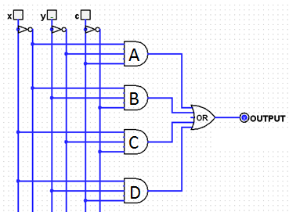
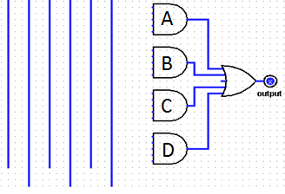
Lab 6: adders!
A full adder sums three input bits to create a 2-bit binary output
x
y
c_{in}
Use this in lab this week!
the full adder
sum
x
y
c_{in}
FA
c_{out}
sum
connect these directly…
Full Adder (FA)
OR
carry_{out}
2 bits of output: a two-bit binary #
for this bottom-half circuit, you'll add the wires you designed a couple of minutes—and a couple of slides—ago…
3 individual bits of input
Notes:
INHANDOUT

Slide 39
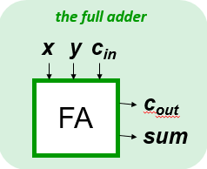
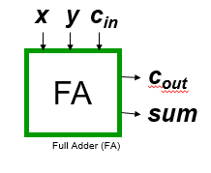
Compose!
Any binary addition at all?
carries…
Carry
X
0 1 1 1
1 1 0 1
X₃
X₂
X₁
X₀
8 bits in
Y
+
Y₃
Y₂
Y₁
Y₀
5 bits out
Do you see how you might use four Full Adders here?
Notes:
Ask class: how have we used 4 FA’s?
Draw the RH FA.
Show how you can reuse circuits in Logisim by just dragging.

Slide 40
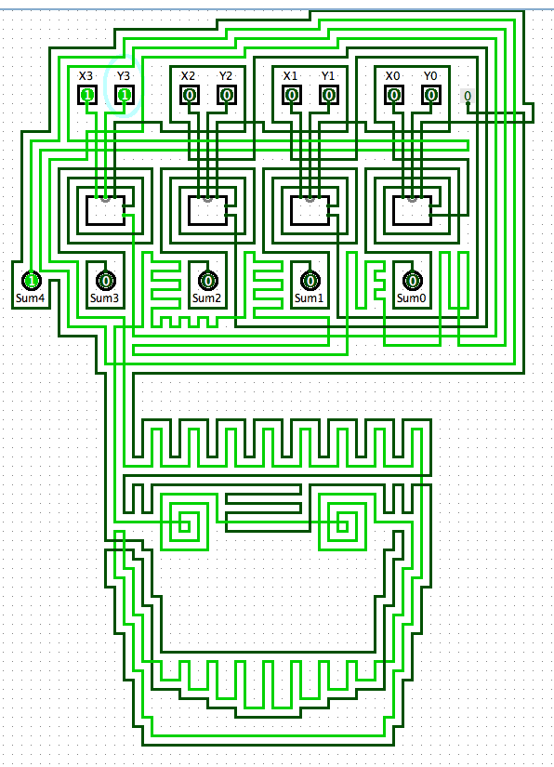
an "official" adder…
A zombie-themed ripple-carry adder
It looks pretty wiry to me!

Slide 41
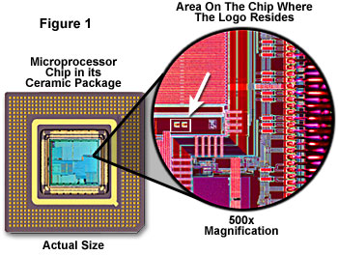
relative scale…
Notes:
Zooming in a bit…see next slide

Slide 42
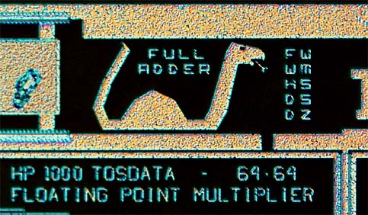
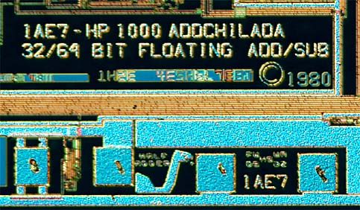
Many adders!
These aren't Easter Eggs, they're adder eggs!

Slide 43
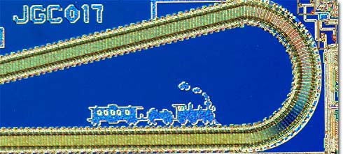
chugging right along…
Ridin' the Rails !

Slide 44
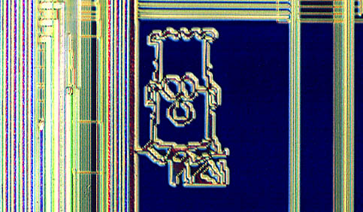
What to do with all that extra silicon?

Slide 45
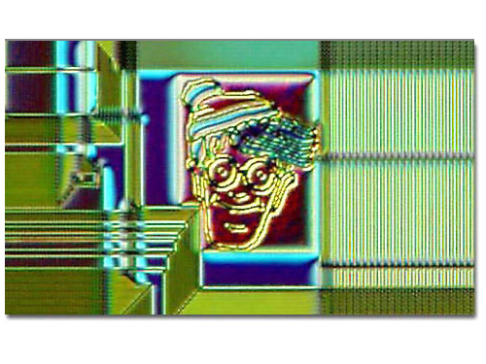
What to do with all that extra silicon?
The "silicon zoo": micro.magnet.fsu.edu/creatures/index.html

Slide 46
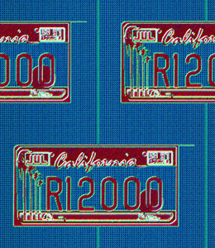
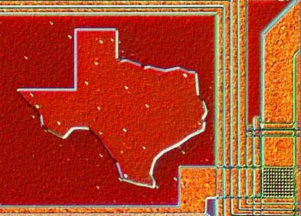
Homestate pride…

Slide 47
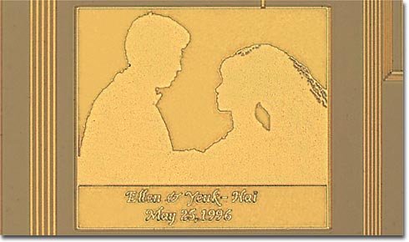
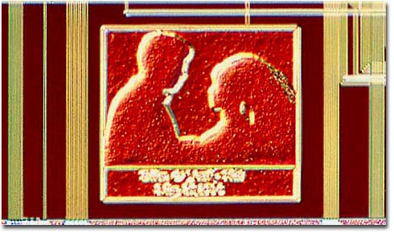
Marriage announcements?
Notes:
This is from

Slide 48
and secret? messages…
Notes:
This is on a chip built for the VAX 11/780, which was introduced in 1977 (during the Cold War). The designers know the Russians would reverse-engineer it…

Slide 49
and secret? messages…
VAX c. 1977

Slide 50
and secret? messages!
VAX...
When you care enough to steal the very best

Slide 51
Composing circuits ~ hw6
4-bit "Ripple-Carry" Adder
4-bit Multiplier
3x2-bit Divider
extra credit
12 nGbits of memory (RAM)
Notes:
The lab is about building a ripple-carry adder.

Slide 52
Composing circuits
4-bit Ripple-Carry Adder
0 1 1 1
1 1 0 1
8 bits in
let's abstract these details away…
+
5 bits out

Slide 53
Composing circuits
4-bit Ripple-Carry Adder
0 1 1 1
1 1 0 1
8 input bits
+
1 0 1 0 0
5 output bits
Now let's make lots of them!!
Notes:
It looks like a school bus.

Slide 54
hw6pr2: A 4-bit multiplier
1 1 0 1 Multiplicand
x 0 1 1 0 Multiplier
0 0 0 0 4 partial products
1 1 0 1
1 1 0 1
+ 0 0 0 0
1 0 0 1 1 1 0 Final answer…
0
(Q1) How could THREE 4-bit ripple-carry adders help here?
(Q2) What bit would be correct for the starred spot ?
(Q3) What circuits could you use to create the four "partial products" ??
Notes:
The * represents a carry.

Slide 55
hw6pr2: A 4-bit multiplier
1 1 0 1 Multiplicand
x 0 1 1 0 Multiplier
0 0 0 0 4 partial products
1 1 0 1
1 1 0 1
+ 0 0 0 0
1 0 0 1 1 1 0 Final answer…
0
(A3) Remember that the AND gate is single-bit multiplication.
(A2) Use a 4x1-bit helper circuit to find the four partial products…
(A1) You need three ripple-carry adders to finish: see above…
Notes:
INHANDOUT

