Slide 1
Any function's circuit can be built from …
… just three logic gates!
Minterm Expansion Principle
CS Today
Notes:
Class 12 gates
Logisim is flaky; reset the simulation or save and restart
Have lec12_demos.circ ready. Editing Logisim files in emacs can be a quick way to do things that Logisim itself doesn’t support, such as renaming, sorting, combining files. You should be ready to show rsff, maybe development of rsff from a wire (in rsff_develop), maybe RCA, multiplier, divider, memory (not necessarily in that order).
Be sure you know how to develop an RSFF from a wire.

Slide 2
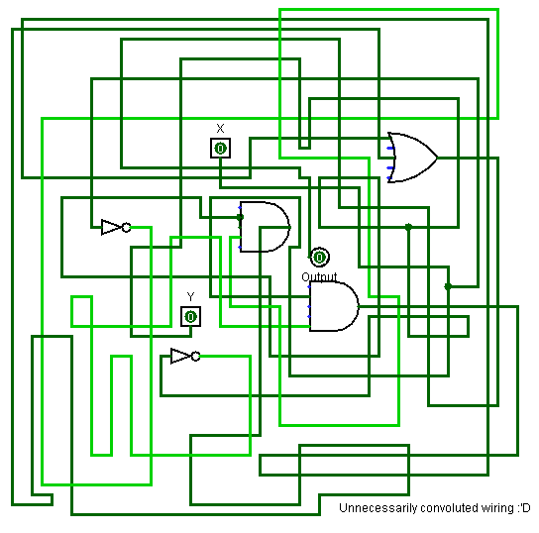
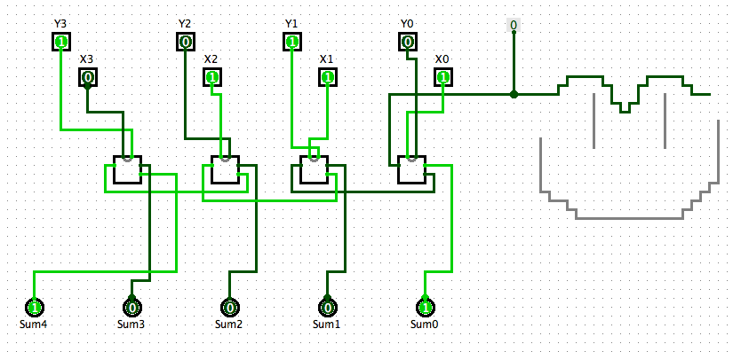
CS 5
Python
taking
Logisim's "canvas" literally
…
Hmmm...
OUR
CS5
PATH
A
B
S
T
R
A
C
T
I
O
N
computer
main memory
registers
1-bit memory: flip-flops
arithmetic
bitwise functions
logic gates
switches: transistors
Things seem to get messy around here…
An example of a happy RCA solution...
Notes:
Class 12 gates
INHANDOUT
RCA = Ripple-Carry Adder
We’re going to go all the way down to transistors today.

Slide 3
Composing circuits ~ hw6
4-bit "Ripple-Carry" Adder
4-bit Multiplier
3x2-bit Divider
extra credit
12 nGbits of memory (RAM)

Slide 4
Composing circuits
4-bit Ripple-Carry Adder
0 1 1 1
1 1 0 1
8 bits in
+
5 bits out
let's abstract these details away…
Notes:
The RCA here (without the smiley) will work for building a multiplier.

Slide 5
Composing circuits
4-bit Ripple-Carry Adder
0 1 1 1
1 1 0 1
8 input bits
+
1 0 1 0 0
5 output bits
Now let's make lots of them!!
Notes:
INHANDOUT
Looking at the RCA as a school bus, it’s a building block for a multiplier.

Slide 6
hw6pr2: A 4-bit multiplier
1 1 0 1 Multiplicand
x 0 1 1 0 Multiplier
0 0 0 0 4 partial products
1 1 0 1
1 1 0 1
+ 0 0 0 0
1 0 0 1 1 1 0 Final answer…
0
(Q3) How could THREE 4-bit ripple-carry adders help here?
(Q2) What bit would be correct for the starred spot ?
(Q1) What circuits could you use to create the four "partial products" ??
Notes:
On the next slide we show the school buses.

Slide 7
hw6pr2: A 4-bit multiplier
1 1 0 1 Multiplicand
x 0 1 1 0 Multiplier
0 0 0 0 4 partial products
1 1 0 1
1 1 0 1
+ 0 0 0 0
1 0 0 1 1 1 0 Final answer…
0
(A2) == 0
(A1) The AND gate is single-bit multiplication.
(A1) Use a 4x1-bit helper circuit to find the four partial products…
(A3) You need three (3) ripple-carry adders to finish: see above…
Notes:
INHANDOUT
Show how first partial-product bit just goes down to output without going through RCA.
Circle bus “wheels”. Talk about how leftmost bit of bus top comes from a zero.
Use Logisim to show 4x4 multiplication: 7x6, 6x7, 15x15

Slide 8
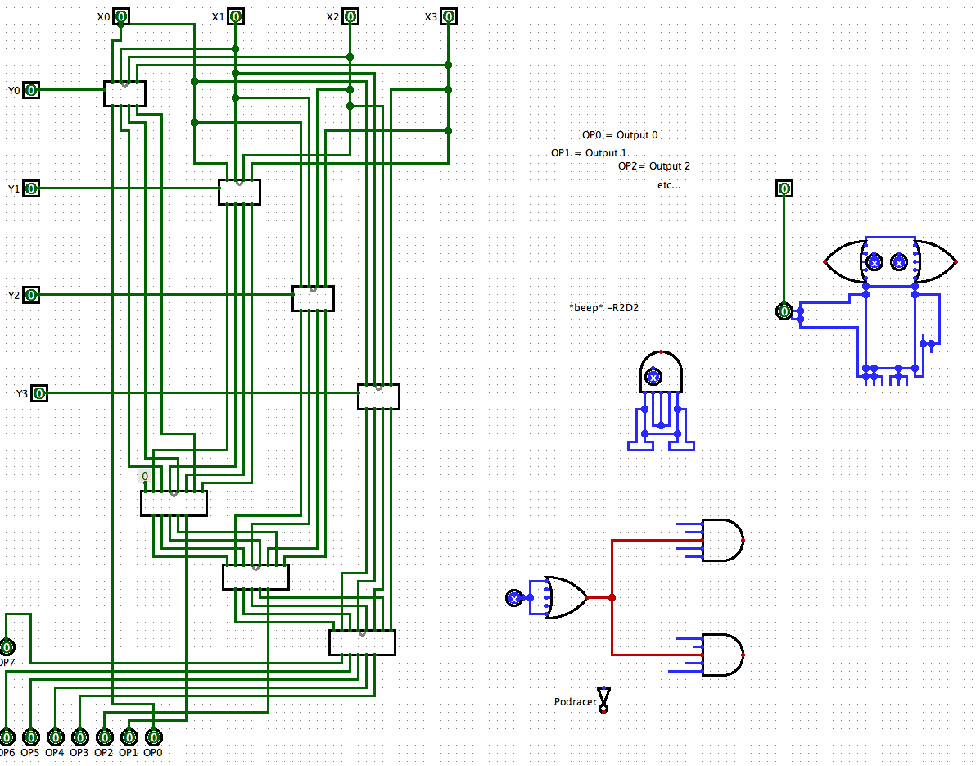
The "canvas"
These are circuit-based compositions!

Slide 9
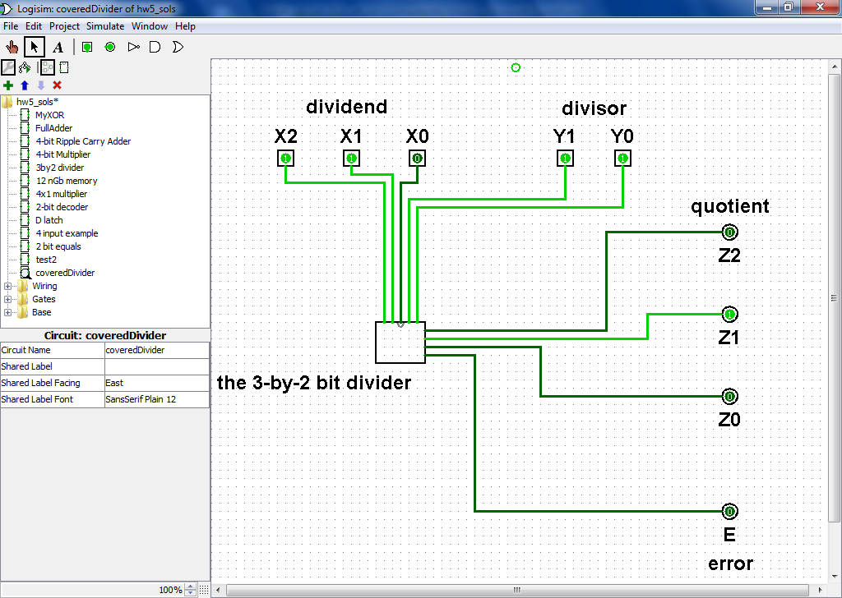
Division? hw6pr3
Ideas?
Notes:
INHANDOUT
Ask for ideas, then turn to logisim covered_divider to show divide by 1 = duplicate, by 0 = error, by 2 = RH bit lost, by 3 is complex

Slide 10
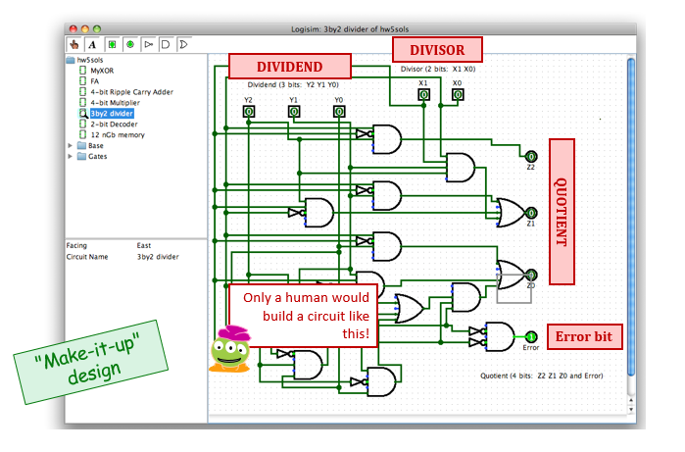
Division! hw6pr3
Notes:
This circuit doesn’t work.

Slide 11
Minterm Division
INPUTS
OUTPUT
principled design
Y2 Y1 Y0 X1 X0
Z2 Z1 Z0 E
dividend
divisor
quotient
error
bit
anything
0 0
1
anything
(0) All computation can be expressed as bits...
0 0 0
0 1
0 0 0 0
0 0 1
0 1
0 0 1 0
(1) Any function of bits can be made a truth table
0 1 0
0 1
0 1 0 0
0 1 1
0 1
0 1 1 0
1 0 0
0 1
1 0 0 0
(2) Consider the output, one bit at a time...
1 0 1
0 1
1 0 1 0
1 1 0
0 1
1 1 0 0
(3) The circuit will output 0 by default!
1 1 1
0 1
1 1 1 0
0 0 0
1 0
0 0 0 0
(4) Are there subcircuit patterns to notice?
0 0 1
1 0
0 0 0 0
0 1 0
1 0
0 0 1 0
0 1 1
1 0
0 0 1 0
(5) Else, use an AND gate to select each input for which the output should be 1 (a minterm!)
1 0 0
1 0
0 1 0 0
1 0 1
1 0
0 1 0 0
1 1 0
1 0
0 1 1 0
1 1 1
1 0
0 1 1 0
To implement the red 1, how many inputs will its AND gate have?
How many negated?
0 0 0
1 1
0 0 0 0
What division is it?
0 0 1
1 1
0 0 0 0
0 1 0
1 1
0 0 0 0
(6) OR the outputs from step (5) together.
0 1 1
1 1
0 0 1 0
1 0 0
1 1
0 0 1 0
1 0 1
1 1
0 0 1 0
(7) optimize your circuit later -- or never
1 1 0
1 1
0 1 0 0
1 1 1
1 1
0 1 0 0
Notes:
INHANDOUT
Every AND would need 5 inputs; there are tons of ANDs.
Show how divide-by-3 is sensible to do with minterm expansion (circle the 1’s)
Is there a way to reduce it further?

Slide 12
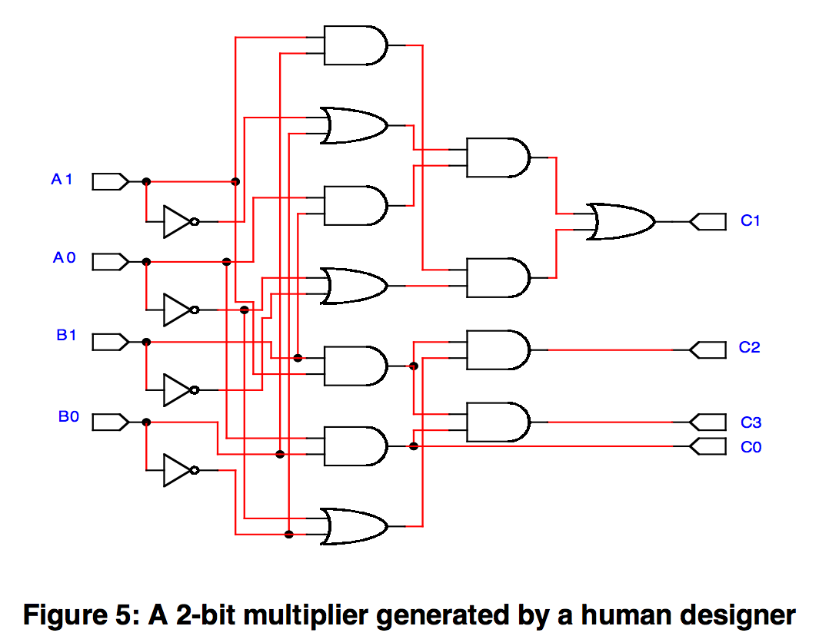
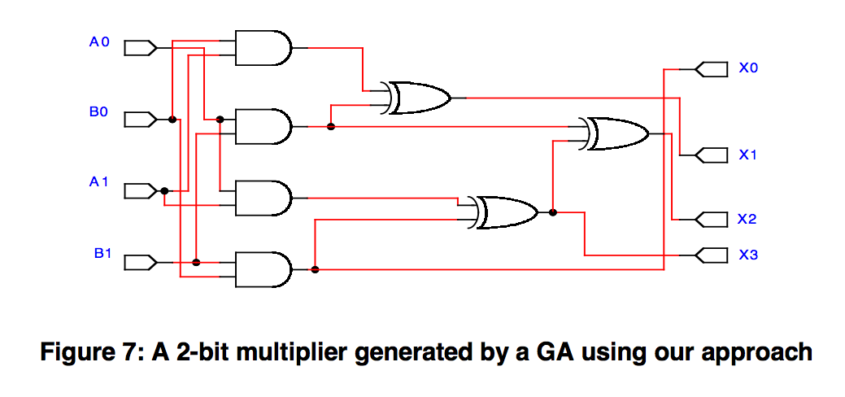
Circuit Optimization?
try E85 !
using a genetic algorithm
7 gates
16 gates
Perhaps artistically optimized!
Optimize for what?!
Notes:
INHANDOUT
Be vague. E85 covers this.
What are you optimizing for? (Next slide)

Slide 13
Time-optimized circuits: Carry lookahead adders
The following circuit is called a carry lookahead adder.
By adding more hardware, we reduced the number of levels in the circuit and sped things up.
We can "cascade" carry lookahead adders, just like ripple carry adders.
We'd have to do carry lookahead between the adders too.
How much faster is this?
For a 4-bit adder, not much. There are 4 gates in the longest path of a carry lookahead adder, versus 9 gates for a ripple carry adder.
But if we do the cascading properly, a 16-bit carry lookahead adder could have only 8 gates in the longest path, as opposed to 33 for a ripple carry adder.
Newer CPUs these days use 64-bit adders. That's 12 vs. 129 gates or 10x speedup!
The delay of a carry lookahead adder grows logarithmically with the size of the adder, while a ripple carry adder's delay grows linearly.
The thing to remember about this is the trade-off between complexity and performance. Ripple carry adders are simpler, but slower. Carry lookahead adders are faster but more complex.
Notes:
INHANDOUT

Slide 14
A 4-bit carry-lookahead adder circuit
A 4-bit ripple-carry adder circuit
What information is needed? Where? How?
speed vs. complexity tradeoffs ~ cs facets of engineering
Notes:
RCA flows information through 2 gates per column.

Slide 15
A 4-bit carry-lookahead adder circuit
Details!
xor
xor
xor
xor
Sum bits
xor
xor
xor
xor
carry-in
“carry-out”, not “c-zero”
Carry bits

Slide 16
What's inside gates?
What's the other half of computation?
Notes:
Now we’re going to go one layer deeper.

Slide 17
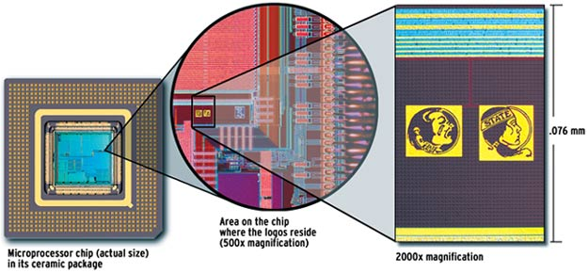
Today's gates?
https://www.youtube.com/watch?v=Fxv3JoS1uY8

Slide 18
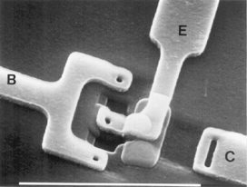
Silicon-based switches (transisors)
a single etched transistor labeled with base (b), emitter (e), and collector (c)

Slide 19
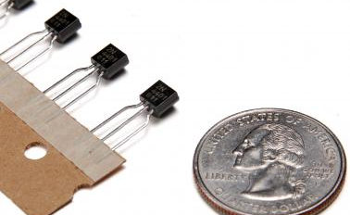
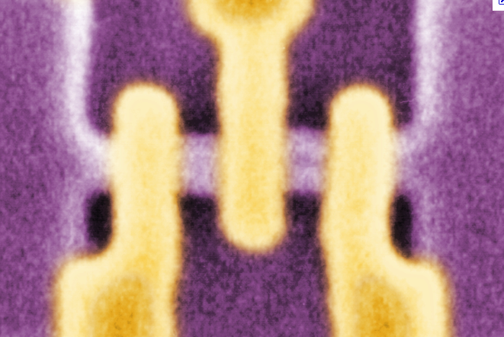
Transistors
Radio Shack transistors
Transistors are current switches:
+3v voltage here
switch-off-type (pmos)
0v
3v
0v “connects" this wire
3v "cuts" this wire
allows current here
switch-on-type (nmos)
0v
3v
20 nm
switch-on-type transistor
0v "cuts" this wire
3v “connects" this wire
single-electron tunneling, or SET transistor
Notes:
Think of it as like a drawbridge

Slide 20
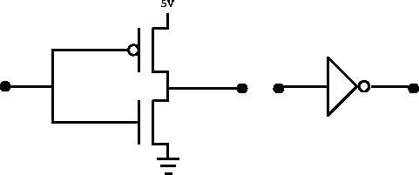
Building a NOT gate
Transistors are current switches:
NOT
input
output
switch-off-type (pmos)
0v
3v
Building a NOT gate from transistors…
0v “connects" this wire
3v "cuts" this wire
POWER
+3 v
switch-on-type (nmos)
0v
3v
(1 or 0)
(0 or 1)
OUTPUT
INPUT
0v "cuts" this wire
3v “connects" this wire
Ground = 0v
Notes:
INHANDOUT
Show how 1 input connects output to ground, 0 does the reverse.

Slide 21
NOT gate
Transistors are current switches:
switch-off-type (pmos)
0v
3v
0v “connects" this wire
3v "cuts" this wire
+3 v
POWER
switch-on-type (nmos)
0v
3v
(1 or 0)
(0 or 1)
OUTPUT
INPUT
0v "cuts" this wire
3v “connects" this wire
Ground = 0v

Slide 22
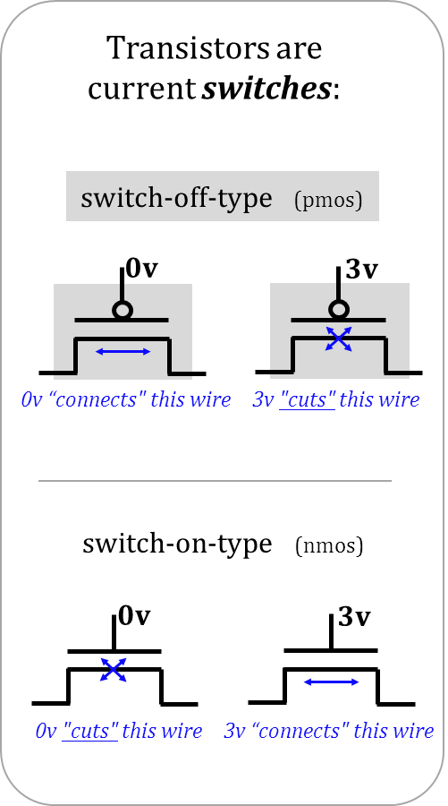
Quiz
X
Y
Z
Name(s) __________________________________________
0
0
0
1
Power, 1 or +3v
1
0
1
1
X
(1) Find the circuit's truth table
Inputs: X, Y
each is 0 or 1 independently
Y
Output: Z
Z
X
Y
Ground, 0 or 0v
(3) Extra! How could you alter the transistor-level design to make an AND?
(2) the above circuit is one of these gates – which one?
NAND
OR
NOR
XOR
"not and"
"not or"
"exclusive or"
Notes:
QUIZSLIDE
Remind them that they built XOR in lab. NAND and NOR are inverses of AND and OR.
Demonstrate how to analyze the 1/1 input case.

Slide 23
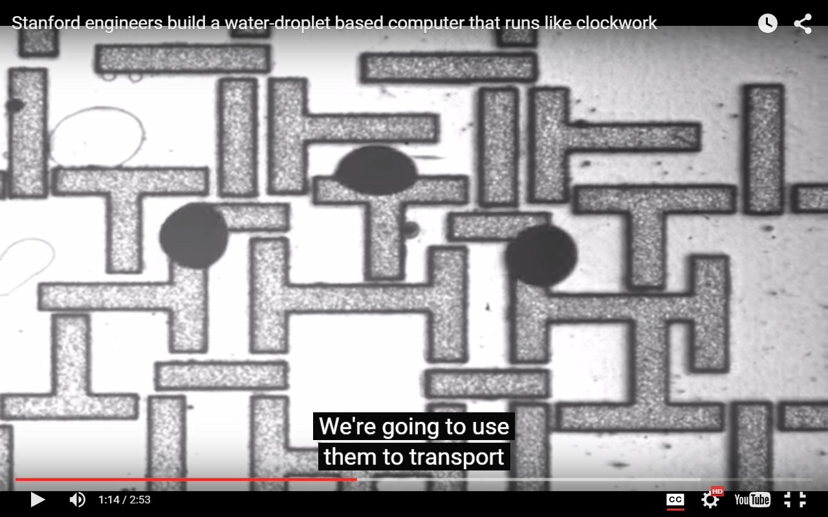
Reading this week: H₂O computing !
Notes:
Take note that it’s this week’s reading

Slide 24
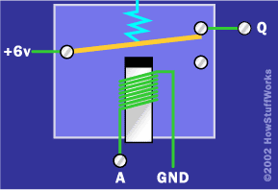
Electromechanical "gates" (relays)
1940's computers
metal plate
Signal Output
Q
Spring
External Power (6v)
Electro-magnet
NOT gate
Signal Input, A

Slide 25
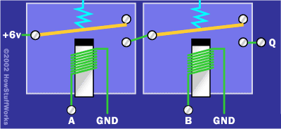
Which gate is this?
External Power (6v)
Signal Output
Q
Input, A
Input, B
AND
NAND
OR
NOR
XOR

Slide 26
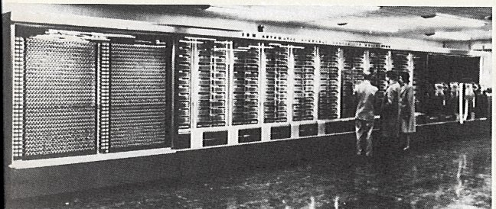
The Mark 1
an early, relay-based computer
http://www-03.ibm.com/ibm/history/exhibits/markI/markI_reference.html
Grace Hopper + Howard Aiken, Harvard ~ 1944
ran at 0.00001 MHz
5 tons
530 miles of wiring
765,299 distinct parts!
Addition: 0.6 seconds
Multiplication: 5.7 seconds
Division: 15.3 seconds
Notes:
10Hz clock
All those parts => always broken

Slide 27
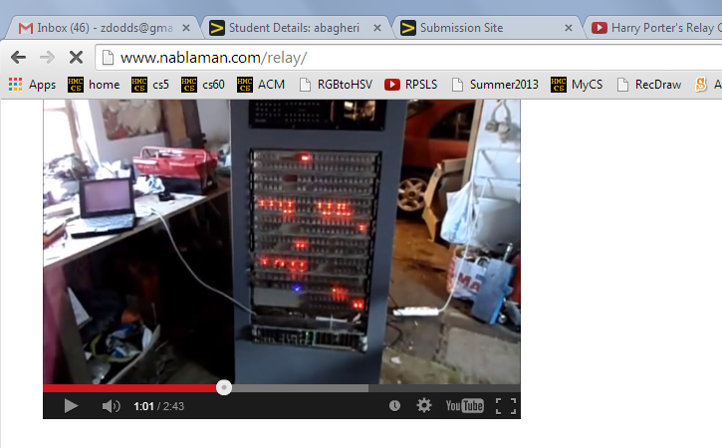
The Mark 1
an early, relay-based computer
a "modern" relay-based computer
http://www-03.ibm.com/ibm/history/exhibits/markI/markI_reference.html
Grace Hopper + Howard Aiken, Harvard ~ 1944
ran at 0.00001 MHz
5 tons
530 miles of wiring
765,299 distinct parts!
Addition: 0.6 seconds
Multiplication: 5.7 seconds
Division: 15.3 seconds
Notes:
Zach has a video showing how loud this is.

Slide 28
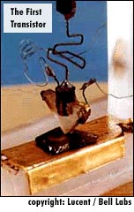
Transistors as disruptive technology
point contact transistor
1947: Bell Labs
seeking amplifiers for phone lines
team of physicists: Walter Brattain, William Shockley, and John Bardeen
1948: Junction transistor
much more robust design
1956: Shockley Semiconductor Co.
in hometown of Palo Alto...
1957: Fairchild Semiconductor Co.
the "traitorous eight" – left - ICs
... and the valley had begun silicon-izing
Notes:
Shockley was a horrible person. Everybody hated him (abrasive, domineering, paranoid).
He had a visiting position at CalTech, was kicked out after only 4 months.
Nobody from Bell Labs would join Shockley Semi so he had to scour the nation for people who didn’t know him.
The self-described “tratorious 8” left after one year.

Slide 29
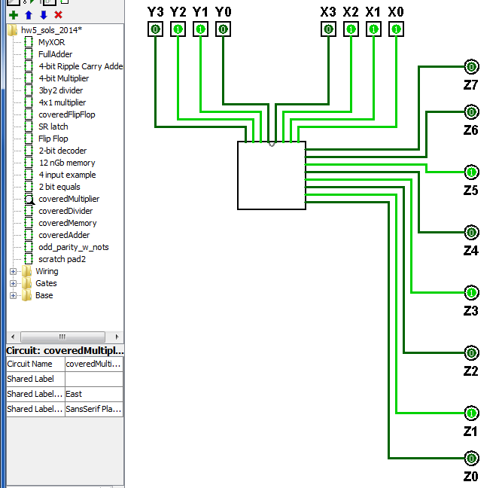
Half a computer: the CPU
transistors
gates
arithmetic
6 x 7… !
Notes:
INHANDOUT

Slide 30
What's inside gates?
What's the other half of computation?

Slide 31
Make no mistake: computers process numbers—not symbols.
We can only automate what we can arithmetize.
- Alan Perlis
Store + Retrieve
incl. communication
True! But it misses 99% of what computers do! What?

Slide 32
For systems, a face-lift is to add an edge that creates a cycle, not just an additional node.
- also Alan Perlis
input
output
Notes:
INHANDOUT
Here, draw a feedback edge through a NOR gate. Show how this just oscillates until X becomes 1.

Slide 33
For systems, a face-lift is to add an edge that creates a cycle, not just an additional node.
- also Alan Perlis
NOR's Truth Table
inputs
NOR
X
Z
X
Y
Z
NOR
Y
output
0
0
1
0
1
0
1
0
0
Let's engineer this into 1 bit of memory!
1
1
0
Notes:
INHANDOUT

Slide 34
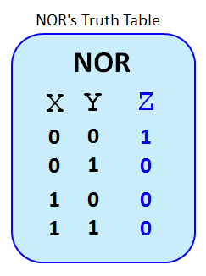
Thought experiment
The circuit starts with R being 0 + S being 0
The internal wires may be undefined, to start (this is ok) ...
0
"Set"
?
S
NOR
?
?
0
?
Q
Q is the output
"Reset"
NOR
R
What happens if R is set to 1? (and S stays 0)
What happens if R is set back to 0? (and S stays 0)
What if, then, S is set to 1? (and R stays 0)
What happens if, then, S is set back to 0? (and R stays 0)
Why does "S" stand for "Set" and R for "Reset" ?
Notes:
INHANDOUT

Slide 35
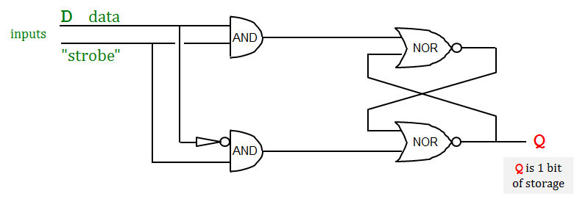
The circuit starts with R being 0 + S being 0
Memory!
What if S stays 0 and R is set to 1?
Q is then set to 0
1
What happens if S stays 0 and R is set back to 0?
"Set"
0
S
NOR
Q still stays (!) at 0
What happens if R is 0 and S is set to 1?
Q is then set to 1
What happens if S is 0 and R is set back to 0?
Q still stays (!) at 1
0
1
Q
"Reset"
NOR
Why does "S" stand for "Set" and R for "Reset" ?
R
Q is 1 bit of storage
S "sets" Q to 1; R "resets" it back to 0.
Take a look at this circuit:
The D (data) line holds a single bit we want to store (either a 0 or a 1).
How does the strobe bit help store the bit D into Q?
"we are ready to handle the data"
Hint: What happens when the "strobe" is 1?
Notes:
The D circuit is on the next slide in the handout.

Slide 36
The flip-flop
Demo!
D
data
inputs
AND
"strobe"
NOR
"we are ready to handle the data"
NOR
Q
AND
Q is 1 bit of storage
D
the flip-flop's diagram
Q
1 bit of memory!
strobe
Notes:
INHANDOUT

Slide 37
The flip-flop
Demo!
D
data
inputs
AND
"strobe"
NOR
But there's a LOT more than 1 bit of memory… !
NOR
Q
AND
Q is 1 bit of storage
D
the flip-flop's diagram
Q
1 bit of memory!
strobe

Slide 38
Random Access Memory
Demo!
Extra this week: Design 12nGbits of RAM
Inputs
Outputs
3 data input bits
Simplified
Prototype for
Accessing
Memory
3 data output bits
write enable line
read enable line
2 data address bits
12 bits of RAM
3 bits stored at location 00
3 bits stored at location 01
3 bits stored at location 10
3 bits stored at location 11
Notes:
INHANDOUT
Demo RAM in Logisim.

Slide 39
Extra Credit
3 data input bits
STORE
the value 5 into mem. loc. #1
0. Make data input bits 101
1. Give 01 to the decoder (the 1 goes on)
2. Make the "Write Enable" high
3. How do the * AND gates make sure that the value does go into memory location #1?
0
D
Q
D
Q
D
Q
4. How do the * AND gates make sure that the value does NOT go into memory location #0?
memory location
strobe
strobe
strobe
0
*
Binary Address Decoder
1
D
Q
D
Q
D
Q
1
strobe
strobe
strobe
*
A1
A0
data address, in binary
2
3
write enable line
OR
read enable line
OR
OR
two other memory lines and their flip-flops are not drawn
3 data output bits
Notes:
INHANDOUT

Slide 40
0. Suppose 101 is in Location #1
3 data input bits
LOAD
take data from mem. location #1
1. Give 01 to the decoder (the 1 goes on)
2. Make the "Read Enable" high
3. Which gates will ensure bits from memory location #1 are read out?
4. Which gates will ensure bits from memory location #0 are not read out?
0
5. Draw where the "Read Enable" wire should go!
memory location
D
Q
D
Q
D
Q
strobe
strobe
strobe
0
Binary Address Decoder
1
D
Q
D
Q
D
Q
1
strobe
strobe
strobe
A1
A0
data address, in binary
2
3
write enable line
OR
read enable line
OR
OR
two other memory lines and their flip-flops are not drawn
3 data output bits
Notes:
INHANDOUT

