Slide 1
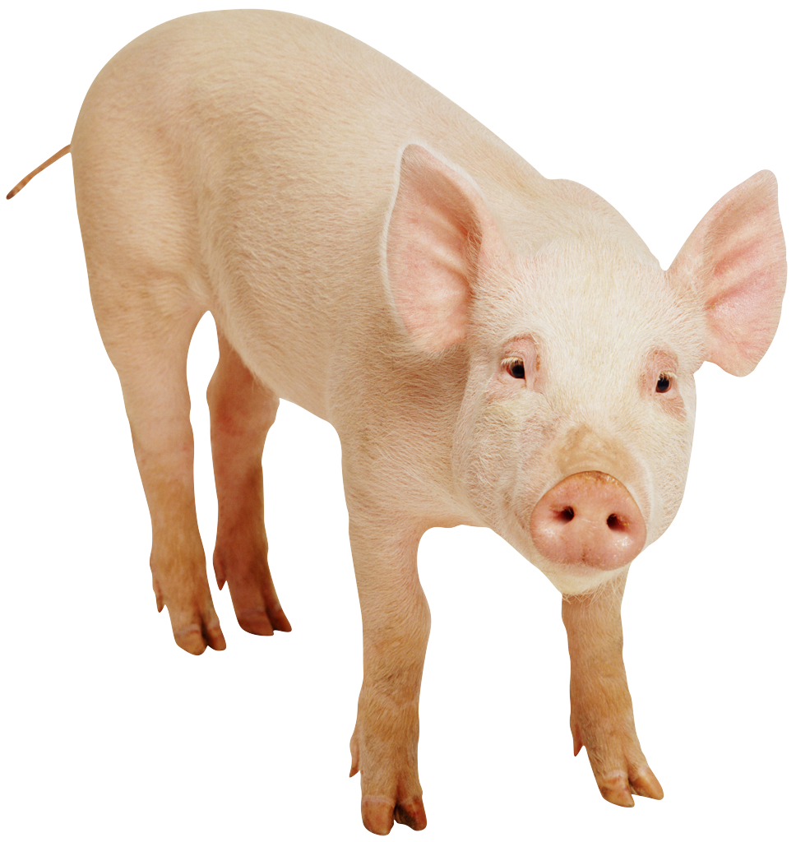
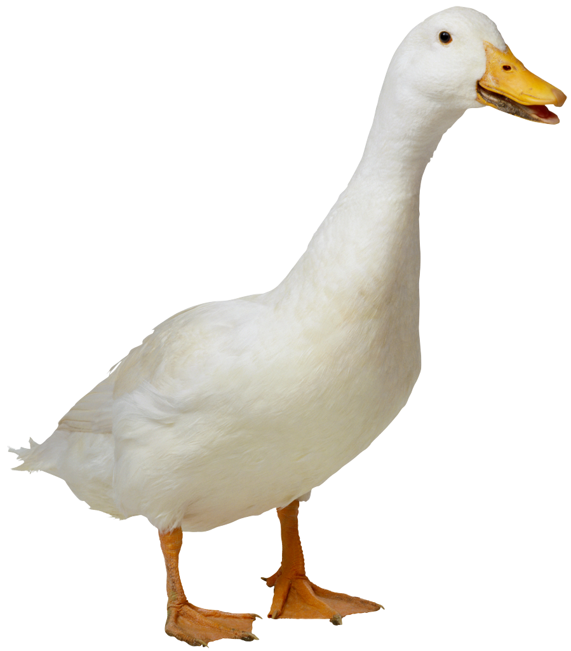
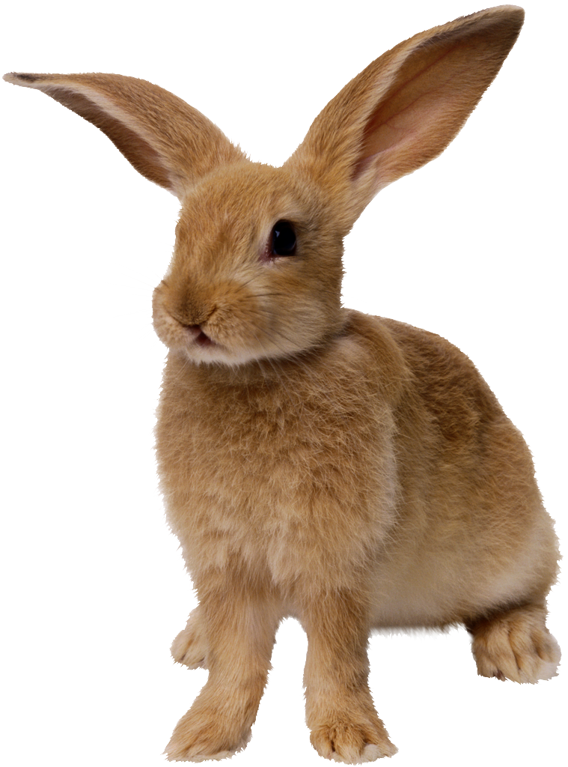
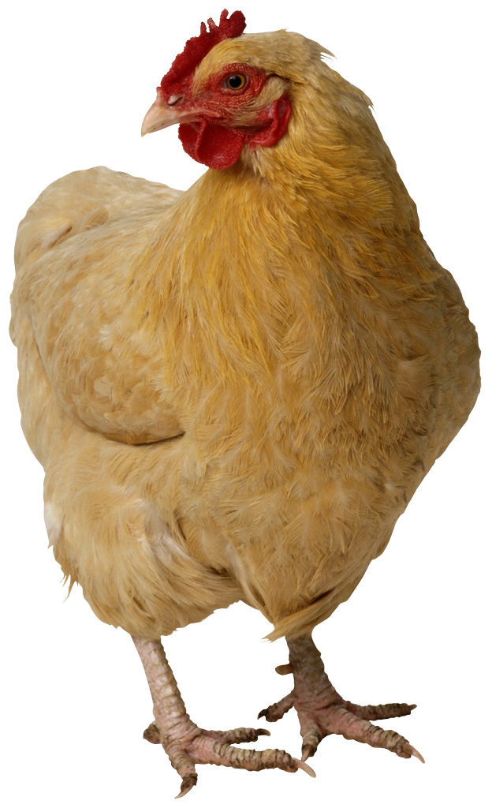
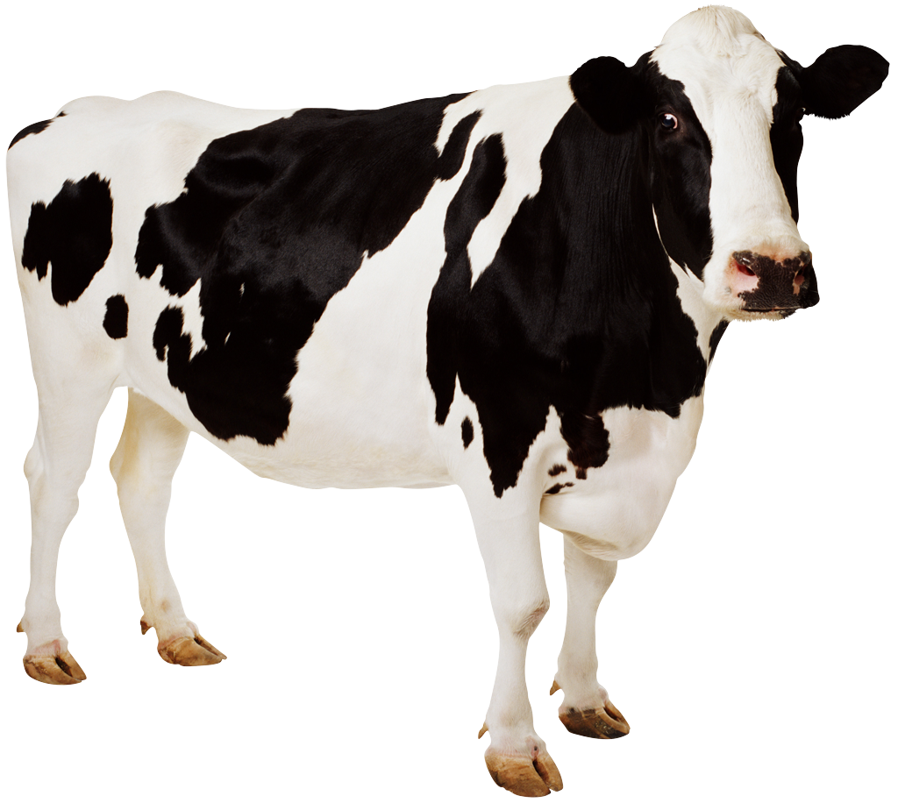
CS 5 Today
Sports: HMC CS Professor to coach 2020 U.S. Olympic chocolate-eating team
Weather: 63.79% chance of weather today
News in Brief
Psychics predict that there was no CS 5 lecture yesterday. Definitive proof of paranormal phenomena!
(Claremont AP): A group of psychics has made an extraordinary set of predictions that, one-by-one, are being corroborated by scientists. “It is indeed true that we didn’t have CS 5 yesterday,” said one CS 5 professor. The psychics have also predicted that fall break will occur sometime within the next 3-10 days.
CS 5 alien abducted
by aliens
(p. 42)
Page 42 will no longer
be published
(p. 42)
Farm animals displace
penguins, invade
CS 5 notes
(p. 42)
We’re going to milk this for all it’s worth!
Notes:
Worksheet is writing a simple Hmmm program.

Slide 2
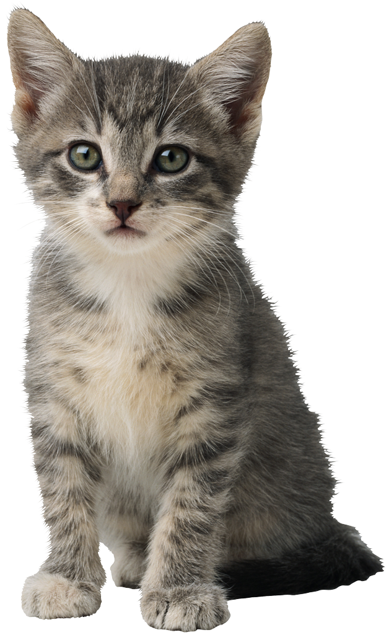
Machine Language Versus…
16 bits wide in Hmmm
Memory Location
Binary Base 10
16 bits wide in Hmmm
00110010
00000000 0
8 bit
address
00000000
00011010
00000001 1
Program Counter
10011101
00000010 2
00110010
00000011 3
Instruction Register
r0 is always 0!
00000100 4
00000000
Register 0
8 bit
data in
8 bit data out
00000010
Register 1
00000001
Register 2
Register 15
00000011
Read
11111111 255
Write
Central Processing Unit (CPU)
Memory
Notes:
What happens next?

Slide 3
…Assembly Language!
16 bits wide in Hmmm
Memory Location
Binary Base 10
16 bits wide in Hmmm
add r3 r0 r2
00000000 0
8 bit
address
00000000
add r1 r2 r2
00000001 1
Program Counter
mul r1 r3 r1
00000010 2
00110010
00000011 3
Instruction Register
r0 is always 0!
00000100 4
00000000
Register 0
8 bit
data in
8 bit data out
00000010
Register 1
00000001
Register 3
Register 15
00000011
Read
11111111 255
Write
Central Processing Unit (CPU)
Memory
Notes:
What happens next?

Slide 4
Hmmm Assembly Language
add r2 r2 r2
reg2 = reg2 + reg2
crazy, perhaps, but used ALL the time
sub r2 r1 r4
reg2 = reg1 - reg4
which is why it is written this way in python!
mul r7 r6 r2
reg7 = reg6 * reg2
div r1 r1 r1
reg1 = reg1 / reg1
INTEGER division—no remainders
setn r1 42
you can replace 42 with anything from -128 to 127
reg1 = 42
addn r1 -1
reg1 = reg1 - 1
a shortcut
read r10
read from keyboard and write to screen
Each instruction (and many more) gets implemented for a particular processor and particular machine…
write r1

Slide 5
jumps
Unconditional jump
jumpn 42
Replaces the PC (program counter) with 42. “Jump to program line number 42.”
Conditional jumps
jeqzn r1 #
IF r1 == 0 THEN jump to line number #
jgtzn r1 #
IF r1 > 0 THEN jump to the location in #
jltzn r1 #
IF r1 < 0 THEN jump to the location in #
jnezn r1 #
IF r1 != 0 THEN jump to the location in #
Register jump
This IS making me jumpy!
jumpr r1
Jump to the line # stored in reg1!

Slide 6
Worksheet
Feeling Jumpy?
1
Write an assembly-language program that reads one integer, X, as keyboard input into register r1. Then the program should compute X²+3X+4, leaving the result in register r13, and write it out.
2
Write an assembly-language program that reads two integers r1 and r2 as keyboard input. Then, the program should compute r1^{r2} in register r13 and write it out. You may assume that r2 >= 0.
Memory - RAM
Memory - RAM
Registers - CPU
0
Registers - CPU
0
0
1
0
1
r0
r0
2
2
r1
3
r1
3
r2
4
r2
4
r3
5
r3
5
6
6
r4
7
r4
7
r5
8
r5
8
9
9
10
10
Notes:
Consider doing only #1 on this worksheet.
Note that the next slide has the Hmmm instruction set for reference purposes.

Slide 7
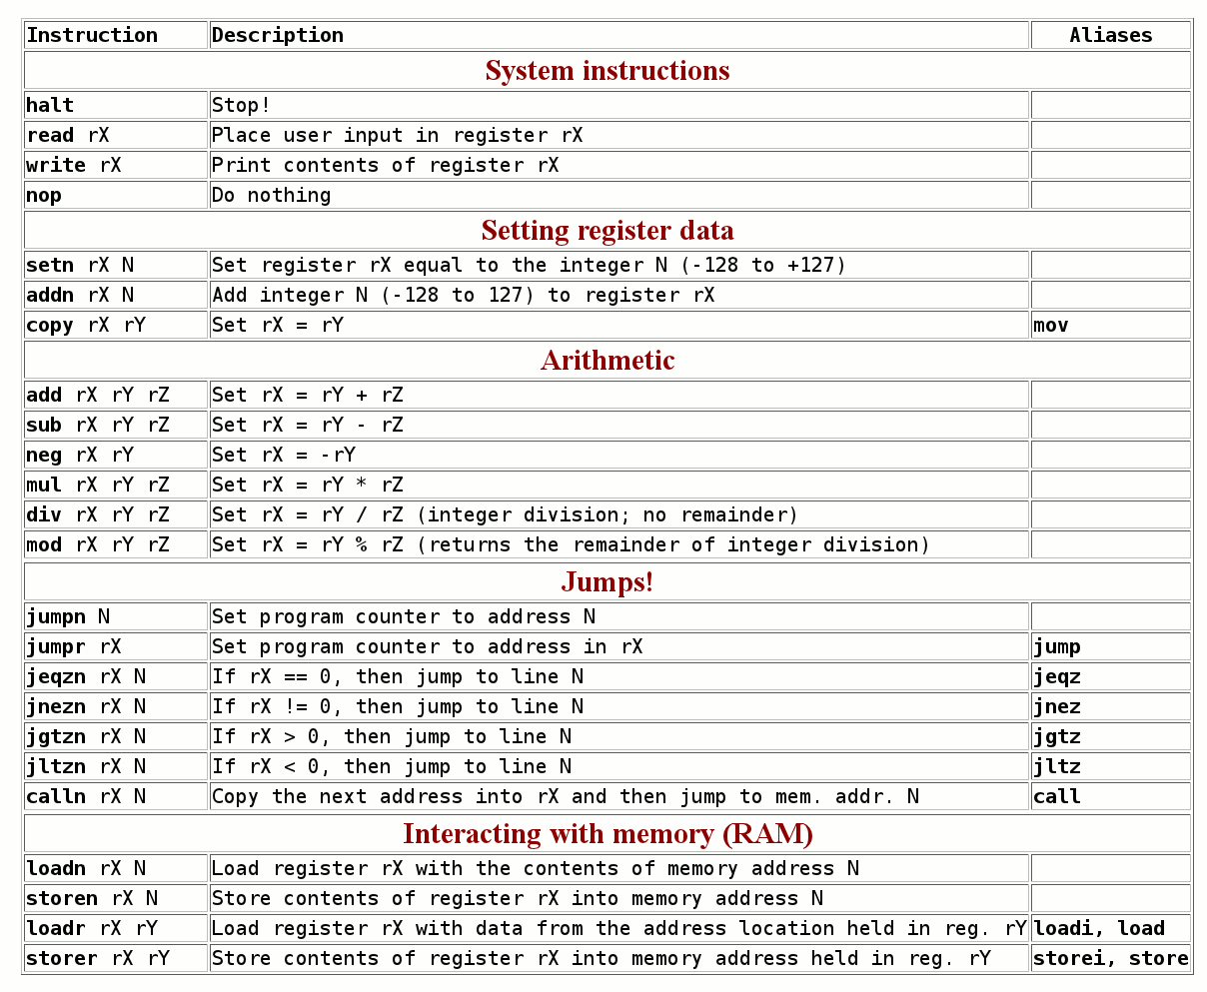
Notes:
There are 24 instructions in the Hmmm instruction set. A few (copy, nop, and neg) are pseudo-ops.

Slide 8


Why Assembly Language?
It’s only the foolish that never climb Mt. Fuji—or that climb it again.
Who writes most of the assembly language used?
Notes:
The compiler!

Slide 9
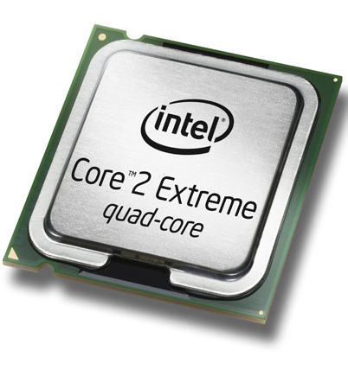
The Compiler
A program that translates from human-usable language into assembly language and machine language
Compiler
0000 0001 0000 0001
1000 0010 0001 0001
0110 0010 0010 0001
0000 0010 0000 0010
x = 6
y = 7
z = x*y
print z
0000 0000 0000 0000
setn r1 6
setn r2 7
mul r3 r1 r2
write r3
executable machine code
assembly or byte-code
the code
0000 0001 …
0010 0001 …
Interpreter
0110 0010 …
1000 0001 …
machine code
interpreting byte code

Slide 10
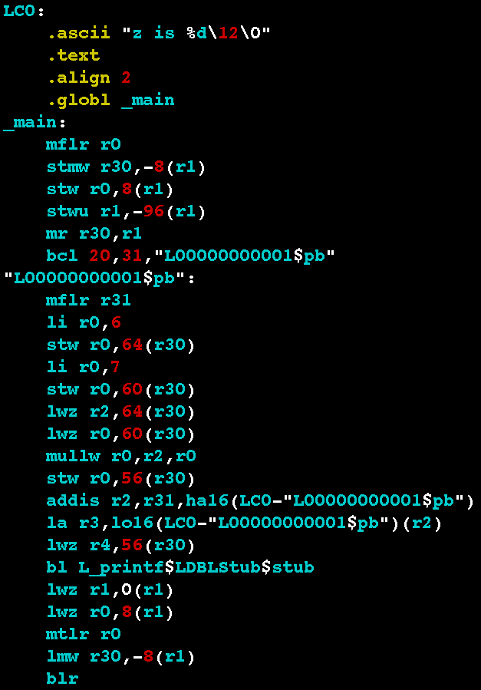
Examples
x = 6
y = 7
z = x*y
print z
Power PC
Core 2 Duo
.globl main
.type main,function
main:
.LFB2:
pushq %rbp
.LCFI:
movq %rsp,%rbp
.LCFI1:
subq $16,%rsp
.LCFI2:
movl $6,-12(%rbp)
movl $7,-8(%rbp)
movl -12(%rbp),%eax
imull -8(%rbp),%eax
movl %eax,-4(%rbp)
movl -4(%rbp),%esi
movl $.LC0,%edi
movl $0,%eax
call printf
leave
ret
The code
Each processor has its own endearing idiosyncrasies...

Slide 11
storer Goes TO Memory
Hmmm CPU
Hmmm RAM
r1
0
read r1
1
blah
2
blah
3
setn r15 42
indirect store
4
storer r1 r15
5
blah
r15
42
…
…
storer r1 r15
42
42
43
…

Slide 12
loadr Comes FROM Memory
Hmmm CPU
Hmmm RAM
r1
loadr r1 r15
0
.
1
.
2
.
3
.
4
.
5
Blah blah blah
6
.
indirect load
7
loadr r1 r15
r15
42
…
8
.
…
storer r1 r15
42
43
…

Slide 13


calln = setn + jumpn!
A function call in python:
Hmmm's call operation:
puts NEXT line # into r14,
then jumps to line 4
def main():
r1 = input()
result = factorial(r1)
print(result)
def factorial(r1):
# do work
return result
0 read r1
1 calln r14 4
2 write r13
3 halt
4 do stuff and
5 answer in r13
6 jumpr r14

Slide 14
Factorial: Function Call!
Hmmm CPU
Hmmm RAM
0
read r1
input
r0
0
1
calln r14 4
function call
Input value: x
2
write r13
r1
output
3
halt
Final result - return value - in progress
4
setn r13 1
the function!
r13
5
jeqzn r1 9
location / line to return TO
6
mul r13 r13 r1
loop
r14
2
7
addn r1 -1
8
jumpn 5
9
jumpr r14
return

Slide 15
Which Factorial Is It?
0
read r1
input
def fac1():
r1 = input()
r13 = 1
while r1 != 0:
r13 = r13 * r1
r1 += -1
print r13
return
def fac2(r1):
if r1 == 0:
return 1
else:
return r1 * fac2(r1-1)
1
setn r13 1
initialize result to 1
2
jeqzn r1 6
3
mul r13 r13 r1
loop
4
addn r1 -1
5
jumpn 2
6
write r13
output
7
halt
Notes:
Ask them to identify whether this is the iterative or recursive factorial.

Slide 16

The Alien’s Life Advice
Travel! And study abroad!
How else are you going to meet a nice alien?

Slide 17
Function Calls…
def main():
r1 = input()
r13 = emma(r1)
r13 = r13 + r1
print(r13)
return
def emma(r1):
r1 = r1 + 1
r13 = sarah(r1)
r13 = r13 + r1
return r13
def sarah(r1):
r1 = r1 + 42
r13 = r1 + 1
return r13
r1=3
Chew on this…
emma(3)
r1=3
r1=4
You should be worried!
sarah(4)
r13=47
r13=??
r1=4
r1=46
r13=47
return(47)
Notes:
This slide has seven animations. The sequence shows how r1 (in particular) has its value preserved across calls, and is local to each function.

Slide 18
Function Calls…
def main():
r1 = input()
r13 = emma(r1)
r13 = r13 + r1
print(r13)
return
def emma(r1):
r1 = r1 + 1
r13 = sarah(r1)
r13 = r13 + r1
return r13
def sarah(r1):
r1 = r1 + 42
r13 = r1 + 1
return r13
r1=3
Chew on this…
emma(3)
r1=3
r1=4
sarah(4)
r13=47
r13=??
r1=4
r1=46
r13=47
return(47)

Slide 19

Function Calls…
def main():
r1 = input()
r13 = emma(r1)
r13 = r13 + r1
print(r13)
return
def emma(r1):
r1 = r1 + 1
r13 = sarah(r1)
r13 = r13 + r1
return r13
def sarah(r1):
r1 = r1 + 42
r13 = r1 + 1
return r13
r1=3
emma(3)
r13=??
r1=3
r1=4
sarah(4)
r13=47
r13=51
return(51)
r1=4
r1=46
r13=47
return(47)
Notes:
This slide continues the animations showing return values.

Slide 20
Function Calls…
def main():
r1 = input()
r13 = emma(r1)
r13 = r13 + r1
print(r13)
return
def emma(r1):
r1 = r1 + 1
r13 = sarah(r1)
r13 = r13 + r1
return r13
def sarah(r1):
r1 = r1 + 42
r13 = r1 + 1
return r13
r1=3
emma(3)
r13=51
r13=54
54
r1=3
r1=4
sarah(4)
r13=47
Cool, but how
does this work!?
r13=51
return(51)
r1=4
r1=46
r13=47
return(47)

Slide 21
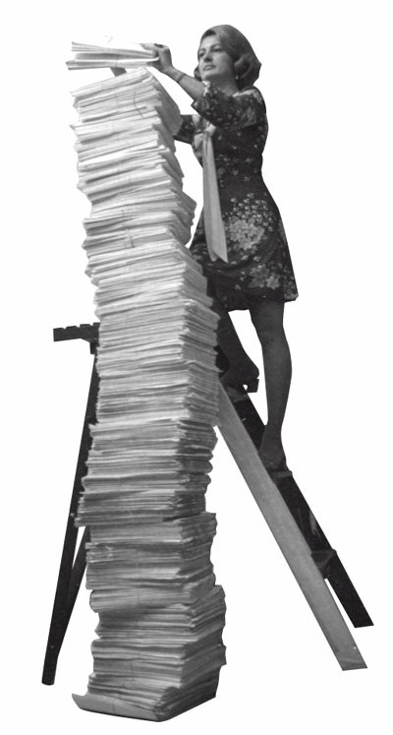
The Stack!
AFLAC, ShmAFLAC!
Be careful up there!
Insert (“push”)
Remove (“pop”)

Slide 22

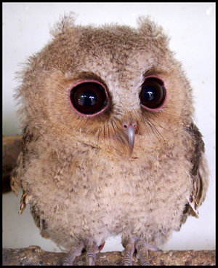
Watch carefully…
What if I don’t give a hoot?!

Slide 23

Function Calls…
Hmmm code up here!
The stack in RAM!
def main():
r1 = input()
r13 = emma(r1)
r13 = r13 + r1
print(r13)
return
def emma(r1):
r1 = r1 + 1
r13 = sarah(r1)
r13 = r13 + r1
return r13
def sarah(r1):
r1 = r1 + 42
r13 = r1 + 1
return r13
3
r1=3
4
r1
3
3
4
4
46
r13
47
return
address
r14
Notes:
This slide has multiple animations showing how the stack works.

Slide 24
Function Calls…
Hmmm code up here!
The stack in RAM!
def main():
r1 = input()
r13 = emma(r1)
r13 = r13 + r1
print(r13)
return
def emma(r1):
r1 = r1 + 1
r13 = sarah(r1)
r13 = r13 + r1
return r13
def sarah(r1):
r1 = r1 + 42
r13 = r1 + 1
return r13
3
r1=3
4
r1
3
4
46
r13
47
return
address
r14

Slide 25
Function Calls…
Hmmm code up here!
The stack in RAM!
def main():
r1 = input()
r13 = emma(r1)
r13 = r13 + r1
print(r13)
return
def emma(r1):
r1 = r1 + 1
r13 = sarah(r1)
r13 = r13 + r1
return r13
def sarah(r1):
r1 = r1 + 42
r13 = r1 + 1
return r13
3
4
r1
3
3
4
4
46
r13
47
51
54
return
address
r14

Slide 26
Function Calls…
Hmmm code up here!
The stack in RAM!
def main():
r1 = input()
r13 = emma(r1)
r13 = r13 + r1
print(r13)
return
def emma(r1):
r1 = r1 + 1
r13 = sarah(r1)
r13 = r13 + r1
return r13
def sarah(r1):
r1 = r1 + 42
r13 = r1 + 1
return r13
3
4
r1
3
4
r13
54
return
address
r14

Slide 27
Now Without Pigs and Geese!
We object to this!!!
RAM!
def main():
r1 = input()
r13 = emma(r1)
r13 = r13 + r1
print(r13)
return
def emma(r1):
r1 = r1 + 1
r13 = sarah(r1)
r13 = r13 + r1
return r13
def sarah(r1):
r1 = r1 + 42
r13 = r1 + 1
return r13
0
01001001
r1=3
1
11001011
…
r1
3
26
01001011
27
r13
return
value
28
r14
return
address
29
r15
26
stack
pointer
30
…
255

Slide 28
Now Without Pigs and Geese!
It was better with pigs and geese!
00 setn r15 26 # set stack pointer to 26
01 read r1 # start of main
02 storer r1 r15 # store r1 on the stack
03 addn r15 1 # increment stack pointer
04 calln r14 10 # call emma
05 addn r15 -1 # decrement stack pointer
06 loadr r1 r15 # load r1 from the stack
07 add r13 r13 r1 # r13 = r13 + r1
08 write r13
09 halt
10 addn r1 1 # start of emma!
11 storer r1 r15 # store r1 on the stack
12 addn r15 1 # increment stack pointer
13 storer r14 r15 # save return addr on stack
14 addn r15 1 # increment stack pointer
15 calln r14 22 # call sarah
16 addn r15 -1 # decrement stack pointer
17 loadr r14 r15 # load ret addr from stack
18 addn r15 -1 # decrement stack pointer
19 loadr r1 r15 # load r1 from the stack
20 add r13 r13 r1 # r13 = r13 + r1
21 jumpr r14 # return!
22 addn r1 42 # start of sarah!
23 setn r2 1 # put 1 in a register
24 add r13 r1 r2
25 jumpr r14 # return
def main():
r1 = input()
r13 = emma(r1)
r13 = r13 + r1
print(r13)
return
def emma(r1):
r1 = r1 + 1
r13 = sarah(r1)
r13 = r13 + r1
return r13
def sarah(r1):
r1 = r1 + 42
r13 = r1 + 1
return r13
save
restore
save
restore
Notes:
This slide is a teaser for next time.

