Slide 1
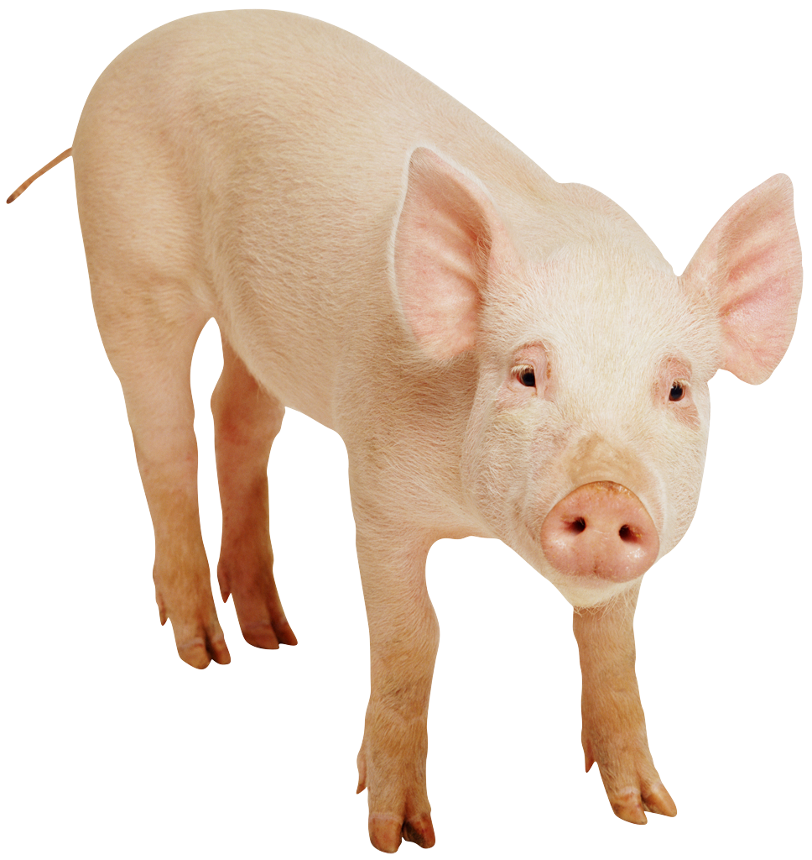
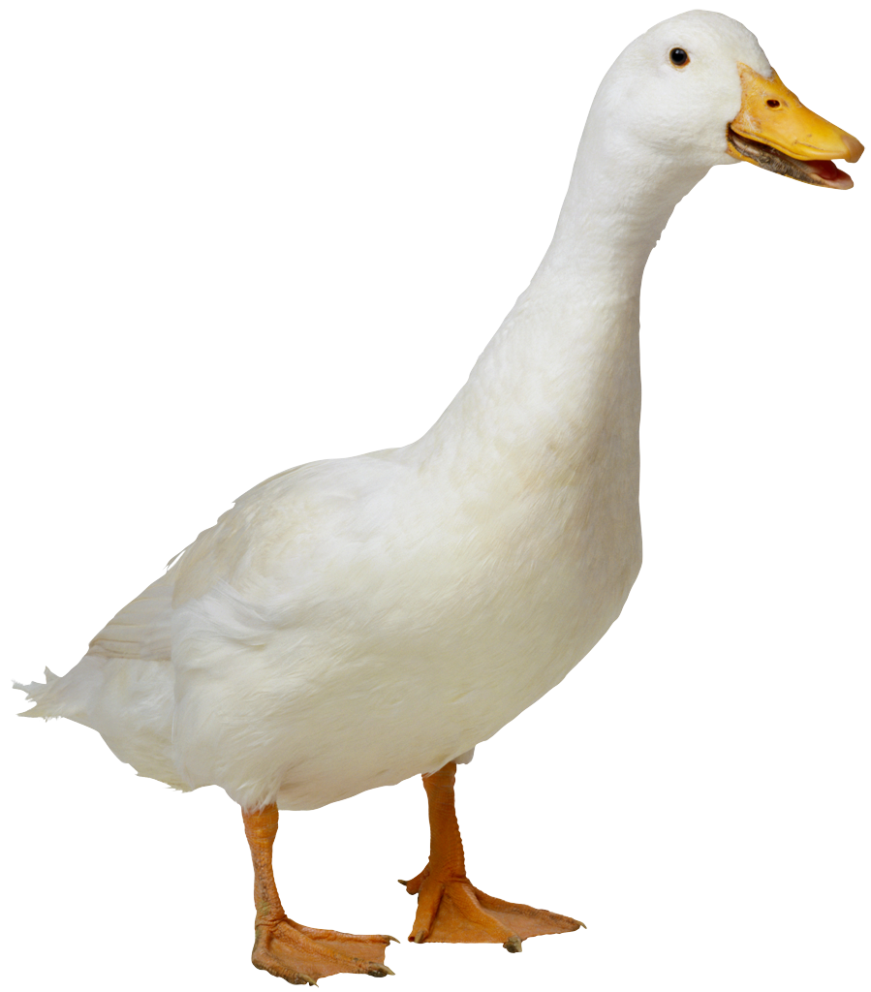
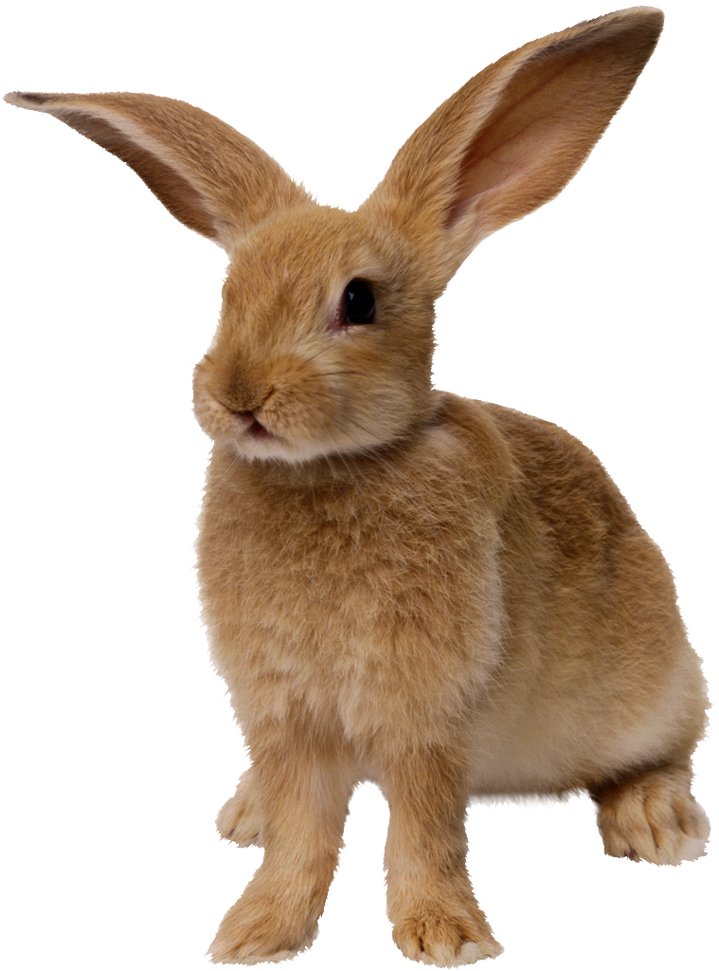
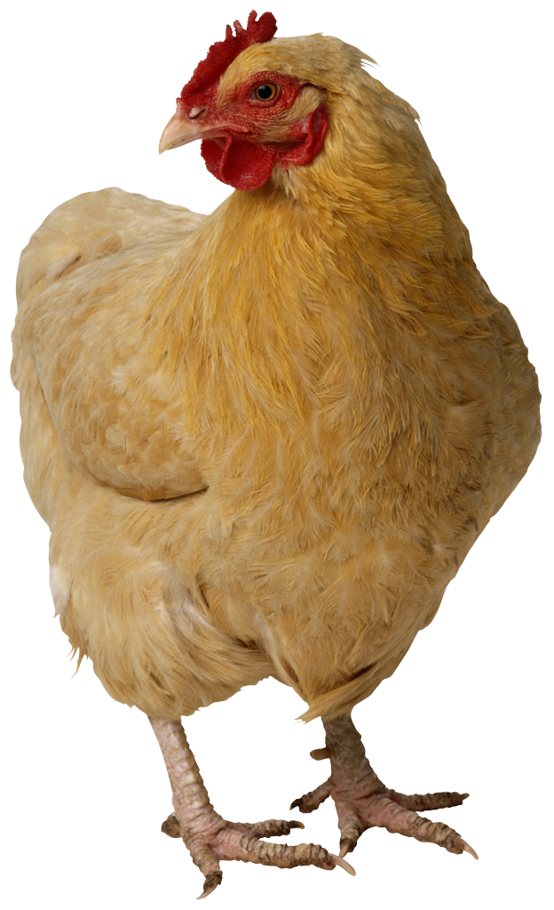
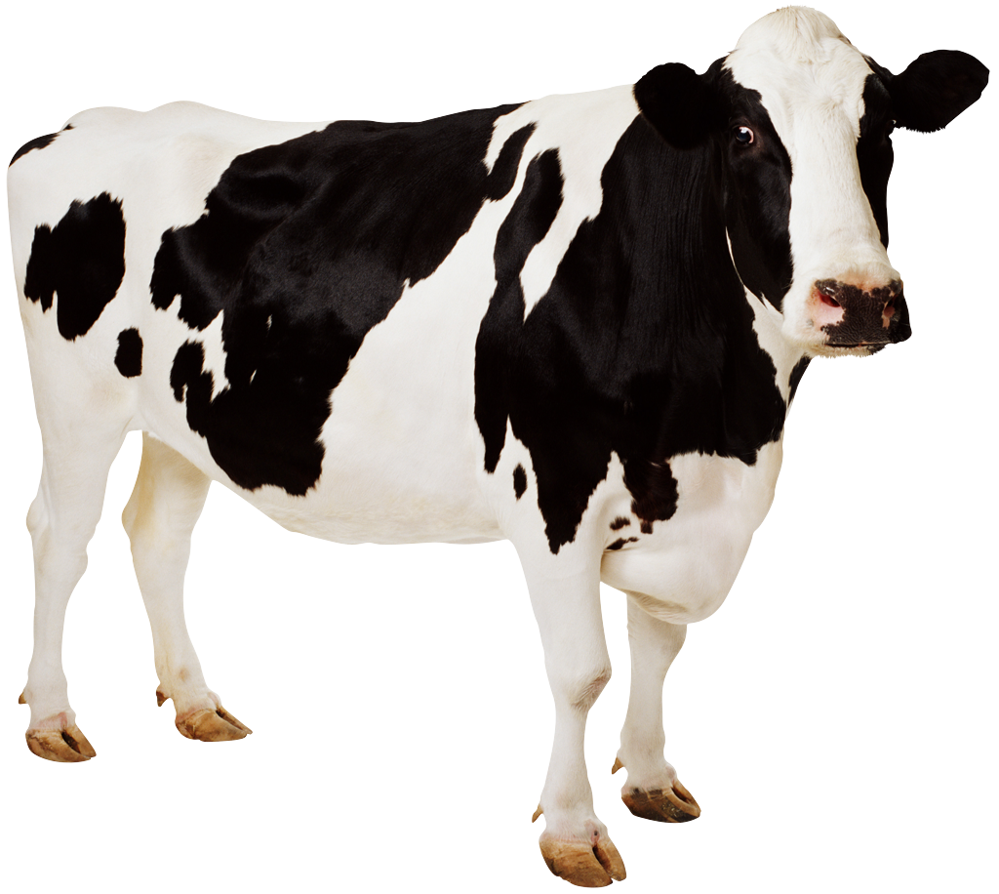
CS 5 Today
Sports: HMC CS Professor to coach 2021 U.S. Olympic chocolate-eating team
Weather: 63.79% chance of weather today
News in Brief
CS 5 alien abducted
by aliens
(p. 42)
Page 42 will no longer
be published
(p. 42)
Farm animals displace
penguins, invade
CS 5 notes
(p. 42)
Psychics predict that there was no CS 5 lecture yesterday. Definitive proof of paranormal phenomena!
(Claremont AP): A group of psychics has made an extraordinary set of predictions that, one-by-one, are being corroborated by scientists. “It is indeed true that we didn’t have CS 5 yesterday,” said one CS 5 professor. The psychics have also predicted that fall break will occur sometime within the next 3-10 days.
Honk! Read sections 4.5-4.6!
We’re going to milk this for all it’s worth!
Notes:
Class 13 organization5
Worksheet is writing a simple Hmmm program.
Demos: prog01-multiply and prog03-countup.

Slide 2
Midterm Feedback (1)
Common themes:
Course is fun
Hard to find grutors who have taken CS 5 Black
Pace is fast
Workload is too high
Need more hints on homework
Trouble understanding things that aren’t on homework (e.g., complexity)
pxfuel.com
Notes:
Things tend more toward Papa bear than Mama or Baby.

Slide 3
Midterm Feedback (2)
What I’m doing
Black grutors are now highlighted on grutoring page
Added more hints to this week’s homework
And will try to continue reducing homework load in the future
Note: as a rule you’re not expected to master non-HW topics
Same is true for extra-credit HW (of course)
It’s all just for fun!

Slide 4
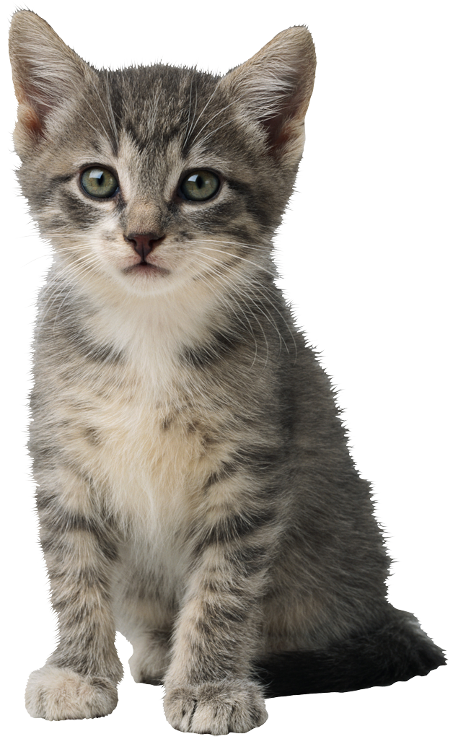
Machine Language Versus…
16 bits wide in Hmmm
Memory Location
Binary Base 10
16 bits wide in Hmmm
00110110
00000000 0
8 bit
address
00000000
00011010
00000001 1
Program Counter
10011101
00000010 2
00110010
00000011 3
Instruction Register
r0 is always 0!
00000100 4
00000000
Register 0
16 bit
data in
16 bit data out
00000010
Register 1
00000001
Register 2
Register 15
00000011
Read
11111111 255
Write
Central Processing Unit (CPU)
Memory

Slide 5
…Assembly Language!
16 bits wide in Hmmm
Memory Location
Binary Base 10
16 bits wide in Hmmm
add r3 r1 r2
00000000 0
8 bit
address
00000000
add r1 r2 r2
00000001 1
Program Counter
mul r1 r3 r1
00000010 2
00110010
00000011 3
Instruction Register
r0 is always 0!
00000100 4
00000000
Register 0
16 bit
data in
16 bit data out
00000010
Register 1
00000001
Register 3
Register 15
00000011
Read
11111111 255
Write
Central Processing Unit (CPU)
Memory
Notes:
What happens next?

Slide 6
Hmmm Assembly Language
add r2 r2 r2
reg2 = reg2 + reg2
crazy, perhaps, but used ALL the time
sub r2 r1 r4
reg2 = reg1 - reg4
which is why it is written this way in Python!
mul r7 r6 r2
reg7 = reg6 * reg2
div r1 r1 r1
reg1 = reg1 // reg1
INTEGER division—no remainders
setn r1 42
you can replace 42 with anything from -128 to 127
reg1 = 42
addn r1 -1
reg1 = reg1 - 1
a shortcut
read r10
read from keyboard and write to screen
Each instruction (and many more) gets implemented for a particular processor and particular machine…
write r1

Slide 7
jumps
Unconditional jump
jumpn 42
Replaces the PC (program counter) with 42. “Jump to program line number 42.”
Conditional jumps
jeqzn r1 #
IF r1 == 0 THEN jump to line number #
jgtzn r1 #
IF r1 > 0 THEN jump to line number #
jltzn r1 #
IF r1 < 0 THEN jump to line number #
jnezn r1 #
IF r1 != 0 THEN jump to line number #
Register jump
This IS making me jumpy!
jumpr r1
Jump to the line # stored in reg1!
Notes:
Demos here: prog01-multiply and prog03-countup.

Slide 8
A Sample Program
00 setn r1 42
01 write r1
02 addn r1 1
03 jumpn 1
04 halt
Notes:
Questions: 1. What does it do? 2: When is line 4 executed?

Slide 9
Worksheet
Feeling Jumpy?
1
Write an assembly-language program that reads one integer, X, as keyboard input into register r1. Then the program should compute X²+3X+4, leaving the result in register r13, and write it out.
2
Write an assembly-language program that reads two integers r1 and r2 as keyboard input. Then, the program should compute r1^{r2} in register r13 and write it out. You may assume that r2 >= 0.
Instructions
Instructions
Registers - CPU
0
read r1
Registers - CPU
0
read r1
0
1
0
1
read r2
r0
r0
2
2
setn r13 1
r1
3
r1
3
r2
4
r2
4
r3
5
r3
5
6
6
r4
7
r4
7
r5
8
r5
8
r13
9
r13
9
10
10
Notes:
Consider doing only #1 on this worksheet.
Note that the next slide has the Hmmm instruction set for reference purposes.

Slide 10
Instruction | Description
System Instructions
halt | Stop!
read rX | Place user input in register rX
write rX | Print contents of register rX
nop | Do nothing
Setting register data
setn rX N | Set register rX equal to the integer N (-128 to 127)
addn rX N | Add integer N (-128 to 127) to register rX
copy rX rY | Copy the number in rX into rY
Arithmetic
add rX rY rZ | Set rX = rY + rZ
sub rX rY rZ | Set rX = rY – rZ
neg rX rY | Set rX = -rY
mul rX rY rZ | Set rX = rY * rZ
div rX rY rZ | Set rX = rY // rZ (integer division; no remainder)
mod rX rY rZ | Set rX = rY % rZ (returns the remainder of integer division)
Jumps!
jumpn N | Set program counter to address N
jumpr rX | Set program counter to address in rX
jeqzn rX N | If rX == 0, then jump to line N
jnezn rX N | If rX != 0, then jump to line N
jgtzn rX N | If rX > 0, then jump to line N
jltzn rX N | If rX < 0, then jump to line N
calln rX N | Copy the next program address into rX and then jump to memory address N
Interacting with memory (RAM)
pushr rX rY | Store contents of rX into memory addressed by rY, and then increment rY
popr rX rY | Decrement rY, and then load the contrents of memory addressed by rY into rX
Notes:
There are 26 instructions in the Hmmm instruction set. A few (copy, nop, and neg) are pseudo-ops. This slide lists the most important ones.
Hmmm doesn’t have jgez or jlez. How could you implement them? (There are two options.)

Slide 11
X² + 3X + 4
00 read r1
01 mul r13 r1 r1
02 setn r2 3
03 mul r2 r1 r2
04 add r13 r13 r2
05 addn r13 4
06 write r13
07 halt
Notes:
Do the registers have to be used this way? Is there another way to calculate r2 = 3*r1?

Slide 12
r1^{r2}
00 read r1
01 read r2
02 setn r13 1
03 jeqz r2 08
04 mul r13 r13 r1
05 addn r2 -1
06 jumpn 03
07 write r13
08 halt
Notes:
Could line 06 be written differently?

Slide 13
The Alien’s Life Advice
Travel! And study abroad!
How else are you going to meet a nice alien?

Slide 14
Why Assembly Language?
It’s only the foolish that never climb Mt. Fuji—or that climb it again.
Who writes most of the assembly language used worldwide?
Notes:
The compiler!

Slide 15
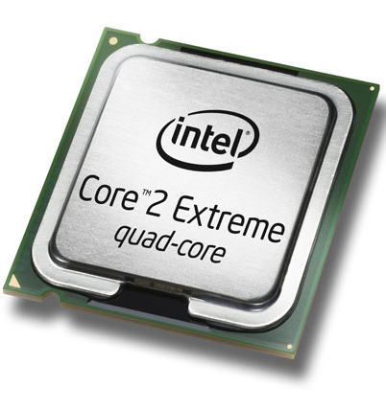
The Compiler
A program that translates from human-usable language into assembly language and machine language
Compiler
0000 0001 0000 0001
1000 0010 0001 0001
0110 0010 0010 0001
0000 0010 0000 0010
x = 6
y = 7
z = x*y
print z
0000 0000 0000 0000
setn r1 6
setn r2 7
mul r3 r1 r2
write r3
executable machine code
assembly or byte-code
the code
0000 0001 …
0010 0001 …
Interpreter
0110 0010 …
1000 0001 …
machine code
interpreting byte code

Slide 16
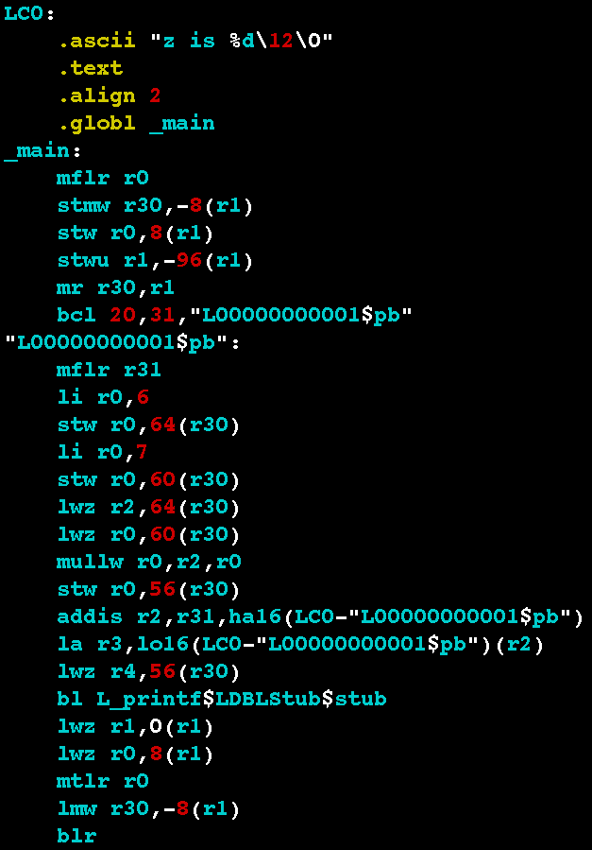
Examples
x = 6
y = 7
z = x*y
print z
Power PC
Intel Haswell
.globl main
.type main,function
main:
.LFB2:
pushq %rbp
.LCFI:
movq %rsp,%rbp
.LCFI1:
subq $16,%rsp
.LCFI2:
movl $6,-12(%rbp)
movl $7,-8(%rbp)
movl -12(%rbp),%eax
imull -8(%rbp),%eax
movl %eax,-4(%rbp)
movl -4(%rbp),%esi
movl $.LC0,%edi
movl $0,%eax
call printf
leave
ret
The code
Each processor has its own endearing idiosyncrasies...

Slide 17
pushr Goes TO Memory
Hmmm CPU
Hmmm RAM
r1
0
read r1
1
blah
indirect “store” followed by increment
2
blah
3
setn r15 42
4
pushr r1 r15
5
blah
r15
42
Increments r15 by 1!
…
…
pushr r1 r15
42
42
43
…
Notes:
This slide animates the actions: first the copy of the bunny, then the increment of r15. The new value of r15 is shown on the next slide.

Slide 18
popr Comes FROM Memory
Hmmm CPU
Hmmm RAM
r1
popr r1 15
0
.
43
1
.
indirect “load” preceded by decrement
2
.
3
.
4
.
5
Blah blah blah
6
.
r15
Decrements r15 by 1!
7
popr r1 r15
43
42
…
8
.
…
42
43
…
Notes:
This animates the pop: first “decrement” appears, then r15 changes to 42, then the bunny gets copied.

Slide 19
popr Comes FROM Memory
Hmmm CPU
Hmmm RAM
r1
popr r1 15
0
.
43
1
.
indirect “load” preceded by decrement
2
.
3
.
4
.
5
Blah blah blah
6
.
r15
Decrements r15 by 1!
7
popr r1 r15
43
…
8
.
…
42
43
…

Slide 20
calln = setn + jumpn!
A function call in python:
Hmmm's call operation:
puts NEXT line # into r14,
then jumps to line 4
def main():
r1 = input()
result = factorial(r1)
print(result)
def factorial(r1):
# do work
return result
0 read r1
1 calln r14 4
2 write r13
3 halt
4 do stuff and
5 answer in r13
6 jumpr r14

Slide 21
Factorial: Function Call!
Hmmm CPU
Hmmm RAM
0
read r1
input
r0
0
1
calln r14 4
function call
Input value: x
2
write r13
r1
output
3
halt
Final result - return value - in progress
4
setn r13 1
the function!
r13
5
jeqzn r1 9
location / line to return TO
6
mul r13 r13 r1
loop
r14
2
7
addn r1 -1
8
jumpn 5
9
jumpr r14
return
Notes:
The circle around the 2 is animated.

Slide 22
Which Factorial Is It?
0
read r1
input
def fac1():
r1 = input()
r13 = 1
while r1 != 0:
r13 = r13 * r1
r1 += -1
print r13
return
def fac2(r1):
if r1 == 0:
return 1
else:
return r1 * fac2(r1-1)
1
setn r13 1
initialize result to 1
2
jeqzn r1 6
3
mul r13 r13 r1
loop
4
addn r1 -1
5
jumpn 2
6
write r13
output
7
halt
Notes:
Ask them to identify whether this assembly code is the iterative or recursive factorial.

Slide 23
Function Calls…
def main():
r1 = input()
r13 = emma(r1)
r13 = r13 + r1
print(r13)
return
def emma(r1):
r1 = r1 + 1
r13 = sarah(r1)
r13 = r13 + r1
return r13
def sarah(r1):
r1 = r1 + 42
r13 = r1 + 1
return r13
r1=3
Chew on this…
emma(3)
r1=3
r1=4
You should be worried!
sarah(4)
r13=47
r13=??
r1=4
r1=46
r13=47
return(47)
Notes:
The material from here on is duplicated in the Thursday lecture.
This slide has seven animations. The sequence shows how r1 (in particular) has its value preserved across calls, and is local to each function.
Emphasize to students that in Hmmm, r1 is a register rather than a variable and there’s only one of it. In Python each function has its own r1.

Slide 24
Function Calls…
def main():
r1 = input()
r13 = emma(r1)
r13 = r13 + r1
print(r13)
return
def emma(r1):
r1 = r1 + 1
r13 = sarah(r1)
r13 = r13 + r1
return r13
def sarah(r1):
r1 = r1 + 42
r13 = r1 + 1
return r13
r1=3
Chew on this…
emma(3)
r1=3
r1=4
sarah(4)
r13=47
r13=??
r1=4
r1=46
r13=47
return(47)

Slide 25
Function Calls…
def main():
r1 = input()
r13 = emma(r1)
r13 = r13 + r1
print(r13)
return
def emma(r1):
r1 = r1 + 1
r13 = sarah(r1)
r13 = r13 + r1
return r13
def sarah(r1):
r1 = r1 + 42
r13 = r1 + 1
return r13
r1=3
emma(3)
r13=??
r1=3
r1=4
sarah(4)
r13=47
r13=51
return(51)
r1=4
r1=46
r13=47
return(47)
Notes:
This slide continues the animations showing return values.

Slide 26
Function Calls…
def main():
r1 = input()
r13 = emma(r1)
r13 = r13 + r1
print(r13)
return
def emma(r1):
r1 = r1 + 1
r13 = sarah(r1)
r13 = r13 + r1
return r13
def sarah(r1):
r1 = r1 + 42
r13 = r1 + 1
return r13
r1=3
emma(3)
r13=51
r13=54
54
r1=3
r1=4
sarah(4)
r13=47
Cool, but how
does this work!?
r13=51
return(51)
r1=4
r1=46
r13=47
return(47)

Slide 27
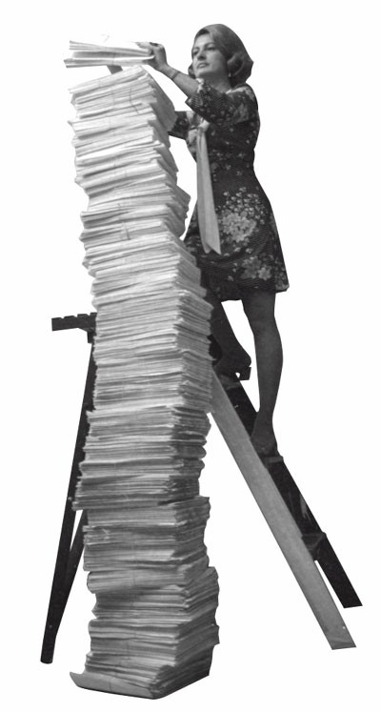
The Stack!
AFLAC, ShmAFLAC!
Be careful up there!
Insert (“push”)
Remove (“pop”)

Slide 28
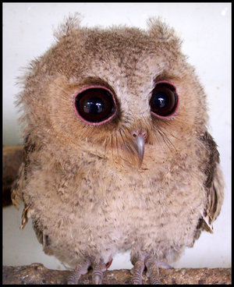
Watch carefully…
What if I don’t give a hoot?!

Slide 29
Function Calls…
Hmmm code up here!
The stack in RAM!
def main():
r1 = input()
r13 = emma(r1)
r13 = r13 + r1
print(r13)
return
def emma(r1):
r1 = r1 + 1
r13 = sarah(r1)
r13 = r13 + r1
return r13
def sarah(r1):
r1 = r1 + 42
r13 = r1 + 1
return r13
3
r1=3
4
r1
3
3
4
4
46
r13
47
return
address
r14
Notes:
This slide has multiple animations (17!) showing how the stack works.

Slide 30
Function Calls…
Hmmm code up here!
The stack in RAM!
def main():
r1 = input()
r13 = emma(r1)
r13 = r13 + r1
print(r13)
return
def emma(r1):
r1 = r1 + 1
r13 = sarah(r1)
r13 = r13 + r1
return r13
def sarah(r1):
r1 = r1 + 42
r13 = r1 + 1
return r13
3
r1=3
4
r1
3
4
46
r13
47
return
address
r14

Slide 31
Function Calls…
Hmmm code up here!
The stack in RAM!
def main():
r1 = input()
r13 = emma(r1)
r13 = r13 + r1
print(r13)
return
def emma(r1):
r1 = r1 + 1
r13 = sarah(r1)
r13 = r13 + r1
return r13
def sarah(r1):
r1 = r1 + 42
r13 = r1 + 1
return r13
3
4
r1
3
3
4
4
46
r13
47
51
54
return
address
r14
Notes:
This slide has 18 more animations.

Slide 32
Function Calls…
Hmmm code up here!
The stack in RAM!
def main():
r1 = input()
r13 = emma(r1)
r13 = r13 + r1
print(r13)
return
def emma(r1):
r1 = r1 + 1
r13 = sarah(r1)
r13 = r13 + r1
return r13
def sarah(r1):
r1 = r1 + 42
r13 = r1 + 1
return r13
3
4
r1
3
4
r13
54
return
address
r14

Slide 33
Now Without Pigs and Geese!
We object to this!!!
RAM!
def main():
r1 = input()
r13 = emma(r1)
r13 = r13 + r1
print(r13)
return
def emma(r1):
r1 = r1 + 1
r13 = sarah(r1)
r13 = r13 + r1
return r13
def sarah(r1):
r1 = r1 + 42
r13 = r1 + 1
return r13
0
01001001
r1=3
Currently garbage!
1
11001011
…
r1
3
42
01001011
43
r13
return
value
44
r14
return
address
45
r15
42
stack
pointer
46
…
255
Notes:
This slide has one animation.

Slide 34
Now Without Pigs and Geese!
It was better with pigs and geese!
00 setn r15 42 # set stack pointer to 42
01 read r1 # start of main
02 push r1 r15 # store r1 on the stack
03 calln r14 10 # call emma
04 popr r1 r15 # load r1 from the stack
05 add r13 r13 r1 # r13 = r13 + r1
06 write r13
07 halt
08 nop
09 nop
10 addn r1 1 # start of emma!
11 pushr r1 r15 # store r1 on the stack
12 pushr r14 r15 # save return addr on stack
13 calln r14 20 # call sarah
14 popr r14 r15 # load ret addr from stack
15 popr r1 r15 # load r1 from the stack
16 add r13 r13 r1 # r13 = r13 + r1
17 jumpr r14 # return!
18 nop
19 nop
20 addn r1 42 # start of sarah!
21 setn r2 1 # put 1 in a register
22 add r13 r1 r2
23 jumpr r14 # return
def main():
r1 = input()
r13 = emma(r1)
r13 = r13 + r1
print(r13)
return
def emma(r1):
r1 = r1 + 1
r13 = sarah(r1)
r13 = r13 + r1
return r13
def sarah(r1):
r1 = r1 + 42
r13 = r1 + 1
return r13
save
restore
save
restore
Notes:
This slide is a teaser for next time.

