Slide 1
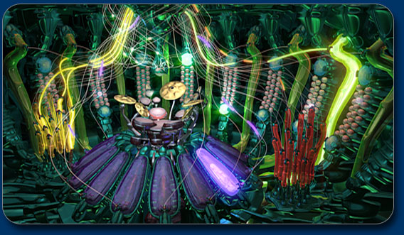
CS ~ Compositional expression
building blocks can be bits, circuits, data, functions, programs, ...
Farewell, Wires!
music-driven animation
https://www.youtube.com/watch?v=M6r4pAqOBDY
Notes:
jazzy!

Slide 2
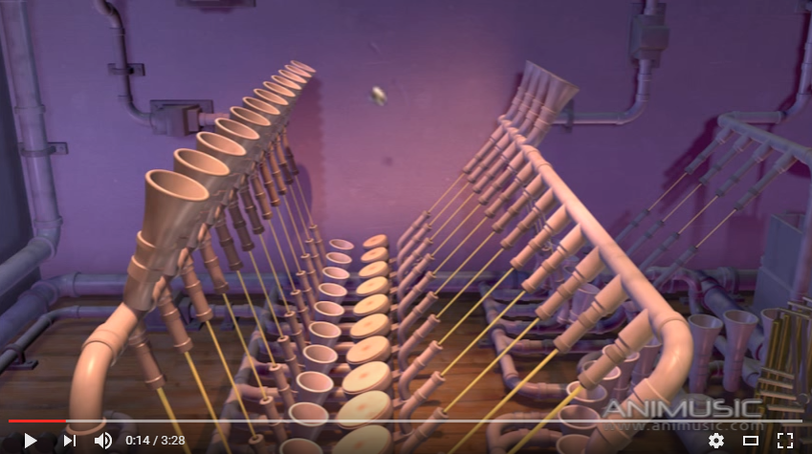
CS ~ Compositional expression
building blocks can be bits, circuits, data, functions, programs, ...
Farewell, Wires!
Farewell, Pipes!
music-driven animation
https://www.youtube.com/watch?v=hyCIpKAIFyo
Notes:
jazzy!

Slide 3
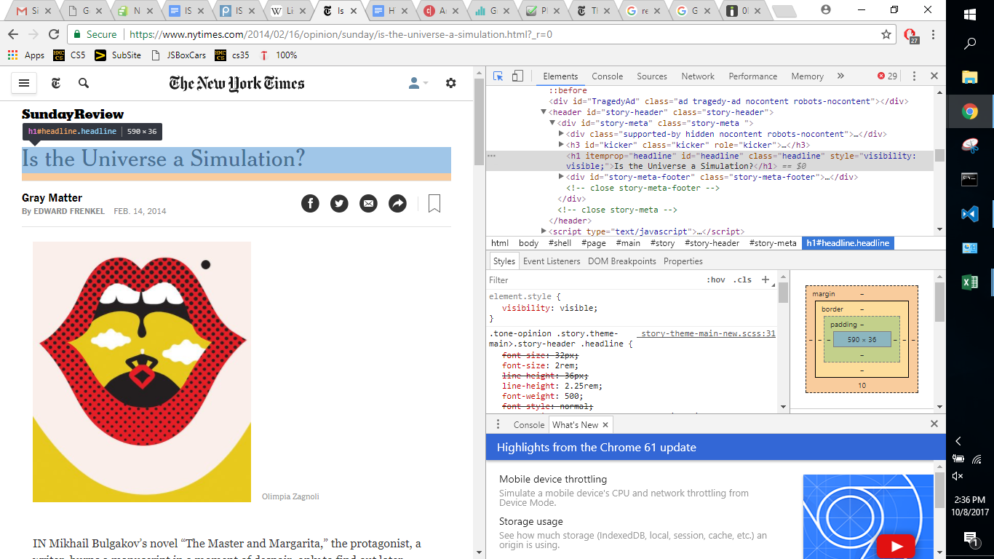
Beyond CS...
Next HW is due Mon. 10/23
Fall break is also a CS hw break…
If you feel fall break might detract from your tech-trajectory...

Slide 4
Beyond CS...
Next HW is due Mon. 10/23
Fall break is also a CS hw break…
If you feel fall break might detract from your tech-trajectory...

Slide 5
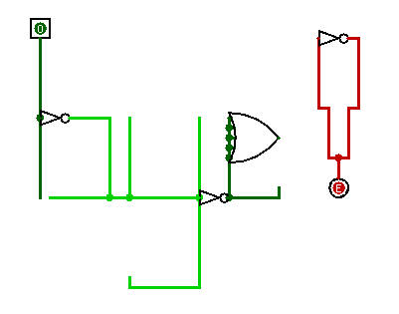
Software
Python
4 Hmmm problems + 1 loop problem due Mon. 3/5
How does Python function ?
Hmmm
RAM
registers
1-bit memory: flip-flops
arithmetic
bitwise functions
logic gates
transistors / switches
CS 5 this week
Hardware

Slide 6
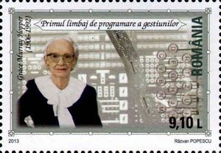
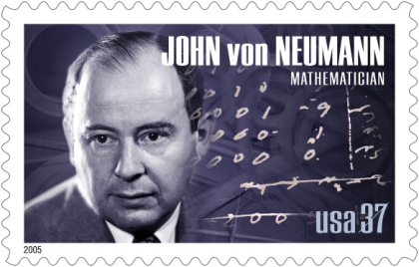
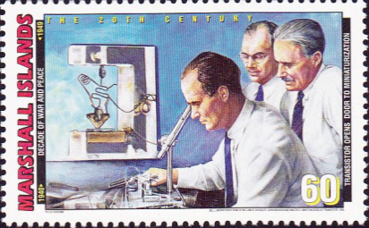
Software
Python
4 Hmmm problems + 1 loop problem due Mon. 3/5
Grace Hopper
How does Python function ?
Hmmm
RAM
John Von Neumann
registers
1-bit memory: flip-flops
arithmetic
Bell labs + beyond
bitwise functions
logic gates
Turing, et al.
transistors / switches
CS 5 this week
Hardware
Notes:
Class 13 hmmm
INHANDOUT
Setup: be ready to run hmmm on lec13prog01.hmmm

Slide 7
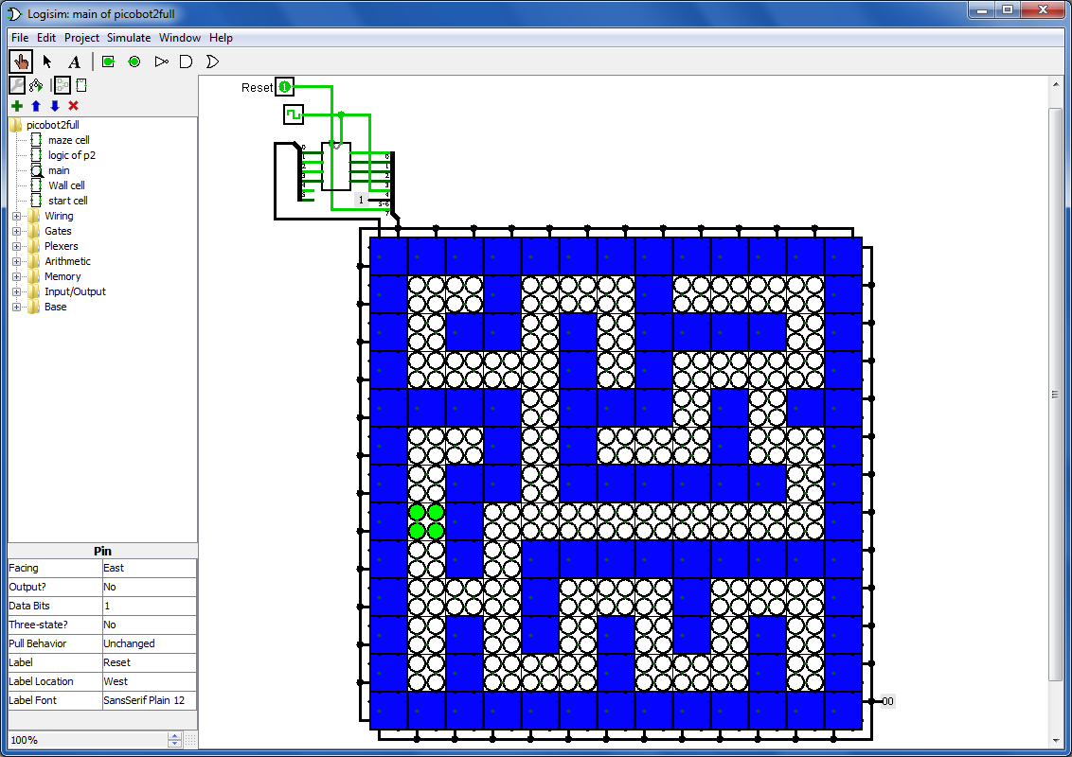
Farewell, Logisim!

Slide 8
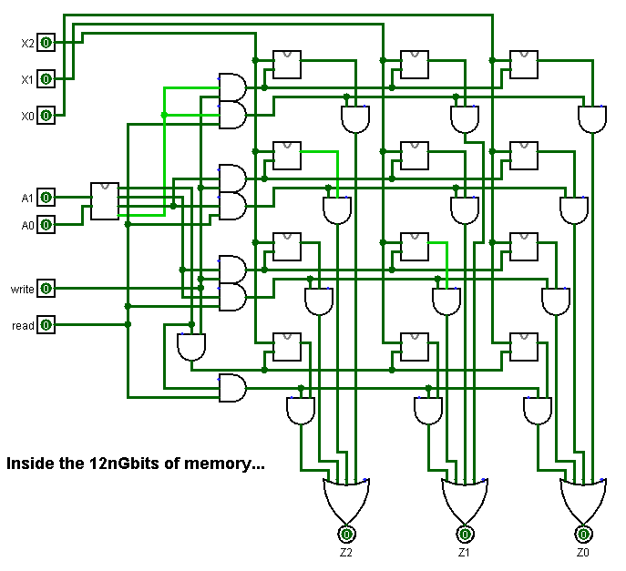
Now, where were we… ?
Memory!
Speaking of data…

Slide 9
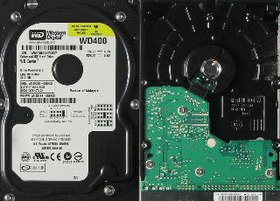
Some memory is more equal than others…
Registers
Main Memory
(replaceable RAM)
Disk Drive
magnetic storage
on the Central Processing Unit
8 flip-flops are an 8-bit register
D
Q
D
Q
D
Q
D
Q
D
Q
D
Q
D
Q
D
Q
s
s
s
s
s
s
s
s
100 Registers of 64 bits each
10 GB memory
4 TB drive
~ 10,000 bits
~ 100 billion bits
~ 42 trillion bits (or more)
memory from logic gates
"Leaky Bucket" capacitors
remagnetizing surfaces
"640K ought to be enough for anybody"
- Bill Gates (contested)
Notes:
INHANDOUT

Slide 10
Some memory is more equal than others…
Registers
Main Memory
(replaceable RAM)
Disk Drive
magnetic storage
on the Central Processing Unit
8 flip-flops are an 8-bit register
D
Q
D
Q
D
Q
D
Q
D
Q
D
Q
D
Q
D
Q
s
s
s
s
s
s
s
s
100 Registers of 64 bits each
10 GB memory
4 TB drive
~ 10,000 bits
~ 100 billion bits
~ 42 trillion bits (or more)
Price
~$100
~$100
~$100
1 clock cycle
100 cycles
10⁷ cycles
Time
10⁻⁹ sec
10⁻⁷ sec
10⁻² sec
If a clock cycle == 1 second
1 sec
1.6 minutes
3.8 MONTHS

Slide 11
Some memory is more equal than others…
Registers
Main Memory
(replaceable RAM)
Disk Drive
magnetic storage
on the Central Processing Unit
8 flip-flops are an 8-bit register
D
Q
D
Q
D
Q
D
Q
D
Q
D
Q
D
Q
D
Q
s
s
s
s
s
s
s
s
100 Registers of 64 bits each
10 GB memory
4 TB drive
~ 10,000 bits
~ 100 billion bits
~ 42 trillion bits (or more)
programs are fetched and executed 1 instruction at a time here…
running programs are stored here…
"Off" data is saved way out here...
Price
~$100
~$100
~$100
1 clock cycle
100 cycles
10⁷ cycles
Time
10⁻⁹ sec
10⁻⁷ sec
10⁻² sec
If a clock cycle == 1 second
1 sec
1.6 minutes
3.8 MONTHS

Slide 12
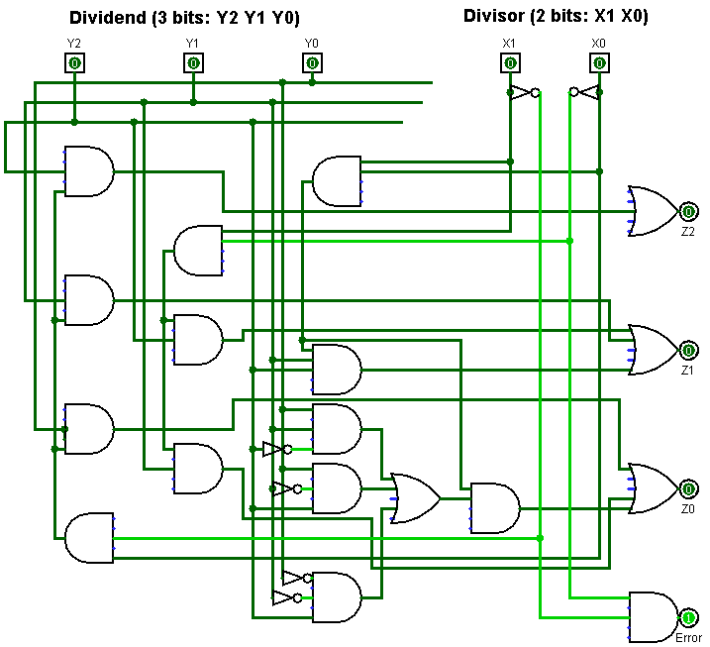
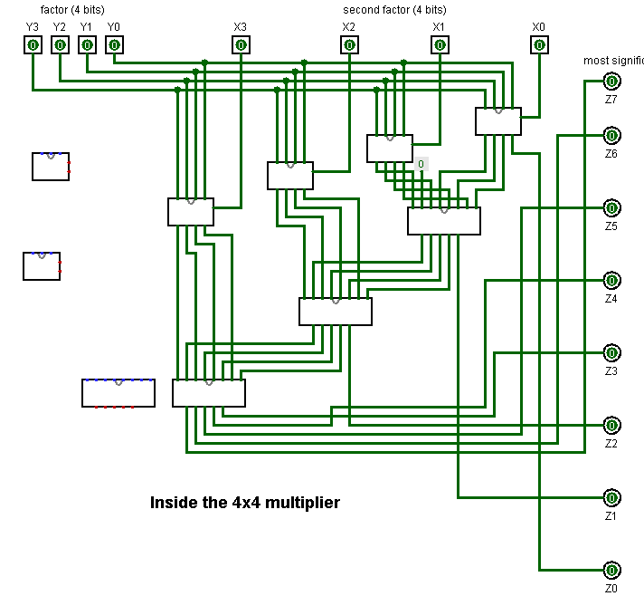
How do we execute sequences of operations?
processor
CPU
RAM
live memory
divider
memory locations (RAM)
multiplier

Slide 13
How do we execute sequences of operations?
processor
CPU
stores all instructions and almost all data
RAM
live memory
the instruction's bits select which circuit to use…
sends next instruction to the CPU …
divider
memory locations (RAM)
runs 1 instruction and sends back results for storage, if requested…
multiplier
sends next instruction to the CPU …

Slide 14
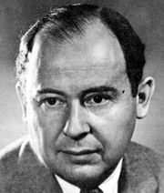
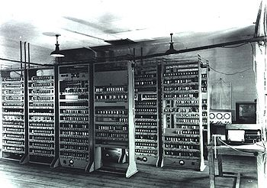
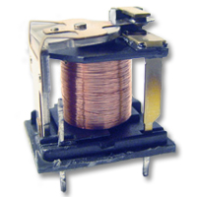
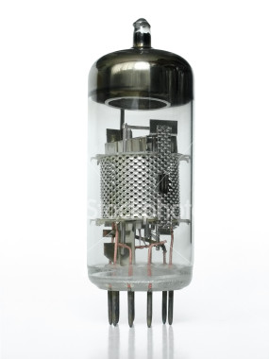
Jon V.N.
70 years ago…
processing
fetch
stored program
CPU
RAM
execute
central processing unit registers
random access memory locations
limited, fast registers + arithmetic
larger, slower memory + no computation

Slide 15
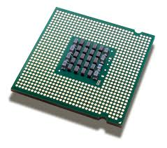
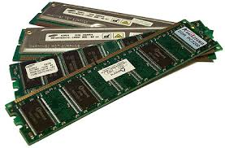
Jon V.N.
70 years later…
processing
fetch
stored program
CPU
RAM
execute
central processing unit registers
random access memory locations
limited, fast registers + arithmetic
larger, slower memory + no computation

Slide 16
Von Neumann Architecture
processing
program
CPU
Von Neumann bottleneck
RAM
central processing unit registers
random access memory locations
r1
0
0000 0001 0000 0001
1000 0010 0001 0001
0110 0010 0010 0001
0000 0010 0000 0010
0000 0000 0000 0000
General-purpose register, r1
1
r2
2
General-purpose register, r2
3
4
Programs are stored in memory in machine language
5
(all bits)
6
Notes:
INHANDOUT
Tne Von Neumann bottleneck arises because RAM is slower than the CPU, so the CPU has trouble getting instructions and data fast enough.

Slide 17
Von Neumann Architecture
processing
program
CPU
Von Neumann bottleneck
RAM
central processing unit registers
random access memory locations
r1
0
0000 0001 0000 0001
1000 0010 0001 0001
0110 0010 0010 0001
0000 0010 0000 0010
0000 0000 0000 0000
General-purpose register, r1
1
r2
2
read r1
General-purpose register, r2
3
mul r2 r1 r1
4
add r2 r2 r1
5
write r2
Programs are shown in assembly language
(all bits)
6
halt
"mnemonics" instead of bits
Notes:
Assembly is just human-readable machine language.

Slide 18
Example #1:
6
(input)
Screen
CPU
Von Neumann bottleneck
RAM
central processing unit registers
random access memory locations
6
read r1
0
r1
General-purpose register r1
1
mul r2 r1 r1
r2
add r2 r2 r1
2
General-purpose register r2
3
write r2
halt
4

Slide 19
Hmmm: Harvey mudd miniature machine
CPU
Von Neumann bottleneck
RAM
central processing unit registers
random access memory locations
read r1
0
r1
General-purpose register r1
1
mul r2 r1 r1
r2
256 memory locations
256 memory locations
add r2 r2 r1
16 registers
2
General-purpose register r2
3
write r2
halt
4
vs. 2018?
Notes:
INHANDOUT

Slide 20
Hmmm vs. 2018
CPU
Von Neumann bottleneck
RAM
central processing unit registers
random access memory locations
read r1
0
r1
General-purpose register r1
1
mul r2 r1 r1
r2
256 memory locations
256 memory locations
add r2 r2 r1
16 registers
2
General-purpose register r2
3
write r2
halt
4
2018 Intel: 50-100 registers per core
2018: ~8,000,000,000 mem loc's

Slide 21
Demo
of assembly-language programming in Hmmm…
hw7's more low-level challenges…
Notes:
Demo lec13prog01 (multiply two numbers) here.

Slide 22
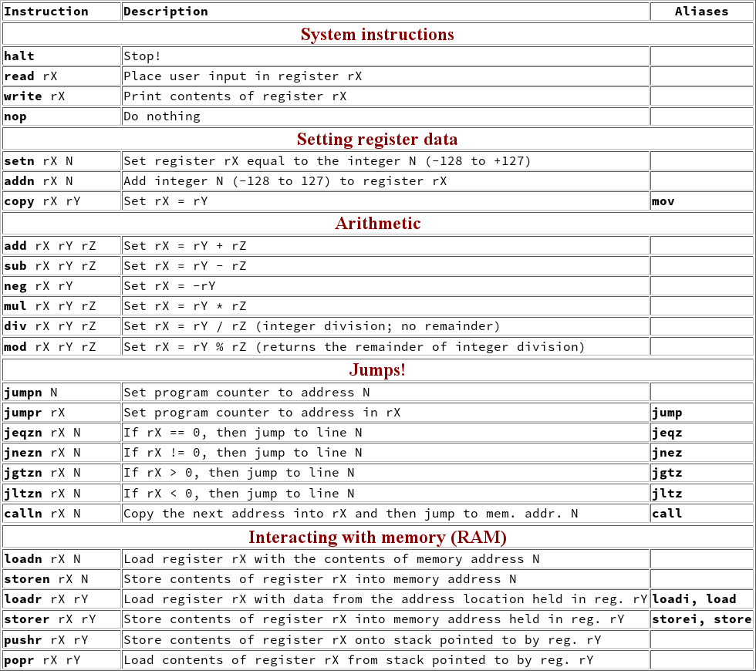
Hmmm
the complete reference
At www.cs.hmc.edu/~cs5grad/cs5/hmmm/documentation/documentation.html
Today
Thurs.
Notes:
INHANDOUT

Slide 23
Assembly Language
ought to be called register language
read r1
reads from keyboard into reg1
write r2
outputs reg2 onto the screen
setn r1 42
you can replace 42 with anything from -128 to 127
reg1 = 42
addn r1 -1
reg1 = reg1 - 1
a shortcut
add r3 r1 r2
reg3 = reg1 + reg2
sub r3 r1 r2
reg3 = reg1 – reg2
mul r2 r1 r1
reg2 = reg1 * reg1
div r1 r1 r2
reg1 = reg1 / reg2
ints only!
This is why they're written R to L in Python!
Notes:
INHANDOUT

Slide 24
Quiz
screen
100
(input)
Name(s)
(output)
CPU
RAM
central processing unit
random access memory
Python
100
0
read r1
r1
r1 = 100
General-purpose register r1
1
setn r2 7
r2
2
mod r4 r1 r2
General-purpose register r2
div r3 r1 r4
3
r3
4
sub r3 r3 r2
General-purpose register r3
5
addn r3 -1
r4
General-purpose register r4
6
write r3
Hmmm...!?
Extra! Change only line 4's instruction to create an output of 0 or 6 or 349 instead?
7
halt
Notes:
QUIZSLIDE
Variations of this are lec13prog02.hmmm. Solutions on next slide.
r1 = 100; r2 = 7; r4 = 2; r3 = 50
line 4: r3 becomes 43
line 5: 42!
Changes: to get 0, line 4 could be div r3 r3 r3
To get 6, line 4 could be copy r3 r2
To get 3499, line 4 should be mul r3 r2 r3

Slide 25
Quiz
screen
100
(input)
Try this on the back page first!
(output)
CPU
RAM
central processing unit
random access memory
Python
100
100
0
read r1
r1
r1 = 100
General-purpose register r1
1
setn r2 7
r2 = 7
r2
7
2
mod r4 r1 r2
r4 = r1 % r2
General-purpose register r2
div r3 r1 r4
3
r3 = r1 // r4
r3
4
sub r3 r3 r2
General-purpose register r3
r3 = r3 – r2
5
addn r3 -1
r4
r3 = r3 + -1
General-purpose register r4
6
write r3
print r3
Hmmm...!?
Extra! Change only line 4's instruction to create an output of 0 or 6 or 3499 instead?
mod
div
mul
halt
7
0
6
349

Slide 26
Could you write a Hmmm program to compute
x + 3x – 4
or
1/ x
?
2
√
when would you want to?

Slide 27
Who writes all of the assembly language that gets executed?
other programs!

Slide 28
Could you write a Python program to write a Hmmm program
to compute
x + 3x – 4
or
1/ x
?
2
√
Yes – you already have!
much better!

Slide 29
Why Assembly?

Slide 30
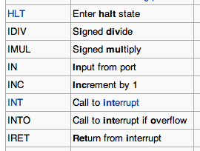
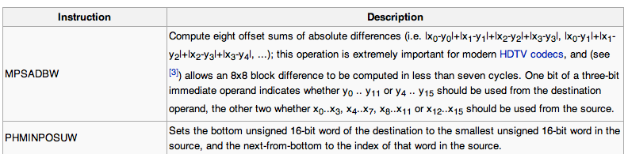
Real Assembly Languages
Hmmm is a subset common to all real assembly languages.
Instruction
Description
A few of the many basic processor instructions (Intel)
two more recent Intel instructions (SSE4 subset)

Slide 31
Is this enough?
read r1
0
What’s missing here?
1
mul r2 r1 r1
add r2 r2 r1
2
3
write r2
halt
4
Why couldn't we implement Python using our Hmmm assembly language up to this point?

Slide 32
For systems, innovation is adding an edge to create a cycle, not just an additional node.
0
feedback loops
"Set"
1
S
NOR
0
1
0
0
Q
1 bit of storage
"Reset"
NOR
R
"Output"

Slide 33
Loops and ifs
We couldn't implement Python using Hmmm so far...
It's too linear!
"straight-line code"
setn r1 42
loop
0
1
write r1
addn r1 1
2
3
jumpn 1
jump!
halt
4
Notes:
INHANDOUT

Slide 34
CPU
RAM
central processing unit
random access memory
setn r1 42
0
r1
General-purpose register r1
1
write r1
r2
not used in this program…
addn r1 1
2
General-purpose register r2
3
jumpn 1
Screen
halt
4
What would happen IF…
• we replace line 3's 1 with a 0?
• we replace line 3's 1 with a 2?
• we replace line 3's 1 with a 3?
• we replace line 3's 1 with a 4?
i
^
jumpn!
Notes:
INHANDOUT
This is lec13prog03.hmmm
Good place for the primes joke

Slide 35
Jumps in Hmmm
Conditional jumps
jeqzn r1 42
IF r1 == 0 THEN jump to line number 42
jgtzn r1 42
IF r1 > 0 THEN jump to line number 42
jltzn r1 42
IF r1 < 0 THEN jump to line number 42
jnezn r1 42
IF r1 != 0 THEN jump to line number 42
Unconditional jump
This is making me jumpy!
jumpn 42
Jump to program line # 42
Indirect jump
jumpr r1
Jump to the line# stored in r1
Notes:
INHANDOUT

Slide 36
Jumps in Hmmm
Conditional jumps
jeqzn r1 42
if equal to zero…
IF r1 == 0 THEN jump to line number 42
jgtzn r1 42
if greater than zero …
IF r1 > 0 THEN jump to line number 42
jltzn r1 42
if less than zero…
IF r1 < 0 THEN jump to line number 42
jnezn r1 42
if not equal to zero …
IF r1 != 0 THEN jump to line number 42
HmmMnemonics!
Unconditional jump
This is making me jumpy!
jumpn 42
Jump to program line # 42
Indirect jump
jumpr r1
Jump to the line# stored in r1

Slide 37
Hmmm
the complete reference
At www.cs.hmc.edu/~cs5grad/cs5/hmmm/documentation/documentation.html
Jumps!

Slide 38
jgtzn
Gesundheit!
What Python function is this?
CPU
RAM
central processing unit
random access memory
r1
0
read r1
1
jgtzn r1 7
General-purpose register r1
2
setn r2 -1
r2
3
mul r1 r1 r2
General-purpose register r2
4
nop
space for future expansion!
5
nop
Screen
-6
(input)
6
nop
7
write r1
8
halt
With an input of -6, what does this code write out?
Notes:
INHANDOUT

Slide 39
Try it!
I think this language has injured my craniuhmmm!
2
Write an assembly-language program that reads a positive integer into r1. The program should compute
the factorial of the input in r2. Once it's computed, it should write out that factorial. Two lines are provided:
Follow this Hmmm program. First run: use r1 = 42 and r2 = 5. Next run: use r1 = 5 and r2 = 42.
1
Memory - RAM
0
read r1
Registers - CPU
Memory - RAM
Registers - CPU
0
read r1
1
setn r2 1
Run 1
Run 2
r1
5
42
5
input
2
r1
1
read r2
r2
1
3
5
42
2
sub r3 r1 r2
result – so far
r2
3
nop
r3
4
r3
not needed; OK to use
5
4
jgtzn r3 7
5
write r1
6
6
jumpn 8
7
Output 1
Output 2
7
write r2
8
write r2
8
halt
9
halt
(1) What common function does this compute?
Hint: try the inputs in both orders...
(2) Extra! How could you change only line 3 so that, if inputs r1 and r2 are equal, the program will ask for new inputs?
Hint: On line 2, could you write a test that checks if the factorial is finished; if it's not, compute one piece and then jump back!
Extra! How few lines can you use here? (Fill the rest with nops…)
Notes:
INHANDOUT
The program on the left is lec13prog03.hmmm
At this point have them only attack the first program. Then we’ll plan factorial.

Slide 40
1
Follow this assembly-language program from top to bottom. First use r1 = 42 and r2 = 5, then swap them on the next run:
Run #1
Memory—RAM
Run #2
0
read r1
r1
42
1
read r2
r1
5
2
sub r3 r1 r2
3
nop
r2
42
r2
5
4
jgtzn r3 7
5
write r1
r3
r3
6
jumpn 8
7
write r2
8
halt
9
(1) What function does this program compute in general?
(2) Extra! How could you change only line 3 so that, if the original two inputs were equal, the program asked for new inputs?

Slide 41
factorial: the plan …
fac(5) is 1*5*4*3*2*1
output (to be)
r1
input
r2
5
1
starting value!
let r1 be the input
and the "counter"
let r2 become the output
Notes:
INHANDOUT
Sketch successive values of r1 and the output here.

Slide 42
Try it!
I think this language has injured my craniuhmmm!
2
Write an assembly-language program that reads a positive integer into r1. The program should compute
the factorial of the input in r2. Once it's computed, it should write out that factorial. Two lines are provided:
Follow this Hmmm program. First run: use r1 = 42 and r2 = 5. Next run: use r1 = 5 and r2 = 42.
1
Memory - RAM
0
read r1
Registers - CPU
Memory - RAM
Registers - CPU
read r1
1
setn r2 1
Run 1
Run 2
0
r1
5
42
5
input
2
r1
1
read r2
r2
1
3
5
42
2
sub r3 r1 r2
result – so far
r2
nop
r3
4
3
r3
not needed; OK to use
5
4
jgtzn r3 7
5
write r1
6
6
jumpn 8
7
Output 1
Output 2
7
write r2
8
write r2
8
halt
9
halt
(1) What common function does this compute?
Hint: try the inputs in both orders...
(2) Extra! How could you change only line 3 so that, if inputs r1 and r2 are equal, the program will ask for new inputs?
Hint: On line 2, could you write a test that checks if the factorial is finished; if it's not, compute one piece and then jump back!
Extra! How few lines can you use here? (Fill the rest with nops…)
Notes:
If time, let them try.

Slide 43
a factorial solution
Memory—RAM
0
read r1
Registers - CPU
1
setn r2 1
2
jeqzn r1 8
r1
3
mul r2 r2 r1
input
4
addn r1 -1
r2
result – so far
5
jumpn 2
6
nop
r3
space for future expansion!
not needed, but OK to use!
7
nop
8
write r2
9
halt
Notes:
INHANDOUT
This is lec13prog05.hmmm.
If time, show how this code works.

Slide 44
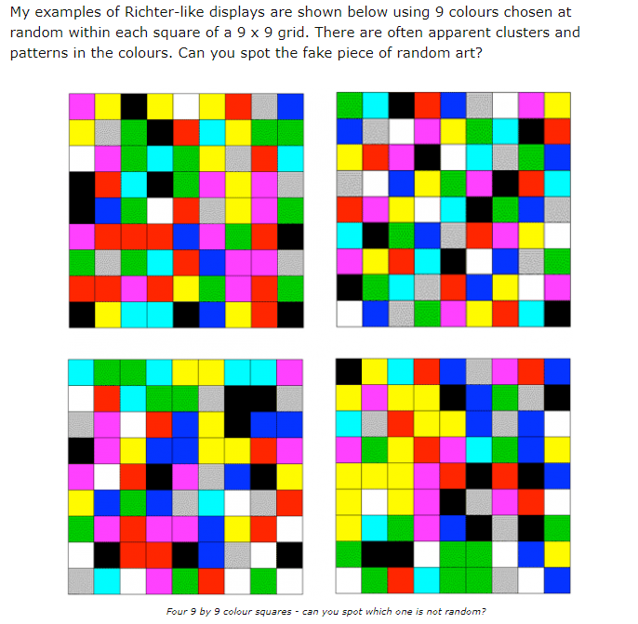
This week in lab:
Randohmmm Numbers…
where you'll write your own random-number generator…
... in Hmmm assembly language
See you there!
https://understandinguncertainty.org/node/1066

