Slide 1
Why Assembly Language ?
It’s only the foolish who never climb Mt. Fuji -- or who climb it again.
Who authors >99.9% of the assembly language that is actually run?
Notes:
Class 14 hmmmfuncs
INHANDOUT

Slide 2
Python!
CS 5 Today
How does Python function?
Hmmm
How should software be assembled ?

Slide 3
Python!
CS 5 Today
How does Python function?
Hmmm
Instructions vs. Functions

Slide 4
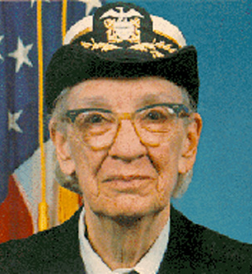
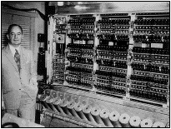
Python!
CS 5 Today
How does Python function?
Hmmm
winning side - eventually
IAS machine
Grace Hopper, admiral + author of the first high-level (human-level) language, COBOL
Jon Von Neumann, advisor
Don Gillies, assembler
Instructions vs. Functions
Notes:
Gillies wrote the first assembler. When Von Neumann found out, he became enraged and told Gillies to stop working because computers would never be used to perform such menial tasks. Hopper took the idea one step further by inventing Cobol. She was also an early advocate for writing functions—surprisingly, the idea was originally controversial!

Slide 5
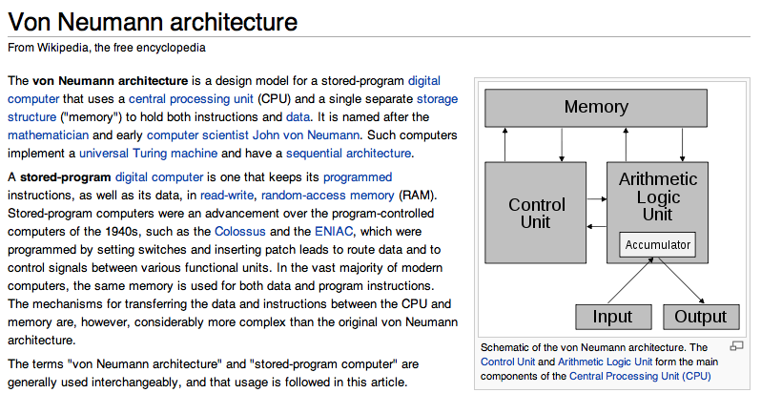
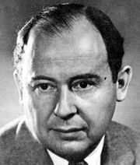
Jon V.N.
too close to the machine… ?!

Slide 6
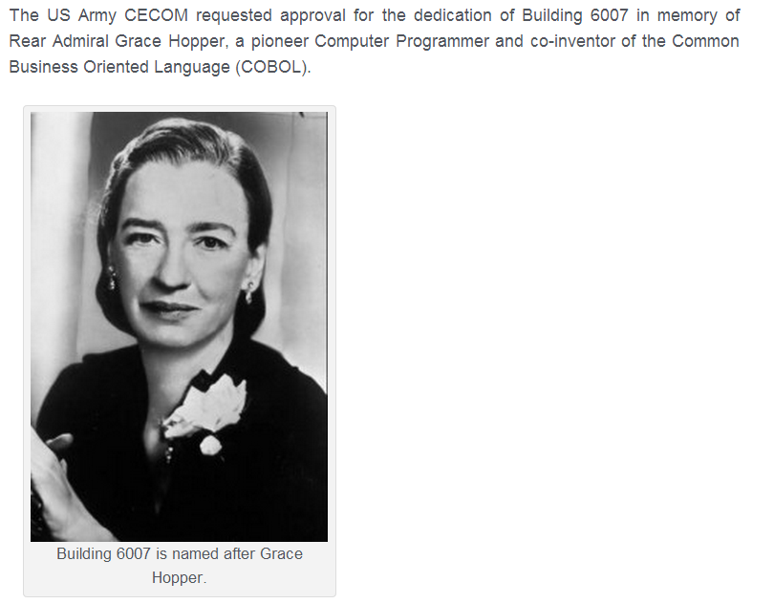
Grace Hopper
Grace Murray Hopper ’28 taught math and physics at Vassar for 12 years before joining the Navy reserves in 1943. During the second world war she programmed the Mark I, the world’s first large-scale computer, which was used to perform the calculations needed to position the Navy’s weaponry: guns, mines, rockets, and, eventually, the atomic bomb.
In 1945, she popularized the term “debugging” after finding a moth stuck in the computer’s machinery. Over the course of her career, Hopper invented the compiler to automate common computer instructions, became the first to start writing computer programs in English, and helped to develop the first “human-friendly” computer language, COBOL
GMH dedications
1970's:
“In the days they used oxen for heavy pulling, when one ox couldn't budge a log, they didn't try to grow a larger ox. We shouldn't be trying for bigger and better computers, but for better systems of computers.”

Slide 7
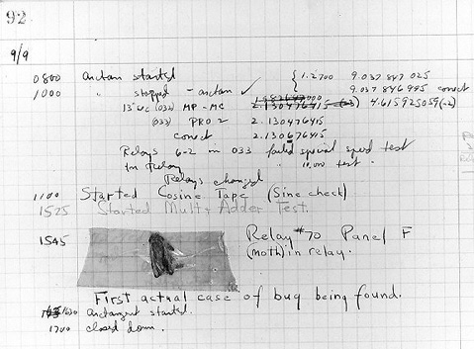
The first bug?
I'm glad it's not called demothing.

Slide 8
The first bug?
I'm glad it's not called demothing.

Slide 9
functions vs. instructions
Functions: Python
Instructions: Hmmm

Slide 10
functions vs. instructions
def main():
x = input()
y = fun(x)
print y
def fun( x ):
y = x*(x-1)
return y
7
7
0
read r1
input
1
calln r14 4
function call
2
write r13
output
3
halt
4
copy r13 r1
5
addn r1 -1
the function
6
mul r13 r13 r1
7
jumpr r14
"return"
Fun: Python
Instructions: Hmmm

Slide 11
functions vs. instructions
1-1 correspondence is very rare!
def main():
x = input()
y = fun(x)
print y
def fun( x ):
y = x*(x-1)
return y
7
7
0
read r1
input
1
calln r14 4
function call
2
write r13
output
3
halt
4
copy r13 r1
5
addn r1 -1
the function
6
mul r13 r13 r1
7
jumpr r14
"return"
Fun: Python
Instructions: Hmmm
Notes:
INHANDOUT

Slide 12
Python
Hmmm
Usually, high-level languages produce LOTS of assembly-level instructions
x = int(input())
y = fac(x)
print y
def fac(x):
if x==0:
return 1
else:
RES = fac(x-1)
return x*RES
main
00 read r1
01 setn r15 42
02 calln r14 5
03 write r13
04 halt
05 jnezn r1 8
06 setn r13 1
07 jumpr r14
08 pushr r1 r15
09 pushr r14 r15
10 addn r1 -1
11 calln r14 5
12 popr r14 r15
13 popr r1 r15
14 mul r13 r13 r1
15 jumpr r14
factorial function
factorial function
case
base
factorial
store
recursive step
load

Slide 13
Python
Hmmm
x = int(input())
y = fac(x)
print y
def fac(x):
if x==0:
return 1
else:
RES = fac(x-1)
return x*RES
main
input
function call
00 read r1
01 setn r15 42
02 calln r14 5
03 write r13
04 halt
05 jnezn r1 8
06 setn r13 1
07 jumpr r14
08 pushr r1 r15
09 pushr r14 r15
10 addn r1 -1
11 calln r14 5
12 popr r14 r15
13 popr r1 r15
14 mul r13 r13 r1
15 jumpr r14
factorial function
output
factorial function
case
base case
base
factorial
store
recursive step
recursive call
calculate final result
load
What's the machine doing here?
Notes:
This is lec14prog01.hmmm.
We will return to this in a while. But first let’s look at recursion a bit more closely.

Slide 14
Our example...
fac(3)
6

Slide 15
Quiz
0
1
2
3
4
5
6
7
8
9
10
11
fac(3)
def fac(x):
"""Factorial with printing"""
print("x is", x)
if x == 0:
print("x:", x, " Res: 1" )
return 1
else:
smaller = fac(x-1)
result = x * smaller
)
return result
factorial
This looks familiar!
Notes:
vault 713?

Slide 16
Quiz
0
1
2
3
4
5
6
7
8
9
10
11
fac(3)
def fac(x):
"""Factorial with printing"""
print("x is", x)
if x == 0:
print("x:", x, " Res: 1" )
return 1
else:
print("Next: fac(", x-1, ")")
smaller = fac(x-1)
result = x * smaller
print("x:", x, " Res:",result)
return result
print statements
Notes:
vault 713?

Slide 17
Quiz
What will this call to fac(3) print?
Names(s) __________________________
[ and by which line? ]
0
1
2
3
4
5
6
7
8
9
10
11
fac(3)
what's printed...
circle the line #
x is 3
2 · 4 · 7 · 10
def fac(x):
"""Factorial with printing"""
print("x is", x)
if x == 0:
print("x:", x, " Res: 1" )
return 1
else:
print("Next: fac(", x-1, ")")
smaller = fac(x-1)
result = x * smaller
print("x:", x," Res:", result)
return result
Next: ______
2 · 4 · 7 · 10
x is 2
2 · 4 · 7 · 10
2 · 4 · 7 · 10
x is 1
2 · 4 · 7 · 10
2 · 4 · 7 · 10
x is 0
2 · 4 · 7 · 10
x:0 Res:1
2 · 4 · 7 · 10
x:1 Res:1
2 · 4 · 7 · 10
x:2 Res:2
2 · 4 · 7 · 10
x:3 Res:6
2 · 4 · 7 · 10
Notes:
QUIZSLIDE

Slide 18
Quiz
What will this call to fac(3) print?
Names(s) __________________________
[ and by which line? ]
0
1
2
3
4
5
6
7
8
9
10
11
fac(3)
what's printed...
circle the line #
x is 3
2 · 4 · 7 · 10
def fac(x):
"""Factorial with printing"""
print("x is", x)
if x == 0:
print("x:", x, " Res: 1" )
return 1
else:
print("Next: fac(", x-1, ")")
smaller = fac(x-1)
result = x * smaller
print("x:", x, " Res:", result)
return result
Next: fac(2)
2 · 4 · 7 · 10
x is 2
2 · 4 · 7 · 10
Next: fac(1)
2 · 4 · 7 · 10
x is 1
2 · 4 · 7 · 10
Next: fac(0)
2 · 4 · 7 · 10
x is 0
2 · 4 · 7 · 10
x:0 Res:1
2 · 4 · 7 · 10
x:1 Res:1
2 · 4 · 7 · 10
x:2 Res:2
2 · 4 · 7 · 10
x:3 Res:6
2 · 4 · 7 · 10
Notes:
vault 713?

Slide 19
Smooth functioning...
What does fac(3) do?
0
1
2
3
4
5
6
7
8
9
10
11
fac(3)
what's printed...
circle the line #
x is 3
2 · 4 · 7 · 10
def fac(x):
""" factorial w/ printing """
print("x is", x)
if x == 0:
print("x:", x, " Res: 1" )
return 1
else:
print("Next: fac(",x-1,")")
smaller = fac( x-1 )
result = x * smaller
print("x:",x," Res:",result)
return result
Next: fac(2)
2 · 4 · 7 · 10
x is 2
2 · 4 · 7 · 10
Next: fac(1)
2 · 4 · 7 · 10
x is 1
2 · 4 · 7 · 10
Next: fac(0)
2 · 4 · 7 · 10
x is 0
2 · 4 · 7 · 10
x:0 Res:1
2 · 4 · 7 · 10
x:1 Res:1
2 · 4 · 7 · 10
x:2 Res:2
2 · 4 · 7 · 10
x:3 Res:6
2 · 4 · 7 · 10

Slide 20
Rough execution... !
What does fac(3) do?
0
1
2
3
4
5
6
7
8
9
10
11
fac(3)
x is 3
2 · 4 · 7 · 10
def fac(x):
""" factorial w/ printing """
print("x is", x)
if x == 0:
print("x:", x, " Res: 1" )
return 1
else:
print("Next: fac(",x-1,")")
smaller = fac( x-1 )
result = x * smaller
print("x:",x," Res:",result)
return result
Next: fac(2)
2 · 4 · 7 · 10
x is 2
2 · 4 · 7 · 10
Next: fac(1)
2 · 4 · 7 · 10
x is 1
2 · 4 · 7 · 10
Next: fac(0)
2 · 4 · 7 · 10
x is 0
2 · 4 · 7 · 10
x:0 Res:1
2 · 4 · 7 · 10
x:1 Res:1
2 · 4 · 7 · 10
x:2 Res:2
2 · 4 · 7 · 10
x:3 Res:6
2 · 4 · 7 · 10

Slide 21
From functions to instructions
Python
Assembly
fac(3)
3
x, the input
r1
x = input()
y = fac(x)
print y
def fac(x):
if x==0: return 1
else:
RES = fac(x-1)
return x*RES
?
r13
main
ret. value
ret. address
r14
A "stack frame" stores all of the important data that might get destroyed during a function call
case
base
factorial
recursive step

Slide 22
From functions to instructions
Python
Assembly
fac(3)
3
x, the input
r1
x = input()
y = fac(x)
print y
def fac(x):
if x==0: return 1
else:
RES = fac(x-1)
return x*RES
?
r13
main
ret. value
ret. address
r14
THE STACK
fac(2)
2
x, the input
r1
?
ret. value
r13
ret. address
r14
case
base
factorial
growing downward
recursive step
Each stack frame stores a potentially different input and return address!

Slide 23
From functions to instructions
Python
Assembly
fac(3)
3
x, the input
r1
x = input()
y = fac(x)
print y
def fac(x):
if x==0: return 1
else:
RES = fac(x-1)
return x*RES
?
r13
main
ret. value
ret. address
r14
THE STACK
fac(2)
2
x, the input
r1
?
ret. value
r13
ret. address
r14
case
base
factorial
fac(1)
1
x, the input
r1
?
r13
ret. value
recursive step
ret. address
r14
growing downward
One stack frame per function call
Notes:
INHANDOUT

Slide 24
From functions to instructions
Python
Assembly
fac(3)
3
x, the input
r1
x = input()
y = fac(x)
print y
def fac(x):
if x==0: return 1
else:
RES = fac(x-1)
return x*RES
?
r13
main
ret. value
ret. address
r14
fac(2)
2
x, the input
r1
?
ret. value
r13
ret. address
r14
case
base
factorial
fac(1)
1
x, the input
r1
?
r13
ret. value
recursive step
ret. address
r14
fac(0)
0
x, the input
r1
1
r13
Aha!
ret. value
ret. address
r14

Slide 25
From functions to instructions
Python
Assembly
fac(3)
3
x, the input
r1
x = input()
y = fac(x)
print y
def fac(x):
if x==0: return 1
else:
RES = fac(x-1)
return x*RES
?
r13
main
ret. value
ret. address
r14
fac(2)
2
x, the input
r1
?
ret. value
r13
ret. address
r14
case
base
factorial
fac(1)
1
x, the input
r1
1
?
ret. value
r13
recursive step
ret. address
r14
this Stack Frame is now gone!

Slide 26
From functions to instructions
Python
Assembly
fac(3)
3
x, the input
r1
x = input()
y = fac(x)
print y
def fac(x):
if x==0: return 1
else:
RES = fac(x-1)
return x*RES
?
r13
main
ret. value
ret. address
r14
fac(2)
2
x, the input
r1
?
ret. value
r13
ret. address
r14
case
base
factorial
fac(1)
1
x, the input
r1
1
r13
ret. value
recursive step
ret. address
r14

Slide 27
From functions to instructions
Python
Assembly
fac(3)
3
x, the input
r1
x = input()
y = fac(x)
print y
def fac(x):
if x==0: return 1
else:
RES = fac(x-1)
return x*RES
?
r13
main
ret. value
ret. address
r14
fac(2)
2
x, the input
r1
?
ret. value
r13
ret. address
r14
case
base
factorial
1
another Stack Frame is gone
recursive step

Slide 28
From functions to instructions
Python
Assembly
fac(3)
3
x, the input
r1
x = input()
y = fac(x)
print y
def fac(x):
if x==0: return 1
else:
RES = fac(x-1)
return x*RES
?
r13
main
ret. value
ret. address
r14
fac(2)
2
x, the input
r1
2
ret. value
r13
ret. address
r14
case
base
factorial
recursive step

Slide 29
From functions to instructions
Python
Assembly
fac(3)
3
x, the input
r1
x = input()
y = fac(x)
print y
def fac(x):
if x==0: return 1
else:
RES = fac(x-1)
return x*RES
?
r13
main
ret. value
ret. address
r14
another Stack Frame is gone
case
base
factorial
2
recursive step

Slide 30
From functions to instructions
Python
Assembly
fac(3)
3
x, the input
r1
x = input()
y = fac(x)
print y
def fac(x):
if x==0: return 1
else:
RES = fac(x-1)
return x*RES
6
r13
main
ret. value
ret. address
r14
case
base
factorial
recursive step

Slide 31
From functions to instructions
Python
Assembly
x = input()
y = fac(x)
print y
def fac(x):
if x==0: return 1
else:
REC = fac(x-1)
return x*REC
The Stack is Empty.
main
6
6
case
base
factorial
recursive step

Slide 32
functions vs. instructions
def main():
x = input()
y = fun(x)
print y
def fun( x ):
y = x*(x-1)
return y
7
7
0
read r1
input
1
calln r14 4
function call
2
write r13
output
3
halt
4
copy r13 r1
5
addn r1 -1
the function
6
mul r13 r13 r1
7
jumpr r14
"return"
Fun: Python
Instructions: Hmmm

Slide 33
calln—jumpr
screen
7
Input value: x
0
read r1
input
r1
1
calln r14 4
function call
2
write r13
output
Final result – ret. value - in progress
3
halt
r13
4
copy r13 r1
5
addn r1 -1
return address register
the function
r14
6
mul r13 r13 r1
7
jumpr r14
"return"
Instructions: Hmmm

Slide 34
Automatic assembly of functions…
r1
def main():
r1 = input()
r13 = fun(r1)
print r13
def fun(r1):
r13 = r1*(r1-1)
return r13
let's agree to put the function arg. into r1
r13
let's agree to put the return value in r13
r14
let's agree to put the return line # into r14
Return there !

Slide 35
Where's my jumpr?
calln and jumpr
0
1
2
4
5
6
def main():
r1 = input()
r13 = fun(r1)
print r13
def fun(r1):
r13 = r1*(r1-1)
return r13
calln r14 4
jumps to line 4, but puts the NEXT line # into r14
r14
jumpr r14
jumps to the line # in r14
we agreed to put the NEXT line # into r14

Slide 36
functions != instructions
7
def main():
x = input()
y = fun(x)
print y+x
def fun(x):
y = x*(x-1)
return y
7
0
read r1
input
1
calln r14 4
function call
add r13 r13 r1
2
write r13
output
3
halt
4
copy r13 r1
5
addn r1 -1
the function
6
mul r13 r13 r1
But what if we wanted fun(x) + x ?
7
jumpr r14
"return"
We'd need the earlier value of x (r1) … after the function call !
Notes:
INHANDOUT

Slide 37
functions != instructions
7
Input value: x
0
read r1
input
r1
6
X
7
1
calln r14 4
function call
add r13 r13 r1
Final result – ret. value - in progress
2
write r13
r13
42
7
output
X
3
halt
return address register
4
copy r13 r1
r14
2
5
addn r1 -1
the function
6
mul r13 r13 r1
if we wanted fun(x) + x ?
7
jumpr r14
"return"
We'd need the earlier value of x (r1) … after the function call !
Notes:
INHANDOUT

Slide 38
There is only ONE set of registers...
... but we want LOTS of function calls.
We want it to SEEM like each function has its own registers!
7
Input value: x
0
read r1
input
r1
6
X
7
1
calln r14 4
function call
clobbering the original data
2
write r13
output
3
halt
Functions will overwrite registers
4
copy r13 r1
5
addn r1 -1
the function
6
mul r13 r13 r1
7
jumpr r14
"return"

Slide 39
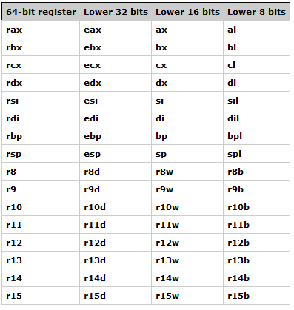
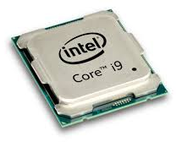
There is only ONE set of registers...
... but we want LOTS of function calls.
We want it to SEEM like each function has its own registers!
Even 2017's chips have very few registers…!

Slide 40
Problem
def main():
r1 = input()
r13 = fun(r1)
print r13
def fun(r1):
r13 = r1*(r1-1)
return r13
Functions clobber stuff!
Solution
CALL our function and let it clobber stuff !
There's no stopping the destruction... let's just keep it all in one place!

Slide 41
Problem
def main():
r1 = input()
r13 = fun(r1)
print r13
def fun(r1):
r13 = r1*(r1-1)
return r13
Functions clobber stuff!
Solution
CALL our function and let it clobber stuff !
There's no stopping the destruction... let's just keep it all in one place!
College administrations like this approach, too…!

Slide 42
Problem
def main():
r1 = input()
r13 = fun(r1)
print r13
def fun(r1):
r13 = r1*(r1-1)
return r13
Functions clobber stuff!
Solution
CALL our function and let it clobber stuff !
There's no stopping the destruction... let's just keep it all in one place!

Slide 43
def main():
r1 = input()
r13 = fun(r1)
print r13
def fun(r1):
r13 = r1*(r1-1)
return r13
Solution:
(1)
STORE important data beforehand
r1 gets stored...
r14 gets stored...
(2)
call our function and let it destroy stuff!
(3)
jumpr back to return
Implementing function calls in assembly
(4)
LOAD important data back afterwards
r1 is back as before!
r14 is back as before!
r13 now holds the result…

Slide 44
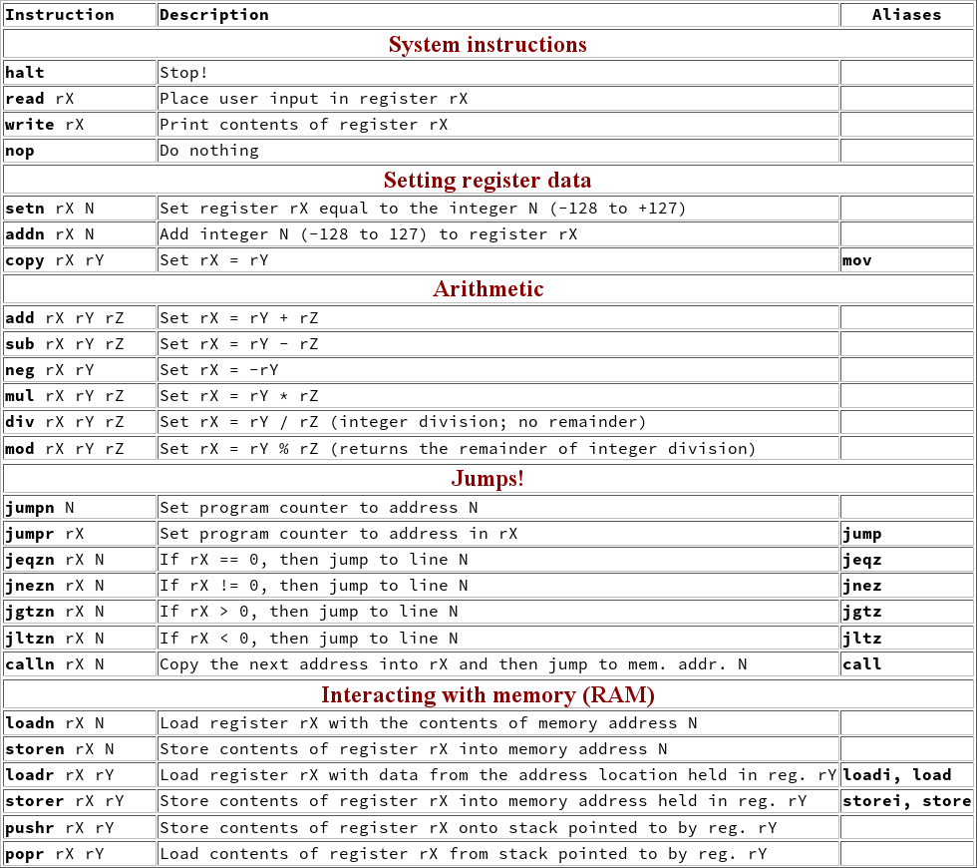
Hmmm
the complete reference
pushr r1 r15
pushr r1 r15
popr r1 r15
popr r1 r15

Slide 45
pushr stores TO memory
CPU
RAM
0
setn r1 3
Input value: x
1
setn r15 42
r1
3
2
pushr r1 r15
Stack pointer
3
addn r1 -1
r15
42
popr r1 r15
4
5
write r1
6
halt
pushr r1 r15
42
stores r1 into r15's MEMORY LOCATION
(not into r15 itself)
And then pushr increments r15!
Notes:
INHANDOUT
The “and then” is animated.

Slide 46
popr loads FROM memory
CPU
RAM
0
setn r1 3
Input value: x
1
setn r15 42
r1
2
3
X
2
pushr r1 r15
Stack pointer
3
addn r1 -1
r15
42
popr r1 r15
4
5
write r1
6
halt
popr r1 r15
3
42
Then it loads data into r1 from r15's MEMORY LOCATION
(not from r15 itself)
First popr decrements r15

Slide 47
CLOBBER!
What’s the Point?
RAM
42
5
43
19
r1
5
44
r2
19
45
46
Stack pointer
47
42
44
43
r15
X
X
48
pushr r1
pushr r2
popr r2
popr r1

Slide 48
What’s the Point?
RAM
42
5
43
19
r1
5
44
r2
19
45
46
Stack pointer
47
r15
42
48
pushr r1
pushr r2
popr r2
popr r1
Notes:
INHANDOUT

Slide 49
popr loads FROM memory
CPU
RAM
0
setn r1 3
With call, jumpr, pushr, and popr, we can now implement functions—and Python and anything else—in assembly!
Input value: x
1
setn r15 42
3
r1
2
X
2
pushr r1 r15
Stack pointer
3
addn r1 -1
r15
42
popr r1 r15
4
5
write r1
6
halt
popr r1 r15
3
42
Let's see it in action...
loads data into r1 from r15's MEMORY LOCATION
(not from r15 itself)
Notes:
There is an animated popup here.

Slide 50
Python
Hmmm
x = int(input())
y = fac(x)
print y
def fac(x):
if x==0:
return 1
else:
RES = fac(x-1)
return x*RES
main
input
function call
00 read r1
01 setn r15 42
02 calln r14 5
03 write r13
04 halt
05 jnezn r1 8
06 setn r13 1
07 jumpr r14
08 pushr r1 r15
09 pushr r14 r15
10 addn r1 -1
11 call r14 5
12 popr r14 r15
13 popr r1 r15
14 mul r13 r13 r1
15 jumpr r14
factorial function
output
factorial function
case
base case
base
factorial
store
recursive step
recursive call
calculate final result
load
Notes:
Again, this is lec14prog01.hmmm.
INHANDOUT

Slide 51
For an input of 0, trace what happens here …
CPU + Registers
Main Memory
00 read r1
01 setn r15 42
02 calln r14 5
03 write r13
04 halt
05 jnezn r1 8
06 setn r13 1
07 jumpr r14
08 pushr r1 r15
09 pushr r14 r15
10 addn r1 -1
11 calln r14 5
12 popr r14 r15
13 popr r1 r15
14 mul r13 r13 r1
15 jumpr r14
"the stack"
main
Input: x
r1
r15
42
case
base
return value (the "result")
43
r13
44
store
to stack
return address (line #)
45
factorial
r14
46
recursive step
47
the stack pointer
from stack
r15
load
running fac(0) in Hmmm
How many lines of assembly code get executed, in total, when the input is 0?
Yesterday I'd never heard of Recursive Assembly, but today I r1.

Slide 52
For an input of 0, trace what happens here …
CPU + Registers
Main Memory
00 read r1
01 setn r15 42
02 calln r14 5
03 write r13
04 halt
05 jnezn r1 8
06 setn r13 1
07 jumpr r14
08 pushr r1 r15
09 pushr r14 r15
10 addn r1 -1
11 calln r14 5
12 popr r14 r15
13 popr r1 r15
14 mul r13 r13 r1
15 jumpr r14
"the stack"
main
Input: x
r1
r15
42
case
base
return value (the "result")
43
r13
44
store
to stack
return address (line #)
45
factorial
r14
46
recursive step
47
the stack pointer
from stack
r15
load
How many lines of assembly code get executed, in total, when the input is 0?
Yesterday I'd never heard of Recursive Assembly, but today I r1.
Notes:
INHANDOUT

Slide 53
For an input of 3, trace what happens here …
CPU + Registers
Main Memory
00 read r1
01 setn r15 42
02 calln r14 5
03 write r13
04 halt
05 jnezn r1 8
06 setn r13 1
07 jumpr r14
08 pushr r1 r15
09 pushr r14 r15
10 addn r1 -1
11 calln r14 5
12 popr r14 r15
13 popr r1 r15
14 mul r13 r13 r1
15 jumpr r14
"the stack"
main
Input: x
r1
r15
42
case
base
return value (the "result")
43
r13
44
store
to stack
return address (line #)
45
factorial
r14
46
recursive step
47
the stack pointer
from stack
r15
load
running fac(3) in Hmmm
Finished? Extra! Change the code so that it instead raises r2 to the r1 power – you need to change very few lines !
It's easy to get lost! Follow these line numbers below to stay on track...
0, 1, 2, 5, 8, 9, 10, 11, 5, 8, 9, 10, 11,, 5, 8, 9, 10, 11,, 5, 6, 7, 12, 13, 14, 15, 12, 13, 14, 15, 12, 13, 14, 15, 3, 4

Slide 54
For an input of 3, trace what happens here …
CPU + Registers
Main Memory
00 read r1
01 setn r15 42
02 calln r14 5
03 write r13
04 halt
05 jnezn r1 8
06 setn r13 1
07 jumpr r14
08 pushr r1 r15
09 pushr r14 r15
10 addn r1 -1
11 calln r14 5
12 popr r14 r15
13 popr r1 r15
14 mul r13 r13 r1
15 jumpr r14
"the stack"
main
Input: x
r1
r15
42
case
base
return value (the "result")
43
r13
44
store
to stack
return address (line #)
45
factorial
r14
46
recursive step
47
the stack pointer
from stack
r15
load
Finished? Extra! Change the code so that it instead raises r2 to the r1 power – you need to change very few lines !
It's easy to get lost! Follow these line numbers below to stay on track...
0, 1, 2, 5, 8, 9, 10, 11, 5, 8, 9, 10, 11,, 5, 8, 9, 10, 11,, 5, 6, 7, 12, 13, 14, 15, 12, 13, 14, 15, 12, 13, 14, 15, 3, 4
Notes:
INHANDOUT

Slide 55
Journey: instructions to functions...
Python
Assembly
Function call !
x = input()
y = fac(x)
print y
def fac(x):
if x==0: return 1
else:
RES = fac(x-1)
return x*RES
main
push everything to memory
make the function call
destroy data as needed
case
jumpr to return
base
factorial
pop all back from memory
recursive step
Conceptually

Slide 56
Strategy: standardize registers
Simplify by having a standard place for standard data.
r1
argument(s) will be in r1, r2, ...
r13
the return value (result) will be in r13
r14
the return address will be in r14
r15
the "stack pointer" will be in r15
This is the NEXT location in memory for storing data
Organizationally
Notes:
INHANDOUT

Slide 57
hw7pr4
00 read r1 # Read user input into r1
01 setn r15 42 # Initialize the stack pointer
02 calln r14 5 # Call factorial function (line 5)
03 write r13 # Write result to the screen
04 halt # All done!
05 jnezn r1 8 # Factorial: test for base case
06 setn r13 1 # Base case: r1 is zero, so answer is 1
07 jumpr r14 # Return to our caller
08 pushr r1 r15 # Recursive case: save r1 for later
09 pushr r14 r15 # ..also save r14 (very important!)
10 addn r1 -1 # Calculate N-1
11 calln r14 5 # Ask for factorial of N-1
12 popr r14 r15 # Recover the registers we saved
13 popr r1 r15 # ...
14 mul r13 r13 r1 # Calculate N * fac(N-1)
15 jumpr r14 # All done; return to our caller
Start with this recursive factorial function...
fac(N)
How much will you need to change to implement a recursive power function?
power(B, N)
Programmatically!

Slide 58
hw7pr4
00 read r1 # Read user input into r1
01 setn r15 42 # Initialize the stack pointer
02 calln r14 5 # Call factorial function (line 5)
03 write r13 # Write result to the screen
04 halt # All done!
05 jnezn r1 8 # Factorial: test for base case
06 setn r13 1 # Base case: r1 is zero, so answer is 1
07 jumpr r14 # Return to our caller
08 pushr r1 r15 # Recursive case: save r1 for later
09 pushr r14 r15 # ..also save r14 (very important!)
10 addn r1 -1 # Calculate N-1
11 calln r14 5 # Ask for factorial of N-1
12 popr r14 r15 # Recover the registers we saved
13 popr r1 r15 # ...
14 mul r13 r13 r1 # Calculate N * fac(N-1)
15 jumpr r14 # All done; return to our caller
Start with this recursive factorial function...
fac(N)
Note that fac's argument is similar to the POWER (not the base)
How much will you need to change to implement a recursive power function?
power(B, N)
Hint for hw7pr4...

Slide 59
Hmmmwork #7
Countdown
hw7pr1.py
Lab!
RandoHmmm #s
hw7pr2.py
Hmmm power!
start from the factorial example from last class
hw7pr3.py
Fibonacci
1, 1, 2, 3, 5, 8, …
ditto, just a bit "more"
hw7pr4.py
Recursive power!
you'll start from the functional factorial example we used today
hw7pr5.py
Python loops
we'll look at these after fall break…

