Slide 1

The CS 5 Black Gazette
CS 5 Penguins Fail
to Return from Fall
Break in Arctic
Claremont (AP): The two
official CS 5 “Black” penguins
failed to return from their fall-
break trip to the Arctic Circle.
“They went up to Northern
Alaska for a little R&R before
the second half of CS 5,” sniffled
one of the CS 5 professors.
“They said they were going to
just chill and maybe play a few
practical jokes. I can’t imagine what
could have happened to them!”
Last photo taken of the CS 5 Penguins before their mysterious disappearance
Notes:
Class 15 Imperative 1
Setup: be prepared to demo lec15prog01.py and lec15prog02.py. Also have a Mandelbrot zoom ready to go.
Worksheet: getmove and printboard for tic-tac-toe.

Slide 2

Recursion is fantastic…

Slide 3
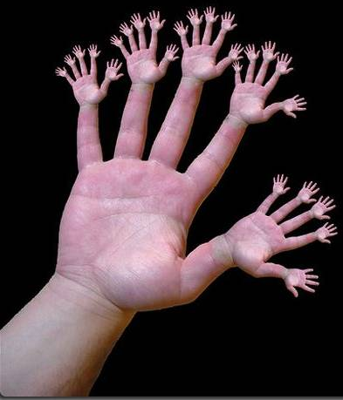
And is often “handy”…

Slide 4

What’s Up Next…
- Loop structures: for and while
Writing some “bigger” programs
Secret Sharing (cryptography)
Games (Nim, Mastermind)
Data compression
That’ll keep us entertained for a few weeks!

Slide 5
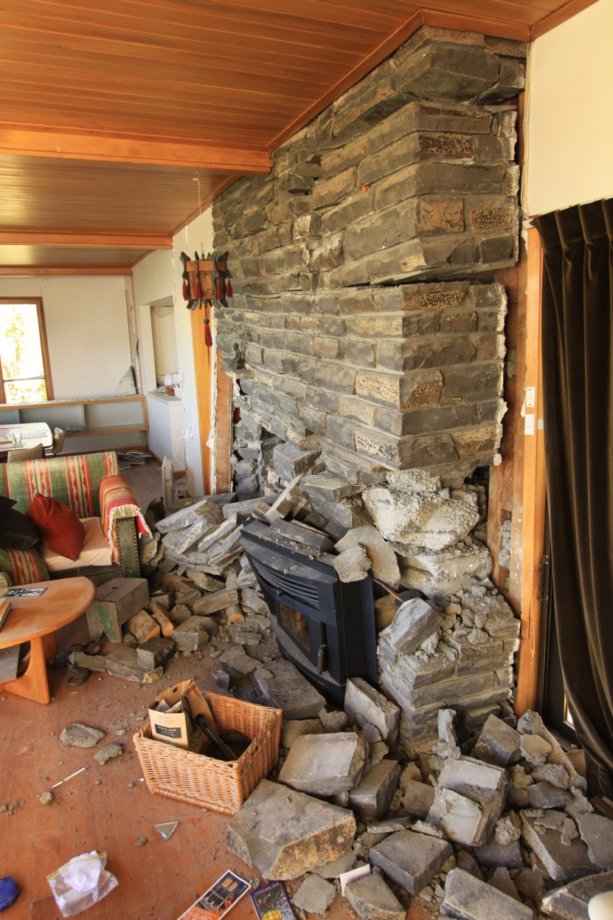
About Earthquakes

Slide 6
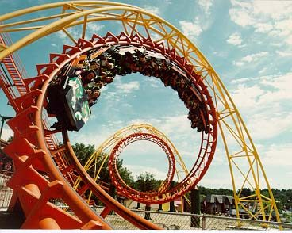
Loops!

Slide 7
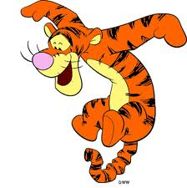
Mystery 1
I love a good mystery!
def leppard(inputString):
outputString = ""
for symbol in inputString:
if symbol == "o":
outputString = outputString + "ooo"
else:
outputString = outputString + symbol
print(outputString)
>>> leppard(″hello″)
>>> leppard(″hello to you″)
Notes:
This is in lec15prog01.py. Don’t take the time to demo.

Slide 8
Mystery 2
I love a good mystery!
vowels = ['a', 'e', 'i', 'o', 'u']
def spamify(word):
for i in range(len(word)):
if word[i] not in vowels:
return word[0:i] + "spam" + word[i+1:]
return word
How many times does the return happen?
>>> spamify(″oui″)
>>> spamify(″hello″)
>>> spamify(″aardvark″)
Notes:
This is in lec15prog01.py. Demo it!

Slide 9

for
for <variable> in <iterable>:
Do stuff!
for symbol in ″blahblahblah″:
for element in [1, 2, 3, 4]:
for index in range(42):
Three uses of for!
I’d like to see four uses of three!
Notes:
Be sure to define “iterable”.

Slide 10
Move Over XBox!
import random
def play():
print("Welcome!”)
secret = random.choice(range(1, 100))
numGuesses = 0
userGuess = 0
while userGuess != secret:
userGuess = eval(input("Enter your guess: "))
numGuesses += 1
if userGuess > secret:
print("Too high”)
elif userGuess < secret:
print("Too low”)
print("You got", secret, "in", numGuesses, "guesses!”)
print("Thanks for playing!”)
Printing strings, numbers, etc.
Notes:
This is lec15prog02.py, which has play, play1 = play, play2, and play3. Demo all three, showing that for #1 you can type "secret", for #2 typing "secret" breaks, and #3 insists on correctness.

Slide 11
Try-als and Tribulations
def safeDivide(x, y):
try:
return x / y
except:
print("Don't DO that!”)
return float("inf")
def saferDivide(x, y):
try:
return x / y
except ZeroDivisionError:
print("Don't DO that!”)
return float("inf")
Notes:
The animation pops up saferDivide.
Demo these from lec15prog03.py, showing how safe/safer/safest increasingly protect against dividing by 0 and strings.
safeDivide returns infinity on strings. saferDivide only gives infinity on true divides by zero but breaks on strings.
safestDivide (next slide) handles all cases.

Slide 12
An Exceptional Program
def safestDivide(x, y):
try:
return x / y
except ZeroDivisionError:
print("Don't DO that!")
if x == 0:
return float("nan")
else:
return float("inf")
except (ValueError, TypeError):
print("That's just silly")
return float("nan")
except:
print("I don't know what happened")
raise

Slide 13
Input Validation
import random
def play():
print("Welcome!”)
secret = random.choice(range(1, 100))
numGuesses = 0
userGuess = 0
while userGuess != secret:
userGuess = input("Enter your guess: ")
try:
userGuess = int(userGuess)
except ValueError:
print("Please enter a number”)
continue
numGuesses += 1
if userGuess > secret:
# Rest of program is the same...

Slide 14
Getting assertive
def count_to_n():
for i in range(1, n + 1):
assert 1 <= i <= n
print(i)
def is42(i):
return i == 42
assert is42(42)
assert not is42(41)
Notes:
Assert can be used to ensure functions are working correctly. It can also be used to test them.

Slide 15

The Alien’s Life Advice
Lose gracefully!

Slide 16
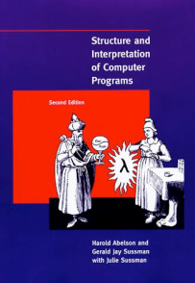
Good Design
Programs must be written for people to read, and only
incidentally for machines to execute. - Abelson and Sussman
Design your program “on paper” first. Identify the separate logical parts and the arguments and return value for each part.
2. Once your design is established, write the function “signatures” (function name, arguments) and docstrings.
Fill in the code for a function, test that function carefully, and proceed only when you are convinced that the function works correctly.
Use descriptive function and variable names (how about x, stuff, florg, jimbob ?).
Don’t replicate functionality. Break out repeated code into helper functions. (Often happens after the fact!)
Keep your code readable and use comments to help! # Here’s one now!
Use whitespace liberally.
Avoid global variables unless absolutely necessary! Instead, pass each function just what it needs.
Use recursion, list comprehension, and functional constructs (e.g. map, reduce, filter, lambda) where appropriate.

Slide 17
An Example…
Tic tac toe
Objective: Write a tic-tac-toe program that lets two human players play, and
stops when a player has won.
Functions:
main(): Welcomes user, plays a game, asks if we want to play again
welcome(): Prints the welcome message
playGame(): Maintains a board and plays one game
getMove(board, player): Queries the player (1 or 2) for their move
and changes the board accordingly
printBoard(board): Takes a board as argument and displays it
gameOver(board): Evaluates a board to see if game over

Slide 18
# Tic-tac-toe by Ran Libeskind-Hadas
debug = True
def main():
"""Play tic-tac-toe with a human"""
welcome()
while True:
if debug: print("About to enter playGame”)
playGame()
response = input("Would you like to play again? (y or n): ")
if response not in ["y", "Y", "yes", "Yes”, ”Yup”, “si”, “oui”, “youbetcha”]:
print("Bye")
return
def welcome():
"""Prints the welcome message for the game.
We might also print the rules for the game and any other
information that the user might need to know."""
print("Welcome to tic-tac-toe!")
def playGame():
"""Play one game of tic-tac-toe"""
if debug: print("Entering the playGame function")
board = [[" ", " ", " "], [" ", " ", " "], [" ", " ", " "]]
player = 1
while not gameOver(board):
print("The board looks like this:”)
printBoard(board)
getMove(board, player)
if player == 1: # Can this be done with clever arithmetic?
player = 2
else:
player = 1
Notes:
Note that main() is the traditional name for a “overall wrapper” function.

Slide 19
# Tic-tac-toe by Ran Libeskind-Hadas
debug = True
def main():
"""Play tic-tac-toe with a human"""
welcome()
while True:
if debug: print("About to enter playGame”)
playGame()
response = input("Would you like to play again? (y or n): ")
if response not in ["y", "Y", "yes", "Yes”, ”Yup”, “si”, “oui”, “youbetcha”]:
print("Bye")
return
def welcome():
"""Prints the welcome message for the game.
We might also print the rules for the game and any other
information that the user might need to know."""
print("Welcome to tic-tac-toe!")
def playGame():
"""Play one game of tic-tac-toe"""
if debug: print("Entering the playGame function")
board = [[" ", " ", " "], [" ", " ", " "], [" ", " ", " "]]
player = 1
while not gameOver(board):
print("The board looks like this:”)
printBoard(board)
getMove(board, player)
if player == 1:
player = 2
else:
player = 1
What’s this?!
How ‘bout:
row = [" ", " ", " "]
board = [row, row, row]
Or
board = [[" ", " ", " "]] * 3

Slide 20
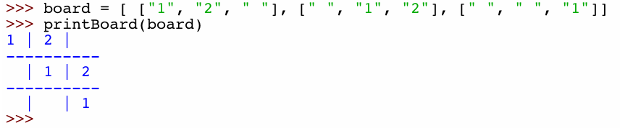
def gameOver(board):
"""Returns False if the game is NOT over. Otherwise, prints a message
indicating which player has won and then returns True indicating that the
game is over. THIS FUNCTION IS NOT IMPLEMENTED CORRECTLY!"""
return False
def getMove(board, player):
"""Takes the board and the current player (1 or 2) as arguments.
Asks the player for a move. If it's legitimate (position
exists and is empty), updates the board. Otherwise, the player
is queried again until a valid move is provided."""
print(“Player ” + str(player) + “'s turn”)
while True:
def printBoard(board):
Fill these in!
print() # new line!
Notes:
Worksheet: write getmove and take a stab at printBoard. We’ll look at my solutions in a moment.

Slide 21
def gameOver(board):
"""Returns False if the game is NOT over. Otherwise, prints a message
indicating which player has won and then returns True indicating that
the game is over. THIS FUNCTION IS NOT IMPLEMENTED CORRECTLY!"""
return False
def getMove(board, player):
"""Takes the board and the current player (1 or 2) as arguments.
Asks the player for a move. If it's legitimate (position
exists and is empty) updates the board. Otherwise, the player
is queried again until a valid move is provided."""
print(“Player ” + str(player) + "'s turn”)
while True:
try:
row = int(input("Enter the row: ”))
column = int(input("Enter the column: ”))
except:
print("You must enter numbers from 0 to 2 for the row and column”)
continue
if not 0 <= row <= 2 or not 0 <= column <= 2:
print("That's not a valid location on the board! Try again.”)
elif board[row][column] != " ":
print("That cell is already taken! Try again.”)
else:
board[row][column] = str(player)
break
Notes:
Note that this introduces the break statement.

Slide 22
Printing the Board
1 | 2 |
---------
| 1 | 2
---------
| | 1
def printBoard(board):
for row in range(3):
for column in range(3):
print(board[row][column], end=" ")
if column < 2:
print("|", end=" ")
if row < 2:
print()
print("----------")
print() # CAUSES A LINEBREAK!
Note the sneaky ends!
And one more thing…
if _ _name_ _ == "_ _main_ _":
main()
The main
trick !

Slide 23
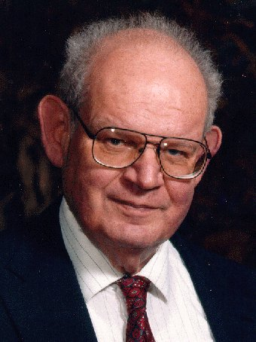
Lab Problem: The Mandelbrot Set
Consider some complex number C
z₀ = 0
z_{n+1} = z_{n}² + C
For which values of C does this not diverge?
Imag axis
C
Real axis

Slide 24
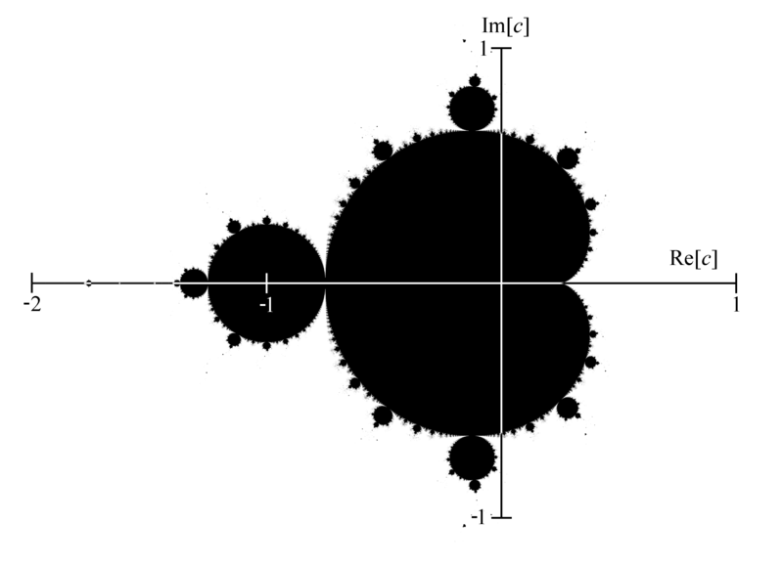
Lab Problem: The Mandelbrot Set
Consider some complex number C
z₀ = 0
z_{n+1} = z_{n}² + C
For which values of C does this not diverge?
Hey, that’s a fractal!

Slide 25
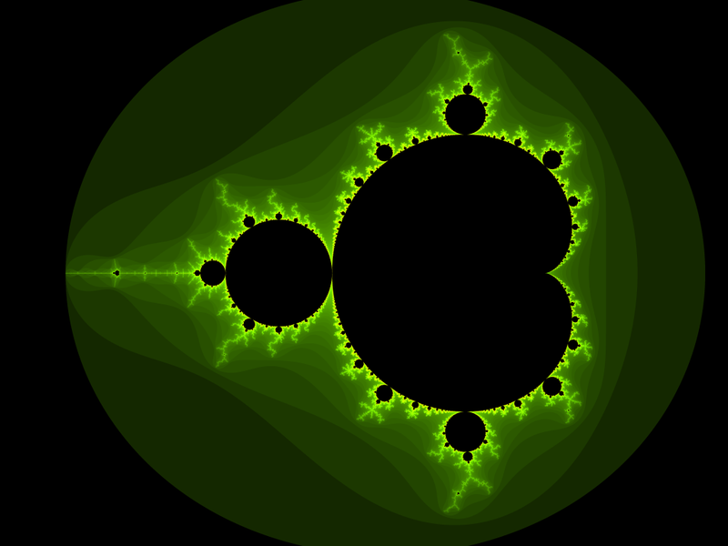

Slide 26


Slide 27
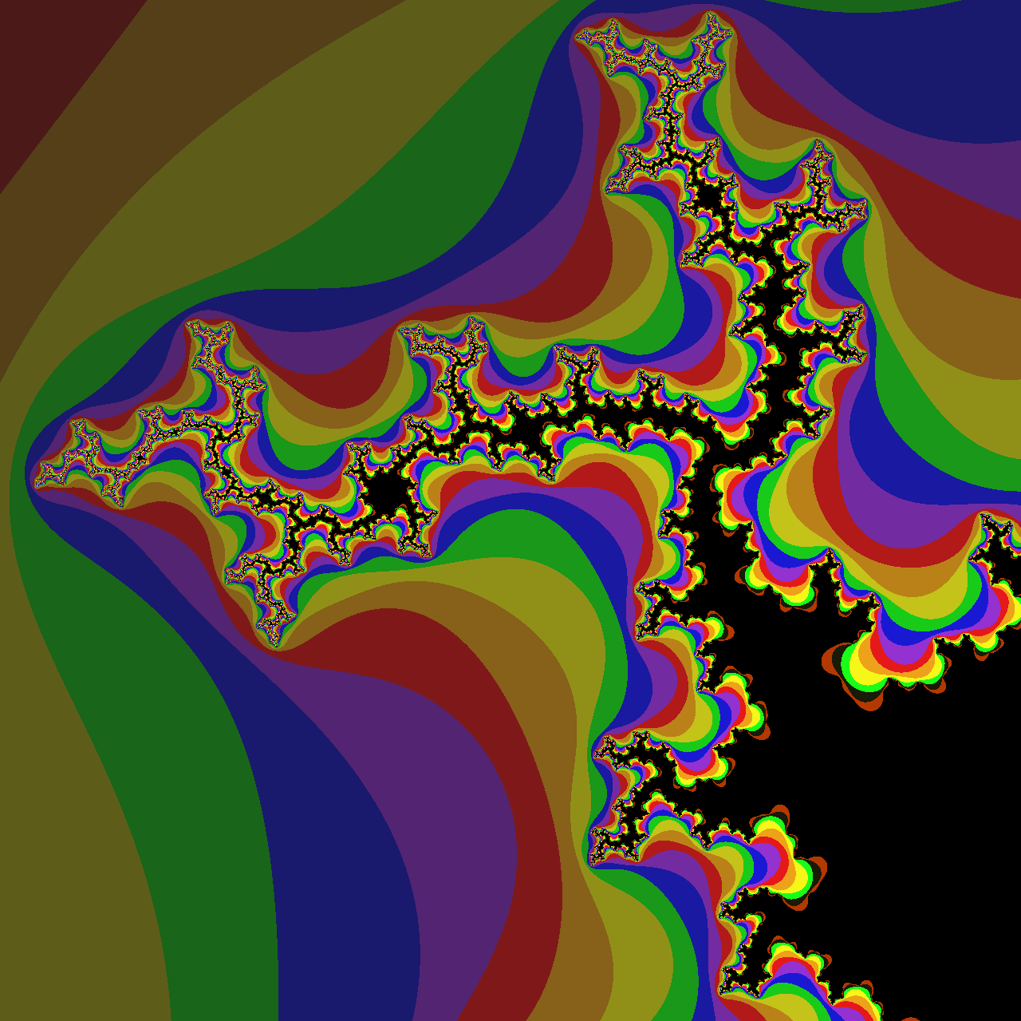
Image courtesy of Aaron Gable, CS 5 Black

Slide 28
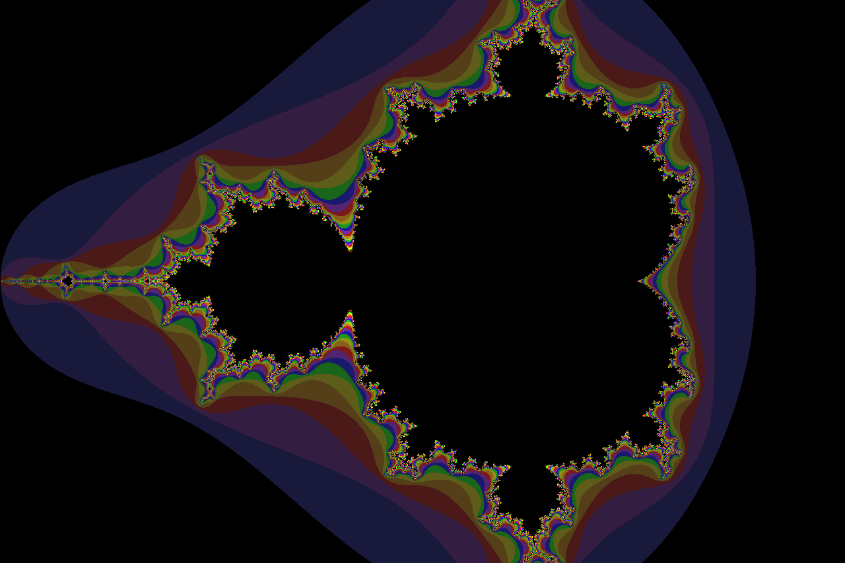
Image courtesy of Aaron Gable, CS 5 Black

Slide 29
Funky Series!
Harmonic Sequence:
1/1 + 1/2 + 1/3 + 1/4 + 1/5 + 1/6 + …
Without composites (primes only):
1/1 + 1/2 + 1/3 + 1/4 + 1/5 + 1/6 + 1/7 +…
Without 9’s…
1/1 + 1/2 + … + 1/8 + 1/9 + … +1/18 + 1/19 + … + 1/88 + 1/89 + 1/90 + 1/91 + …
Notes:
The harmonic series diverges (slowly). The primes-only series also diverges. But the no-9's series doesn't diverge. Why? Because as you get to big numbers, almost everything contains a 9, so the terms become sparse!

Slide 30
Look-And-Say Sequences
(aka “Read-It-And-Weep”)
1
11
21
1211
111221
312211
?
Number of digits in the n^{th} term of the sequence is asymptotically
C λ^{n}
C = 1.567…
λ = 1.30357726034296…
I wonder how many digits there are in the n^{th} term of this sequence?
Conway’s Constant
Notes:
Next is: 13112221

Slide 31
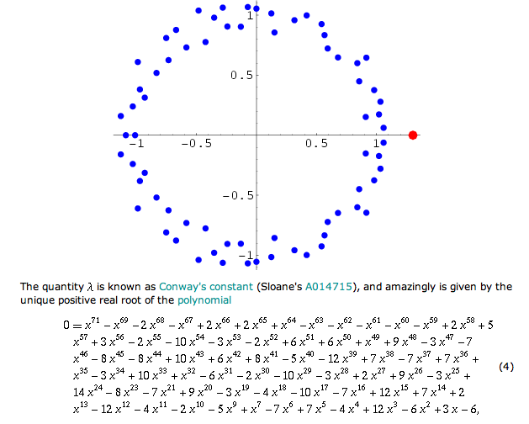
Look-And-Say Sequences
(aka “Read-It-And-Weep”)
Number of digits in the n^{th} term of the sequence is asymptotically
C λ^{n}
C = 1.567…
λ = 1.30357726034296…
Conway’s Constant
Notes:
Next is: 13112221

