Slide 1
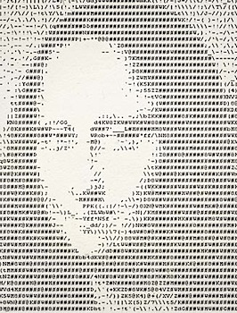
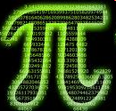
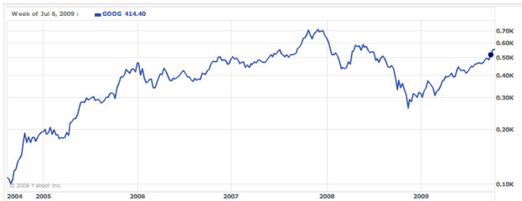
CS5
Coding in circles!
Thinking loopily and cumulatively
for a while
+=
sounds natural to me!
Today Loops have arrived…
This week + next: putting loops to good use:
Notes:
INHANDOUT
Class 15 loops1
HW9 is due the Monday after the Monday after we get back from spring break.
No grutoring after today (so you can use a Euro) except by appointment. Grutoring will resume Tuesday 3/20, or by appointment (ask on Piazza).
Loops are today and Thursday, plus one lecture after break. There is no lecture—but there IS lab—on the Tuesday after break.

Slide 2
Hmmm-thinking in Python
Loops in Python
Jumps in Hmmm
def fac(x):
result = 1
while x != 0:
result *= x
x -= 1
return result
00 read r1
01 setn r13 1
02 jeqzn r1 6
03 mul r13 r13 r1
04 addn r1 -1
05 jumpn 02
06 write r13
07 halt
It figures a Python would prefer looping to jumping!
Notes:
INHANDOUT
Zoom through this stuff.

Slide 3
Hmmm-thinking in Python
Loops in Python
Jumps in Hmmm
def fac(x):
result = 1
while x != 0:
result *= x
x -= 1
return result
00 read r1
01 setn r13 1
02 jeqzn r1 6
03 mul r13 r13 r1
04 addn r1 -1
05 jumpn 02
06 write r13
07 halt
It figures a Python would prefer looping to jumping!

Slide 4
Hmmm-thinking in Python
Loops in Python
Jumps in Hmmm
def fac(x):
result = 1
while x != 0:
result *= x
x -= 1
return result
00 read r1
01 setn r13 1
02 jeqzn r1 6
03 mul r13 r13 r1
04 addn r1 -1
05 jumpn 02
06 write r13
07 halt
It figures a Python would prefer looping to jumping!

Slide 5
Hmmm-thinking in Python
Loops in Python
Jumps in Hmmm
def fac(x):
result = 1
while x != 0:
result *= x
x -= 1
return result
00 read r1
01 setn r13 1
02 jeqzn r1 6
03 mul r13 r13 r1
04 addn r1 -1
05 jumpn 02
06 write r13
07 halt
It figures a Python would prefer looping to jumping!

Slide 6
Hmmm-thinking in Python
Loops in Python
Jumps in Hmmm
def fac(x):
result = 1
while x != 0:
result *= x
x -= 1
return result
00 read r1
01 setn r13 1
02 jeqzn r1 6
03 mul r13 r13 r1
04 addn r1 -1
05 jumpn 02
06 write r13
07 halt
It figures a Python would prefer looping to jumping!

Slide 7
Hmmm-thinking in Python
Loops in Python
Jumps in Hmmm
def fac(x):
result = 1
while x != 0:
result *= x
x -= 1
return result
00 read r1
01 setn r13 1
02 jeqzn r1 6
03 mul r13 r13 r1
04 addn r1 -1
05 jumpn 02
06 write r13
07 halt
It figures a Python would prefer looping to jumping!

Slide 8
Hmmm-thinking in Python
Loops in Python
Jumps in Hmmm
def fac(x):
result = 1
while x != 0:
result *= x
x -= 1
return result
00 read r1
01 setn r13 1
02 jeqzn r1 6
03 mul r13 r13 r1
04 addn r1 -1
05 jumpn 02
06 write r13
07 halt
It figures a Python would prefer looping to jumping!

Slide 9
Hmmm-thinking in Python
Loops in Python
def fac(x):
result = 1
while x != 0:
result *= x
x -= 1
return result
We get the advantages of explicit looping AND self-contained functions
All the advantages of Hmmm? I'm sold!
Notes:
We did recursive factorial in HW. But recursive Hmmm won’t be on the test.

Slide 10
Hmmm
Recursive Hmmm factorial, hw7pr4
Looping Hmmm factorial, similar to hw7pr2 and pr3
00 read r1
01 setn r15 42
02 calln r14 5
03 jumpn 17
04 nop
05 jnezn r1 8
06 setn r13 1
07 jumpr r14
08 pushr r1 r15
09 pushr r14 r15
10 addn r1 -1
11 calln r14 5
12 popr r14 r15
13 popr r1 r15
14 mul r13 r13 r1
15 jumpr r14
16 nop
17 write r13
18 halt
00 read r1
01 setn r13 1
02 jeqzn r1 6
03 mul r13 r13 r1
04 addn r1 -1
05 jumpn 02
06 write r13
07 halt
Functional programming
Iterative programming
Hmmm… I think I'll take Python!

Slide 11
Iterative design in Python
for
for x in [40, 41, 42]:
print(x)
jumpn, jeqzn, …
x = 42
while x > 0:
print(x)
x -= 1
while
the initial value is often not the one we want in the end
x = 41
x += 1
addn r1 1
variables vary
a lot!
But we change it as we go…
Notes:
INHANDOUT

Slide 12
for loops: examples…
This slide is four for for!
for x in [2, 4, 6, 8]:
print('x is', x)
for y in [7]*6:
print(y)
for c in 'down with loops!':
print(c)
How could we get this loop to run 42 times?
for i in
print(i)
There is a range of answers to this one…
Notes:
INHANDOUT
Demo these in Python (from lec16prog01.py, commented out at the top). Show print(c, end="")
can take just the for part !!

Slide 13
for!
It's what the fox says: Duck!
1
x is assigned each value from this sequence
for x in [2, 4, 6, 8]:
print('x is', x)
print('Done!')
3
LOOP back to the top for EACH value in the list
This is the #1 for-loop error! (what? why?)
2
the BODY or BLOCK of the for loop runs with that x
4
Code AFTER the loop will not run until the loop is finished.
anatomy?
empty?
x unused?
Notes:
INHANDOUT
Demo first with print(done) indented, then with it outdented.

Slide 14
That's why they're called variables
Only in code can one's newer age be older than one's older age!
age = 41
age = age + 1
The "old" value (41)
age += 1
The "new" value (42)
Echoes from Hmmm:
05 addn r1 1
Notes:
Demo += in terminal

Slide 15
That's why they're called variables
Only in code can one's newer age be older than one's older age!
age = 41
age = age + 1
The "old" value (41)
age += 1
The "new" value (42)
Python shortcuts
hwToGo = 7
hwToGo = hwToGo - 1
amoebas = 100000
amoebas = amoebas * 2
u235 = 10000000000000;
u235 = u235 / 2
hwToGo -= 1
amoebas *= 2
u235 /= 2
Notes:
INHANDOUT

Slide 16
four questions for for
for x in [1, 2, 3, 4, 5, 6, 7]:
print('x is', x)
avoid writing the whole list?
find the sum of the list?
showing partial sums?
factorial function?
Notes:
INHANDOUT
In visual, edit above code to show how to add the x’s up, printing inside the loop.
Show how you can use end= to put debugging information on one line.
Change it into a function and demo again. Then change summation to factorial, demo again.

Slide 17
fac with for
def fac(N):
result = 1
for x in list(range(1, N + 1)):
result = result * x
return result
Hey!? This is not the right answer… YET
Notes:
INHANDOUT

Slide 18
Warning: no one else uses this term…
Laddering for loops
4
result
x
def fac(N):
result = 1
for x in list(range(1, N + 1)):
result = result * x
return result
meets up with Jacob's ladder
Notes:
Laddering: write result and x, with diagonal arrows showing progress of values

Slide 19
Name(s): ________________
Quiz
Bday(s): ________________
What does the loop say?
mild
res.
x
mild-ish
x
i
result = 1
for x in [2, 5, 1, 4]:
result *= x
print(result)
x = 0
for i in list(range(4)):
x += 10
print(x)
medium
spicy
L = ['golf','fore!','club','tee']
for i in list(range(len(L))):
if i%2 == 1:
print(L[i])
S = 'time to think this over! '
result = ''
for i in list(range(len(S))):
if S[i-1] == ' ':
result += S[i]
print(result)
25
i
i%2
L[i]
only ladder as needed...
These seem unexpected, but only at first… !?
Extra! How could you change one character above to yield
or another to yield
or another to yield
mns
etns!
eoks!
Notes:
Put your birthday month and day on the quiz.
Do the first problem on-screen (see following slide). Other answers are on subsequent slides.

Slide 20
Name(s): ________________
Quiz
What does the loop say?
mild
res.
x
mild-ish
x
i
result = 1
for x in [2, 5, 1, 4]:
result *= x
print(result)
x = 0
for i in list(range(4)):
x += 10
print(x)
medium
spicy
L = ['golf','fore!','club','tee']
for i in list(range(len(L))):
if i%2 == 1:
print(L[i])
S = 'time to think this over! '
result = ''
for i in list(range(len(S))):
if S[i-1] == ' ':
result += S[i]
print(result)
25
i
i%2
L[i]
only ladder as needed...
These seem unexpected, but only at first… !?
Extra! How could you change one character above to yield
or another to yield
or another to yield
mns
etns!
eoks!
Notes:
QUIZSLIDE
Put your birthday month and day on the quiz.
Do the first problem on-screen (see following slide). Other answers are on subsequent slides.

Slide 21
Quiz
What does the loop say?
result
x
result = 1
for x in [2, 5, 1, 4]:
result *= x
print(result)
1
2

Slide 22
Quiz
What does the loop say?
[0, 1, 2, 3]
x
i
x = 0
for i in list(range(4)):
x += 10
print(x)
0
0

Slide 23
Quiz
What does the loop say?
L = ['golf','fore!','club','tee']
for i in list(range(len(L))):
if i%2 == 1:
print(L[i])
L[i]
i%2
i
[0, 1, 2, 3]
4
0
0
'golf'
1
1
'fore!'
0
2
'club'
1
3
'tee'
Notes:
fore tee too

Slide 24
Quiz
What does the loop say?
res.
S[i-1]
S[i]
i
S = 'time to think this over! '
result = ''
for i in list(range(len(S))):
if S[i-1] == ' ':
result += S[i]
print(result)
' '
't'
0
[0, 1, 2, ..., 24]
't'
'i'
1
25
'i'
'm'
2
'm'
'e'
3
'e'
' '
4
' '
't'
5
't'
'o'
6
'o'
' '
7
' '
't'
8
Notes:
tttto = four-t to

Slide 25
Quiz
What does the loop say?
res.
S[i-1]
S[i]
i
S = 'time to think this over! '
result = ''
for i in list(range(len(S))):
if S[i-1] == ' ':
result += S[i]
print(result)
't'
' '
't'
0
[0, 1, 2, ..., 24]
't'
'i'
1
25
'i'
'm'
2
'm'
'e'
3
'e'
' '
4
'tttto'
'tt'
' '
't'
5
Looks like a four-'t' 'to' to me!
't'
'o'
6
'o'
' '
7
change ' ' to 'i'
change 1 to 4
change - to +
'ttt'
' '
't'
8
Extra! How could you change one character above to yield
or another to yield
or another to yield
mns
etns!
eoks!
Notes:
Don’t review these (answers aren’t in handout)

Slide 26
Quiz
What does the loop say?
res.
S[i-1]
S[i]
i
S = 'time to think this over! '
result = ''
for i in list(range(len(S))):
if S[i-1] == ' ':
result += S[i]
print(result)
' '
't'
0
't'
'i'
1
'i'
'm'
2
'm'
'e'
3
'e'
' '
4
' '
't'
5
't'
'o'
6
'o'
' '
7
' '
't'
8

Slide 27
for: two types
L = [3, 15, 17, 7]
x
for x in L:
print(x)
element-based loops

Slide 28
for: two types
L[0]
L[1]
L[2]
L[3]
L = [3, 15, 17, 7]
0
1
2
3
i
for i in range(len(L)):
print( )
list
index-based loops
for x in L:
print(x)
element-based loops
Notes:
INHANDOUT

Slide 29
for: two types
L[0]
L[1]
L[2]
L[3]
L = [3, 15, 17, 7]
0
1
2
3
i
for i in range(len(L)):
print(L[i])
list
index-based loops
for x in L:
print(x)
element-based loops

Slide 30
for: two types
L[0]
L[1]
L[2]
L[3]
L = [3, 15, 17, 7]
0
1
2
3
i
for i in range(len(L)):
print(L[i])
list
index-based loops
printing is NOT common in loops—these are just by way of example...
for x in L:
print(x)
element-based loops

Slide 31
Simpler vs. More Flexible
L = [3, 15, 17, 7]
x
def sum(L):
total = 0
for x in L:
total += x
return total
element-based loops

Slide 32
Simpler vs. More Flexible
L = [3, 15, 17, 7]
0
1
2
3
i
def sum(L):
total = 0
for x in L:
total += x
return total
def sum(L):
total = 0
for i in range(len(L))
total += _____
return total
list
element-based loops
index-based loops
Notes:
INHANDOUT

Slide 33
Extreme Looping
What does this code do?
print('It keeps on')
while 41+1 == 42:
print('going and')
print('Phew! I\'m done!')
continuing if
I'm whiling away my time with this one!
Notes:
A while loop is basically an “if” that repeats.
Demo this infinite loop

Slide 34
Extreme Looping
Anatomy of a while
print('It keeps on')
while 41+1 == 42:
print('going and')
print('Phew! I\'m done!')
the loop keeps on running as long as the test is True
while loop body
other tests we could use here?
This won't print until the while loop finishes - In this case, it never prints!
I'm whiling away my time with this one!
Notes:
INHANDOUT

Slide 35
Extreme Looping
lots of different tests…
print('It keeps on')
while 42 == 42:
print('going and')
print('Phew! I\'m done!')
others?
I'm whiling away my time with this one!

Slide 36
Extreme Looping
lots of different tests…
a "while True" loop
print('It keeps on')
while True:
print('going and')
print('Phew! I\'m done!')
I'm whiling away my time with this one!

Slide 37
Escape ?!
import random
escape = 0
while escape != 42:
print('Help! Let me out!')
escape = random.choice([41,42,43])
print('At last!')
starting value, not the final or desired value!
test to see if we keep looping
watch out for infinite loops!
after the loop ends
how could we count the number of loops we run?
how could we make it easier/harder to escape?
random.uniform!
Notes:
INHANDOUT
This is esc() in lec15prog01.py (more or less).
Start with escape hardwired to 41, no random choice. Then add choice, then expand to range(100).
Modify into a function; show using a list comprehension to find the average escape count.

Slide 38
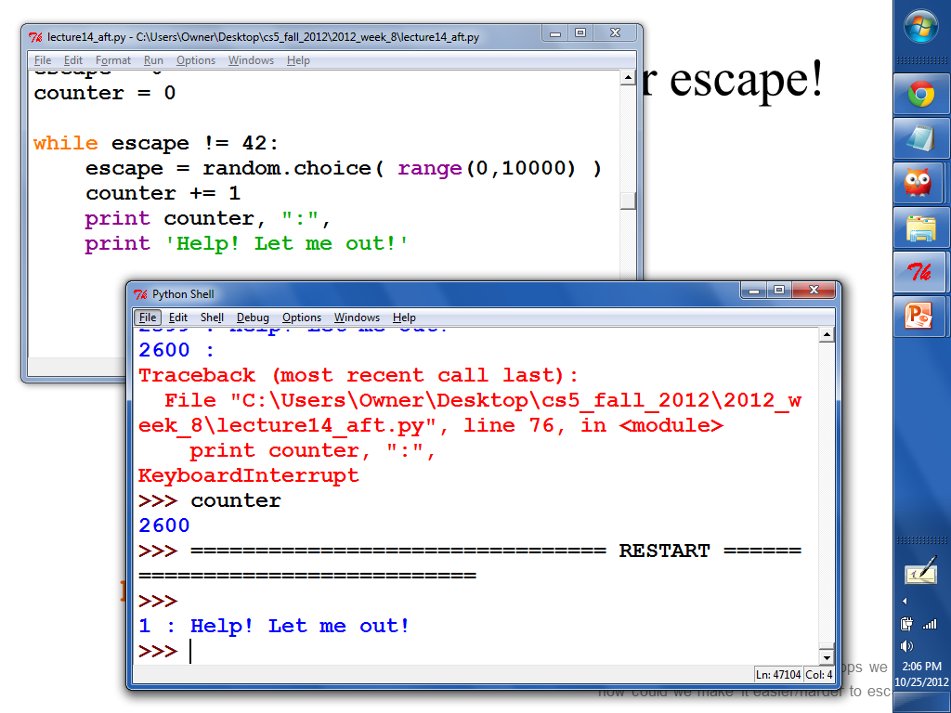
screenshot !!!
Notes:
A few years ago Zach lucked out in a demo.

Slide 39
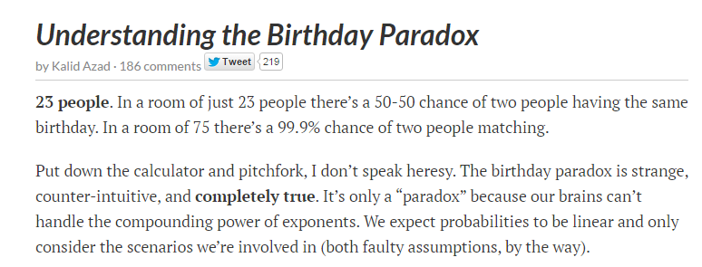
How long till a repeat?
Sooner than you might think…
http://betterexplained.com/articles/understanding-the-birthday-paradox/
birthday paradox!

Slide 40
How long til a repeat?
import random
LoBs = [] # List of BDays
while
b = random.choice( range(365))
LoBs += [b]
print("Repeat! # tries:", len(LoBs))
start w/ an empty list
What should this test be?
list
get a new birthday
add a new birthday – need to add list + list!
birthday paradox!
Notes:
bday() is in the sample file.
print(L) is automatically non-pretty.
Run bday(False).

Slide 41
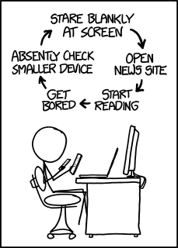
XKCD's loop
and this was before watches – or glasses...

Slide 42
Try these…
What do these two loops return?
Finish this loop to find and return the min of a list, L
L will be a non-empty list of numbers.
Let word = 'forty-two'
def min(L):
result = L[0]
for x in L:
if
return result
What to check about x?
def count(word):
n = 0
for c in word:
if c not in 'aeiou':
n += 1
return n
:
What to do?
Extra: Write a loop so that this function returns True if the input n is prime and False otherwise
Let n = 12
Let n = 8
def mystery(n):
while n > 1:
if n%2 == 0:
n = n/2
else:
return False
return True
n will be a positive integer >= 2
12
8
def isPrime(n):
Challenge: for what values of n does mystery return True?
Hint: check all possible divisors to see if they "work"…
Notes:
INHANDOUTFULL

Slide 43
What do these two loops return?
Let n = 12 (then 8)
Let word = 'forty-two'
def mystery(n):
while n > 1:
if n%2 == 0:
n = n/2
else:
return False
return True
def count(word):
n = 0
for c in word:
if c not in 'aeiou':
n += 1
return n
n
c
0
12
8
'f'
1
'o'
1
6
4
'r'
2
't'
3
'y'
3
False
2
4
5
'-'
't'
1
True
6
7
'w'
7
'o'
Challenge: what are argumentsfor which mystery returns True?

Slide 44
L will be a non-empty list of numbers.
n will be a positive integer >= 2
def min(L):
def isPrime(n):
for d in range(2, n):
result = L[0]
for x in L:
if x < result:
return result
int(sqrt(n))
min so far
n/2
list
if n%d == 0:
return
min so far
return
min so far
[50,55,43,99,45,42]
An example list to consider…
Hint: check all possible divisors to see if they "work"…

Slide 45
Have a great spring break!

