Slide 1
The CS 5 Black Gazette
CS 5 Penguins Located
at Massive Penguin Party
(AP) The two missing CS 5 “Black”
penguins surfaced on a large ice
floe near Antarctica. Authorities
indicated that an enormous penguin
dance party was underway there that
would likely last well into Novembrrrr.
The CS 5 instructors were relieved to
hear that the penguins are safe.
“I’m glad they’re OK, but I’m a bit
disappointed that I wasn’t invited to
this very 'cool' party,” said one of the profs.
Notes:
Worksheet: write a function to read in a list of numbers.
Demo: have Python shell ready to demonstrate negative value for n in get_list. Also demo mastermind. Only mastermind2 is cheatable.
Finally, be able to demo nim.

Slide 2
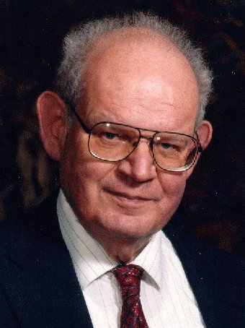
Lab Problem: The Mandelbrot Set
Consider some complex number C
z₀ = 0
z_{n+1} = z_{n}² + C
For which values of C does this not diverge?
Imag axis
C
Real axis

Slide 3
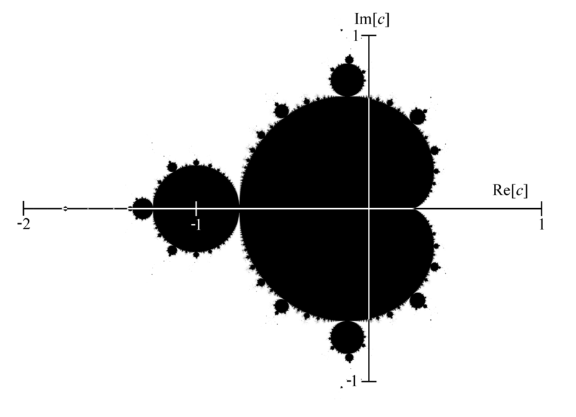
Lab Problem: The Mandelbrot Set
Consider some complex number C
z₀ = 0
z_{n+1} = z_{n}² + C
For which values of C does this not diverge?
Hey, that’s a fractal!

Slide 4
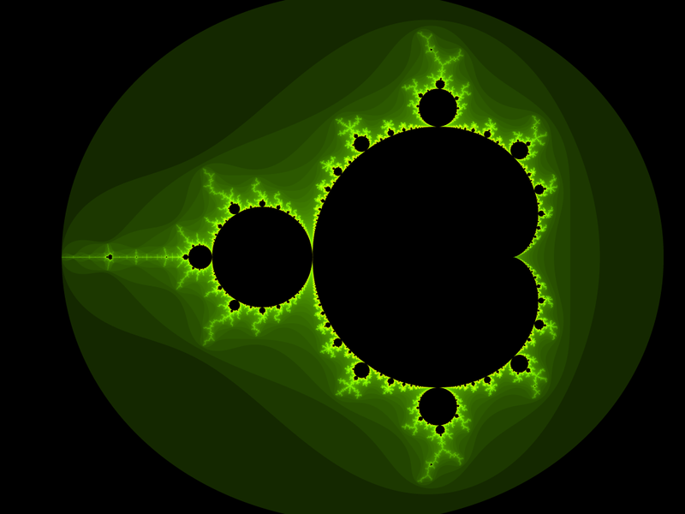

Slide 6
Image courtesy of Aaron Gable, CS 5 Black

Slide 7
Image courtesy of Aaron Gable, CS 5 Black

Slide 8
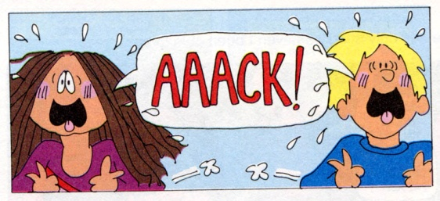
About the Midterm

Slide 9
About the Midterm
Tuesday, November 1st
Comprehensive through 10/27
You should definitely know:
Recursion (including multiple base cases)
map, reduce, filter, lambda
List comprehension: [x*2 for x in L]
Higher-order functions (functions that return functions)
Use-it-or-lose-it

Slide 10
More You Should Know
Logic circuits
AND, OR, NOT
Writing truth tables
Minterm expansion principle
Using AND and OR to choose an output
Hmmm programming
Recursion techniques
Conditional jumps
(We will supply a Hmmm reference sheet)

Slide 11
Yet More
Simple imperative programming
Assignment statements
If/else/elif
For loops (for i in iterable)
While loops
Break and continue
Return from inside loops
Notes:
Loop and a half?

Slide 12
Your Cheat Sheet
You’re allowed ONE sheet of 8.5x11 paper, with contents up to you
Double-sided!

Slide 13
Deep vs. Shallow Copy
>>> foo = [1, 2, 3]
>>> bar = foo
>>> bar[0] = 42
>>> foo
[42, 2, 3]
>>> bar = [“spam”, “is”, “yummy”]
>>> foo
[42, 2, 3]
>>> x = 42
>>> y = x
>>> y = 57
>>> x
42
foo
bar
[42, 2, 3]
[1, 2, 3]
[“spam”, “is”, “yummy”]
This is a deep concept!

Slide 14
Deep vs. Shallow Copy
>>> from copy import *
>>> foo = [1, 2, 3]
>>> bar = deepcopy(foo)
>>> bar[0] = 42
>>> foo
[1, 2, 3]
foo
bar
[1, 2, 3]
[1, 2, 3]
This is a deep concept!
Notes:
What I want people to take away from this is that saying “foo = bar” when bar is a list, tuple, or dictionary will produce unexpected results. When in doubt, use deepcopy. If you’re getting inexplicable bugs, try deepcopy.

Slide 15
Isn’t Mutability Always Preferable?
def ben(List):
if List != [] : List[0] = -1
def jerry():
myList = [1, 2, 3]
ben(myList)
print("My list is " + str(myList))
>>> jerry()
My list is [-1, 2, 3]
Watch out here!

Slide 16
Isn’t Mutability Always Preferable?
def ben(List): List = [“yowza!”]
def jerry():
myList = [1, 2, 3]
ben(myList)
print("My list is " + str(myList))
>>> jerry()
My list is [1, 2, 3]
Watch out here!

Slide 17
Isn’t Mutability Always Preferable?
def ben(x): x = 43
def jerry():
myNum = 42
ben(myNum)
print("My number is " + str(myNum))
>>> jerry()
My number is 42

Slide 18
Type Casting
>>> int(1.3)
1
>>> str(1.3)
'1.3'
>>> str(2+3j)
'(2+3j)'
>>> str([1, 2, 3])
'[1, 2, 3]'
>>> str("hello")
'hello'
>>> int("hello")
Traceback (most recent call last):
File "<stdin>", line 1, in ?
ValueError: invalid literal for int(): hello
I hate being typecast!

Slide 19
Non-Built-In “Types”
>>> from decimal import *
>>> getcontext().prec = 20
>>> x = Decimal(1)/Decimal(3)
>>> x
Decimal("0.33333333333333333333")
>>> x + 1
Decimal("1.3333333333333333333")
>>> int(x)
0
>>> float(x)
0.33333333333333331
>>> str(x)
'0.33333333333333333333'
Notice that argument
to Decimal can be
a string or an integer,
but (strangely) not
a floating point
number!
>>> Decimal(0.333)
BARF!!!
Notes:
All of the expressions involving x pop up together as the slide’s single animation.

Slide 20
Input and Output
def get_input():
"""Takes no arguments. Queries user for name
and age and returns a list [name, age] where
name is a string and age is an integer."""
name = input("Enter your name: ")
age = int(input("Enter your age: "))
return [name, age]
Worksheet: write a function that asks the user for a number n, asks the user to enter n integers, and returns the list of those n integers. Be robust against input errors. Helper functions encouraged!

Slide 21
Worksheet: write a function that asks the user for a number n, asks the user to enter n integers, and returns the list of those n integers. Be robust against input errors. Helper functions encouraged!
def get_list():
n = int(input("How many numbers in your list? "))
user_list = []
for index in range(n):
input = int(input("Enter the next number: "))
user_list.append(input)
return user_list
There’s something wrong here!
Notes:
Question for class and Python shell: is this robust against negative n?

Slide 22
Worksheet: write a function that asks the user for a number n, asks the user to enter n integers, and returns the list of those n integers. Be robust against input errors. Helper functions encouraged!
def get_number(prompt):
while True:
try:
return int(input(prompt))
except ValueError:
print("Please enter a valid number!”)
def get_list():
n = get_number("How many numbers in your list? ")
user_list = []
for index in range(n):
input = get_number("Enter the next number: ")
user_list.append(input)
return user_list
Nice!

Slide 23
The Alien’s Life Advice
Keep in touch with your parents.
It makes them feel like they didn’t screw up!

Slide 24
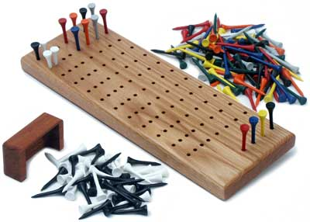
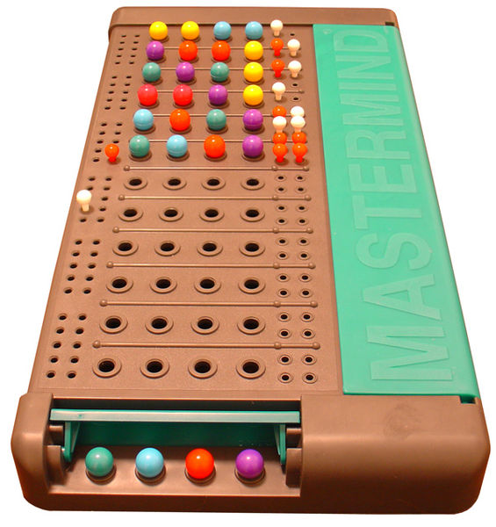
Mastermind!
“Secret Code”
Colors:
Red, Blue, Green,
Orange, Purple,
Pink
Guess
Score
Notes:
Invented by an Israeli telecommunications expert in 1970. White means right color, wrong place; black means right color right place.

Slide 25
Mastermind!
“Secret Code”
Colors:
Red, Blue, Green,
Orange, Purple,
Pink
Guess
Score
Notes:
DEMO!

Slide 26
Mastermind!
“Secret Code”
Colors:
Red, Blue, Green,
Orange, Purple,
Pink
Guess
Score
DEMO!
Notes:
DEMO!

Slide 27
Mastermind Bonus!
Welcome to Mastermind!
----------------------
How many holes per row shall we have? 5
How many rounds shall we have? 10
How many colors shall we have? 8
Who is the guesser (“computer” or “human”): computer
Notes:
DEMO!

Slide 28
Mastermind Bonus!
Algorithms for 4-hole, 6-color “standard” version:
- Donald Knuth (“K-nooth”) 1976: 5 guesses
maximum, 4.478 guesses on average
- Koyama and Lai 1993: 6 guesses maximum,
4.340 guesses on average
- Koyama and Lai 1993: 5 guesses maximum,
4.341 guesses on average
- Swaszek 1999-2000: Random “consistent”
guess gives average of 4.638
Notes:
A "consistent" guess is one that has a chance of being correct; i.e., it isn't precluded by previous answers.
Three animations give successive improvements.

Slide 29
Mastermind Bonus!
Algorithms for 4-hole, 6-color “standard” version:
“Static” Version: Make a certain number of
guesses right away without having them
scored. Then, ask for them to be scored and
make one final (correct) guess.
Chvatal (1983): Six unscored guesses followed
by seventh final guess!

Slide 30
Mastermind Revisited
How do you compute the black-white score?
guess = [2, 1, 2, 2, 5]
code = [2, 2, 3, 4, 5]
guess.count(2) code.count(2)
[
colors-1
min(guess_{c,} code_{c})] - blackscore
Σ
c = 0
number of occurrences of color c in guess
number of occurrences of color c in code
Notes:
Animation brings up the count function, which is how to calculate the subscript-c things.

Slide 31
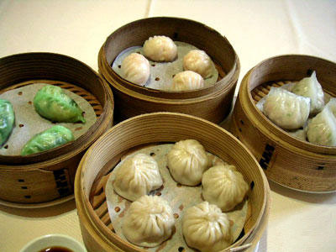
Nim and the Nim Sum
I don’t know about nim sum, but I sure do love dim sum!
Notes:
Rules of nim (normal play): you have n heaps of stones. Each player in turn can remove an arbitrary (nonzero) number of stones from exactly one heap. The player who removes the last stone wins.
Nim sum: express the size of each heap in binary. The num sum is just h1^h2^h3^…
Winning strategy: Force the nim sum to be zero after your play. The easiest way to do this is to calculate the current nim sum, then look for a heap with a 1 in the same position as the highest bit of the nim sum. Xor the nim sum with the size of that heap to get the final size you want to achieve.

Slide 32
Nim Summary
Oooh, that’s BAD!
Calculate nim sum as xor of heap sizes
Force nim sum to be zero
Pick a heap where highest nonzero nim-sum bit matches corresponding heap bit
Final size must be heap size xor nim sum
See Wikipedia for how to win “loser takes last” game
Notes:
Rules of nim (normal play): you have n heaps of stones. Each player in turn can remove an arbitrary (nonzero) number of stones from exactly one heap. The player who removes the last stone wins.
Nim sum: express the size of each heap in binary. The num sum is just h1^h2^h3^…
Winning strategy: Force the nim sum to be zero after your play. The easiest way to do this is to calculate the current nim sum, then look for a heap with a 1 in the same position as the highest bit of the nim sum. Xor the nim sum with the size of that heap to get the final size you want to achieve.

