Slide 1
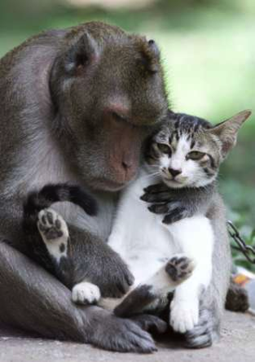
CS 5 Black Meets Artificial Intelligence!
Just to be clear, I represent the intelligence!

Slide 2
A short aside on Dictionaries…
>>> D = {} # initialize empty dictionary
>>> D[“spam”] = 42
>>> D[“spam”]
42
>>> D[“cat”] = “a very clever animal”
>>> D[“cat”]
“a very clever animal”
>>> “cat” in D
True
>>> D
{ “cat” : “a very clever animal”,
“spam”: 42
}
Look, I has key!

Slide 3
Keys must be immutable…
Strings, numbers, tuples are OK
Lists are not!
>>> D = {}
>>> D[("I", "like")] = ["spam", "pizza", "spam", ”cake", "spam"]
Key type must be immutable
Value type can be anything!
Look! I’m mutable! (Cats are so clever.)

Slide 4
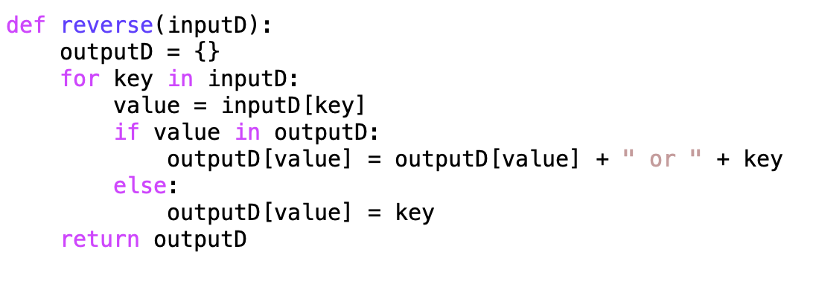
Reverse Translation
TtoE = {"dude!":"hello", "later":"goodbye", "stoked":"happy”, "ciao":"goodbye"}
>>> EtoT = reverse(TtoE)
>>> EtoT
{'hello': 'dude!', 'goodbye': 'ciao or later', 'happy': 'stoked'}
>>> EtoT[“goodbye”]
'ciao or later’

Slide 5
Reverse Translation
TtoE = {"dude!":"hello", "later":"goodbye", "stoked":"happy”, "ciao":"goodbye"}
>>> EtoT = reverse(TtoE)
>>> EtoT
{'hello': 'dude!', 'goodbye': 'ciao or later', 'happy': 'stoked'}
>>> EtoT[“goodbye”]
'ciao or later’

Slide 6
Markov text generation (WMSCI 2005)
Dan Aguayo
Max Krohn
Jeremy Stribling
Demo!
Notes:
WMSCI Story 2005
Show the website
Show the movie

Slide 7
>>> markov(‘cs5greenbook’, 1, 500)
We've consulted with very clear syntax. This chapter to major computational ideas that you a computer scientist is to experiment! It will tell you could do any of biology. Simply put, computing is 2. Consider, for phylogenetics the use of finding the url. The best way that Python will tell you to learn to be infectious.

Slide 8
Markov Text Generation
To be, or not to be, that is the question:
Whether 'tis nobler in the mind to suffer
The slings and arrows of outrageous fortune,
Or to take Arms against a Sea of troubles,
And by opposing end them: to die, to sleep
No more; and by a sleep, to say we end…
Dictionary = {
(“in”,) : [“the”, “thy”, “thy”],
(“ the”,) : [“heartache”, “rub”,
“pangs”, …]
}
Markov learning algorithm
Training file
Markov model
(a dictionary)

Slide 9
How it works… (k = 2 in this example)
>>> test = "A B C. A B B! D A A?”
>>> wordList = test.split()
>>> wordList
['A', 'B', 'C.', 'A', 'B', 'B!', 'D', 'A', 'A?']
>>> dollarify(wordList, 2)
['$', '$', 'A', 'B', 'C.',
'$', '$', 'A', 'B', 'B!',
'$', '$', 'D', 'A', 'A?']

Slide 10
test = "A B C. A B B! D A A?”
wordList =
['$', '$', 'A', 'B', 'C.', '$', '$', 'A', 'B', 'B!', '$', '$', 'D', 'A', 'A?']
mm2 = markov_model(wordList, 2)
{
('D', 'A'): ['A?'],
('$', 'D'): ['A'],
('A', 'B'): ['C.', 'B!'],
('$', 'A'): ['B', 'B'],
('$', '$'): ['A', 'A', 'D']
}

Slide 11
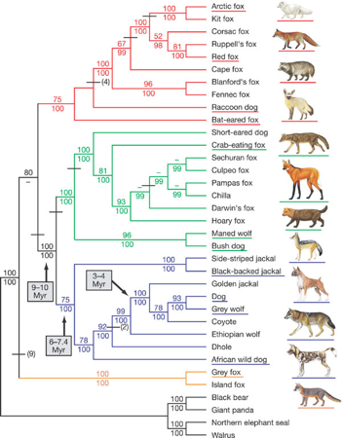
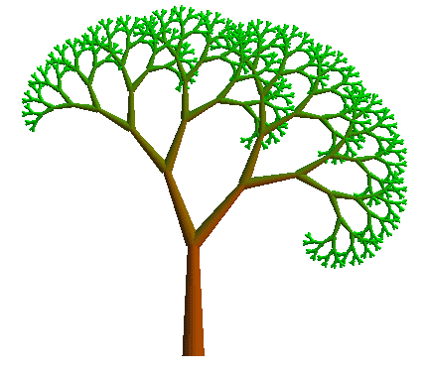
“I wonder about Trees” –Robert Frost
“We wonder about Robert Frost” - Trees

Slide 12
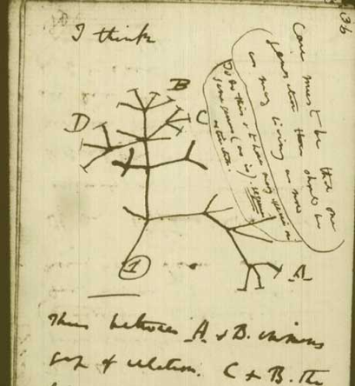
Phylogenetic Trees…
From Darwin’s notebooks, 1837

Slide 13
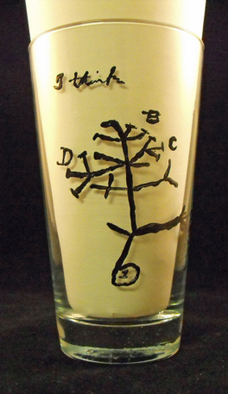

Slide 14
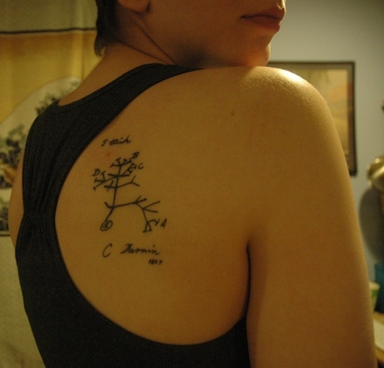
Really?

Slide 15
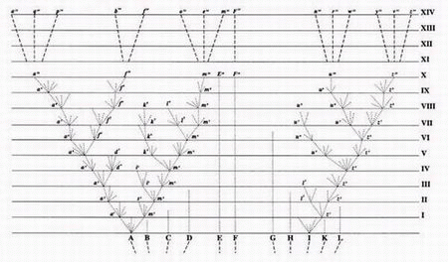
The only figure in On the Origin of Species by Natural Selection (Darwin, 1859)
From the 6th edition (1872): “The affinities of all the beings of the same class have sometimes been represented by a great tree. I believe this simile largely speaks the truth. The green and budding twigs may represent existing species; and those produced during former years may represent the long succession of extinct species.”

Slide 16
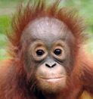
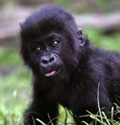
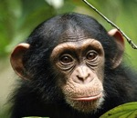
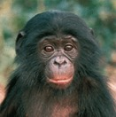
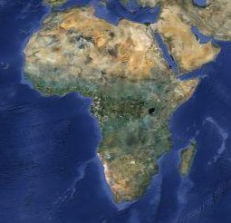
Trees and human evolution
Orangutan
Gorilla
Human
Common chimpanzee
Bonobo
~3 MYA
~6 MYA
~7 MYA
~15 MYA

Slide 17
Phylogenetic Trees
West Dorm Groody (“W”)
“Y”
East Dorm Groody (“E”)
“Z”
“X”
Linde Dorm Groody (“L”)
Case Groody (“C”)
These are called internal nodes
These are called leaf nodes or leaves or tips of the tree.
How do we represent this in Python?
Notes:
Show two things on board:
1. (Root, subtree1, subtree2)
2. Leaves look like this: (“L”,(),())

Slide 18
West Dorm Groody (“W”)
“Y”
East Dorm Groody (“E”)
“Z”
“X”
Linde Dorm Groody (“L”)
Case Groody (“C”)
A tree is either:
None ← This is a built-in value in Python
(Root, Left, Right)

Slide 19
How many nodes are in this tree?
West Dorm Groody (“W”)
>>> nodeCount(Groodies)
7
“Y”
East Dorm Groody (“E”)
“Z”
“X”
Linde Dorm Groody (“L”)
Case Groody (“C”)
It would be a shame to “leaf” out the base case!

Slide 20
Is my favorite species in this tree?
West Dorm Groody (“W”)
>>> find("E", Groodies)
True
>>> find("Sontag", Groodies)
False
“Y”
East Dorm Groody (“E”)
“Z”
“X”
Linde Dorm Groody (“L”)
Case Groody (“C”)

Slide 21
Is my favorite species in this tree?
West Dorm Groody (“W”)
>>> find("E", Groodies)
True
>>> find("Sontag", Groodies)
False
“Y”
East Dorm Groody (“E”)
“Z”
“X”
Linde Dorm Groody (“L”)
Case Groody (“C”)

Slide 22
Four problem worksheet bonanza!
West Dorm Groody (“W”)
“Y”
>>> height(Groodies)
4
>>> height(None)
0
>>> nodeList(Groodies)
['X', 'Y', 'W', 'Z', 'E', 'L', 'C']
>>> leafList(Groodies)
['W', 'E', 'L', 'C']
>>> mrca("L", "E", Groodies) # use find as a helper!
'Z'
>>> mrca("W", "E", Groodies)
'Y'
>>> mrca("W", "C", Groodies)
'X'
>>> mrca("W", "Prof. Ran", Groodies)
None
East Dorm Groody (“E”)
“Z”
“X”
Linde Dorm Groody (“L”)
Case Groody (“C”)
>>> find(“L”, Groodies)
True
Notes:
Worksheet Bonanza!!!

Slide 23
height
West Dorm Groody (“W”)
“Y”
East Dorm Groody (“E”)
“Z”
“X”
Linde Dorm Groody (“L”)
Case Groody (“C”)
>>> height(Groodies)
4

Slide 24
nodeList
West Dorm Groody (“W”)
“Y”
East Dorm Groody (“E”)
“Z”
“X”
Linde Dorm Groody (“L”)
Case Groody (“C”)
>>> nodeList(Groodies)
['X', 'Y', 'W', 'Z', 'E', 'L', 'C']

Slide 25
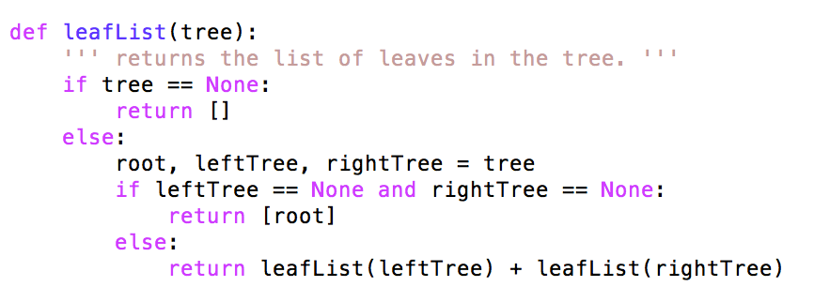
leafList
West Dorm Groody (“W”)
“Y”
East Dorm Groody (“E”)
“Z”
“X”
Linde Dorm Groody (“L”)
Case Groody (“C”)
>>> leafList(Groodies)
['W', 'E', 'L', 'C']

Slide 26
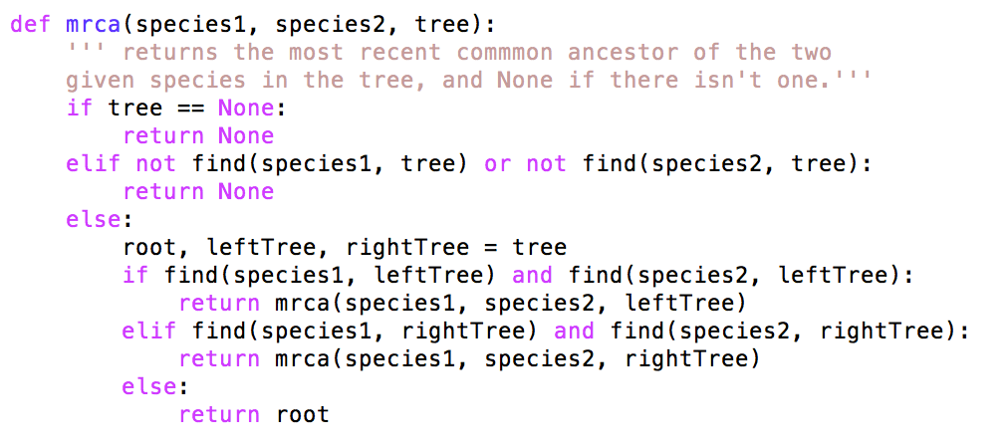
mrca
West Dorm Groody (“W”)
“Y”
East Dorm Groody (“E”)
“Z”
“X”
Linde Dorm Groody (“L”)
Case Groody (“C”)

Slide 27
Binary search trees (BSTs)
Set ADT:
insert(x)
find(x)
delete(x)
insert delete find
Dictionary O(n) O(n) O(n)
Array O(n) O(n) O(n)
Sorted array O(n) O(n) O(log n)
Linked list O(1) O(n) O(n)
Sorted linked list O(n) O(n) O(n)
BST “good” “good” “good”
“good” seems pretty imprecise!

Slide 28
Assume for now that there are no duplicate elements!
50
20
95
10
42
99
5
15
21
48
17
45
49
43
44
What’s “good” about this?

Slide 29
Binary Search Trees!
>>> tree = None
>>> tree = insert(42, tree)
>>> tree
(42, None, None)
>>> tree = insert(47, tree)
>>> tree
(42, None, (47, None, None))
>>> find(27, tree)
False
>>> find(47, tree)
True
>>> inorder(tree)
[42, 47]

Slide 30
inorder(tree)

Slide 31
inorder(tree)

Slide 32
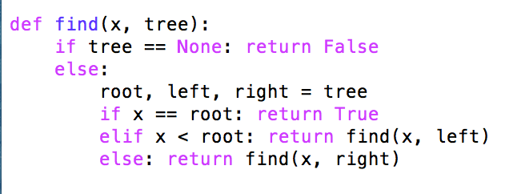
find(num, tree)

Slide 33
find(num, tree)

Slide 34
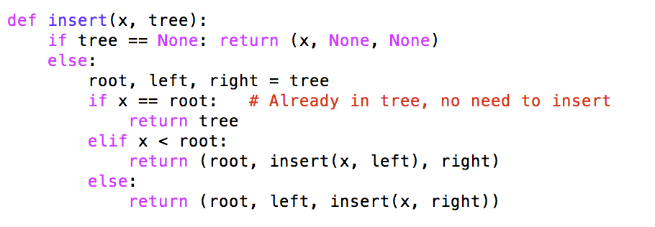
insert(num, tree)

Slide 35
insert(num, tree)

