Slide 1
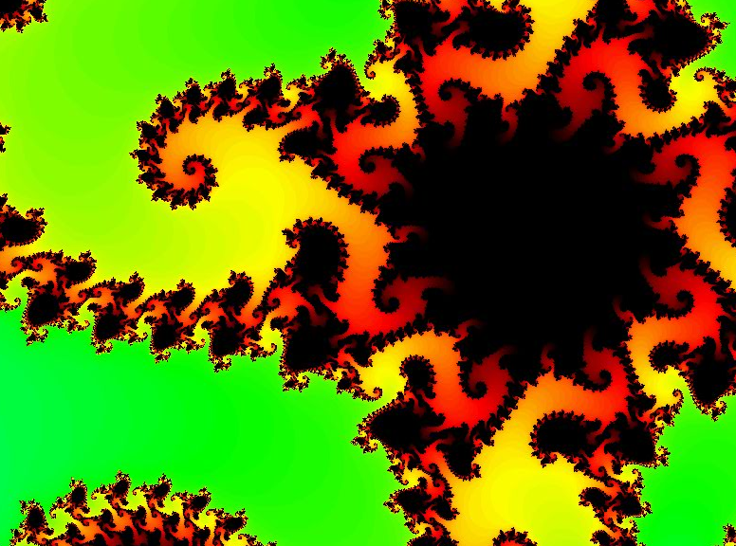
Seems more like two-thirds term to me...
CS 5 Today
infinitely nested structure…
CS Midterm
Thursday, Mar. 29
In-class, written
Page of notes is OK
Recursion in Python
Function composition
Circuit design
Hmmm assembly code
Loops in Python
Topics
from finitely nested loops
See online practice…
Homework 9 Loops! due 3/26
Notes:
INHANDOUT
class16 loops2
Reminders: no grutoring until Tuesday after break, but grutoring by appointment is available.
Possible demos: lec16prog01.py, hw8_pi.py
Be prepared to show a Mandelbrot zoom on YouTube: https://www.youtube.com/watch?v=G_GBwuYuOOs is 101 seconds.
A good longer one is https://www.youtube.com/watch?v=pCpLWbHVNhk

Slide 2
A week from Thursday, 3/29 will be the CS 5 in-class midterm
Un-warnings:
Concerns? Accommodations? See me…
only 5 minutes?
Try list comprehensions & LoL !
Five problems, written
Worth 1 hw assignment
Wcore worries? Extra extra-credit in hw10 and beyond
Loops will appear, as well..
Suggestions:
Go over in-class exercises and homework problems
Create a page of notes; 2-sided is OK
Consider small variations of the problems—and how they would change the solutions…
that's our approach…
Notes:
INHANDOUT

Slide 3
Homework 9 preview
#0
When Algorithms Discriminate...
#1 ~ lab
The Mandelbrot Set
#2
Pi from Pie
TT Securities
#3
Loopy thinking
(Extra)
ASCII Art

Slide 4
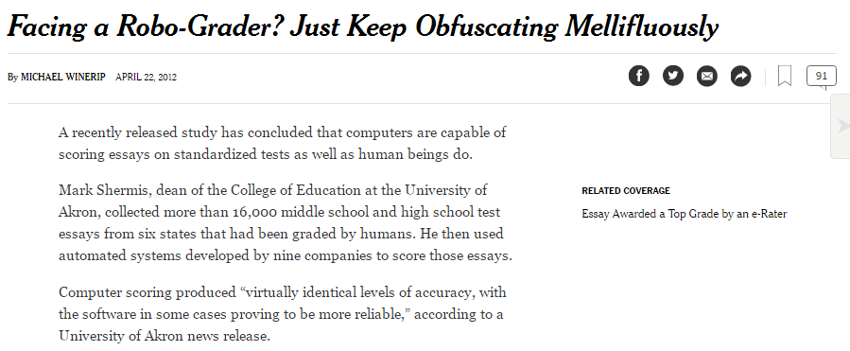
Homework 9 preview
#0
When Algorithms Discriminate...
#1 ~ lab
The Mandelbrot Set
#2
Pi from Pie
TTS Securities
#3
Loopy thinking
(Extra)
ASCII Art

Slide 5
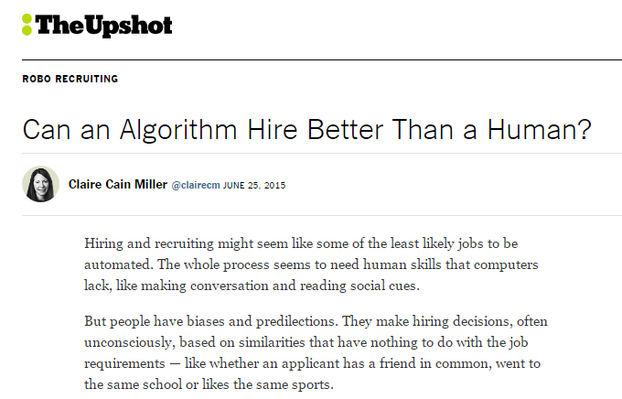
Homework 9 preview
#0
When Algorithms Discriminate...
#1 ~ lab
The Mandelbrot Set
#2
Pi from Pie
TTS Securities
#3
Loopy thinking
(Extra)
ASCII Art

Slide 6
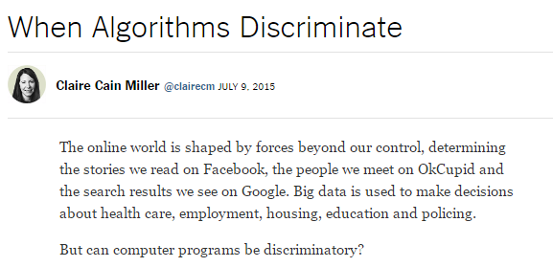
Homework 9 preview
#0
When Algorithms Discriminate...
#1 ~ lab
The Mandelbrot Set
#2
Pi from Pie
TTS Securities
#3
Loopy thinking
(Extra)
ASCII Art

Slide 7
Homework 9 preview
#0
When Algorithms Discriminate...
#1 ~ lab
The Mandelbrot Set
#2
Pi from Pie
TTS Securities
#3
Loopy thinking
(Extra)
ASCII Art

Slide 8
Thinking in loops
for
while
x = 1
while x < 42:
print(x)
x *= 2
list
for x in range(42):
print(x)
What are the design differences between these two types of Python loops?
Notes:
INHANDOUT

Slide 9
Thinking in loops
for
while
definite iteration
indefinite iteration
For a known list or # of iterations
For an unknown number of iterations

Slide 10
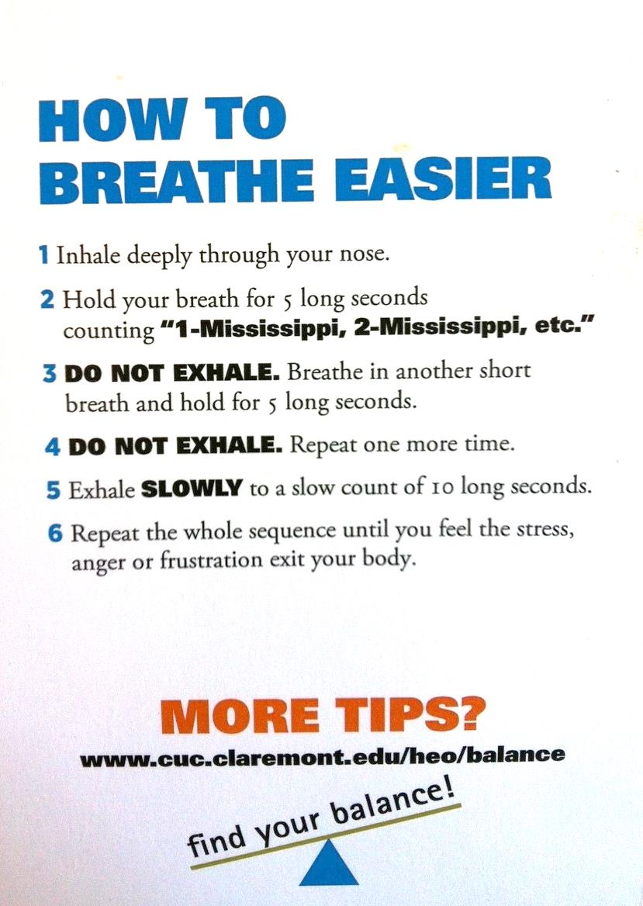
Loops are familiar ?
Careful here!
Table tent…

Slide 11
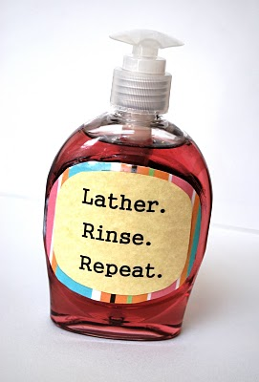
Loops are familiar ?

Slide 12
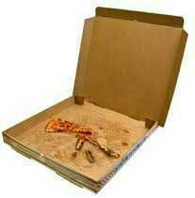
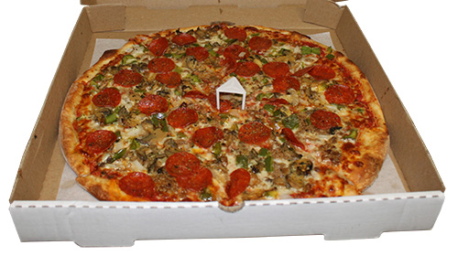
Hw9 Pr2
Pi from Pie?
π
Pizza is the universal constant, after all…

Slide 13
(1,1)
Hw9 Pr2
Estimating π from pie?
Pie
What if we just throw darts at this picture?
(0,0)
Box
(-1,-1)

Slide 14
(1,1)
Hw9 Pr2
Estimating π from pie?
Pie
(1) Suppose you throw 100 darts at the square (all of them hit the square)
(2) Suppose 80 of the 100 hit inside the circle.
(0,0)
(3) How could you estimate π from these throws?
Hints
How big is a side of the square? its area?
How big is the radius of the circle? its area?
How do these help!?
Box
(-1,-1)
Notes:
INHANDOUT

Slide 15
(1,1)
Hw8 Pr2
Pie
Estimating π from pie!
area
π
(0,0)
=
area
4
4
*
hits
Box
π
~
hits
(-1,-1)

Slide 16
Loops: for or while?
pi_one(e)
e == how close to π we need to get
pi_two(n)
n == number of darts to throw
Which function will use which kind of loop?
Notes:
INHANDOUT

Slide 17
Loops: for or while?
pi_one(e)
e == how close to π we need to get
while
pi_two(n)
n == number of darts to throw
for

Slide 18
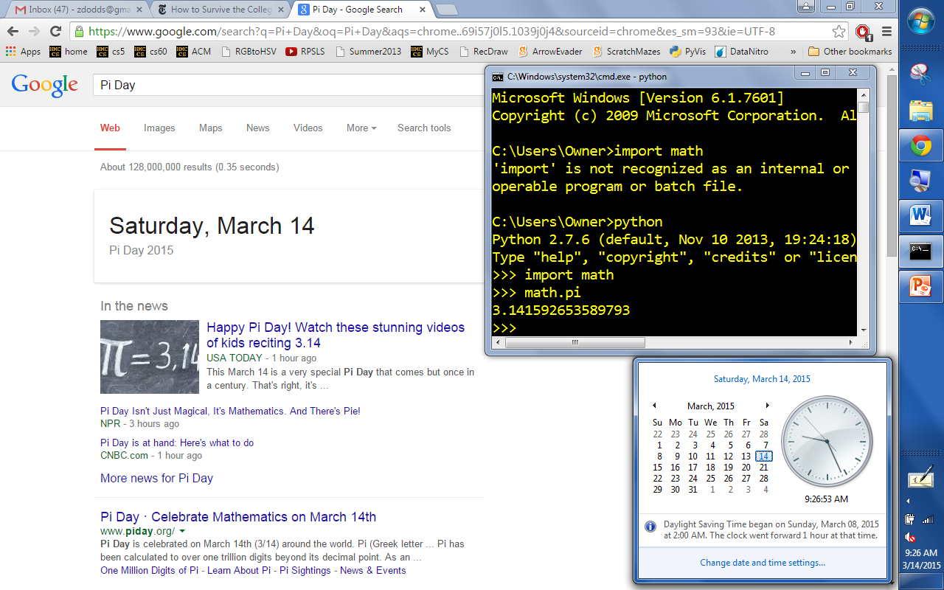
π day!

Slide 19
Homework 9 preview
#0
When Algorithms Discriminate...
#1 ~ lab
The Mandelbrot Set
#2
Pi from Pie
TTS Securities
#3
Nested looping structures!
(Extra)
ASCII Art

Slide 20
Nested loops are familiar, too!
for min in range(60):
for sec in range(60):
tick()
list
list

Slide 21
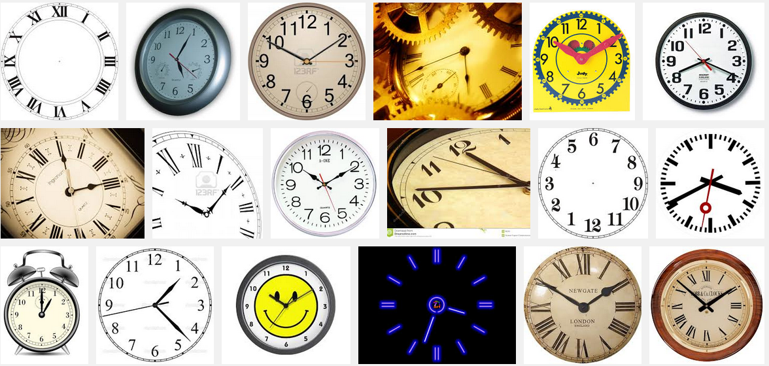
Nested loops are familiar, too!
So close!

Slide 22
Nested loops
Life clock
for y in range(84):
for m in range(12):
for d in range(f(m,y)):
for h in range(24):
for min in range(60):
for s in range(60):
tick()
list
list
list
list
list
list
Notes:
INHANDOUT

Slide 23
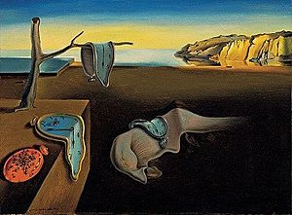
Nested loops!
for y in range(84):
for m in range(12):
for d in range(f(m,y)):
for h in range(24):
for min in range(60):
for s in range(60):
tick()
Claremont- College time
list
Persistence of Memory, S. Dali (MoMA)
list

Slide 24
s == 0
s == 59
mn == 0
Nested loops' 2d structure
One hour ~ 3600 seconds
mn == 42
42nd minute's
59th second
mn == 59
for min in range(60):
for s in range(60):
tick()
list
list
Notes:
INHANDOUT

Slide 25
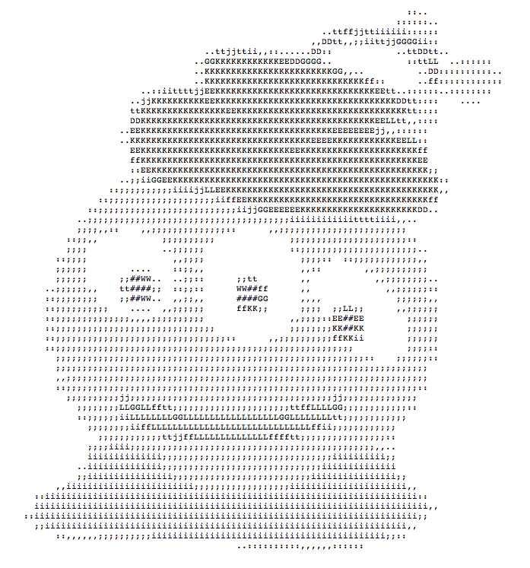
Nested loops via ASCII Art
That's my type of alien!

Slide 26
Creating 2d structure
col
0
1
2
3
# # # #
# # # #
# # # #
0
row
1
2
for row in range(3):
for col in range(4):
print("#")
list
list
Wait! this needs something more…
Notes:
ex1() in samples

Slide 27
Creating 2d structure
[0,1,2]
for row in range(3):
for col in range(4):
print('#',end = '')
print()
list
row =
[0,1,2,3]
list
col =
col =
col =
col =
row =
col
col =
col =
col =
col =
0
1
2
3
0
row =
row
1
col =
col =
col =
col =
2
Notes:
INHANDOUT
Walk thru step by step, emphasizing that inner loop repeats for each pass through outer.

Slide 28
Creating 2d structure
Let's take an alien's-eye view!
for row in range(3):
for col in range(4):
if col == row:
print('#',end = '')
else:
print(' ',end = '')
print()
0
list
row =
list
0
col =
col =
col =
col =
1
2
3
1
row =
0
col =
col =
col =
col =
1
col
2
3
0
1
2
3
2
row =
0
0
col =
col =
col =
col =
row
1
1
2
2
3
Notes:
Add the if to create the diagonal. This is ex3().

Slide 29
Match!
What code creates the fourth one?
Quiz
Name(s): ____________________________
* and ** are extra!
[0,1,2]
for r in range(3):
for c in range(6):
if c%2 == 1:
print('#',end = '')
else:
print(' ',end = '')
print()
for r in range(3):
for c in range(6):
if c%2 == r%2:
print('#',end = '')
else:
print(' ',end = '')
print()
for r in range(3):
for c in range(6):
if c > r:
print('#',end = '')
else:
print(' ',end = '')
print()
[0,1,2,3,4,5]
A
B
C
1
cols
2
cols
*
cols
2
3
4
2
5
3
4
5
2
3
1
1
1
4
0
0
0
0
# # # #
# # #
# #
0
# # #
# # #
# # #
0
# # # # #
# # #
#
1
1
1
2
2
2
rows
rows
3
cols
4
cols
**
cols
2
3
4
5
2
3
2
1
4
3
4
5
0
1
1
0
0
0
# # # # #
# # # #
# # #
0
# # #
# # #
# # #
0
# # #
# # #
# # # #
1
1
1
2
2
2
rows
rows
Notes:
QUIZSLIDE

Slide 30
Match!
What code creates the fourth one?
Quiz
Try this on the back first...
* and ** are extra!
[0,1,2]
for r in range(3):
for c in range(6):
if c%2 == 1:
print('#',end = '')
else:
print(' ',end = '')
print()
for r in range(3):
for c in range(6):
if c%2 == r%2:
print('#',end = '')
else:
print(' ',end = '')
print()
for r in range(3):
for c in range(6):
if c > r:
print('#',end = '')
else:
print(' ',end = '')
print()
[0,1,2,3,4,5]
A
B
C
1
cols
2
cols
*
cols
2
3
4
2
5
3
4
5
2
3
1
1
1
4
0
0
0
0
# # # #
# # #
# #
0
# # #
# # #
# # #
0
# # # # #
# # #
#
1
1
1
2
if c+r<4
2
2
rows
rows
if c+r<=4 and c>=r
3
cols
4
cols
**
cols
2
3
4
5
2
3
2
1
4
3
4
5
0
1
1
0
0
0
# # # # #
# # # #
# # #
0
# # #
# # #
# # #
0
# # #
# # #
# # # #
1
1
1
2
2
2
rows
rows
if not (c == r or c == 4-r)
Notes:
On lower-right diagram, draw the two diagonals that are left as spaces.

Slide 31
Nested loops' 2d structure
for d in range(f(m)):
for m in range(1,13):
num_bdays(m,d)
What trends appear in this birthday data?
How might we be suspicious of the fairness of this data?!
how many shared birthdays are in CS5?
vizwiz.blogspot.com/2012/05/how-common-is-your-birthday-find-out.html
Notes:
INHANDOUT
This shows all births in the US, 1973-1999. Note that US births contain a component of choice.
Patterns:
1. Summer birthdays are more common.
2. People avoid the 13th.
3. Doctors like to avoid holidays (7/4, Christmas, Thanksgiving)
4. Valentine’s Day is popular.
5. Births just before 1/1 have tax advantages.

Slide 32
From ASCII to real images...
or maybe complex images?

Slide 33
Python and images
from cs5png import *
arguments are width and height
image = PNGImage(300, 200)
objects are variables that can contain their own functions, often called methods
image.plotPixel(10, 100)
image.plotPixel(42, 42, (255,0,0))
col x
row y
red
green
blue
image.saveFile( )
These functions are clearly plotting something – if only I knew what they were up to...
Notes:
INHANDOUT
Note that columns come first (X), then rows (Y).

Slide 34
Imagining Images
from cs5png import *
def testImage():
"""Image demonstration"""
WD = 300
HT = 200
image = PNGImage(WD, HT)
for row in range(HT):
for col in range(WD):
if col == row:
image.plotPoint(col, row)
image.saveFile()
thicker line?
other diagonal?
stripes ?
thicker stripes?
thatching?
Notes:
INHANDOUT
This is testImage () in the sample code.
Comment out the if and else; show test.png (gqview will auto-refresh).
Show various color choices, demonstrating a bit of RGB (e.g. magenta).
Change “if col == row” to “if col >= row” to get a triangle.

Slide 35
Python's Complex Numbers
i
can't believe this!
>>> c = 3 + 4j
>>> c.real
3.0
>>> c.imag
4.0
>>> abs(c)
5.0
Nothing's too complex for Python!
Notes:
It’s OK to be new to complex #’s; they’re really just 2-D numbers. The + sign is more definition than addition.
abs(c) is distance from origin – see next slide.

Slide 36
Lab 9: the Mandelbrot Set
z₀ = 0
z_{n+1} = z_{n}² + c
Consider an update rule for all complex numbers c
4j
c = 3 + 4j
3
Real axis
Imaginary axis
Notes:
Draw abs(c) as hypotenuse.

Slide 37
Mandelbrot Definition
z₀ = 0
z_{n+1} = z_{n}² + c
Consider an update rule for all complex numbers c
Imaginary axis
Small values of c keep the sequence near the origin, 0+0j.
z₃
c = 3 + 4j
c = .3 + .4j
c
z = z**2 + c; print(z)
z₁
z₂
z₄
z₀
Real axis
z₅
some "stick around": oscillate or converge
Notes:
INHANDOUT
Do “z = z**2 + c; print(z)” repeatedly in Python window. Show c = 0.1 + 0.1j

Slide 38
Mandelbrot Definition
z₀ = 0
z_{n+1} = z_{n}² + c
Consider an update rule for all complex numbers c
Which c's
stick around?
Small values of c keep the sequence near the origin, 0+0j.
Benoit B. Mandelbrot 1924 – 2010
c
Real axis
c
Other values of c make the sequence head to infinity.
Imaginary axis
Notes:
INHANDOUT

Slide 39
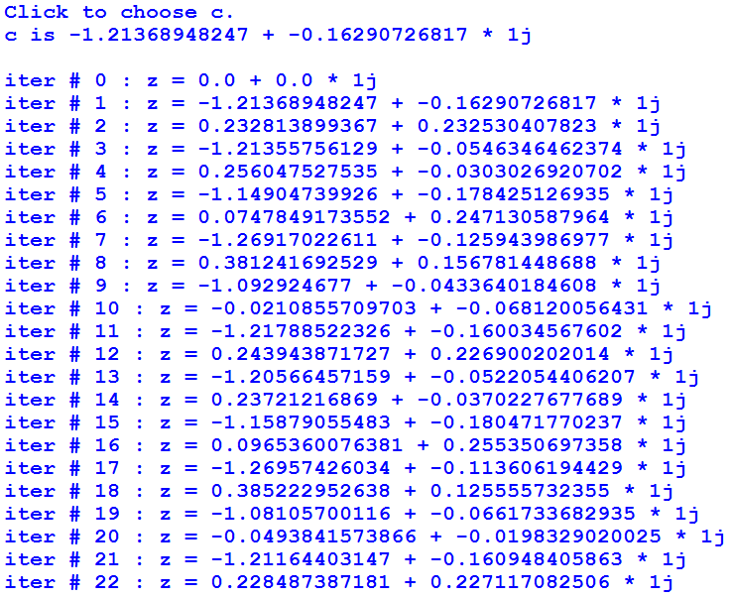
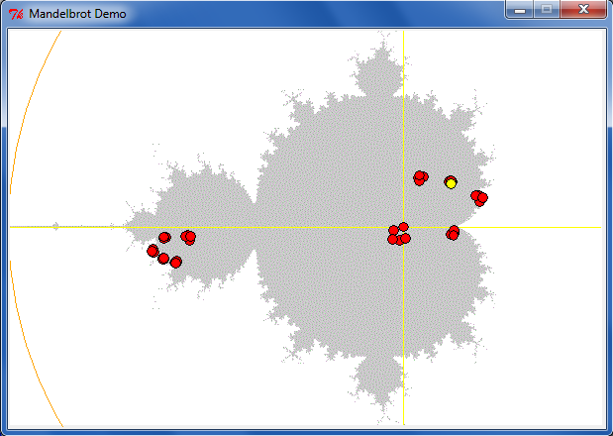
Lab 9: the Mandelbrot Set
z₀ = 0
z_{n+1} = z_{n}² + c
Consider an update rule for all complex numbers c
some c's stick around

Slide 40
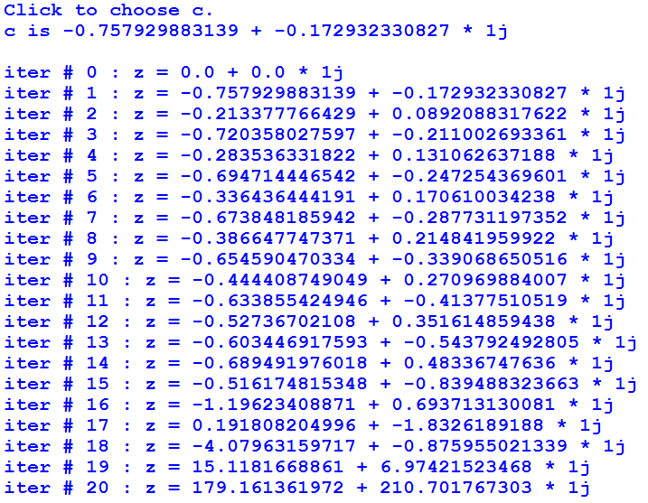
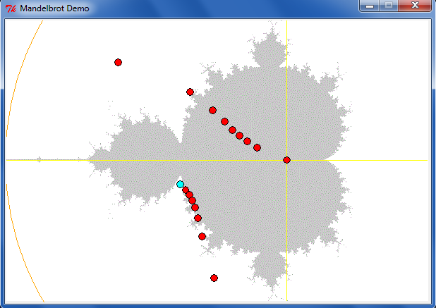
Lab 8: the Mandelbrot Set
z₀ = 0
z_{n+1} = z_{n}² + c
Consider an update rule for all complex numbers c
other c's diverge
Notes:
Run mshow.py. Click on a (diverging) point. Then repeatedly click; each click (anywhere) plots the next point in the sequence.

Slide 41
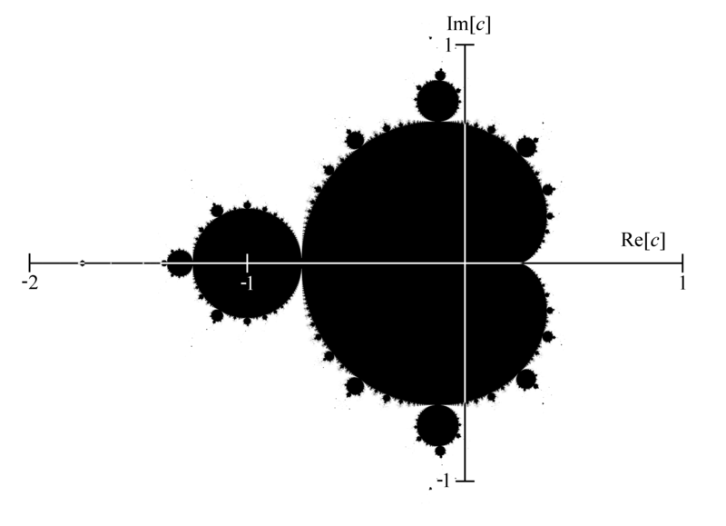
Mandelbrot Set ~ points that stick around
mid 70's resolution
The shaded area are points that do not diverge for z = z**2 + c

Slide 42
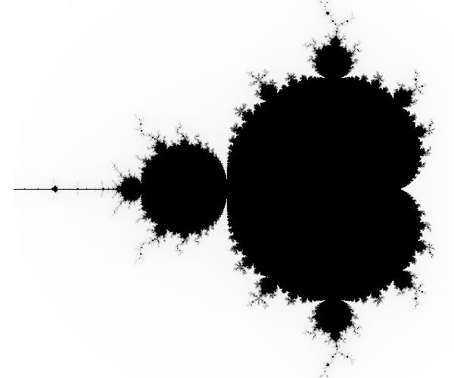
Higher-resolution Mandelbrot Set
-2 + 1j
1 + 1j
connected
finite area
∞ perimeter!
-2 - 1j
1 - 1j
The black pixels are points that do not diverge for z = z**2 + c

Slide 43
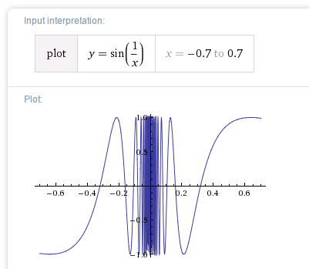
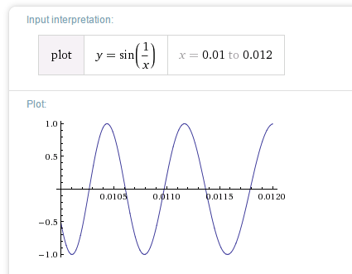
Chaos?
Complex things always consisted of simple parts…

Slide 44
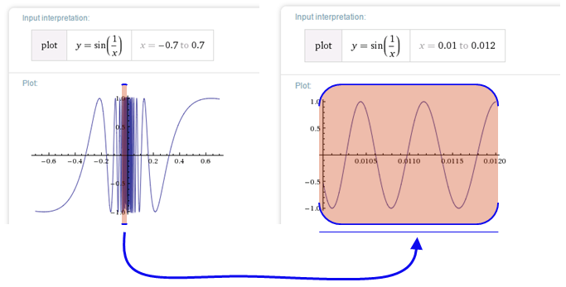
Before the Mandelbrot Set, complex things were made of simple parts:
Chaos!
This was a "naturally occurring" object where zooming uncovers more detail, not less:
not self-similar but quasi-self-similar
http://www.youtube.com/watch?v=0jGaio87u3A
Notes:
INHANDOUT

Slide 45
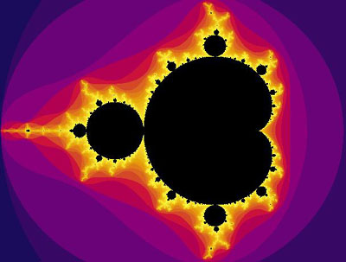
The black pixels are points that do not diverge for z = z**2 + c
What are these colors?

Slide 46
The black pixels are points that do not diverge for z = z**2 + c
escape velocities
What are these colors?

Slide 47
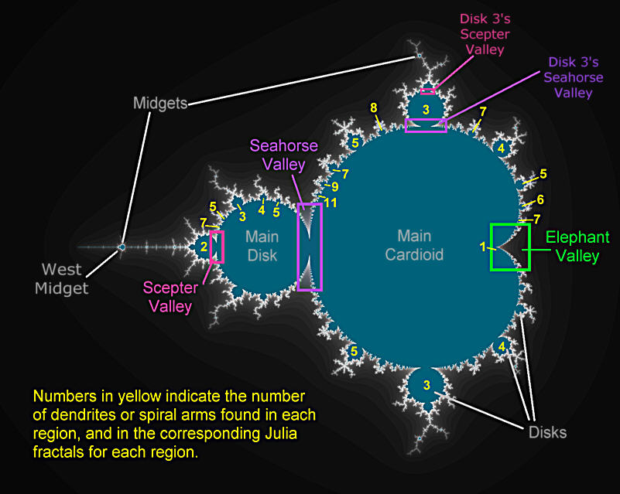
Atlas of the M. Set
Notes:
INHANDOUT

Slide 48
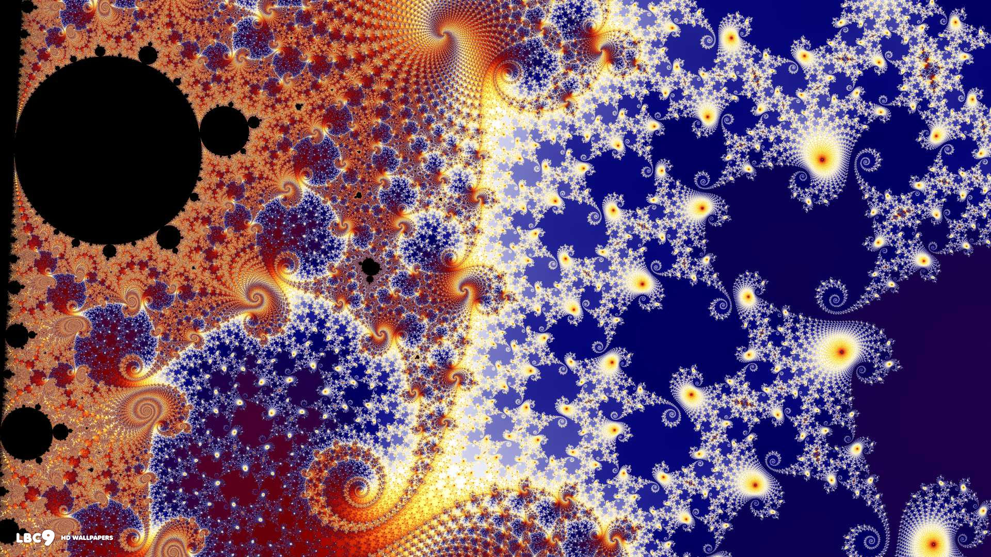
In the Seahorse Valley….

Slide 49
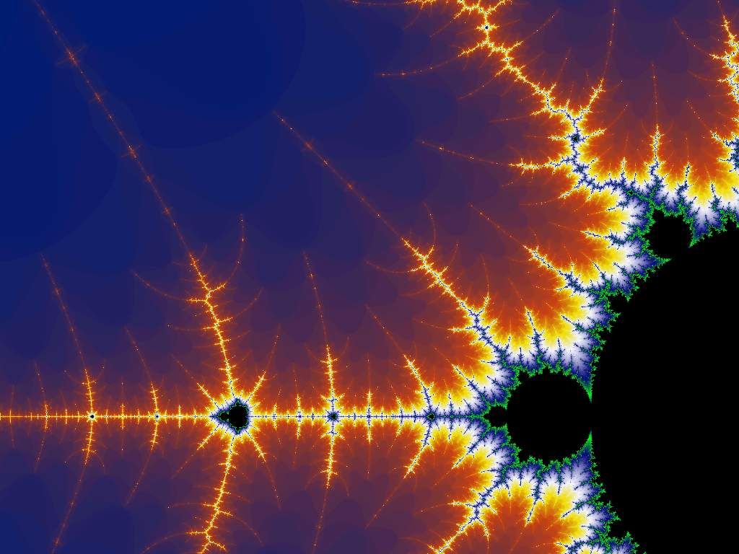
Happy Mandelbrotting!
www.cs.hmc.edu/~jgrasel/projects
http://www.youtube.com/watch?v=0jGaio87u3A
Notes:
This was created by a CS5 student.
Youtube: deepest Mandelbrot zoom ever: https://www.youtube.com/watch?v=0jGaio87u3A

Slide 50
Have a great spring break!

