Slide 1


The CS 5 Black Herald
Read 5.6-5.7!
GIANT PENGUIN FOUND IN GALILEO CORRIDORS
Claremont (PPI): An enormous penguin, nearly six feet in length, was found in the corridors of Harvey Mudd College’s Libra Complex late Wednesday evening. Scientists from Penguin Pleasures, a volunteer rescue group, said the animal appeared to have expired from an overdose of sugar. “Sadly, many people do not realize that penguins are terribly sensitive to sweets,” stated Dr. D.I. Section as she examined the corpse. “I imagine that a well-meaning person must have intended to give it a treat.”
The saddened campus plans to hold a moment of silence on the first day of final exams, since students are generally quiet and mournful during that time anyway.
Notes:
Class 17 imperative3
Be ready to demo Twenty Questions (lec17prog01.py). Make sure tqtree.txt is updated from tqtree-master.txt.
Worksheet: fill in play() function for 20 Questions

Slide 2
Abstract Data Types (ADTs)
Abstract set: insert(x), delete(x), find(x)
Average and worst cases (n is number of items in the set):
 | Insert (avg) | Delete (avg) | Find (avg) | Insert (worst) | Delete (worst) | Find (worst)
Dictionary | O(1) | O(1) | O(1) | O(n) | O(n) | O(n)
Python List | O(1) | O(n) | O(n) | O(n) | O(n) | O(n)
BST | O(log n) | O(log n) | O(log n) | O(log n) | O(log n) | O(log n)
Notes:
Strictly speaking, the worst case for a simple BST is O(n); getting to O(log n) requires keeping it balanced.

Slide 3
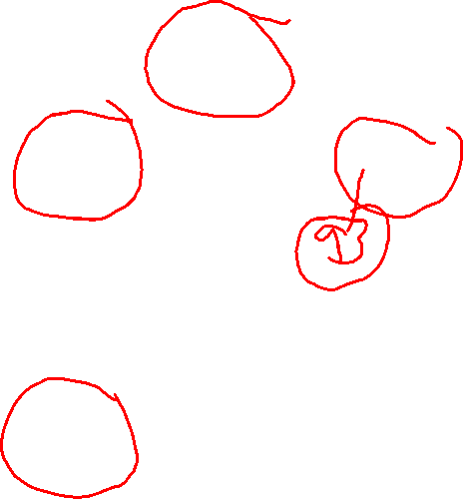
Binary Search Trees
50
20
95
10
42
99
5
15
21
48
17
45
49
43
44

Slide 4
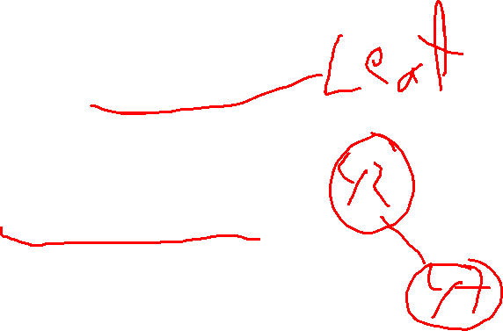
Binary Search Trees!
>>> tree = None
>>> tree = insert(42, tree)
>>> tree
(42, None, None)
>>> tree = insert(47, tree)
>>> tree
(42, None, (47, None, None))
>>> find(27, tree)
False
>>> find(47, tree)
True
>>> inorder(tree)
[42, 47]
Notes:
A tree consists of a value and two subtrees. The definition itself is recursive–and for that reason, working with the tree is a naturally recursive process.

Slide 5
inorder(tree)
def inorder(tree):
if tree is None:
return []
else:
key, left, right = tree
return inorder(left) + [key] + inorder(right)
Notes:
The solution here is hidden by a white box that disappears on click.

Slide 6
find(x, tree)
def find(x, tree):
if tree is None:
return False
else:
key, left, right = tree
if x == key:
return True
elif x < key:
return find(x, left)
else:
return find(x, right)
Notes:
The solution here is hidden by a white box that disappears on click.

Slide 7


insert(x, tree)
def insert(x, tree):
if tree is None:
return (x, None, None)
else:
key, left, right = tree
if x == key:
return tree # Already in tree, done!
elif x < key:
return (key, insert(x, left), right)
else:
return (key, left, insert(x, right))
This will be handy when we save a tree to a file!
Notes:
The solution here is hidden by a white box that disappears on click.
The alien’s comment specifically refers to the problem of reading a tree back from a file.

Slide 8
Twenty Questions Game
Demo!
Playing the game gives back a new tree!
How do we save the tree?
How do we restore the tree? (Optional, but recommended!)
Is it bigger than a breadbox?
("Is it bigger than a breadbox?",
("an elephant", None, None),
("a mouse", None, None)
)
an elephant?
a mouse?
Notes:
Clarify that the elephant and mouse are leaves; they contain answers rather than questions.

Slide 9
Bigger Trees
Is it bigger than a breadbox?
Does it have wheels?
a mouse?
a car?
an elephant?
("Is it bigger than a breadbox?",
("Does it have wheels?", ("a car", None, None), ("an elephant", None, None)),
("a mouse", None, None)
)

Slide 10

play(tree)
def play(tree):
if isLeaf(tree):
return playLeaf(tree)
else:
question, yesChild, noChild = tree
if yes(question + " "):
else:
tree = …
while(…):
tree = play(tree)
Imagine a function called
playLeaf(tree)!
Fill this in! Then talk with a neighbor about what playLeaf will need to do.
Worksheet!
Notes:
Worksheet

Slide 11
play(tree)
def play(tree):
if leaf(tree):
return playLeaf(tree)
else:
root, yesChild, noChild = tree
if yes(root + " "):
return (root, play(yesChild), noChild)
else:
return (root, yesChild, play(noChild))
What does this function do?

Slide 12
The Alien’s Life Advice
If you’re naturally quiet, speak up for a change.
And if you’re a talker, try being quiet!

Slide 13

Saving a Tree to a File
What does the file look like?
("Is it bigger than a breadbox?",
("Is it gray?",
(“an elephant", None, None),
("a tree“, None, None)),
("a mouse", None, None)
)
Is it bigger than a breadbox?
yes
no
Is it gray?
a mouse?
yes
no
Internal node
Is it bigger than a breadbox?
Internal node
Is it gray?
Leaf
an elephant
Leaf
a tree
Leaf
a mouse
an elephant?
a tree?

Slide 14
Writing to a File
saveFile = open("tqtree.txt", "w")
saveTree(saveFile, tree)
saveFile.close()
...
def saveTree(saveFile, tree):
text, yesChild, noChild = tree
if isLeaf(tree):
print("Leaf", file = saveFile)
print(text, file = saveFile)
else:
...

Slide 15
Reading a Tree
try:
loadFile = open(TREE_FILE, "r")
tree = loadTree(loadFile)
loadFile.close()
except FileNotFoundError:
pass
...
def loadTree(loadFile):
line = loadFile.readline().strip()
if line == "Leaf":
answer = loadFile.readline().strip()
return (answer, None, None)
else:

Slide 16
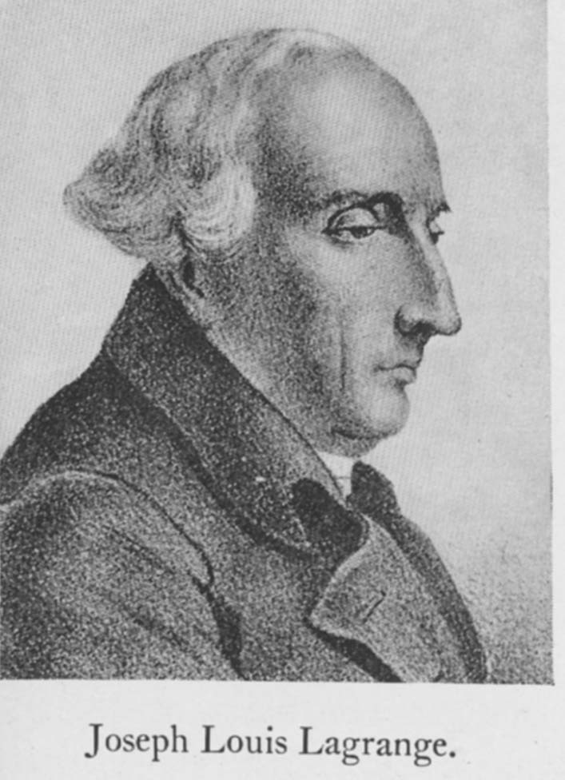

The Lagrange Polynomial Method!
Steganography = Math + CS
Suppose we have a secret…
And we don’t trust any single person with it.
Notes:
Animation: bottom line
What Lagrange did was figure out a method that, given a set of points in the xy plane, would created a polynomial that passes through those points.
Shamir’s secret sharing depends on this approach.

Slide 17


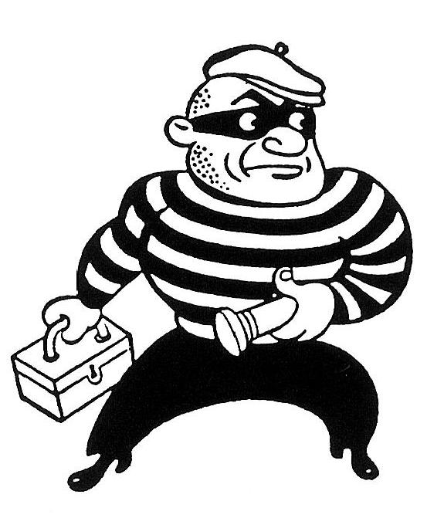
The Lagrange Polynomial Method!
Wouldn’t it be cool if we could split a secret into n parts,
such that any k people could get it back?
!!!

Slide 18

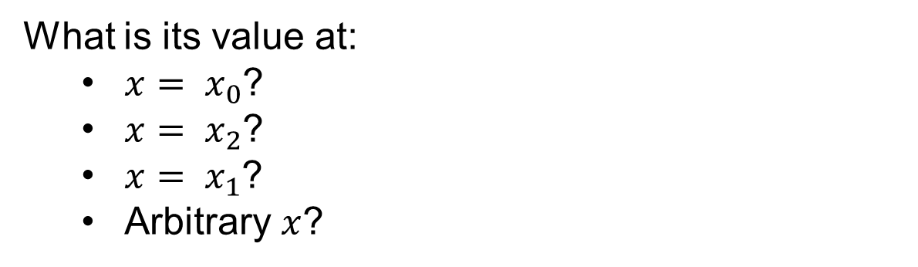
Lagrange Basis Functions
Consider the following basis function:
Note that
x₀ ≠ x₁ ≠ x₂
Notes:
Think/pair/share

Slide 19
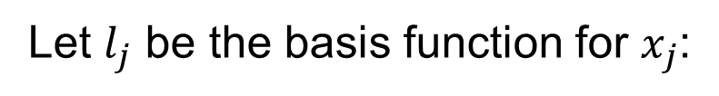

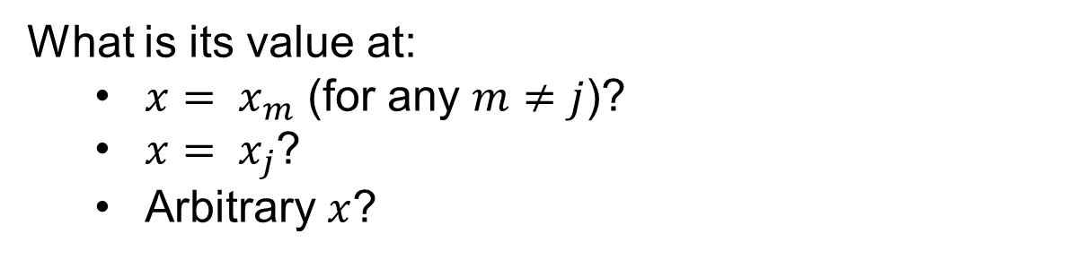
Lagrange Basis Functions
Notes:
Limits are 0 to k. Don’t forget to explain product notation. Question: what built-in Python feature can calculate this? (reduce)

Slide 20
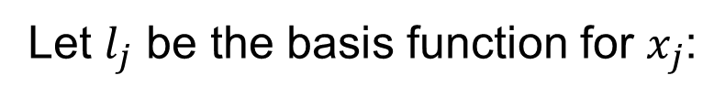

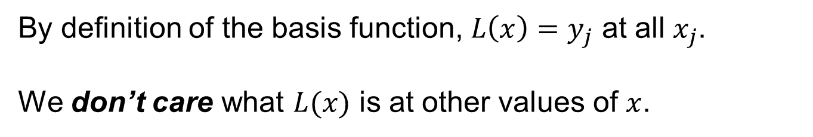
A Polynomial Through k Points
Notes:
Don’t forget to explain summation notation. Note that it’s implemented in the Python sum function.

Slide 21
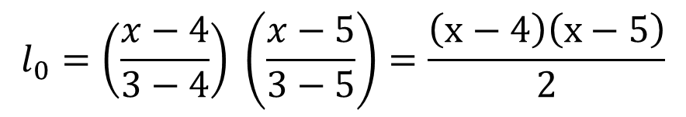
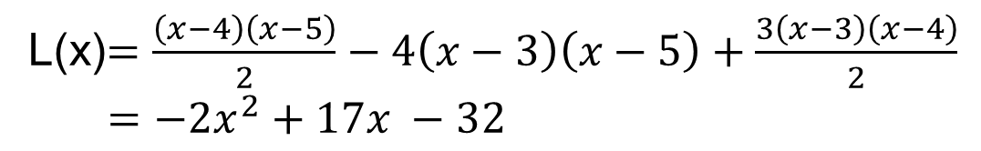
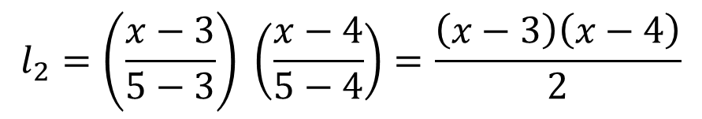
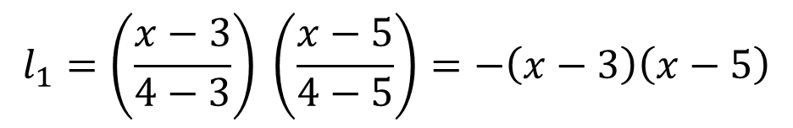
A Concrete Example
Let x₀ = 3, x₁ = 4, x₂ = 5, y₀ = 1, y₁ = 4, y₂ = 3. Then:
$$l_{0}=\left(\frac{x−4}{3−4}\right) \left(\frac{x−5}{3−5}\right)=\frac{\left(x−4\right)\left(x−5\right)}{2}$$
$$l_{1}=\left(\frac{x−3}{4−3}\right) \left(\frac{x−5}{4−5}\right)=−\left(x−3\right)\left(x−5\right)$$
$$l_{2}=\left(\frac{x−3}{5−3}\right) \left(\frac{x−4}{5−4}\right)=\frac{\left(x−3\right)\left(x−4\right)}{2}$$
L(x)$=\frac{\left(x−4\right)\left(x−5\right)}{2}−4\left(x−3\right)\left(x−5\right)+\frac{3\left(x−3\right)\left(x−4\right)}{2}$
$=−2x^{2}+17x −32$
Notes:
Clearly, this is a quadratic, which makes sense because in general you need a quadratic to be able to pass through three arbitrary points. It’s easy to show how a 2-point polynomial L(x) = y0(x-x1)/(x0-x1) + y1(x-x0)/(x1-x0) simplifies to y = mx + b. (But don’t do so; it takes too much time.)

Slide 22
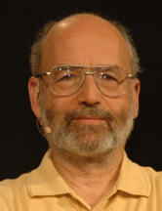
Shamir’s Secret Sharing
This brings us to Shamir’s method for sharing a secret s such that any k of n people can reconstruct it:
Pick a polynomial of degree k-1, with random coefficients a_{i}:
y = a_{k-1}x^{k-1} + a_{k-2}x^{k-2} + … + a₁x¹ + s
For each holder of the secret, pick a random x and use the polynomial to calculate a corresponding y.
Reconstruct the secret by creating a Lagrange polynomial of degree k-1 and evaluating it at x = 0.
Wow! Is it really that easy?
Notes:
Adi Shamir is an Israeli cryptographer born in 1952. Besides this clever secret-sharing scheme, he was co-inventor (along with Ron Rivest and Len Adleman) of the RSA public-key encryption algorithm, which was the first practical approach to public-key encryption (and which is in wide use today). R, S, and A won the 2002 Turing award for this and other contributions to cryptography.
A nice property of Shamir’s method is that you can add new people at any time, as long as k remains unchanged.

Slide 23
Data Compression
The zzyzva is known to be a xenophobic creature with a zealous personality…
B6^9)=\n%%spam!=&&penguin/?’,/+
compression algorithm
(e.g. zip)
Now we can delete the original file!
TEXT FILE
zzyzva.txt
58,254 bytes
TEXT FILE
zzyzva.txt.Z
23,124 bytes

Slide 24
Data Compression!
Letter ord(Letter) Binary
T 84 01010100
h 104 01101000
e 101 01100101
z 122 01111010
The zzyzva is known to be a xenophobic creature with a zealous personality…
" " - 1226754 19.04%
E - 655257 10.17%
T - 474521 7.37%
A - 425718 6.61%
… skipping a few …
J - 5329 0.08%
Q - 4923 0.08%
Z - 3378 0.05%
TEXT FILE
But these statistics are on average, not for my essay on the zzyzva!
English text
letter frequencies

Slide 25
The Prefix Property
The zzyzva is known to be a xenophobic creature with a zealous personality…
Letter frequency Binary code
z 0.25 00
y 0.10 01
x 0.09 10
a 0.08 111
r 0.02 1100
TEXT FILE
101110100001100 = 10 111 01 00 00 1100
Notes:
The prefix property says you can always unambiguously identify a code just by looking at a prefix of the string. Another name for this is an "instantaneously decodable code".

Slide 26
Consider the Language “Spamish”, with a Four-Letter Alphabet…
Letter Freq Fixed Length Variable Length
s 0.6 00 0
p 0.2 01 10
a 0.1 10 110
m 0.1 11 111
Expected average number of bits
per symbol = 2
Expected average number of bits per symbol =
0.6x1 + 0.2x2 + 0.1x3 + 0.1x3 = 1.6
Notes:
This slide has one animation, showing the second expected average.

Slide 27

The Variable-Length Coding Problem…
These frequencies are from the specific file that we’re planning to compress!!
Letter Frequency
a₁ freq(a₁) a₂ freq(a₂) a₃ freq(a₃) … a_{n} freq(a_{n})
Objective: Find a binary prefix code that minimizes the average number of bits per symbol

Slide 28
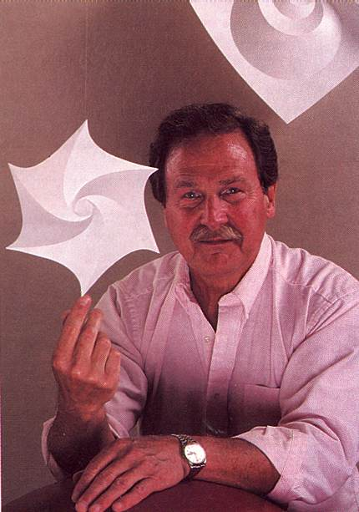
The David Huffman Story!
Letter freq
s 0.6
p 0.2
a 0.1
m 0.1
map smppam
ssampamsmam
…
TEXT FILE
Huffman coding is one of the fundamental ideas that people
in computer science and data communications are using all
the time - Donald Knuth
Notes:
1951 David Huffman took information theory at MIT from Robert Fano. He was give a choice of taking a final exam or finding an optimal prefix code. Fano didn’t tell him that he himself had struggled with the problem. Huffman worked for a long time, without success. He had an idea, but couldn’t prove it was optimal. Finally, he gave up, and as he was on the way to see Fano he suddenly had the necessary insight. When he showed his result to Fano, Fano exclaimed, “Is it really that easy?”

Slide 29
File I/O
def read_file():
filename = input("Enter the name of a file: ")
myfile = open(filename, "rb") # "r" means "read"
contents = myfile.read().decode('latin-1') # MAYBE
myfile.close()
return contents
def write_file(string):
filename = input("Enter the name of a file: ")
myfile = open(filename, "wb") # "w" means "write"
myfile.write(string.encode('latin-1')) # MAYBE
myfile.close()
return
>>> write_file("Spam is the secret to all :^)!")
Enter the name of a file to write: spam.txt
>>> read_file()
Enter the name of a file: spam.txt
'Spam is the secret to all :^)!'
What about line breaks in the file?
Notes:
Python treats text and binary files very differently. For binary files, use “rb” and “wb”. The encode/decode part is only for Huffman.

Slide 30

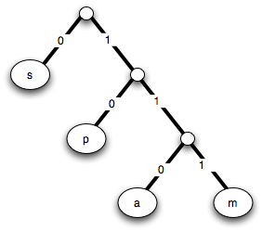
I wonder about trees - Robert Frost
We wonder about Robert Frost - Trees
Recursive definition of a binary tree…
A binary tree is:
1. Just a symbol (i.e. a “leaf”) or
2. A left subtree and a right subtree
(“s”, (“p”, (“a”, “m”)) )
???
???
(“p”, (“a”, “m”) )
“s”
Shouldn’t that be the list
[“a”, “m”] ?
(“a”, “m”)
“p”
“a”
“m”
Notes:
How do you make the tree? On next slide they’ll do it by trial and error.

Slide 31
I wonder about trees - Robert Frost
We wonder about Robert Frost - Trees
Recursive definition of a binary tree…
A binary tree is:
1. Just a symbol (i.e. a “leaf”) or
2. A left subtree and a right subtree
???
“s”
Shouldn’t that be the list
[“a”, “m”] ?
(“a”, “m”)
“p”
“a”
“m”
Notes:
How do you make the tree? On next slide they’ll do it by trial and error.

Slide 32
You Try It!
Letter Frequency
h 0.40
a 0.20
r 0.15
v 0.15
e 0.06
y 0.04
Notes:
WORKSHEET PROBLEM: Try to find an optimal code for these letter frequencies. The optimal code is 2.3 bits per symbol; see “You Try It” a few slides further on for the tree.

Slide 33
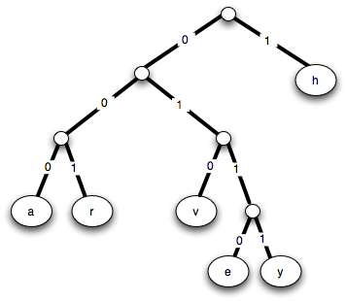
You Try It!
Worksheet
( ( (a, r) , (v, (e, y) ) ) , h )
( (a, r) , (v, (e, y) ) )
(a, r)
(v, (e, y) )
(e, y)
Notes:
Here’s what we want: most frequent letters near the top (short codes); frequent ones near the bottom. The way to do it is to start at the bottom; that way infrequent pairs can combine to become higher frequency.

Slide 34
Huffman Coding
ENCODING:
Scan text file to compute frequencies.
Build “Huffman Tree”.
Find code for every symbol (letter)—why is this a prefix code?
Create new compressed file by saving the entire code at the top of the file, followed by the code for each symbol (letter) in the file.
NOTE: Open the compressed file with "wb".

