Slide 2
CS 5: Putting loops to work…
[-35, -24, -13, -2, 9, 20, 31, ?]
[26250, 5250, 1050, 210, ?]
[90123241791111, 93551622, 121074, 3111, ?]
What's next?
[1, 11, 21, 1211, 111221, ?]
I'm glad you asked!
Homework 9: due Mon., 3/26 by midnight
"Office" hrs. Mon! + lots of tutoring, LAC & ...
Midterm 3/29; review on the CS5 homepage
Final Exam: 5/8 @ 2pm
quizzes!
Notes:
Class 17 loops3
INHANDOUT
Possible demos: lec17fun.py
Have a browser window visible for in-python browse calls
Don’t do the sequences here; the answers are on an upcoming slide.
Sequences: add 11; divide by 5; add pairs of numbers (syntactic and arithmetic); read it and weep (purely syntactic)

Slide 3
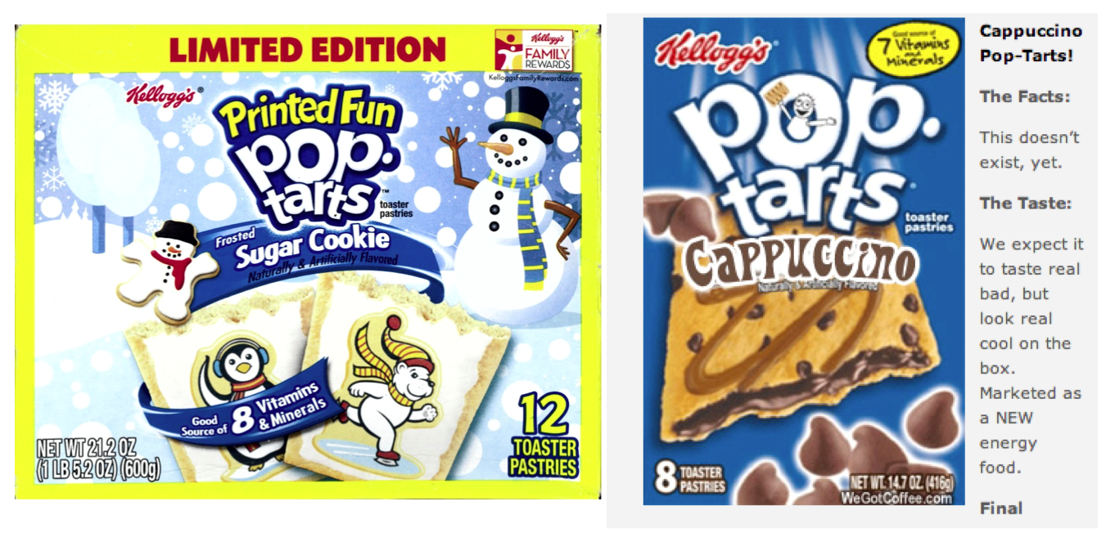
Pop tarts > candy
Official CS5 snack comparison
pop-tart recursion!
But this should exist!

Slide 4
Next Thursday will be the CS 5 in-class midterm
Un-warnings:
Worries? concerns? See me…
Five problems, written
Worth 1 homework assignment
Score worries? Extra extra-credit in hw9 and beyond
Suggestions:
Go over in-class exercises and homework problems
create a page of notes, 2-sided is OK
Consider small variations of the problems – and how they would change the solutions…
only 5 minutes? Try list comprehensions & LoL!
all quizzes so far? they're posted!
Notes:
Creating your notes page is an excellent review method.
The midterm will be all written, very similar to the in-class quizzes.
Lab next week is “1/2” lab, and homework will be lighter.

Slide 5
Mid-term feedback…
Don't put your name
I would love to know any thoughts you have about CS5 thus far in the term. In particular, how you feel about the time and effort CS5 requires…
On average, how much time per week do you spend on CS5 outside class + lab?
How does CS5's workload compare to other classes you're taking this term?
How would you judge the pace of CS5?
much lighter
about the same
much heavier
much too slow
about right
much too fast
Circle your school: CMC Pitzer Pomona Scripps Other
Something you'd keep about CS5 …?
Later today
Something you'd change about / get rid of / add to CS5 …?
Other thoughts optional, but 142% welcome:

Slide 6
CS 5: Putting loops to work…
[-35, -24, -13, -2, 9, 20, 31, ?]
[26250 5250, 1050, 210, ?]
[90123241791111, 93551622, 121074, 3111, ?]
What's next?
[1, 11, 21, 1211, 111221, ?]
I'm glad you asked!
Homework 9: due Mon., 3/26 by midnight
"Office" hrs. Mon! + lots of tutoring, LAC & ...
Midterm 3/29; review on the CS5 homepage
Final Exam: 5/8 @ 2pm
quizzes!
Notes:
The third sequence is syntactic (add pairs of digits). Fourth is syntactic and semantic.
Show weep(11), n_weeps(10).

Slide 7
The read it and weep sequence
1
11
21
1211
111221
312211
13112221
…
str vs. int
When does the first 4 appear?
How fast do these terms grow?
Extra extra credit: in wk9!
Notes:
Next is: 1113213211
4 never appears.

Slide 8
Growth determined empirically…
1
11
21
1211
111221
312211
13112221
…
In the limit, the length of the Nth term of the read-it-and-weep sequence is
(1.303577...)
exponential growth
N
this base was found computationally by taking repeated ratios of term lengths...
Notes:
Next is: 1113213211

Slide 9
Growth determined analytically…
λ = 1.30357726034296…
"Conway's Constant" has an analytic definition!
It is the largest real root of this 71st-degree polynomial !!
the 71 roots (complex plane)
This seems frightening...!
http://www.njohnston.ca/2010/10/a-derivation-of-conways-degree-71-look-and-say-polynomial/

Slide 10
empirical?
def fac(N):
result = 1
for x in range(1, N + 1):
result *= x
return result
Loops
Basic design strategies
Is one more reasonable than the other?
def fac(N):
if N == 1:
return 1
else:
return N * fac(N - 1)
Recursion
theoretical?

Slide 11
def fac(N):
result = 1
for x in range(1, N + 1):
result *= x
return result
Loops
Design strategy: look for repetition + describe it… .
Is one more reasonable than the other?
Design strategy: look for self-similarity + describe it… .
def fac(N):
if N == 1:
return 1
else:
return N * fac(N - 1)
Recursion
Notes:
INHANDOUT
Midterm will have at least 1 each of looping and recursion.

Slide 12
for: two types
L = [3, 15, 17, 7]
x
"deceptively easy"
for x in L:
print x
element-based loops

Slide 13
for: two types
L[0]
L[1]
L[2]
L[3]
L = [3, 15, 17, 7]
0
1
2
3
i
for i in range(len(L)):
print L[i]
list
index-based loops
for x in L:
print x
element-based loops

Slide 14
elements vs. indices
L[0]
L[1]
L[2]
L[3]
L = [3, 15, 17, 7]
0
1
2
3
x
i
def sum(L):
total = 0
for x in L:
total += x
return total
def sum(L):
total = 0
for i in range(len(L)):
total += L[i]
return total
list
element-based loops
index-based loops
Notes:
INHANDOUT

Slide 15
hw9pr3: T. T. Securities (TTS)
Analyzes a sequence of stock prices
i
day
0
day
1
day
2
day
3
day
4
day
5
day
6
day
7
L = [40, 80, 10, 30, 27, 52, 5, 15]
x
(0) Input a new list
(1) Print the current list
(2) Find the average price
(3) Find the standard deviation
(4) Find the min and its day
(5) Find the max and its day
(6) Your TTS investment plan
(9) Quit
Enter your choice:
Implement a (text) menu:
tts()
Notes:
Run tts with its built-in list. Show all options except investment plan.

Slide 16
User input…
meters = input('How many m? ')
cm = meters * 100
print('That is', cm, 'cm.')
What will Python think?
I think I like these units better than light years per year!
Notes:
INHANDOUT
Run m_to_cm1(); input 42 meters

Slide 17
User input…
meters = input('How many m? ')
cm = meters * 100
print('That is', cm, 'cm.')
input ALWAYS returns a string—no matter what has been typed!
What will Python think?
I think I like these units better than light years per year!

Slide 18
Fix #1: convert to the right type
m_str = input('How many m? ')
meters = float(m_str)
cm = meters * 100
print('That is', cm, 'cm.')
'42'
42.0
4200.0
name: m_str type: string
name: meters type: float
name: cm
type: float
... but crash-able
Notes:
INHANDOUT
m_to_cm2()
Demo with illegal input

Slide 19
Fix #2: convert and check
m_str = input('How many m? ')
try:
meters = float(m_str)
except:
print("What? Does not compute!")
print("I don't get", m_str)
print("Setting meters = 42")
meters = 42.0
cm = meters * 100
print('That is', cm, 'cm.')
crash-able
try-except lets you try code and—if it crashes—catch an error and handle it
Notes:
INHANDOUT m_to_cm3()

Slide 20
Fix #2: convert and check
These errors are called exceptions.
This is exception handling.
m_str = input('How many m? ')
try:
meters = float(m_str)
except:
print("What? Does not compute!")
print("I don't get", m_str)
print("Setting meters = 42")
meters = 42.0
cm = meters * 100
print('That is', cm, 'cm.')
crash-able
try-except lets you try code and—if it crashes—catch an error and handle it

Slide 21
Fix #3: eval executes Python code!
m_str = input('How many m? ')
meters = eval(m_str)
cm = meters * 100
print('That is', cm, 'cm.')
What could go wrong here?
Notes:
m_to_cm4()
Show string, list inputs

Slide 22
Fix #3: eval executes Python code!
m_str = input('How many m? ')
try:
meters = eval(m_str)
except:
print("What? Does not compute!")
print("I don't get", m_str)
print("Setting meters = 42")
meters = 42.0
cm = meters * 100
print('That is', cm, 'cm.')
What could go wrong here?
Notes:
INHANDOUT
This is m_to_cm_eval.
Show FAVE, PIN, secret
getsource(secret)

Slide 23
A larger application
def menu():
"""Prints our menu of options."""
print("(0) Continue")
print("(1) Enter a new list")
print("(2) Predict")
print("(9) Break (quit)")
def main():
"""Handles user input for our menu."""
while True:
menu()
uc = input('Which option? ')
try:
uc = int(uc) # was it an int?
except:
print("I didn't understand that")
continue # back to the top!
Calls a helper function
Perhaps uc the reason for this?
Notes:
INHANDOUT
uc = user choice
Show main() handling bad input of various sorts.
Hidden options: -1 is Minecraft CPU, 13 = Rick roll, 42 = Nyan cat, 8 = Halloween costumes

Slide 24
def main():
"""Handles user input for our menu."""
L = [30, 10, 20] # a starting list
while True:
menu() # print menu
uc = input('Which option? ') # ...
if uc == 9:
elif uc == 0:
elif uc == 1:
elif uc == 2:
(9) Quit
(0) Continue
(1) Get new list
(2) Predict !
... and so on ...

Slide 25
def main():
"""Handles user input for our menu."""
L = [30, 10, 20] # a starting list
while True:
menu() # print menu
uc = input('Which option? ')
if uc == 9:
break
elif uc == 0:
continue
elif uc == 1:
... input ... eval ...
elif uc == 2:
(9) Quit
break jumps out of the loop
continue jumps back to the top
(0) Continue
uses eval (+check) for a new L
(1) Get new list
(2) Predict !
other functions as needed...
... and so on ...
Notes:
Show option 3 (pass)
option 8: browser to static picture
42: rick roll
3: nyancat
Encourage surprising the graders

Slide 26
Full program example of user interactions
(1) Which block below handles an input of 7 ?
(2) What does choice 0 not print that 3 does?
def menu():
"""A function that simply prints the menu"""
print()
print("(0) Continue!")
print("(1) Enter a new list")
print("(2) Predict the next element")
print("(9) Break! (quit)")
print()
def main():
"""A sample main user-interaction loop"""
print()
print("+++++++++++++++++++++++++")
print("Welcome to the PREDICTOR!")
print("+++++++++++++++++++++++++")
print()
secret_value = 4.2
L = [30, 10, 20] # an initial list
while True: # the user-interaction loop
print("\nThe list is", L)
menu()
uc = input("Choose an option: ")
# "clean and check" the user's input
#
try:
uc = int(uc) # make into an int!
except:
print("I didn't understand your input! Continuing..
continue
# run the appropriate menu option
#
if uc == 9: # we want to quit
break # leaves the while loop altogether
elif uc == 0: # we want to continue...
continue # goes back to the top of the while loop
elif uc == 1: # we want to enter a new list
newL = input("Enter a new list: ") # enter _something_
# "clean and check" the user's input
#
try:
newL = eval(newL) # Note: Danger!
if type(newL) != type([]):
print("That didn't seem like a list. Not changing L.")
else:
L = newL # things were OK, so let's set L
except:
print("I didn't understand your input. Not changing L.")
elif uc == 2: # predict and add the next element
n = predict(L) # get next element from predict function
print("The next element is", n)
print("Adding it to your list...")
L = L + [n] # and add it to the list
elif uc == 3: # unannounced menu option!
pass # this is Python’s "nop" (do-nothing) statement
elif uc == 4: # intersting unannounced menu option
m = find_min(L)
print("The minimum value in L is", m)
elif uc == 5: # more interesting unannounced option
minval, minloc = find_min_loc(L)
print("The minimum in L is", minval, "at day #", minloc)
else:
print(uc, " ? That's not on the menu!")
# last line of while True loop
print("\nRunning again... !\n")
print()
print("I predict... \n\n ... that you'll be back!")
(4) What could you input for newL that would print this?
main function
(5) What could you type for newL that would print this?
while True:
(3) What line of code runs after this break ?
(6) predict is a function defined elsewhere (off this page) Find the two other functions called here, but defined elsewhere: they both include find in their names!
(EC) How could a user learn the value of secret_value if they knew that variable name and could run the program—but didn't have this code?
Notes:
INHANDOUTFULL
Exercise: work with your neighbor to analyze this code and answer the questions.

Slide 27
Functions you'll write
All use loops…
Menu
def average(L)
def stdev(L)
(0) Input a new list
(1) Print the current list
(2) Find the average price
(3) Find the standard deviation
(4) Find the min and its day
(5) Find the max and its day
(6) Your TTS investment plan
(9) Quit
Enter your choice:
Σ
(L[i] - L_{av})²
i
len(L)
def minday(L)
def maxday(L)
import webbrowser
webbrowser.open_new_tab(url)
Notes:
INHANDOUT Explain sigma notatoin

Slide 28
Min price
Just call min ?
day
0
day
1
day
2
day
3
day
4
day
5
day
6
day
7
L = [40, 80, 10, 30, 27, 52, 5, 15]
m =
m is the "min so far"
What's the idea for finding the smallest (minimum) price?
Track the value of the minimum so far as you loop over L

Slide 29
Min price vs. min day
day
0
day
1
day
2
day
3
day
4
day
5
day
6
day
7
L = [40, 80, 10, 30, 27, 52, 5, 15]
m = 40
m = 10
m = 5
5 is returned
def minprice(L):
m = L[0]
for x in L:
if x < m:
m = x
return m
What about the day of the minimum price?

Slide 30
Mid-term feedback …
Don't put your name
I would love to know any thoughts you have about CS5 thus far in the term. In particular, how you feel about the time and effort CS5 requires…
On average, how much time per week do you spend on CS5 outside class + lab?
How does CS5's workload compare to other classes you're taking this term?
How would you judge the pace of CS5?
much lighter
about the same
much heavier
much too slow
about right
much too fast
Circle your year: CMC Pitzer Pomona Scripps Other
Something you'd keep about CS5 …?
Something you'd change about / get rid of / add to CS5 …?
Other thoughts optional, but 142% welcome:
Notes:
QUIZSLIDE

Slide 31
j
0
1
2
3
Finish this code to return the index (location) of L's min.
What does this print?
0
L
list
for i in range(4):
for j in range(4):
print(abs(i-j), end='')
print()
1
>>> i_min( [9, 8, 5, 7, 42] )
2
list
0
1
2
3
4
2
def i_min(L):
minval = L[0]
minloc = 0
for i in range(len(L)):
if :
minval =
minloc =
return minloc
3
i
Write mindiff to return the smallest absolute difference between any two elements from L.
Only consider abs differences.
L will be a list of numbers.
Hint: Use a nested loop!
list
>>> mindiff( [42, 3, 47, 100, -9] )
5
def mindiff(L):
Hints:
track of the minimum value in minval
track the location of the min inside minloc
Quiz, p.2
Notes:
QUIZSLIDE

Slide 32
Anya W
Fire and Ice
Danielle M
or, just fire
Brots… !

Slide 33
Brots… !
Cameron K et al.

Slide 34
Brots… !
Hanna H

Slide 35
Brots… !
Richard Z

Slide 36
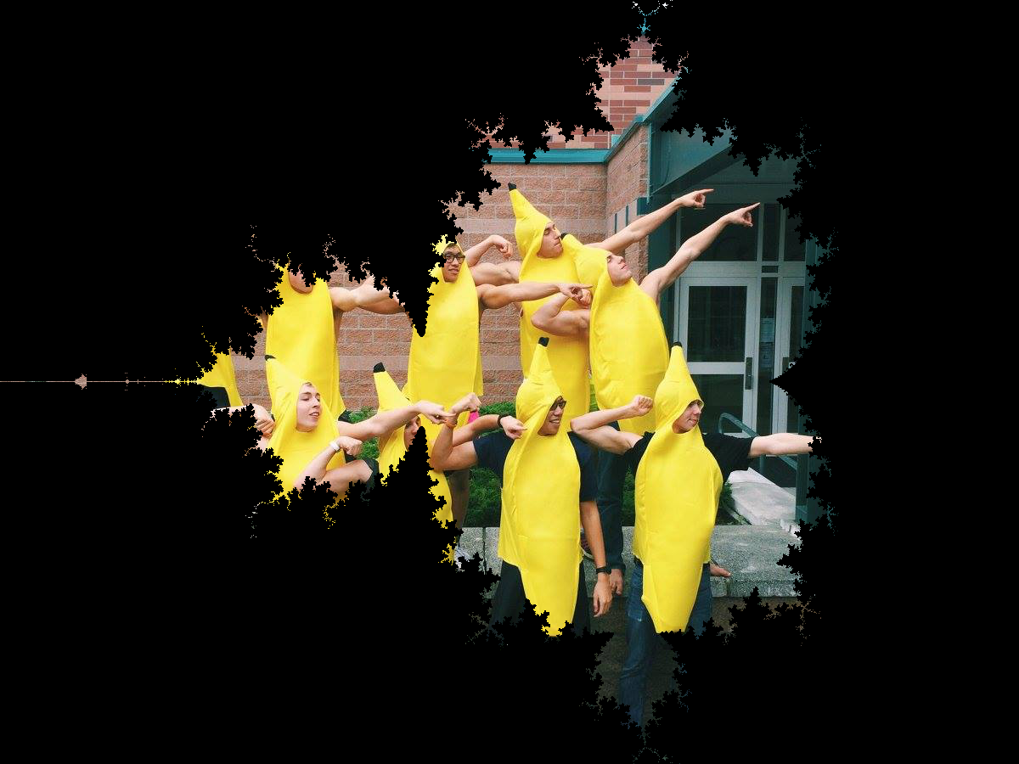
BananaBrot… !
Dave M

Slide 37
Spaced Out
Brots… !
Emelia

Slide 38
6 is returned
minloc
= 0
= 2
= 6
i
day
0
day
1
day
2
day
3
day
4
day
5
day
6
day
7
L = [40, 80, 10, 30, 27, 52, 5, 15]
= 40
= 10
= 5
minval
def i_min(L):
minval = L[0]
minloc = 0
for i in range(len(L)):
if
return minloc
track both day and price
loop!
update when needed
Notes:
INHANDOUT

Slide 39
6 is returned
minloc
= 0
= 2
= 6
i
day
0
day
1
day
2
day
3
day
4
day
5
day
6
day
7
L = [40, 80, 10, 30, 27, 52, 5, 15]
= 40
= 10
= 5
minval
def i_min(L):
minval = L[0]
minloc = 0
for i in range(len(L)):
if L[i] < minval:
minval = L[i]
minloc = i
return minloc
track both day and price
loop!
update when needed

Slide 40
Nested loops...
[0,1,2,3]
j
list
for i in range(4):
for j in range(4):
print(abs(i-j), end='')
print()
i
0
1
2
3
list
0
0 1 2 3
1
1 0 1 2
2
2 1 0 1
3
3 2 1 0

Slide 41
Write mindiff to return the smallest abs. diff. between any two elements from L.
mindiff([42,3,7,100,-9])
4
L
def mindiff(L):
m = abs(L[1]-L[0])
for i in range(len(L)):
for j in range( , len(L)):
if
return m
Hint: Use nested loops:
for i in range(4):
for j in range(4):
Track the value of the minimum so far as you loop over L twice…
Notes:
INHANDOUT

Slide 42
Write mindiff to return the smallest abs. diff. between any two elements from L.
mindiff( [42,3,7,100,-9])
4
L
def mindiff( L ):
m = abs(L[1]-L[0])
for i in range(len(L)):
for j in range(i+1, len(L)):
if abs(L[j]-L[i]) < m:
m = abs(L[j]-L[i])
return m
Hint: Use nested loops:
for i in range(4):
for j in range(4):
Track the value of the minimum so far as you loop over L twice…

Slide 43
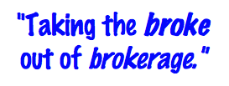
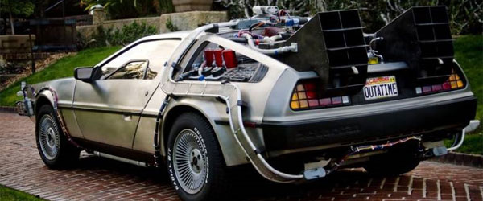
T. T. Securities
(0) Input a new list
(1) Print the current list
(2) Find the average price
(3) Find the standard deviation
(4) Find the min and its day
(5) Find the max and its day
(6) Your TTS investment plan
(9) Quit
Enter your choice:
Software side …
Hardware side…
Investment analysis for the 21st century…and beyond

Slide 44
personal motivation for TT securities…
LightPath, Fall 1999 ~ wedding gift…

Slide 45
advice…?
LightPath, Fall 1999

Slide 46
advice…?
LightPath, Spring 2000

Slide 47
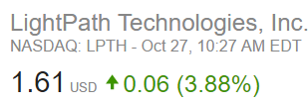
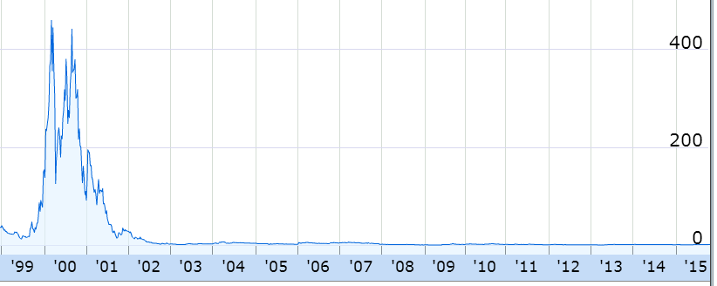
Why it's called a brokerage…
LightPath, Fall 2016
inspiration…

Slide 48
What is the best TTS investment strategy here?
The TTS advantage!
L = [40, 80, 10, 30, 27, 52, 5, 15]
Your stock's prices:
Day Price
0 40.0
1 80.0
2 10.0
3 30.0
4 27.0
5 52.0
6 5.0
7 15.0
Important fine print:
To make our business plan realistic, however, we only allow selling after buying.

Slide 49
What is the best TTS investment strategy here?
The TTS advantage!
L = [40, 80, 10, 30, 27, 52, 5, 15]
Your stock's prices:
Day Price
0 40.0
1 80.0
2 10.0
3 30.0
4 27.0
5 52.0
6 5.0
7 15.0
for each buy-day, b:
for each sell-day, s:
compute the profit
if it's the max-so-far:
remember it in a variable!
Important fine print:
To make our business plan realistic, however, we only allow selling after buying.
Notes:
INHANDOUT

