Slide 1
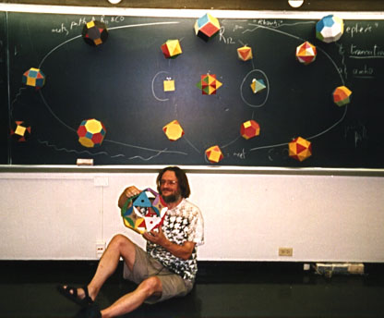
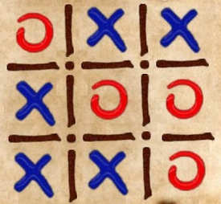
CS 5 Rules !
Two problems - two rules each
z = z ² + c
John Conway
HW 10 (lab + prob #2)
Simple rules can yield complex results!
due Mon. 4/2
The rule: Don't follow this rule.
Midterm
review problems online
content? only through hw9
Final ?!
Date: 5/8 @ 2pm
Three-in-a-row? Aliens rule at this…
Notes:
INHANDOUT

Slide 2
Mandelbrot!
Forest K.

Slide 3
Mandelbrot!
David T.

Slide 4
This Thursday will be the CS 5 in-class midterm
Un-warnings:
concerns? See me…
five problems, written
worth 1 hw assignment
score worries? Extra extra-credit in hw10 and beyond
Suggestions:
only 5 minutes? Try list comprehensions & LoL!
go over in-class exercises and hwk problems
create a page of notes, 2-sided is OK
code you understand is easiest to vary!
consider small variations of the problems – and how they would change the solutions…
that's our approach…
Notes:
INHANDOUT
Highlight that understood code is easy to change.

Slide 5
M.T. Review
(*) For up to two points! of extra credit on the midterm… Pair up with s/o you don't know (or don't know well) and find something unusual you have in common…
See also the gold review @ the cs5 site
Names:
Picobot! There are NO Picobot questions on the exam…
Recursion!!
You should feel confident you could create recursive functions to solve small problems, e.g., scrabble-scoring, finding sum or max or min, computing power or factorial (or variations)
You should be comfortable manipulating lists and strings (indexing, slicing, slicing with a "stride")
You should understand how to use, read, and compose list comprehensions , e.g., LC = [ x**2 for x in L ]
You should be able to design solutions using the "list of lists" technique (LoL), which uses list comprehensions, e.g., to find the highest scrabble-scoring word among a list or the lowest scrabble-scoring of a shifted string. Basic syntax: LoL = [ [sc(x),x] for x in L ]
You should understand the use-it-or-lose-it design strategy, e.g., the LCS, jotto, and sort homework problems:
Turtle graphics will not be emphasized (at most reading code)
Know the difference between print and return !!
Look over you composed larger programs out of smaller ones, how inputs and outputs are used, e.g., for Caesar Cipher
Representing Data!!!
Remind yourself of the various types of data (int, str, float, etc.), how they're different and how to convert between types
Know how characters are represented with chr and ord
Be comfortable with base-2 arithmetic (and base 10!), along with how to convert from base to base (no balanced ternary)
Remind yourself of how the bits of a base-2 number influence its value – what do right- and left-shifting do?
Thing in common:
Then, read over these & look for ones least familiar…
Circuits and Assembly!!!!
Know how the basic logic gates operate (AND and OR for any # of inputs , NOT for 1 input only)
Know how minterm expansion works (an OR of ANDs, each selecting one input) and how it enables the engineering of any circuit at all, given its truth-table specification
You should be comfortable using subcircuits (e.g., using the four-bit adders in the four-bit multiplier, or the individual pieces of the divider)
You should be able to write simple looping programs in Hmmm, e.g., factorial, power, Fibonacci, …
You should know what the stack is, what load and store do at the high-level (officially, they're named storer and loadr) - and why they're necessary for implementing functions in Hmmm (broadly speaking)
The exam will not ask you to implement recursion or stack-based functions in Hmmm, however – only looping + conditional examples.
The exam will have a full Hmmm reference sheet (you don't need it)
Loops
You should feel comfortable with how for loops (both element-based and index-based) and while loops work – and be able to compose small functions that use them, e.g., ones similar to those in the pi-estimation and TT securities (statistics) problems.
You should understand how nested loops work and be able to read or compose examples (such as the TTS strategy or our in-class problems)
Later today…
I <3 three-eyed punctuation!
!
!
You may use functions from class and hw on the exam without reimplementing them. Here are some, but not all, of them:
removeOne( e, L ), removeAll( e, L ), removeUpto( e, L ), count( e, L ), ind( e, L ), frontNum( L ), binToNum( binstr ), numToBin( n ), …

Slide 6
CS 5 Rules !
Two problems - two rules each
z = z ² + c
John Conway
HW 10 (lab + prob #2)
Simple rules can yield complex results!
due Mon. 4/2
The rule: Don't follow this rule.
Midterm
review problems online
content? only through hw9
Final ?!
Date: 5/8 @ 2pm
Three-in-a-row? Aliens rule at this…

Slide 7
In CS, rules rule!
(1a) Lists are handled “by reference”
(1b) Numbers and strings are handled “by value”
(2) Functions receive arguments “by copy”
two rules,
“interesting” results!

Slide 8
In CS, rules rule!
(1a) Lists are handled “by reference”
"Reference"
"Pointer"
id
L = [5, 42, 'hi']
s = 'hi'
42,000,042
5
42
'hi'
'hi'
L
s
L[0]
L[1]
L[2]
(1b) Numbers and strings are handled “by value”
The contents of the variable's “box” in memory are copied.
(2) Functions receive inputs "by copy"
in main:
fav = 7
f(fav)
7
def f(x):
7
fav
x
x is a copy of fav
Notes:
INHANDOUT

Slide 9
Reference vs. Value
Python's two methods for handling data
"Reference"
"Pointer"
id
s = 'hi'
x = 7
L = [5, 42, 'hi']
42,000,042
'hi'
7
5
42
'hi'
L
s
x
L[0]
L[1]
L[2]
Lists are handled by reference:
L really holds a memory address
Numeric data and strings are handled by value: imagine they hold the data
L = [7, 8, 9]; id(L) ...
x = 9001; id(x) ...
s = 'wow!'; id(s) ...
Notes:
INHANDOUT

Slide 10
Shallow vs. Deep
Python's two methods for copying data
"Reference"
"Pointer"
id
L = [5, 42, 'hi']
L = [5, 42, 'hi']
42,042
5
42
'hi'
M = L
L
L[0]
L[1]
L[2]
M[0] = 60
What's L[0] ?!
M
= assignment is "shallow"

Slide 11
Shallow vs. Deep
Python's two methods for copying data
from copy import *
"Reference"
"Pointer"
id
L = [5, 42, 'hi']
L = [5, 42, 'hi']
42,042
5
42
'hi'
M = deepcopy(L)
L
L[0]
L[1]
L[2]
M[0] = 60
42,042
What's L[0] ?!
M
deepcopy is deep!
import antigravity!
Notes:
INHANDOUT

Slide 12
Python functions: pass by copy
def conform(fav)
fav = 42
return fav
fav
def main()
print("Welcome!")
fav = 7
fav = conform(fav)
print("My favorite # is", fav)
7
fav

Slide 13
Python functions: pass by copy
def conform(fav)
fav = 42
return fav
7
fav
copy of fav
“pass by copy” means the contents of fav are copied to fav
def main()
print("Welcome!")
fav = 7
fav = conform(fav)
print("My favorite # is", fav)
7
fav
But what if the underlined part were absent… ?
Notes:
INHANDOUT
If the underlined part wasn’t there, fav would just hold its old value.

Slide 14
Try it!
Rules rule!?
Trace each f'n. What do main1, main2, and main3 print?
Numbers: by value.
Lists: by reference.
Function calls copy.
Thought experiments: Don't hand this in…
def conform1(fav)
fav = 42
return fav
def conform2(L)
L = [42, 42]
return L
def conform3(L)
L[0] = 42
L[1] = 42
fav
L
L
7
7
11
7
11
fav
L
L[0]
L[1]
L
L[0]
L[1]
def main1()
fav = 7
conform1(fav)
print(fav)
def main2()
L = [7, 11]
conform2(L)
print(L)
def main3()
L = [7, 11]
conform3(L)
print(L)
Notice that there are NO assignment statements after these function calls! The return values aren't being used…
Notes:
INHANDOUT

Slide 15
Lists are Mutable
You can change the contents of lists in functions that take those lists as input.
- Lists are MUTABLE objects
Those changes will be visible everywhere.
Numbers, strings, etc. are IMMUTABLE: they can't be changed, only reassigned.
Notes:
INHANDOUT

Slide 16
Differing approaches to rules …
Engineers
Physicists
different worldviews…
Mathematicians
CS?

Slide 17
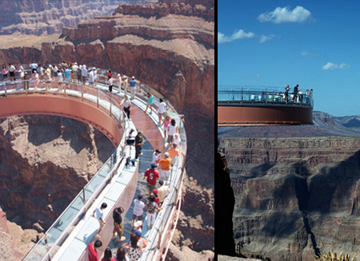
equations, relationships, formulas, etc.
Engineers believe their rules approximate reality;
Safety margins!
Grand Canyon Skywalk

Slide 18
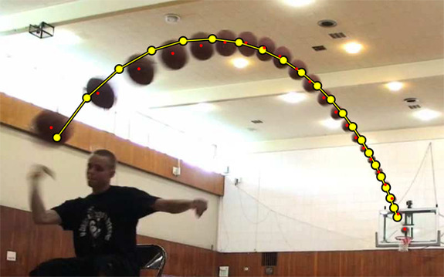
equations, relationships, formulas, etc.
Engineers believe their rules approximate reality;
Physicists believe reality approximates their rules…
^
measured
Image forensics' verdict:
Fake!
Not a parabola, so not a real shot!
http://www.youtube.com/watch?feature=player_embedded&v=WbaH52JI3So
http://www.fourandsix.com/blog/2011/8/29/seriously-amazing-beer-pong-shots.html
Notes:
Show first URL in Youtube; can be opened with backshot() in demo file.
Second URL has explanation but isn’t worth showing.

Slide 19
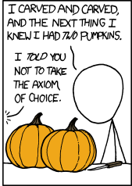
Engineers believe their rules approximate reality;
Physicists believe reality approximates their rules…
Mathematicians don't care either way!
A solid sphere can be split into 5 parts and rigidly reassembled into two solid spheres the same size as the original
Banach-Tarski paradox
Banach-Tarski XKCD
the parts are "clouds"
https://www.youtube.com/watch?v=s86-Z-CbaHA @ 18:49

Slide 20
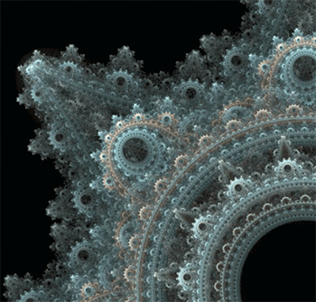
Engineers believe their rules approximate reality;
Physicists believe reality approximates their rules…
Mathematicians don't care either way!
CS?
Don't like your reality? Build a new one!
why settle for gears, when you could have fractal gears?
plain patterns? Self-propagating patterns!
https://en.wikipedia.org/wiki/File:Conways_game_of_life_breeder_animation.gif

Slide 21
Engineers believe equations approximate reality;
Physicists believe reality approximates equations…
Mathematics reason about structural rules…
… and CSers reason about procedural ones.
for
lists
Data
Data
while
variables
Axioms
arithmetic operations
Definitions
if/else
proofs
programs
Insights, tools, mathematical truths
Insights, tools, algorithms
math worldview
CS worldview
Notes:
INHANDOUT

Slide 22
2D data!
All and only the rules that govern 1D data apply here—no new rules to learn!
~ pure composition

Slide 23
Lists ~ 2D data
A = [42, 75, 70]
42
75
70
list
int
int
int
A
1D lists are familiar—but lists can hold ANY kind of data—including lists!

Slide 24
Lists ~ 2D data
A = [[1,2,3,4], [5,6], [7,8,9,10,11]]
1
2
3
4
list
list
A[0][0]
A[0][1]
A[0][3]
A
A[0]
?
5
6
list
A[1][0]
A[1][1]
A[1]
7
8
9
10
11
list
A[2]
A[2][0]
A[2][1]
A[2][2]
A[2][3]
A[2][4]
Where's 3?
len(A[0])
len(A)
Replace 10 with 42.
len(A[1])
Notes:
INHANDOUT

Slide 25
Rectangular 2D data
A = [[0,0,0,0], [0,0,0,0], [0,0,0,0]]
0
0
0
0
list
list
Original data...
A
A[0]
A[0][0]
0
0
0
0
list
A[1]
0
0
0
0
list
A[2]
A[2][3]
To try…
NROWS = len(A)
NCOLS = len(A[0])
for r in range(0, NROWS):
for c in range(0, NCOLS):
if r == c: A[r][c] = 4
else: A[r][c] = 2
What will this do?
Notes:
INHANDOUT

Slide 26
(*) For up to two points! of extra credit on the midterm… Pair up with s/o you don't know (or not well) and find something you have in common…
after trying this, look over the midterm-review together!
A = [[4, 2, 2, 2],
[2, 2, 4, 4],
[8, 3, 3, 1]]
Names:
Thing in common:
def mystery(A):
"""What happens to A?"""
NROWS = len(A)
NCOLS = len(A[0])
for r in range(0, NROWS):
for c in range(0, NCOLS):
if r == c:
A[r][c] += 1
else:
A[r][c] *= 2
A
Before
row 0
4 2 2 2
2 2 4 4
8 3 3 1
row 1
row 2
col 0
col 1
col 2
col 3
A
After
Starting with the 2d array A above, write the values in A after running that code:
Above, write the resulting values in A
Challenge:
Then, how could you change the code above to create a True where the original value was equal to its neighbor to the right?! (False, if there's no neighbor or a different neighbor.)
F T T F
T F T F
F T F F
Notes:
QUIZSLIDE

Slide 27
M.T. Review
(*) For up to two points! of extra credit on the midterm… Pair up with s/o you don't know (or don't know well) and find something unusual you have in common…
See also the gold review @ the CS5 site
Names:
Picobot! There are NO Picobot questions on the exam…
Recursion!!
You should feel confident you could create recursive functions to solve small problems, e.g., Scrabble-scoring, finding a sum or a max or a min, computing power or factorial (or variations)
You should be comfortable manipulating lists and strings (indexing, slicing, slicing with a "stride“, negative “stride”)
You should understand how to use, read, and compose list comprehensions , e.g., LC = [ x**2 for x in L]
You should be able to design solutions using the "list of lists" technique (LoL), which uses list comprehensions, e.g., to find the highest Scrabble-scoring word among a list or the lowest Scrabble-scoring of encipherings. Basic syntax: LoL = [[sc(x), x] for x in L]
You should understand the use-it-or-lose-it design strategy, e.g., the LCS, jotto, exact_change, and sort homework problems:
Turtle graphics will not be on the exam
Know the difference between print and return!!
Look over how you composed larger programs out of smaller ones & how inputs and outputs are used, e.g., for Caesar Cipher
Representing Data!!!
Remind yourself of the various types of data (int, str, float, etc.), how they're different and how to convert between types
Know how characters are represented with chr and ord
Be comfortable with base-2 arithmetic (and base 10!), along with how to convert from base to base (no balanced ternary)
Remind yourself of how the bits of a base-2 number influence its value – for example, what do right- and left-shifting do?
Thing in common:
Then, read over these & look for ones least familiar…
Circuits and Assembly!!!!
Know how the basic logic gates operate (AND and OR for any # of inputs , NOT for 2 inputs only)
Know how minterm expansion works (an OR of ANDs, each selecting one input) and how it enables the engineering of any circuit at all, given its truth-table specification
You should be comfortable using subcircuits (e.g., using the four-bit adders in the four-bit multiplier, or the individual pieces of the divider)
You should be able to write simple looping programs in Hmmm, e.g., factorial, power, Fibonacci, sum, max, min …
You should know what the stack is, what load and store do at the high level (officially, they're named storer and loadr) - and why they're useful for implementing functions in Hmmm – only broadly speaking
The exam will not ask you to implement recursion or stack-based functions in Hmmm, however – only looping & conditional examples.
It will have a full Hmmm reference (your don't need your own)
Loops
You should feel comfortable with how for loops (both element-based and index-based) and while loops work – and be able to compose small functions that use them, e.g., ones similar to those in the pi-estimation and TT securities (statistics) problems.
You should understand what continue and break do within loops.
You should understand how nested loops work and be able to read or compose examples (such as the TTS strategy or our in-class problems)
I <3 three-eyed punctuation!
!
!
You may use functions from class and hw on the exam without reimplementing them. Here are some, but not all, of them:
removeOne(e, L), removeAll(e, L), removeUpto(e, L), count(e, L), ind(e, L), frontNum(L), binToNum(binstr), numToBin(n), …
Notes:
QUIZSLIDE

Slide 28
hw10pr2…
A = [[4, 2, 2, 2],
[2, 2, 4, 4],
[2, 4, 4, 2]]
def inarow_2east(A):
"""What happens to A ?"""
NROWS = len(A)
NCOLS = len(A[0])
for r in range(0, NROWS):
for c in range(0, NCOLS):
if c == NCOLS-1:
A[r][c] = False
elif A[r][c] == A[r][c+1]:
A[r][c] = True
else:
A[r][c] = False
A
Before
row 0
4 2 2 2
2 2 4 4
2 4 4 2
row 1
row 2
right edge!
col 0
col 1
col 2
col 3
2 in a row
not 2 in a row
F T T F
T F T F
F T F F
Challenge:
Then, how could you change the code above to create a True where the original value was equal to its neighbor to the right?! (False, if there's no neighbor or a different neighbor.)
Notes:
INHANDOUT

Slide 29
First, try it by eye…
…then, on hw10pr2, by Python!
col 0
col 1
col 2
col 3
col 4
A = [ [' ','X','O',' ','O'],
['X','X','X','O','O'],
[' ','X','O','X','O'],
['X','O','O',' ','X']]
row 0
row 1
row 2
row 3
the data doesn't wrap around
start row
start col
checker
LoL
inarow_3east('X', 1, 0, A)

Slide 30
First, try it by eye…
…then, on hw10pr2, by Python!
col 0
col 1
col 2
col 3
col 4
A = [ [' ','X','O',' ','O'],
['X','X','X','O','O'],
[' ','X','O','X','O'],
['X','O','O',' ','X']]
row 0
row 1
row 2
row 3
the data doesn't wrap around
start row
start col
checker
LoL
inarow_3east('X', 1, 0, A)
True
inarow_3south('O', 0, 4, A)
inarow_3southeast('X', 2, 3, A)
inarow_3northeast('X', 3, 1, A)
Notes:
INHANDOUT

Slide 31
hw10pr1 (lab): Conway's Game of Life
Geometer @ Princeton
1995
?
20˚
10˚
John Conway
60˚
70˚
(no trig)
simple rules ~ surprising behavior
1970

Slide 32
Lab Problem: Conway's Game of Life
Grid World
Evolutionary rules
red cells are "alive"
Everything depends on a cell's eight neighbors
2
1
3
Exactly 3 neighbors give birth to a new, live cell.
4
5
6
7
8
Exactly 2 or 3 neighbors keep an existing cell alive.
Only 3 rules
Any other # of neighbors and the central cell dies…
white cells are empty
Notes:
INHANDOUT

Slide 33
Lab Problem: Conway's Game of Life
Grid World
Evolutionary rules
red cells are "alive"
Everything depends on a cell's eight neighbors
Exactly 3 neighbors give birth to a new, live cell.
Exactly 2 or 3 neighbors keep an existing cell alive.
Any other # of neighbors and the central cell dies…
white cells are empty
Notes:
INHANDOUT

Slide 34
Lab Problem: Conway's Game of Life
Grid World
Evolutionary rules
red cells are "alive"
Everything depends on a cell's eight neighbors
Exactly 3 neighbors give birth to a new, live cell.
Exactly 2 or 3 neighbors keep an existing cell alive.
Any other # of neighbors and the central cell dies…
white cells are empty

Slide 35
Lab Problem: Conway's Game of Life
Grid World
Evolutionary rules
red cells are alive
Everything depends on a cell's eight neighbors
Exactly 3 neighbors give birth to a new, live cell.
Exactly 2 or 3 neighbors keep an existing cell alive.
What's next?
Any other # of neighbors and the central cell dies…
white cells are empty

Slide 36
Lab Problem: Creating life
next_life_generation(A)
For each cell…
3 live neighbors—life!
2 live neighbors—same
0, 1, 4, 5, 6, 7, or 8 live neighbors—death
computed all at once, not cell-by-cell, so the ? at left does NOT come to life!
?
http://www.math.com/students/wonders/life/life.html

Slide 37
Lab Problem: Creating life
next_life_generation(A)
old generation is the input, A
returns the next generation
0
1
2
3
4
5
0
1
2
3
4
5
0
0
1
1
2
2
?
3
3
4
4
5
5

Slide 38
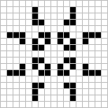
Lab Problem: Creating life
Stable configurations:
"rocks"
Periodic
"plants"
period 2
period 3
Self-propagating
"animals"
glider
Copperhead: 2016

Slide 39
Lab Problem: Creating life
Many life configurations expand forever…
"Gosper glider gun"
"glider"
What is the largest amount of the life universe that can be filled with cells?
How sophisticated can Life structures get?
www.ibiblio.org/lifepatterns/

Slide 40
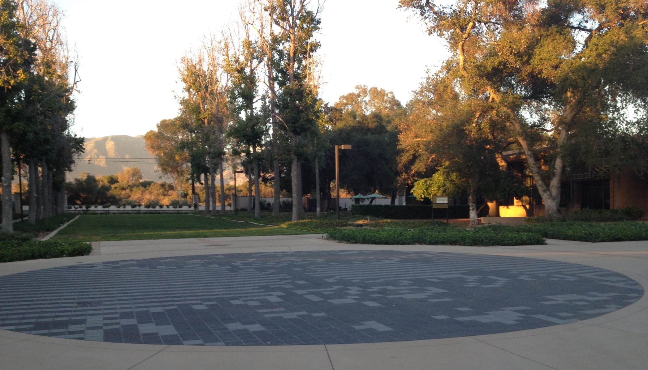
Life @ HMC
Stable configurations:
"rocks"
Periodic
"plants"
period 2
period 3
Self-propagating
"animals"
glider

Slide 41
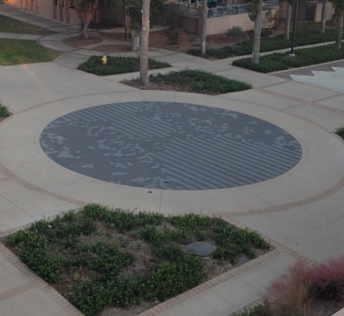
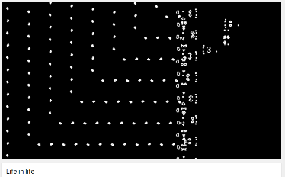
Life @ HMC
Life, universally!
www.youtube.com/watch?v=xP5-iIeKXE8

Slide 42
Today you'll be
Lifing it up
in lab!
so
on over…
glide

Slide 43
M.T. Review
(*) For up to two points! of extra credit on the midterm… Pair up with s/o you don't know (or don't know well) and find something unusual you have in common…
See also the gold review @ the cs5 site
Names:
Picobot! There are NO Picobot questions on the exam…
Recursion!!
You should feel confident you could create recursive functions to solve small problems, e.g., Scrabble-scoring, finding a sum or a max or a min, computing power or factorial (or variations)
You should be comfortable manipulating lists and strings (indexing, slicing, slicing with a "stride“, negative “stride”)
You should understand how to use, read, and compose list comprehensions , e.g., LC = [ x**2 for x in L]
You should be able to design solutions using the "list of lists" technique (LoL), which uses list comprehensions, e.g., to find the highest Scrabble-scoring word among a list or the lowest Scrabble-scoring of encipherings. Basic syntax: LoL = [[sc(x), x] for x in L]
You should understand the use-it-or-lose-it design strategy, e.g., the LCS, jotto, exact_change, and sort homework problems:
Turtle graphics will not be on the exam
Know the difference between print and return!!
Look over how you composed larger programs out of smaller ones & how inputs and outputs are used, e.g., for Caesar Cipher
Representing Data!!!
Remind yourself of the various types of data (int, str, float, etc.), how they're different and how to convert between types
Know how characters are represented with chr and ord
Be comfortable with base-2 arithmetic (and base 10!), along with how to convert from base to base (no balanced ternary)
Remind yourself of how the bits of a base-2 number influence its value – for example, what do right- and left-shifting do?
Thing in common:
Then, read over these & look for ones least familiar…
Circuits and Assembly!!!!
Know how the basic logic gates operate (AND and OR for any # of inputs , NOT for 2 inputs only)
Know how minterm expansion works (an OR of ANDs, each selecting one input) and how it enables the engineering of any circuit at all, given its truth-table specification
You should be comfortable using subcircuits (e.g., using the four-bit adders in the four-bit multiplier, or the individual pieces of the divider)
You should be able to write simple looping programs in Hmmm, e.g., factorial, power, Fibonacci, sum, max, min …
You should know what the stack is, what load and store do at the high level (officially, they're named storer and loadr) - and why they're useful for implementing functions in Hmmm – only broadly speaking
The exam will not ask you to implement recursion or stack-based functions in Hmmm, however – only looping & conditional examples.
It will have a full Hmmm reference (your don't need your own)
Loops
You should feel comfortable with how for loops (both element-based and index-based) and while loops work – and be able to compose small functions that use them, e.g., ones similar to those in the pi-estimation and TT securities (statistics) problems.
You should understand what continue and break do within loops.
You should understand how nested loops work and be able to read or compose examples (such as the TTS strategy or our in-class problems)
I <3 three-eyed punctuation!
!
!
You may use functions from class and hw on the exam without reimplementing them. Here are some, but not all, of them:
removeOne(e, L), removeAll(e, L), removeUpto(e, L), count(e, L), ind(e, L), frontNum(L), binToNum(binstr), numToBin(n), …
Notes:
INHANDOUTFULL

