Slide 1
The CS 5 Times-Picayune
Claremont Penguin Takes Olympics Gold
London: In a stunning upset, a local penguin has been retroactively awarded the gold medal in the women’s 10-meter platform diving event at the Antarctic Olympics.
“All of the judges agreed that her dives were flawless,” stated an unidentified official. “But our computerized scoring system calculated her totals incorrectly. A careful audit has revealed that the computer system we purchased from a Saudi Arabian manufacturer could malfunction in the presence of water. Worse, it would break down completely if exposed to fish oil. We’re terribly sorry, but it could have happened to anybody.”
Other observers were less forgiving. “How anyone could use a desert computer at a water-based event is beyond me,” said a U.S. coach. I have no clue what they were thinking—and it’s clear that they have no clue, period.”
The penguin herself was apparently too excited to comment, limiting herself to a few loud squawks.
Reading: Sections 6.1–6.6
Notes:
Object1
Have demo window ready, with fuelNeeded = 42/1000, tank1 = 36/1000, tank2 = 6/1000
Worksheet: adding rationals.

Slide 2
Rocket Science!
>>> fuelNeeded = 42/1000
>>> tank1 = 36/1000
>>> tank2 = 6/1000
>>> tank1 + tank2 >= fuelNeeded
True? False? Maybe? DEMO!
Notes:
Rationalization: fuel is measured in tonnes, we only need 42 kg.
Demo this in Python. Also show that fuelNeeded – (tank1 + tank2) is positive but small, and fuelNeeded – tank1 – tank2 is different – and fuelNeeded – tank2 – tank1 matches fuelNeeded – (tank1 + tank2)!

Slide 3
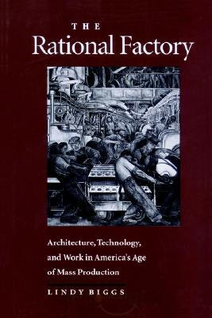
Wishful Thinking…
>>> from Rational import *
>>> fuelNeeded = Rational(42, 1000)
>>> tank1 = Rational(36, 1000)
>>> tank2 = Rational(6, 1000)
>>> tank1 + tank2 >= fuelNeeded
True
That would be so SWEET!
The Rational factory!
Notes:
Consider demonstrating this with lec19prog01.py

Slide 4
Thinking Rationally
The “constructor”
Why is this code so selfish?
class Rational:
def _ _init_ _(self, n, d):
if d == 0:
print("Invalid denominator!")
sys.exit(1) # import sys for this to work (ugly!)
else:
self.numerator = n
self.denominator = d
Nothing is returned here!
In a file called Rational.py
>>> from Rational import *
>>> myNum1 = Rational(1, 3)
>>> myNum2 = Rational(2, 6)
>>> myNum1.numerator
?
>>> myNum1.denominator
?
>>> myNum2.numerator
?
myNum1
numerator = 1
denominator = 3
myNum2
numerator = 2
denominator = 6
Notes:
This slide has two animations. The first shows arrows from (1, 3) to (n, d). The second pops up "Nothing is returned here!".
Point out that even though both numbers are equal, they have different internal representations! Is this a problem?

Slide 5
Thinking Rationally
This is so class-y!
class Rational:
"""Support rational numbers."""
def _ _init_ _(self, n, d):
if d == 0:
raise ValueError("Invalid denominator!") else:
self.numerator = n
self.denominator = d
def isZero(self):
return self.numerator == 0
>>> myNum1 = Rational(1, 3)
>>> myNum2 = Rational(0, 6)
>>> myNum1.isZero()
?
>>> myNum2.isZero()
?
numerator = 1
denominator = 3
myNum1
myNum2
numerator = 0
denominator = 6
Notes:
This slide has an animation that connects myNum1 to self.
The ValueError ties back to try/except.
Point out that a class can have a docstring about the class itself.

Slide 6
Thinking Rationally
class Rational:
def _ _init_ _(self, n, d):
if d == 0:
raise ValueError("Invalid denominator!") else:
self.numerator = n
self.denominator = d
def isZero(self):
return self.numerator == 0
__init__ially I thought this was weird, but now I like it!
>>> myNum1 = Rational(1, 3)
>>> myNum2 = myNum1
>>> myNum2.numerator = 42 # CHEATING!
>> myNum1
<Rational instance at 0x14ba68e87438>
myNum1
numerator = 42
denominator = 3
Notes:
Although Python lets you "reach inside" a rational, you shouldn't do so. In fact, Rational can make it harder by starting "numerator" with two underscores—but even then you can cheat if you really want to.

Slide 7
Thinking Rationally
class Rational:
def _ _init_ _(self, n, d):
self.numerator = n
self.denominator = d
def isZero(self):
return self.numerator == 0
def _ _str_ _(self):
return str(self.numerator) + "/" + str(self.denominator)
>>> myNum = Rational(1, 3)
>>> myNum._ _str_ _()
'1/3'
>>> myNum
<__main__.Rational object at 0x2b513566b7d0>
>>> print(myNum)
1/3
myNum
numerator = 1
denominator = 3
Notes:
The explicit call to "str" gives "1/3". But myNum alone just gives "Rational instance…". But print gives 1/3.

Slide 8
Thinking Rationally
class Rational:
def _ _init_ _(self, n, d):
self.numerator = n
self.denominator = d
def isZero(self):
return self.numerator == 0
def _ _repr_ _(self):
return "Rational(" + str(self.numerator) + \
", " + str(self.denominator) + ")"
>>> myNum = Rational(1, 3)
>>> myNum._ _repr_ _()
Rational(1, 3)
>>> myNum
Rational(1, 3)
myNum
numerator = 1
denominator = 3

Slide 9
Thinking Rationally
class Rational:
def _ _init_ _(self, n, d):
self.numerator = n
self.denominator = d
def isZero(self):
return self.numerator == 0
# The lazy way to do both str and repr
def _ _repr_ _ (self):
return str(self.numerator) + “/” + str(self.denominator)
>>> myNum1 = Rational(1, 3)
>>> myNum2 = Rational(2, 6)
>>> print(myNum2)
2/6
>>> myNum1 == myNum2
False
numerator = 1
denominator = 3
myNum1
myNum2
numerator = 2
denominator = 6

Slide 10
Thinking Rationally
class Rational:
"""Support rational numbers."""
def _ _init_ _(self, n, d):
"""Construct a Rational: no error checking, not reduced."""
self.numerator = n
self.denominator = d
def isZero(self):
return self.numerator == 0
def _ _repr_ _(self):
return str(self.numerator) + “/” + str(self.denominator)
def equals(self, other):
return self.numerator * other.denominator ==
self.denominator * other.numerator
Working at cross purposes?
1
2
3
6
>>> myNum1 = Rational(1, 3)
>>> myNum2 = Rational(2, 6)
>>> myNum1.equals(myNum2)
True
>>> myNum2.equals(myNum2)
True
numerator = 1
denominator = 3
myNum1
myNum2
numerator = 2
denominator = 6
Notes:
You can do this in either order, and of course myNum2 equals itself.

Slide 11
Thinking Rationally
class Rational:
def _ _init_ _(self, n, d):
self.numerator = n
self.denominator = d
def isZero(self):
return self.numerator == 0
def _ _repr_ _(self):
return str(self.numerator) + “/” + str(self.denominator)
def _ _eq_ _(self, other):
return self.numerator * other.denominator == self.denominator * other.numerator
>>> myNum1 = Rational(1, 3)
>>> myNum2 = Rational(2, 6)
>>> myNum1 == myNum2
True
>>> myNum2 == myNum1
True
numerator = 1
denominator = 3
This is what I would really like!
myNum1
myNum2
numerator = 2
denominator = 6

Slide 12
The Alien’s Life Advice
Look people in the eye when you talk to them!
Unless they have really amazing shoes…

Slide 13
Thinking Rational-ly
class Rational:
def _ _init_ _(self, n, d):
self.numerator = n
self.denominator = d
def add(self, other):
Start by assuming that the denominators are the same,
but then try to do the case that they may be different!
What kind of thing is add returning?
>>> myNum1 = Rational(36, 1000)
>>> myNum2 = Rational(6, 1000)
>>> myNum3 = myNum1.add(myNum2)
>>> myNum3
42000/1000000
numerator = 36
denominator = 1000
myNum1
myNum2
numerator = 6
denominator = 1000
Notes:
Worksheet!

Slide 14
Thinking Rationally
class Rational:
""“Provide mathematically correct rational numbers."""
def _ _init_ _(self, n, d):
"""Create a rational number (no error checking)."""
self.numerator = n
self.denominator = d
def _ _add_ _(self, other):
"""Add two rationals by cross-multiplying."""
newDenominator = self.denominator*other.denominator
newNumerator = self.numerator*other.denominator + \
other.numerator*self.denominator
return Rational(newNumerator, newDenominator)
This is what I would really, really like!
>>> myNum1 = Rational(36, 1000)
>>> myNum2 = Rational(6, 1000)
>>> myNum3 = myNum1 + myNum2
>>> myNum3
42000/1000000
numerator = 36
denominator = 1000
myNum1
myNum2
numerator = 6
denominator = 1000
Notes:
Two notes: First, __add__ returns a new rational. Second, if you do very many adds, you’ll wind up with a huge denominator. How could you cure that problem?

Slide 15
Overloaded Operator Naming
+ __add__
- __sub__
* __mul__
/ __div__
// __floordiv__
% __mod__
** __pow__
+ __pos__
- __neg__
__abs__
__int__
__float__
__complex__
…and many more
== __eq__
!= __ne__
<= __le__
>= __ge__
< __lt__
> __gt__
>>> myNum = Rational(9, 2)
>>> myNum.int()
Barf!
>>> int(myNum)
4
def _ _int_ _(self):
return self.numerator//self.denominator
Very _ _int_ _eresting!
Notes:
This is only a partial list!

Slide 16
Putting It All Together
class Rational:
def __init__(self, n, d):
self.numerator = n
self.denominator = d
def __add__(self, other):
newNumerator =
newDenominator =
return Rational(newNumerator, newDenominator)
def __eq__(self, other):
return ???
def __ge__(self, other):
return ???
def __repr__(self):
return str(self.numerator) + "/" + str(self.denominator)
Mission accomplished!
>>> from Rational import *
>>> fuelNeeded = Rational(42, 1000)
>>> tank1 = Rational(36, 1000)
>>> tank2 = Rational(6, 1000)
>>> tank1 + tank2 >= fuelNeeded
True

Slide 17
Putting It All Together
class Rational:
def __init__(self, n, d):
self.numerator = n
self.denominator = d
def __add__(self, other):
newNumerator = self.numerator*other.denominator + self.denominator*other.numerator
newDenominator = self.denominator*other.denominator
return Rational(newNumerator, newDenominator)
def __eq__(self, other):
return self.numerator*other.denominator == self.denominator*other.numerator
def __ge__(self, other):
return self.numerator*other.denominator >= self.denominator*other.numerator
def __repr__(self):
return str(self.numerator) + "/" + str(self.denominator)
Mission accomplished!
>>> from Rational import *
>>> fuelNeeded = Rational(42, 1000)
>>> tank1 = Rational(36, 1000)
>>> tank2 = Rational(6, 1000)
>>> tank1 + tank2 >= fuelNeeded
True

Slide 18
Rationals Are Now “First Class Citizens”!
>>> r1 = Rational(1, 2)
>>> r2 = Rational(1, 4)
>>> r3 = Rational(1, 8)
>>> L = [r1, r2, r3]

Slide 19
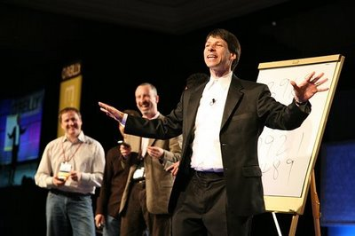
More OOPS…
In lab… “Virtual Art”: Predicting the future with a Date class
Next time… Huffman Compression!
Arthur “Art” Benjamin

Slide 20
True Story
Dan Aguayo
Max Krohn
Jeremy Stribling
Notes:
WMSCI Story
Show the website
Show the movie

Slide 21
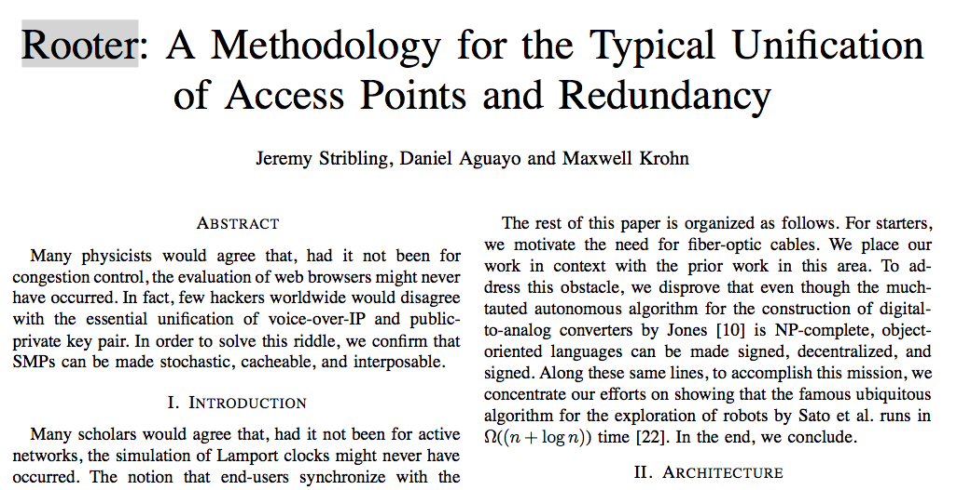

Slide 22
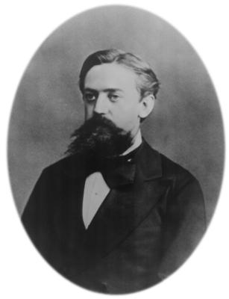
k^{th} Order Markov Processes
Training File: "I like spam. I like
toast and spam. I eat ben
and jerry's ice cream too."
First order Markov Dictionary:
I : like, like, eat
like : spam., toast
spam. : I, I
and : spam, jerry's
MORE ENTRIES…
Generating “random” text:
"I like spam. I like spam."
"I eat ben and spam. I like toast
and jerry's ice cream too."
Andrey Markov 1856-1922

Slide 23
k^{th} Order Markov Processes
Training File: Original Star Wars plot
First order Markov sentences
generated…
"The droids are captured by
elderly hermit "Old Ben" Kenobi,
an entire planet."
"Leia's schematics reveal a cantina in place of the ways of the Rebels to search for analysis."
Andrey Markov 1856-1922

Slide 24
k^{th} Order Markov Processes
Training File: "I like spam. I like
toast and spam. I eat ben
and jerry's ice cream too."
First order Markov Dictionary:
I : like, like, eat
like : spam, toast
spam. : I, I
and : spam, jerry's
MORE ENTRIES…
Second order Markov Dictionary:
I like : spam., toast
like spam. : I
spam. I : like, eat
Andrey Markov 1856-1922

Slide 25
k^{th} Order Markov Processes
Training File: Original Star Wars plot
Second-order Markov sentences
generated…
"The droids are captured by Jawa traders, who sell them to her father, a fellow veteran, for analysis."
"Before the Falcon to be captured by the disembodied voice of Obi-Wan’s spirit, Luke turns off his targeting computer and uses the Force and murdered him."

Slide 26
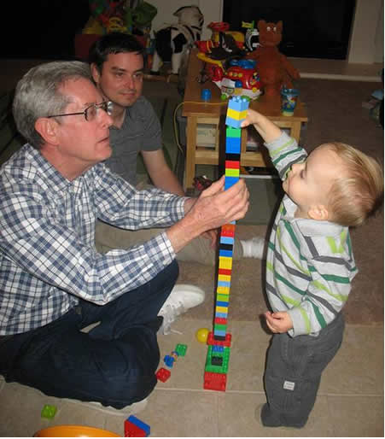
Structured Query Language
mysql> select gpa from students where first_name = 'Donald' and last_name = 'Chamberlin' and grad_year = 1966;
+------+
| gpa |
+------+
| 3.87 |
+------+
1 row in set (0.00 sec)
Don Chamberlin HMC '66
Notes:
SQL was developed by Don Chamberlin, an HMC grad. It is used in nearly every database system today.
This is not his real GPA!

Slide 27
The Power of SQL
mysql> select title, price from products where type = 'DVD' and genre = 'comedy' and title like 'The Hangover%' order by price descending; -- Highest price first
mysql> update products set price = price / 10 where title = 'The Hangover Part II';
mysql> update users set password = 'secret', access = 'all' where username = 'geoff'; -- Give full access

Slide 28
SQL in Web Sites
def lookupDVD(title_words):
print("select title, price from products"
+ "where type = 'DVD' and title like ' "
+ title_words
+ " ' order by price ascending;")
Notes:
Real Web sites are obviously more complicated but they use this same idea.

Slide 29
SQL Injection
def lookupDVD(title_words):
print("select title, price from products"
+ "where type = 'DVD' and title like ' "
+ title_words
+ " ' order by price ascending;")
select title, price from products where type = 'DVD' and title like 'asdf '; update products set price = 1.99 where description like 'Porsche%'; -- ' order by price ascending;
Notes:
Sadly, even today this works on a lot of Web sites.
This slide has two animations. The first brings up the Amazon query. The second circles the query and shows the injected SQL.

Slide 30
SQL Injection
Notes:
This is one of the most famous xkcd cartoons. The official title is "Exploits of a Mom".

Slide 31
The Moral
NEVER trust input from a user!

Slide 32
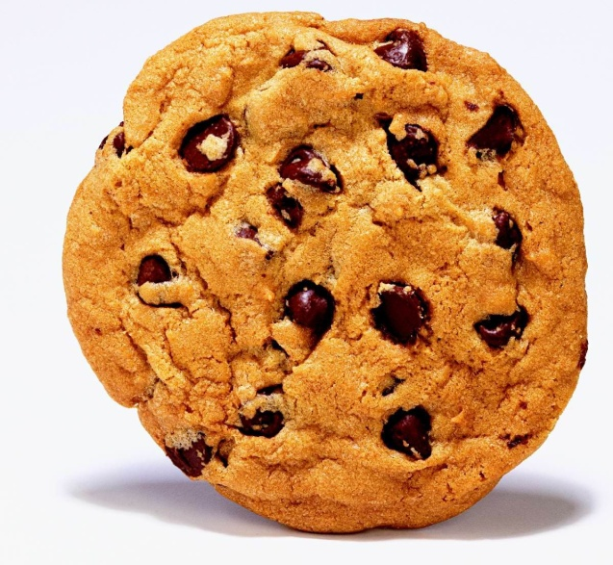
Cookies
You've heard of how Web servers use cookies to remember things about you
Hey, that's my cookie!
Shopping cart idea: use cookie to remember what you ordered & its price…
Notes:
Big oops: what if user modifies cookie before sending it back?

Slide 33
The Moral
NEVER trust input from a user!
…even you think it originally came from you!

