Slide 1
A whole new class of programming
CS 5 overview
CS's building blocks: functions and composition
Exams...
behind CS's curtain: circuits, assembly, loops
Designing Data!
The Date class
Whose convenience?
CS: theory + practice
https://www.vecteezy.com/
Notes:
Demos are in lec19fun.py. Have code ready to edit.

Slide 2
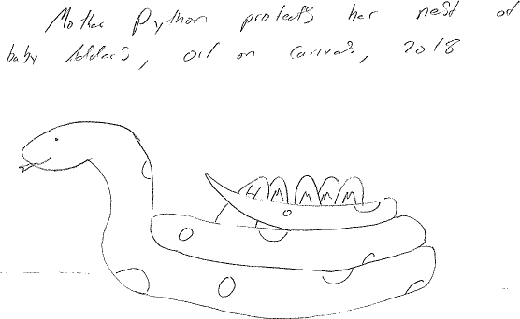
Midterm Art

Slide 3
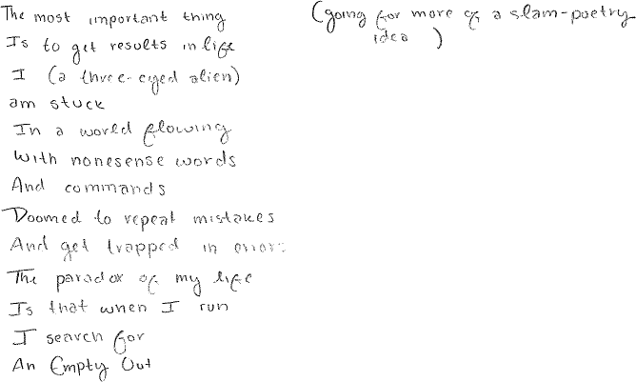
Midterm Poetry

Slide 4
Midterm Art & Poetry

Slide 5
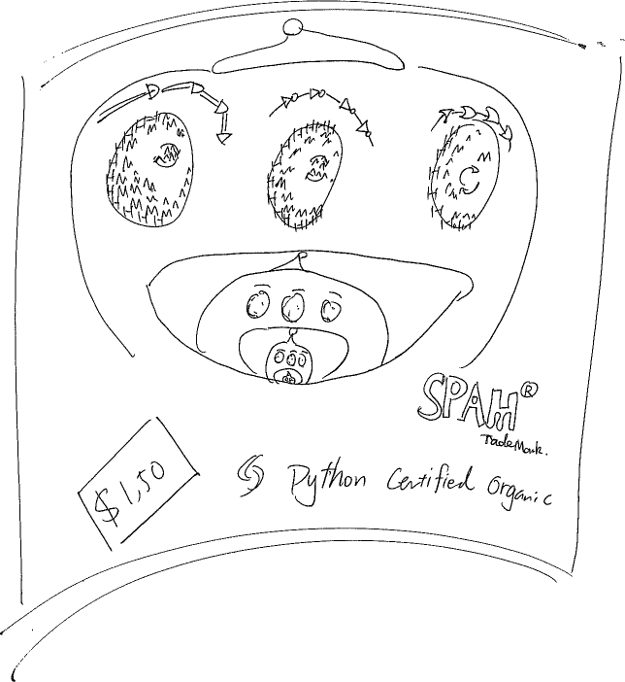

Slide 6
A whole new class of programming
CS 5 overview
CS's building blocks: functions and composition
behind CS's curtain: circuits, assembly, loops
Designing Data!
The Date class
Whose convenience?
CS: theory + practice
https://www.vecteezy.com/
Notes:
INHANDOUT

Slide 7
Classes and Objects
Notes:
INHANDOUT

Slide 8
Classes and Objects
Customizing Python

Slide 9
Everything in Python is an object!
Its capabilities depend on its class.
functions
type
"methods"
What's more, you can build your own...

Slide 10
One-page example
# defining our own Student class
class Student”
"""A class representing complex numbers""“
# The CONSTRUCTOR method (function) [sets initial data]
def __init__(self, name, yr):
"""Remember anything that's important"""
self.name = name
self.year = yr
# The “REPRESENTATION” method (for printing) [2020 vs. ‘20?]
def __repr__(self):
"""Let's make it look good!"""
S = self.name + " (" + str(self.year) + ")“
return S
# here’s a method of our own (not one of Python's)
def defer(self, numyrs):
""“Defer enrollment for NUMYRS years""“
self.year += numyrs
Student is a class
1. construct an object
2. its string representation
3. change things
define
RS = Student("Robin S.", 2021) # Constructs the object RS
print("RS is", RS) # __repr__ generates the printable object
RS.defer(1) # Calling a method on/by RS
CA = Student("Cameron A.", 2020) # Constructs another object, CA
CA.defer(2) # CA invokes the defer method
print("CA is ", CA) # Prints the object CA
use
RS and CA are objects
Notes:
iNHANDOUT

Slide 11
Everything is an object!
Take strings, for example:
>>> s = str(42)
>>> type(s)
<type 'str'>
>>> dir(s)
['__add__', '__class__', '__contains__', '__delattr__', '__doc__', '__eq__', '__format__', '__ge__', '__getattribute__', '__getitem__', '__getnewargs__', '__getslice__', '__gt__', '__hash__', '__init__', '__le__', '__len__', '__lt__', '__mod__', '__mul__', '__ne__', '__new__', '__reduce__', '__reduce_ex__', '__repr__', '__rmod__', '__rmul__', '__setattr__', '__sizeof__', '__str__', '__subclasshook__', '_formatter_field_name_split', '_formatter_parser', 'capitalize', 'center', 'count', 'decode', 'encode', 'endswith', 'expandtabs', 'find', 'format', 'index', 'isalnum', 'isalpha', 'isdigit', 'islower', 'isspace', 'istitle', 'isupper', 'join', 'ljust', 'lower', 'lstrip', 'partition', 'replace', 'rfind', 'rindex', 'rjust', 'rpartition', 'rsplit', 'rstrip', 'split', 'splitlines', 'startswith', 'strip', 'swapcase', 'title', 'translate', 'upper', 'zfill']
This calls the str constructor.
Shows the type of s is str
Shows all of the methods (functions) of s
Let's try some!

Slide 12
Objects
Like a list, an object is a container, but much more customizable:
(1) Its data elements have names chosen by the programmer.
(2) An object contains its own functions, called methods
(3) In its methods, objects refer to themselves as self
(4) Python signals special methods with double underscores:
__init__ is called the constructor; it creates new objects
__repr__ tells Python how to print its objects
I guess we should doubly underscore these two methods!
Notes:
INHANDOUT

Slide 13
A Date object, d
d
4
4
2017
month
day
year
memory location == 47245108030176

Slide 14
class Date(object):
"""A user-defined data structure that
stores and manipulates dates."""
def __init__(self, mo, dy, yr):
""""Construct a Date with
the given month, day, and year."""
self.month = mo
self.day = dy
self.year = yr
The Date class
This is the start of a new type called Date
It begins with the keyword class
This is the constructor for Date objects
As is typical, it assigns its arguments to the data members.
These are data members–they are the information inside every Date object.
Notes:
INHANDOUT
crash1, crash2, crash3 are stock market crash dates
Create some birthdays (geoff already exists)

Slide 15
Date
This is a class. It is a user-defined data type that you'll build in Lab 10 this week…
>>> d = Date(4,4,2017)
>>> d.month
4
>>> d.day
4
Add a print statement to see that this is OUR OWN code…
Constructor!
d contains data members named day, month, and year
>>> d
04/04/2017
The repr!
the representation of an object of type Date
The isLeapYear method returns True or False. How does it know what year to check?
>>> d.isLeapYear()
False
Notes:
INHANDOUT
Demo isLeapYear for several dates. Show that you can get at month/day/year.
“dot” means “contains”.

Slide 16
class Date(object):
"""A user-defined data structure that
stores and manipulates dates."""
def __init__(self, mo, dy, yr):
"""Construct a Date with
the given month, day, and year."""
self.month = mo
self.day = dy
self.year = yr
def __repr__(self):
"""Display a date in a nice format."""
s = "{:02}/{:02}/{:04}".format(self.month, self.day, self.year)
return s
The Date class
Why is everyone so far away?!
This is the repr for Date objects
It tells Python how to print these objects.
Why self instead of d ?
Notes:
INHANDOUT
Show changing repr to do day/month/year and other stuff.

Slide 17
self
is the variable calling a method
>>> d = Date(4, 4, 2017)
>>> print d
04/04/2017
>>> d.isLeapYear()
False
These methods need access to the object that calls them: it's self
>>> ny = Date(1, 1, 2017)
>>> print ny
01/01/2017
>>> ny.isLeapYear()
False
Notes:
INHANDOUT

Slide 18
class Date(object):
"""A user-defined data structure that
stores and manipulates dates."""
def __init__(self, mo, dy, yr):
"""Construct a Date with
the given month, day, and year."""
self.month = mo
self.day = dy
self.year = yr
def __repr__(self):
"""Display a date in a nice format."""
s = "{:02}/{:02}/{:04}".format(self.month, self.day, self.year)
return s
def isLeapYear( self ):
"""Anyone know the rule?"""
The Date class
Why is everyone so far away?!
which are leap years?

Slide 19
class Date(object):
def __init__(self, mo, dy, yr): # (constructor)
def __repr__(self): # (for printing)
def isLeapYear(self):
"""Here it is in all its glory"""
if self.year % 400 == 0: return True
elif self.year % 100 == 0: return False
elif self.year % 4 == 0: return True
else: return False
Notes:
INHANDOUT

Slide 20
== vs. equals
UFO license
Area 51, CA
What id is on your Date?
>>> wd = Date(11, 12, 2013)
>>> wd
11/12/2013
>>> wd2 = Date(11, 12, 2013)
>>> wd2
11/12/2013
this constructs a different Date
Python objects are handled by reference…
== compares references!
>>> wd == wd2
False
How can this be False ?
Notes:
INHANDOUT
Demo this, show id(wd) and id(wd2).
Note that at this point, __eq__ must be undefined in the code.
lec19fun.py has it as disabled__eq__.

Slide 21
Two Date objects:
d
wd
wd2
12
11
2013
day
month
year
memory location ~ 42042778
== compares memory locations, not contents
originals underneath…

Slide 22
== vs. equals
UFO license
Area 51, CA
What date is on your id?
What id is on your Date?
>>> wd = Date(11, 12, 2013)
>>> wd
11/12/2013
>>> wd2 = Date(11, 12, 2013)
>>> wd2
11/12/2013
this constructs a different Date
Python objects are handled by reference…
.equals compares contents
>>> d.equals(d2)
True
Notes:
INHANDOUT
Demo, then show next slide. Highlight that you have to recreate objects to pick up latest function defs.

Slide 23
class Date(object):
def __init__(self, mo, dy, yr): …
def __repr__(self): …
def isLeapYear(self): …
def equals(self, d2):
"""Returns True if self and d2
represent the same date;
False otherwise."""
if self.year == d2.year and \
self.month == d2.month and \
self.day == d2.day:
return True
else:
return False
equals
How many Dates are here?
Which one is selfish?
To use this, write d.equals(d2)
Notes:
Show how d, d2 become the arguments.
Equals is inconvenient…

Slide 24
class Date(object):
def __init__( self, mo, dy, yr ): …
def __repr__(self): …
def isLeapYear(self): …
def __eq__(self, d2):
"""Returns True if self and d2
represent the same date;
False otherwise."""
if self.year == d2.year and \
self.month == d2.month and \
self.day == d2.day:
return True
else:
return False
equals
L==k! This is T== C==L!
Redefined for our convenience!
To use this, write d == d2
Notes:
Enable code by removing diasbled, highlight that objects need recreation.

Slide 25
DIY operators …
__eq__(self, other) defines the equality operator, ==
__ne__(self, other) defines the inequality operator, !=
__lt__(self, other) defines the less-than operator, <
__gt__(self, other) defines the greater-than operator, >
__le__(self, other) defines the less-or-equal-to operator, <=
__ge__(self, other) defines the gr.-or-equal-to operator, >=
__add__(self, other) defines the addition operator, +
__sub__(self, other) defines the subtraction operator, -
… and many more! Use dir('')
there are two underscores on each side here
I should underscore this unusual syntax!

Slide 26
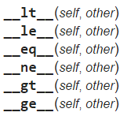
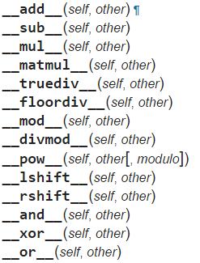
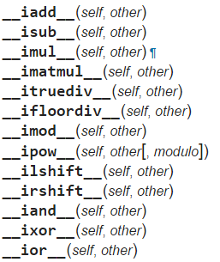
More operators!
Booleans
arithmetic
+
+=
-
-=
*
*=
@
@=
in-place arithmetic
https://docs.python.org/3/reference/datamodel.html#special-method-names
Notes:
INHANDOUT
This actually isn’t a complete list (e.g. abs isn’t there).
Demo date differences, also show when somebody will be 30K days old (+ or +=). 30K days = 82 years.

Slide 27
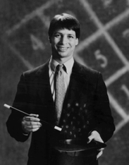
Lab today
Add these to your Date class!
yesterday(self)
tomorrow(self)
addNDays(self, N)
subNDays(self, N)
isBefore(self, d2)
isAfter(self, d2)
diff(self, d2)
dow(self)
Prof. Benjamin !
No computer required…
and use your Date class to analyze our calendar a bit…
Notes:
As a hack, abs(d) gives dow.

Slide 28
Quiz
Name(s) ______________________________
class Date(object):
def isBefore(self, d2):
"""True if self is before d2, else False."""
if self.year < d2.year:
return True
elif self.month < d2.month:
return True
elif self.day < d2.day:
return True
else: return False
d prints as 4/1/2018
What does d.isBefore(d2) return?
Challenge #1
If
Which of the 4 return statements is used?
d2 prints as 4/4/2018
Is this the correct value?
Challenge #2
Find different dates, d and d2, for which d.isBefore(d2) returns an INCORRECT value...
This Date is Late!
Extra!
Above, show how to fix the isBefore method ...
Notes:
QUIZSLIDE

Slide 29
isBefore
I <3 Elf! But what about Elif?
class Date(object):
def isBefore(self, d2):
"""True if self is before d2, else False"""
if self.year < d2.year:
return True
elif self.month < d2.month and self.year == d2.year:
return True
elif self.day < d2.day and self.year == d2.year \
and self.month == d2.month:
return True
return False

Slide 30
<
I want LESS !
__lt__
class Date(object):
def __lt__(self, d2):
"""If self is before d2, this should
return True; else False."""
if self.isBefore(d2):
return True
else:
return False

Slide 31
<
__lt__
LESS !
class Date(object):
def __lt__(self, d2):
"""This is less than most code!"""
return self.isBefore(d2)
Notes:
INHANDOUT

Slide 32
Date's purpose…?!
>>> d = Date(4, 4, 2018)
>>> print d
4/4/2018
always create with the CONSTRUCTOR …
the tomorrow method returns nothing at all. Is it doing anything?
d += 1
>>> d.tomorrow()
>>> print d
4/5/2018
>>> d.addNDays(38)
lots of printing, but no return value!
d has changed!
d += 38
Why is this important?
Some methods return a value; others change the object that call it!

Slide 33
class Date:
def tomorrow(self):
"""Moves the self date ahead 1 day."""
DIM = [0,31,28,31,30,31,30,31,31,30,31,30,31]
Don't hand this in... Use for hw11pr1 this week!
DIM looks pretty bright to me!
self.day += 1
first, add 1 to self.day
if
test if we have gone "out of bounds!"
then, adjust the month and year, only if needed
Don't return anything. This CHANGES the date object that calls it.
Extra how could we make this work for leap years, too?
Notes:
INHANDOUT

Slide 34
class Date(object):
def tomorrow(self):
"""Moves the self date ahead 1 day."""
DIM = [0,31,fdays,31,30,31,30,31,31,30,31,30,31]
self.day += 1 # add 1 to the day!
if self.day > DIM[self.month]: # check day
self.month += 1
self.day = 1
if self.month > 12: # check month
self.year += 1
self.month = 1
better as a variable!
Notes:
I

Slide 35
class Date(object):
def tomorrow(self):
"""Moves the self date ahead 1 day"""
if self.isLeapYear(): fdays = 29
else: fdays = 28
DIM = [0,31,fdays,31,30,31,30,31,31,30,31,30,31]
self.day += 1 # add 1 to the day!
if self.day > DIM[self.month]: # check day
self.month += 1
self.day = 1
if self.month > 12: # check month
self.year += 1
self.month = 1
Notes:
INHANDOUT

Slide 36
class Date(object):
def tomorrow(self):
"""Moves the self date ahead 1 day"""
fdays = 28 + self.isLeapYear() # What ?!
DIM = [0,31,fdays,31,30,31,30,31,31,30,31,30,31]
self.day += 1 # add 1 to the day!
if self.day > DIM[self.month]: # check day
self.month += 1
self.day = 1
if self.month > 12: # check month
self.year += 1
self.month = 1
the "Luke trick"!

Slide 37
Don't hand this in... Use for hw10pr1 this week!
class Date(object):
def yesterday(self):
"""Moves the self date backwards 1 day."""
fdays = 28 + self.isLeapYear() # Yay!
DIM = [0,31,fdays,31,30,31,30,31,31,30,31,30,31]
For lab: how will "wrap-around" work in this case? What cases do we need to worry about?!

Slide 38
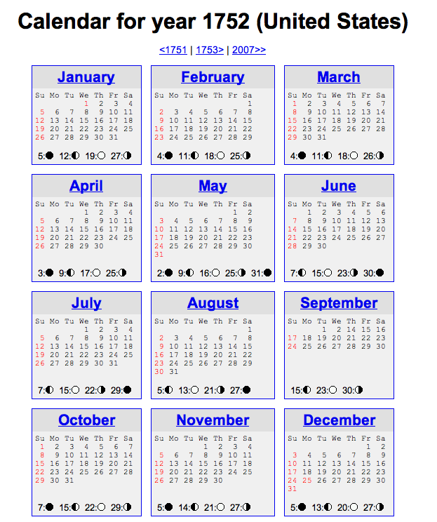
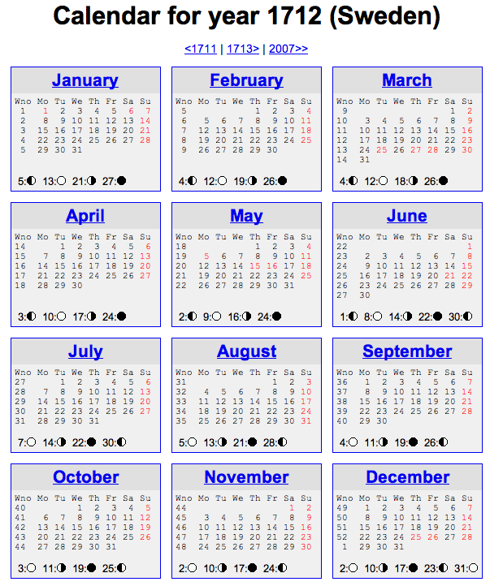
Not all years are the same!

Slide 39
See you @ this week's lab …
… it's a Date!
class-y
^

