Slide 1


The CS 5 Herald
Goodwill Gesture Goes Awry
Claremont (AP): Seven rooms were damaged in a Harvey Mudd College dormitory Tuesday evening after a misguided attempt to cheer up sleep-deprived students. “We were approached by a group of three penguins who wanted to sing Christmas carols,” explained a witness. “They promised that it would help us study.” Instead, the raucous squawking of the untrained and untalented birds quickly led to a violent dispute between supporters and detractors. One student attempted to encase the singers in foam rubber, but a second set fire to the material in hopes of freeing the animals. The resulting explosion unleashed a conflagration that spread to North Dorm, where there was extensive damage. However, losses in North were estimated at only $35.47, due to the advanced age of the furniture there.
Read 6.7-6.9
Notes:
Worksheet: figure out a Huffman tree.

Slide 2
Data Compression
The zzyzva is known to be a xenophobic creature with a zealous personality…
B6^9)=\n%%spam!=&&penguin/?’,/+
compression algorithm
(e.g. zip)
Now we can delete the original file!
TEXT FILE
zzyzva.txt
58,254 bytes
TEXT FILE
zzyzva.txt.Z
23,124 bytes
Notes:
The animation makes the original file disappear.

Slide 3
Data Compression
The zzyzva is known to be a xenophobic creature with a zealous personality…
B6^9)=\n%%spam!=&&penguin/?’,/+
DEcompression algorithm
(e.g. unzip)
Now we can delete the original file!
TEXT FILE
zzyzva.txt
58,254 bytes
TEXT FILE
zzyzva.txt.Z
23,124 bytes

Slide 4
Data Compression!
Letter ord(Letter) Binary
T 84 01010100
h 104 01101000
e 101 01100101
z 122 01111010
The zzyzva is known to be a xenophobic creature with a zealous personality…
TEXT FILE
' '- 1226754 19.04%
E - 655257 10.17%
T - 474521 7.37%
A - 425718 6.61%
… skipping a few …
J - 5329 0.08%
Q - 4923 0.08%
Z - 3378 0.05%
But these statistics are on average, not for my essay on the zzyzva!
English text
letter frequencies

Slide 5
Variable Length Encodings
Letter frequency Binary code
z 0.25 0
y 0.10 1
x 0.09 00
a 0.08 01
…
r 0.02 10100111100
p 0.01 10100111101
The zzyzva is known to be a xenophobic creature with a zealous personality…
TEXT FILE
Yes!! These frequencies are for my essay!!
Cute idea, but what’s the problem here?
Notes:
The problem is how to know whether 00 represents an x or zz. The code doesn’t have the prefix property.

Slide 6
The Prefix Property
Letter frequency Binary code
z 0.25 00
y 0.10 01
x 0.09 10
a 0.08 111
r 0.02 1100
The zzyzva is known to be a xenophobic creature with a zealous personality…
TEXT FILE
101110100001100 = 10 111 01 00 00 1100
Notes:
The prefix property says you can always unambiguously identify a code just by looking at a prefix of the string. Another name for this is an "instantaneously decodable code".

Slide 7
Consider the Language “Spamish” which has only four letters in its alphabet…
Letter freq Fixed Length Variable Length
s 0.6 00 0
p 0.2 01 10
a 0.1 10 110
m 0.1 11 111
Expected average number of bits
per symbol = 2
1.6 is 80% of 2.0, so we expect 20% space savings!
Expected average number of bits per symbol =
0.6x1 + 0.2x2 + 0.1x3 + 0.1x3 = 1.6
Notes:
This slide has one animation, showing the second expected average and the alien.

Slide 8
The Variable Length Coding Problem…
Letter Frequency
a₁ freq(a₁)
a₂ freq(a₂)
a₃ freq(a₃)
… a_{n} freq(a_{n})
These frequencies are from the specific file that we’re planning to compress!!
Objective: Find a binary prefix code that minimizes…
freq(a₁) × codelength(a₁) +
freq(a₂) × codelength(a₂) + …
freq(a_{n}) × codelength(a_{n})

Slide 9
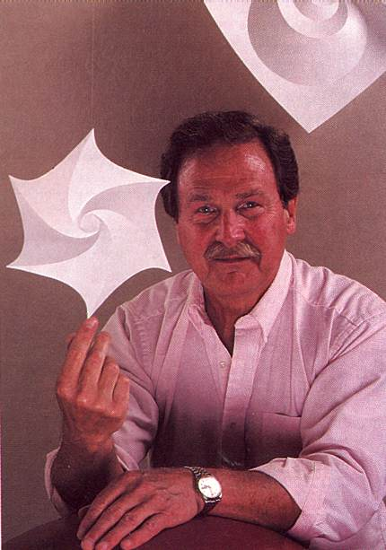
The David Huffman Story!
Letter freq
s 0.6
p 0.2
a 0.1
m 0.1
map smppam
ssampamsmam
…
TEXT FILE
Huffman coding is one of the fundamental ideas that people
in computer science and data communications are using all
the time - Donald Knuth
Notes:
1951 David Huffman took information theory at MIT from Robert Fano. He was given a choice of taking a final exam or finding an optimal prefix code. Fano didn’t tell him that he himself had struggled with the problem. Huffman worked for a long time, without success. He had an idea, but couldn’t prove it was optimal. Finally, he gave up, and as he was on the way to see Fano he suddenly had the necessary insight. When he showed his result to Fano, Fano exclaimed, “Is it really that easy?”

Slide 10
The David Huffman Story!
Letter freq
s 0.6
p 0.2
a 0.1
m 0.1
map smppam
ssampamsmam
…
TEXT FILE
ENCODING:
Scan text file to compute frequencies
Build Huffman tree
Find code for every symbol (letter)—why is this a prefix code?
Create new compressed file by saving the entire code at the top of
the file followed by the code for each symbol (letter) in the file
Notes:
It’s guaranteed to be a prefix code because every code is a path through the tree to a leaf.

Slide 11

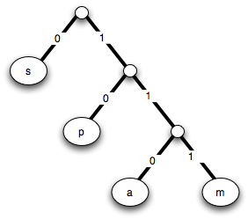
I wonder about trees—Robert Frost
We wonder about Robert Frost—Trees
Recursive definition of a binary tree…
A binary tree is:
1. Just a symbol (i.e. a “leaf”) or
2. A left subtree and a right subtree
("s", ("p", ("a", "m")) )
???
???
("p", ("a", "m") )
"s"
Shouldn’t that be the list
["a", "m"] ?
("a", "m")
"p"
"a"
“m"
Notes:
How do you make the tree? On next slide they’ll do it by trial and error. Don’t show the animations until after they’ve written the tree down. (But this isn’t the primary worksheet.) We’ll show a more realistic tree later.
This slide has three animations showing the tree nodes as they get built.
It shouldn’t be a list because we want to be able to use the tuples as dictionary indices.

Slide 12
I wonder about trees—Robert Frost
We wonder about Robert Frost—Trees
Recursive definition of a binary tree…
A binary tree is:
1. Just a symbol (i.e. a “leaf”) or
2. A left subtree and a right subtree
"s"
"p"
"a"
"m"
Notes:
Students will work it out on this slide.

Slide 13
Huffman’s Algorithm
Find two lowest-frequency symbols
Combine them into a tree node
  Add their frequencies
Repeat until only one node left
Notes:
The optimality proof uses induction starting at the two least frequent nodes.

Slide 14
Huffman Example
1.0
.40
.60
.20
.20
.10
.10
Notes:
The combined frequencies are animated.

Slide 15
You Try It!
Worksheet
Letter Frequency
h 0.40
a 0.20
r 0.15
v 0.15
e 0.06
y 0.04
Build the tree and write down the codes for each of the
symbols
Then encode the string “haha” using this code
Notes:
Worksheet!

Slide 16
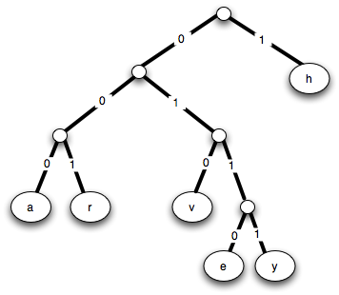
You Try It!
Worksheet
10001000
.60
.40
.35
.25
Build the tree and write down the codes for each of the symbols
Then encode the string “haha” using this code
.10
.20
.15
.15
.06
.04
Notes:
The animations bring up the combined frequencies, one by one. Note that the “v” vs. “r” choice is arbitrary. The final animation brings up the haha encoding.

Slide 17
Python Representation
( ( (a, r) , (v, (e, y) ) ), h )
( (a, r) , (v, (e, y) ) )
(a, r)
(v, (e, y))
(e, y)

Slide 18
Tuples (“immutable lists”)
>>> foo = (42, 'hello', (5, 'spam'), 'penguin')
>>> foo
(42, 'hello', (5, 'spam'), 'penguin')
>>> foo[0]
42
>>> foo[-1]
'penguin'
>>> foo[0:2]
(42, 'hello')
>>> foo[0:1]
(42,)

Slide 19
Tuples (“immutable lists”)
>>> foo = (42, 'hello', (5, 'spam'), 'penguin')
>>> foo
(42, 'hello', (5, 'spam'), 'penguin')
>>> foo[0]
42
>>> foo[-1]
'penguin'
>>> foo[0:2]
(42, 'hello')
>>> foo[0:1]
(42,)
>>> bar = (42)
>>> bar
42
>>> bar = (42,)
(42,)
>>> foo[0] = 100
BARF!!!

Slide 20
Dictionaries
>>> D = {}
>>> D[“Ran”]= "spam"
>>> D[“Lucy”]= "chocolate"
>>> D[“Justin”]= 42
>>> D["Ran"]
'spam'
>>> D["Penguin"]
BARF!
>>> D.has_key("Ran")
True
>>> D.has_key("Penguin")
False
“Ran”, “Lucy”, and “Justin” are called the
“keys” in the dictionary. Any immutable
object can be a key.

Slide 21
Dictionaries
>>> D.keys()
['Ran', ’Lucy', ’Justin']
>>> D
{'Ran': 'spam', ’Lucy': 'chocolate', ’Justin': 42}
>>> del D["Ran"]
>>> D
{’Lucy': 'chocolate', ’Justin': 42}

Slide 22
Dictionaries
>>> D.keys()
['Ran', ’Lucy', ’Justin']
>>> D
{'Ran': 'spam', ’Lucy': 'chocolate', ’Justin': 42}
>>> del D["Ran"]
>>> D
{’Lucy': 'chocolate', ’Justin': 42}
>>> cal = {2005: "rooster",
2006: "dog",
2007: "pig",
2008: "rat"}
>>> cal[2008]
"rat"
>>> len(cal)
4
Notes:
This slide has an animation that brings up cal.

Slide 23

The Alien’s Life Advice
Ask questions when you don’t get it!
It makes you seem human!
OK, so maybe humans can't get dates with xohptzl stars, but you’ll learn more!

Slide 24
Building the Huffman Tree!
frequencies = {"h": 0.40,
"a": 0.20, "r": 0.15,
"v": 0.15, "e": 0.06,
"y": 0.04}
Letter Frequency
h 0.40
a 0.20
r 0.15
v 0.15
e 0.06
y 0.04
How do I get these!?
OBJECTIVE: Convert this into a tree…
Notes:
Note that the frequencies don’t have to be normalized, since the only thing that matters is their relative values.

Slide 25
Building the Huffman Tree!
frequencies = {"h": 0.40,
"a": 0.20, "r": 0.15,
"v": 0.15, "e" :0.06,
"y": 0.04}
Assume a function minfrequency(frequencies)
that returns the character (key) with min frequency!
def make_tree(self, counter):
make list of one-item HuffmanNodes
one for each Counter entry
while len(tree_list) >= 2:
combine 2 least-frequent trees
what should their frequency be?
use tree to figure out codes
save codes in self.encodings dict
( ( (a, r) , (v, (e, y) ) ) , h )
minfrequency can be written using Counter’s most_common() function with [-1] and the del keyword!
Notes:
Step one is creating new HuffmanNodes (constructor). Step 2 uses the overloaded add operator. Step 3 uses get_codes. Steps 2, 3, and 4 are animated.

Slide 26
Building the Huffman Tree!
frequencies = {"h": 0.40,
"a": 0.20, "r": 0.15,
"v": 0.15, "e" :0.06,
"y": 0.04}
Assume a function minfrequency(frequencies)
that returns the character (key) with min frequency!
def make_tree(self, counter):
( ( (a, r) , (v, (e, y) ) ) , h )
minfrequency can be written using Counter’s most_common() function with [-1] and the del keyword!
Notes:
Step one is creating new HuffmanTrees (constructor). Step 2 uses the overloaded add operator. Step 3 uses get_codes.

Slide 27
The Huffman Encoder
frequencies = {"h": 0.40,
"a": 0.20, "r": 0.15,
"v": 0.15, "e": 0.06,
"y": 0.04}
Read input file into string S
Count letter frequencies in S
Build the Huffman tree
Find the Huffman code for each character
binary_sequence = ""
for each character c in S
binary_sequence += Huffman code for c
Write encoding to codes file
Write output to compressed file
h: 1 a : 000 r: 001
v: 010 e: 0110 y: 0111
Notes:
The first two lines are one statement each. We just saw how to build the tree and get the codes. The rest is write_to_files.

Slide 28
File I/O
def read_file():
filename = input("Enter the name of a file: ")
myfile = open(filename, "rb") # "r" means "read"
contents = myfile.read().decode('latin-1') # MAYBE
myfile.close()
return contents
def write_file(string):
filename = input("Enter the name of a file: ")
myfile = open(filename, "wb") # "w" means "write"
myfile.write(string.encode('latin-1')) # MAYBE
myfile.close()
return
>>> write_file("Spam is the secret to all :^)!")
Enter the name of a file to write: spam.txt
>>> read_file()
Enter the name of a file: spam.txt
'Spam is the secret to all :^)!'
What about line breaks in the file?
Notes:
Python treats text and binary files very differently. For binary files, use “rb” and “wb”. The encode/decode part is only for Huffman.

Slide 29
The Huffman Decoder
Read compressed file into string E
Read Huffman table from codes file
Expand E to original text string S
Save S to file
6
2001
h: 1 a : 000 r: 001
v: 010 e: 0110 y: 0111
$a!*&spam^>\n):^)
pen*guin!*blah/~.\cs5!.<-42
blahblahblah
Notes:
The trick here is the first step: recovering the Huffman tree.

Slide 30
OOPs! (Object-Oriented Programs)
>>> today = Date(11, 9, 2021)
>>> due = Date(11, 15, 2021)
>>> due – today
6
>> if due > today:
print("Go watch a movie!”)
Notes:
One of the points of using objects is that you can hide implementation details.

Slide 31
One Implementation
class Date:
def __init__(self, m, d, y):
self.month = m
self.day = d
self.year = y
>>> d = Date(1, 21, 1969)

Slide 32
Another Implementation…
class Date:
def __init__(self, m, d, y):
self.daysSince1900 = …
>>> d = Date(1, 21, 1969)
Why would any rational person want to store the date as the number of days since January 1, 1900?

Slide 33
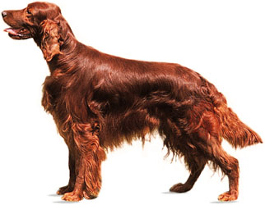
Getters and Setters
class Date:
def __init__(self, m, d, y):
self._daysSince1900 = …
def setDay(self, d):
if d <= 0 or d > 31:
…
else:
self._daysSince1900 = …
>>> d = Date(1, 21, 1969)
>>> d.setDay(28) # SETTER
>>> x = d.getDay() # GETTER

Slide 34
Date “Abstraction”
Date
__init__(self, month, day, year)
setDay(self, day)
setMonth(self, month)
setYear(self, year)
getDay(self)
getMonth(self)
getYear(self)
==, >, <, >=, <=, +, -

Slide 35
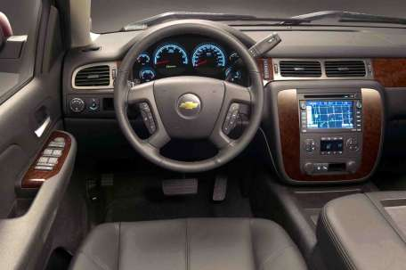
The Advantage of Abstraction
Rack-and-pinion? Recirculating ball? Worm-and-sector? Steer-by-wire?

Slide 36
An Important Point
import turtle
import math
import Date
turtle.forward(100)
print(math.cos(math.pi))
today = Date.Date(11, 9, 2011)
from turtle import *
from math import cos, pi
from Date import *
forward(100)
print(cos(pi))
today = Date(11, 9, 2011)
Notes:
Note that for Python packages you can either import the whole package, in which case you need to use the dots, or you can import individual functions and avoid the dot.

Slide 37
Another Point…
class Point:
def __init(self, inputX, inputY)
self.x = inputX
self.y = inputY
def __str__(self):
return "(" + str(self.x) + "," + str(self.y) + ")"
def __repr__(self):
return "Point(" + str(self.x) + "," + str(self.y) + ")"
def __eq__(self, other):
return self.x == other.x and self.y == other.y
What’s the Point?
>>> P1 = Point(1.0, 2.0)
>>> P2 = Point(1.0, 2.0)
>>> P1
???
>>> P1 == P2
???

Slide 38
repr vs. str
class Silly:
# No __init__ needed!
def __str__(self):
return "silly indeed"
def __repr__(self):
return "Silly()"
>>> s = Silly()
>>> s
Silly()
>>> print(s)
silly indeed

Slide 39
Thinking Linearly
class Point:
def __init(self, inputX, inputY)
self.x = inputX
self.y = inputY
def __repr__(self):
return "(" + str(self.x) + "," + str(self.y) + ")"
def __eq__(self, other):
return self.x == other.x and self.y == other.y
>>> P1 = Point(1.0, 2.0)
>>> P2 = Point(2.0, 3.0)
>>> L1 = Line(P1,P2)
>>> L1
y = 1.0 x + 1.0
>>> P3 = Point(3.0, 4.0)
>>> P4 = Point(42.0, 43.0)
>>> L2 = Line(P3, P4)
>>> L1 == L2
True
class Line:
def __init__(self, point1, point2):
self.point1 = point1
self.point2 = point2
self.slope = (point1.y – point2.y) / (point1.x – point2.x) # BUG!
self.yIntercept = point1.y – point1.x*(point2.y – point1.y)/(point2.x – point1.x)
def __repr__(self):
return "y = " + str(self.slope) + " x + " + str(self.yIntercept)
def __eq__(self, other):
return self.slope == other.slope and self.yIntercept == other.yIntercept
Notes:
This slide has two animations, showing the implementations of repr and eq. The repr implementation is really str. How would we write a "real" repr?

Slide 40
L2
y
>>> from Point import *
>>> p1 = Point(0, 1)
>>> p2 = Point(1, 2)
>>> L1 = Line(p1, p2)
>>> p3 = Point(2, 0)
>>> p4 = Point(0, 2)
>>> L2 = Line(p3, p4)
>>> L1.isParallel(L2)
False
>>> L1.intersection(L2)
(0.5,1.5)
L1
p2
p4
p1
x
p3
class Point:
def __init(self, inputX, inputY)
self.x = 1.0 * inputX
self.y = 1.0 * inputY
def __repr__(self):
return "(" + str(self.x) + "," + str(self.y) + ")"
def __eq__(self, other):
return self.x == other.x and self.y == other.y
class Line:
def __init__(self, point1, point2):
self.point1 = point1
self.point2 = point2
self.slope = (point1.y – point2.y) / (point1.x – point2.x)
self.yIntercept = point1.y – point1.x*(point2.y – point1.y)/(point2.x – point1.x)
def __repr__(self):
return "y = " + str(self.slope) + "x + “ + str(self.yIntercept)
def __eq__(self, other):
return self.slope == other.slope and self.yIntercept == other.yIntercept
def intersection(self, other):
if self.isParallel(other): return None
else:
x = (self.yintercept – other.yintercept)/(other.slope – self.slope)
y = self.slope * x + self.yintercept
return Point(x, y)
Can you think of another way of writing this line?
Notes:
This slide has an animation, showing the return statement and asking how else to write the "return None" line. The intention is that they will see that you can write other.parallel(self), and could also just compare slopes directly.

Slide 41
Default Arguments
In my experience, arguments are usually default of deperson who started them!
class Student:
def __init__(self, firstName, lastName,
school = "HMC", major = "undeclared")
>>> where = Student("Carmen", "Sandiego")
>>> stu = Student("Stu", "Dious", "PIT")
>>> anna = Student("Anna", "Litik", major = "Physics")
>>> elmo = Student("Elmo")
>>> bigBird = Student("Big", "Bird", firstName = "Tweety")
>>> bart = Student(school = "PIT", "Bart", "Simpson")

Slide 42
Inheritance
class Person:
def __init__(self, first, last):
self.firstName = first
self.lastName = last
def asleep(self, time):
return 0 <= time <= 7 # MILITARY TIME IN HOURS
def __repr__(self):
return self.firstName + " " + self.lastName
>>> geoff = Person("Geoff", "Kuenning")
>>> geoff
Geoff Kuenning
>>> geoff.asleep(2)
True

Slide 43
class Person:
def __init__(self, first, last):
self.firstName = first
self.lastName = last
def asleep(self, time):
return 0 <= time <= 7
def __repr__(self):
return self.firstName + " " + self.lastName
class Student(Person):
def __init__(self, first, last, age):
super(Student, self).__init__(self, first, last)
self.age = age
def asleep(self, time):
return 3 <= time <= 11
def __repr__(self):
return Person.__repr__(self) + ", " + str(self.age) + " years old"
Sleeping until 11 AM!?
>>> s = Student("Sue", "Persmart", 18)
>>> s
Sue Persmart, 18 years old
>>> s.asleep(2)
False
Notes:
This is overriding (not “overwriting”) a function in the “base class”.

Slide 44
class Person:
def __init__(self, first, last):
self.firstName = first
self.lastName = last
def asleep(self, time):
return 0 <= time <= 7
def __repr__(self):
return self.firstName + " " + self.lastName
class Student(Person):
def __init__(self, first, last, age):
super(Student, self).__init__(self, first, last)
self.age = age
def asleep(self, time):
return 3 <= time <= 11
def __repr__(self):
return Person.__repr__(self) + ", " + str(self.age) + " years old"
class Mudder(Student):
def __init__(self, first, last, age, dorm):
super(Mudder, self).__init__(self, first, last, age)
self.dorm = dorm
def asleep(self, time):
return False
>>> wally = Mudder("Wally", "Wart",
42, "West")
>>> wally
?
>>> wally.asleep(4)
?
Get some sleep!!!

Slide 45
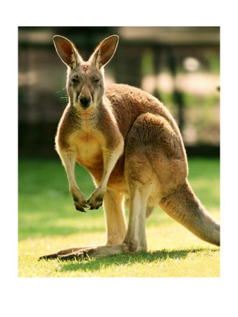
The Dangers of Inheritance
Notes:
The story goes that the Australian Army had a great helicopter battlefield simulator, which they wanted to demo for some visiting American brass. Shortly before the visit, they decided to "Aussie" it up by putting kangaroos on the landscape. Being good programmers, they inherited from the existing Soldier class and overriding (not "overwriting") the display method to show kangaroos. Demo day came; they flew the simulated helicopter over the Outback, and came across a herd of kangaroos. Sure enough, the 'roos scattered and disappeared behind the hills. Just as the brass were chuckling at the cute demo, the kangaroos reappeared—with surface-to-air missiles!

Slide 46
Python Forbids Personality Transplants!
class Vector:
def __init__(self, x, y):
self.x = x
self.y = y
def magnitude(self):
blah, blah, blah
return …
def normalize(self):
mag = self.magnitude()
newVector = Vector(
self.x/mag, self.y/mag)
self = newVector
class Vector:
def __init__(self, x, y):
self.x = x
self.y = y
def magnitude(self):
blah, blah, blah
return …
def normalize(self):
mag = self.magnitude()
self.x = self.x/mag
self.y = self.y/mag
Notes:
This slide has an animation.

Slide 47
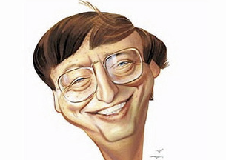
Millisoft “Shapes”
Gill Bates
>>> r = Rectangle(100, 50, center=Vector(80, 60), color=“blue”)
>>> c = Circle(radius=30, color = “red”) # default center (0,0)
>>> r.rotate(15) # 15 degree ccw rotation
>>> r.render()
>>> c.render()
That rectangle ain’t parallel to the x-axis!
100
50
(80, 60)
Demo ShapesDemo.py
Notes:
Demo0 draws a 3-eyed face; demo1 rotates a rectangle repeatedly.

Slide 48
Transformation Matrices
Rotation
Scaling
Translation ???
Rotation matrices make my head spin.
Notes:
Develop this on the board. For everything except translation, assume that the object is centered at (0,0). Start with scaling. If a rectangle is of size 2x1, how do you scale it up by 3? Just multiply all points by 3 in both X and Y. Can you write a matrix that, when multipled by the (transpose of) the vector (x, y), produces the new vector (3x, 3y)?
Now do rotation. In general, it turns out that newx = oldx*cos(theta)-oldy*sin(theta) and newy = oldx*sin(theta)+oldy*cos(theta). Can we write this as a matrix?
Finally, what about translation? Clearly, newx = oldx+deltax and newy = oldy+deltay. Can this be done as a matrix?
We'll (maybe) get to a way to do translation later.

Slide 49
A 2x2 Matrix Class
>>> m1 = Matrix2(0, -1, 1, 0)
>>> m2 = Matrix2(1, 2, 3, 4)
>>> m1
0 -1
1 0
>>> m2
1 2
3 4
>>> m1+m2
1 1
4 4
>>> m1*m2
-3 -4
1 2
>>> m1.get(0, 1)
-1
>>> m1.set(1, 0, 42)
I thought that Linear Algebra was the Matrix Class!

Slide 50
A 2x2 Matrix Class
def Matrix2:
"""2x2 matrix class"""
def __init__(self, a11=0, a12=0, a21=0, a22=0):
self.array = [[a11, a12], [a21, a22]]
def __repr__(self):
def set(self, row, column, value):
def get(self, row, column):
def __mul__(self, other):
"""other may be a matrix OR a vector and returns
the product of self and other."""
class Vector2:
def __init__(self, x, y):
self.x = x
self.y = y
def magnitude(self):
blah, blah, blah
return …
def normalize(self):
mag = self.magnitude()
self.x = self.x/mag
self.y = self.y/mag
Blah, blah, blah
if other.__class__.__name__ == "Matrix2":
blah, blah, blah
else: # it’s HOPEFULLY a Vector2!
Notes:
You'll implement this in the homework.

Slide 51
class Vector2:
def __init__(self, x, y):
self.x = x
self.y = y
def magnitude(self):
blah, blah, blah
return …
def normalize(self):
mag = self.magnitude()
self.x = self.x/mag
self.y = self.y/mag
def __mul__(self, other):
"""If other is a Matrix2, returns a Matrix2.
If other is a Vector2, returns a Vector2."""
if other.__class__.__name__ == "Matrix2":
result = Matrix2()
for row in range(0, 2):
for col in range(0, 2):
# Compute result matrix
entry = 0
for i in range(0, 2):
entry += _______________________________
result.set(row, col, entry)
return result
elif other.__class__.__name__ == "Vector":
x = ______________________________________
y = ______________________________________
return ___________________________________
else:
raise ValueError("Can't multiply a matrix by a " \
+ other.__class__.name__
Fill this in on your worksheet…

Slide 52
def __mul__(self, other):
"""If other is a Matrix2, returns a Matrix2.
If other is a Vector2, returns a Vector2."""
if other.__class__.__name__ == "Matrix2":
result = Matrix()
for row in range(0, 2):
for col in range(0, 2):
# Compute result matrix in the given row and col
entry = 0
for i in range(0, 2):
entry += self.get(row, i) * other.get(i, col)
result.set(row, col, entry)
return result
elif other.__class__.__name__ == "Vector2":
x = self.get(0, 0) * other.x + self.get(0, 1) * other.y
y = self.get(1, 0) * other.x + self.get(1, 1) * other.y
return Vector2(x, y)
else:
raise ValueError("Can't multiply a matrix by a " \
+ other.__class__.name__

Slide 53
import math # Now we have math.cos(angle), math.sin(angle), etc. Angles are in radians
import turtle
from Matrix import *
from Vector import *
class Shape:
def __init__(self):
self.points = [] # List of Vectors!
def render(self):
turtle.penup()
turtle.setposition(self.points[0].x, self.points[0].y)
turtle.pendown()
turtle.fillcolor(self.color)
turtle.pencolor(self.color)
turtle.begin_fill()
for vector in self.points[1:]:
turtle.setposition(vector.x, vector.y)
turtle.setposition(self.points[0].x, self.points[0].y)
turtle.end_fill()
def erase(self):
temp = self.color
self.color = "white"
self.render()
self.color = temp
def rotate(self, theta):
"""Rotate shape by theta degrees"""
theta = math.radians(theta) # Python thinks in radians
class Rectangle(Shape):
def __init__(self, width, height, center = Vector2(0, 0), color = "black"):
class Square… # (constructor takes width, optional center, optional color)
Time to get our Object-Oriented muscles in Shape!
Notes:
The point here is that Rectangle inherits from Shape, so it doesn't need to do much, and Square inherits from Rectangle, so it needs to do even less.

Slide 54
class Shape:
def __init__(self):
self.points = []
def render(self):
def rotate(self, theta):
"""Rotate shape by theta degrees"""
theta = math.radians(theta) # Python thinks in radians
class Square
def __init__(self, width, center=Vector(0, 0), color = "black"):
Do this one last
class Rectangle(Shape):
def __init__(self, width, height, center = Vector2(0, 0), color = "black"):
SW = Vector2(center.x – width/2.0, center.y – height/2.0)
NW = Vector2(center.x – width/2.0, center.y + height/2.0)
NE = Vector2(center.x + width/2.0, center.y + height/2.0)
SE = Vector2(center.x + width/2.0, center.y – height/2.0)
self.points = [SW, NW, NE, SE]
self.color = color
Do this one first

Slide 55
class Shape:
def __init__(self):
self.points = []
def render(self):
def rotate(self, theta):
"""Rotate shape by theta degrees"""
theta = math.radians(theta) # Python thinks in radians!
Do this one last
class Rectangle(Shape):
def __init__(self, width, height, center = Vector(0, 0), color = "black"):
SW = Vector2(center.x – width/2.0, center.y – height/2.0)
NW = Vector2(center.x – width/2.0, center.y + height/2.0)
NE = Vector2(center.x + width/2.0, center.y + height/2.0)
SE = Vector2(center.x + width/2.0, center.y – height/2.0)
self.points = [SW, NW, NE, SE]
self.color = color
class Square(Rectangle):
def __init__(self, width, center=Vector(0, 0), color = "black"):
super(Square, self).__init__(self, width, width, center, color)

Slide 56
class Shape:
def __init__(self):
self.points = []
def render(self):
def rotate(self, theta):
"""Rotate shape by theta degrees"""
theta = math.radians(theta) # Python thinks in radians!
RotationMatrix = Matrix2(math.cos(theta), -1*math.sin(theta),
math.sin(theta), math.cos(theta))
newPoints = []
for vector in self.points:
newvector = RotationMatrix * vector
newPoints.append(newvector)
self.points = newPoints
class Rectangle(Shape):
def __init__(self, width, height, center = Vector(0, 0), color = "black"):
SW = Vector2(center.x – width/2.0, center.y – height/2.0)
NW = Vector2(center.x – width/2.0, center.y + height/2.0)
NE = Vector2(center.x + width/2.0, center.y + height/2.0)
SE = Vector2(center.x + width/2.0, center.y – height/2.0)
self.points = [SW, NW, NE, SE]
self.color = color
class Square(Rectangle):
def __init__(self, width, center=Vector(0, 0), color = "black"):
super(Square, self).__init__(self, width, width, center, color)

Slide 57
class Shape:
def __init__(self):
self.points = []
def render(self):
def rotate(self, theta):
class Circle(Shape):
def __init__(self, center=Vector(0,0), radius=10, color="black"):
turtle.circle(50)
Can I inherit render and rotate from Shape?

Slide 58
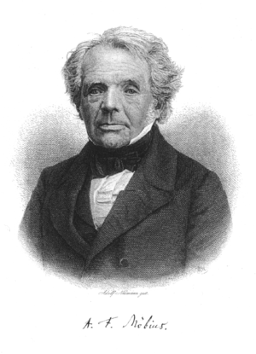
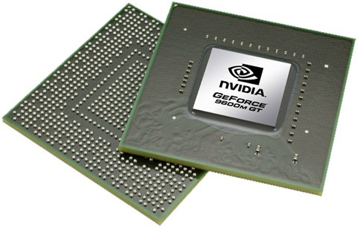
More “Draw” Tricks
Rotation about an arbitrary point
Homogenous coordinates and translation!
August Mobius

