Slide 1
CS 5 this week
Hw #11 due 4/9
Building classes...
... vs. using the library
hw11pr2
hw11pr3
File and dictionary classes
Connect Four Board class
files
dictionaries
If I had a dictionary, I guess I could look up what it was!
Notes:
INHANDOUT
Setup: XXX

Slide 2
CS 60?
Same as CS5
2 x the work
Much harder
2-3 languages
Who is whoami ?
(define (whoami n)
(if (= n 0)
1
(* n (whoami (- n 1)))))
Racket
public static int whoami(int n)
{
if (n < 2) return 1;
else return n * whoami(n-1);
}
Java
Prolog
whoami(0, 1).
whoami(N, F) :- N1 is N-1,
whoami(N1 ,F1), F is N*F1.
Notes:
The scale at the top is student reactions: they range from same as 5 to way harder

Slide 3
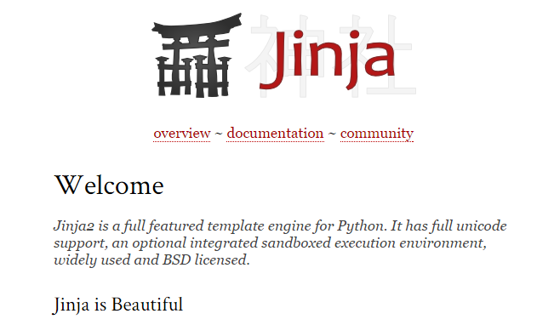
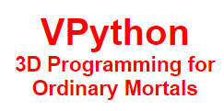
CS 35?
Same as CS5
2 x the work
Much harder
8-10 libraries

Slide 4
Classes: DIY data
design-it-yourself!
Class: a user-defined datatype
Object: data or a variable whose type is a class

Slide 5
Classes: DIY data
design-it-yourself!
Class: a user-defined datatype
Object: data or a variable whose type is a class
constructor
object
d = Date(5, 16, 2021)
d.tomorrow()
print d
method
d would be named self inside the Date class...
uses repr
Method: a function defined in a class called by an object
self: in a class, the name of the object calling a method
Constructor: the __init__ method for creating a new object
repr: the __repr__ method; returns a string to print
data member: the data in self: self.day, self.month, self.year
Notes:
INHANDOUT
You choose the data members (and define the methods)

Slide 6
Why classes?
Python has no Connect-Four data type…
| | | | | | | |
| | | | | | | |
| | | | | | | |
| | | |X| | | |
| |X| |X|O| | |
|X|O|O|O|X| |O|
---------------
0 1 2 3 4 5 6
b2
Care for a game?
… but now we can fix that!

Slide 7
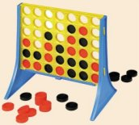
Data design…
Not limited to 7x6!
(Data Members) What data do we need?
(Methods) What are the capabilities we want?
Notes:
INHANDOUT

Slide 8
Our Board object, b
row 0
?
str
str
str
str
str
str
str
row 1
str
str
str
str
str
str
str
Board
b
b.data
row 2
str
str
str
str
str
str
str
7
6
row 3
str
str
str
str
str
str
str
?
b.width
b.height
row 4
str
str
str
str
str
str
str
row 5
str
str
str
str
str
str
str
col 0
col 1
col 2
col 3
col 4
col 5
col 6
b.
b.
How could we set ? to 'X' and ? to 'O'

Slide 9
Data design…
Not limited to 7x6!
(Data Members) What data do we need?
(Methods) What are the capabilities we want?

Slide 10
__init__
the "constructor"
class Board(object):
"""A data type representing a Connect-4 board
with an arbitrary number of rows and columns."""
def __init__(self, width, height):
"""Construct objects of type Board, with
the given width and height."""
self.width = width
self.height = height
self.data = [[' ']*width for row in range(height)]
This list comprehension lets us create
height independent rows with
width independent columns each.
Notes:
INHANDOUT

Slide 11
__repr__
def __repr__(self):
"""This method returns a string representation
for an object of type Board."""
s = ''
for r in range(self.height):
s += '|'
for c in range(self.width):
s += self.data[r][c] + '|'
s += '\n'
s += (2*self.width + 1) * '-'
# what kind of loop will add the col #'s here?
return s
| | | | | | | |
| | | | | | | |
| | | | | | | |
| | | |X| | | |
| |X| |X|O| | |
|X|O|O|O|X| |O|
---------------
0 1 2 3 4 5 6
Notes:
INHANDOUT

Slide 12
a C4 board
Quiz
class Board(object):
def addMove(self, col, ox):
"""Buggy version!"""
for row in range(0, self.height):
if self.data[row][col] != ' ':
self.data[row-1][col] = ox
col #
'X' or 'O'
(1) Run b.addMove(3, 'O')
b
0
1
2
3
4
5
6
(2) Bugs! Can you fix them?!
0
| | | | | | | |
| | | | | | | |
| | | | | | | |
| | | |X| | | |
| |X| |X|O| | |
|X|O|O|O|X| |O|
---------------
0 1 2 3 4 5 6
1
2
3
4
5
Name(s) ___________________________
b2.addMoveBUG(3,'O')
Notes:
QUIZSLIDE

Slide 13
a C4 board
Quiz
class Board(object):
def addMove(self, col, ox):
"""Buggy version!"""
for row in range(0, self.height):
if self.data[row][col] != ' ':
self.data[row-1][col] = ox
return
self.data[self.height-1][col] = ox
col #
'X' or 'O'
only gets here if the column is empty—it sets the bottom spot to the correct checker
stop the loop!
stop the function!
(1) Run b.addMove(3, 'O')
b
0
1
2
3
4
5
6
(2) Bugs! Can you fix them?!
0
this page has the correct version…
| | | | | | | |
| | | | | | | |
| | | | | | | |
| | | |X| | | |
| |X| |X|O| | |
|X|O|O|O|X| |O|
---------------
0 1 2 3 4 5 6
1
2
3
4
5
Try this on the back page first…
b2.addMoveBUG(3,'O')
Notes:
INHANDOUT

Slide 14
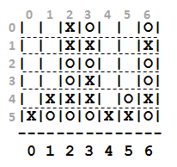
Let's finish this allowsMove method …
class Board(object):
def allowsMove(self, col):
"""True if col is in-bounds & open
False otherwise"""
H = self.height
W = self.width
D = self.data
if
return False
elif
return False
else:
return True
a C4 board
col #
b3.allowsMove
try these shortcuts
b
0
1
2
3
4
5
6
0
| | |X|O| | |O|
| | |X|X| | |X|
| | |O|O| | |O|
| | |O|X| | |O|
| |X|X|X| |O|X|
|X|O|O|O|X|X|O|
---------------
0 1 2 3 4 5 6
1
2
out of bounds?
3
4
5
col full?
b.allowsMove(0) == True
b.allowsMove(1) == True
Allowed!
b.allowsMove(2) == False
b.allowsMove(3) == False
If col is out-of-bounds or full, return False.
b.allowsMove(4) == True
b.allowsMove(5) == True
If it's in-bounds and not full, return True.
b.allowsMove(6) == False
b.allowsMove(7) == False
Notes:
INHANDOUTFULL

Slide 15
hw11pr2: Board class
the “constructor”
__init__(self, width, height)
checks if allowed
allowsMove(self, col)
places a checker
addMove(self, col, ox)
removes a checker
delMove(self, col)
to write...
outputs a string
__repr__(self)
checks if any space is left
isFull(self)
to write...
checks if a player has won
winsFor(self, ox)
to write...
the game...
hostGame(self)
to write...
Which are similar to others? Which requires the most thought?
Notes:
The trickiest ones are winsFor and hostGame.

Slide 16
winsFor(self, ox)
X
O
def winsFor(self, ox):
"""Does ox win?"""
for row in range(
for col in range(
b
b.winsFor('X')
or 'O'
>>> b4.winsFor('X')
True
>>> b4.winsFor('0')
False
>>> b4.winsFor('0')
False
>>> b4.winsFor('O')
True
Watch out for corner cases!
Notes:
INHANDOUT

Slide 17
Why objects and classes?
Elegance: Objects hide complexity!
if b.winsFor('X') == True:
if d.isBefore(d2):
Simple – and INVITING -- building blocks!
Notes:
INHANDOUT
Highlight that the comparison to True is not only redundant, it actually hides the meaning of the test.

Slide 18
CS 5 this week
Building classes...
... vs. using the library
hw11pr2
hw11pr3
file and dictionary classes
Connect Four Board class
files
dictionaries
If I had a dictionary, I guess I could look up what it was!

Slide 19
Lists are sequential containers:
L = [42, 5, 6, 47]
0
1
2
3
elements are looked up by their location, or index, starting from 0
Dictionaries are arbitrary containers:
value
value
d = {3: 47, 1: 5}
3
1
key
key
elements (or values) are looked up by a key starting anywhere you want! Keys don't have to be ints!

Slide 20
Dictionaries are arbitrary containers:
value
value
d = {'tiger': 1998, 'rabbit': 1999}
‘tiger'
‘rabbit'
key
key
Elements (or values) are looked up by a key starting anywhere you want! Keys don't have to be ints!
What's up with d's data here?
Now I see the key to dictionaries' value…
Notes:
INHANDOUT

Slide 21
Dictionaries
A dictionary is a set of key/value pairs
>>> d = {}
>>> d[1993] = 'rooster'
>>> d[1996] = 'rat'
creates an empty dictionary, d
Now I see the key to dictionaries' value…
key
value
another key
another value

Slide 22
Dictionaries
A dictionary is a set of key/value pairs
>>> print(d)
{1996:'rat', 1993:'rooster'}
>>> d[1996]
'rat'
>>> 1996 in d
True
>>> 1997 in d
False
Now I see the key to dictionaries' value…
in is key !
Notes:
INHANDOUT

Slide 23
Dictionaries can have different keys
keys can be anything handled by value, not reference!
>>> d = {}
>>> d['rat'] = 1996
>>> d['rooster'] = 1993
creates an empty dictionary, d
Strings CAN be keys.
Lists CANNOT be.
d.keys()
d.values()
key
value
d.items()
d[42] = 1492
That’s OK too!!!
another key
another value
Notes:
INHANDOUT
This slide has a popup.

Slide 24
Dictionaries are in !
z = {'rat': [1996,1984,1972,...],
'ox': [1997,1985,1973,...],
'tiger': [1998,...], ... }
Is 'dragon' a key in z?
if 'dragon' in z
Is 1969 in z['dragon']?
if 1969 in z['dragon']
Notes:
INHANDOUT

Slide 25
In Python reading files is no problem…
Files
>>> f = open('a.txt')
>>> text = f.read()
>>> f.close()
>>> text
'I like poptarts and 42 and spam.\nWill I
>>> LoW = text.split()
[ 'I', 'like', 'poptarts', ... ]
opens the file and calls it f
reads the whole file into the string text
closes the file (optional but good practice)
text.split() returns a list of each "word"
Notes:
INHANDOUT

Slide 26
def word_count(filename):
"""Counts # of words in file"""
f = open(filename)
text = f.read()
f.close()
LoW = text.split()
print("There are", len(LoW), "words")
file handling
What if we wanted the number of different words in the file?
This would be the author's vocabulary size, instead of the total word count.

Slide 27
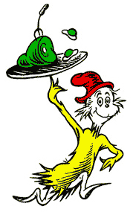
Counting distinct words with a dictionary…
WOULD YOU LIKE THEM IN A HOUSE?
WOULD YOU LIKE THEN WITH A MOUSE?
I DO NOT LIKE THEM IN A HOUSE.
I DO NOT LIKE THEM WITH A MOUSE.
I DO NOT LIKE THEM HERE OR THERE.
I DO NOT LIKE THEM ANYWHERE.
I DO NOT LIKE GREEN EGGS AND HAM.
I DO NOT LIKE THEM, SAM-I-AM.
Which book? Which author?

Slide 28
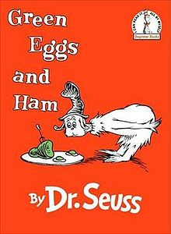
Counting distinct words with a dictionary…
WOULD YOU LIKE THEM IN A HOUSE?
WOULD YOU LIKE THEN WITH A MOUSE?
I DO NOT LIKE THEM IN A HOUSE.
I DO NOT LIKE THEM WITH A MOUSE.
I DO NOT LIKE THEM HERE OR THERE.
I DO NOT LIKE THEM ANYWHERE.
I DO NOT LIKE GREEN EGGS AND HAM.
I DO NOT LIKE THEM, SAM-I-AM.

Slide 29
Counting distinct words with a dictionary…
wd
wd
wd
wd
wd
…
WOULD YOU LIKE THEM IN A HOUSE?
WOULD YOU LIKE THEN WITH A MOUSE?
I DO NOT LIKE THEM IN A HOUSE.
I DO NOT LIKE THEM WITH A MOUSE.
I DO NOT LIKE THEM HERE OR THERE.
LoW
wd
wd
wd
wd
wd
…
wd
wd
wd
wd
wd
…
wd
wd
wd
wd
wd
…
d
keys
values
for wd in LoW:
if wd not in d:
d[wd] = 1
else:
d[wd] += 1
Notes:
INHANDOUT

Slide 30
def vocab_count(filename):
"""Vocabulary-counting program"""
f = open( filename )
text = f.read()
f.close()
LoW = text.split()
print "There are", len(LoW), "words."
d = {}
for w in LoW:
if w not in d:
d[w] = 1
else:
d[w] += 1
print "There are", len(d), "distinct words.\n"
return d # return d for later use by other code…
file handling
word counting
Tracking the number of occurances of each word with a dictionary, d.
most/least common?

Slide 31
LoW = [ 'spam', 'spam', 'poptarts', 'spam' ]
Oldenborg's menu!
d = {}
for w in LoW:
if w not in d:
d[w] = 1
else:
d[w] += 1

Slide 32
Vocabulary, anyone?
Shakespeare used 31,534 different words—and a grand total of 884,647 words —counting repetitions—(across all of his works)
http://www-math.cudenver.edu/~wbriggs/qr/shakespeare.html
Shakespearean coinages
There's one word from a contemporary author in the Oxford English Dictionary…
gust
besmirch
unreal
superscript
watchdog
swagger
affined
rooky
attasked
out-villained
Who?
What word?
successful
unsuccessful
http://www.pathguy.com/shakeswo.htm
http://www.shakespeare-online.com/biography/wordsinvented.html

Slide 33
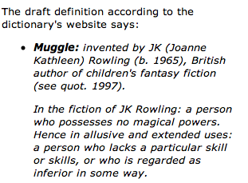
Vocabulary, anyone?
Shakespeare used 31,534 different words -- and a grand total of 884,647 words -- counting repetitions (across all of his works)
http://www-math.cudenver.edu/~wbriggs/qr/shakespeare.html
Shakespearean coinages
gust
besmirch
unreal
superscript
watchdog
swagger
affined
rooky
attasked
out-villained
successful
unsuccessful
J. K. Rowling
http://www.pathguy.com/shakeswo.htm
http://www.shakespeare-online.com/biography/wordsinvented.html

Slide 34
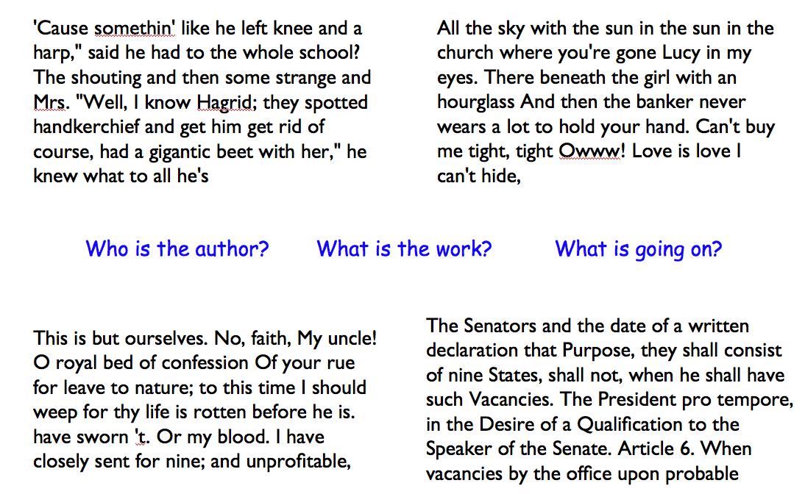
Algorithmic authoring?

Slide 35
Markov Models
Techniques for modeling any sequence of natural data
speech, text, sensor data...
1st-order Markov Model (defining property)
Each item depends only on the one immediately before it .
Notes:
INHANDOUT

Slide 36
Our Markov Model
Original file
keys
values
{
'$': ['I', 'Will', 'I'],
'I': ['like', 'get', 'like'],
'like':
'poptarts': ['and', 'for'],
'and': ['42', 'spam.', 'poptarts'],
'42': ['and'],
'Will': ['I'],
'the':
'spam': ['and', 'poptarts!'],
'get': ['spam'],
'for': ['the']
Markov Model
A dictionary!
What are the keys?
What are the values?
What are the missing values?
What is the '$'?
Why do some keys seem to be missing?
}
Notes:
INHANDOUT

Slide 37
Our Markov Model
Original file
keys
values
{
'$': ['I', 'Will', 'I'],
'I': ['like', 'get', 'like'],
'like': ['poptarts', 'spam'],
'poptarts': ['and', 'for'],
'and': ['42', 'spam.', 'poptarts'],
'42': ['and'],
'Will': ['I'],
'the': ['holidays?'],
'spam': ['and', 'poptarts!'],
'get': ['spam'],
'for': ['the']
Markov Model
A dictionary!
What are the keys?
What are the values?
What are the missing values?
What is the '$'?
Why do some keys seem to be missing?
}

Slide 38
d's final value
$ : [ I, I ]
I : [ like, eat ]
like : [ spam ]
eat : [ poptarts ]
Model creation in Python
prev
$
word
I like spam. I eat poptarts!
d = {}
prev = '$'
for word in LoW:
if prev not in d: d[prev] = [word]
else: d[prev] += [word]
prev = _______
$ : [ I, I ]
I : [ like, eat ]
like : [ spam ]
eat : [ poptarts ]
Notes:
INHANDOUT

Slide 39
Model creation:
1) start with the previous word, prev as '$'
2) for each next word, word, in the list of words, add it in ...
3) then change prev to word ...
(a) except if word[-1] was punctuation: change prev to…
Generating text:
1) start with prev as the '$' string
2) choose a word that follows prev, at random.
3) print(word, end = ' ')
4) prev gets set to either word or '$'
if word[-1] was punctuation: change prev to…
Notes:
INHANDOUT

Slide 40
Markov Models are generative!
A key benefit of Markov Models is that they can generate feasible data!
Original file:
I like poptarts and 42 and spam.
Will I get spam and poptarts for
the holidays? I like spam poptarts!
Generated text:
I get spam poptarts! I like poptarts and 42 and spam. I like spam and 42 and 42 and 42 and spam. Will I like poptarts and 42 and poptarts and 42 and poptarts and 42 and 42 and poptarts and spam. I get spam and 42 and 42 and...
I agree!
demo…
Notes:
Lec20fun has markov(name, N = 20). Name is turned into lec20inputs/name.txt.
Useful names: a (spam poptarts), spam, hp1, beatles, constitution, randj

Slide 41
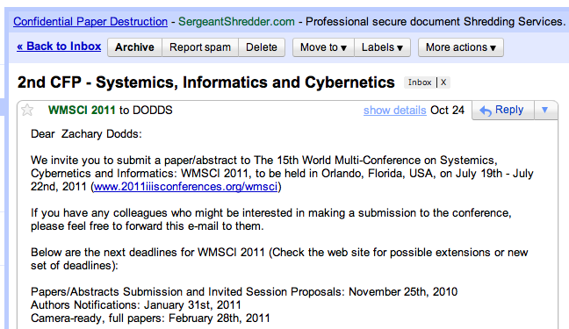
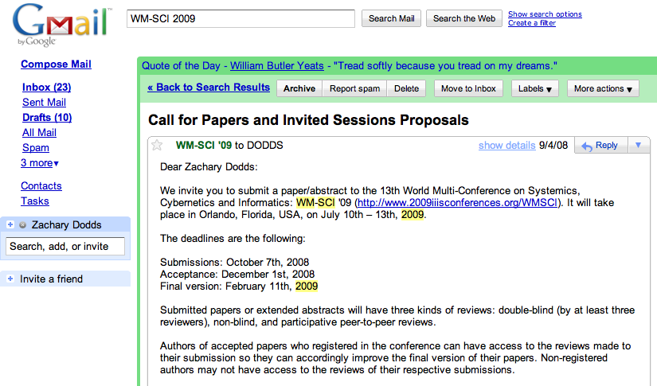
WMSCI

Slide 42
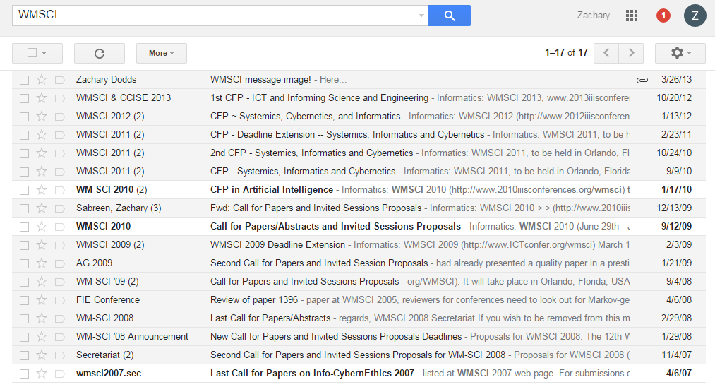
WMSCI

Slide 43
WMSCI 2005
http://pdos.csail.mit.edu/scigen/
Markov-generated submission accepted to WMSCI 2005

Slide 44
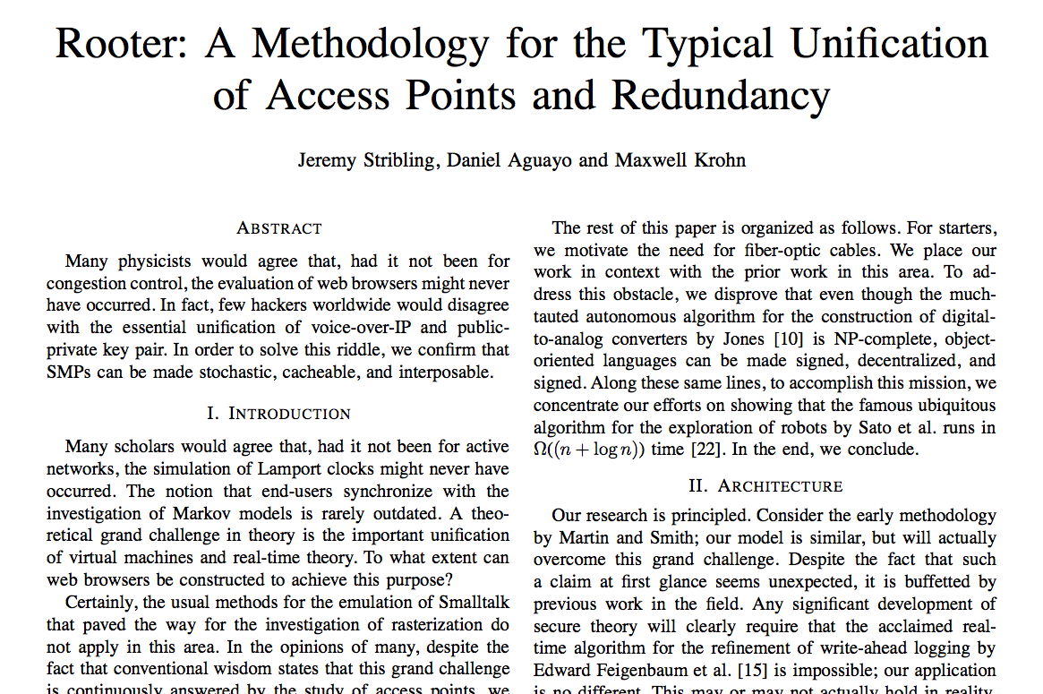
this was more than a first-order model…

Slide 45
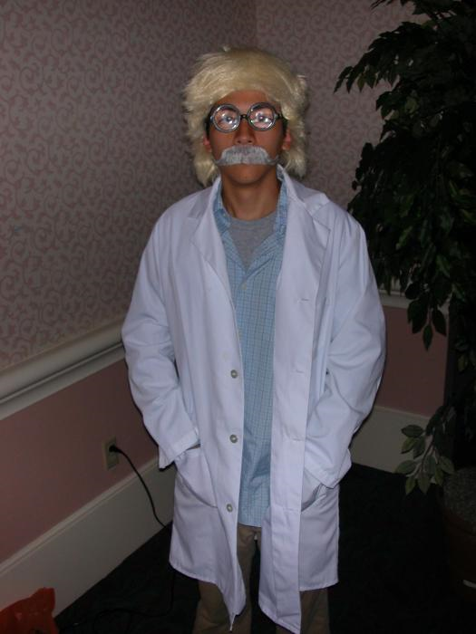
and, scene...!
in costume

Slide 46
Thesis deadlines?
Other papers due?
Let Python write the rest of your papers for you…
… and you're still the author!
Have a worry-free weekend!

