Slide 1
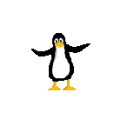

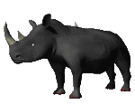

The CS 5 Sun
Crushing Athletic Defeat
Pomona (PPI): The CS "NP-Complete Penguins" suffered a devastating blow here Saturday when they lost to the Physics "Lightspeed Rhinos" in the national gymnastics finals.
The Penguins were leading the competition until the final round, having built on the outstanding flips performed by their star, Petunia "Pirouette" Penguin, and the leaps of the renowned Peter "Popup" Prancer. The Rhinos, by contrast, had had difficulty from the beginning. They upset the judges' table when they first entered, and sullied the gymnasium floor during their admittedly thrilling synchronized charging performance.
But disaster struck when one of the Rhinos "accidentally" gored Petunia and another stepped on Peter. squashing him flat. "I'm terribly sorry," apologized the perpetrator. "I just didn't see him through my beady little eyes."
Deprived of their "A" team, the Penguins were forced to replace them with an uncoordinated CS professor, who fell flat on his face and ensured the Penguin loss.
Notes:
Object3
Worksheet: hand-scoring a Connect 4 board
Have C4 ready to demo

Slide 2
Summer Research!
Yes, there are some research positions for frosh
Lots of cool projects
To learn more:
CS colloquium, Thursday Jan. 20 or 27
4:15 PM, location TBA
Or join the cs-info-l mailing list
Also visit https://uro.hmc.edu

Slide 3

Default Arguments
In my experience, arguments are usually default of deperson who started them!
class Student:
def __init__(self, firstName, lastName,
school = "HMC", major = "undeclared")
>>> where = Student("Carmen", "Sandiego")
>>> stu = Student("Stu", "Dious", "PIT")
>>> anna = Student("Anna", "Litik", major = "Physics")
>>> elmo = Student("Elmo")
>>> bigBird = Student("Big", "Bird", firstName = "Tweety")
>>> bart = Student(school = "PIT", "Bart", "Simpson")

Slide 4
Inheritance
class Person:
def __init__(self, first, last):
self.firstName = first
self.lastName = last
def asleep(self, time):
return 0 <= time <= 7 # MILITARY TIME IN HOURS
def __repr__(self):
return self.firstName + " " + self.lastName
>>> geoff = Person("Geoff", "Kuenning")
>>> geoff
Geoff Kuenning
>>> geoff.asleep(2)
True

Slide 5
class Person:
def __init__(self, first, last):
self.firstName = first
self.lastName = last
def asleep(self, time):
return 0 <= time <= 7
def __repr__(self):
return self.firstName + " " + self.lastName
class Student(Person):
def __init__(self, first, last, age):
super(Student, self).__init__(self, first, last)
self.age = age
def asleep(self, time):
return 3 <= time <= 11
def __repr__(self):
return Person.__repr__(self) + ", " + str(self.age) + " years old"
Sleeping until 11 AM!?
>>> s = Student("Sue", "Persmart", 18)
>>> s
Sue Persmart, 18 years old
>>> s.asleep(2)
False
Notes:
This is overriding (not “overwriting”) a function in the “base class”.

Slide 6
class Person:
def __init__(self, first, last):
self.firstName = first
self.lastName = last
def asleep(self, time):
return 0 <= time <= 7
def __repr__(self):
return self.firstName + " " + self.lastName
class Student(Person):
def __init__(self, first, last, age):
Person.__init__(self, first, last)
self.age = age
def asleep(self, time):
return 3 <= time <= 11
def __repr__(self):
return Person.__repr__(self) + ", " + str(self.age) + " years old"
class Mudder(Student):
def __init__(self, first, last, age, dorm):
super(Mudder, self).__init__(first, last, age)
self.dorm = dorm
def asleep(self, time):
return False
>>> wally = Mudder("Wally", "Wart",
42, "West")
>>> wally
?
>>> wally.asleep(4)
?
Get some sleep!!!

Slide 7
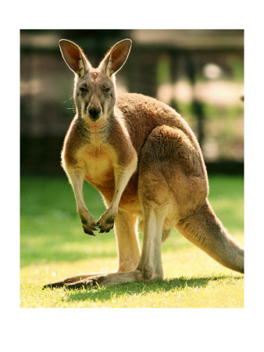
The Dangers of Inheritance
Notes:
The story goes that the Australian Army had a great helicopter battlefield simulator, which they wanted to demo for some visiting American brass. Shortly before the visit, they decided to "Aussie" it up by putting kangaroos on the landscape. Being good programmers, they inherited from the existing Soldier class and overriding (not "overwriting") the display method to show kangaroos. Demo day came; they flew the simulated helicopter over the Outback, and came across a herd of kangaroos. Sure enough, the 'roos scattered and disappeared behind the hills. Just as the brass were chuckling at the cute demo, the kangaroos reappeared—with surface-to-air missiles!

Slide 8
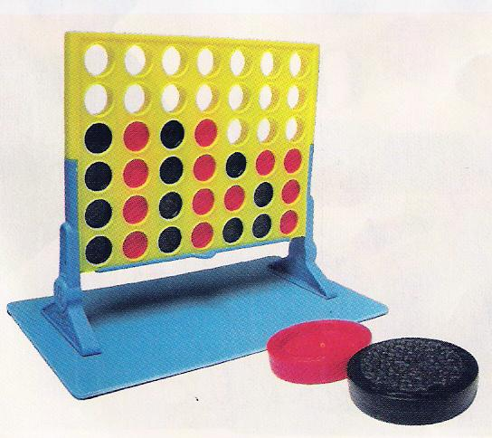
Connect Four!

Slide 9
Rules for Connect Four
Tic-Tac-Toe with stacking
7x6 board
Checkers slide down onto top of column
Four in a row (including diagonal) wins
Notes:
The game is in lec21prog01-connect4.py. 4 plies is fast; 5 plies has delays but they are acceptable;

Slide 10

A Board Class
class Board:
def __init__(self, width = 7, height = 6):
self.width = width
self.height = height
self.board = [self.width*[0]
for i in range(self.height)]
...

Slide 11
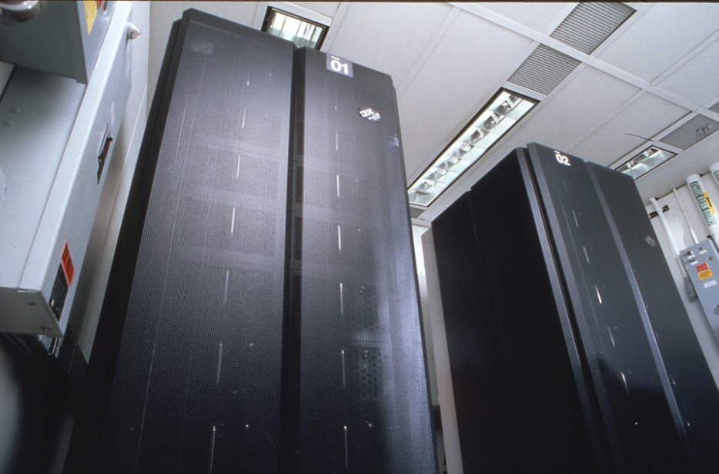
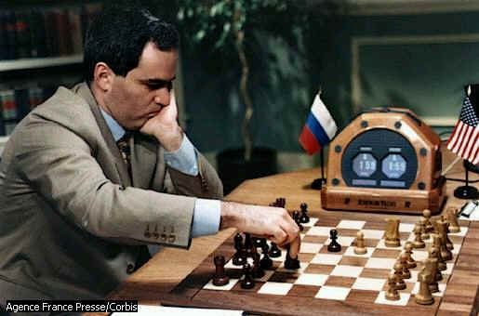
Artificial Intelligence
Catch-all term for anything that “appears human”
  Eliza
  Chess programs
  Expert systems
Many approaches
  N-ply lookahead:
  good for games

Slide 12
Looking into the Future, Part I
Basic idea
  Guess a move
  See whether it makes your position better
  Repeat for many guesses, pick best result
What defines “better”?
  Simple answer: use board-evaluation function

Slide 13
Evaluating a Connect-4 Board
What are some ways to numerically rate a Connect-4 board?
If opponent has won, 0
If I have won, 100
Otherwise…
?

Slide 14
Looking Into the Future, Part II
Problem: evaluating a board is HARD
Solution: look at where the board leads
  For each possible move:
    Make the move in “trial mode”
    For each possible opponent's response:
      Make that move in “trial mode”
      Evaluate that board instead
    Choose opponent's best option
      This is the “worst case” for us
    Our best move is “best of the worst cases”
Call ourselves recursively
Notes:
This slide has two animations. The first crosses out "Evaluate that board instead". The second adds "Call ourselves recursively."

Slide 15
Looking Into the Future, Part II
Problem: evaluating a board is HARD
Solution: look at where the board leads
  For each possible move:
    Make the move in “trial mode”
    For each possible opponent's response:
      Make that move in “trial mode”
      Evaluate that board instead
    Choose opponent's best option
      This is the “worst case” for us
    Our best move is “best of the worst cases”

Slide 16
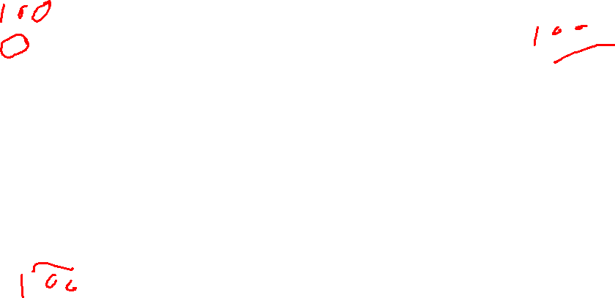
'X'
Scoring Each Column
'O'
new 'X'
For each possible move:
(1) Add it to the board
(2) Ask OPPONENT ('O') to score the resulting board
Worksheet problem: What should you ('X') assign for your score? (self's score)
What would 'O's scores be if 'O' could look ahead one more move?
0.0
50.0
Col 0
Col 6
Col 1
Col 5
Col 2
Col 3
Col 4
50.0
50.0
0.0
0.0
0.0
Notes:
Worksheet problem! The boards show the scores O (red) would assign.
Explain column 0: the gray is where black would move. Red would then give that board a 0 because red loses instantly.
For the first problem, they’re just supposed to come up with the 100-min(s) formula.
For the second problem, they should see that the 50’s for columns 1 and 6 become 100’s because Red has a winning move, but column 5 stays at 50 because the winning move is blocked.
This is tricky; it will generate discussion.

Slide 17
'X'
Choosing the Best Move
'O'
new 'X'
For each possible move:
(1) Add it to the board
(2) Ask OPPONENT ('O') to score the resulting board
(3) Reverse the scores
100.0
50.0
Col 0
Col 6
Col 1
Col 5
Col 2
Col 3
Col 4
50.0
50.0
100.0
100.0
100.0

Slide 18
'X'
Choosing the Best Move
'O'
new 'X'
For each possible move:
(1) Add it to the board
(2) Ask OPPONENT ('O') to score the resulting board
(3) Reverse the scores
(4) Find one max—that's it!
100.0
50.0
Col 0
Col 6
Col 1
Col 5
Col 2
Col 3
Col 4
50.0
50.0
100.0
100.0
100.0
Notes:
If there are multiple maxima, as here, use a tie-breaking scheme of some sort: left, right, random…

Slide 19
The Alien’s Life Advice
Get to know some profs!
Some of them are pretty interesting people…
…and the others might write a recommendation letter someday!

Slide 20
Limiting Recursion
When do we stop?
That's easy:
  When we find path that leads to a win
    No matter what opponent does (e.g., Nim)
  When all paths lead to losses (sigh)
  When we have explored all possible moves

Slide 21
The Move Tree
X
O
X
O
X
O
X
O X
X O
X
O
X
O
X
O
X
O X
X
O X
X
O X
O X X
O X
X
O X
X
O X
X
How many unique boards in the tic-tac-toe move tree?
How many boards in the tic-tac-toe move tree?
Notes:
This slide has two animations. Start by talking about the shape of the tree and how it is constructed. Then animate the first question. The answer is 9!. Then animate the second question. Don't do the calculation, but let them see that it's a much smaller number—especially when you consider reflections and rotations.

Slide 22
The Move Tree
X
O
X
O
X
O
X
O X
X O
X
O
X
O
X
O
X
O X
X
O X
X
O X
O X X
O X
X
O X
X
O X
X
How many boards in the tic-tac-toe move tree?

Slide 23
Explosive Growth
Connect-4 move tree has < 7⁴² nodes
Roughly 311×10³³
Tree size depends on two parameters:
  Branching factor per move, B
  Maximum moves in game, N
Approximately B^{N} possibilities
  Chess: B≈35, N≈150
  Backgammon: B≈300, N≈50
I can do that in my head!

Slide 24
Limiting Growth
Simplest strategy: stop looking ahead after evaluating N moves (“plies”)
Alternative: stop after t seconds elapsed
Good for chess clocks!
Trickier: prune move tree
  Don't follow a path if first move is way worse
  Don't explore if already found better choice
  Alpha/Beta pruning
Notes:
Alpha/Beta pruning: Suppose you've found a move with value 50. When evaluating another possible move, suppose the opponent has a response that produces value 40 (for you). Then the opponent is going to choose that response or an even worse (for you) one, so you know that move isn't your best. There is no need to explore further opponent responses because you can reject the move out of hand.

Slide 25
The Curse of the AI Researcher
AI is always defined as “something a lot smarter than what my computer can do”
Corollary: if my computer can do it, it's not artificial intelligence
  ⇒ Every time we achieve AI, people decide it's not really AI!
Notes:
This slide has an animation.

Slide 26
The Curse of the AI Researcher
AI is always defined as “something a lot smarter than what my computer can do”
Corollary: if my computer can do it, it's not artificial intelligence

Slide 27
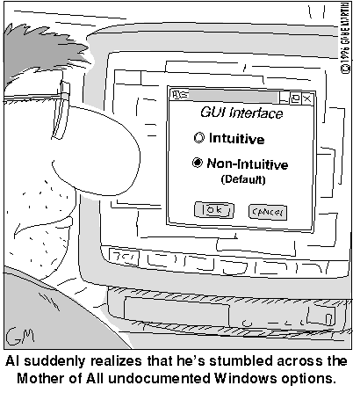
Interfaces: Programmers vs. Users

Slide 28
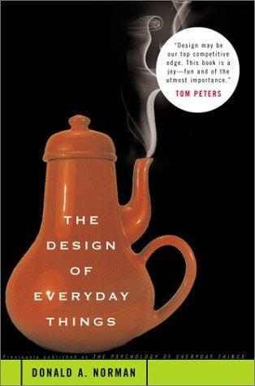
Design For Software and Beyond
Don Norman's key principles:
Conceptual models
Mapping
Visibility
Feedback
Affordances
Um…you can pour…

Slide 29
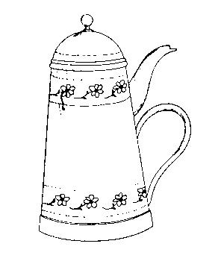
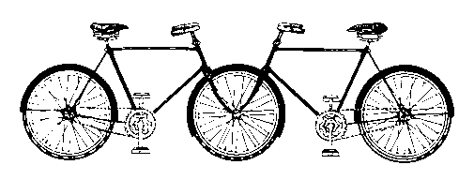
Conceptual Models
Users always bring something "to the table"
Images from The Design of Everyday Things
That bike looks OK to me!
These don't work!

Slide 30
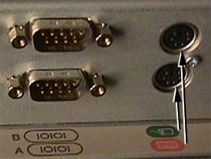
Mapping
Is matching expected (spatial) relationships
?
Where to plug in the keyboard and mouse?

Slide 31
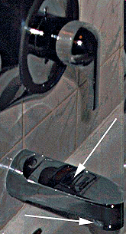
Visibility
Is making functionality apparent
"I used to have that awful shower controller where you pull down on the nozzle to turn it on. I had to tell every guest how to do it, and when we sold our house, we got a call from the new owners about 5 days later asking how to turn on the shower. They had been taking baths for 5 days! Unbelievable." - BL
From: www.baddesigns.com
Shower?

Slide 32
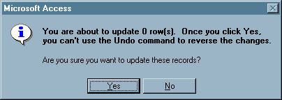
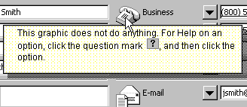
Feedback
Providing information back to the user
Microsoft Access
Microsoft Outlook
from the UI Hall of Shame
http://homepage.mac.com/bradster/iarchitect/shame.htm
Notes:
This slide has two animations, one to pop up each silly message.

Slide 33
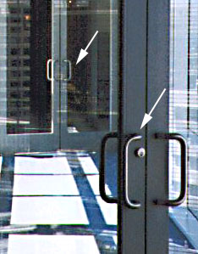
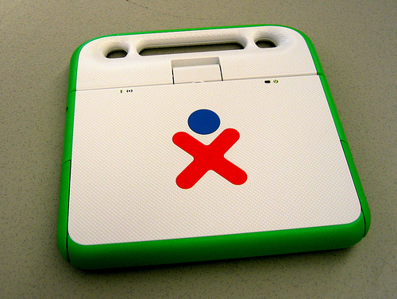
Affordances
Are the functions that form suggests…
built-in user's manual
Opening the XO?
Door handles

Slide 34
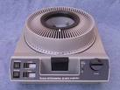
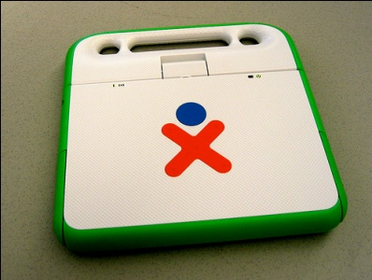
Norman's Principles
Mapping
Meeting expectations for
spatial relationships
Visibility
Making functionality apparent
Feedback
Information provided by the UI to the user
Affordances
Functions suggested by an object's form

Slide 35
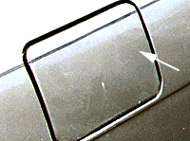
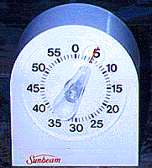
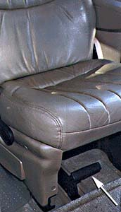
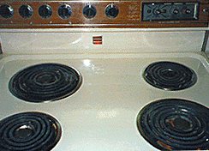
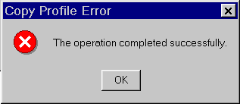
Where Do These Go Wrong?
Mapping
Visibility
Feedback
Affordances
Set to 5 minutes?
How to open this gas cap?
This handle … ?
Win NT Dialog
How to turn on this stove?
Notes:
The next slide shows that the handle unfastens the seat!

Slide 36
Where Do These Go Wrong?
Mapping
Visibility
Feedback
Affordances
Set to 5 minutes?
How to open this gas cap?
This handle unfastens the seat from the floor !
Win NT Dialog
How to turn on this stove?

Slide 37
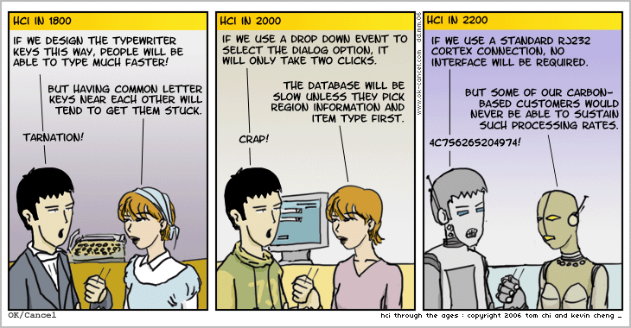
User Interfaces aren't easy.
(Designers aren't users!)

Slide 38
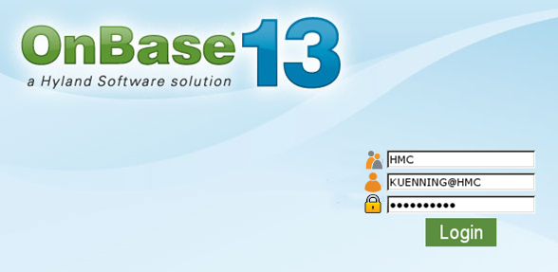
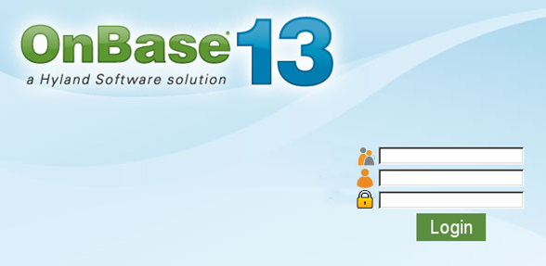
User Testing in One Slide
Start with paper prototypes
Have sample users think out loud
Take notes or (WAY better) video them
Above all, don't offer help!
Analyze results, go back, fix your silly mistakes, try again
Notes:
This was software that was actually deployed at Mudd for a while. Where does the user name go? What about the password? What’s the third box for?

