Slide 1
Any memorable prose composed for (well, by) hw#11 ?
This week's classes
Homework #12, due 4/16
Notice that the value of (dimension + eyes) is conserved!
Three-eyed? This week, we're 3d'ed!
Connect 4 aiMove
Whether it's black's move or red's, they're eye-ing the same column!
Notes:
INHANDOUT
Class 21 vpython
Prep: be ready to run at least bounce.py and billiard_bounce.py under GlowScript (in Chrome).
NOTE: billiard_bounce doesn’t work right now.

Slide 2
Connect 4, Part 2
hw12pr2.py
what methods will help?
b
colsToWin(self, ox)
b.colsToWin('O') # red
b.colsToWin('X') # black
what methods will help?
aiMove(self, ox)
| | | | | | | |
| | | | | | | |
| | | | | | | |
| |X|O| | | | |
| |X|O| |X|X| |
|O|O|O|O|X|O|X|
---------------
0 1 2 3 4 5 6
b.aiMove('O') # red
b.aiMove('X') # black
hostGame(self)
Notes:
INHANDOUT

Slide 3
Connect 4, Part 2
hw12pr2.py
what methods will help?
b
colsToWin(self, ox)
If you write aiMove, you're in our annual C4 tournament...
b.colsToWin('O')
b.colsToWin('X')
what methods will help?
aiMove(self, ox)
| | | | | | | |
| | | | | | | |
| | | | | | | |
| |X|O| | | | |
| |X|O| |X|X| |
|O|O|O|O|X|O|X|
---------------
0 1 2 3 4 5 6
b.aiMove('O') # red
b.aiMove('X') # black
hostGame(self)

Slide 4
Python features, motivated by VPython
Tuples are similar to lists, but they're parenthesized:
T = (4,2)
V = (1,0,0)
Example of a two-element tuple named T and a three-element tuple named V
def f(x = 3, y = 17):
return 10*x + y
example of default arguments in a function definition
Notes:
INHANDOUT

Slide 5
Tuples!
Lists that use parentheses are called tuples:
but what about that name?!
>>> T = (4, 2)
>>> T
(4, 2)
>>> T[0]
4
>>> T[0] = 42
Error!
>>> T = ('a',2,'z')
>>>
Tuples are immutable lists: you can't change their elements...
...but you can always redefine the whole variable, if you want!
+ Tuples are more memory & time efficient
+ Tuples can be dictionary keys: lists can't be
- But you can't change tuples' elements...

Slide 6
Tuples!
Lists that use parentheses are called tuples:
T = (4, 2)
T
(4, 2)
T[0]
4
T[0] = 42
Error!
T = ('a', 2, 'z')
Tuples are immutable lists: you can't change their elements...
...but you can always redefine the whole variable, if you want!
+ Tuples are more memory & time efficient
+ Tuples can be dictionary keys: lists can't be
- But you can't change tuples' elements...
Notes:
INHANDOUT

Slide 7
Tuple problems…
Creating 0- and 1-tuples would seem like a problem!
A bug from last week’s Board class:
W = 4 # for example
s = " ",
for col in range(W):
s += str(col), " "
trying for
" 0 1 2 3 "
yields a surprising result for s
Notes:
Without the first comma, it's an error. Here, the tuple is implied by the comma; you can also write “a = 1, 2” and get a tuple.

Slide 8
Tuple problems…
Creating 0- and 1-tuples would seem like a problem!
A bug from last week's Board class:
W = 4 # for example
s = " ",
for col in range(W):
s += str(col), " "
yields a surprising result for s
(' ', '0', ' ', '1', ' ', '2', ' ', '3', ' ')
starting value
Notes:
Without the first comma, it's an error

Slide 9
Python details... (that VPython uses)
Functions can have default arguments and can take named arguments
def f(x = 3, y = 17):
return 10*x + y
example of default arguments for x and y
f(x = 4, y = 2)
example of named arguments for x and y
Function arguments look like tuples, but they're not quite the same…

Slide 10
Python details in VPython…
Functions can have default arguments and can take named arguments
def f(x = 3, y = 17):
return 10*x + y
example of an ordinary function call—totally OK
f(4, 2)
example of default arguments
f()
example using only one default argument
f(1)
example of a named argument
f(y = 1)
Notes:
INHANDOUT

Slide 11
Named arguments
def f(x = 2, y = 11):
return x + 3*y
Try this on the back page first…
f(3, 1)
f()
f(3)
f(y = 2, x = 1)
What will these function calls to f return?
None of the above are 42!
What call to f returns the string 'Lalalalala' ?
These are tuples—they work like lists!
What is f( ( ), (1,0) ) ?
What is the shortest call to f returning 42?
it's only four characters, too!
Extra… what does this return? x = 60; y = -6; f(y = x, x = y)
Notes:
INHANDOUT

Slide 12
Named arguments
def f(x = 2, y = 11):
return x + 3*y
Your name(s) as an argument________________________
f(3, 1)
f()
f(3)
f(y = 2, x = 1)
What will these function calls to f return?
None of the above are 42!
What call to f returns the string 'Lalalalala' ?
These are tuples – they work like lists!
What is f( ( ), (1,0) ) ?
What is the shortest call to f returning 42?
it's only four characters, too!
Extra… what does this return? x = 60; y = -6; f(y = x, x = y)
Notes:
QUIZSLIDE

Slide 13
feedback feedback

Slide 14
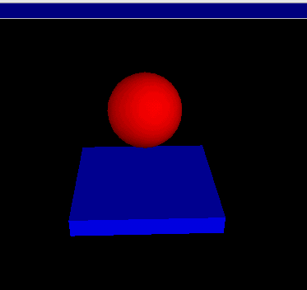
VPython
Where were we... ?
www.vpython.org
stonehenge.py
Built by and for physicists to simplify 3d simulations
bounce.py
Lots of available classes, objects and methods in its API
Available at glowscript.org
Notes:
vPython is fragile and hard to get working. But GlowScript puts it on the Web. The downside is that it’s a fork that doesn’t have quite the same API. Sigh. And the editor kind of sucks.

Slide 15
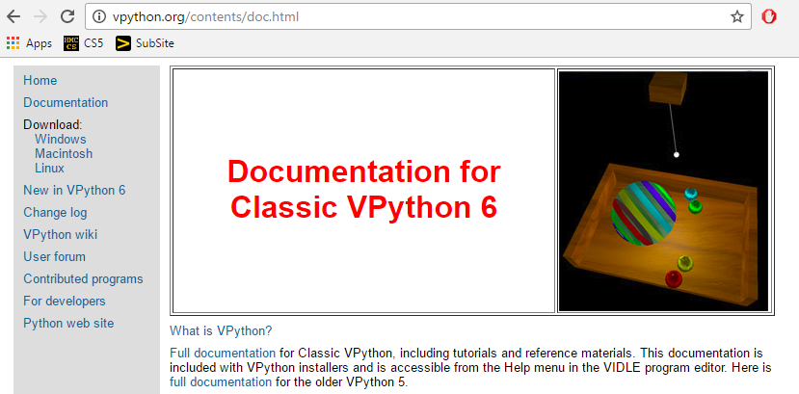
Installing VPython
or, use the lab's machines…
Windows & Mac OS
Tutorials and documentation…

Slide 16
API
... stands for Application Programming Interface
A programming description of how to use a software library
A demo of GlowScript's API:
What's cylinder?
What's c?
What's main?
What are those last two lines?
GlowScript 2.7 Vpython
def main():
c = cylinder()
while True:
rate(10)
# This calls main when the file is run
if __name__ == "__main__":
main()
at least it's not Visual C…
VPython example API calls
Notes:
INHANDOUT

Slide 17
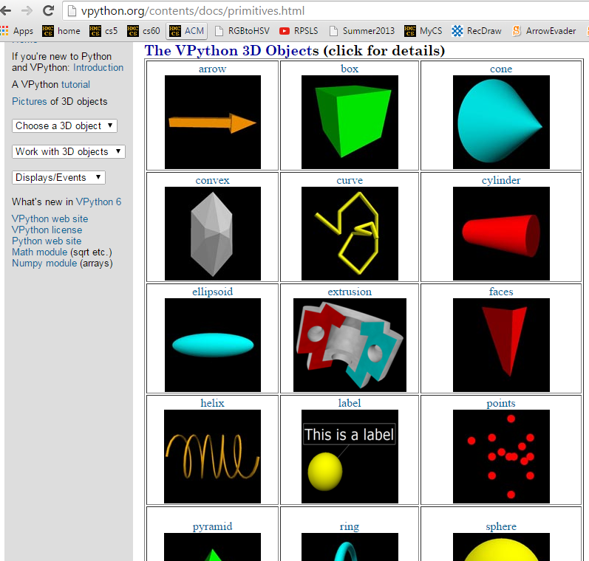
API
... stands for Application Programming Interface
constructors + methods!
shapes!

Slide 18
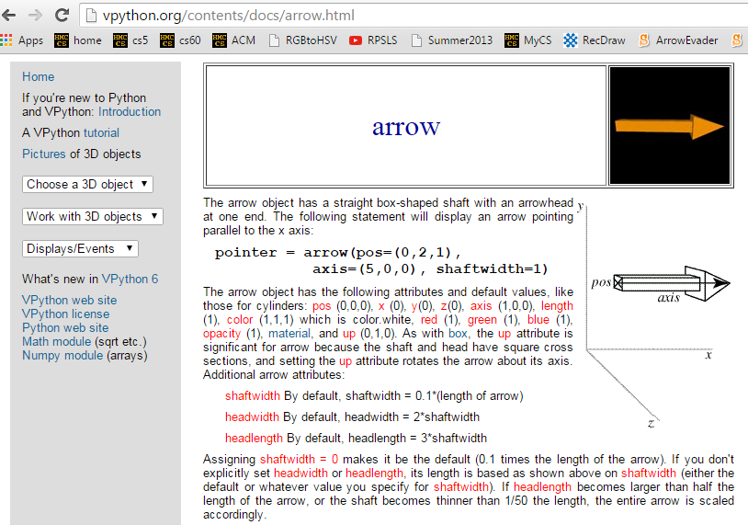
API
... stands for Application Programming Interface

Slide 19
VPython
Set up world with 3d objects…
b = box()
b.color = color.red
# 1: change colors…
color.red or a tuple
# 3: add objects
scene.autoscale = False
c = cylinder(pos = vec(4,0,0))
a = sphere(pos = vec(0,0,4))
Then, run a simulation using those objects…
more objects and API calls
while True:
rate(30) # times/sec
print("b.pos is", b.pos)
# 2: change position
(most will be added before the while loop)
# 4: define velocity (above loop)
# 5: then, change pos (in loop)
if __name__ == "__main__":
main()
Notes:
INHANDOUT
Note that this code would produce a super-fast scroll of b.pos printouts; rate(1) might be a better choice.

Slide 20
vectors
b.pos, b.vel,… are vectors
b.vel = vector(1, 0, 0)
vel.z
named components
vel.y
vel.x
b.pos = vector(0, 0, 0)
scalar multiplication
b.pos = b.pos + b.vel*0.2
component-by-component addition
let's compare with tuples…
Notes:
vec is a synonym for vector

Slide 21
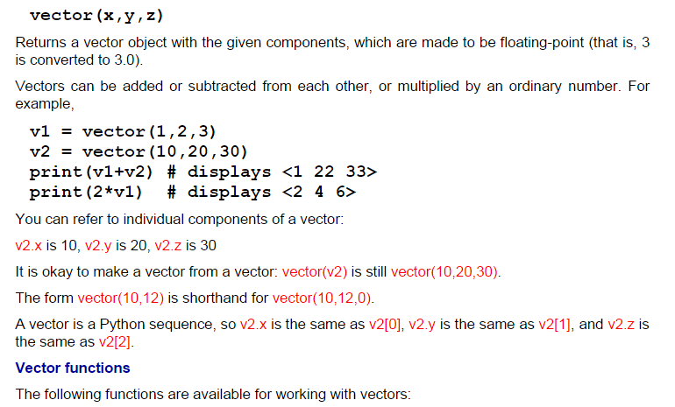
vectors
act like "arrows"
http://www.glowscript.org/docs/VPythonDocs/vector.html
Notes:
INHANDOUT

Slide 22
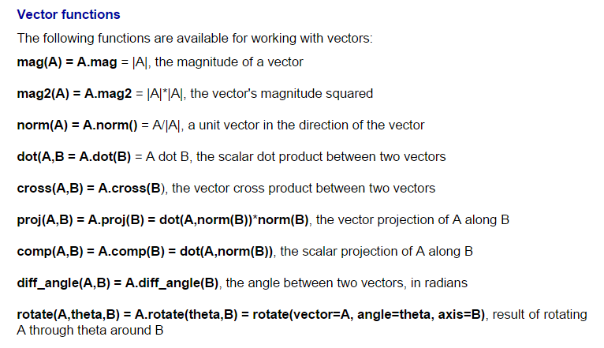
vectors
lots of support… (don't write your own)
http://www.glowscript.org/docs/VPythonDocs/vector.html
Notes:
INHANDOUT

Slide 23
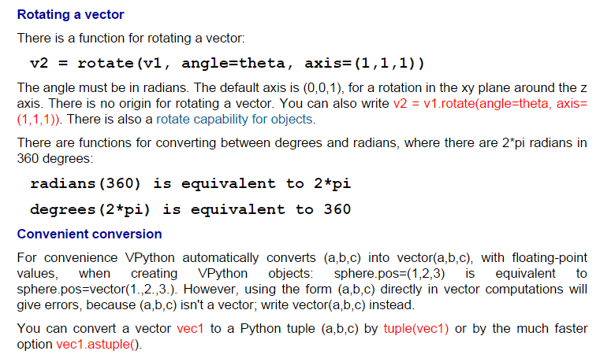
vpython.org/contents/docs
Documentation!

Slide 24
vPython!
(1) How many vPython classes are used in this code? ____
(2) How many vPython objects are used here? ________
(3) What line of code handles collisions ?
(4) How does physics work? Where is it?
(5) Tricky! How many tuples are here?
Look over this VPython program to determine
from visual import *
def main():
"""docstring!"""
floor = box(length=4,width=4,height=0.5,color=(0,0,1))
ball = sphere(pos=(0,8,0),radius=1,color=color.red)
ball.vel = vector(0,-1,0)
RATE = 30
dt = 1.0/RATE
while True:
rate(RATE)
ball.pos += ball.vel*dt
if ball.pos.y < ball.radius:
ball.vel.y *= -1.0
else:
ball.vel.y += -9.8*dt
Physics is here.
Let's run it!
what is this += doing?
what is this if/else doing?
Notes:
INHANDOUT
This is bounce.py (or bounce in GlowScript’s interface).

Slide 25
Lab goals
(0) Try out VPython!
(1) Make a few changes to the starter code
(2) Implement walls and wall collisions…
(3) Improve your alien!
(4) Optional: add scoring, enemies, or a moving target, hoops, traps, holes, etc.—your own game…
final-project option

Slide 26
Collisions…
point-to-line collisions
# if the ball hits wallA
if ball.pos.z < wallA.pos.z: # hit - check for z
ball.pos.z = wallA.pos.z # bring back into bounds
ball.vel.z *= -1.0 # reverse the z velocity
# if the ball hits wallB
if ball.pos.x < wallB.pos.x: # hit - check for x
ball.pos.x = wallB.pos.x # bring back into bounds
ball.vel.x *= -1.0 # reverse the x velocity
# if the ball collides with the alien, give a vertical velocity
if mag(ball.pos - alien.pos) < 1.0:
print("To infinity and beyond!")
alien.vel = vector(0, 1, 0)
point-to-point collisions
Notes:
INHANDOUT

Slide 27
compound

Slide 28
compound
What's what here?
alien_body = sphere( size=1.0*vector(1,1,1), pos=vector(0,0,0), color=color.green )
alien_eye1 = sphere( size=0.3*vector(1,1,1), pos=.42*vector(.7,.5,.2), color=color.white )
alien_eye2 = sphere( size=0.3*vector(1,1,1), pos=.42*vector(.2,.5,.7), color=color.white )
alien_hat = cylinder( pos=0.42*vector(0,.9,-.2), axis=vector(.02,.2,-.02),
size=vector(0.2,0.7,0.7), color=color.magenta)
alien_objects = [alien_body, alien_eye1, alien_eye2, alien_hat]
com_alien = compound( alien_objects, pos=starting_position )
Notes:
INHANDOUT

Slide 29
# +++ start of EVENT_HANDLING section -- separate functions
# for keypresses and mouse clicks...
def keydown_fun(event):
"""Function called with each key pressed."""
ball.color = randcolor()
key = event.key
ri = randint( 0, 10 )
print("key:", key, ri) # prints the key pressed
amt = 0.42 # "strength" of the keypress's velocity changes
if key == 'left':
ball.vel = ball.vel + vector(0, 0, -amt)
elif key == 'down':
ball.vel = ball.vel + vector(-amt, 0, 0)
elif key == 'right':
ball.vel = ball.vel + vector(0, 0, amt)
elif key == 'up':
ball.vel = ball.vel + vector(amt ,0, 0)
elif key in " rR":
ball.vel = vector(0, 0, 0) # reset! via the spacebar
ball.pos = vector(0, 0, 0)
Random change of the sphere's color
Printing is great for debugging!
Variables make it easy to change behavior across many lines of code (Here, all four motion directions)
key presses…
Have shortcuts to make your game easier—or reset it!
Notes:
INHANDOUT

Slide 30
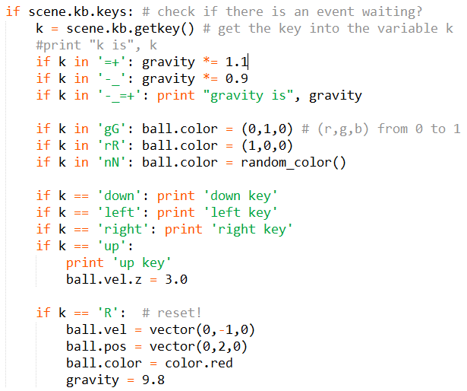
key presses…
Notes:
INHANDOUT

Slide 31
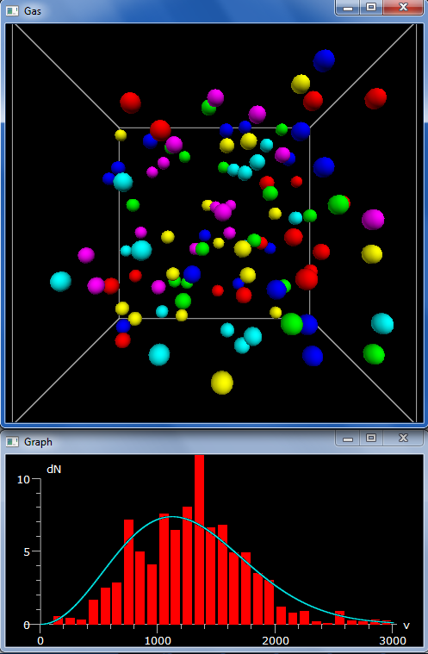
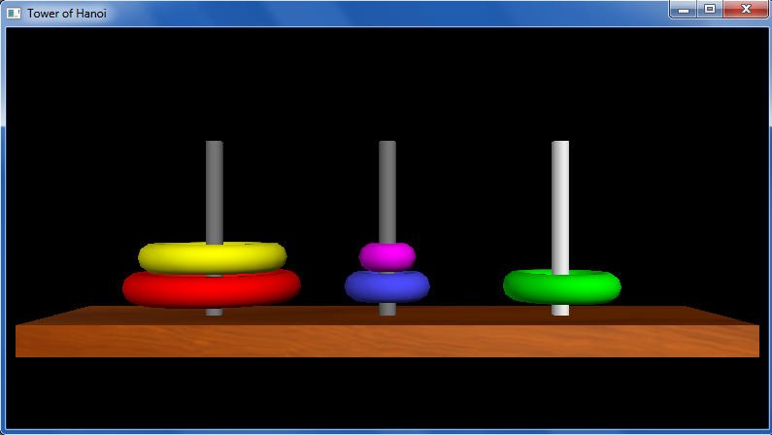
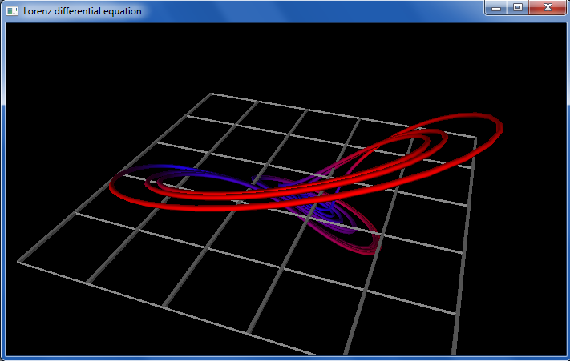
vPython examples…

Slide 32
vPython examples…
Try out vPython in lab this week!
~ if you enjoy it, consider it for a final project (next Tues. is the overview of the projects)

