Slide 1
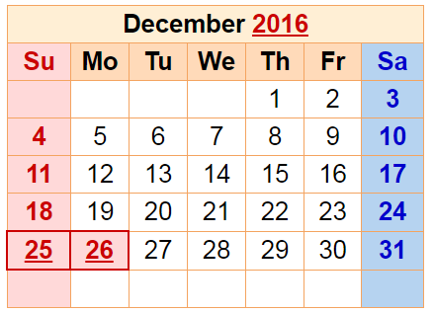
Apr. in CS 5
(0,0,0)
(110,102,0)
(220,205,0)
Mon., 12/5 – hw12+milestone due
Fri., 12/9 – 8pm: final proj. due
final project
Sun., 12/11 7 pm – review
Mon., 12/12 7 pm – final
Tue., 12/13 2 pm – final
Either exam is OK: you choose…
CS 5 black final exam 12/13 @ 2pm
final exam

Slide 2
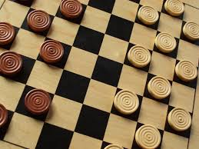
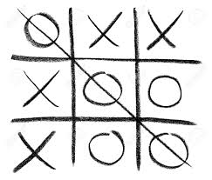
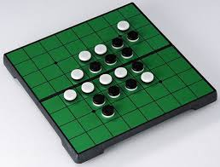
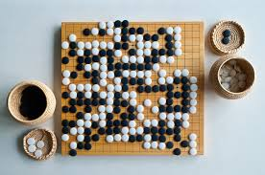
Connecting Connect Four ...
tic-tac-toe
checkers
reversi
Go
How complex are these games, from least to most?
... to other strategy games.
Notes:
Class 22 projects
INHANDOUT
Have browser window with rednuht.org/genetic_cars_2?
Be prepared to run samples under wine.

Slide 3
Games' Branching Factors
0 Ply
On average, Connect 4 players have seven choices per move.
Chess players have more, perhaps around 40, possible choices in a given move.
1 Ply
2 Ply
Boundaries for qualitatively different games…
Branching Factors
for different two-player games
Tic-tac-toe 4
Connect Four 7
Checkers 10
Reversi 30
Chess 40
Go 300
Arimaa 17,000
“solved” games
computer-dominated
only 'til 2015-16
human-dominated
Notes:
Arimaa was specifically designed to be hard for computers. But in 2015 computers were better.

Slide 4
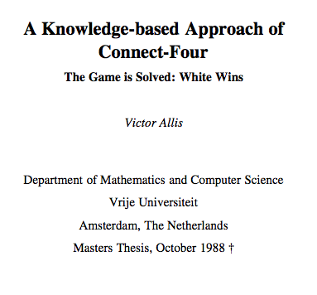
draw/tie with perfect play
first-player losses (with perfect play)
first-player win (with perfect play)
Connect 4 was solved in 1988.

Slide 5
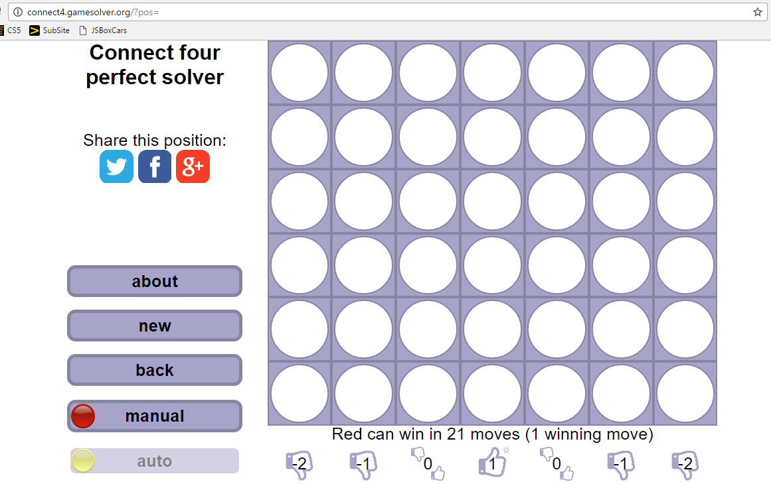
Nice site showing ideal play...
Connect 4 is solved ~ like tic-tac-toe
Notes:
This site is connect4.gamesolver.org.

Slide 6
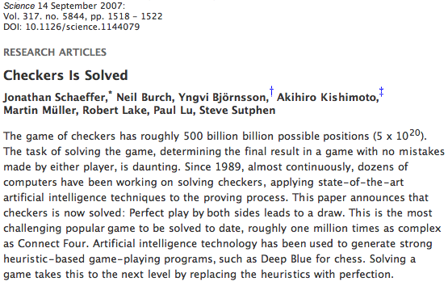
Checkers was solved in 2007.

Slide 7
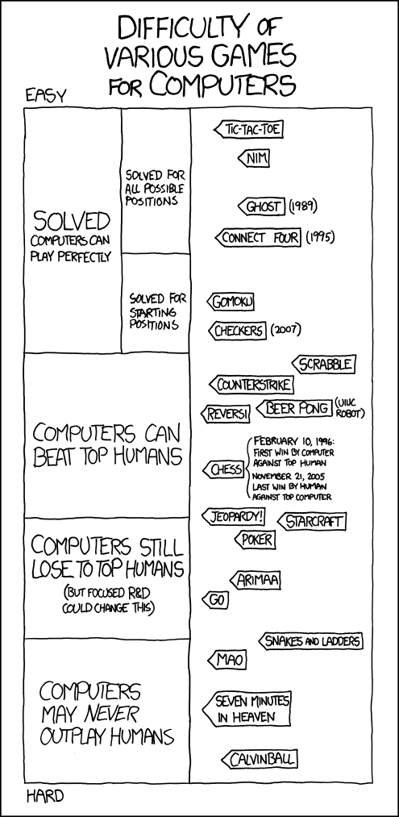
Games' Branching Factors
Notes:
Only spend a moment on this slide; rotated versions follow.

Slide 8
(Games' Branching Factors)

Slide 9
2015
2016
unlikely

Slide 10
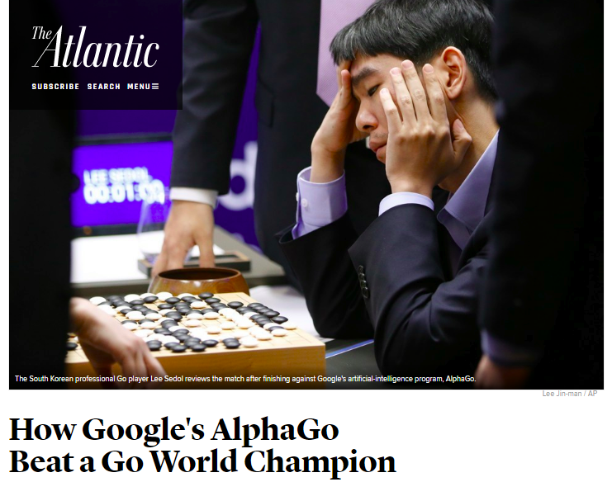
2015
2016
unlikely

Slide 11
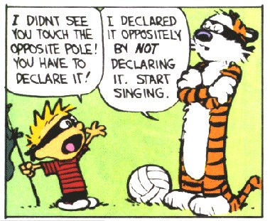

Slide 12
'tis the season for final projects…
Today is about the CS 5 final projects
+ it's a sales pitch for the four possible options:
vPool
TextID
Picobot
Connect 4 AI
I've got my eyes on some of these projects!
Eye'll bet !

Slide 13
Final projects
open-ended
comprehensive
Final CS hw
same projects for black/gold
three choices…
Working in teams of 1-3 is OK
Eye, eye!
Teams need to work together—in the same place—and need to share the work equally
Black/gold pairs are welcome...
Teaming is extra-encouraged on the final project!

Slide 14
Final projects
open-ended
comprehensive
Final CS hw
same projects for black/gold
three choices…
Working in teams of 1-3 is OK
Eye, eye!
Teams need to work together—in the same place—and need to share the work equally
Teaming is extra-encouraged on the final project!
Notes:
INHANDOUT

Slide 15
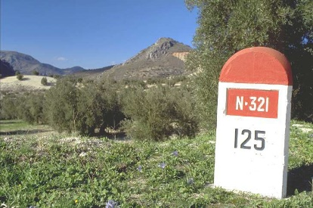
4/16
"Start“—part of hw12
When?!
Mon. 4/23
Wed. 5/2
"Milestone" is part of hw13
Final project & short reflection on how to run it and how it went.
Project-specific tasks to help with progress...
Due at 8pm
Euros OK; grutoring tapers.
Nice milestone!
It's a kilometer stone, actually!

Slide 16
Final lab days…
Labs will meet the last 2 weeks of class, but...
They're "extra-optional“: no lab problem
Lab time: final projects assistance + progress
There are theocomp problems, too (hw13)
Plus, hw13 has up to +50 pts of extra credit!
no sign-in
-2i
or two!
Now we're in a state!
+2i
Notes:
INHANDOUT

Slide 17
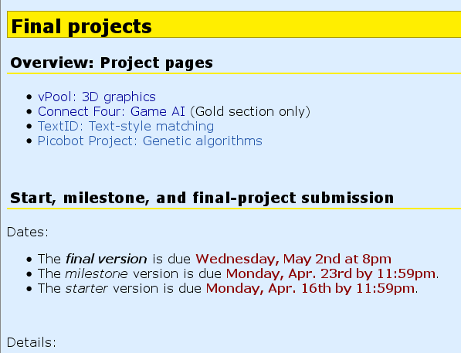
The project page...

Slide 18
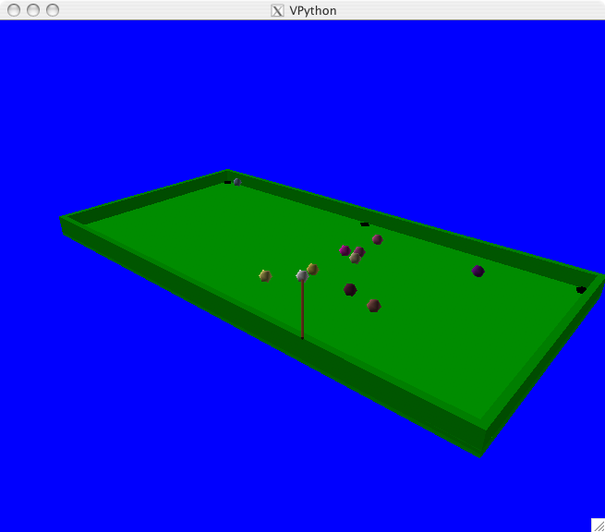
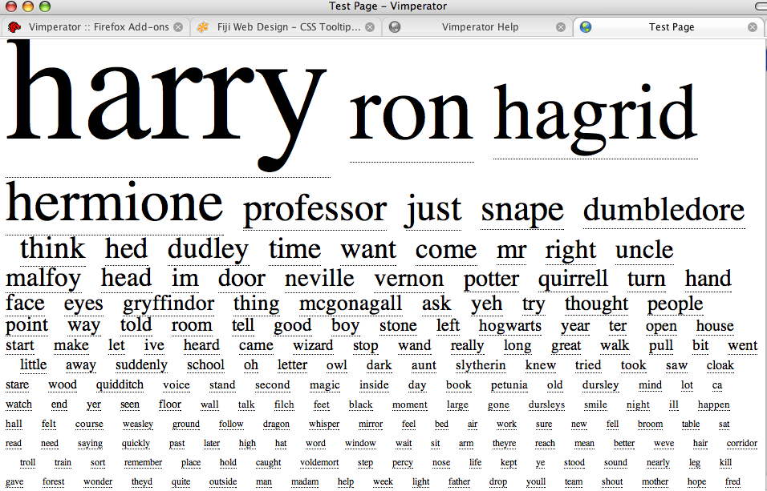
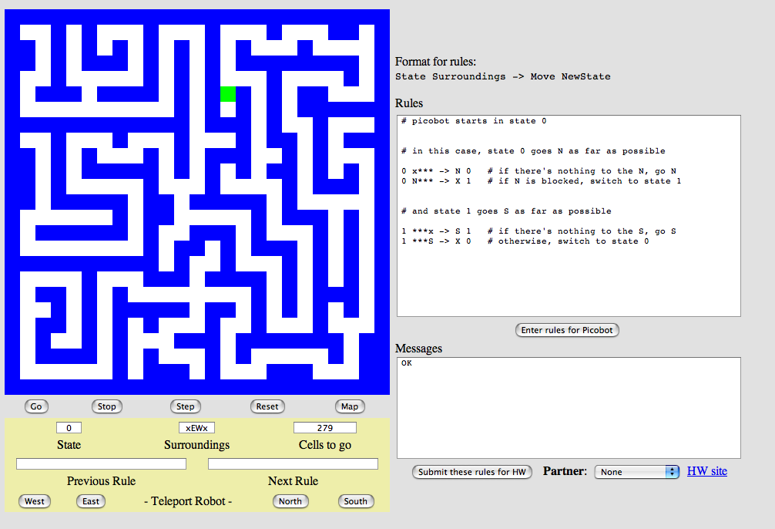
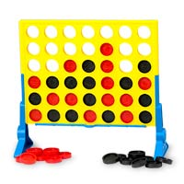
The projects...
VPool
TextID
C4 AI
Picobot!

Slide 19
Connect Four ...
Create an N-ply lookahead
Allow computer vs. computer and computer vs. human games of any difficulty...
Extend the game in some way:
(1) Change the rules!
(2) Graphics
Gravity
2d or 3d
Randomness
or, even, web...
WildCards
Tetris
(3) Tourney!
Notes:
INHANDOUT

Slide 20
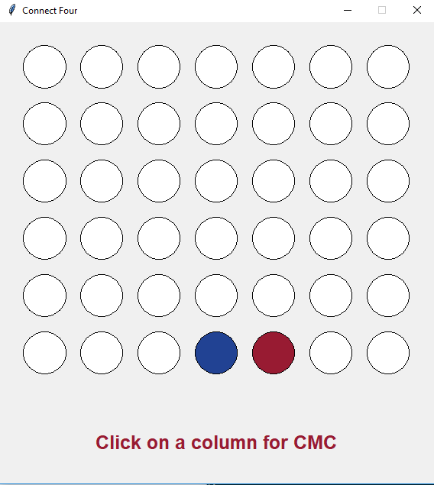
Creative connect fours...
5C C4?!

Slide 21
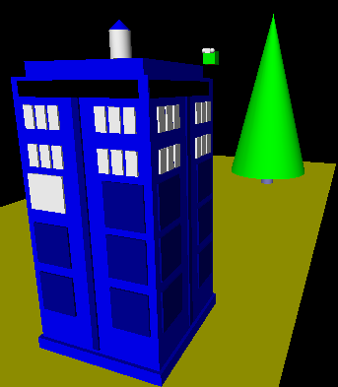
3d graphics-based game using VPython
vPool
I'll take your cue...
Let's play!
… it's not really very constrained at all!
A few constraints…
need ≥4 physically interacting objects
allow the user to direct 1+ objects, either by keyboard or mouse or both
needs a game goal + be winnable!
must detect some "linear" and some "spherical" collisions and implement their results on the motion of the objects
Notes:
INHANDOUT

Slide 22
The vPool project
VPython was designed to make 3d physics simulations simpler to program – as a result, the library itself is physics-free!
⇒ Phunky Physics is welcome!
sounds like all physics to me!
Linear collisions should be somewhere ("walls")
Spherical collisions should be somewhere ("points")
You need "pockets“—or some other game objective
You need user control of at least one object (mouse/kbd)

Slide 23
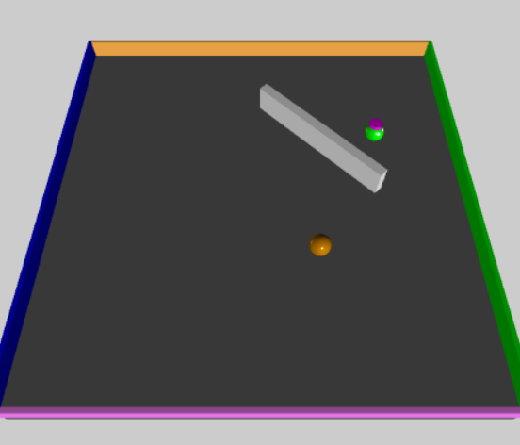
vPython: Linear + Spherical collisions...
At least some of the game needs to be about detecting collisions and changing velocities
x = 10
+x
Line ~ wall at x=10
How to bounce?
What else to do?

Slide 24
vPython: Linear collisions
+z
x = 10
At least some of the game needs to be about detecting collisions and changing velocities
ball.vel = vector(1,0,1)
while True:
ball.pos += dt*ball.vel
if ball.pos.x > 10:
ball.vel.x
ball.pos.x
ball.pos += dt*ball.vel
+x
Line ~ wall at x=10
How to bounce?
What else to do?
Notes:
INHANDOUT

Slide 25
Spherical collisions
r.vel
1 First approximation:
Stop q. Undo any overlap.
Make r.vel = q.vel.
r
2 Second approximation:
q
Stop q. Undo any overlap.
Compute d = r.pos – q.pos
Make r.vel = d
q.vel
3 Third approximation:
Same as second, but
Make q.vel = d ⊥ , at 90° from d
Reality is just three eyes away!

Slide 26
Spherical collisions
1 First approximation:
r.vel
Stop q. Undo any overlap.
Make r.vel = q.vel.
d
r
2 Second approximation:
q
Stop q. Undo any overlap.
Compute d = r.pos – q.pos
Make r.vel = d
q.vel
3 Third approximation:
Same as second, but
Make q.vel = d ⊥ , at 90° from d
Reality is just two eyes away!

Slide 27
Spherical collisions
1 First approximation:
r.vel
new q.vel
Stop q. Undo any overlap.
Make r.vel = q.vel.
d⊥
d
r
2 Second approximation:
q
Stop q. Undo any overlap.
Compute d = r.pos – q.pos
Make r.vel = d
old q.vel
3 Third approximation:
Same as second, but
Make q.vel = d ⊥ , at 90° from d
Reality is just one eye away!
Notes:
INHANDOUT

Slide 28
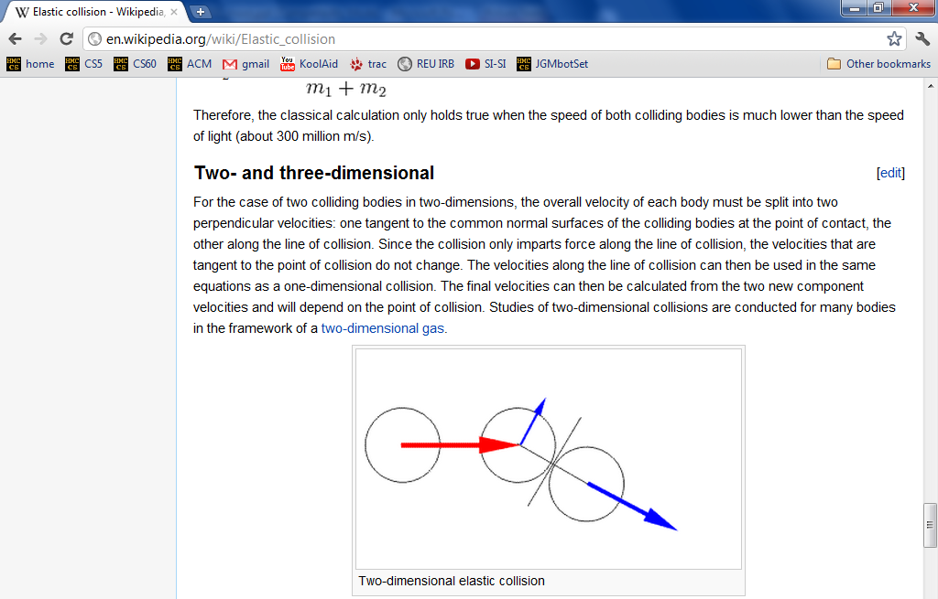
vPool – physics?
http://en.wikipedia.org/wiki/Elastic_collision
equations below...

Slide 29
vPool – physics?
http://en.wikipedia.org/wiki/Elastic_collision

Slide 30
vector library!
This is how I like my vectors: well done!
(or, at least, already done…)

Slide 31
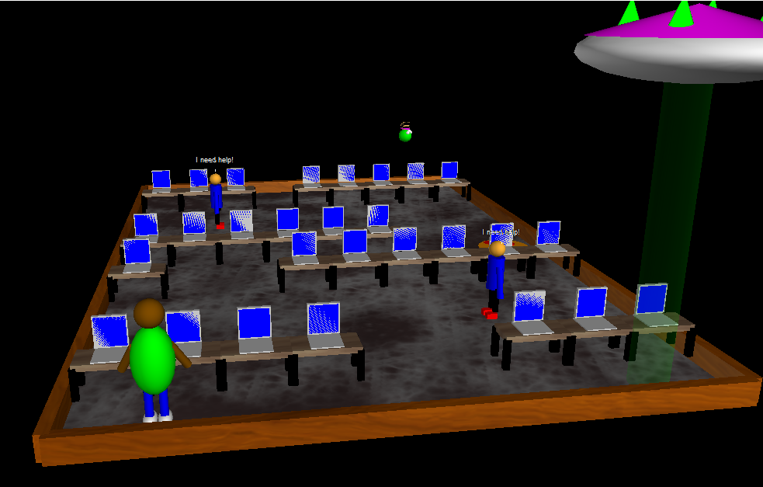
Example vProjects...
Notes:
Run wine python vpython_examples/name/final.py
(Anna) acunningham: pool, sheep shooting range. Prints instructions. Option 2 doesn’t work; option 3 mouse doesn’t work. Shoot with backspace.
(Anna) aserbent: putt putt golf, shows instructions
(Amy) asorto: pool. Arrow keys to move cue, up/down for strength, enter to fire.
(Dina) daluzri: frogger, use arrow keys. Weak graphics.
(Daniel) dbennett: Grutor needs to avoid students and rescue alien. Arrows move, space halts.

Slide 32
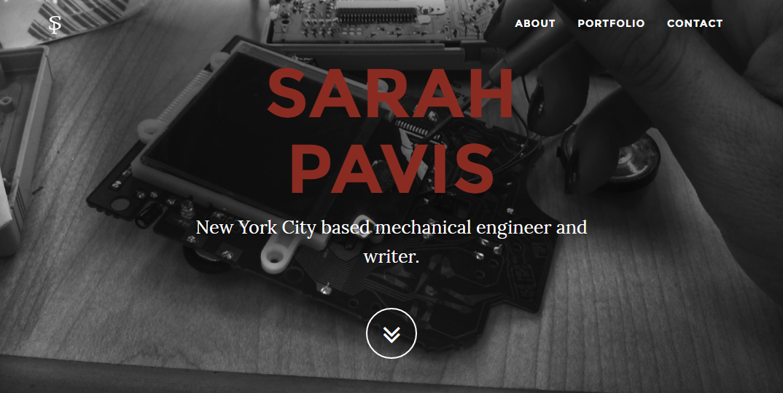
the TextID IDer...
Though Robin Ellacott’s twenty-five years of life had seen their moments of drama and incident, she had never before woken up in the certain knowledge that she would remember the coming day for as long as she lived.
April 4, 2013
First paragraph of The Cuckoo's Calling by R. Galbraith
Notes:
Sarah Pavis unmasked Galbraith.

Slide 33
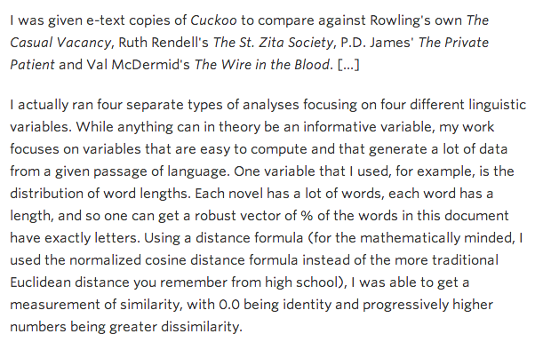
kottke.org/13/08/how-jk-rowling-was-found-to-be-robert-galbraith

Slide 34
the TextID project
Big ideas:
(1) Build lexical models of bodies of text…
(2) Use a similarity score to measure Rowlingness
vs.
Shakepearity
NYTimes-iness
vs.
WSJournalicity
Big Bang Theory
Modern Family
vs.
even better: your own choice of two or more comparisons…
Notes:
INHANDOUT

Slide 35
I like poptarts and 42 and spam. Spamful poptarts are like poptartful spams -- and are liked by all!
Will _Thanksgiving_ bring spam poptarts?
File
class TextModel
... contains at least five Python dictionaries, e.g.,
count of each word
{'and': 3, 'poptartful': 1, 'liked': 1, 'spamful': 1, 'like': 2, '': 1, 'spam': 2, 'i': 1, '42': 1, 'all': 1, 'thanksgiving': 1, 'will': 1, 'bring': 1, 'poptarts': 3, 'spams': 1, 'by': 1, 'are': 2}
{0: 1, 1: 1, 2: 2, 3: 6, 4: 5, 5: 3, 7: 1, 8: 3, 10: 1, 12: 1}
{'and': 3, '': 1, 'all': 1, 'like': 3, 'thanksgiv': 1, 'spam': 4, 'i': 1, '42': 1, 'by': 1, 'will': 1, 'bring': 1, 'ar': 2, 'poptart': 4}
{12: 1, 5: 1, 7: 1}
{'!': 1, '-': 2, '?': 1, '_': 2, '.': 1}
???
???
???
???
What are these four other dictionaries counting?!
Notes:
INHANDOUT

Slide 36
I like poptarts and 42 and spam. Spamful poptarts are like poptartful spams -- and are liked by all!
Will _Thanksgiving_ bring spam poptarts?
File
class TextModel
... contains at least five Python dictionaries, e.g.,
count of each word
{'and': 3, 'poptartful': 1, 'liked': 1, 'spamful': 1, 'like': 2, '': 1, 'spam': 2, 'i': 1, '42': 1, 'all': 1, 'thanksgiving': 1, 'will': 1, 'bring': 1, 'poptarts': 3, 'spams': 1, 'by': 1, 'are': 2}
{0: 1, 1: 1, 2: 2, 3: 6, 4: 5, 5: 3, 7: 1, 8: 3, 10: 1, 12: 1}
{'and': 3, '': 1, 'all': 1, 'like': 3, 'thanksgiv': 1, 'spam': 4, 'i': 1, '42': 1, 'by': 1, 'will': 1, 'bring': 1, 'ar': 2, 'poptart': 4}
{12: 1, 5: 1, 7: 1}
{'!': 1, '-': 2, '?': 1, '_': 2, '.': 1}
word lengths
stems
sentence lengths
punctuation
What are these four other dictionaries counting?!

Slide 37
TextID's building blocks…
This looks familiar...
(1) Get text from file…
(2) Split up the text into words (first pass)
(3) Model punctuation marks (optional)
(4) Model sentence lengths (using '.!?')
(5) Take a breather...
(6) Clean up the words (second pass)
(7) Model words and word lengths
(8) Stem words and model those stems
(9) You're ready to score against your model!
text with punctuation preserved
text with punctuation removed
Notes:
INHANDOUT

Slide 38
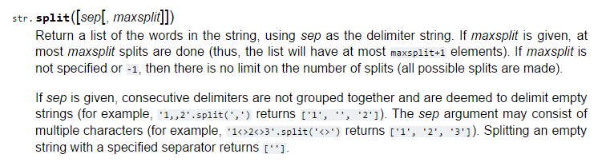
I bet they told you the age of the library was over…
but It's just begun!
TextID's library resources
Notes:
INHANDOUT
You can use any of Python’s documented string methods.

Slide 39
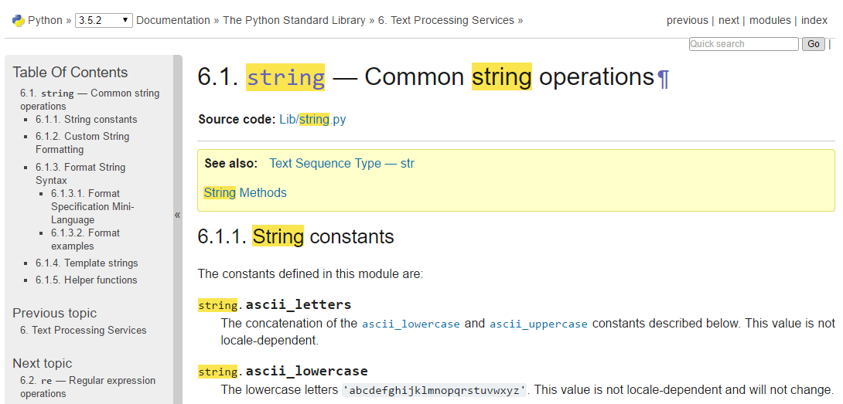
I bet they told you the age of the library was over…
but It's just begun!
TextID's library resources
string.ascii_lowercase

Slide 40
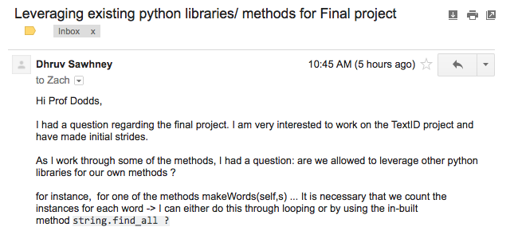
I bet they told you the age of the library was over…
but It's just begun!
TextID's library resources
Yes!

Slide 41
Stemming
An algorithm that outputs the root of the input word.
stem('parties')
'parti'
ends in ies
stem('love')
'lov'
these don't have to be words, just stems…
ends in vow + cons + e
stem('swerving')
'swerv'
ends in vow + cons + ing
stem('quickly')
'quick'
ends in vow + cons + ly
stem('slowest')
'slow'
ends in vow + cons + est
but, they can also be words
stem('stems')
'stem'
ends in cons + s
stem('stemming')
'stem'
ends in vow + 2*cons + ing
either way, they all have exceptions!
Notes:
INHANDOUT

Slide 42
Stemming!
getting to the root of the problem…
def stem(w):
exception
Find an English exception to each of these stemming patterns:
incorrect stem
π
pies
stem('parties')
'parti'
ends in ies
kite
stem('love')
'lov'
kit
ends in vow + cons + e
nothing
stem('swerving')
'swerv'
noth
ends in vow + cons + ing
ally
stem('quickly')
'quick'
al
ends in vow + cons + ly
interest
stem('slowest')
'slow'
inter
ends in vow + cons + est
princess
stem('stems')
'stem'
princes
ends in cons + s
lemming
stem('stemming')
'stem'
lem
ends in vow + 2*cons + ing
under
undo
do
der
stem(__________)
_______
create your own rule for stemming

Slide 43
Stemming!
getting to the root of the problem…
def stem(w):
exception
Find an English exception to each of these stemming patterns:
incorrect stem
π
pies
stem('parties')
'parti'
ends in ies
kite
stem('love')
'lov'
kit
ends in vow + cons + e
nothing
stem('swerving')
'swerv'
noth
ends in vow + cons + ing
ally
stem('quickly')
'quick'
al
ends in vow + cons + ly
interest
stem('slowest')
'slow'
inter
ends in vow + cons + est
princess
stem('stems')
'stem'
princes
ends in cons + s
lemming
stem('stemming')
'stem'
lem
ends in vow + 2*cons + ing
under
undo
do
der
stem(__________)
_______
create your own rule for stemming

Slide 44
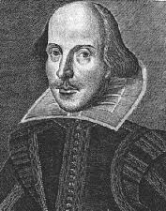
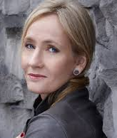
Model matching
Suppose we have two trained models:
WS: { "love": 50,
"spell": 8,
"thou": 42 }
JKR: { "love": 25,
"spell": 275,
"potter": 700 }
how do we handle different-sized texts?
Unknown text: { "love": 3,
"thou": 1,
"potter": 2,
"spam": 4 }
These must have been some really avant-garde texts!

Slide 45
Model matching
Suppose we have two trained models:
WS: { "love": 50,
"spell": 8,
"thou": 42 }
JKR: { "love": 25,
"spell": 275,
"potter": 700 }
normalize for size
WS: { "love": 0.50,
"spell": 0.08,
"thou": 0.42 }
JKR: { "love": 0.025,
"spell": 0.275,
"potter": 0.700 }
Unknown text: { "love": 3,
"thou": 1,
"potter": 2,
"spam": 4 }
Notes:
INHANDOUT

Slide 46
Model matching
Suppose we have two normalized models:
WS: { "love": 0.50,
"spell": 0.08,
"thou": 0.42 }
JKR: { "love": 0.025,
"spell": 0.275,
"potter": 0.700 }
how do we compare the models with an unknown text?
What's the likelihood of the new model arising from each?
Unknown text: { "love": 3,
"thou": 1,
"potter": 2,
"spam": 4 }
There's probably a way to do this!

Slide 47
Model matching
Suppose we have two normalized models:
WS: { "love": 0.50,
"spell": 0.08,
"thou": 0.42 }
JKR: { "love": 0.025,
"spell": 0.275,
"potter": 0.700 }
How do we compare the models with an unknown text?
What's the likelihood of the new model arising from each?
Let's just pretend that the words are all independent of each other…
Unknown text: { "love": 3,
"thou": 1,
"potter": 2,
"spam": 4 }
There's probably a way to do this!

Slide 48
Model matching
Suppose we have two normalized models:
WS: { "love": 0.50,
"spell": 0.08,
"thou": 0.42 }
JKR: { "love": 0.025,
"spell": 0.275,
"potter": 0.700 }
The WS-based probability of each word in Unknown text
=
.50
.50
.50
_?_
?
?
?
?
?
?
???
love
love
love
thou
potter
potter
spam
spam
spam
spam
0? 1?
Unknown text: { "love": 3, "potter": 2,
"thou": 1, "spam": 4 }
I've got near-zero ideas on this one!

Slide 49
Model matching
Suppose we have two normalized models:
WS: { "love": 0.50,
"spell": 0.08,
"thou": 0.42 }
JKR: { "love": 0.025,
"spell": 0.275,
"potter": 0.700 }
The WS-based probability of each word in Unknown text
=
.50
.50
.50
.42
1
1
1
1
1
1
0.0525
love
love
love
thou
potter
potter
spam
spam
spam
spam
Why is this especially incorrect?
???
Unknown text: { "love": 3, "potter": 2,
"thou": 1, "spam": 4 }
I've got near-zero ideas on this one!
Notes:
It’s incorrect because it gives the highest weight to words that the neither author ever used!

Slide 50
Model matching
Suppose we have two normalized models:
WS: { "love": 0.50,
"spell": 0.08,
"thou": 0.42 }
JKR: { "love": 0.025,
"spell": 0.275,
"potter": 0.700 }
The WS-based probability of each word in Unknown text
Correct, but not helpful!
=
.50
.50
.50
.42
0
0
0
0
0
0
0.0
love
love
love
thou
potter
potter
spam
spam
spam
spam
???
Unknown text: { "love": 3, "potter": 2,
"thou": 1, "spam": 4 }
I've got near-zero ideas on this one!

Slide 51
Model matching
Suppose we have two normalized models:
WS: { "love": 0.50,
"spell": 0.08,
"thou": 0.42 }
JKR: { "love": 0.025,
"spell": 0.275,
"potter": 0.700 }
The WS-based probability of each word in Unknown text
For missing words, use half the smallest value – across both normalized models!
=
.50
.50
.50
.42
.012
.012
.012
.012
.012
.012
1.57e-13
love
love
love
thou
potter
potter
spam
spam
spam
spam
What?
3
1
2
4
Unknown text: { "love": 3, "potter": 2,
"thou": 1, "spam": 4 }
half of ϵ !

Slide 52
Model matching
Suppose we have two normalized models:
WS: { "love": 0.50,
"spell": 0.08,
"thou": 0.42 }
JKR: { "love": 0.025,
"spell": 0.275,
"potter": 0.700 }
the WS-based probability of each word in Unknown text
for missing words, use half the smallest value – across both normalized models!
=
.50
.50
.50
.42
.012
.012
.012
.012
.012
.012
1.57e-13
love
love
love
thou
potter
potter
spam
spam
spam
spam
too small!
3
1
2
4
take logs of everything!
Unknown text: { "love": 3, "potter": 2,
"thou": 1, "spam": 4 }
half of ϵ !

Slide 53
Model matching
Suppose we have two normalized models:
WS: { "love": 0.50,
"spell": 0.08,
"thou": 0.42 }
JKR: { "love": 0.025,
"spell": 0.275,
"potter": 0.700 }
the WS-based probability of each word in Unknown text
for missing words, use half the smallest value – across both normalized models!
=
3*log(.50)
+ log(.42)
+ 2*log(.012)
+ 4*log(.012)
-29.48
love
love
love
thou
potter
potter
spam
spam
spam
spam
OK!
3
1
2
4
take logs of everything!
Unknown text: { "love": 3, "potter": 2,
"thou": 1, "spam": 4 }
half of ϵ !
Notes:
INHANDOUT

Slide 54
Model matching
Suppose we have two normalized models:
WS: { "love": 0.50,
"spell": 0.08,
"thou": 0.42 }
JKR: { "love": 0.025,
"spell": 0.275,
"potter": 0.700 }
the WS-based probability of each word in Unknown text
=
3*log(.025)
+ log(.012)
+ 2*log(.7)
+ 4*log(.012)
-33.89
love
love
love
thou
potter
potter
spam
spam
spam
spam
3
1
2
4
Unknown text: { "love": 3, "potter": 2,
"thou": 1, "spam": 4 }
this looks close…

Slide 55
Model matching
Suppose we have two normalized models:
WS: { "love": 0.50,
"spell": 0.08,
"thou": 0.42 }
JKR: { "love": 0.025,
"spell": 0.275,
"potter": 0.700 }
Unknown text:
{ "love": 3, "potter": 2,
"thou": 1, "spam": 4 }
-29.48
-33.89
the (much) better match…

Slide 56
Naïve Bayes classification
Don't take these formulas too seriously…
done!

Slide 57
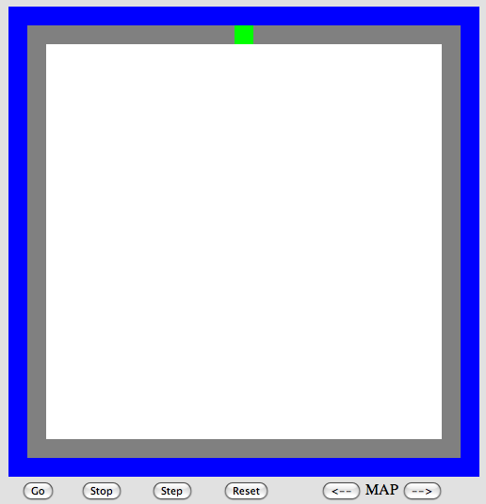
The Picobot project
Big ideas
(1) Implement Picobot in Python
(2) Train Python to write successful Picobot programs!
Talk about going full circle...
Notes:
INHANDOUT

Slide 58
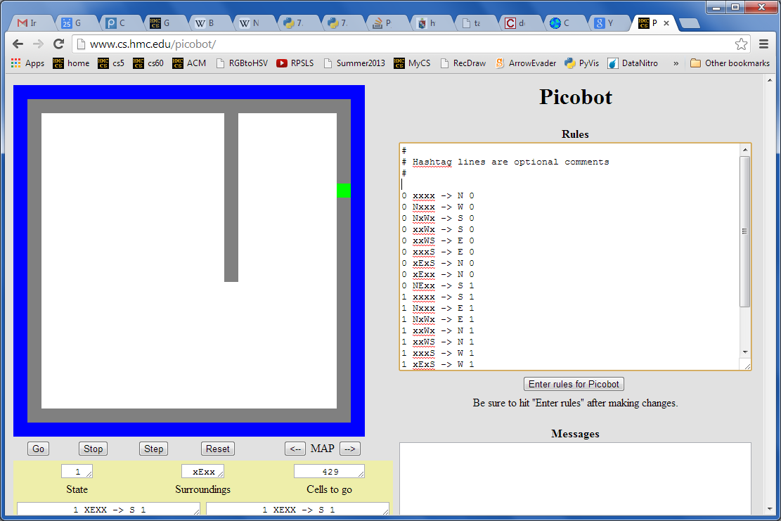
Picobot returns!
What data structures (classes) might be helpful in implementing Picobot?

Slide 59
Picobot's classes
0 xxxx -> N 0
0 Nxxx -> W 0
0 NxWx -> S 0
0 xxWx -> S 0
0 xxWS -> E 0
0 xxxS -> E 0
0 xExS -> N 0
0 xExx -> N 0
0 NExx -> S 1
1 xxxx -> S 1
1 Nxxx -> E 1
1 NxWx -> E 1
1 xxWx -> N 1
1 xxWS -> N 1
1 xxxS -> W 1
1 xExS -> W 1
1 xExx -> S 1
1 NExx -> W 0
class Program:
What in Python could most usefully hold all of these rules?
What type should self.rules be?

Slide 60
Picobot's classes
0 xxxx -> N 0
0 Nxxx -> W 0
0 NxWx -> S 0
0 xxWx -> S 0
0 xxWS -> E 0
0 xxxS -> E 0
0 xExS -> N 0
0 xExx -> N 0
0 NExx -> S 1
1 xxxx -> S 1
1 Nxxx -> E 1
1 NxWx -> E 1
1 xxWx -> N 1
1 xxWS -> N 1
1 xxxS -> W 1
1 xExS -> W 1
1 xExx -> S 1
1 NExx -> W 0
class Program:
What in Python could most usefully hold all of these rules?
What type should self.rules be?
both tuples
Python dictionary
key
value
self.rules[ (1,"NExx") ] = ("W",0)
Notes:
INHANDOUT

Slide 61
Picobot's classes
+++++++++++++++++++++++++
+oooooPooooooooooooooooo+
+o o o+
+o o o+
+o o o+
+o o o+
+o o o+
+o o o+
+o o o+
+o o o+
+o o+
+o o+
+o o+
+o o+
+o o+
+o o+
+o o+
+o o+
+o o+
+o o+
+o o+
+o o+
+o o+
+ooooooooooooooooooooooo+
+++++++++++++++++++++++++
What type in Python could most usefully hold the environment?
class World:
What class that you've already written will be most similar to Picobot's World?
Wall:
+
What will self.room be?
o
Visited:
Picobot:
P

Slide 62
Picobot's classes
+++++++++++++++++++++++++
+oooooPooooooooooooooooo+
+o o o+
+o o o+
+o o o+
+o o o+
+o o o+
+o o o+
+o o o+
+o o o+
+o o+
+o o+
+o o+
+o o+
+o o+
+o o+
+o o+
+o o+
+o o+
+o o+
+o o+
+o o+
+o o+
+ooooooooooooooooooooooo+
+++++++++++++++++++++++++
What type in Python could most usefully hold the environment?
class World:
class Board
What class that you've already written will be most similar to Picobot's World?
Wall:
+
What will self.room be?
o
Visited:
The same as the Connect-Four board's self.data!
P
Picobot:
a list-of-lists-of-one-character-strings….
Notes:
INHANDOUT

Slide 63
The Picobot project
Current State: 1
Current Rule: 1 N*W* -> X 2
++++++++++
+o++o+o+++
+oooooo ++
++++o++ +
+oooo+++++
++++o +
+oooo+++ +
++++o+++++
+Pooo +
++++++++++
First, build an ASCII simulation
Picobot started here…
then, evolve it…
with your own genetic algorithm
and is now here…
Your actual ASCII is likely to be more monochromatic!
http://rednuht.org/genetic_cars_2/ or http://boxcar2d.com/
Box2d: https://www.youtube.com/watch?v=uxourrlPlf8

Slide 64
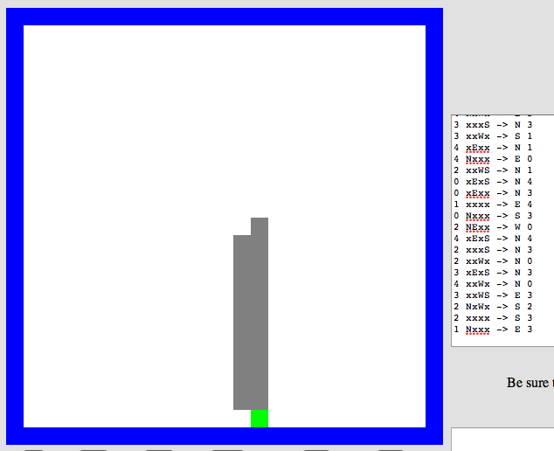
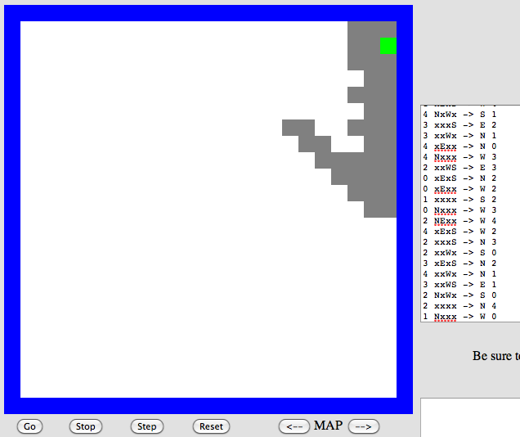
Program evolution
An example of genetic algorithms, which are used for optimizing hard-to-describe functions with easily-splittable solutions.
program p1
program p2
Start with a population of, say, ~200 random Picobot programs…

Slide 65
Program evolution
An example of genetic algorithms, which are used for optimizing hard-to-describe functions with easily-splittable solutions.
program p1
fitness = 0.03
program p2
fitness = 0.05
Then, measure the fitness of all of those programs
Measure? How??

Slide 66
program p1
fitness = 0.03
program p2
fitness = 0.05
mate + mutate the fittest rulesets
to create a new generation of ~200 programs…
program c1
fitness = 0.19
What the goal?
Notes:
INHANDOUT

Slide 67
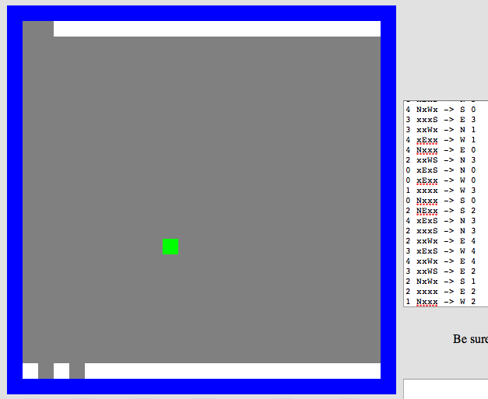
Repeat this "survival of the fittest" process for many generations…
… and by the end, your Python code should/will have evolved a much more capable Picobot program!
Solving hw0!
fitness = 0.90

Slide 68
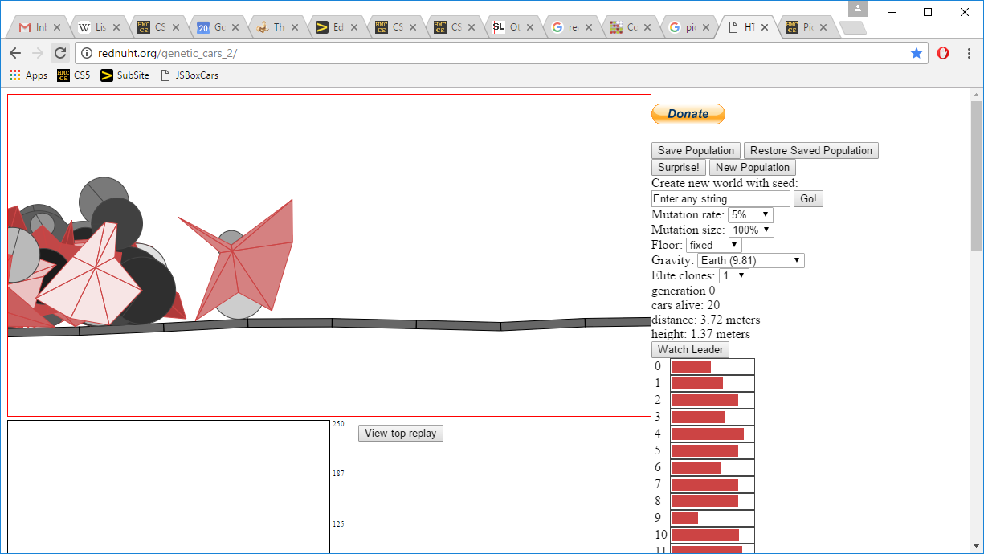
Genetic Algorithms...!
the current "fitness" leader
fitnesses!
the current "generation"
Rafael Matsunaga: rednuht.org/
Notes:
rednuht.org/genetic_cars_2

Slide 69
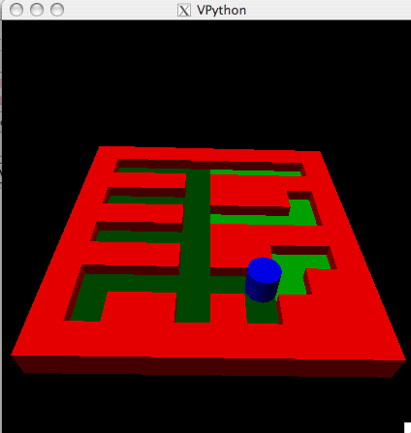
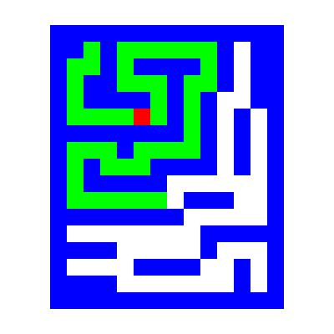
Extra: Picobot graphics…
Choice of graphical packages
2d: graphics.py from C4
3d: VPython
Mine's going to be in 5d!
or 3d …
2d should be enough for anybody
What? All the best stuff is 3d! Think coffee, poptarts, etc.
2d version…

Slide 70
Project space…
algorithmic
Picobot!
C4
VPool
open-ended (and 3d!)
TextID
practical + checkable
Notes:
INHANDOUT

Slide 71
What's due?
Mon. 4/23
Wed. 5/2
The "milestone"
Final-project due date
project-specific tasks ~ to ensure that everyone has started!
(Note: we can't grade these in time)
A zip file with everything needed to run your final project and a .txt file describing how to do so!
Nice milestone!
It's a kilometer stone, actually!
Notes:
INHANDOUT

Slide 72
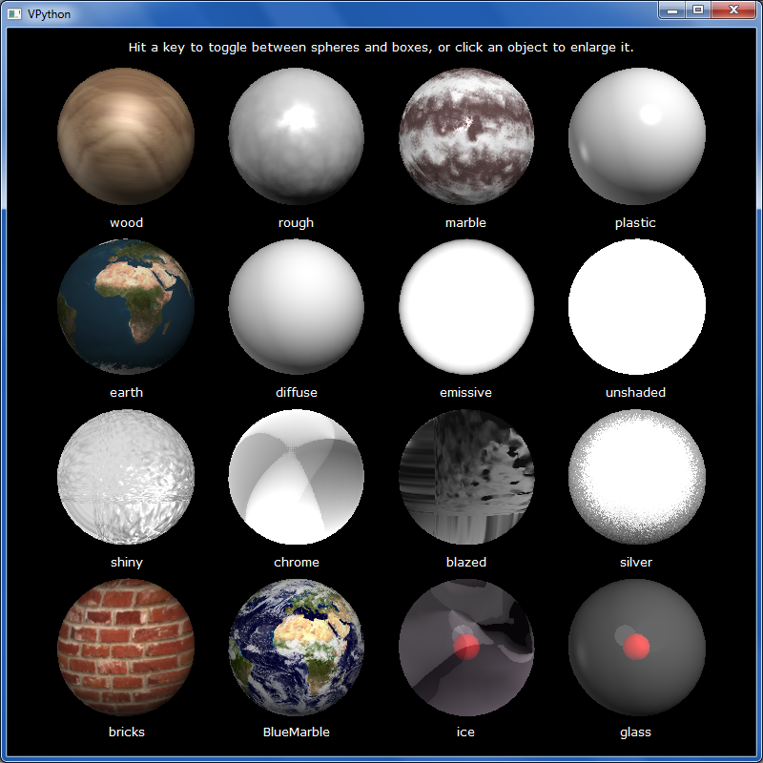
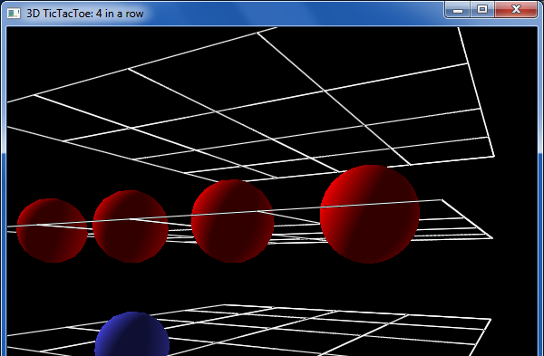
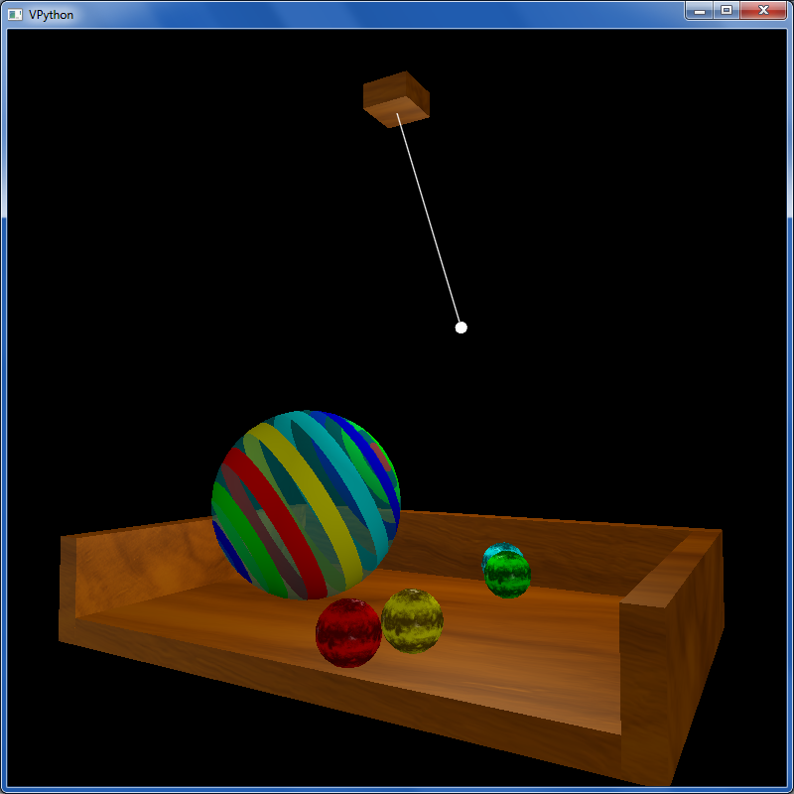
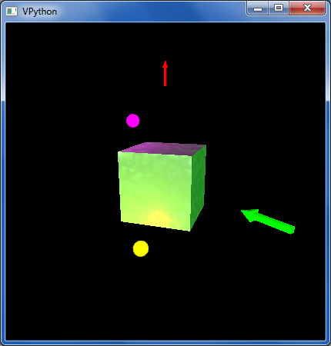
other VPython examples
tictac.py – a 3d game of tic-tac-toe
material_test.py – lots of materials
texture_and_lighting.py – fancier textures, opacity and a pendulum example
boxlighttest.py – very short + simple rotation and lighting example

Slide 73
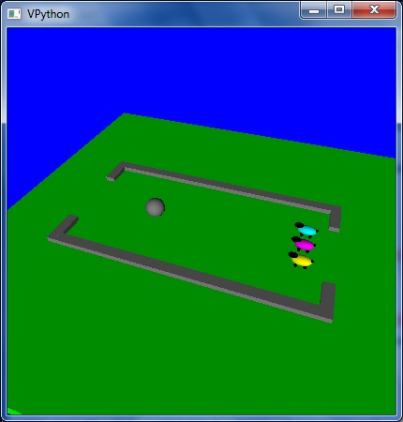
Enjoy the projects!
An unusual variation on VPool
… the graders certainly do!
Notes:
wine python vpython_examples/acunningham/final.py [with option 4]

