Slide 1

CS 5 Not-Quite-Daily News
Cheating Penguin
Claremont (Antarctic News Service): A disgraced penguin left a local college after being caught violating the institution's honor code.
The bird had been working on a computer science game project when a fellow student discovered that the game’s animated fish were in fact live animals trapped in his laptop.
“Apparently he couldn’t get the animation to look right, so he thought he could take a shortcut and nobody would notice,” said a professor. “But when water started leaking from his screen, it was pretty obvious that something was going on. By then the fish had died, and the smell was so bad we had to evacuate the lab.”
The penguin will be punished with a one-year suspension and a ban on all future contact with marine life forms.
Notes:
Class 23 theory1
Worksheet: FSM that accepts strings where the number of zeros is a multiple of three.
Demo: Jsflap.
Side note: it would be cute to have a slide where the alien is a state in the FSM…

Slide 2
Real Headlines (Why AI Is Hard)
Drunk Gets Nine Months in Violin Case
Police Begin Campaign to Run Down Jaywalkers
Prostitutes Appeal to Pope
Red Tape Holds Up New Bridges
Miners Refuse to Work After Death
Local High School Dropouts Cut in Half
Man Struck by Lightning Faces Battery Charge
Kids Make Nutritious Snacks

Slide 3
Elastic Collisions

Slide 4
Elastic Collisions

Slide 5
Elastic Collisions

Slide 6
Elastic Collisions

Slide 7
Homework 12
Building finite-state machines
  Mathematical foundations of CS
Project milestone (“progress report”)

Slide 8
Labs in Weeks 12-13
Tue and Wed, 2:45 PM and 6 PM
Entirely optional
  Work on FSMs (HW 12)
  Work on final project milestone
Note: you won’t get quick feedback on milestone, so join us for lab!

Slide 9

State?
The state of a computation (or computer) is
all the internal information needed to take the next step
0 NEWx -> S 1
Do I need parental permission to enter a new state?
previous state
next state
external input data
literal next step

Slide 10
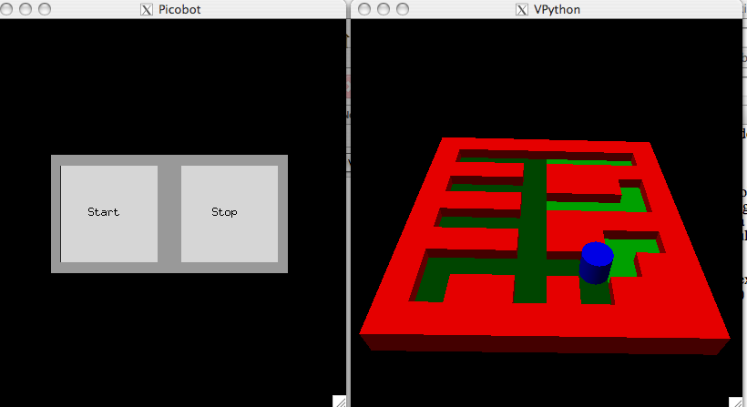
Picobot == State Machine
x***
transitions move from state to state
state pattern -> move new state
N***
0 x*** -> N 0
0 N*** -> S 1
1 ***x -> S 1
1 ***N -> N 0
go N
go S
each circle represents a different robot state

Slide 11

Computer == State Machine
“States”
Instruction Pointer (Program Counter)
01001000
10101010001000
10001010101010
00101010101010
10101011010100
00000010010000
11110000000010
00000101011101
Instruction
Register
00000000
11001000
10101010001000
10001010101010
00101010101010
10101011010100
00000010010000
11110000000010
00000101011101
10101010001000
10001010101010
00101010101010
10101011010100
00000010010000
11110000000010
00000101011101
01001000
10101010001000
10001010101010
00101010101010
10101011010100
00000010010000
11110000000010
00000101011101
Other
Registers
10010011
CPU (Processor)
10101010001000
10001010101010
00101010101010
10101011010100
00000010010000
11110000000010
00000101011101
Time
RAM (Memory)
Total snapshot of computer’s state!

Slide 12
Our Model of Computation: FSMs
FSM or Finite State Machine (also called a Deterministic Finite Automaton)
Example:
0
0
1
q₀
q₁
1
start state
transitions
accepting states
“input funnel”
“where to go”
double circled
labeled by input!
What does each state “mean”?
How it runs:
100101
What does this FSM do overall?
input sequence
Notes:
“How it runs” pops up. Then the following slides “animate” the machine’s response to the input.

Slide 13
Our Model of Computation: FSMs
FSM or Finite State Machine (also called a Deterministic Finite Automaton)
Example:
0
0
1
q₀
q₁
1
start state
transitions
accepting states
“input funnel”
“where to go”
double circled
labeled by input!
What does each state “mean”?
How it runs:
100101
What does this FSM do overall?
input sequence

Slide 14
Our Model of Computation: FSMs
FSM or Finite State Machine (also called a Deterministic Finite Automaton)
Example:
0
0
1
q₀
q₁
1
start state
transitions
accepting states
“input funnel”
“where to go”
double circled
labeled by input!
What does each state “mean”?
How it runs:
100101
What does this FSM do overall?
input sequence

Slide 15
Our Model of Computation: FSMs
FSM or Finite State Machine (also called a Deterministic Finite Automaton)
Example:
0
0
1
q₀
q₁
1
start state
transitions
accepting states
“input funnel”
“where to go”
double circled
labeled by input!
What does each state “mean”?
How it runs:
100101
What does this FSM do overall?
input sequence

Slide 16
Our Model of Computation: FSMs
FSM or Finite State Machine (also called a Deterministic Finite Automaton)
Example:
0
0
1
q₀
q₁
1
start state
transitions
accepting states
“input funnel”
“where to go”
double circled
labeled by input!
What does each state “mean”?
How it runs:
100101
What does this FSM do overall?
input sequence

Slide 17
Our Model of Computation: FSMs
FSM or Finite State Machine (also called a Deterministic Finite Automaton)
Example:
0
0
1
q₀
q₁
1
start state
transitions
accepting states
“input funnel”
“where to go”
double circled
labeled by input!
What does each state “mean”?
How it runs:
100101
What does this FSM do overall?
input sequence

Slide 18
Our Model of Computation: FSMs
FSM or Finite State Machine (also called a Deterministic Finite Automaton)
Example:
0
0
1
q₀
q₁
1
start state
transitions
accepting states
“input funnel”
“where to go”
double circled
labeled by input!
What does each state “mean”?
How it runs:
100101
What does this FSM do overall?
input sequence

Slide 19
Our Model of Computation: FSMs
FSM or Finite State Machine (also called a Deterministic Finite Automaton)
Example:
0
0
1
q₀
q₁
1
start state
transitions
accepting states
“input funnel”
“where to go”
double circled
labeled by input!
What does each state “mean”?
How it runs:
100101
What does this FSM do overall?
input sequence
Notes:
This slide has an animation that stops the blinking.

Slide 20
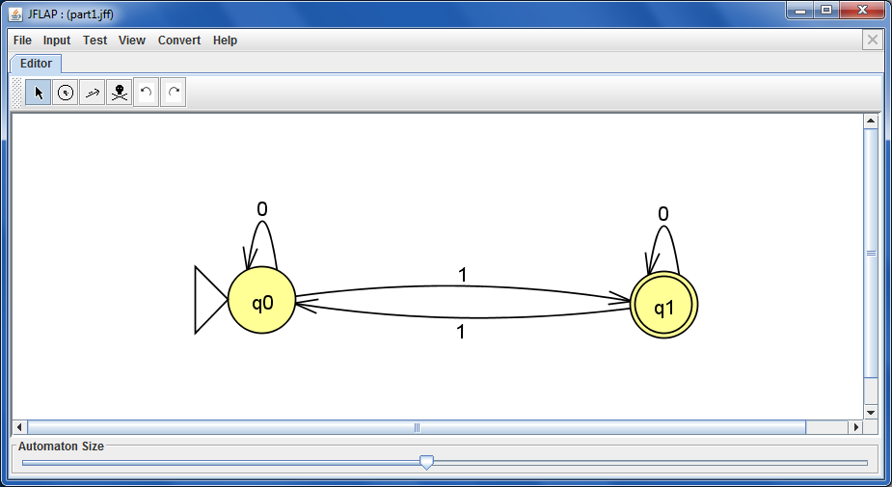
JSFLAP!
Graphical state-machine builder for HW12
Notes:
Demo JSFLAP here. Create a three-state machine. Show delete, undo, loop transitions on multiple inputs, exporting to text files.

Slide 21
Another Example
0
1
q₁
q₀
1
0
q₂
0,1
What are three inputs this machine accepts?
How about three it rejects?
In English, what inputs are accepted?
What does each state mean?
Notes:
Think/pair/share.

Slide 22

The Alien’s Life Advice
Faculty talk among themselves about two kinds of students
Don’t be the second kind

Slide 23
No Occurrences of 110
Draw an FSM to accept strings that don’t contain the pattern 110 anywhere
Does your solution use the minimum number of states?
Notes:
The next slide has a drawing they can fill in.

Slide 24
No Occurrences of 110
Draw an FSM accepting strings that do NOT contain the pattern 110 anywhere
0
1
1
1
0
0
The minimum possible number of states?
Notes:
This slide is to be completed by the students on their handouts.

Slide 25
Zeros Are a Multiple of 3
Draw an FSM to accept strings for which the number of zeros is a multiple of 3
This seems to require some circular reasoning!
Worksheet problem!

Slide 26
Zeros Are a Multiple of 3
Draw an FSM to accept strings for which the number of zeros is a multiple of 3

Slide 27
Third From Left Is 1
Draw an FSM to accept strings for which the third digit from the left is a 1
This one makes me feel loopy!
Notes:
This one is relatively easy.

Slide 28
Third-to-Last Character Is a 1
Draw an FSM to accept strings for which the third-from-last digit is a 1
Start with a tree-like structure!
Notes:
This one is hard.

Slide 29
Third-to-Last Character Is a 1
Draw an FSM to accept strings for which the third-from-last digit is a 1
The minimum possible number of states?
Notes:
Develop this with the students. The partial solution is on the next slide.

Slide 30
Third-to-Last Character Is a 1
Draw an FSM accepting strings whose third-to-last digit (from the right) is a 1.
q∅
1
0
q₀
q₁
0
1
0
1
q₀₀
q₀₁
q₁₀
q₁₁
0
1
0
1
0
1
0
1
q₀₀₀
q₀₀₁
q₀₁₀
q₀₁₁
q₁₀₀
q₁₀₁
q₁₁₀
q₁₁₁
Something seems to be missing…
The minimum possible number of states?
Notes:
This slide is not in the handout.

Slide 31
Third-to-Last Character Is a 1
Draw an FSM accepting strings whose third-to-last digit (from the right) is a 1.
q₀₀₀
q₀₀₁
q₀₁₀
q₀₁₁
q₁₀₀
q₁₀₁
q₁₁₀
q₁₁₁
Where does this go?
8 states suffice!
Notes:
Show them this slide but not the solution. Let them figure out where the start state goes.

Slide 32
FSM Computability
Are there limits to an FSM's capabilities?
only 1s and 0s?
OUTPUT ?
variables, lists, memory?
Notes:
This slide has one animation that makes the questions appear.

Slide 33
Two More FSMs
What FSM accepts inputs whose first character is the same as the last character?
Is this even possible?

Slide 34
Two More FSMs
What FSM accepts inputs that are palindromes ?
Are computers more powerful than FSMs?

Slide 35
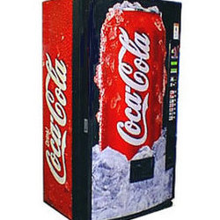
FSMs are Everywhere!
penny, fifty cent piece,
silver dollar, Canadian
currency, ….
q_{start}
nickel
select drink
dime
quarter
q_{5 cents}
q_{10 cents}
q_{25 cents}
nickel
quarter
dime
nickel
nickel
25 cent Cokes? Where is this machine!?
q_{15 cents}
q_{20 cents}
(some transitions not shown)

Slide 36
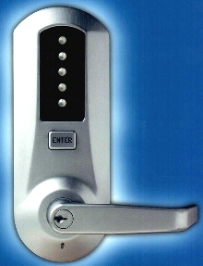
FSMs are Everywhere!
Open Door
q_{start}
q₁
q₂
q₃
q₄
q₅
q₁₂
q₁₃
q₁₄
q₁₅
q₂₃
There’s a lot missing here!
q_{12,3}
q_{12,4}
q_{12,5}
How many states total in this kind of lock?
q_{12,5,34}

Slide 37
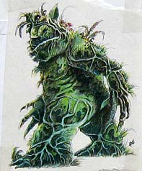
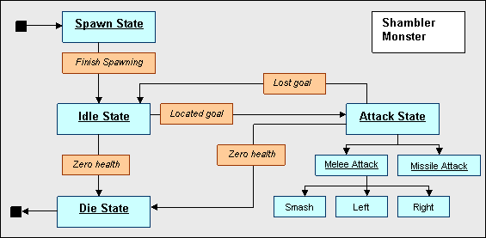
FSM == FearSoMe?
The FSM controlling Quake’s Shambler monsters…
I'm Quaking in my AstroBoots

