Slide 1
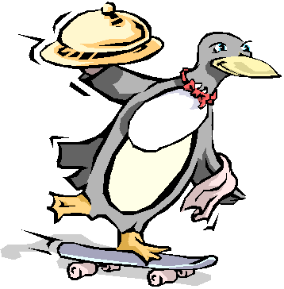
CS 5 Daily Food News
Startup Announces Delivery Service
Upland (Penguin Press): A new startup company founded by disgruntled Harvey Mudd College students is inaugurating a new food delivery service, to be called FishDash.
“Existing delivery companies are too slow,” said new CEO S.P. Dee. “That’s especially a problem for fish-based dishes, which must be served fresh. Our company has hired a flock of penguins who will catch the fish themselves and then rush them to customers in almost no time. By using skateboards, the penguins will be able to zip in and out of traffic and get the food to its destination in just minutes.”
Representatives of a competing company, Roastmates, were not impressed. “Our roasted tuna always arrives so hot that it burns people’s mouths,” stated S. Cald, VP of customer satisfaction. “Try to beat that, FishDash!”
Our reporter was unable to gather further comments as the two officials initiated fisticuffs.
Notes:
Class 23 projects
Setup: browser window ready to accept new tabs with vpython games

Slide 2
Final Projects!
Today is about the CS 5 final projects
It's a sales pitch for the three possible options:
3D Game
TextID
Picobot
I've got my eyes on some of these projects!
Eye'll bet !

Slide 3
Final Projects!
Open-ended
Final CS assignment
Comprehensive
Gold also has these three
Working in teams of 1-3 is OK
…actually, more than OK!
Eye, eye!
Teams need to work together—in the same place—and need to share the work equally
Black/gold pairs are welcome...
Teaming is extra-encouraged on the final project!

Slide 4
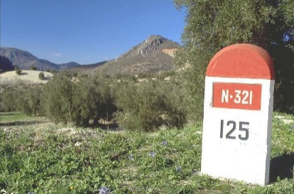
When?
Monday 12/6
Friday 12/10
"Milestone" is part of homework 12
Final project & short reflection on how to run it and how it went.
Project-specific tasks to help with progress...
Due at 11:00 PM
Euros OK; grutoring tapers.
Nice milestone!
It's a kilometer stone, actually!

Slide 5
Final Lab Days
Labs will meet the last 2 weeks of class, but...
no sign-in
They're "extra-optional“: no lab problem
Lab time: final projects assistance + progress
There are theocomp problems, too (hw12)
-2i
or two!
Now we're in a state!
+2i

Slide 6
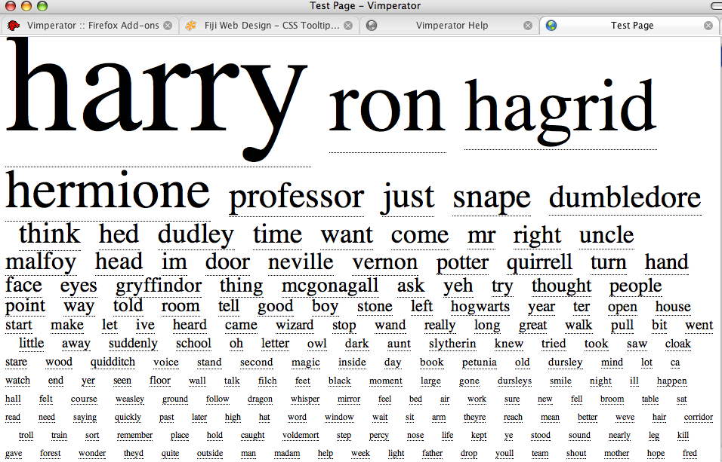
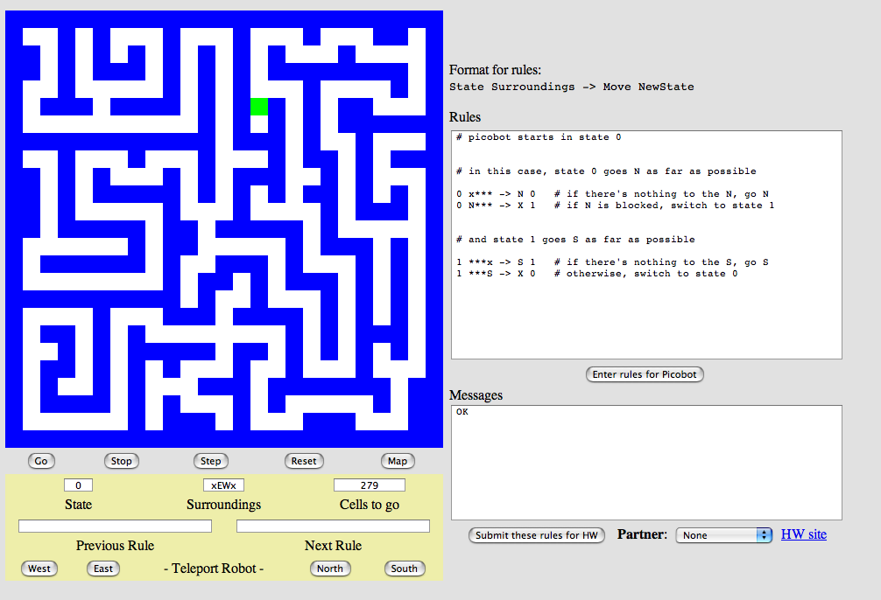
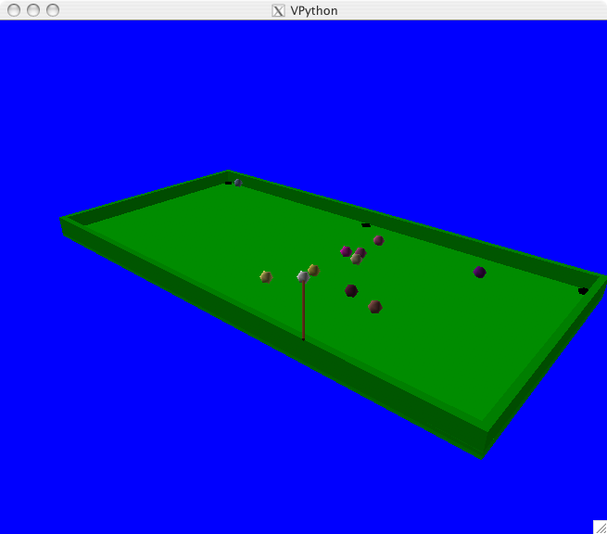
The Projects
TextID
Picobot!
3D Game

Slide 7
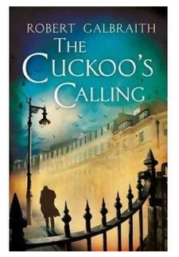
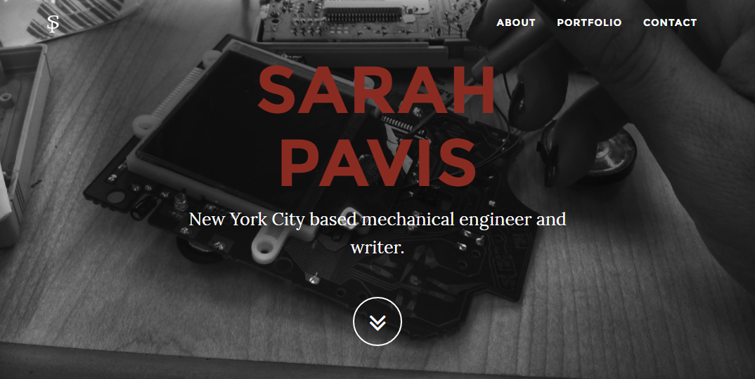
TextID
Though Robin Ellacott’s twenty-five years of life had seen their moments of drama and incident, she had never before woken up in the certain knowledge that she would remember the coming day for as long as she lived.
April 4, 2013
First paragraph of The Cuckoo's Calling by R. Galbraith
Notes:
Sarah Pavis is a popup. She unmasked Galbraith.

Slide 8
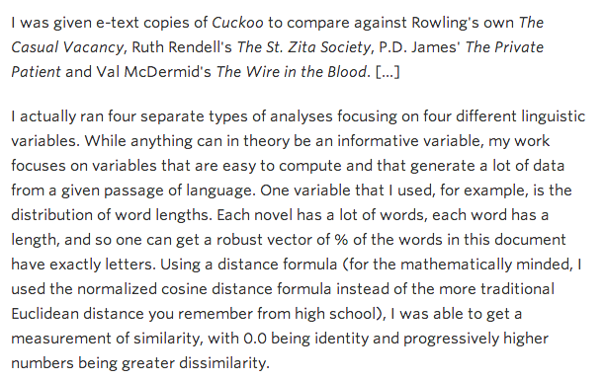
Unmasking Robert Galbraith
kottke.org/13/08/how-jk-rowling-was-found-to-be-robert-galbraith
Notes:
Two animations pop up the highlights.

Slide 9
The TextID Project
Big ideas:
(1) Build lexical models of bodies of text…
(2) Use a similarity score to measure Rowlingness
vs.
Shakepearity
NYTimes-iness
vs.
WSJournalicity
Big Bang Theoretical
vs.
Squid Gameish
Your own choice of two or more comparisons…
Notes:
Two animations.

Slide 10
I like poptarts and 42 and spam. Spamful poptarts are like poptartful spams -- and are liked by all!
Will _Thanksgiving_ bring spam poptarts?
File
class TextModel
... contains at least five Python dictionaries, e.g.,
count of each word
{'and': 3, 'poptartful': 1, 'liked': 1, 'spamful': 1, 'like': 2, '': 1, 'spam': 2, 'i': 1, '42': 1, 'all': 1, 'thanksgiving': 1, 'will': 1, 'bring': 1, 'poptarts': 3, 'spams': 1, 'by': 1, 'are': 2}
{0: 1, 1: 1, 2: 2, 3: 6, 4: 5, 5: 3, 7: 1, 8: 3, 10: 1, 12: 1}
{'and': 3, '': 1, 'all': 1, 'like': 3, 'thanksgiv': 1, 'spam': 4, 'i': 1, '42': 1, 'by': 1, 'will': 1, 'bring': 1, ‘are': 2, 'poptart': 4}
{12: 1, 5: 1, 7: 1}
{'!': 1, '-': 2, '?': 1, '_': 2, '.': 1}
???
???
???
???
What are these four other dictionaries counting?!
Notes:
The next slide has the answers.
The first dictionary, as it says, counts word frequencies.
The second counts word lengths.
The third counts stems.
The fourth counts sentence lengths.
The last counts punctuation.

Slide 11
I like poptarts and 42 and spam. Spamful poptarts are like poptartful spams -- and are liked by all!
Will _Thanksgiving_ bring spam poptarts?
File
class TextModel
... contains at least five Python dictionaries, e.g.,
count of each word
{'and': 3, 'poptartful': 1, 'liked': 1, 'spamful': 1, 'like': 2, '': 1, 'spam': 2, 'i': 1, '42': 1, 'all': 1, 'thanksgiving': 1, 'will': 1, 'bring': 1, 'poptarts': 3, 'spams': 1, 'by': 1, 'are': 2}
{0: 1, 1: 1, 2: 2, 3: 6, 4: 5, 5: 3, 7: 1, 8: 3, 10: 1, 12: 1}
{'and': 3, '': 1, 'all': 1, 'like': 3, 'thanksgiv': 1, 'spam': 4, 'i': 1, '42': 1, 'by': 1, 'will': 1, 'bring': 1, 'ar': 2, 'poptart': 4}
{12: 1, 5: 1, 7: 1}
{'!': 1, '-': 2, '?': 1, '_': 2, '.': 1}
word lengths
stems
sentence lengths
punctuation
What are these four other dictionaries counting?!

Slide 12
TextID’s Building Blocks
(1) Get text from file…
(2) Split up the text into words (first pass)
(3) Model punctuation marks (optional)
(4) Model sentence lengths (using '.!?')
(5) Take a breather...
(6) Clean up the words (second pass)
(7) Model words and word lengths
(8) Stem words and model those stems
(9) You're ready to score against your model!
Text with punctuation preserved
Text with punctuation removed

Slide 13
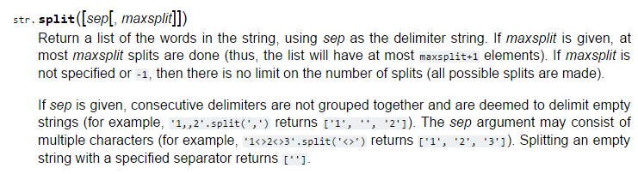
Useful Library Resources
Notes:
You can use any of Python’s documented string methods.

Slide 14
Stemming (An algorithm that generates the root of a word)
stem('parties')
'parti'
ends in ies
stem('love')
'lov'
these don't have to be words, just stems…
ends in vow + cons + e
stem('swerving')
'swerv'
ends in vow + cons + ing
stem('quickly')
'quick'
ends in vow + cons + ly
stem('slowest')
'slow'
ends in vow + cons + est
but, they can also be words
stem('stems')
'stem'
ends in cons + s
stem('stemming')
'stem'
ends in vow + 2*cons + ing

Slide 15
Stemming (An algorithm that generates the root of a word)
stem('parties')
'parti'
ends in ies
stem('love')
'lov'
these don't have to be words, just stems…
ends in vow + cons + e
stem('swerving')
'swerv'
ends in vow + cons + ing
stem('quickly')
'quick'
ends in vow + cons + ly
stem('slowest')
'slow'
ends in vow + cons + est
but, they can also be words
stem('stems')
'stem'
ends in cons + s
stem('stemming')
'stem'
ends in vow + 2*cons + ing
Either way, they all have exceptions!

Slide 16
Stemming!
getting to the root of the problem…
def stem(w):
exception
Find an English exception to each of these stemming patterns:
incorrect stem
π
pies
stem('parties')
'parti'
ends in ies
kite
stem('love')
'lov'
kit
ends in vow + cons + e
nothing
stem('swerving')
'swerv'
noth
ends in vow + cons + ing
ally
stem('quickly')
'quick'
al
ends in vow + cons + ly
interest
stem('slowest')
'slow'
inter
ends in vow + cons + est
princess
stem('stems')
'stem'
princes
ends in cons + s
lemming
stem('stemming')
'stem'
lem
ends in vow + 2*cons + ing
under
undo
do
der
stem(__________)
_______
create your own rule for stemming

Slide 17
Stemming!
getting to the root of the problem…
def stem(w):
exception
Find an English exception to each of these stemming patterns:
incorrect stem
π
pies
stem('parties')
'parti'
ends in ies
kite
stem('love')
'lov'
kit
ends in vow + cons + e
nothing
stem('swerving')
'swerv'
noth
ends in vow + cons + ing
ally
stem('quickly')
'quick'
al
ends in vow + cons + ly
interest
stem('slowest')
'slow'
inter
ends in vow + cons + est
princess
stem('stems')
'stem'
princes
ends in cons + s
lemming
stem('stemming')
'stem'
lem
ends in vow + 2*cons + ing
under
undo
do
der
stem(__________)
_______
create your own rule for stemming

Slide 18
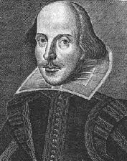
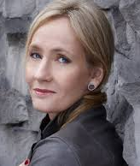
Model Matching
WS: { "love": 50,
"spell": 8,
"thou": 42 }
Suppose we have two trained models:
JKR: { "love": 25,
"spell": 275,
"potter": 700 }
How do we handle different-sized texts?
Unknown text: { "love": 3,
"thou": 1,
"potter": 2,
"spam": 4 }
These must have been some really avant-garde texts!
Notes:
“Different-sized texts” is a popup.

Slide 19
Normalization
WS: { "love": 50,
"spell": 8,
"thou": 42 }
JKR: { "love": 25,
"spell": 275,
"potter": 700 }
Normalize for size
WS: { "love": 0.50,
"spell": 0.08,
"thou": 0.42 }
JKR: { "love": 0.025,
"spell": 0.275,
"potter": 0.700 }
Unknown text: { "love": 3,
"thou": 1,
"potter": 2,
"spam": 4 }

Slide 20
Matching Normalized Models
WS: { "love": 0.50,
"spell": 0.08,
"thou": 0.42 }
JKR: { "love": 0.025,
"spell": 0.275,
"potter": 0.700}
Suppose we have two normalized models:
How do we compare the models with an unknown text?
What's the likelihood of the new model arising from each?
Unknown text: { "love": 3,
"thou": 1,
"potter": 2,
"spam": 4 }
There's probably a way to do this!

Slide 21
Probabilities
WS: { "love": 0.50,
"spell": 0.08,
"thou": 0.42 }
JKR: { "love": 0.025,
"spell": 0.275,
"potter": 0.700 }
The WS-based probability of each word in Unknown text
=
.50
.50
.50
_?_
?
?
?
?
?
?
???
love
love
love
thou
potter
potter
spam
spam
spam
spam
0? 1?
Unknown text: { "love": 3, "potter": 2,
"thou": 1, "spam": 4 }
I've got near-zero ideas on this one!

Slide 22
Fixing Probabilities (1)
WS: { "love": 0.50,
"spell": 0.08,
"thou": 0.42 }
JKR: { "love": 0.025,
"spell": 0.275,
"potter": 0.700 }
The WS-based probability of each word in Unknown text
=
.50
.50
.50
.42
1
1
1
1
1
1
0.0525
love
love
love
thou
potter
potter
spam
spam
spam
spam
Why is this especially incorrect?
Unknown text: { "love": 3, "potter": 2,
"thou": 1, "spam": 4 }
Notes:
The “especially” is animated.
It’s incorrect because it gives the highest weight to words that the neither author ever used!

Slide 23
Fixing Probabilities (0)
WS: { "love": 0.50,
"spell": 0.08,
"thou": 0.42 }
JKR: { "love": 0.025,
"spell": 0.275,
"potter": 0.700 }
Correct, but not helpful!
The WS-based probability of each word in Unknown text
=
.50
.50
.50
.42
0
0
0
0
0
0
0.0
love
love
love
thou
potter
potter
spam
spam
spam
spam
Unknown text: { "love": 3, "potter": 2,
"thou": 1, "spam": 4 }
Notes:
The “not helpful” is animated.

Slide 24
Fixing Probabilities (0.5)
WS: { "love": 0.50,
"spell": 0.08,
"thou": 0.42 }
JKR: { "love": 0.025,
"spell": 0.275,
"potter": 0.700 }
For missing words, use half the smallest value – across both normalized models!
The WS-based probability of each word in Unknown text
=
too small!
.50
.50
.50
.42
.012
.012
.012
.012
.012
.012
1.57e-13
love
love
love
thou
potter
potter
spam
spam
spam
spam
I’m sorry…what?
Unknown text: { "love": 3, "potter": 2,
"thou": 1, "spam": 4 }
Notes:
The “too small” is animated.

Slide 25
Fixing Probabilities (log)
WS: { "love": 0.50,
"spell": 0.08,
"thou": 0.42 }
JKR: { "love": 0.025,
"spell": 0.275,
"potter": 0.700 }
For missing words, use half the smallest value – across both normalized models!
The WS-based probability of each word in Unknown text
=
3*log(.50) + log(.42) + 2*log(.012) + 4*log(.012)
-29.48
love
love
love
thou
potter
potter
spam
spam
spam
spam
OK!
Unknown text: { "love": 3, "potter": 2,
"thou": 1, "spam": 4 }
Ta-da!
Notes:
The same calculation for JKR gives -33.89. So “Love thou, potter, spam” is Shakespearean!
Note that although -29.48 and -33.49 are close in linear space, they’re far apart in logarithmic space. Shakespeare is a much better match.

Slide 26
The Alien’s Life Advice
Assume the best of people
The world has very few 100% jerks!

Slide 27
The Picobot Project
Big ideas
(1) Implement Picobot in Python
(2) Train Python to write successful Picobot programs!
Talk about going full circle...

Slide 28
Picobot’s Rules
class Program:
0 xxWS -> E 0
0 xxxS -> E 0
0 xExS -> N 0
0 xExx -> N 0
0 NExx -> S 1
1 xxxx -> S 1
1 Nxxx -> E 1
1 NxWx -> E 1
1 xxWx -> N 1
1 xxWS -> N 1
1 xxxS -> W 1
1 xExS -> W 1
1 xExx -> S 1
1 NExx -> W 0
What in Python could most usefully hold all of these rules?
Python dictionary
What type should self.rules be?
both tuples
key
value
self.rules[(1, "NExx")] = ("W" ,0)
Notes:
This slide has an animation that makes all the stuff at the bottom appear.

Slide 29
Picobot’s World
What type in Python could most usefully hold the environment?
+++++++++++++++++++++++++
+oooooPooooooooooooooooo+
+o o o+
+o o o+
+o o o+
+o o o+
+o o o+
+o o o+
+o o o+
+o o o+
+o o+
+o o+
+o o+
+o o+
+o o+
+o o+
+o o+
+o o+
+o o+
+o o+
+o o+
+o o+
+o o+
+ooooooooooooooooooooooo+
+++++++++++++++++++++++++
class World:
What class that you've already written will be most similar to Picobot's World?
What will self.room be?
Wall:
+
o
Picobot:
P
Visited:

Slide 30
Steps to Picobot
Current State: 1
Current Rule: 1 N*W* -> X 2
++++++++++
+o++o+o+++
+oooooo ++
++++o++ +
+oooo+++++
++++o +
+oooo+++ +
++++o+++++
+Pooo +
++++++++++
First, build an ASCII simulation
Picobot started here…
Then evolve it with your own genetic algorithm
…and is now here
Your actual ASCII is likely to be more monochromatic!
http://rednuht.org/genetic_cars_2/ or http://boxcar2d.com/
Box2d: https://www.youtube.com/watch?v=uxourrlPlf8

Slide 31
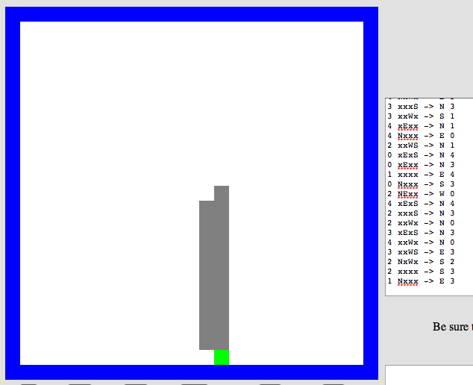
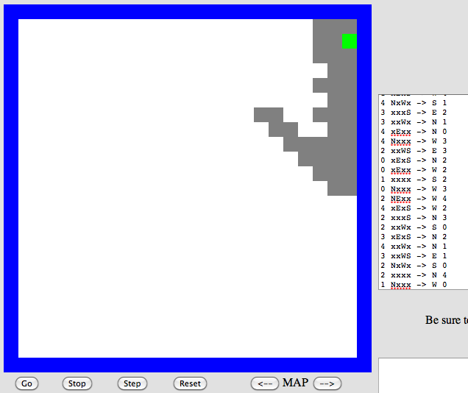
Program Evolution
An example of genetic algorithms, which are used for optimizing hard-to-describe functions with easily-splittable solutions.
program p1
program p2
Start with a population of about 200 random Picobot programs

Slide 32
Fitness
An example of genetic algorithms, which are used for optimizing hard-to-describe functions with easily-splittable solutions.
program p1
program p2
Then measure the fitness of all those programs

Slide 33
Recombination
program p1
fitness = 0.03
program p2
fitness = 0.05
Mate & mutate the fittest rulesets to create a new generation of the same size
program c1
fitness = 0.19

Slide 34
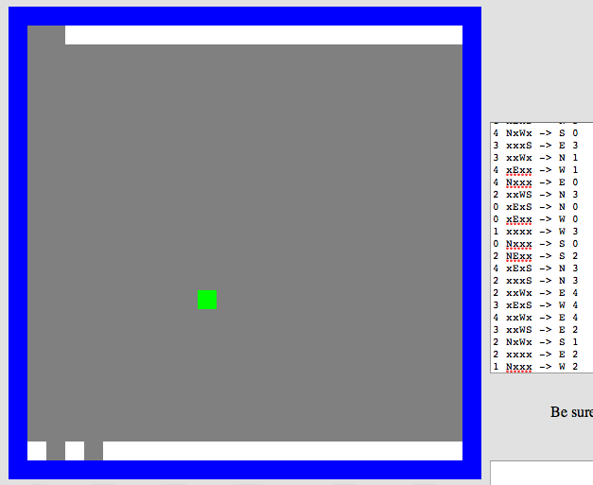
Lather, Rinse, Repeat
Repeat this "survival of the fittest" process for many generations and you’ll evolve a much more capable Picobot program!
fitness = 0.90

Slide 35
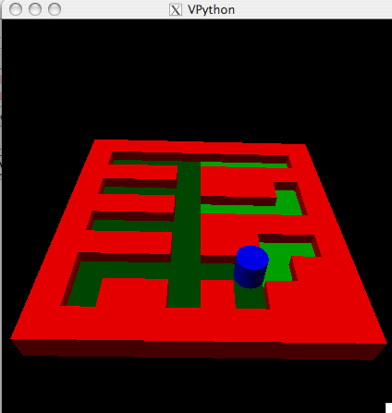
Extra: Picobot Graphics
Choice of graphical packages
2d: pyglet from Life
3d: VPython
Mine's going to be in 5d!
or 3d …
2d should be enough for anybody
What? All the best stuff is 3d! Think coffee, poptarts, etc.
2d version…

Slide 36
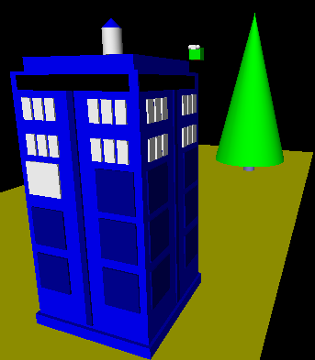
3d graphics-based game using VPython
(vPool)
I'll take your cue...
Let's play!
… it's not really very constrained at all!
A few constraints…
Need ≥4 physically interacting objects
Allow the user to direct 1+ objects, either by keyboard or mouse or both
Needs a game goal + be winnable!
Must detect some "linear" and some "spherical" collisions, and implement their results on the motion of the objects

Slide 37
The 3D Game Project
Sounds like all physics to me!
VPython was designed to make 3D physics simulations simpler to program—as a result, the library itself is physics-free!
⇒ Phunky Physics is welcome!
Linear collisions should be somewhere ("walls")
Spherical collisions should be somewhere ("points")
You need “pockets”—or some other game objective
You need user control of at least one object (mouse or keyboard)

Slide 38
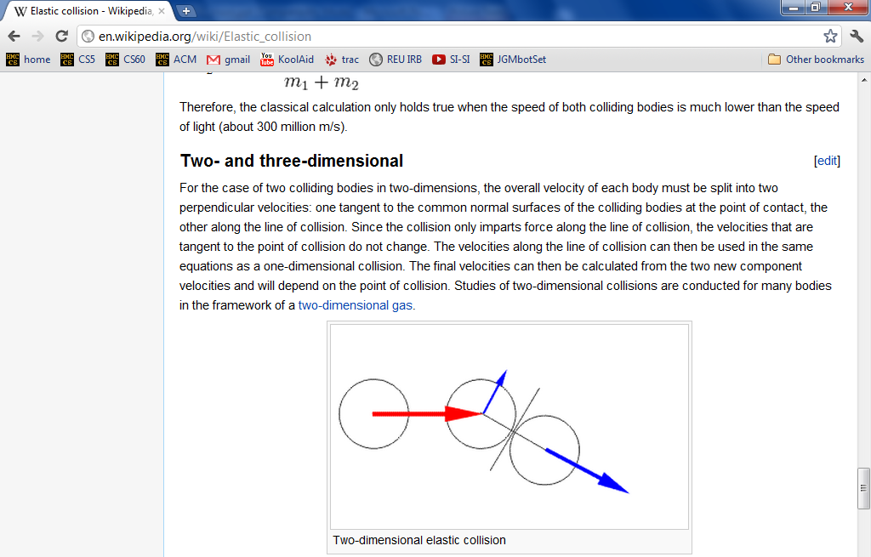
Collisions—Physics?

Slide 39
Linear Collisions
x = 10
At least some of the game needs to be about detecting collisions and changing velocities
+z
ball.vel = vector(1, 0, 1)
while True:
ball.pos += dt * ball.vel
if ball.pos > 10:
ball.vel.x =
ball.pos.x =
+x
Line ~ wall at x=10
How to bounce?
What else to do?

Slide 40
Head-On Spherical Collisions
All of q’s velocity transfers to r!
new r.vel
r
How to do it:
Undo any overlap
Make r.vel = q.vel
Stop q
q
old q.vel

Slide 41
General Spherical Collisions
Now only the q.vel in the d direction transfers!
r.vel
new q.vel
d⊥
d
r
How to do it:
Undo any overlap
Find d = r.pos − q.pos
Normalize d
Make r.vel = q.vel ∙ d
Make q.vel = q.vel ∙ d ⊥ , at 90° from d
q
old q.vel

Slide 42
The Physics
http://en.wikipedia.org/wiki/Elastic_collision

Slide 43
vector library!
This is how I like my vectors: well done!

Slide 44
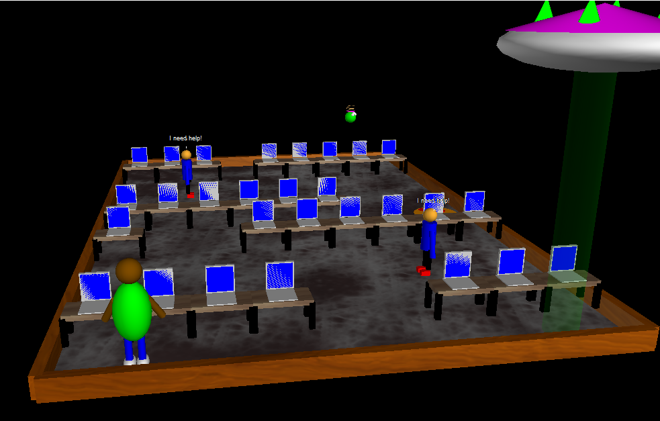
Example vProjects...
Notes:
All examples run with python3 foo.py, bring up in browser
air_hockey.py: don’t show
cs_lab/final.py: Grutor needs to avoid students and rescue alien. Arrows move, space halts.
frogger/final.py: use arrow keys.
office_scene.py: don’t show
pool/final.py: Arrow keys move cue, up/down for strength, enter to fire
putt_putt/final.py: Shows instructions. Don’t show.
sheep_games/final.py: Option 3 is sheep shooting range. Shoot with backspace.
sheepderby.py: Final demo
tortoise_and_hare.py: just show graphics
winter_wonderland.py: just show graphics

