Slide 1
CS5's view from here…
I've got all my eyes on this view!
CS Practice
Final Projects
Picobot
vPool
TextID
What's next?
… and the CS5 finale.
Notes:
Class 23 fsm
INHANDOUT
Setup: be ready to run jflap alone, also on start_end_same.jff
java -jar /h/src/utils/jflap-7.0/JFLAP_Thin.jar start_end_same.jff
Have a window ready to show https://www.youtube.com/watch?v=gy5g33S0Gzo (towel-folding robot)
Projects are dominant work from here on out

Slide 2
Homework 13
Due: Mon. 4/23
mathematical foundations of CS
(1) Building finite-state machines
50 assigned points; up to +50 ex. cr. pts; due by 5/1
(2) project milestone ~ "progress report"
vpython_milestone.zip
picobot_milestone.zip
textid_milestone.zip
For the milestone, you’ll submit a zip file:
milestone.zip
25 assigned points
Notes:
HW 13 is a “half-size” homework.

Slide 3
Labs in weeks 13+
These are entirely optional meeting times:
no signing in
Tuesday 2:45-4:45pm a2:45-4:45pm
Labs:
Tuesday 2:45-4:45pm and 6-8pm
We won't be able to get you graded feedback on the milestone before the final project is due – so join us for lab!
To work on your milestone/final projects
To work on HW 13's finite-state machines

Slide 4
CS5's view from here…
I've got all my eyes on this view!
CS Practice
Final Projects
Picobot
vPool
TextID
What's next?
CS Applications
simulation+ analysis/ algorithms
graphics / media / games ...
feature-based modeling + classification
other state-machines + fun stuff
recursion
variables
loops
circuits and memory
data: classes and objects
functions
CS 5
CS Theory
is under here:
CS Foundations
What can we compute...
...and how well ?

Slide 5
CS5's view from here…
Final Projects
Picobot
vPool
TextClouds
CS 5 ~ all corners of CS
CS Applications
biological analysis + algorithms
graphics media games ...
robots and computer vision
search and the web
recursion
variables
loops
circuits and memory
data: classes and objects
functions
CS 5
CS Theory
CS Theory
CS Foundations
CS Foundations
What can be computed...
What can we compute...
...and how well ?
... and how efficiently?

Slide 6
The next two weeks in CS5…
(1) Define "computer" precisely
(2) Define "compute" precisely
(3) See what computers provably can't compute
(4) Go back to step (1) and define things better…
(5) …until time runs out...
Aargh!
CS Foundations
CS Foundations
What can be computed...
What can we compute...
...and how well ?
... and how efficiently?

Slide 7
Unifying idea: State
0 NEWx -> S 1
previous state
next state
external input
next step
The state of a computation is
all the internal information
For Picobot, next step is taken literally!
needed to take the next step
Notes:
INHANDOUT
“State” is a bit of an uncomfortable concept, and we STILL expect that people will struggle a bit with it.

Slide 8
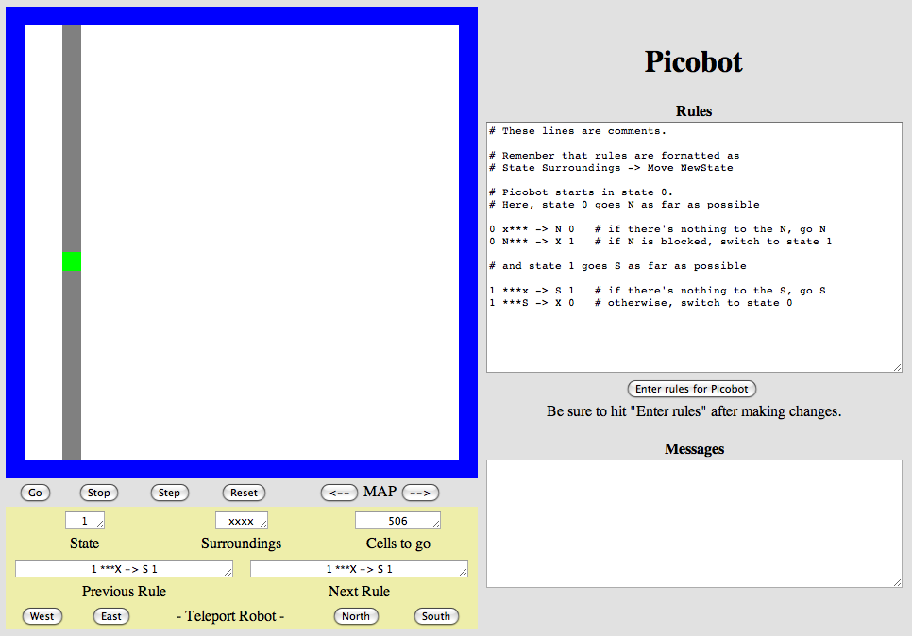
States as subtasks
State Machine:
Each oval represents a different Picobot state
x***
***x
N***
surroundings
state pattern -> move new state
starting funnel
state 0
state 1
0 x*** -> N 0
0 N*** -> X 1
1 ***x -> S 1
1 ***S -> X 0
The "go North" state
The "go South" state
***S
Transitions move from state to state
Notes:
INHANDOUT
Show how rules 2 & 4 transition to new states.

Slide 9
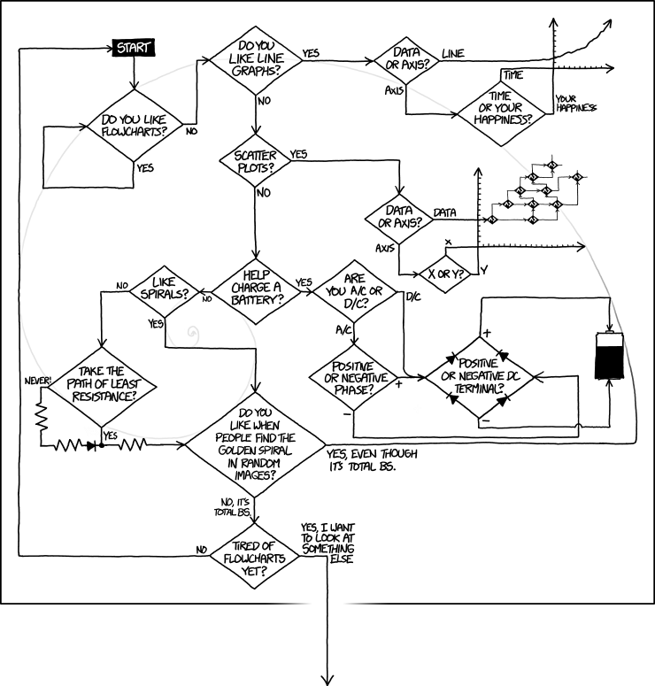
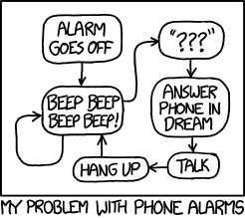
XKCD FSMs !
Notes:
INHANDOUT

Slide 10
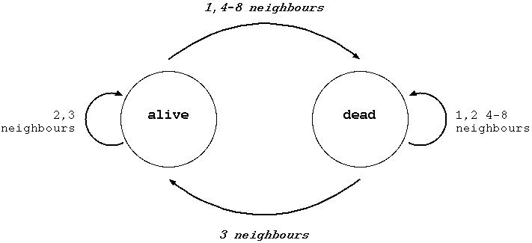
states as subtasks
What is this state machine?
State Machine:
each oval represents a different robot state
x***
***x
N***
state pattern -> move new state
starting funnel
state 0
state 1
0 x*** -> N 0
0 N*** -> X 1
1 ***x -> S 1
the "go North" state
the "go South" state
***S
transitions move from state to state
Notes:
INHANDOUT

Slide 11
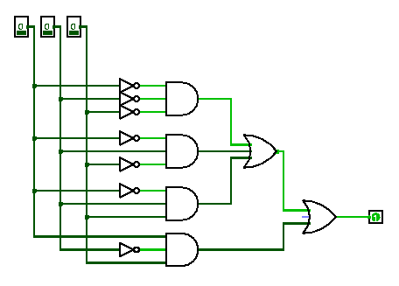
Computation is a deliberate sequence of state changes
This doesn't seem very meaningful
1010100101100000000000
1010100101100000001110
bits before
bits after
Notes:
The bits here mean 42 / 3 == 14

Slide 12
Computation is a deliberate sequence of state changes
Computer ~ a finite state machine
this doesn't seem very meaningful
apple or not...
1010100101100000000000
1010100101100000001110
bits before
bits after
https://www.youtube.com/watch?v=1nzkxL1to4w

Slide 13
A model of computation: FSM
Finite State Machine
Example FSM
0
0
1
s0
s1
1
Notes:
Next slide expands on this.

Slide 14
A model of computation: FSM
Finite State Machine
Example input
100101
This input's output:
input sequence
read left-to-right
0
0
1
s0
s1
1
start state
transitions
accepting states
“input funnel”
“where to go”
double circled
labeled by input !

Slide 15
A model of computation: FSM
Finite State Machine
Example input
100101
This input's output:
input sequence
read left-to-right
another accepted str:
rejected example str:
0
0
1
s0
s1
1
start state
transitions
accepting states
“input funnel”
“where to go”
double circled
labeled by input !
Notes:
INHANDOUT
Hand-write “accept” and “reject.”
Demonstrate this machine on the board, using a student to consume the input.

Slide 16
FSM: Finite state machine
another input sequence
0010111
output for this input
always left-to-right
transition on 0
transition on 0
transition on 1
State 0
State 1
transition on 1
What does each state MEAN ?
What does this FSM do overall?
Notes:
Discuss the “meaning” of the states.

Slide 17
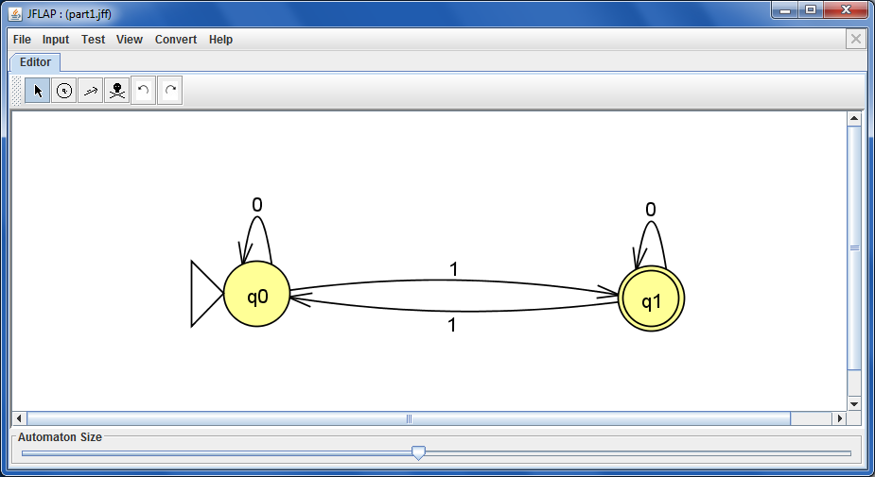
JFLAP !
graphical state-machine builder for hw13
Notes:
Show building this machine and stepping, then show multiple run.

Slide 18
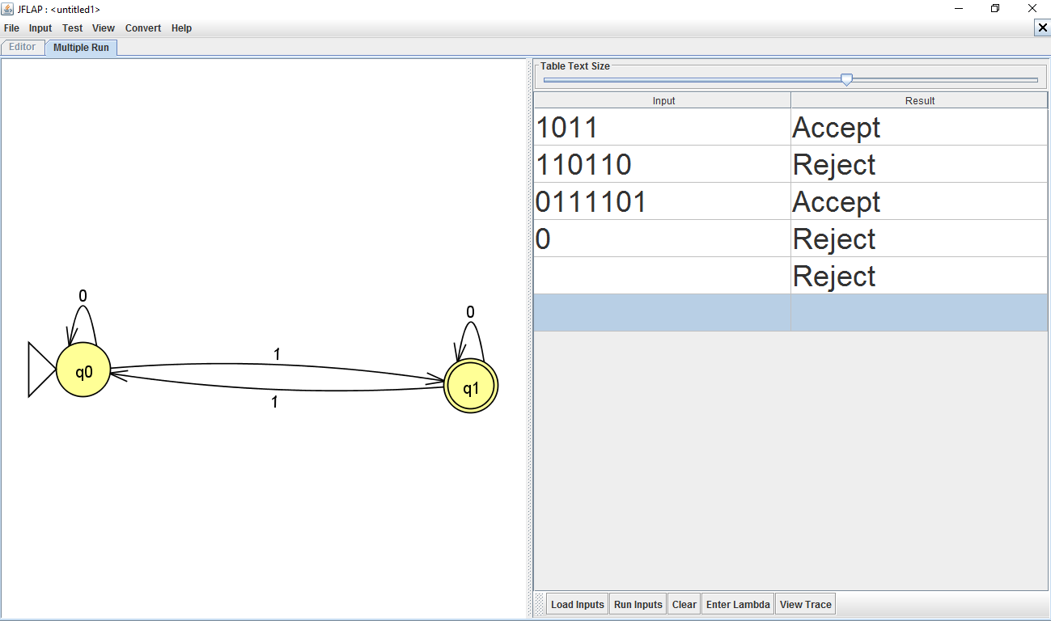
JFLAP !
Multiple-input runs ⇒ lots of tests provided!
empty string, or λ
lambda
Notes:
INHANDOUT

Slide 19
Quiz
Name(s) _____________________________
0
1
1
q1
q0
1
0
0
1
q3
q2
0
List three different-length inputs that this FSM accepts:
List three different-length inputs that this FSM rejects:
In general, what English phrase describes the rejected inputs?
This machine rejects strings that …
q0 means ACCEPTING + ending in a 0 … or ...
What does each state say about the current state of the input?!?
q1 means ACCEPTING + ending in a 1
q2 means REJECTING + ending in a 0 … or ...
q3 means REJECTING + ending in a 1
Could you get the same behavior with fewer states? What's the minimum # possible? How do you know?
Hint: do strings have to be in separate states?
Extra!
Notes:
QUIZSLIDE
This machine rejects strings with two consecutive ones, and accepts all others.

Slide 20
Quiz
Try this on the back page first…
0
1
1
q1
0
q0
0
1
q2
graveyard state: two transitions in JFLAP
List three different-length inputs that this FSM accepts:
List three different-length inputs that this FSM rejects:
In general, what English phrase describes the rejected inputs?
This machine rejects strings that …
have two 1's in a row (anywhere in the string)
What does each state say about the current state of the input?!?
q0 means ZERO 1's in a row ...
q1 means ONE 1 in a row...
q2 means TWO 1's in a row...
Could you get the same behavior with fewer states? What's the minimum # possible? How do you know?
Hint: do strings have to be in separate states?
Extra!
3 state min.
Notes:
For q0 & q1, ask for two 2-character strings that put you into those states. Then ask for a third character that produces different resulting states. That proves that the two strings have different “futures” and thus must have different states.

Slide 21
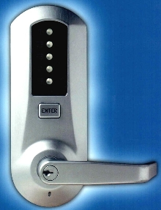
FSMs are everywhere!
12
5
34
q_{start}
q₁
q₂
q₃
q₄
q₅
q₁₂
q₁₃
q₁₄
q₁₅
q₂₃
Locks
q_{12,3}
q_{12,4}
q_{12,5}
q_{12,5,34}
Notes:
Draw the path for 12-5-34

Slide 22
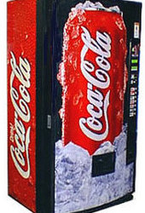
FSMs are everywhere!
penny, fifty cent piece,
silver dollar, Canadian
currency, CS 5 Euro, ….
q_{start}
nickel
dime
quarter
q_{5 cents}
q_{10 cents}
q_{25 cents}
nickel
mechanical
vending machine
dime
nickel
nickel
q_{15 cents}
q_{20 cents}
nickel
(some transitions not shown)
www.youtube.com/watch?v=85C4eh0mEJg @ 1:42 !
Notes:
INHANDOUT
The YouTube video isn’t worth showing.

Slide 23
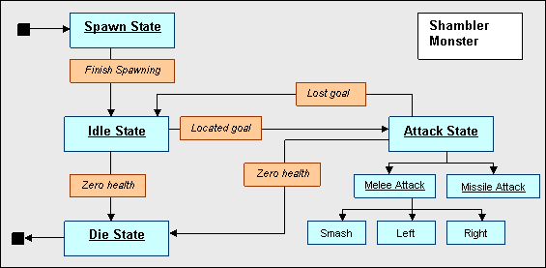
FSM ~ Game AI
The state machine that controls Quake's Shambler monsters…
I'm Quaking in my AstroBoots

Slide 24
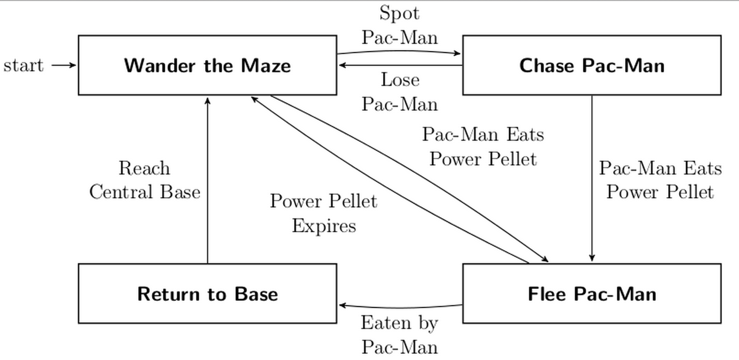
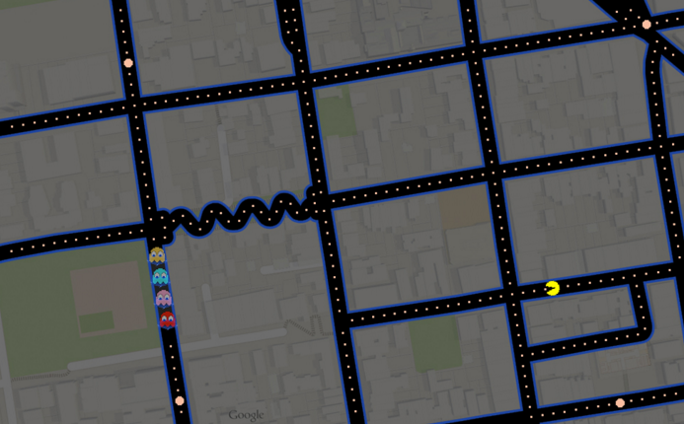
FSM ~ Game AI
Here, it's Ghost AI
Recognize this street?

Slide 25
All robots use FSM control
50x
What states can you "factor out" from watching this towel-folding?
Notes:
https://www.youtube.com/watch?v=gy5g33S0Gzo
Note that the video is 50X real speed!
This was done in 2011.

Slide 26
Towel-folding states!
Notes:
The debugging cycle was hours long because the robot was so slow.

Slide 27
Towel-folding?
singled out as a questionable use of dollars...
Notes:
Highlight the headline.

Slide 28
Build-your-own FSMs
Draw a FSM accepting strings in which the number of zeros (0s) is a multiple of 3, so there are 0, 3, 6, … zeros. 1s don't matter!
4
10
2
Draw a FSM accepting strings with at least two 1s (anywhere). Others are rejected.
10
Accepted: 110101110, 11, 0000010
Rejected: 101, 0000, 111011101111
Hint: 1s never change the state!
Accepted examples: 0101, 00010110, 111011, 11
Rejected examples: 0100, 1000, 000000, 1, 0
Another hint: make a triangle!
Hint - modify this starter FSM by adding labels, transitions, and one more state:
1
What's the minimum number of states needed?
more stuff needed!
Draw a FSM accepting strings in which the third digit (3d from the left) is a 1.
8
6
Draw a FSM that accepts strings that don't contain the pattern 110 anywhere.
10
10
Accepted: 1010001, 011 Rejected: 11000100, 11, 0
Accepted: 1010001, 011 Rejected: 101001100, 01101
1
1
0
What's the minimum number of states needed?
10
Extra! Draw a FSM accepting strings whose third-to-last digit (3d from the right) is a 1.
Acc: 0100 and 01101
Hint - there are FIVE more transitions – but no more states - needed here
10
Rej: 101001 and 11
Notes:
INHANDOUTFULL
The fractions in the corners are difficulty levels.
Ask students to put their successes on the board.
This slide appears twice: show this, then show the Python one, then move forward to this one again.

Slide 29
Build-your-own FSMs
Draw a FSM accepting strings in which the number of zeros (0s) is a multiple of 3, so there are 0, 3, 6, … zeros. 1s don't matter!
4
10
2
Draw a FSM accepting strings with at least two 1s (anywhere). Others are rejected.
10
Accepted: 110101110, 11, 0000010
Rejected: 101, 0000, 111011101111
Hint: 1s never change the state!
Accepted examples: 0101, 00010110, 111011, 11
Rejected examples: 0100, 1000, 000000, 1, 0
Another hint: make a triangle!
if count('0', s)%3 == 0:
return True
else:
return False
if count('1', s) >= 2:
return True
else:
return False
Hint - modify this starter FSM by adding labels, transitions, and one more state:
1
What's the minimum number of states needed?
FSMs ~ "software circuits"
more stuff needed!
Draw a FSM accepting strings in which the third digit (3d from the left) is a 1.
8
6
Draw a FSM that accepts strings that don't contain the pattern 110 anywhere.
10
10
Accepted: 1010001, 011 Rejected: 11000100, 11, 0
Accepted: 1010001, 011 Rejected: 101001100, 01101
if s[2] == '1':
return True
else:
return False
if '110' not in s:
return True
else:
return False
1
1
0
if s[-3] == '1':
return True
else:
return False
What's the minimum number of states needed?
10
Extra! Draw a FSM accepting strings whose third-to-last digit (3d from the right) is a 1.
Acc: 0100 and 01101
Hint - there are FIVE more transitions – but no more states - needed here
10
Rej: 101001 and 11
Notes:
INHANDOUT

Slide 30
Build-your-own FSMs
Draw a FSM accepting strings in which the number of zeros (0s) is a multiple of 3, so there are 0, 3, 6, … zeros. 1s don't matter!
4
10
2
Draw a FSM accepting strings with at least two 1s (anywhere). Others are rejected.
10
Accepted: 110101110, 11, 0000010
Rejected: 101, 0000, 111011101111
Hint: 1s never change the state!
Accepted examples: 0101, 00010110, 111011, 11
Rejected examples: 0100, 1000, 000000, 1, 0
Another hint: make a triangle!
Hint - modify this starter FSM by adding labels, transitions, and one more state:
1
What's the minimum number of states needed?
more stuff needed!
Draw a FSM accepting strings in which the third digit (3d from the left) is a 1.
8
6
Draw a FSM that accepts strings that don't contain the pattern 110 anywhere.
10
10
Accepted: 1010001, 011 Rejected: 11000100, 11, 0
Accepted: 1010001, 011 Rejected: 101001100, 01101
1
1
0
What's the minimum number of states needed?
10
Extra! Draw a FSM accepting strings whose third-to-last digit (3d from the right) is a 1.
Acc: 0100 and 01101
Hint - there are FIVE more transitions – but no more states - needed here
10
Rej: 101001 and 11

Slide 31
Has at least two 1s… ?
Draw a FSM accepting strings with at least two 1s (anywhere). Others are rejected.
Accepted: 0101, 00010110, 111011, 11
Rejected: 0100, 1000, 000000, 1, 0
1
q0
q1
has ZERO 1's
What do we need to complete this machine?
Notes:
INHANDOUT
Draw a solution.

Slide 32
Number of 0s is div. by 3
Draw a FSM accepting strings in which the number of zeros (0s) is a multiple of 3, so there are 0, 3, 6, … zeros. 1s don't matter.
Accepted: 110101110, 11, 0000010
Rejected: 101, 0000, 111011101111
1
#Zeros%3 == 1
1
1
0
q1
0
q0
q2
0
1
#Zeros%3 == 0
#Zeros%3 == 2
0
q3
Combine two of these?
#Zeros%3 == 3
Minimum number of states?
Notes:
INHANDOUT

Slide 33
No occurrences of 110?
Draw a FSM accepting strings that do NOT anywhere contain the pattern 110
Accepted: 1010001, 0001011
Rejected: 101001100, 011001
1
start
0
end w/1
end w/11
fail!
0
1
1
0
q0
q1
q2
q3
Which transitions are still needed here?
Notes:
INHANDOUT

Slide 34
Third character is a 1
Draw a FSM accepting strings in which the third digit (from the left) is a 1.
Accepted: 1010001 and 0110
Rejected: 11000100 and 11
one char
two chars
no chars
0
0
1
1
q0
q1
q2
s1
Why must s1 and s2 be separate states?
Minimum number of states?
s2
Notes:
INHANDOUT

Slide 35
Third-to-last character is a 1?
Draw a FSM accepting strings whose third-to-last digit (from the right) is a 1.
Accepted: 0100 and 01101
Rejected: 101001 and 11
Minimum number of states?

Slide 36
Third-to-last character is a 1
0
q∅
1
q0
q1
1
0
1
0
q00
q01
q10
q11
0
1
0
1
0
1
0
1
q000
q001
q010
q011
q100
q101
q110
q111
I don't accept this solution!
Something's not right here: it's down-right harrowing!
Do we need 15 states?
Notes:
INHANDOUT
Which are the accepting states?

Slide 37
Third-to-last character is a 1
q000
q001
q010
q011
q100
q101
q110
q111
8 states?
Are 8 states required?
Notes:
INHANDOUT

Slide 38
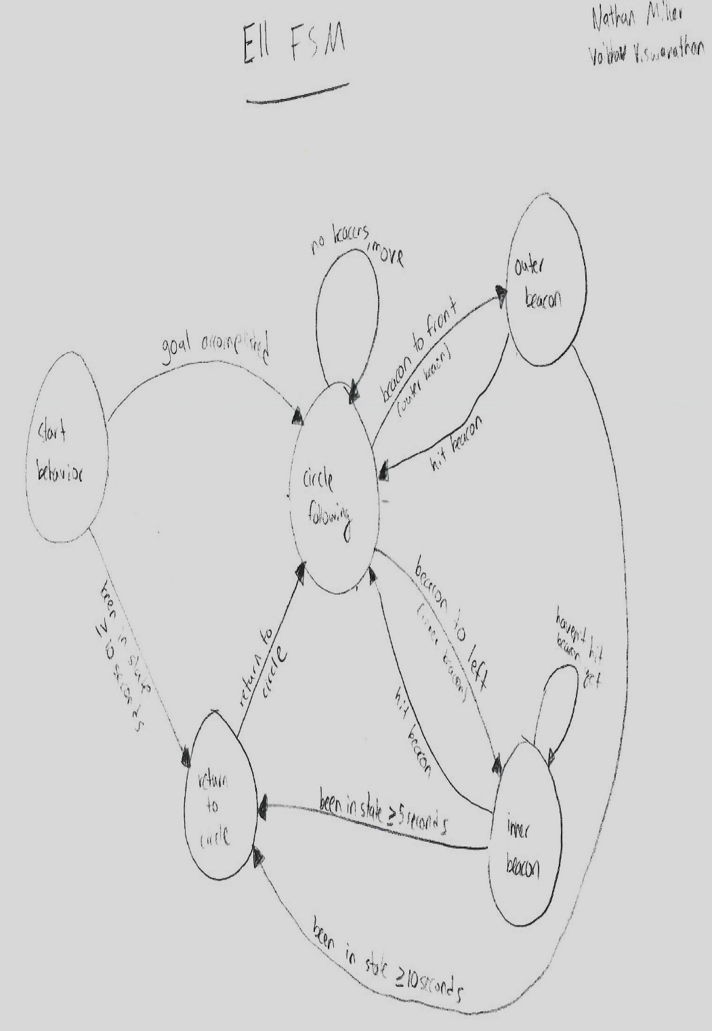
All robots use FSM control
… send me your FSM so that I can show it off in 2017!

Slide 39
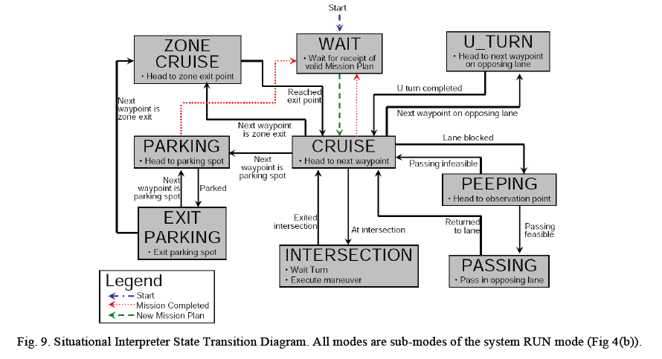
An autonomous vehicle's FSM

