Slide 1
CS 5 today:
more machines!
Turing Machines and the MANY things computers can't compute... !
Final ideas...
This machine doesn't look all-powerful to me!
Final tutoring hrs/labs meet this week + next
Final projects...
HW13 + milestone due on Monday, 4/23
5 finite-state machines due as part of hw13
Turing machines extra!
Notes:
Class 24 cantor
INHANDOUT

Slide 2
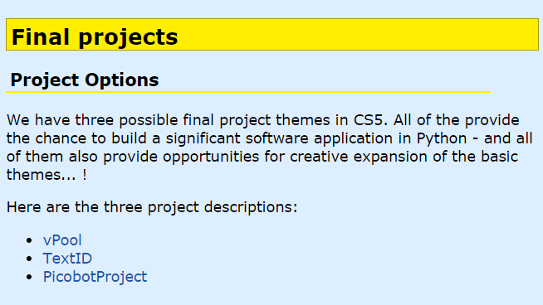
Final-project help…
Tutoring hours ⇒ guidance vs. problem-solving
Be sure to read over these pages!
Key piece of final project advice... !
hw13 JFLAP ~ autograded

Slide 3
Final-project state machine
still broken
still works
it's broken
stop adding features + start adding print statements
comment out print statements + start adding more features
it works
store a copy somewhere else!

Slide 4
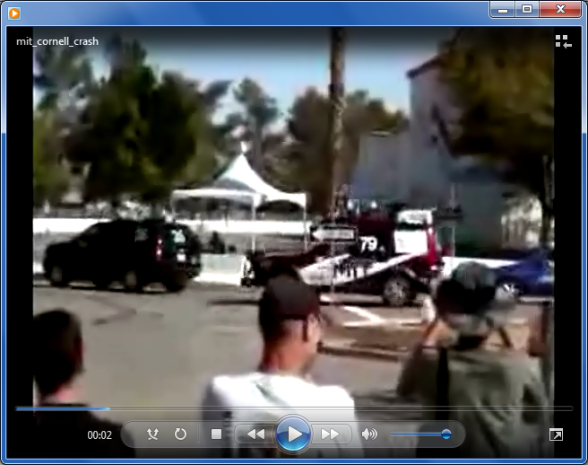
State-machine limits?
Are there limits to what FSMs can do?
they can't necessarily drive safely...
MIT's car, Talos

Slide 5
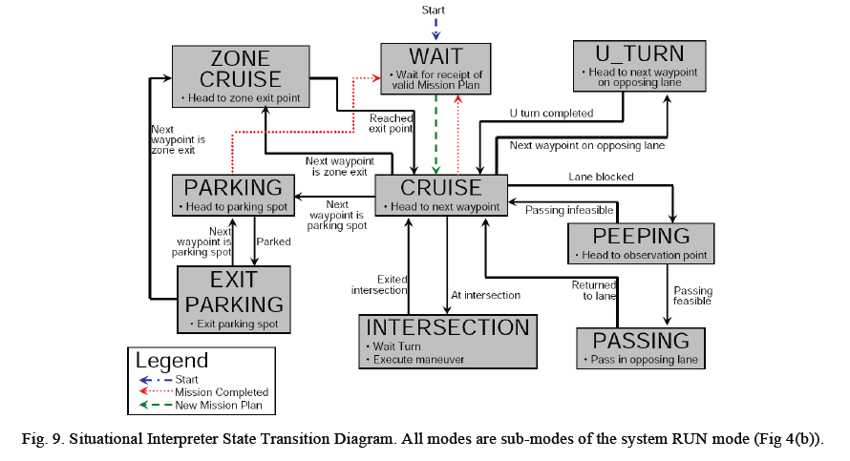
An autonomous vehicle's FSM

Slide 6
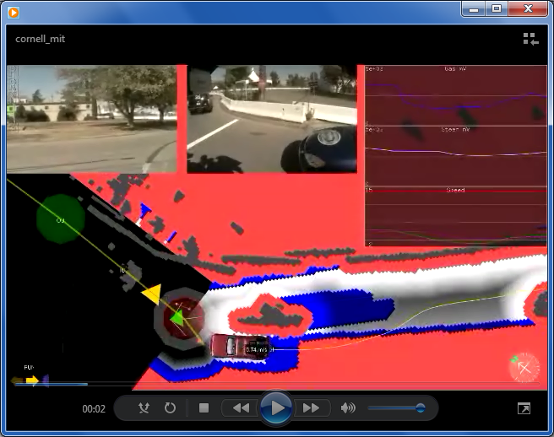
The data driving the state machine...
MIT's car, Talos - and its sensor suite
But are there any binary-string problems that FSMs can't solve?

Slide 7
State-machine limits?
You don't need three eyes to see some problems here!
accepting
0
0
0
zero 0s
one 0
two 0s
three 0s
1
1
1
Let's build a FSM that accepts strings with any # of 0s followed by the same #of 1s
rejected
accepted
011
FSMs "can't count"
000111
001
0011
11100
at least, not arbitrarily high
01
00110
λ
Notes:
This slide contains a popup.

Slide 8
FSMs can't count...
So, let's build a better machine!
Shiny!
Turing Machine

Slide 9
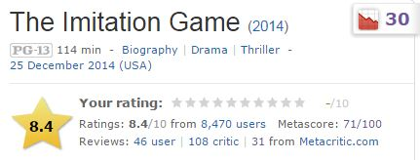
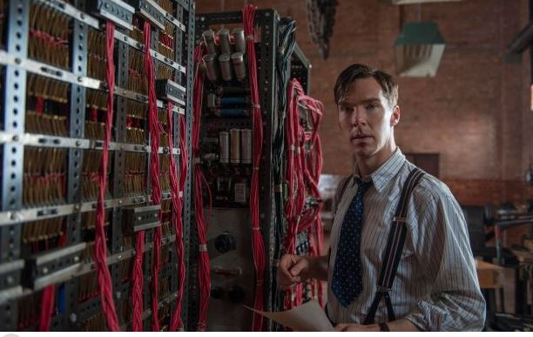
CS 5 spokesperson of the day!
Alan Turing
I want a 1950's network!

Slide 10
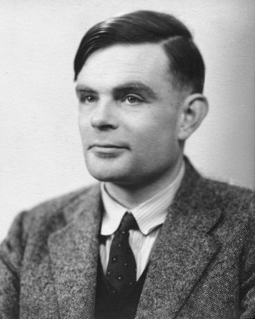
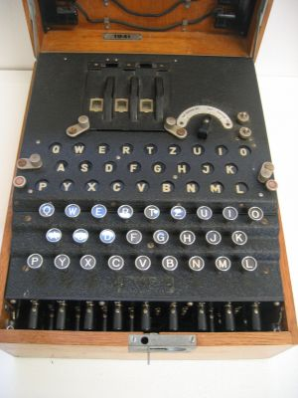
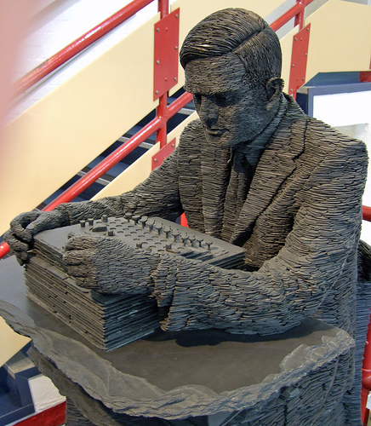
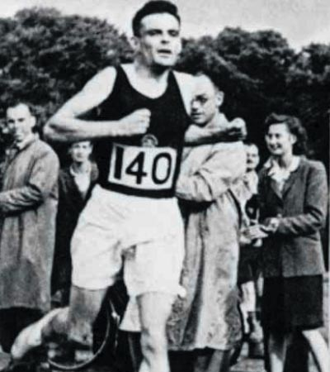
Alan Turing
AI!
1912-1954
WWII
Enigma machine ~ The axis's encryption engine
2007
1946
Bletchley Park

Slide 11
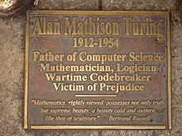
Alan Turing
AI!
1912-1954
WWII
Enigma machine ~ The axis's encryption engine
2007
1946
Bletchley Park

Slide 12
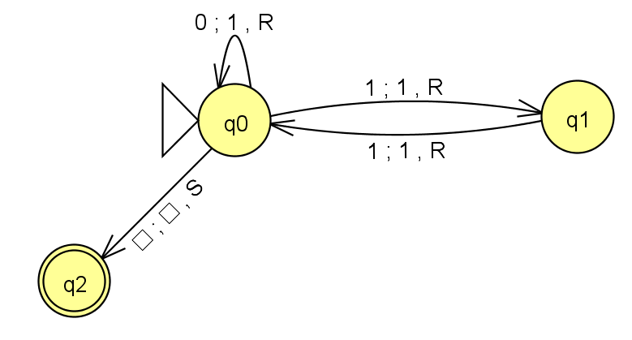
The input
The tape
R/W head
“Blanks" are the default
An accepting state always halts—then basks in its success!
If a transition is missing, the input FAILS!
0
;
1
,
A Turing Machine rule:
R
READ
WRITE
MOTION
Try it in JFLAP...

Slide 13
The input
0
1
1
The tape
R/W head
Accepted Input!
If a transition is missing, the input FAILS!
0
;
1
,
A Turing Machine rule:
R
READ
WRITE
MOTION
Try it in JFLAP...

Slide 14
The input
0
1
0
The tape
R/W head
Rejected Input.
An accepting state always halts —then basks in its success!
If a transition is missing, the input FAILS!
0
;
1
,
A Turing Machine rule:
R
READ
WRITE
MOTION
Try it in JFLAP...

Slide 15
The input
0
1
1
0
0
The tape
R/W head
What happens here?
If it gets here, it succeeds.
If a transition is missing, the input FAILS!
0
;
1
,
A Turing Machine rule:
R
READ
WRITE
MOTION
Try it in JFLAP...

Slide 16
The input
0
1
1
0
0
The tape
R/W head
“Blanks" are everywhere else
An accepting state always halts —then basks in its success!
If a transition is missing, the input FAILS!
0
;
1
,
A Turing Machine rule:
R
READ
WRITE
MOTION
Try it in JFLAP...

Slide 17
The tape
0
0
1
1
1
start
Is this input accepted or rejected by this TM?
Try it!
What does one "loop" of (q0-q1-q2-q3-q0) do?
What inputs are accepted in general?
Extra: How could you change this TM to accept palindromes?
(thought experiment and ex. cr.)

Slide 18
Keep this page – don't hand in...
The tape
0
0
1
1
1
start
With room to work...
Is this input accepted or rejected by this TM?
What does one "loop" of (q0-q1-q2-q3-q0) do?
What inputs are accepted in general?
Extra: How could you change this TM to accept palindromes?
(thought experiment and ex. cr.)

Slide 19
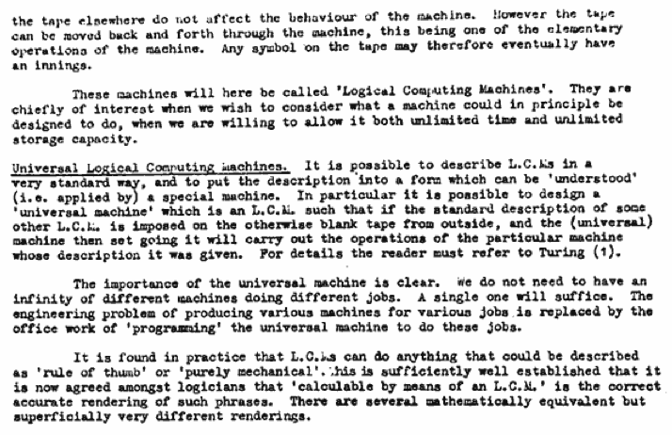
Can TMs compute everything?
Alan Turing says yes...
Turing called them Logical Computing Machines
Turing’s Intelligent Machines, 1948
http://www.alanturing.net/turing_archive/archive/l/l32/L32-005.html

Slide 20
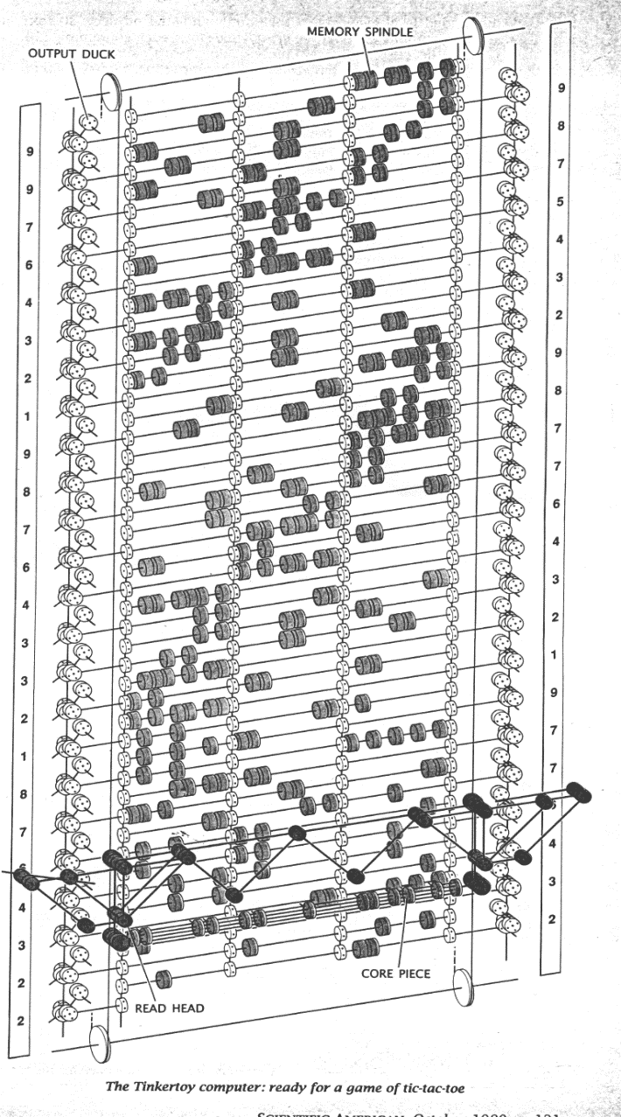
So far, all known computational devices can compute only what Turing Machines can...
Some are faster than others…
Quantum computation
http://www.cs.virginia.edu/~robins/The_Limits_of_Quantum_Computers.pdf
Molecular computation
http://www.arstechnica.com/reviews/2q00/dna/dna-1.html
Parallel computers
Integrated circuits
Electromechanical computation
Water-based computation
Tinkertoy computation
Turing machine

Slide 21
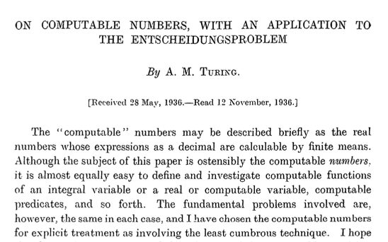
Can TMs compute everything?
computers
Alan Turing says No!
decision problems!
http://www.cs.virginia.edu/~robins/Turing_Paper_1936.pdf

Slide 22
There are many problems computers can't solve at all !
Perhaps this is not that surprising…
Rising sea levels
What!?
Disbelief in aliens
Losing to your own Connect4 (at 0 ply!)
Towel folding! (well, fast towel folding…)

Slide 23
Unprogrammable functions?
well-defined mathematical functions
computer program
There are
that no
can compute
even with any amount of memory!
or TM
functions
programs
1 if x is odd
def prog1(x):
return x%2
f(x) =
0 if x is even

Slide 24
Unprogrammable functions?
There are many more of these…
…than these!
well-defined mathematical functions
computer program
There are
that no
can compute
even with any amount of memory!
programs
or TM
mathematical functions
functions
programs
1 if x is odd
def prog1(x):
return x%2
f(x) =
0 if x is even

Slide 25
Functions
int⇒bool
f_{A}(x) = 1
These are "int⇒bool" mathematical functions.
They're also sometimes called
"integer predicates."
Argument is an integer, x >= 0
Result is 0/1 (boolean or bit)
1 if x is odd
f_{B}(x) =
0 if x is even
1 if x is 0, 1, or 2
f_{C}(x) =
0 otherwise
...even if you restrict your functions to be totally discrete!

Slide 26
programs
int⇒bool
def prog1(x):
return x%2
all int inputs:
x >= 0
Example programs
Argument is one integer, x >= 0
Result is 0/1 (boolean or bit)
If programs look different they are different—even if they compute the same function!
def prog2(x):
return x<3
def prog3(x):
return 1
def prog4(x):
return len(str(x+42))>1
...and allow ANY programs at all—even syntax errors
Let's match!

Slide 27
Functions
Programs
def prog1(x):
return x%2
f_{A}(x) = 1
all int inputs:
x >= 0
1 if x is odd
def prog2(x):
return x<3
f_{B}(x) =
0 if x is even
def prog3(x):
return 1
1 if x is 0, 1, or 2
f_{C}(x) =
0 otherwise
def prog4(x):
return len(str(x+42))>1
def prog5(x):
return x in [0,1,2]
1. Match each program with the function it computes.
2. There are three different functions on the left side—how many different programs are in the right side?
def prog6(x):
if x<2: return x
else: return prog6(x-2)
How—or why—is the set of all functions larger than the set of all programs ?
Quiz!
Name(s): _______________________

Slide 28
Functions
Programs
There are many more of these …
than these!
def prog1(x):
return x%2
f_{A}(x) = 1
all int inputs:
x >= 0
1 if x is odd
def prog2(x):
return x<3
f_{B}(x) =
programs
0 if x is even
mathematical functions
def prog3(x):
return 1
1 if x is 0, 1, or 2
f_{C}(x) =
0 otherwise
def prog4(x):
return len(str(x+42))>1
def prog5(x):
return x in [0,1,2]
1. Match each program with the function it computes.
2. There are three different functions on the left side—how many different programs are in the right side?
def prog6(x):
if x<2: return x
else: return prog6(x-2)
How—or why—is the set of all functions larger than the set of all programs ?
Quiz!
Name(s): _______________________

Slide 29
Uncomputable functions?
well-defined mathematical functions
computer program
There are
that no
can compute
even with any amount of memory!
Why?
or TMTM
There are many more of these …
than these!
programs
mathematical functions
vs.

Slide 30
Programs are "like" integers…
def alien( x ):
if x == 42:
return True
else:
return not \ alien(x+1)
programs
For each program, there is an integer.
This is true: but how?
For each integer, there is a "program."
At least a string!
Some have syntax errors...

Slide 31
Programs are integers (and vice-versa)
def alien( x ):
if x == 42:
return True
else:
return not \ alien(x+1)
programs
=
Positive integers
Every program is a string.
Every string is just a sequence of bits
Every sequence of bits is also an int!

Slide 32
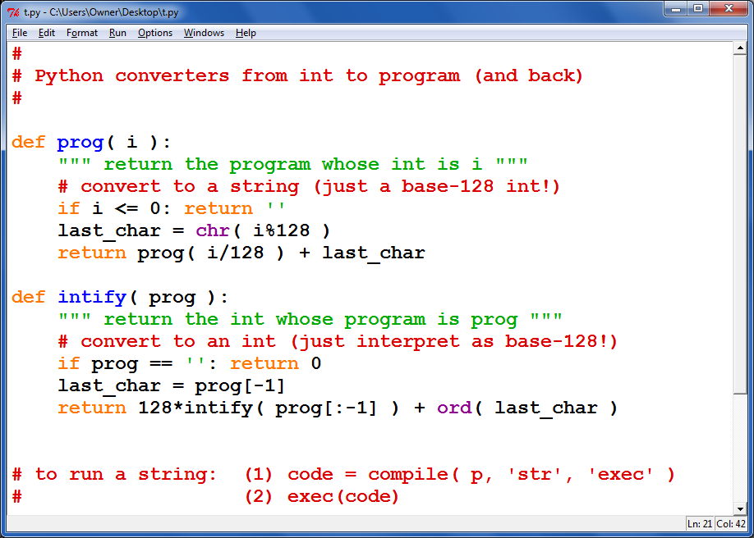
From progs to ints—and back...

Slide 33
Functions vs. Programs !
The Reals from 0 to 1
Positive integers
functions
programs
vs.

Slide 34
int⇒bool functions are real numbers!
(integer predicates)
This margin is too small to hold my marvelous proof!
The Reals from 0 to 1
=
functions
For each real #, there is a function.
This is true: but how?
For each function, there is a real #.

Slide 35
int-bool
For each real # …
There's a function
ARG: a pos. integer x ANS: a 0/1 bool value
f₁(x) = 1
Any real # from 0-1
One bit at a time...
1
2
3
4
5
6
7
8
1 if x is odd
f₂(x) =
r₁ = .11111111 ...
0 if x is even
r₂ = .10101010 ...
1 if x is 1 or 2
f₃(x) =
0 otherwise
r₃ = .11000000 ...
1 if x s prime
r₄ = .01101010 ...
f₄(x) =
0 otherwise
6 and 8 are not prime, so these digits are 0
2 and 3 are prime, so these digits are 1

Slide 36
For each real # …
There's a function
ARG: a pos. integer x ANS: a 0/1 bool value
f₁(x) = 1
Any real # from 0-1
One bit at a time...
1
2
3
4
5
6
7
8
1 if x is odd
f₂(x) =
r₁ = .11111111 ...
0 if x is even
r₂ = .10101010 ...
1 if x is 1 or 2
f₃(x) =
0 otherwise
r₃ = .11000000 ...
1 if x s prime
r₄ = .01101010 ...
f₄(x) =
0 otherwise
r₅ =
1 if x is div. by 3
f₅(x) =
r₆ = .00000000 ...
0 otherwise
f₆(x) =

Slide 37
For each real # …
There's a function
ARG: a pos. integer x ANS: a 0/1 bool value
f₁(x) = 1
Any real # from 0-1
One bit at a time...
1
2
3
4
5
6
7
8
1 if x is odd
f₂(x) =
r₁ = .11111111 ...
0 if x is even
For each real number, there's a different function—and vice-versa!
r₂ = .10101010 ...
1 if x is 1 or 2
f₃(x) =
0 otherwise
r₃ = .11000000 ...
1 if x s prime
r₄ = .01101010 ...
f₄(x) =
0 otherwise
r₅ = .00100100...
1 if x is div. by 3
f₅(x) =
r₆ = .00000000 ...
0 otherwise
f₆(x) =
0, except when x == 42

Slide 38
Functions vs. Programs !
The Reals from 0 to 1
Positive integers
?
functions
programs

Slide 39
Functions vs. Programs !
The Reals from 0 to 1
Positive integers
>
functions
programs

Slide 40
To infinity—and beyond
Pixar owes Cantor for this one!
Strictly larger
>
The Reals from 0 to 1
Positive integers
Uncountably infinite
>
Countably infinite
>

Slide 41
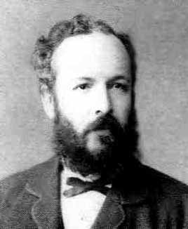
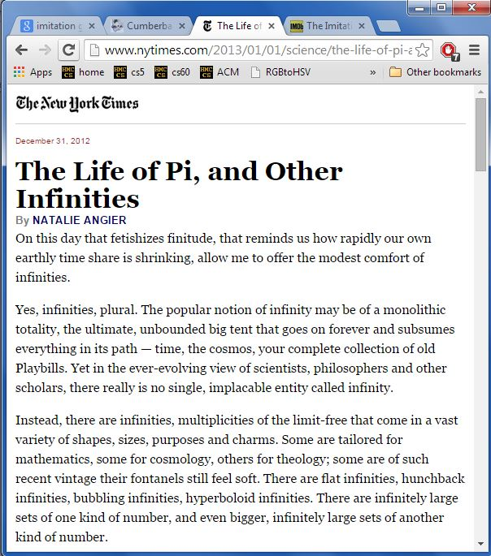
To infinity - and beyond
Pixar owes Cantor for this one!
strictly larger
G. Cantor
>
the Reals from 0 to 1
Positive integers
Uncountably infinite
>
Countably infinite
>

Slide 42
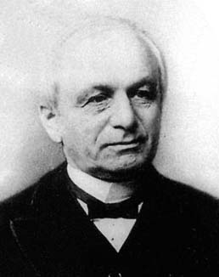
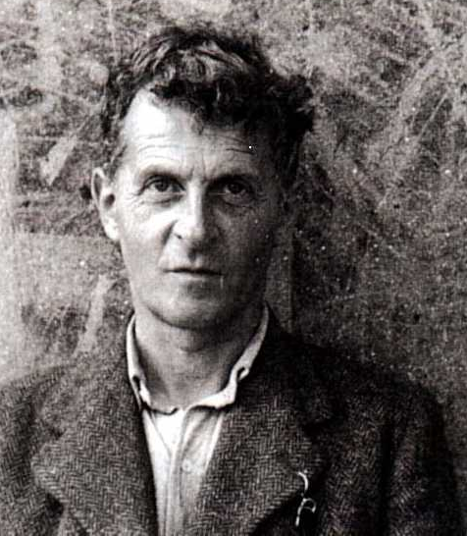
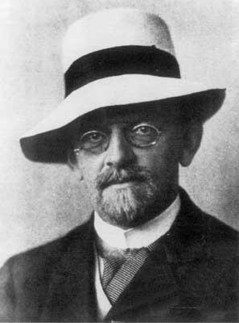
Cantor and "friends"
"Charlatan"
"Renegade"
"Laughable and wrong"
"Utter nonsense"
No one shall expel us from the paradise that Cantor has created.
Ouch!
Leopold Kronecker 1823-1891
Lugwig Wittgenstein
1889-1951
David Hilbert 1862-1943

Slide 43
Cantor and "friends"
"Charlatan"
"Renegade"
"Corrupter of Youth"
"Laughable and wrong"
"Utter nonsense"
No one shall expel us from the paradise that Cantor has created.
And this was before 1900!
Leopold Kronecker 1823-1891
Lugwig Wittgenstein
1889-1951
David Hilbert 1862-1943

Slide 44
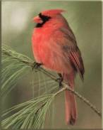
Different infinities!?
There are infinitely many functions & programs…
…but not all infinities are created equal!
{ , , }
{ 1 , 2 , 3 }
Two sets have equal size if
their elements have a
one-to-one matching
This matching is called a bijection.
These sets have the same cardinality

Slide 45
One-to-one mappings also define equal-sized infinite sets, but the results can be surprising!
Positive
evens
E = { 2, 4, 6, 8, 10, … }
Positive integers
N = { 1, 2, 3, 4, 5, … }
ALL
integers
Z = {…, -3, -2, -1, 0, 1, 2, 3, …}
With no negative repercussions!
E and N and Z all have the same size!

Slide 46
One-to-one mappings also define equal-sized infinite sets, but the results can be surprising!
Positive
evens
E = { 2, 4, 6, 8, 10, … }
Positive integers
N = { 1, 2, 3, 4, 5, … }
ALL
integers
Z = {…, -3, -2, -1, 0, 1, 2, 3, …}
With no negative repercussions!
E and N and Z all have the same size!

Slide 47
One-to-one mappings also define equal-sized infinite sets, but the results can be surprising!
Positive
evens
E = { 2, 4, 6, 8, 10, … }
Positive integers
N = { 1, 2, 3, 4, 5, … }
ALL
integers
Z = {…, -3, -2, -1, 0, 1, 2, 3, …}
With no negative repercussions!
E and N and Z all have the same size!

Slide 48
Let's get real
The reals (from 0 to 1)
The integers
(positive)
Are these sets equal-sized?
{ 0.0 <= r <= 1.0 }
{ 1, 2, 3, 4, 5, … }
.1
1
.2
2
.3
3
…
Why is this NOT a valid matching?
…
.11
11
.12
12
…
…
Notes:
It’s invalid because all integers have finite lengths, but some reals (1/3, pi, etc.) are infinite in length.

Slide 49
Georg Cantor
1845-1918
Cantor Diagonalization
There are always real #s missing from any list!
The Reals from 0 to 1
Positive integers
Real #s are always missing
r =
4 if r_{i}[i] != 4 else 2
0
Regardless of the matching…
r = .333333333333333…
1
1
r = .424242424242424…
2
2
r = .314159426535897…
3
3
r = .090909090909090…
4
4
r = …
5
5

Slide 50
(Many) more functions than programs !
the Reals from 0 to 1
Positive integers
>
functions
programs
Uncountably infinite
Countably infinite

Slide 51
int⇒bool functions are uncountable
(integer predicates)
This margin is too small to hold my marvelous proof!
The Reals from 0 to 1
=
functions
For each real #, there is a function.
This is true: How? Why?
For each function, there is a real #.

Slide 52
There are lots of functions
Uncountably many
Well-defined mathematical functions (uncountable)
What's swimming around out here?
Programs (countable)
There are "a few" programs
Countably many

Slide 53
Philosophically thinking …
Human-describable things…
How big is the set of the human-describable things... ?
finite!
Well-defined mathematical functions
Programs
…and how does it overlap with all functions or all programs?

Slide 54
Do all HD things include all functions? (No…)
Well-defined mathematical functions
Programs
Human-describable things…
finite!

Slide 55
Do all HD things include all programs? (No…)
Well-defined mathematical functions
Programs
Human-describable things…
finite!

Slide 56
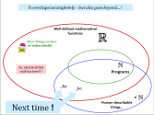
It overlaps incompletely—but also goes beyond... !
Well-defined mathematical functions
Wow! Things out here are indescribable
So, what is all this stuff out here?!?
Programs
kc
hc
Next time !
Human-describable things…

