Slide 1
The CS 5 Post
ALIEN INVASION!!!
Claremont (AP): A party at a private college here was disrupted when uninvited aliens burst through the gates.
“Every year, we celebrate Long Tall Penguins,” explained an angry student. “We get together, dress like the stuffiest professors, and chip bits off an iceberg to cool our drinks. This year, just as we were about to chill the mackerel, two strange alien creatures ran into the courtyard, picked everyone up, and took turns stacking us in piles.”
But another student claimed that the aliens were just misunderstood. “They love to play Connect 4, and since we were wearing black and white clothes, they thought we were playing pieces. They stacked us up in a 5-ply lookahead formation. It was fun!”
According to police, no charges will be filed because the aliens are not subject to Solar jurisdiction.
Read 7.1-7.2!
Notes:
Theory2
Worksheet: analyze a Turing machine.
Demo: Jsflap for Turing machines or jflap zerosones.jff.
java -jar /h/src/utils/jflap-7.0/JFLAP_Thin.jar zerosones.jff

Slide 2
Simplest Model of Computation
Finite State Machines
Example:
0
0
1
s0
s1
1
start state
transitions
accepting states
“input funnel”
“where to go”
double circled
labeled by input !

Slide 3
FSM's Can't Count! (High)
Because they're finite, FSMs can only count finitely high !
They can handle modulo, but not arbitrary, arithmetic
Computable with FSMs
Uncomputable with FSMs
Even/odd sums or differences
Equal numbers of two values
Multiples of other integers
A given difference between two values
Finite constraints on the input:
Palindromes
Third digit is a 1
Third-to-last digit is a 1
Third digit == third-to-last digit
etc.
Anything modeled by a potentially unbounded while loop
Can computers handle abitrary arithmetic?

Slide 4
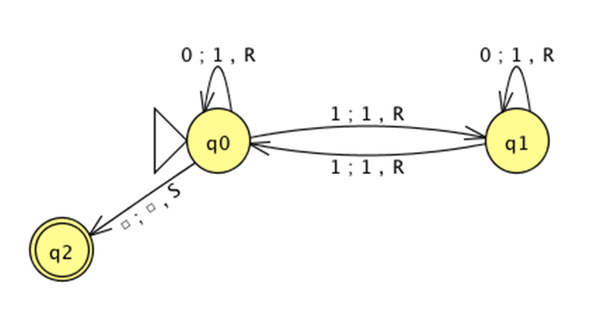
FSM's Can't Count!
So let's build a better machine!
"Turing Machine"
Notes:
The first item is the input, the second is what to write on the tape, and the third is the tape motion: left/right/stay. This machine is boring: it’s almost the same as the first FSA we looked at. Don’t explain this slide.

Slide 5
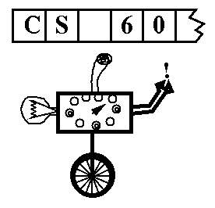
Turing Machines
Alan Turing: “Logical Computing Machines”
A simple model of universal computation
Starts on the leftmost character
The tape: an unbounded amount of memory. Consists of cells, each containing exactly one character (e.g. 0, 1, or  (blank))
Read/write head for the tape
The control: a finite amount of memory, the control states—some are accepting, some are not.
Ability to move left and right
The control state
The symbol now under the head
The symbols to the right of the head
The symbols to the left of the head
The complete state of a TM is determined by:

Slide 6
Turing Machines
The input
0
1
0
1
1
"Blanks" are everywhere else
The tape
R/W head
An accepting state halts and basks in its acceptance!
If a transition is missing, the input FAILS!
0
;
1
,
R
A Turing Machine rule:
Try it in JSFLAP!
READ SYMBOL
WRITE SYMBOL
MOTION
Notes:
This slide has many animations, showing the various pieces:
“The input”
“Blanks are everywhere else”
R/W head
Sample rule
State machine
Accepting state
Missing transition implies failure
This machine is silly; it accepts strings with an even number of 1’s, which an FSM could do just as well. It can’t be an “interesting” TM because it always moves the tape in just one direction, so nothing that it “memorizes” is ever used again.

Slide 7
Worksheet
0
0
1
1
Is this input accepted or rejected?
What inputs are accepted in general? How does it work?
Extra: How could you change this to accept palindromes?
(just a thought experiment)
Notes:
This is a more interesting machine. It accepts strings with N zeros followed by N ones. It can be demoed in zerosones.jff by running:
java -jar /h/src/utils/jflap-7.0/JFLAP_Thin.jar zerosones.jff
Demo it first with 000111 and then with 001 to show how it dies when there are no more transitions.

Slide 8
The Alien’s Life Advice
Accept contradictions
The world isn't 100% math!

Slide 9
Uncomputability!
You are here!
Mathematics
Computer
Science
Cognitive Science
Engineering
Philosophy
Notice that CS has more eccentricity than the others!
I don’t understand your elliptic statement!
Notes:
“You are here” is animated.

Slide 10
Uncomputable Functions?
well-defined computational problems
no computer program
can solve
There are
that
even with ∞ memory!
CS 5 homework
def is_even(X):
return X%2 == 0
Video
games
Pico-
bot
Int-bool functions
def is_three(X):
return X == 3
Mario Kart
Well-defined computational tasks
Programs

Slide 11
Uncomputable Functions?
well-defined computational problems
no computer program
can solve
There are
that
even with ∞ memory!
There are more of these…
def is_even(X):
return X%2 == 0
than these!
def is_three(X):
return X == 3
Well-defined computational tasks
Programs

Slide 12
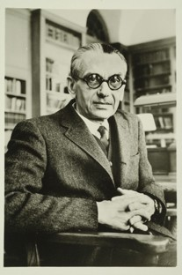
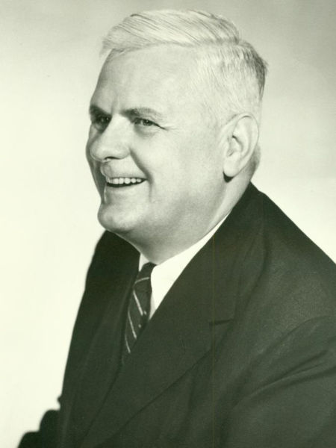
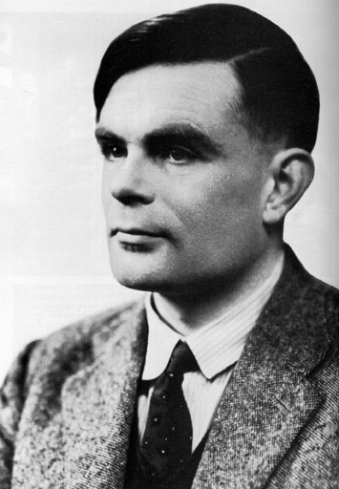
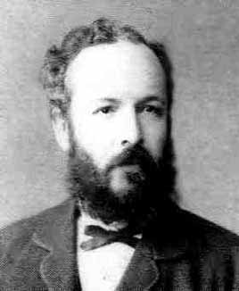
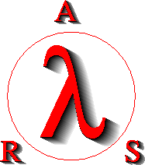
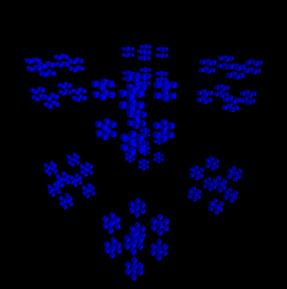
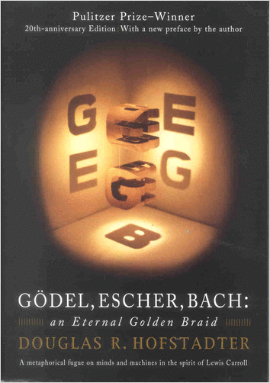
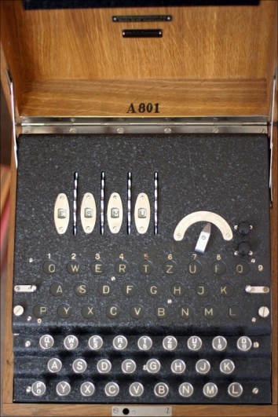
The Cast of Characters
Georg Cantor
1845-1918
Kurt Gödel 1906-1978
Alonzo Church 1903-1995
Alan Turing 1912-1954
Notes:
Cantor studied set theory and proved the uncountability of real numbers using diagonalization. The diagram is a 2-D version of a Cantor set (I think).
Gödel gave us the famous Incompleteness Theorem, and was immortalized in the book “Gödel, Escher, Bach.”
ARS is Abstraction, Reference, Synthesis, referring to the essential elements of the lambda calculus.
Turing is considered the father of the modern computer, and proved the unsolvability of the Halting Problem, which is the basis of the autograder we will see today. He was instrumental in winning WWII by cracking the German Enigma encryption machine (shown).

Slide 13
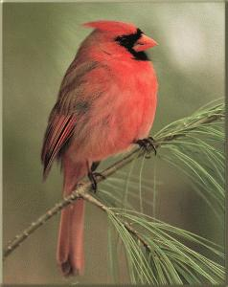
A Brief Digression on Cardinality
{ , , }
{ 1 , 2 , 3 }
Hang on though, there’s some new stuff here!
I saw some of this in a math class already…
Notes:
The animation pops up the one-to-one mapping.

Slide 14
A Brief Digression on Cardinality
{ , , }
{ 1 , 2 , 3 }
A perfect matching is
called a “bijection”
Hang on though, there’s some new stuff here!
I already saw some of this in a Math course…
Notes:
There are many orderings; what matters is that it’s one-to-one.

Slide 15
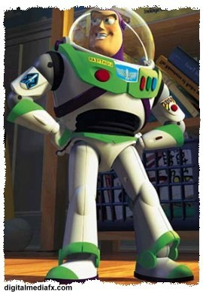
To Infinity and Beyond!
N = {1, 2, 3, 4, 5, … }
E = {2, 4, 6, 8, 10, … }
The “natural”
numbers
The positive
evens
I don’t know, but let’s tell him that he has to pay rent to be in our slides!
Hey, who is that guy with the funny hat!?
Notes:
At this point explain that there’s a bijection between N and E, so they have the same cardinality!

Slide 16
To Infinity and Beyond!
The “natural”
numbers
N = {1, 2, 3, 4, 5, … }
E = {2, 4, 6, 8, 10, … }
Z = {…, -4, -3, -2, -1, 0, 1, 2, 3, 4, …}
Q = { -3/42, 1/2, 2/3, … }
The positive
evens
The
integers
The
rationals
This material is totally unnatural and even irrational!
But it’s integral to showing that there are functions that can’t be computed!
Notes:
Z and Q can also be matched up, though it’s slightly trickier to do so.

Slide 17
To Infinity and Beyond!
The “natural”
numbers
N = {1, 2, 3, 4, 5, … }
E = {2, 4, 6, 8, 10, … }
Z = {…, -4, -3, -2, -1, 0, 1, 2, 3, 4, …}
Q = { -3/42, 1/2, 2/3, … }
The positive
evens
The
integers
The
rationals
These sets are said to be countably infinite.

Slide 18
Cantor Diagonalization
Proving that the set [0, 1) is uncountably infinite!
Georg Cantor
1845-1918
[0, 1) = The set of real numbers between 0 and 1
Your claim: you have a way to list all real numbers in order so you can match them to the integers
Cantor’s claim: you left something off the list
Notes:
Do this proof on the board. Make sure they copy it down. Or it’s on the next slide.
There's a bug in the straightforward proof: because of trailing zeros, you can potentially generate another number on the list. Ask the class how to fix it. Answer: never generate zeros. . Likewise, a string of 9’s rounds up to the next higher digit. So never generate 9’s. You’re responsible for not putting duplicates on the original list.

Slide 19
Cantor Diagonalization
Georg Cantor
1845-1918
Your list:
1 0.100000000000000000000…
2 0.333333333333333333333…
3 0.314159265358979323846…
4 0.424242424242424242424
5 0.917119021099999999999…
Cantor’s number:
N 0.…
Your list:
1 0.100000000000000000000…
2 0.333333333333333333333…
3 0.314159265358979323846…
4 0.424242424242424242424
5 0.917119021099999999999…
Cantor’s number:
N 0.2…
Your list:
1 0.100000000000000000000…
2 0.333333333333333333333…
3 0.314159265358979323846…
4 0.424242424242424242424
5 0.917119021099999999999…
Cantor’s number:
N 0.21…
Your list:
1 0.100000000000000000000…
2 0.333333333333333333333…
3 0.314159265358979323846…
4 0.424242424242424242424
5 0.917119021099999999999…
Cantor’s number:
N 0.213…
Your list:
1 0.100000000000000000000…
2 0.333333333333333333333…
3 0.314159265358979323846…
4 0.424242424242424242424
5 0.917119021099999999999…
Cantor’s number:
N 0.2135…
Your list:
1 0.100000000000000000000…
2 0.333333333333333333333…
3 0.314159265358979323846…
4 0.424242424242424242424
5 0.917119021099999999999…
Cantor’s number:
N 0.21356…
Notes:
Animations highlight each successive digit in red.
Note that this proof depends on the fact that there can be an infinite number of digits after the decimal point.
There's a bug in the straightforward proof: because of trailing zeros, you can potentially generate another number on the list. Ask the class how to fix it. Answer: never generate zeros. Likewise, a string of 9’s rounds up to the next higher digit. So never generate 9’s. You’re responsible for not putting duplicates on the original list.

Slide 20
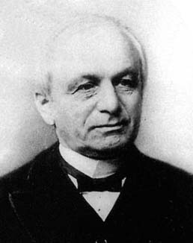
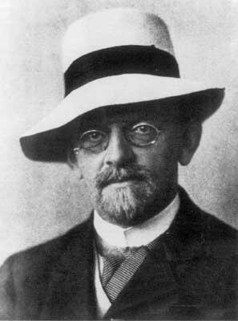
The Tragic Story of Georg Cantor
“I don't know what predominates in Cantor's theory—philosophy or theology, but I am sure that there is no mathematics there.”
- Leopold Kronecker
Leopold Kronecker 1823-1891
“No one shall expel us from the paradise that Cantor has created for us.” - David Hilbert
David Hilbert 1862-1943
Notes:
From Wikipedia: Some Christian theologians (particularly neo-Scholastics) saw Cantor's work as a challenge to the uniqueness of the absolute infinity in the nature of God.
Writing decades after Cantor's death, Ludwig Wittgenstein lamented that mathematics is "ridden through and through with the pernicious idioms of set theory," which he dismissed as "utter nonsense" that is "laughable" and "wrong".

Slide 21
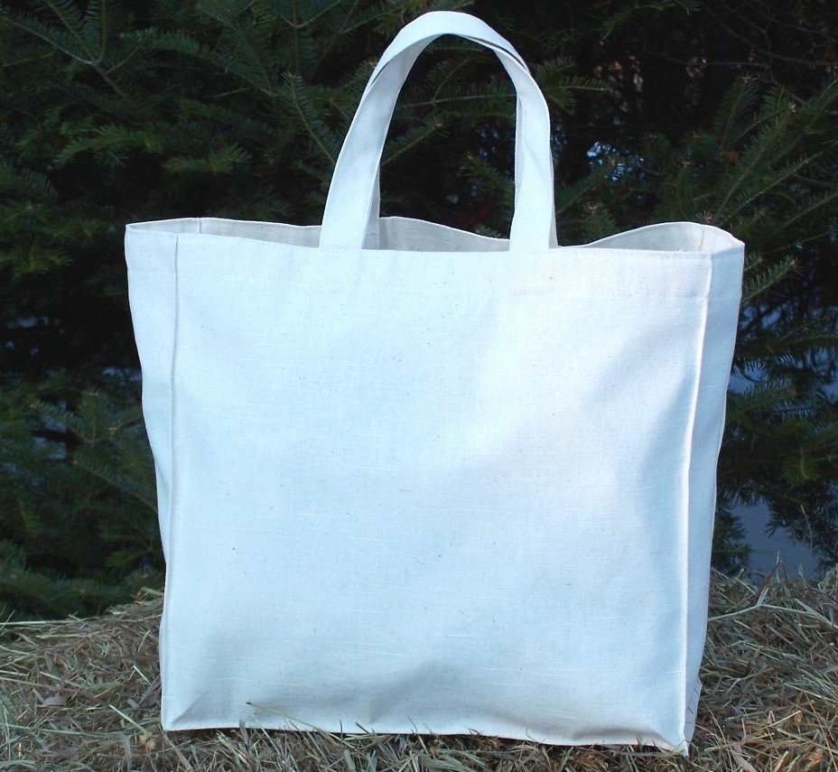
A Bag of Reals
I’m going to reach into this bag of real numbers and pick one out!
Wow, that’s a fun game!
Bag of Real Numbers
Notes:
The point here is that you are far more likely to get a non-integer than an integer, so there are far more reals than integers. In fact, the probability of getting an integer is vanishingly small. This is easy to see from diagonalization: there is an infinite number of ways to generate a number that is different from the first number on the list, an infinite number of ways to miss the second, etc.

Slide 22
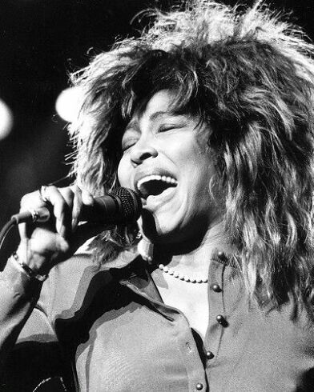
What’s Computation Got to Do, Got to Do With It?
Plan:
- Show that the number of Python
programs is countably infinite
(a small infinity)
- Show that the number of possible
“computational tasks” is uncountably infinite
(a big infinity)!
Conclusion: ?

Slide 23
Computational Tasks?
Plan:
- Show that the number of Python
programs is countably infinite (a small infinity)
- Show that the number of possible
“computational tasks” is uncountably infinite
(a big infinity)!
CS 5 assignments
positive integer input
Video
games
def pi():
return 3.14159265…
Functions that
return reals
Real output!
Computational Tasks
Notes:
In fact, we're just going to show that the functions that return reals are uncountably infinite; that's sufficient!

Slide 24
Counting Python Programs
The empty string is a Python program. So is “a”.
After “z” we could write “+”, “-”, etc. Most of those are illegal Python programs—but we don’t care!
Now we do the 2-character programs, then 3, etc.
Lots of these programs do nothing—but again we don’t care!
Notes:
If the legal, illegal, and non-functional programs are countable, certainly the legal, functional ones are countable—just like the even numbers.

Slide 25
Functions
Consider all the constant mathematical functions f(N) = x, where x is a real number from 0 to 1:
f(N) = 0.5
g(N) = 0.707107…
h(N) = 0.314159…
I can do that math in my head!
Wait…that means those functions are uncountable!
Notes:
The Gold alien is animated

Slide 26
Functions and Programs
We know that programs are countable...
…and even simple functions are uncountable…
…so there must be more functions than programs…
…and therefore there are functions that can’t be computed!

Slide 27
Next Time
Let’s look at some interesting and useful—but (sadly) uncomputable—functions!

