Slide 1
5
16
Arguments
Results
42
17
43
17
100
18
1000
19
10000
20
100000
20
100005
22
100042
23
10000000
20
10000005
22
100000…00000
22
This seems alien!!!
a "googol"
100 total zeros
a "googolplex"
100000…00000
26
1 googol total zeros
Notes:
Class 25 uncompute
INHANDOUT
Setup: be prepared to show https://www.youtube.com/watch?v=vmINGWsyWX0 (with sound)
Extra credit is due 5/2. Resubmit the same file; it’s autograded.
Final projects due 5/2.

Slide 2
kc
kc(5) == 16
These are fun f'ns!
hc
hc(CS5) == True
Two uncomputable functions
These would be useful—if only they were possible
Help! lab times and evening hours all week…
Final projects:
Final project due 5/2 under hw “final”
Check out the online practice problems…
Final exam:
Two pages of notes are welcome…
Exam: Tue. 5/8 @ 2 PM
Notes:
INHANDOUT

Slide 3
There are well-defined mathematical functions no program can compute!
This seems impossible...
An example!?
it's computable!
Anything expressed w/math…
it's computable!
Human-discernable patterns…
The complexity of an integer
Notes:
INHANDOUT
There are several popups. Crossouts appear on the first two.

Slide 4
What is the complexity of an integer?
100,000 zeros total
100000000…00000000000000000000000
Each of these integers has the same number of digits
170117684…20006872822488857785601
Intuition:
The complexity or compressibility of x is the length of the shortest description of x.
Same number of total digits as above
Which one “feels like” the more complicated number...Why ?
Notes:
INHANDOUT
This slide has a popup.

Slide 5
5
16
Arguments
(x)
Results
kc(x)
42
17
43
17
100
18
1000
19
10000
20
The complexity, kc, of a number x is the length of x's shortest description
100000
20
100005
22
100042
23
10000000
20
10000005
22
100000…00000
22
This seems alien!!!
a "googol"
100 total zeros
a "googolplex"
100000…00000
26
1 googol total zeros
Notes:
This slide has a popup.
The insight here comes from going from 10K to 100K.

Slide 6
The complexity of x is the length of the shortest zero-argument function that returns x.
"description"
The complexity, kc, of a number x is the length of x's shortest description
Notes:
INHANDOUT

Slide 7
The complexity of x is the length of the shortest zero-argument function that returns x.
"description"
Kolmogorov Complexity
kc(42) = 17
The int 42 has a complexity of 17.
Why 17 ?

Slide 8
The complexity of x is the length of the shortest zero-argument function that returns x.
"description"
Kolmogorov Complexity
kc(42) = 17
def f():return 42
1
2
3
4
5
6
7
8
9
10
11
12
13
14
15
16
17
…because Python has 15 characters of overhead and 2 more are needed
I could do it with 15!!

Slide 9
5
16
Arguments (x)
Results kc(x)
42
17
43
17
100
18
1000
19
10000
20
?
100000
20
def f():return 42
1
2
3
4
5
6
7
8
9
10
11
12
13
14
15
16
17
… because Python has 15 characters of overhead and 2 more are needed
Notes:
INHANDOUT

Slide 10
The complexity of x is the length of the shortest zero-argument function that returns x.
?
kc(100000) = 21
or does it?
def f():return 100000
1
2
3
4
5
6
7
8
9
10
11
12
13
14
15
16
17
18
19
20
21
… Python has 15 characters of overhead, but we can do better here!

Slide 11
The complexity of x is the length of the shortest zero-argument function that returns x.
shortest == tricky!
kc(100000) = 20
def f():return 10**5
1
2
3
4
5
6
7
8
9
10
11
12
13
14
15
16
17
18
19
20
21
… Python has 15 characters of overhead, but we can do better here!

Slide 12
So, what are the complexities of these integers?
100,000 zeros total
100000000…00000000000000000000000
Rach of these integers has the same # of digits
170117684…20006872822488857785601
Same number of total digits as above
Let's get used to the idea first…

Slide 13
Quiz!
kc(42) = 15 + 2 = 17
Name(s) ___________________
kc(9001) = 15 + 4 = 19
What does kc(x)return for each of these integers, x?
a million
kc(1000000)=
15 + ____
6 zeros
a googolplex
kc(100…000) =
a million and 42
1 googol zeros
kc(1000042)=
kc(31415926…) =
a billion
estimate?
kc(1000000000)=
1 billion digits of pi, as an integer
9 zeros
a googol
kc(86753098…) =
kc(10000…0000)=
100 zeros
1 million patternless digits
Extra: What's the largest x with kc(x) == 20?
Extra Extra: Are there any integers x with kc(x) > 50,000?
Extra Extra Extra! How big is the SMALLEST such integer?
Notes:
QUIZSLIDE
Hignlight that we can calculate pi.

Slide 14
Although kc(x) is a well-defined mathematical function, with an int result for each int argument x,
kc(x)
is not a computable function.
No program computes it!
The complexity of x
the compressability of x
You'll show every possible program for kc has a bug!
you
This is a function that we will prove can't be computed…
How!?
Notes:
This slide has a popup.

Slide 15
Proof idea
(1) We know kc(42)==17, so consider one possible program for kc(x):
def kc(x):
return x - 25
It works for 42
kc(43) should also be 17.
But this kc(43) outputs 18, not 17.
This kc has a bug! (actually, LOTS of bugs!)
(2) Find a bug:
Notes:
This slide has a popup.

Slide 16
Proof idea
(1) Fixed! Since kc(42)==17 and kc(43)==17 we consider this program for kc(x):
def kc(x):
return len(str(x)) + 15
It works for 42 and 43
googol
kc(100...00) should be 22.
But, this kc(100...00) isn't 22.
So, this kc also has a bug! (lots, in fact…)
because 10**100
(2) Find a bug:
100 zeros
it's 116
100 zeros
Notes:
This slide has a popup.

Slide 17
Proof idea
The challenge: we have to find a bug in any possible version of kc(x)!
(1) Fixed! Since kc(42)==17 and kc(10)==17 we consider this program for kc(x):
def kc(x):
do stuff and return
I guess you'd call this part of the code a GRAY AREA…
(2) Find a bug:
???

Slide 18
def kc(x):
do stuff and then…
return answer
Suppose this version of kc is 42,000 characters long and claims to return the complexity of x
We need to prove that this
kc(x) function contains a bug.
We're going to write a function to find and show that bug!

Slide 19
def BFF():
x = 0
while kc(x) < 50000:
x += 1
return x
def kc(x):
do stuff and then…
return answer
Suppose this version of kc is 42,000 characters long and claims to return the complexity of x
BFF?
bug = BFF()
Notes:
INHANDOUT
Note that def inside def is legal—demonstrate that fact.

Slide 20
def BFF():
x = 0
while kc(x) < 50000:
x += 1
return x
def kc(x):
do stuff and then…
return answer
Suppose this version of kc is 42,000 characters long and claims to return the complexity of x
Bug-Finding Function!
bug = BFF()
Notes:
The BFF itself is 70 characters long.

Slide 21
def BFF():
x = 0
while kc(x) < 50000:
x += 1
return x
def kc(x):
do stuff and then…
return answer
Suppose this version of kc is 42,000 characters long and claims to return the complexity of x
Note that BFF is a zero-argument function that is 42,070 characters long…
… and it returns an integer named bug!
bug = BFF()
The complexity of x is the length of the shortest zero-argument function that returns x.

Slide 22
def BFF():
x = 0
while kc(x) < 50000:
x += 1
return x
def kc(x):
do stuff…
return answer
Suppose this version of kc is 42,000 characters long and claims to return the complexity of x
Proof
Note that this loop uses kc(x), not x itself.
(1) Does the while loop stop
[A] When kc(x)< 50,000 or
[B] When kc(x)>= 50,000 or
[C] It never stops
(2) kc claims the x that BFF returns is
[T] An int x whose complexity is < 50,000
[U] An int x whose complexity is >= 50,000
[V] Nothing—it never returns at all
(3) Why does this mean kc has a bug?
[F] Because x != bug
[G] Because bug's complexity is 42,070—or less!
[H] Because there were no aliens involved
(1)
bug = BFF()
(2)
(3)
Notes:
INHANDOUT

Slide 23
def BFF():
x = 0
while kc(x) < 50000:
x += 1
return x
def kc(x):
do stuff…
return answer
Suppose this version of kc is 42,000 characters long and claims to return the complexity of x
Note that BFF is a zero-argument function that is 42,070 characters long…
… and it returns an integer named bug!
bug = BFF()
The complexity of x is the length of the shortest zero-argument function that returns x.

Slide 24
def BFF():
x = 0
while kc(x) < 50000:
x += 1
return x
def kc(x):
do stuff…
return answer
Suppose this version of kc is 42,000 characters long…
This implementation of kc(x) contains a bug!
bug = BFF()
But we allowed it to do anything at all!
So, every implementation of kc(x) contains a bug!
kc lied!
Notes:
INHANDOUT
This slide contains a popup saying we’re allowed to do anything.

Slide 25
Although kc(x) is a well-defined mathematical function, with an int result for each int argument x,
kc(x)
is not a computable function.
Every implementation of kc(x) contains a bug!
proven!
Notes:
INHANDOUT

Slide 26
Compression connection?
The best-compressed version of any data D is the shortest program that generates D.

Slide 27
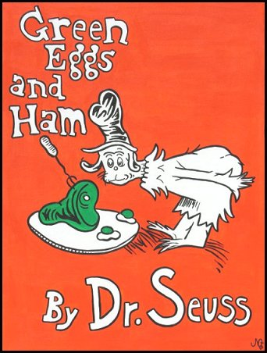
Compression connection?
The best-compressed version of any data D is the shortest program that generates D.
An impressive compression result!
Notes:
INHANDOUT
(Note that this compression is both incomplete and erroneous. It’s only the beginning of the book, and the last lilne repeats “them”—the slash shouldn’t be there. It’s from a Reddit thread on how compression works.)

Slide 28
Compression connection?
The best-compressed version of any data D is the shortest program that generates D.
best-compressed version?
Uncomputable!

Slide 29
XkcD

Slide 30
Haltchecking is uncomputable.
Halt Checking
hc(f)
Returns True if f() halts
hc always has a bug!

Slide 31
Haltchecking is uncomputable.
any Python function
def hc(f):
It is impossible to write a (bug-free) function hc(f) that determines if a function f halts when run:
hc(f) returns True if f() halts and
hc(f) returns False if f() loops infinitely
Notes:
INHANDOUT

Slide 32
Suppose hc(f) worked for all f
Create this BFF:
def BFF():
if hc(BFF) == True:
while 1+1==2: print 'Ha!'
else:
return # halt!
Is hc(BFF) == True ?
Is hc(BFF) == False ?
hc always has a bug
Proven!
Notes:
INHANDOUT

Slide 33
And this is important because …
∞ loops are undetectable
Some are detectable, but some are not—and there's no way to know!
Bugs are inevitable
Infinite loops are just one type of bug… In general, they're all undetectable
(all behavioral, not syntactic, bugs)
Rice's Theorem: CS81
Programming is not automatable…
At least, not bug-free programming
Notes:
INHANDOUT
This slide has three popups.

Slide 34
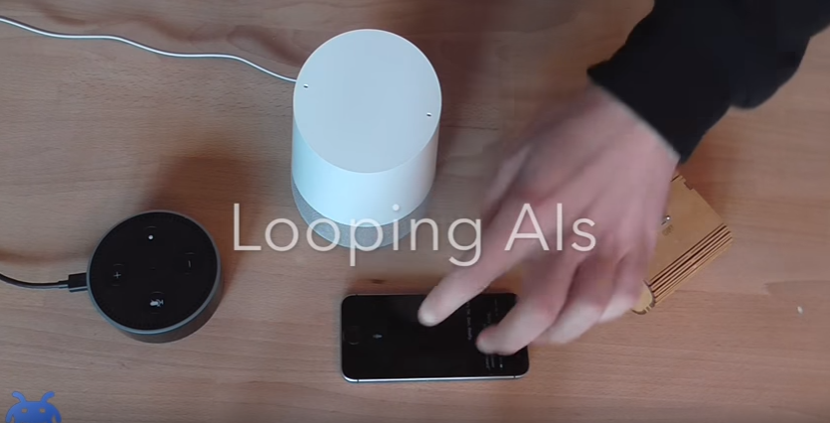
Let's celebrate!
https://www.youtube.com/watch?v=vmINGWsyWX0
Notes:
This is https://www.youtube.com/watch?v=vmINGWsyWX0

Slide 35
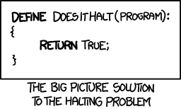
xkcd's take is…
… all too True, in fact.
Good luck with final projects
They will halt all too soon!
Tutoring hours and labs through Friday...!

