Slide 1
CS 5 Herald
Penguin Honoured by Queen
London (Antarctic News Service)—A revered Scottish citizen of the penguin persuasion was knighted today by Queen Elizabeth II. “This bold and brave bird has backed British battalions in both Bolivia and Bangladesh,” she announced. “Bruce Burns has blown on his bagpipes in barracks and barns, brought blessings to bombardiers, and basically been the best brother a Briton could beg for.
Penguin Burns was modest in his acceptance of the honour. “I appreciate the Queen’s approbation,” he commented. “All of this adulation and these awards have been acquired because of my awesome army of associates. I always appreciate their amazing additions to my academic accomplishments, and they always accept my accent. Accolades to all!”
Notes:
No demos, no worksheet.

Slide 2
What We Hope You’ve Learned
Big picture: CS is broad and rich
Artificial intelligence
Proofs of uncomputability
Robotics
Graphics
Security
Usability
…and lots more!

Slide 3
All About the Final
3 hours long
Tuesday, December 13th, 2-5 PM*
Here in Beckman B126
Bring two 8.5x11” sheets, double-sided
Contents are up to you
Hmmm reference will be provided
*Or see me about alternatives

Slide 4
What Will Be Covered?
Comprehensive exam (entire semester)
Some things are more important than others
Want to be sure you understand basics of CS

Slide 5
Exam Coverage
The high-level view:
Functional programming
Computer organization
Imperative and object-oriented programming
Theory of computation

Slide 6
Functional Programming
Be sure you know (and command):
List indexing and slicing (including ::-1)
Recursion (multiple base cases)
Functions that return functions
List comprehensions:
[x**2 for x in L if x < 100]
map, reduce, and filter
lambda
Especially lambda!

Slide 7
Functional Challenge
Write compose(L), where L is a list of functions. Compose returns a single function, f(x), that calculates L[0](L[1](L[2]…(x))
Example:
f = compose([log, sin])
f(pi/2) == 0.0
f(pi/4) == -0.34657...

Slide 8
Functional Challenge
def compose(L):

Slide 9
Functional Challenge
def compose(L):
if L == []: return lambda x: x
return lambda x: \
L[0](compose(L[1:])(x))

Slide 10
A Bit of Python Cuteness
Remember memoization?
memo = {}
def fastFunc(x):
if x in memo:
return memo[x]
else:
# slow stuff to find answer
memo[x] = answer
return answer

Slide 11
A Bit of Python Cuteness
from functools import lru_cache
@lru_cache(maxsize = 32)
def fastFunc(x):
# slow stuff to find answer
return answer
It’ll remember the last 32 answers!

Slide 12
The Alien’s Life Advice
Don’t assume you’re stupid just because somebody else is showing off.
Show-offs are insecure too!

Slide 13
Computer Organization
Important things:
Binary numbers (can you count in binary?)
Boolean equations
Minterm expansion principle
Hmmm programming
Be sure you understand function calls and how r13, r14, and r15 are used

Slide 14
Minterm Expansion
Be systematic!
0 0 0 1
0 0 1 1
0 1 0 0
0 1 1 1
1 0 0 0
1 0 1 1
1 1 0 0
1 1 1 1
What does this compute?
Notes:
It computes “(x or y) <= z”

Slide 15
A Hmmm Problem
What does this program do?
00 read r1
01 setn r2 0
02 jltzn r1 06
03 add r2 r2 r1
04 addn r1 -1
05 jgtzn r1 03
06 write r2
07 halt
Is there anything ADDitional needed here?
Oooh, that’s awful!
Notes:
It adds the numbers from 1 to r1.

Slide 16
Imperative Programming
What to know:
Nested for loops
for i in range(len(L)) vs. for i in L
try/except
Deep and shallow copy
What NOT to know:
Huffman coding

Slide 17
Loop Exercise
Consider a matrix (list of lists) M, containing strings or integers. For elements not on the diagonal, if they are numbers, convert them into their (floating-point) reciprocals. All other elements stay the same.
Example: [[1, 2, “spam”], [[1, 0.5, “spam”],
[3, “hi”, 5], ⇒ [0.33, “hi”, 0.2],
[7, 4, 9]] [0.14, 0.25, 9]]
Notes:
Some of them haven’t studied matrices. Remind them that in matrix theory there is only one diagonal, not two.

Slide 18
Loop Exercise
for i in
for j in

Slide 19
Loop Exercise
for i in range(len(M)):
for j in range(len(M[0])):
if i != j:
try:
M[i][j] = 1.0 / M[i][j]
except:
pass

Slide 20
Object-Oriented Programming
What to know:
__init__, __str__, __repr__
self
__add__, __mul__, etc.
Methods, getters, setters
Inheritance

Slide 21
Object-Oriented Exercise
Implement the __add__ function for a Rational class. The numerator is in self.n, the denominator in self.d. Assume self.gcd(a, b) will return the greatest common divisor of a and b.

Slide 22
Object-Oriented Exercise
class Rational:
# ...
def __add__(

Slide 23
Object-Oriented Exercise
class Rational:
# ...
def __add__(self, other):
n = self.n * other.d \
+ other.n * self.d
d = self.d * other.d
gcd = self.gcd(n, d)
return Rational(n / gcd, d / gcd)

Slide 24
Theory of Computation
What to know:
Finite state machines
FSMs can’t count
Existence of uncomputable functions
Uncomputability of halting problem
What NOT to know:
Turing machines
How to prove uncomputability

Slide 25
FSM Exercise
Draw an FSM that accepts strings in which each 1 is followed by two or more 0’s.
Extra credit: draw an FSM that accepts strings in which each 1 is followed by two or more 0’s, or strings in which each 0 is followed by two or more 1’s.

Slide 26
FSM Exercise (1)

Slide 27
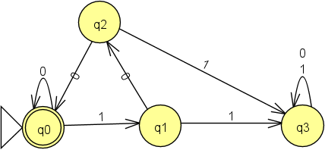
FSM Exercise (1)

Slide 28
FSM Exercise (2)

Slide 29
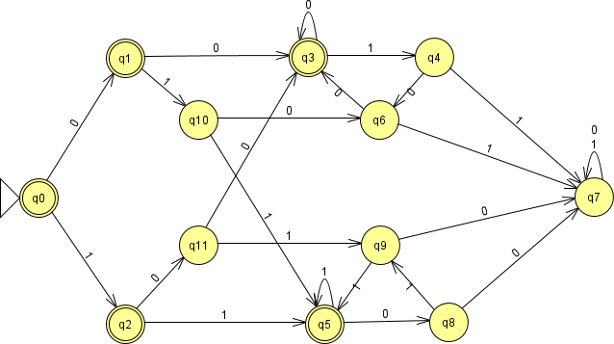
FSM Exercise (2)

